Slide 1

Data For Marketing Material
1846 - 1979
By Sam Lawson

Slide 2
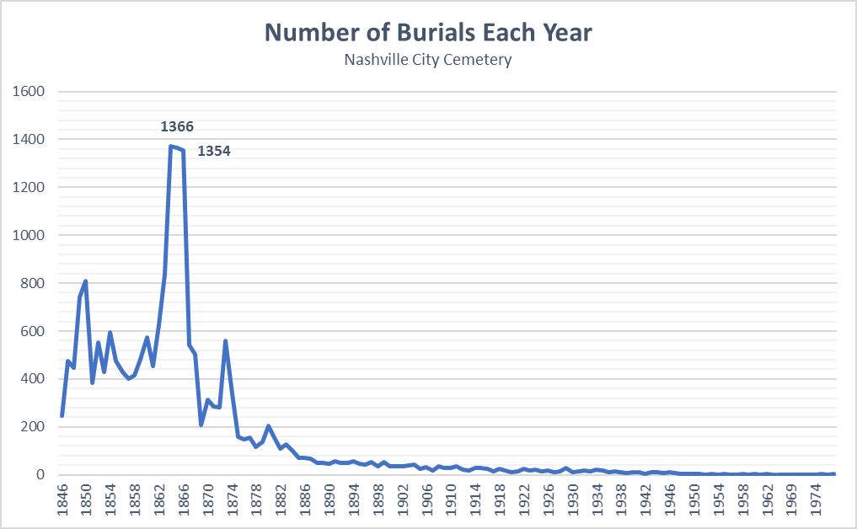
1865 & 1866: Why So Many Deaths?
Battle of Nashville - Dec. 1864
Decimated infrastructure after the battle and during Reconstruction led to there being little options for the population to get treatment for their various illnesses.
Less treatment options = more deaths

Slide 3
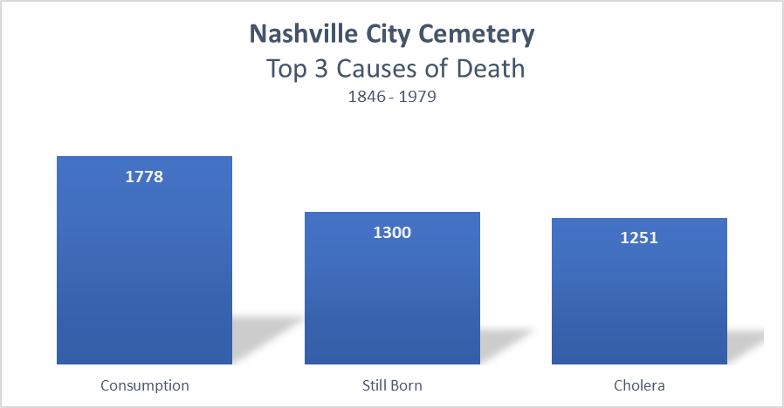
The Big 3
These 3 causes of death account for 22% of all burials from 1846 – 1979

Slide 4
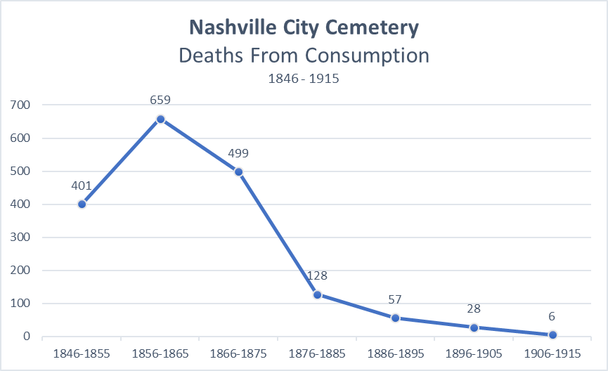
Consumption Deaths
Also known as Tuberculosis
March 24, 1882: Robert Koch reveals the disease is caused by an infectious agent. This day is now known as World Tuberculosis Day.
1895: Wilhelm Roentgen discovered the X-ray, allowing physicians to diagnose and track the disease.
Fun Facts:
During the 19th Century, consumption was seen as a “romantic disease”.
Many young, upper-class women purposefully paled their skin to achieve the consumptive appearance.
Some 19th Century poets, novelists, and composers glorified the disease in works such as Les Misérables by Victor Hugo and La Traviata by Giuseppe Verdi.

Slide 5
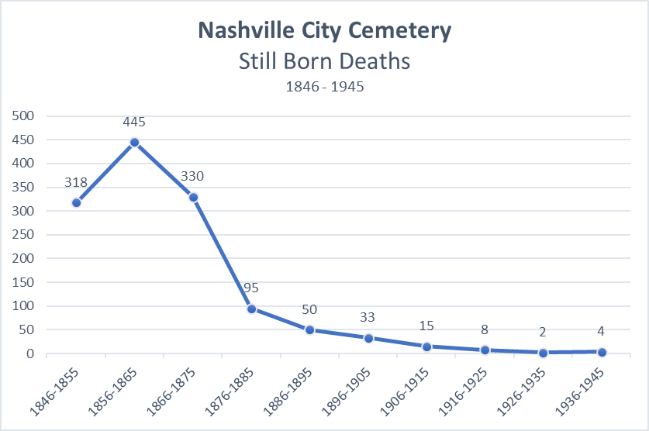
Still Born Deaths
One factor in still born deaths is the socioeconomic status of the mother.
The lower the status, the higher the chance of a still born child.
The vast majority of Southerners in the Civil War era lived in poverty.
In 1863, British economist J.E. Carines described the Southern economy as a small oligarchy of wealthy planters who used four million slaves to rule four million wretched and debased whites.

Slide 6
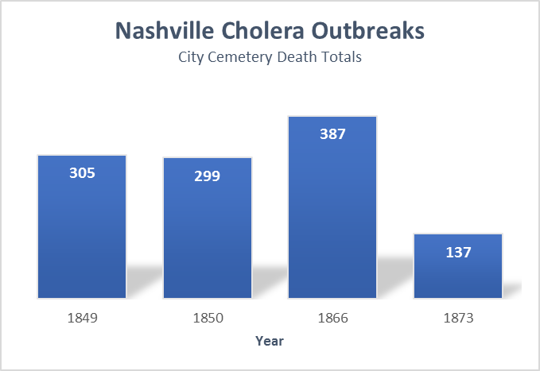
Nashville Cholera Epidemics
1849 – 1850
Nashville had a population of roughly 10,000 people at this time.
In July 1850, it was reported that the epidemic was waning, as the death rate had dropped to only "three to six or eight deaths" per day.
Former President James K. Polk is believed to have died from cholera in 1849.
Cause of death is “Complicated” in the dataset.
1873
In July, the epidemic was reportedly so bad that older remains were exhumed to make way for more burials.
On July 2, a reported 73 people across Nashville died of cholera.
24 White & 49 Black
The cholera deaths in the 4 years above account for 90% of total cholera deaths from 1846-1979.

Slide 7
Sources
https://www.history.com/topics/american-civil-war/battle-of-nashville
https://en.wikipedia.org/wiki/History_of_tuberculosis
https://en.wikipedia.org/wiki/Stillbirth
https://www.abbevilleinstitute.org/blog/was-the-south-poor-before-the-war/#_edn2
https://www.newspapers.com/clip/1800384/black_distrust_of_white_physicians_in/
https://sharetngov.tnsosfiles.com/tsla/exhibits/disasters/epidemics.htm

