Slide 1

Sam Lazrak
API-Caller

Slide 2
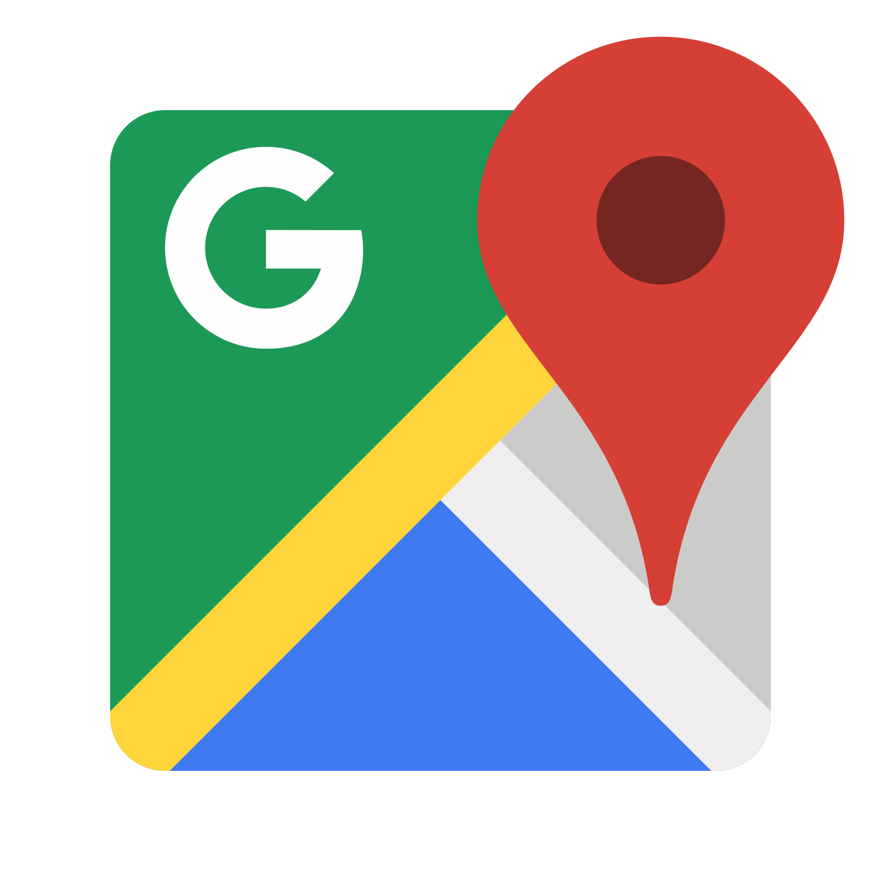


Sam Lazrak API-Caller
Firebase backend
Firebase Authentication
Github Api integration
Google Maps Api
My app is built using the ionic framework.
I use a few different API’s and plugins in it.

Slide 3
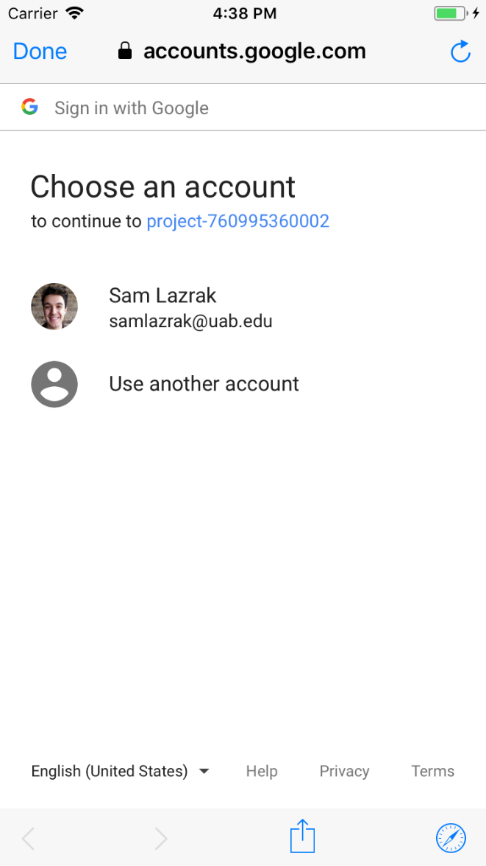
Firebase integration
Authentication with google sign in
Saving of user’s for later use

Slide 4

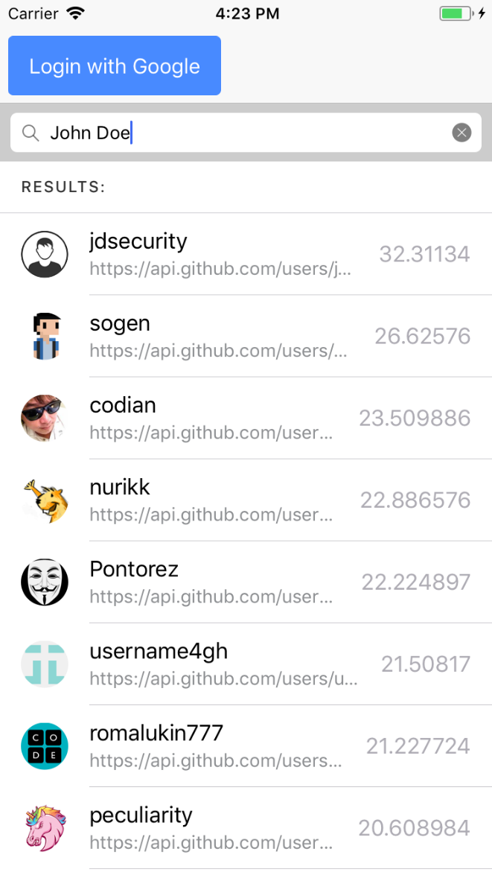
Github Integration
Utilizes Github to search for users

Slide 5
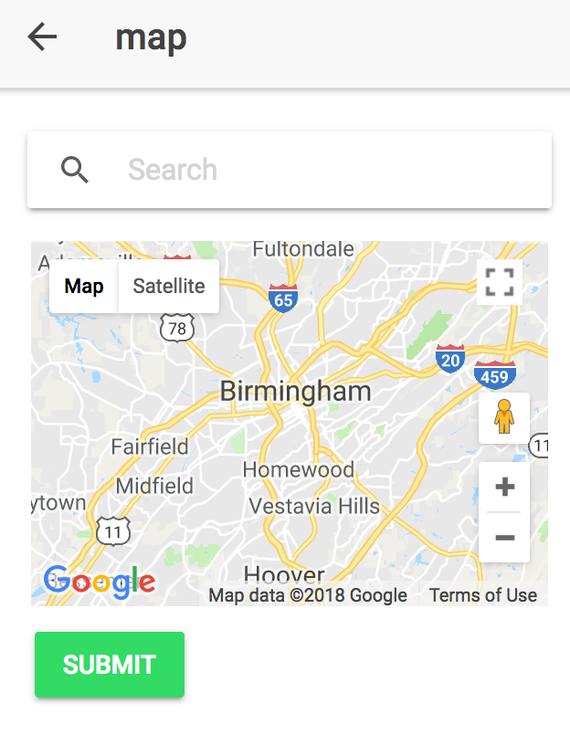
Google maps
Google maps integration for searching locations
Getting user’s location utilizing the geolocation plugin
Saves location locally

Slide 6
What I learned
How to utilize firebase for authentication

Slide 7
Next Steps
Add other authentication to the app using other authentications such as github.

