Slide 1
ht-1
ht
ht+1
X
+
X
+
X
+
A
tanh
tanh
A
tanh
X
X
X
X
X
X
$$σ$$
$$σ$$
$$tanh$$
$$σ$$
$$σ$$
$$σ$$
$$tanh$$
$$σ$$
$$σ$$
$$σ$$
$$tanh$$
$$σ$$
Xt-1
Xt
Xt+1

Slide 2
ht
ht
X
+
X
+
tanh
SELU
X
X
X
X
$$σ$$
$$σ$$
$$tanh$$
$$σ$$
$$σ$$
$$σ$$
$$tanh$$
$$σ$$
Xt
Xt

Slide 3
Baseline model | Prediction Time | RMSE | MAE | NSE
RNN | T | 100.34 | 53.51 | 0.78
 | T+1 | 104.08 | 55.05 | 0.77
MLP | T | 53.49 | 16.74 | 0.94
 | T+1 | 59.89 | 16.95 | 0.93
Support Vector Regressor | T | 63.78 | 26.06 | 0.92
 | T+1 | 73.12 | 28.80 | 0.89
Random Forest Regressor | T | 66.63 | 15.76 | 0.91
 | T+1 | 58.21 | 15.95 | 0.93
Gradient Boosting Regressor | T | 76.90 | 16.71 | 0.90
 | T+1 | 64.78 | 17.21 | 0.93
Comb –ML (RF_MLP)* | T | 69.79 | 16.44 | 0.92
 | T+1 | 71.01 | 16.80 | 0.92
Comb -ML (GB_MLP)* | T | 69.39 | 16.73 | 0.92
 | T+1 | 71.17 | 16.97 | 0.92
Ours | T | 44.17 | 14.94 | 0.96
 | T+1 | 58.59 | 17.11 | 0.94
*Hong, Jiyeong, Seoro Lee, Joo Hyun Bae, Jimin Lee, Woon Ji Park, Dongjun Lee, Jonggun Kim, and Kyoung Jae Lim. "Development and evaluation of the combined machine learning models for the prediction of dam inflow." Water 12, no. 10 (2020): 2927.

Slide 4
ht-1
ht
ht+1
X
+
X
+
X
+
A
SELU
SELU
A
SELU
X
X
X
X
X
X
$$σ$$
$$σ$$
$$tanh$$
$$σ$$
$$σ$$
$$σ$$
$$tanh$$
$$σ$$
$$σ$$
$$σ$$
$$tanh$$
$$σ$$
Xt-1
Xt
Xt+1

Slide 5
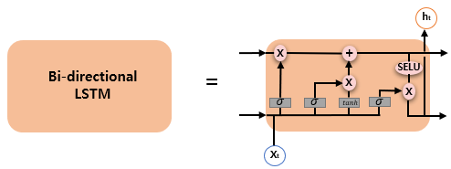

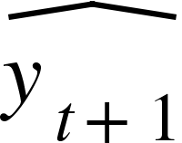
Time Distributed
Dense Layer
ENCODER OUTPUT
DECODER OUTPUT
Bi-directional
LSTM
Bi-directional
LSTM
Bi-directional
LSTM
E
N
C
O
D
E
R
S
T
A
T
E
S
Bi-directional
LSTM
Bi-directional
LSTM
Bi-directional
LSTM
Bi-directional
LSTM
Bi-directional
LSTM
Bi-directional
LSTM
Bi-directional
LSTM
Bi-directional
LSTM
Bi-directional
LSTM
Bi-directional
LSTM
Bi-directional
LSTM
Bi-directional
LSTM
Bi-directional
LSTM
Bi-directional
LSTM
Bi-directional
LSTM
INPUT
ENCODER OUTPUT

Slide 6
Y0
Y1
Y2
Yi
S’1
A’
A’
A’
A’
S’1
S0
A
A
A
A
S0
X0
X1
X2
Xi

Slide 7
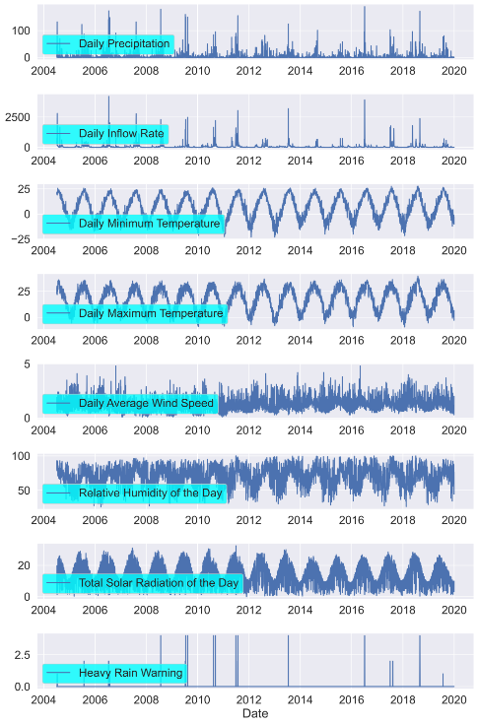

Slide 8
