Slide 1
CS512 FUN Project Spell Checking System
Shengjie Li
Weikang Li
Junlin Lu

Slide 2
Project Description
Spelling checking plays an important part in our daily life, especially for international students whose mother language is not English, therefore developing a spell-checking system helps a lot and is extremely useful.
Specifically, this system takes sentences as input, and give user suggestions on wrong words, which is very convenient and easy to use.

Slide 3
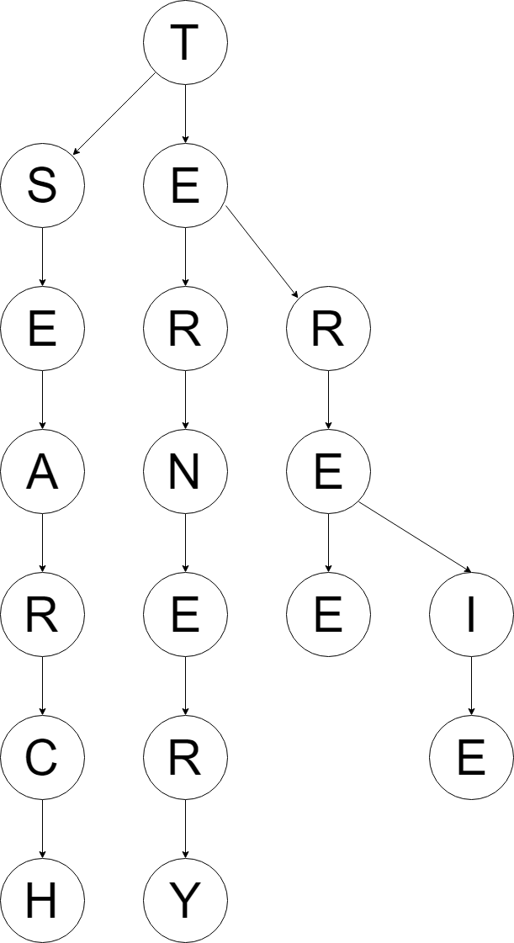
Data Structure
In this project, we are using ternary search tree, which is a type of trie(or prefix tree). Compared to the 26-arytrie and binary tree, it has at most three children. So it’s more space-efficient than trie.
Ternary search tree supports tree operations: Insertion, search and deletion. The time complexity, as stated be-fore, are O(log n).

Slide 4
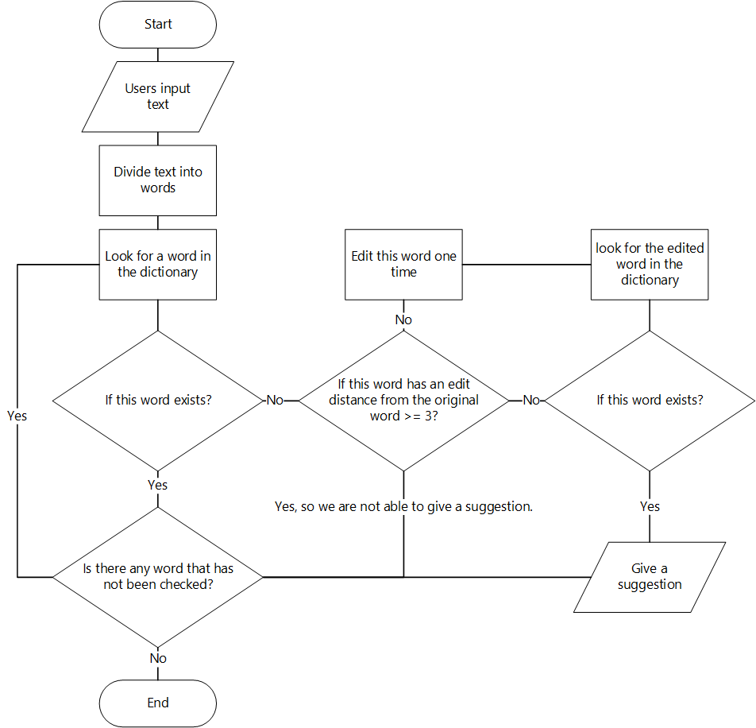
Flow Diagram

Slide 5
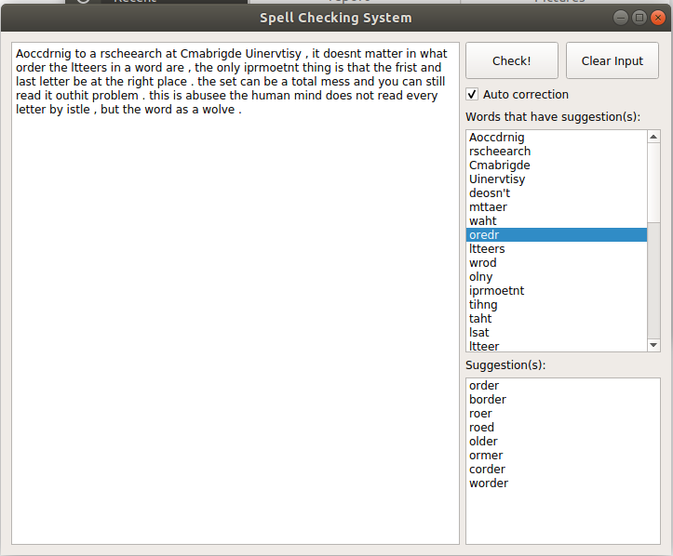
Demo screenshot

