Slide 1









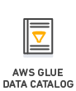

Global Temperatures Data Analysis Pipeline
S3://udacity-dend-samuel
http://berkeleyearth.org
*/raw-data
*/staged-data
*/clean-data

