Slide 1
2021 CAD Contest @ ICCAD Macro Legalization
National Taiwan University of Science and Technology
YU-CHE LEE

Slide 2
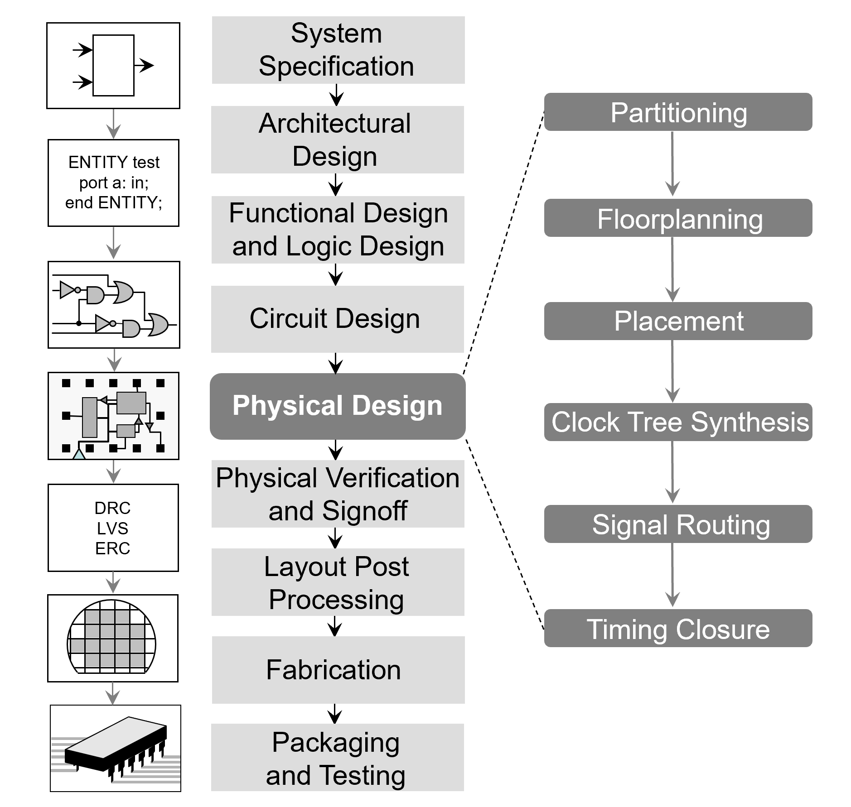
Problem：Macro Legalization
Mixed-size Prototyping
Macro Placement
Standard-cell Placement

Slide 3
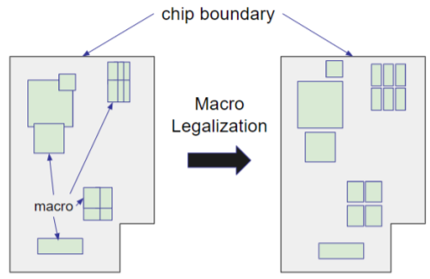
Problem Statement
Design Rules
Non-overlapping constraint
Fixed-outline constraint
Min. channel spacing constraint
Buffer area reservation constraint
Objective Function
Minimize total displacement
Small disturbance
Minimize dead space
More space for standard cell
Within 15 minutes

Slide 4
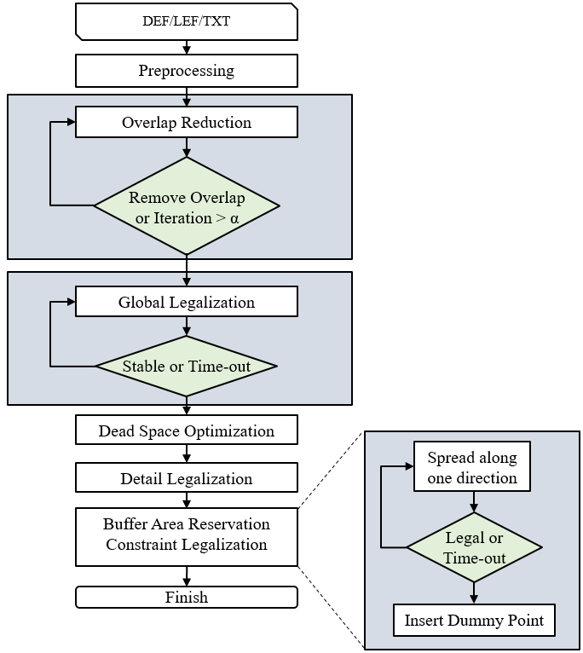
Algorithm Flow Chart

Slide 5
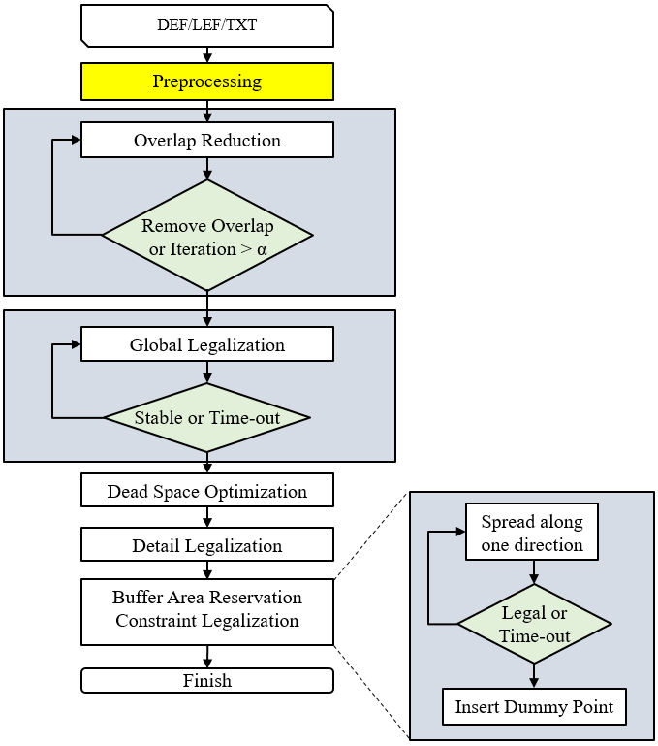
Step 1 - Preprocessing

Slide 6
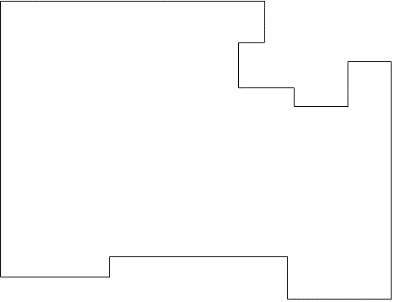
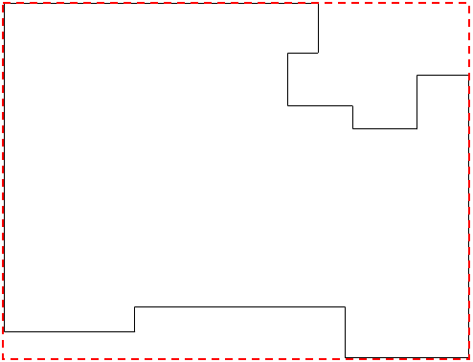
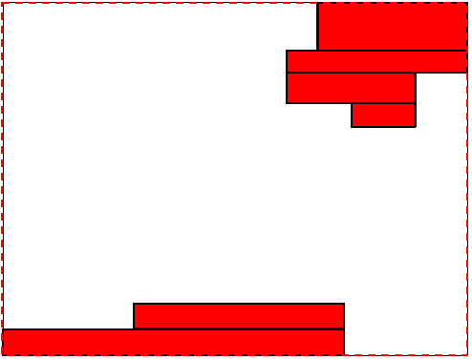
Make Chip Boundary Rectangular
Use sweep-line algorithm to fill up notches with pre-placed macros.
Chip boundary
Find bounding box
Fill up with pre-placed macro

Slide 7
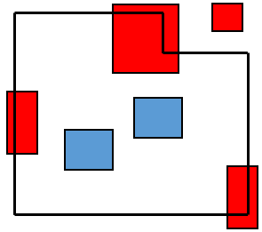
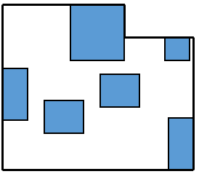
Move Macro Into Boundary
Move the macro which violates fixed-outline constraint inside the nearest boundary.

Slide 8
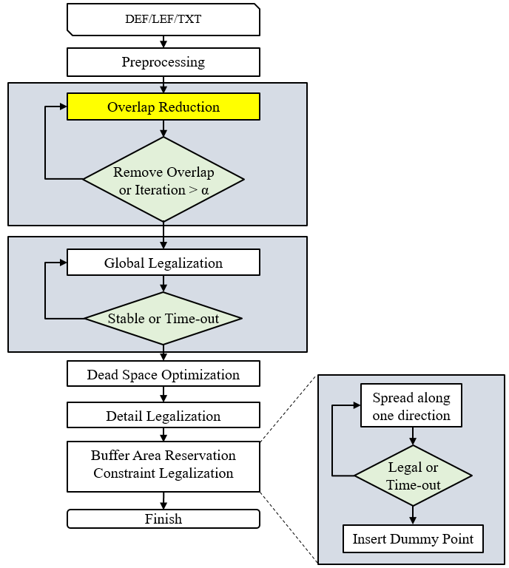
Step 2 - Overlap Reduction

Slide 9
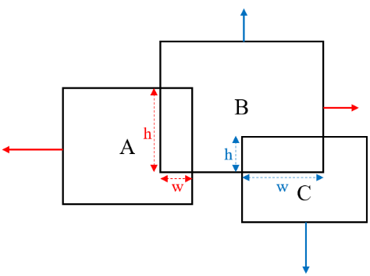
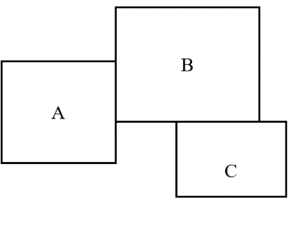
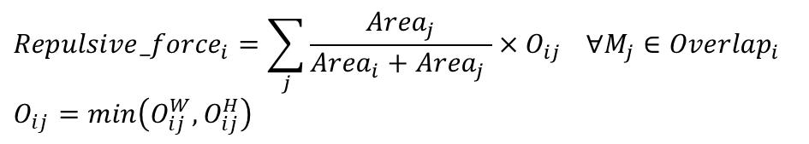
Force-directed-like Algorithm
Repulsive force are applied within macros to globally reduce overlap.
where Area is the size of macro, and O is the min{Width, Height of overlapped
region}
$${Repulsive_force}_{i}=\sum_{j}{\frac{{Area}_{j}}{{Area}_{i}+{Area}_{j} }×O_{ij}} ∀M_{j}∈{Overlap}_{i}$$
$$O_{ij}=min\left(O_{ij}^{W}, O_{ij}^{H}\right)$$

Slide 10
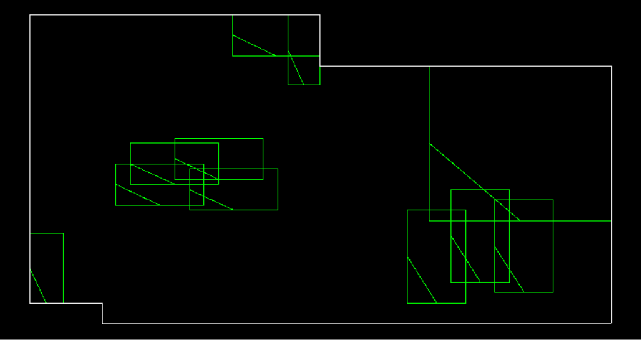
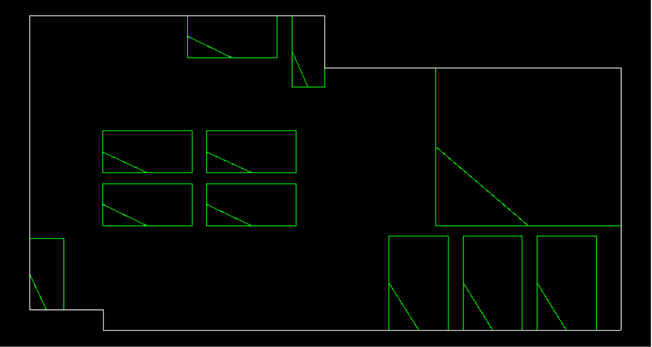
Overlap Reduction Example
Simple case can be handled easily
Before reduce overlap
After reduce overlap

Slide 11
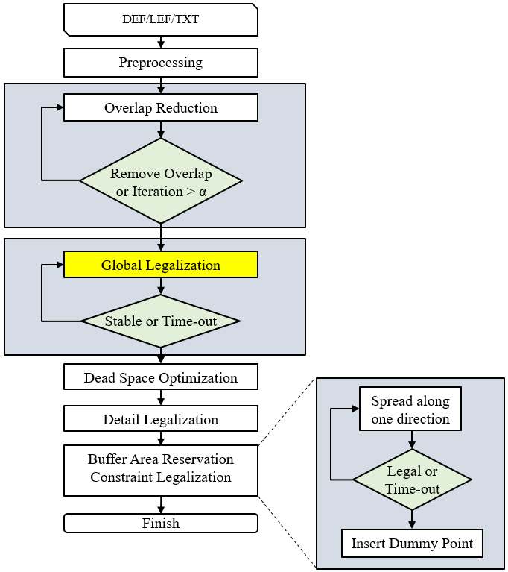
Step 3 - Global Legalization

Slide 12
Build Constraint Graph
According to the placement, build the horizontal and vertical constraint graph(CG).
: Macro
ω
: Edge, ω is edge weight, representing the non-overlapping constraint of two end-points
Horizontal CG
Placement
Vertical CG

Slide 13
Check Critical Path
Check if the critical path of CG is longer than the chip size
If yes, remove the smallest macro in the critical path
…
Critical path
Removed smallest macro

Slide 14

Linear Programming Formulation
Transform both CGs into linear inequality as constraint
Take minimal displacement as the objective function
$$\min{ }\sum_{i=1}^{n}{d_{x_{i}}+d_{y_{i}}}$$
s.t. $x_{j}^{′}−x_{i}^{′}≥{\text{ω}}_{ij} if ∃e_{ij}∈G^{H}$
$y_{j}^{′}−y_{i}^{′}≥{\text{ω}}_{ij} if ∃e_{ij}∈G^{V}$
$x_{i}^{′}=x_{i} if n_{i} is Fixed$
$y_{i}^{′}=y_{i} if n_{i} is Fixed$
Horizontal CG
Vertical CG

Slide 15
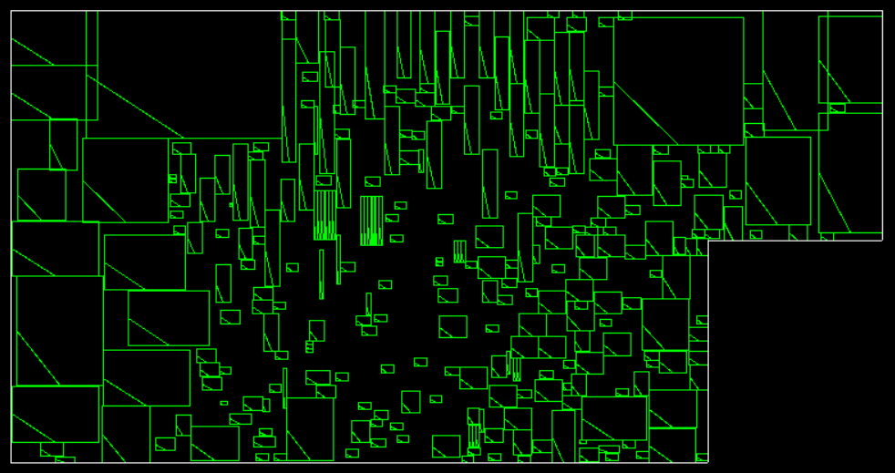
Remove Overlap - Before
Linear programming solver removes overlap with minimal displacement
Macro Removed macro
Before remove overlap

Slide 16
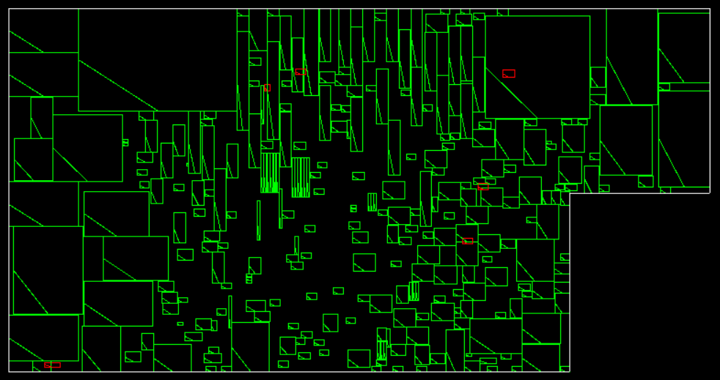
Remove Overlap - After
Linear programming solver removes overlap with minimal displacement
Macro Removed macro
After remove overlap

Slide 17
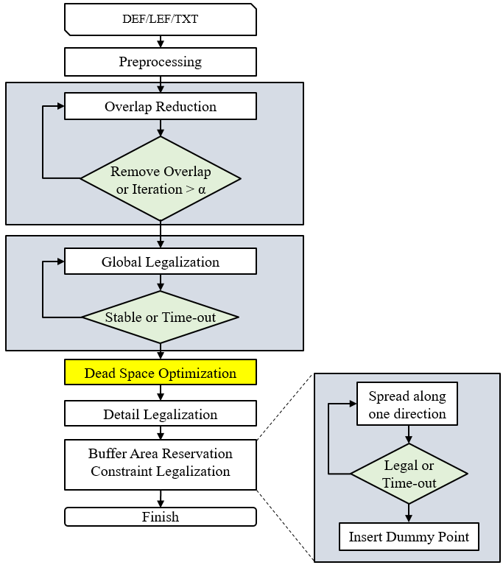
Step 4 - Dead Space Optimization

Slide 18
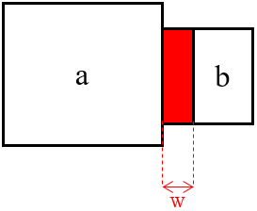
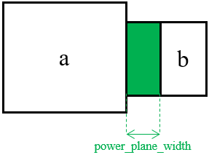
Dead Space Optimization
Expand two adjacent macros’ distance, trying to turn dead space into free space
Dead space
Free space
Non-overlapping constraint
1
Non-overlapping constraint +=
Power_plane_constraint
2
3

Slide 19
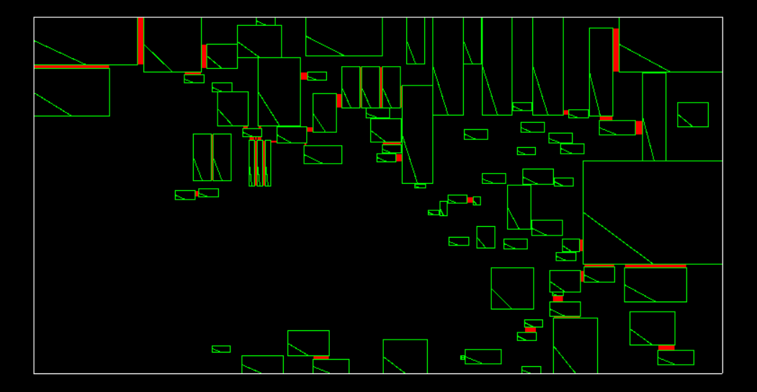
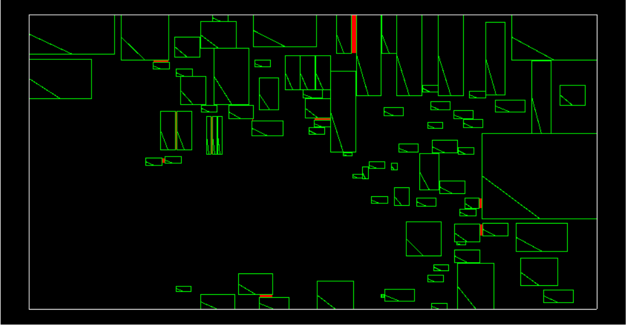
Dead Space Optimization - Example
Macro
Dead Space
Before Dead Space Optimization
Reduce 39.14% dead space
After Dead Space Optimization

Slide 20
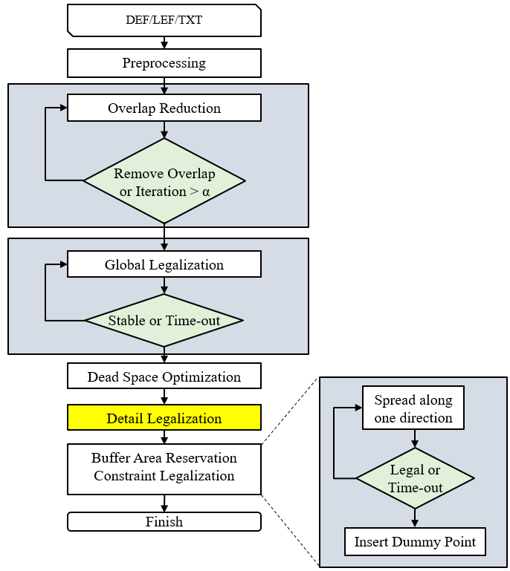
Step 5 - Detail Legalization

Slide 21
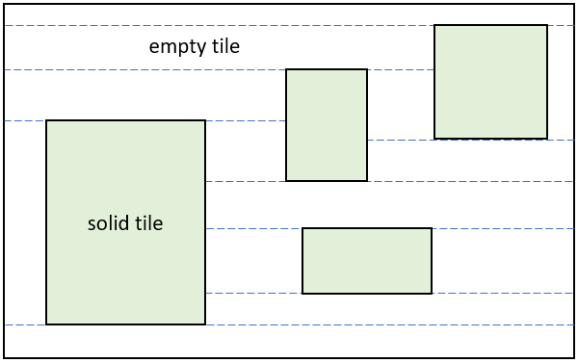
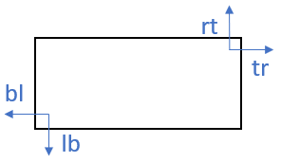
Corner Stitching Structure
Empty space is represented explicitly
Rectangular objects are stitched together at their corners

Slide 22
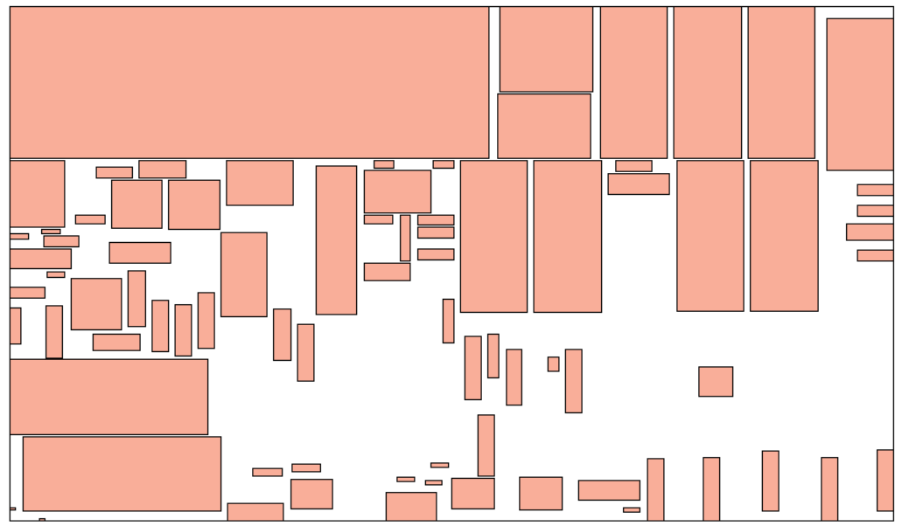
Corner Stitching Structure - Example
Before empty space is represented

Slide 23
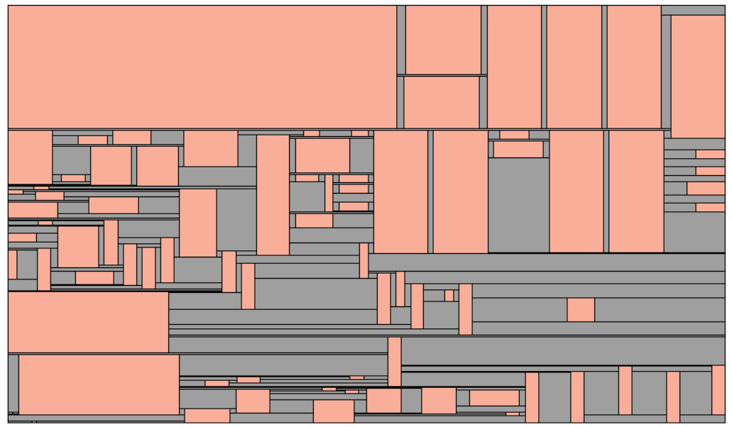
Corner Stitching Structure - Example
After empty space is represented

Slide 24
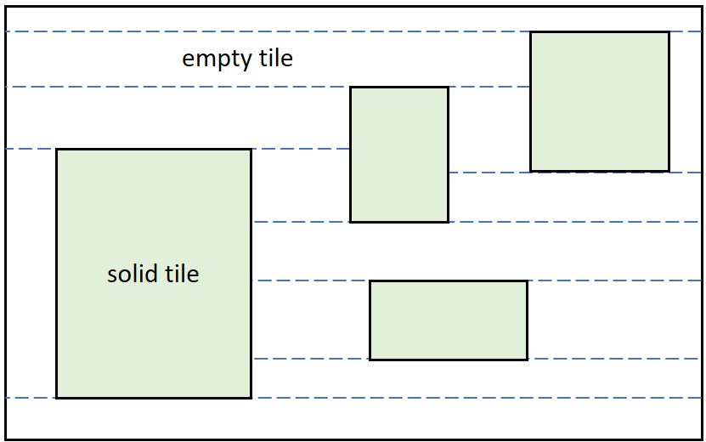
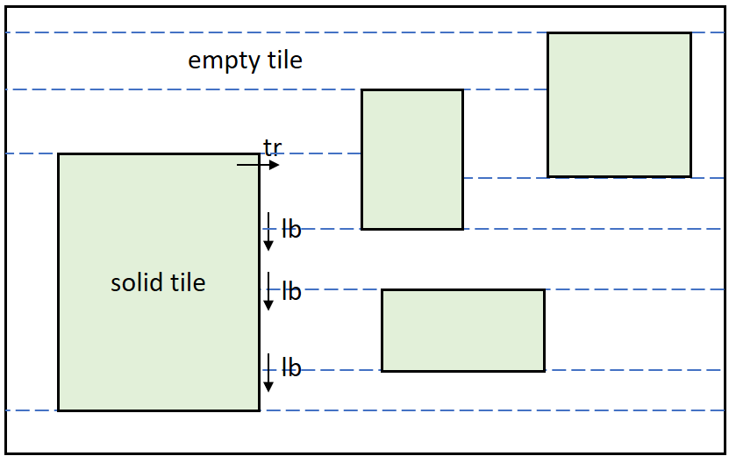
Search Area Using Corner Stitching
Linear time for searching empty area surrounding the macro

Slide 25
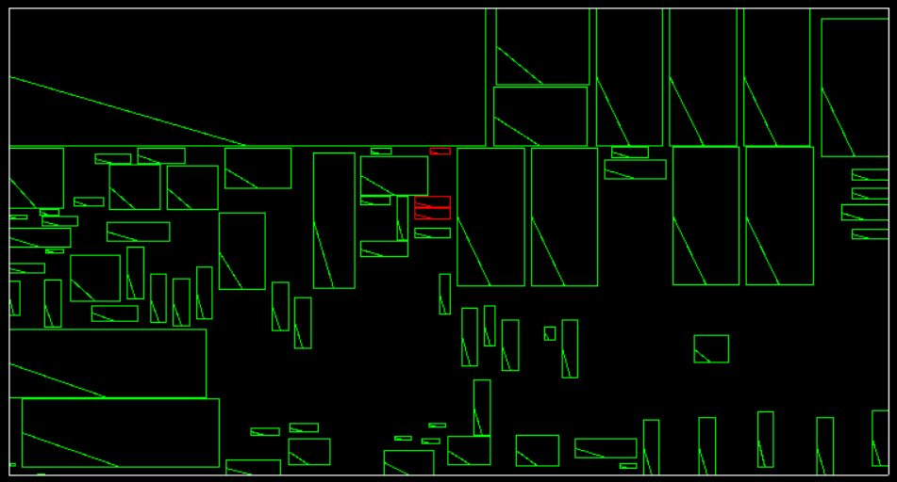
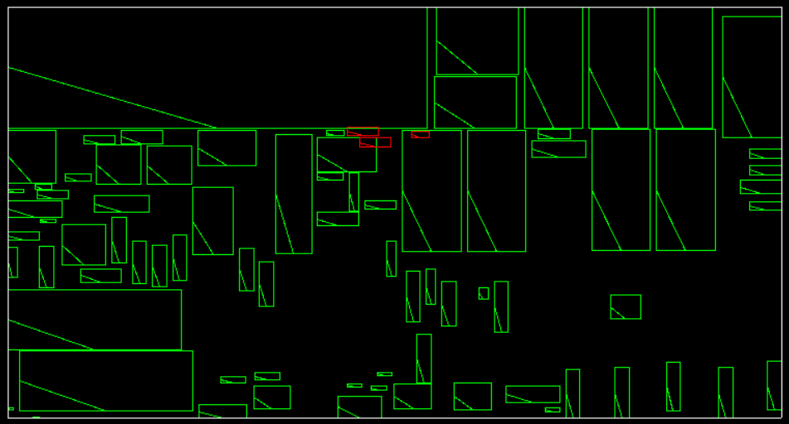
Detail Legalization - Example
Place the illegal macro into the nearest empty space by using corner stitching

Slide 26
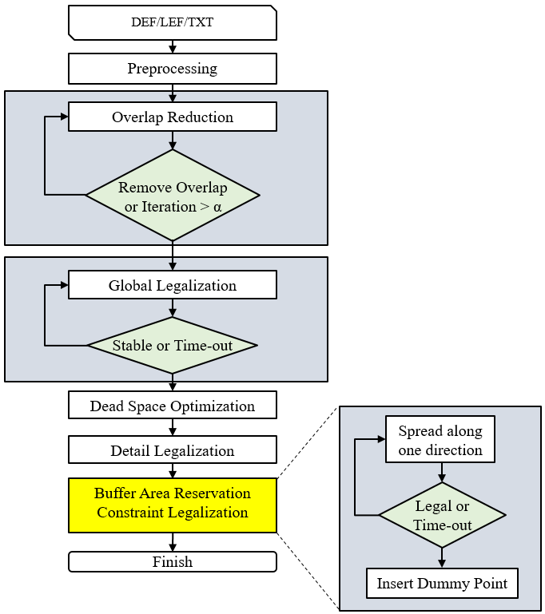
Step 6 - Buffer Area Reservation Constraint Legalization

Slide 27
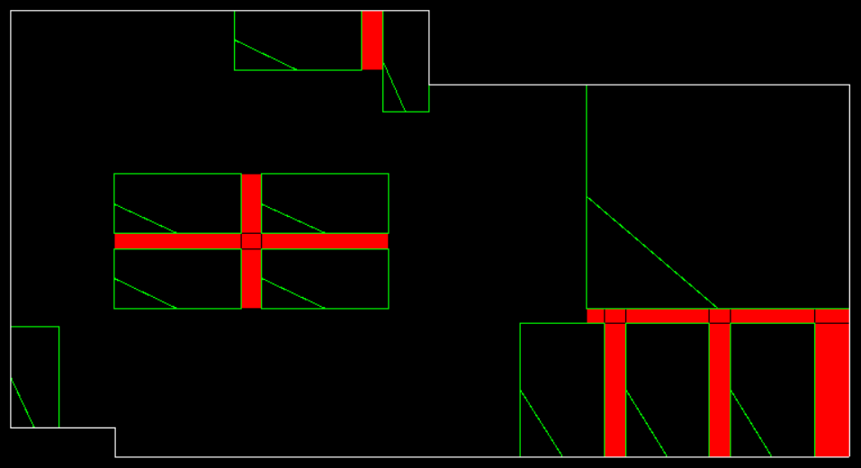
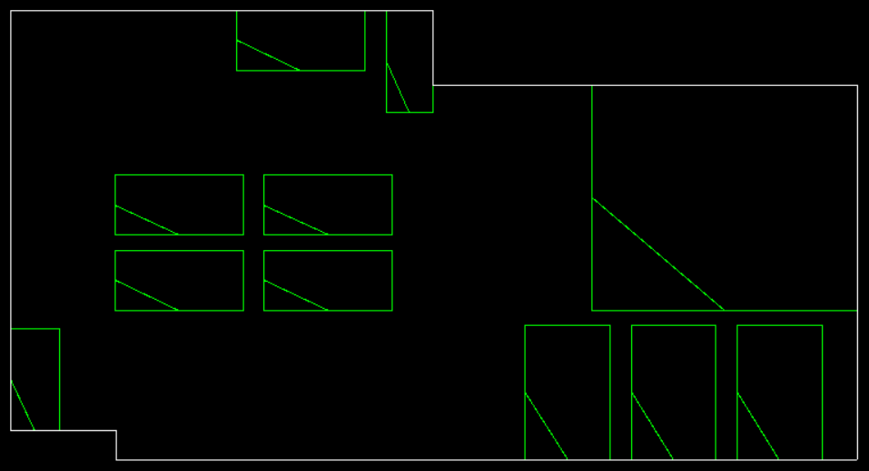
Buffer Area Reservation Constraint Intro.
Every extended distance from the macro must cover free space
Legal
Illegal

Slide 28
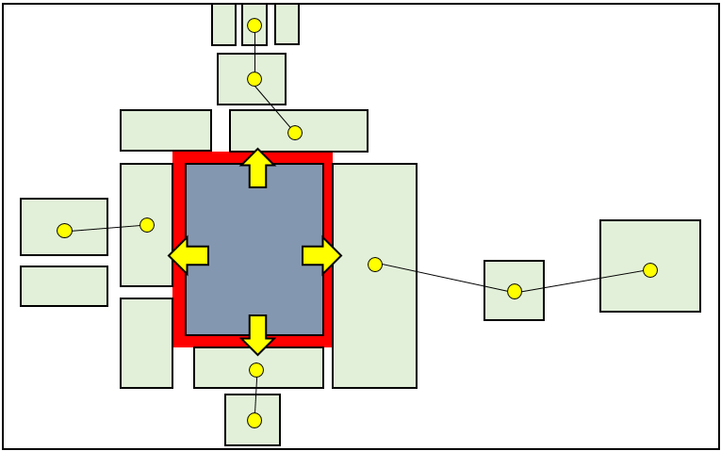
Spread Along One Direction
Find the least crowed direction
Illegal macro
Legal macro

Slide 29
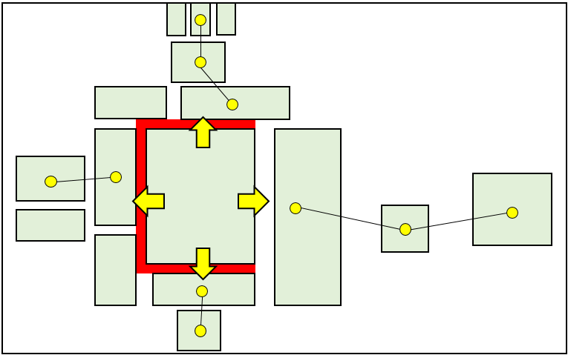
Spread Along One Direction
Find the least crowed direction
Push macro which belongs to that direction away
Illegal macro
Legal macro

Slide 30
Dummy Point Insertion Intro.
Dummy point is a minimal rectangle to represent a std. cell
Every extended distance from the macro must cover free space
≡
Every extended distance from the macro must cover a dummy point

Slide 31
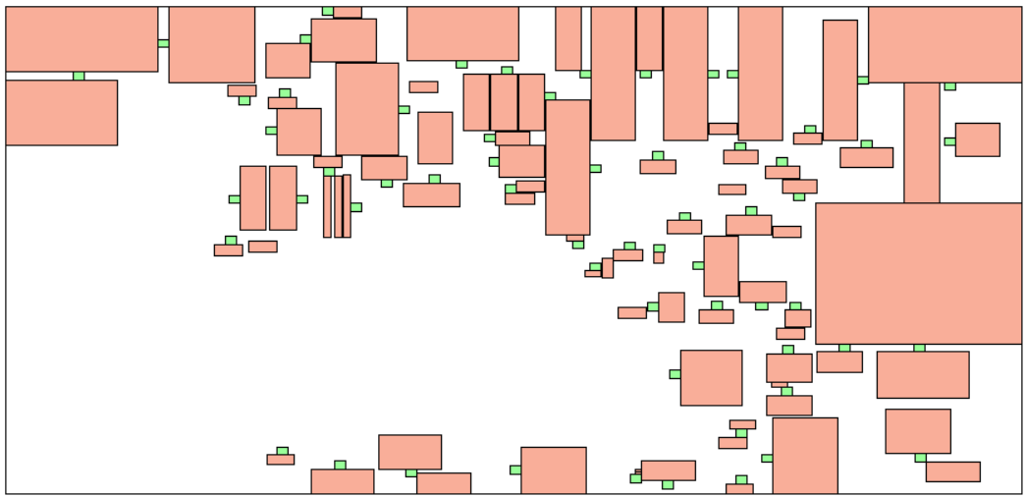
Dummy Point Insertion - Example
Macro
Dummy point

Slide 32
Experimental Result
Benchmark (Synopsys, Inc.) | Total displacement (micron) | Free space (micron^2) | Ranking
Industrial 1 | 2130 | 66593 | 2/21
Industrial 2 | 28093 | 114488 | 5/21
Industrial 3 | 21521 | 383400 | 2/21
Industrial 4 | 2303 | 43287 | 3/21
Industrial 5 | 2381 | 92627 | 3/21
Industrial 6 | 12632 | 245548 | 2/21
Industrial 7 | 3295 | 106870 | 4/21
Industrial 8 | 5001 | 111967 | 3/21
Industrial 9 | 15214 | 557947 | 1/21
Industrial 10 | 11362 | 408946 | 1/21

Slide 33
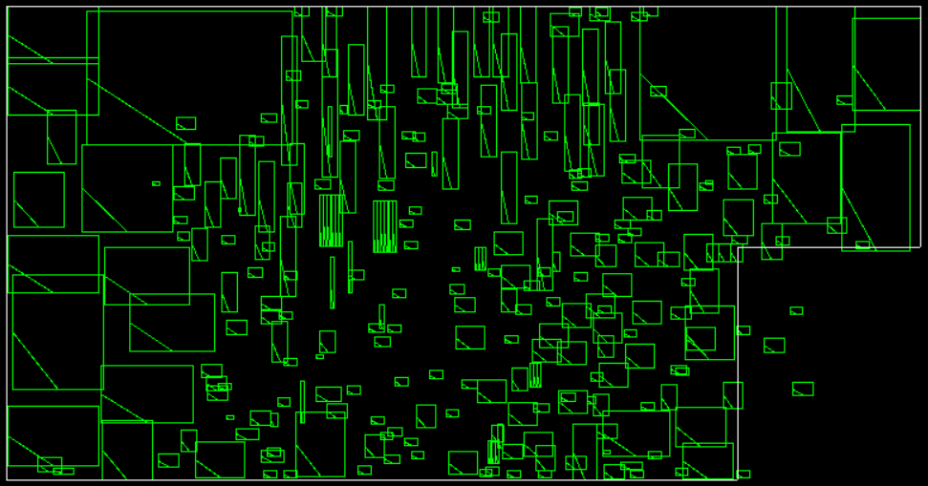
Final Example – Industrial 3
Initial placement violates the design rules

Slide 34
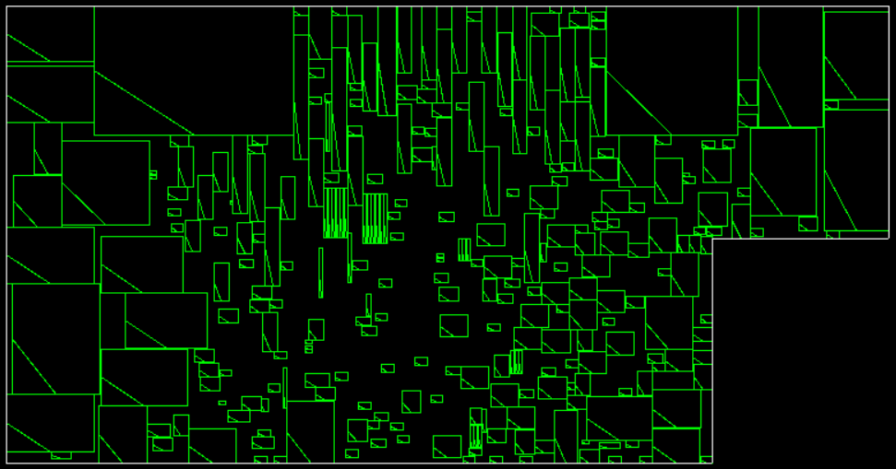
Final Example – Industrial 3
Placement after running the macro legalization

Slide 35
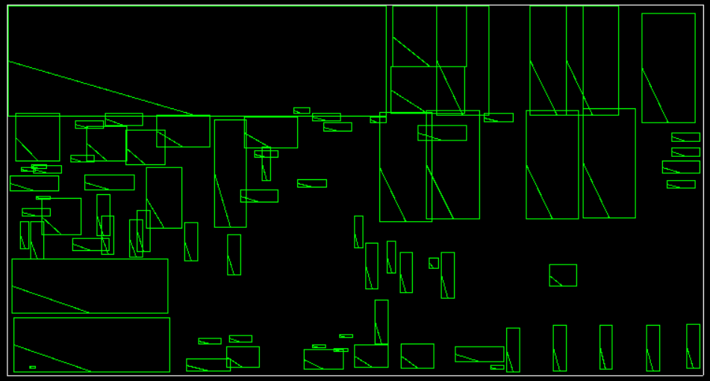
Final Example – Industrial 5
Initial placement violates the design rules

Slide 36
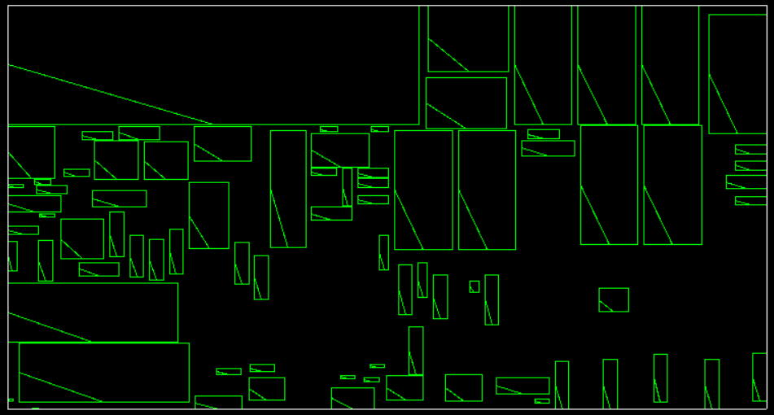
Final Example – Industrial 5
Placement after running the macro legalization

Slide 37
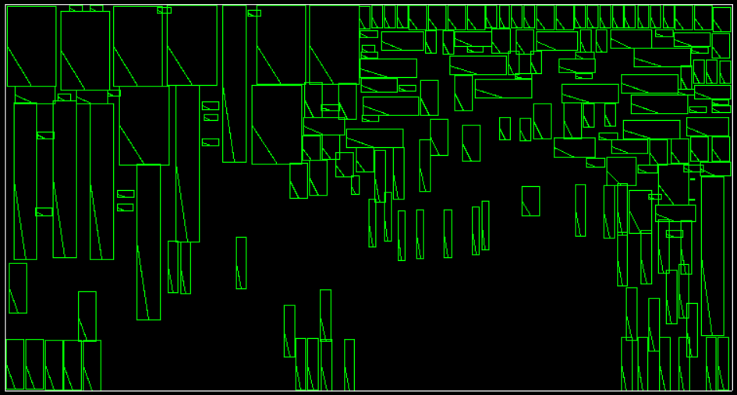
Final Example – Industrial 6
Initial placement violates the design rules

Slide 38
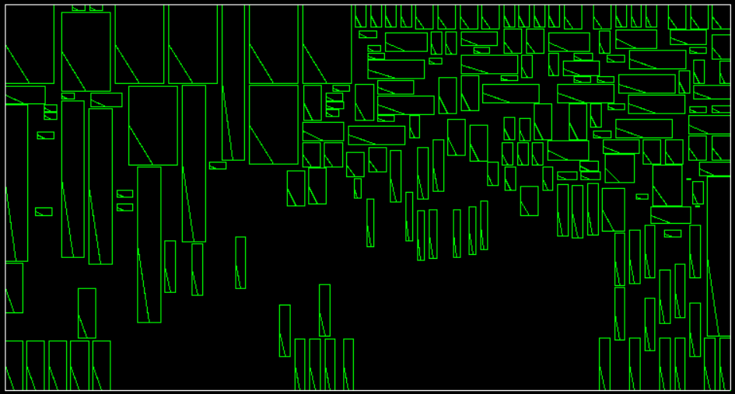
Final Example – Industrial 6
Placement after running the macro legalization

Slide 39
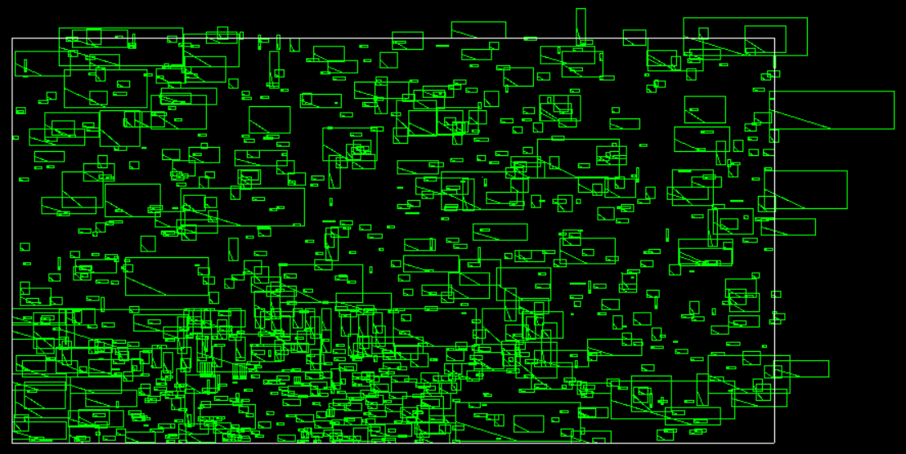
Final Example – High Density Case
Initial placement violates the design rules

Slide 40
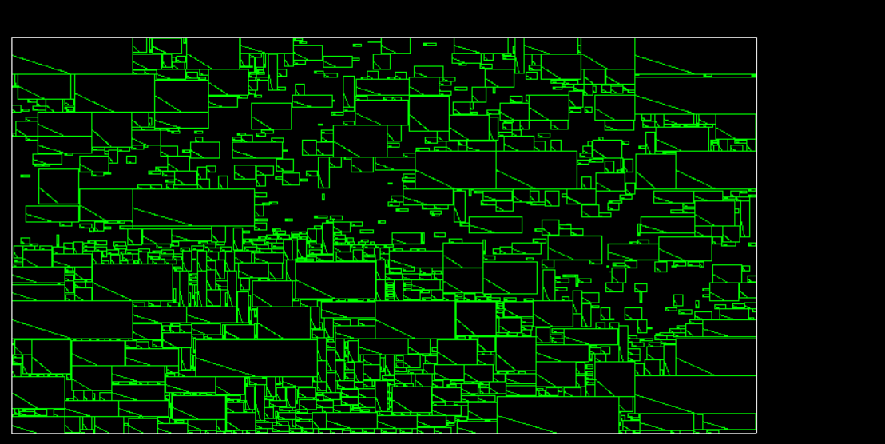
Final Example – High Density Case
Placement after running the macro legalization

