Slide 1
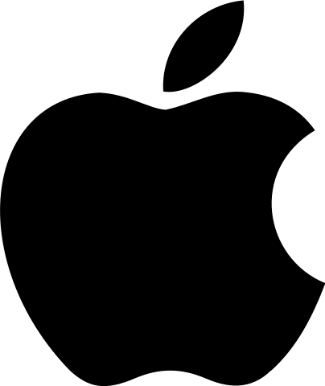


Capstone Project: Comparing Consumer Sentiment of Apple, Google, and Android from the Past and Present on Twitter
By: Sam Lim
Date: 7/28/21

Slide 2
Business problem
For better or worse, people's perception of tech giants have changed over time. A company that consults these large companies' PR teams have hired me to find how the consumers' sentiments have changed. To gather the necessary information, I am going to go to Twitter, and perform NLP sentiment analysis of the general public's sentiment towards these companies from the past and present.
Notes:
© Copyright PresentationGO.com – The free PowerPoint template library

Slide 3
Data collection
Old Twitter data was gathered from https://data.world/crowdflower/brands-and-product-emotions. After cleaning, 8,306 total tweets remained in the old Twitter data frame.
Using Tweepy and Twitter's Developer API, I collected 1,500 tweets per company, but around 1/3 of the tweets were not related to the company.
After cleaning, 3,405 tweets remained in the new Twitter data frame.
Notes:
© Copyright PresentationGO.com – The free PowerPoint template library

Slide 4
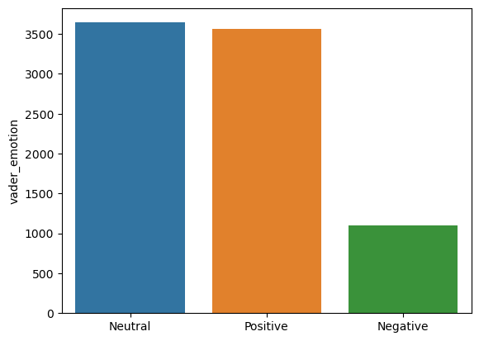
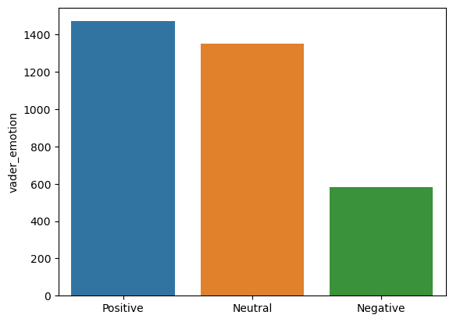
Data Imbalance
There was an imbalance in the number of the three sentiments in both data frames.
The number of negative tweets were around a third of the size of the neutral tweets and positive tweets.
Notes:
For both the old tweets and new tweets, there was an imbalance in the number of the three sentiments.
The top image represents the number of old tweets with the respective sentiments, and the bottom represents the new tweets with the respective sentiments.
For both old and new tweets, the number of negative tweets were around a third of the size of the neutral tweets and positive tweets.

Slide 5
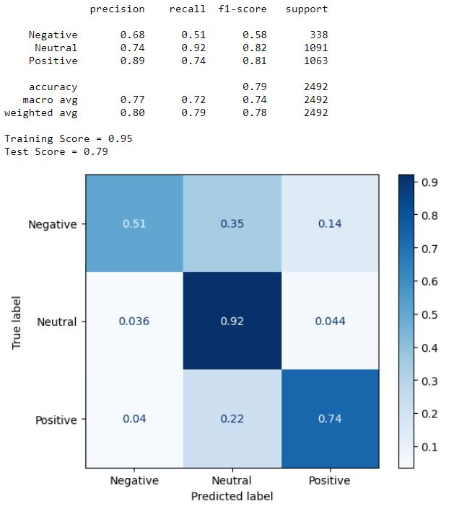
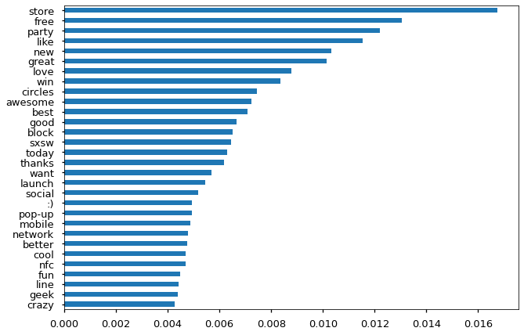
Random Forest (Old Tweets)
Because of the small number of negative tweets, the recall score for 'Negative' is low.
Notes:
For each old and new tweets, Random Forest Modeling and Naïve Bayesian Modeling were performed.
The image on the right shows the confusion matrix of the random forest model after the gridsearch was performed.
As shown before, the number of negative tweets were far less, which resulted in the low recall score for the negative tweets.

Slide 6
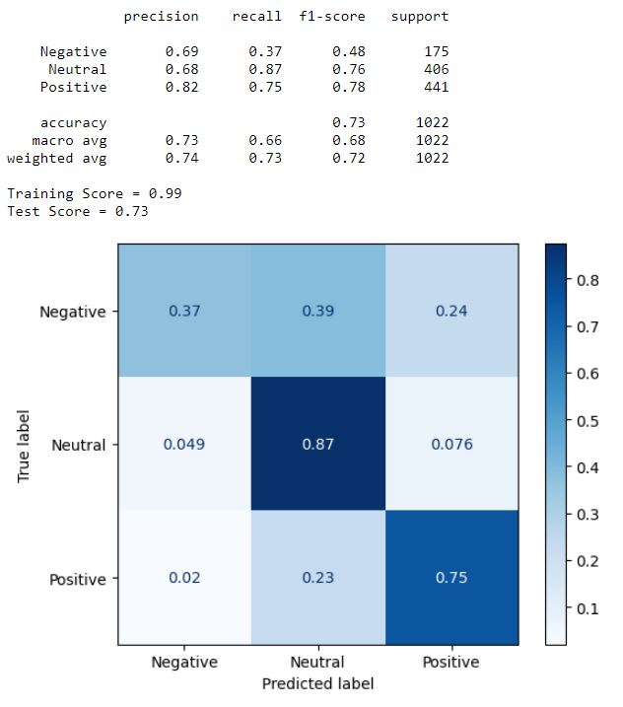
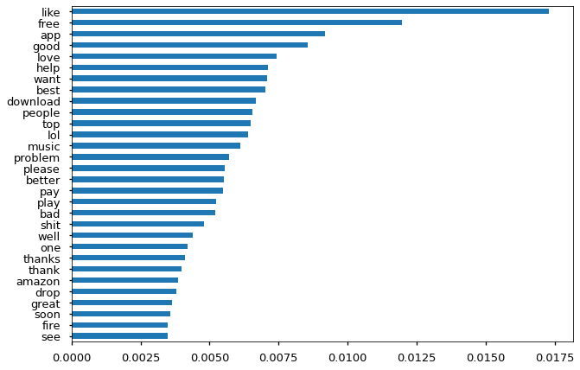
Random Forest with Grid Search (New Tweets)
Same problem as the old tweets
Still recommended because it was able to maintain a relatively high recall scores while improving the recall score for the negative tweets.
Notes:
The recall score of the random forest model with grid search for the new tweets also show the same problem.
However, I would still recommend this model (random forest with gridsearch) above others because it was able to maintain a relatively high recalls core for the positive and neutral tweets while improving the recall score for the negative tweets.

Slide 7
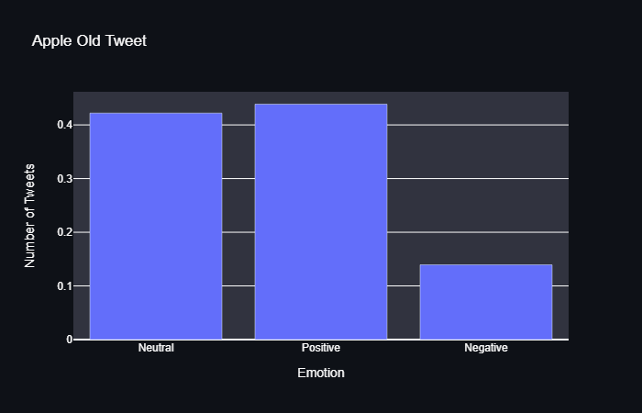
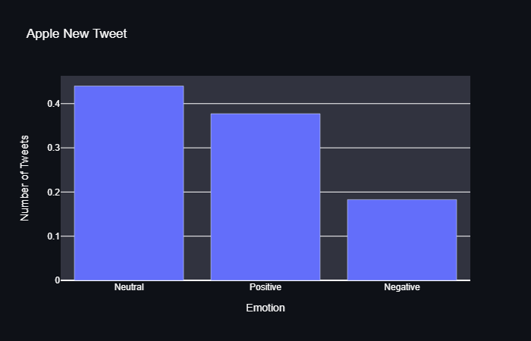
APPLE
When comparing the user sentiments generated from the old tweets to the newer tweets, we can see an increase in the ratio of negative tweets.
Notes:
© Copyright PresentationGO.com – The free PowerPoint template library

Slide 8
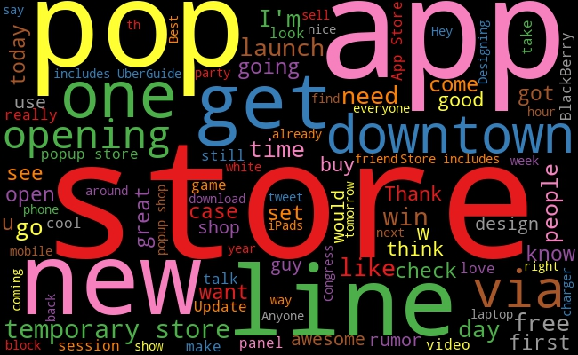
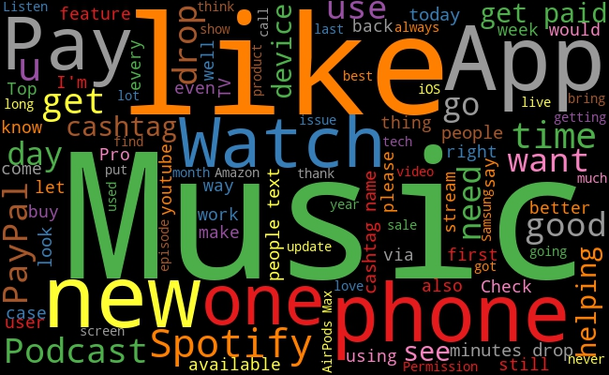
Word Cloud Comparison: Apple
Old
New
Notes:
© Copyright PresentationGO.com – The free PowerPoint template library

Slide 9
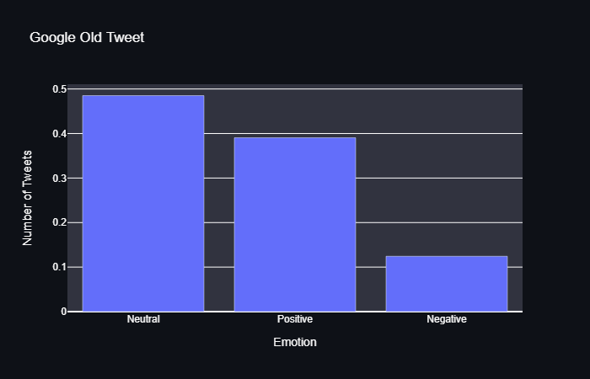
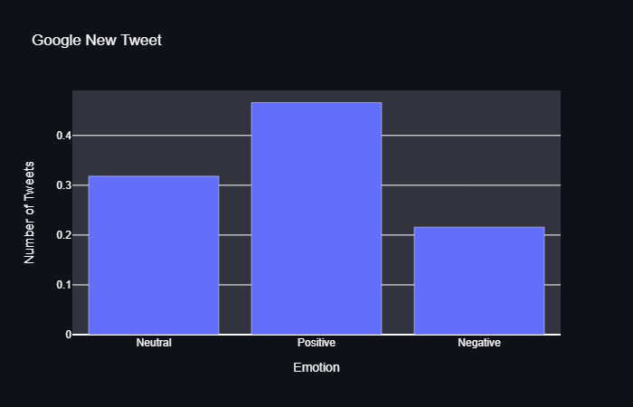
Google
Sentiment towards Google also became slightly worse.
While the graphs may seem to represent a positive change, the ratio of negative to positive comments have increased by nearly two-fold.
Notes:
© Copyright PresentationGO.com – The free PowerPoint template library

Slide 10
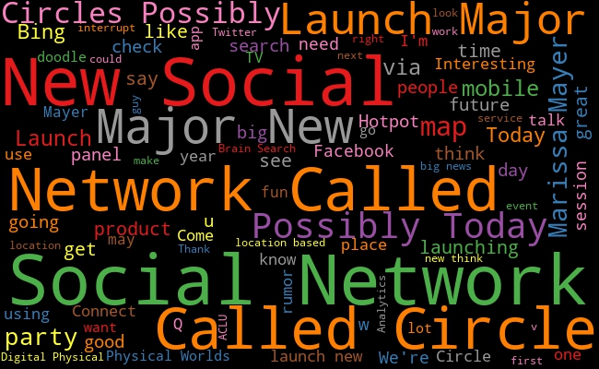
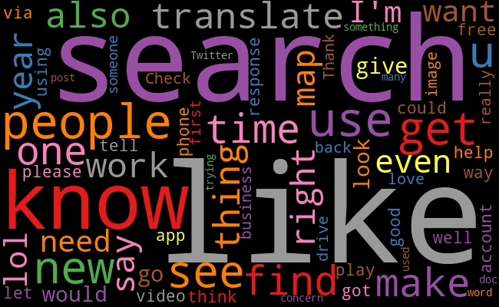
Word Cloud Comparison: Google
Old
New
Notes:
© Copyright PresentationGO.com – The free PowerPoint template library

Slide 11
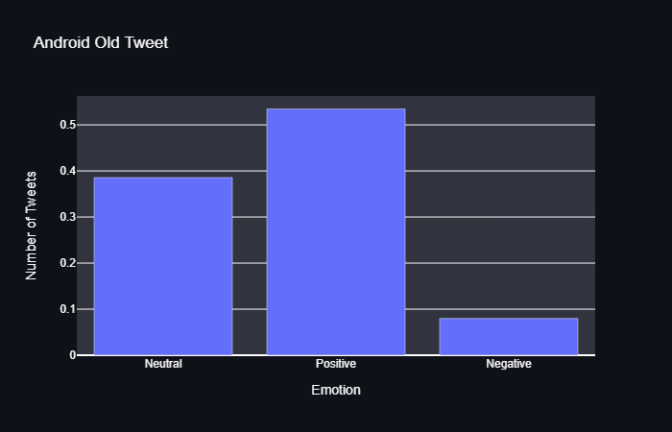
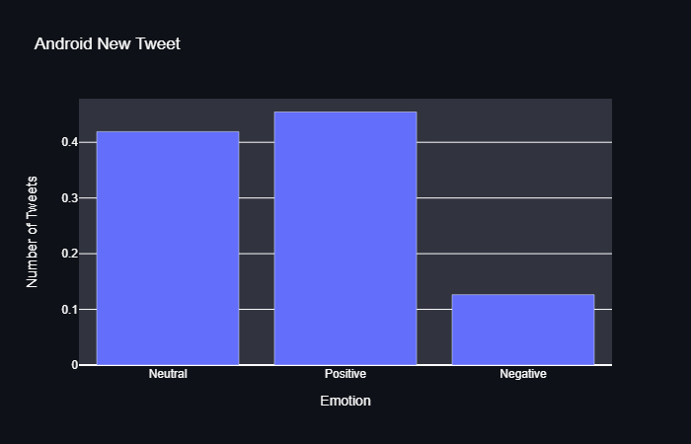
Android
User's sentiment towards Android has improved significantly.
The graph may seem to show similar sentiment, the ratio of negative to positive sentiments are not too different, but the total number of positive sentiments has increased.
Notes:
© Copyright PresentationGO.com – The free PowerPoint template library

Slide 12
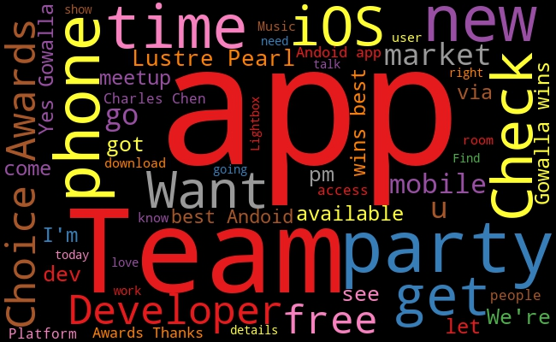
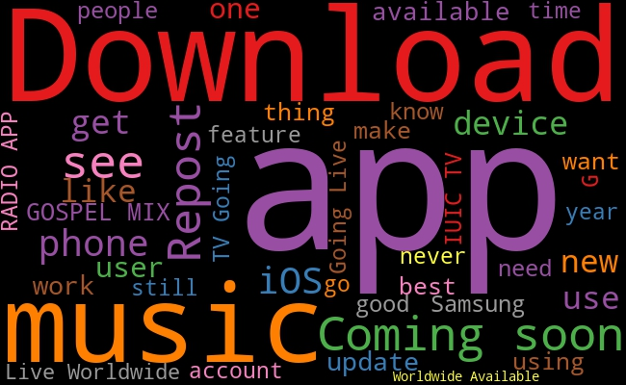
Word Cloud Comparison: Android
Old
New
Notes:
© Copyright PresentationGO.com – The free PowerPoint template library

Slide 13
Recommendation
I recommend using the Random Forest model with gridsearch.
This model was able to improve on the low recall score for tweets with negative sentiments while maintaining the relatively high recall scores for other tweets.
Given that the consumer's sentiment towards some of these companies have turned more negative, it could be recommended that these companies start paying more attention to their consumers to retain/improve their relationships with their customers.
Notes:
© Copyright PresentationGO.com – The free PowerPoint template library

Slide 14
Future Works
Create a timeline that displays continuous changes in public's sentiment towards these companies.
Add important events to the timelines to have a better understanding of what end consumers' wants and needs.
Add monthly/quarterly/annual earnings to show the relationship between the rate of increase in earnings to public sentiment.
Add companies that have continuously improved its relations with the end consumers and report on the changes in their earnings.

Slide 15
Thank You Q&A

Slide 16
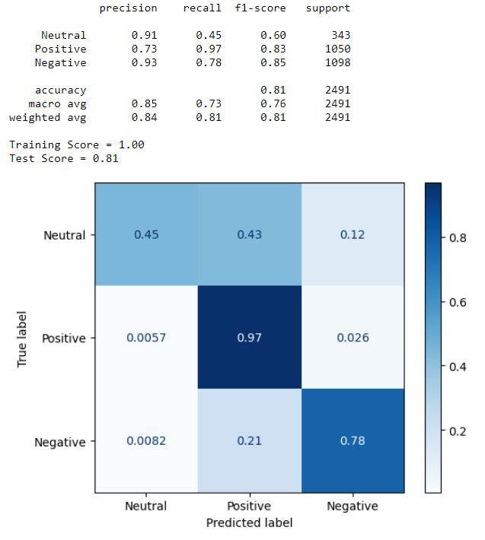

Appendx: Random Forest Base model and Pipeline (Old Tweet)
Base
Piepeline

Slide 17
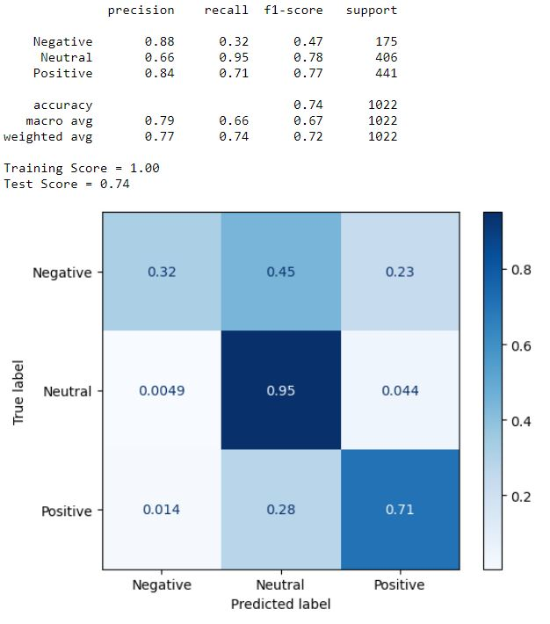
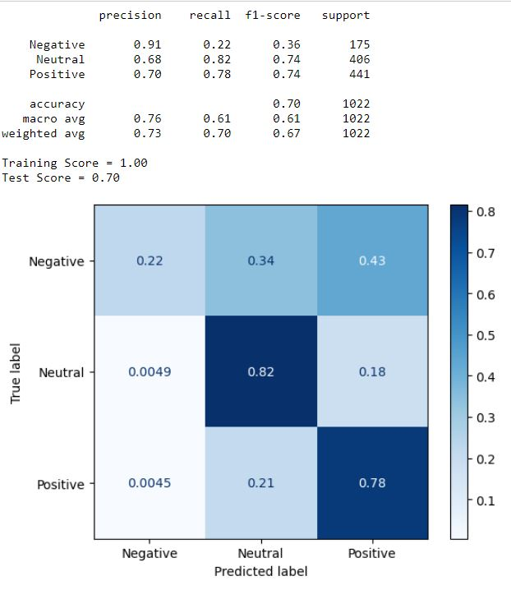
Appendx: Random Forest Base model and Pipeline (New Tweet)
Base
Piepeline

Slide 18
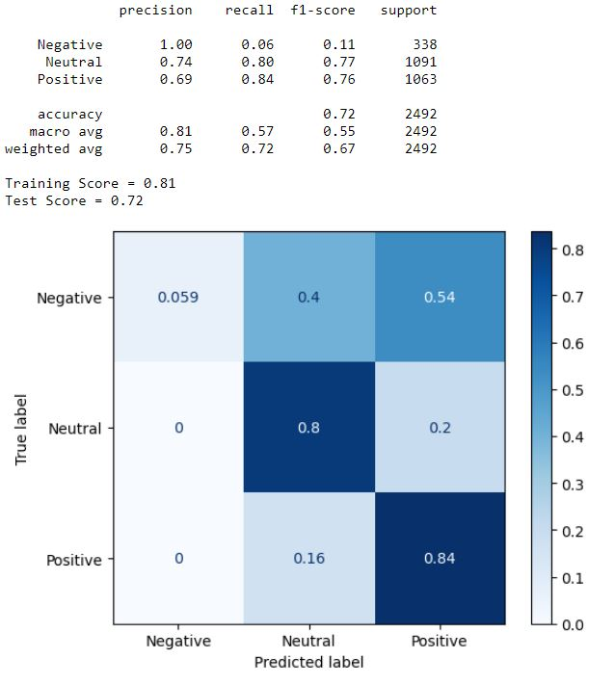
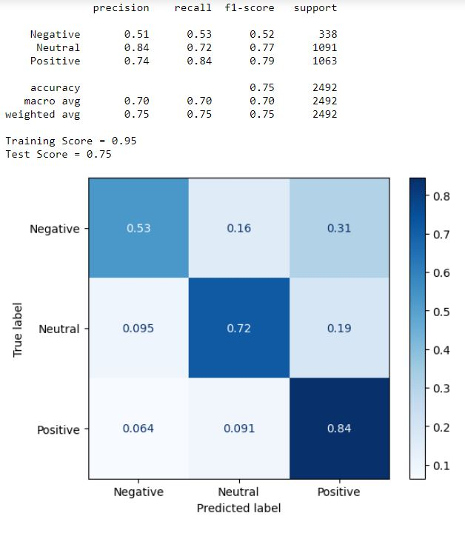
Appendx: Naïve Bayesian Base model and Grid Search (Old Tweet)
Base
Grid Search

Slide 19
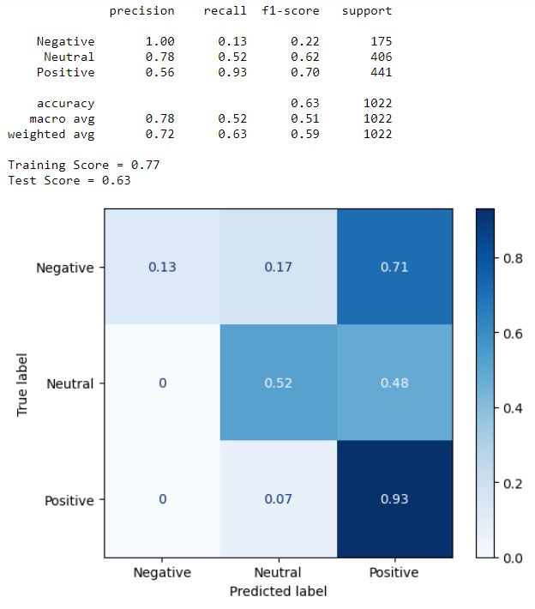
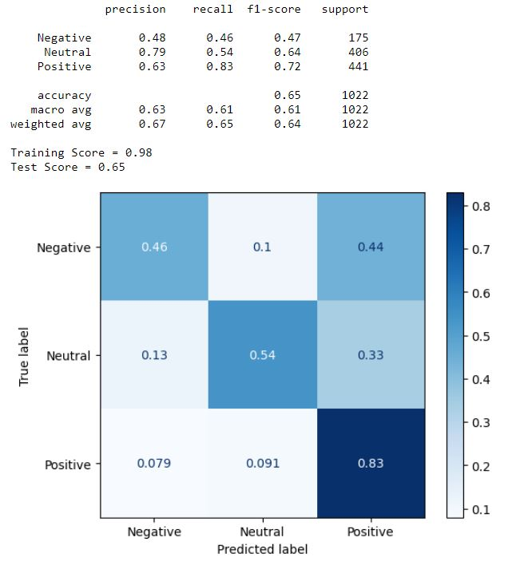
Appendx: Naïve Bayesian Base model and Grid Search (New Tweet)
Base
Grid Search

