Slide 1
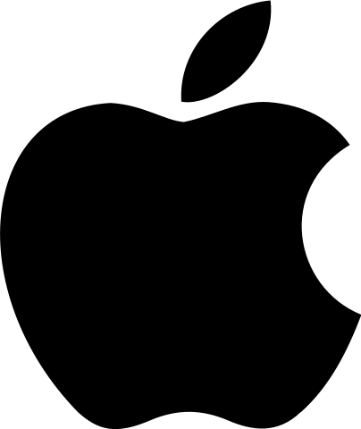


Capstone Project: Comparing Consumer Sentiment of Apple, Google, and Android from the Past and Present on Twitter
By: Sam Lim
Date: 7/28/21

Slide 2
Business problem
For better or worse, people's perception of tech giants have changed over time. A company that consults these large companies' PR teams have hired me to find how the consumers' sentiments have changed. To gather the necessary information, I am going to go to Twitter, and perform NLP sentiment analysis of the general public's sentiment towards these companies from the past and present.
Notes:
© Copyright PresentationGO.com – The free PowerPoint template library

Slide 3
Data collection
Old Twitter data was gathered from https://data.world/crowdflower/brands-and-product-emotions. After cleaning, 8,306 total tweets remained in the old Twitter data frame.
Using Tweepy and Twitter's Developer API, I collected 1,500 tweets per company, but around 1/3 of the tweets were not related to the company.
After cleaning, 3,405 tweets remained in the new Twitter data frame.
Notes:
© Copyright PresentationGO.com – The free PowerPoint template library

Slide 4
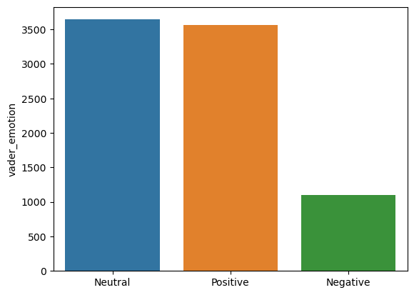
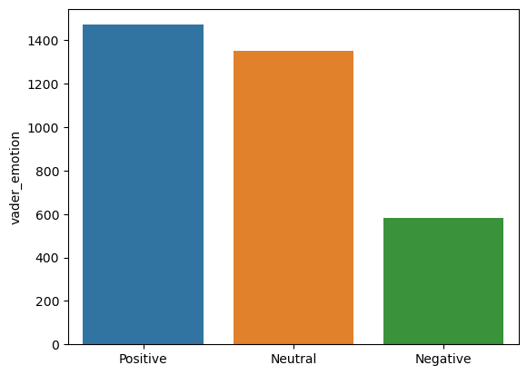
Data Imbalance
Old Tweet
There was an imbalance in the number of the three sentiments in both data frames.
The number of negative tweets were around a third of the size of the neutral tweets and positive tweets.
New Tweet
Notes:
For both the old tweets and new tweets, there was an imbalance in the number of the three sentiments.
The top image represents the number of old tweets with the respective sentiments, and the bottom represents the new tweets with the respective sentiments.
For both old and new tweets, the number of negative tweets were around a third of the size of the neutral tweets and positive tweets.

Slide 5
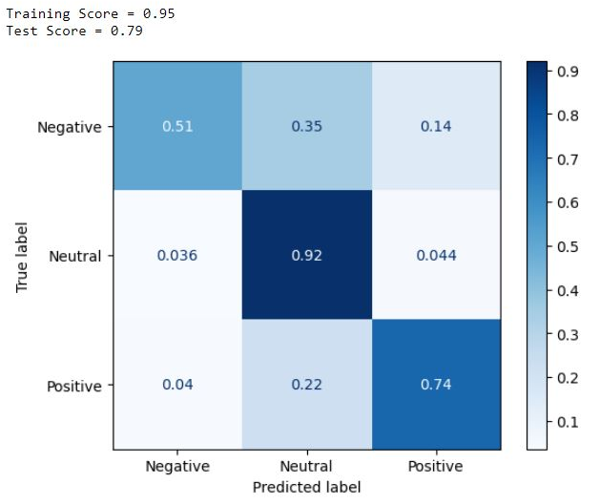
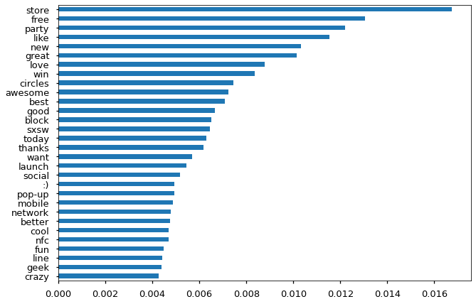
Random Forest (Old Tweets)
Because of the small number of negative tweets, the recall score for 'Negative' is low.
Notes:
For each old and new tweets, Random Forest Modeling and Naïve Bayesian Modeling were performed.
The image on the right shows the confusion matrix of the random forest model after the gridsearch was performed.
As shown before, the number of negative tweets were far less, which resulted in the low recall score for the negative tweets.

Slide 6
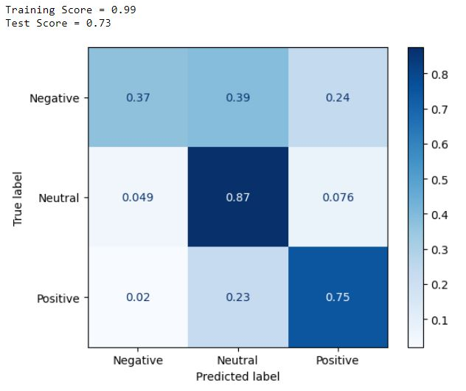
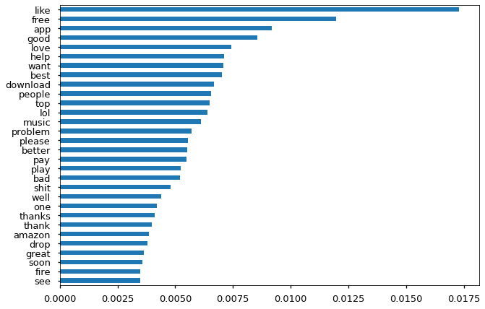
Random Forest with Grid Search (New Tweets)
Same problem as the old tweets
Still recommended because it was able to maintain a relatively high recall scores while improving the recall score for the negative tweets.
Notes:
The recall score of the random forest model with grid search for the new tweets also show the same problem.
However, I would still recommend this model (random forest with gridsearch) above others because it was able to maintain a relatively high recalls core for the positive and neutral tweets while improving the recall score for the negative tweets.

Slide 7
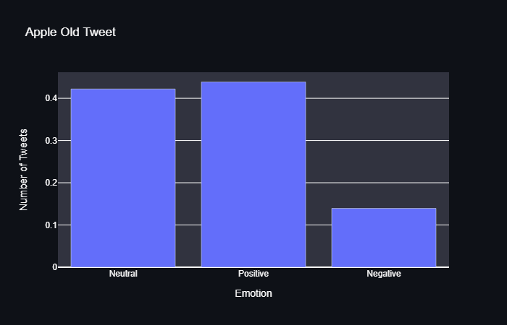
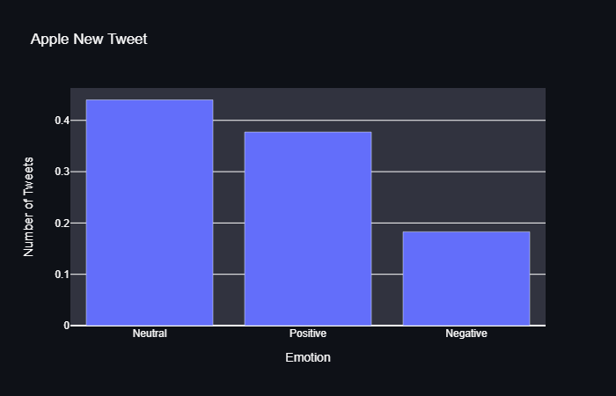
APPLE
When comparing the user sentiments generated from the old tweets to the newer tweets, we can see an increase in the ratio of negative tweets.
Notes:
© Copyright PresentationGO.com – The free PowerPoint template library

Slide 8
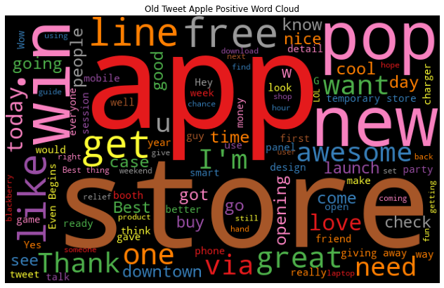
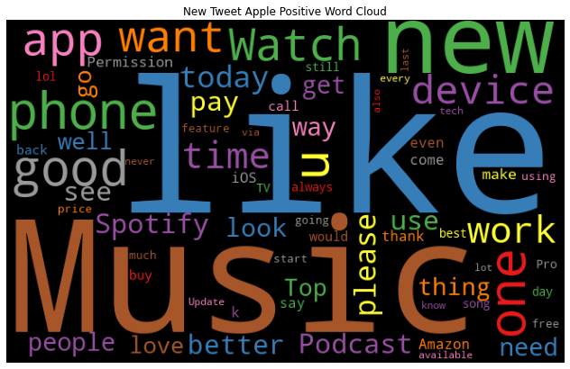
Word Cloud Comparison: Positive Sentiment Towards Apple
Old Tweet: store, app, line, opening, win, great, Thank, want
New Tweet: music, like, phone, Spotify, want, Watch
Words associated with positive sentiment seems to change from one's experience at the Apple store or using their product apps such as Apple Music or Spotify.
Notes:
© Copyright PresentationGO.com – The free PowerPoint template library

Slide 9
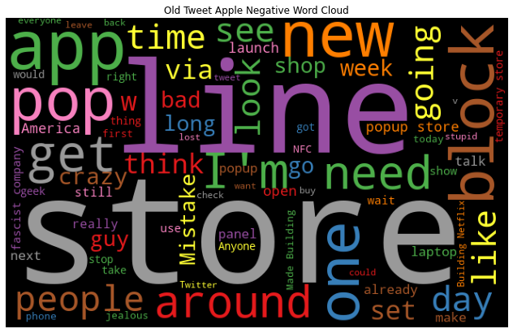
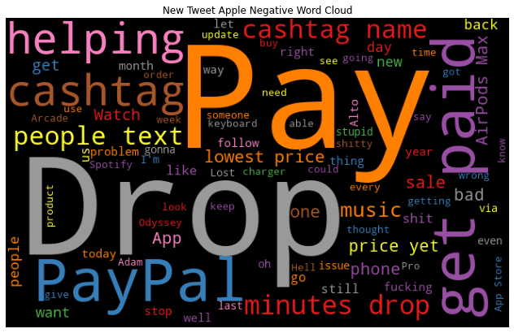
Word Cloud Comparison: Negative Sentiment Towards Apple
Old Tweet: store, line, block, need, crazy
New Tweet: price yet, people text, problem, stop, minutes drop
As with before, the negative sentiment towards Apple has shifted from the Apple experience to people's discontent towards Apple's products and prices.
Cashtag, get paid, cashtag name are all from advertisements that use an app called Cashpay. PayPal also seems to be associated with advertisements.
Notes:
© Copyright PresentationGO.com – The free PowerPoint template library

Slide 10
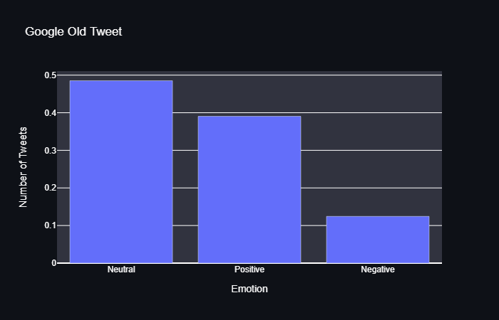
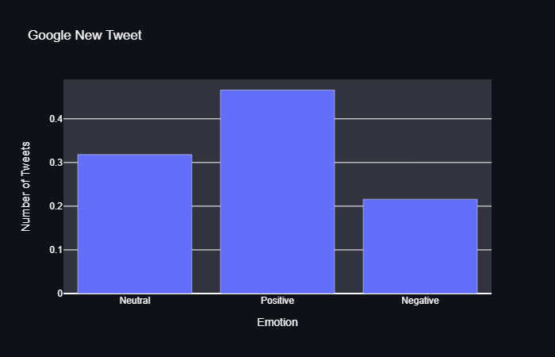
Google
Sentiment towards Google has increased.
The ratio of positive tweets have increased significantly. T
he ratio of neutral sentiments decreased while the ratio of negative sentiments did not show too much change.
Notes:
© Copyright PresentationGO.com – The free PowerPoint template library

Slide 11
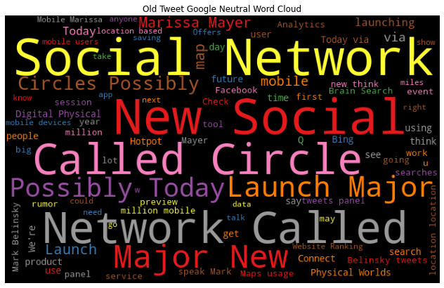
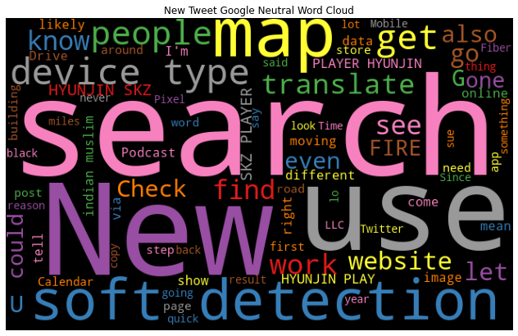
Word Cloud Comparison: Neutral Sentiment Towards Google
Old Tweet: Social Network, Major New, Possibly Today, Launch
New Tweet: Search, New, use, map, soft detection, translate
Neutral sentiment towards Google seems to have shifted from texts relating to social media to general uses of the google search engine.
Notes:
© Copyright PresentationGO.com – The free PowerPoint template library

Slide 12
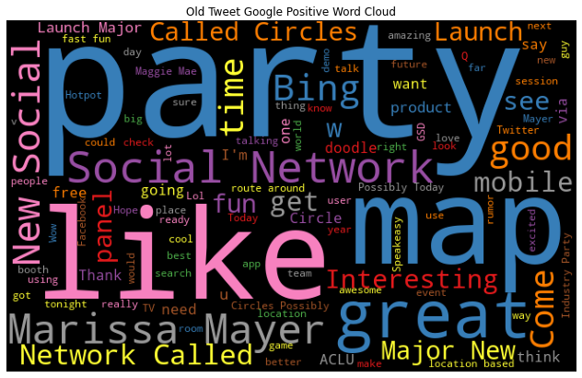
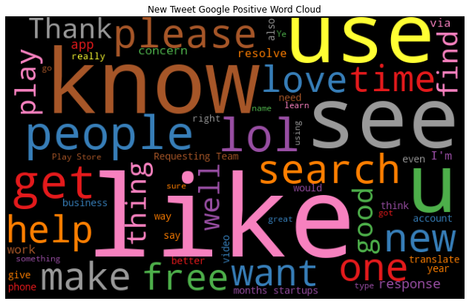
Word Cloud Comparison: Positive Sentiment Towards Google
Old Tweet: New Social, map, great, party, Social Network
New Tweet: like, know, use, see, help, search, find
Overall, the number of words related to positive sentiment towards Google seems to have decreased.
Similar to the tweets with neutral sentiment, new tweets seem to be more related to the Google's search engine rather than Google as a company.
Notes:
© Copyright PresentationGO.com – The free PowerPoint template library

Slide 13
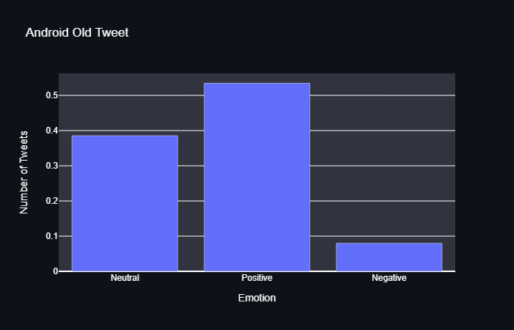
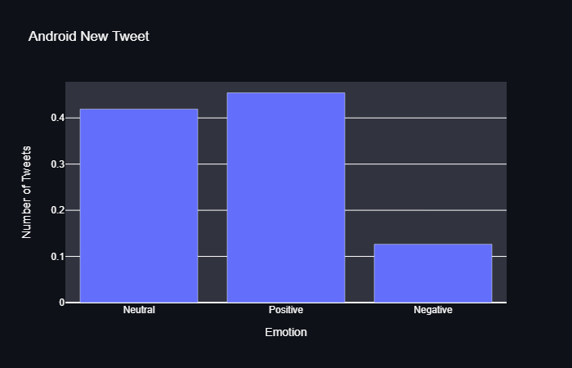
Android
User's sentiment towards Android has more or less remained the same.
The ratio of all sentiments in the new tweets do not differ too much from those of the old tweets.
Notes:
© Copyright PresentationGO.com – The free PowerPoint template library

Slide 14
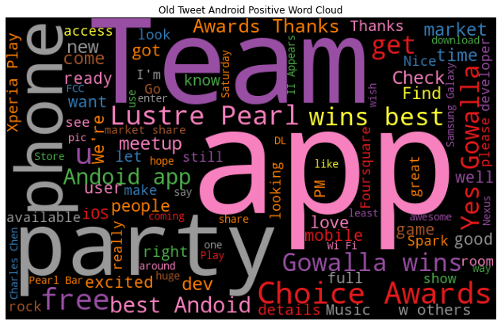
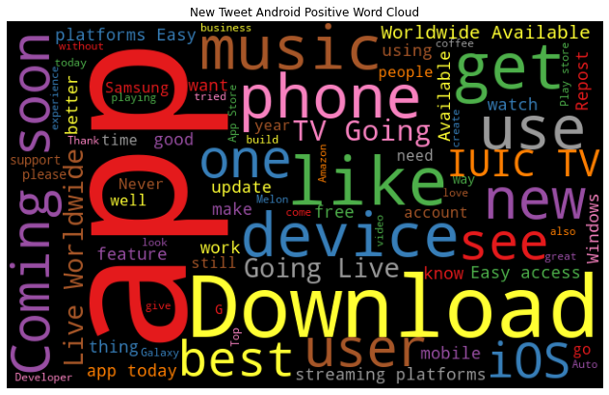
Word Cloud Comparison: Positive Sentiment Towards Android
Old Tweet: Team, App, wins best, phone, best Android
New Tweet: app, music phone, device, Easy access
Like the tweets about Apple, people seem to use their phones for music apps more.
From the wording in the old tweets, there is a rivalry between the users of Android phones and iPhone users, which we can no longer observe in the new tweets.
Notes:
© Copyright PresentationGO.com – The free PowerPoint template library

Slide 15
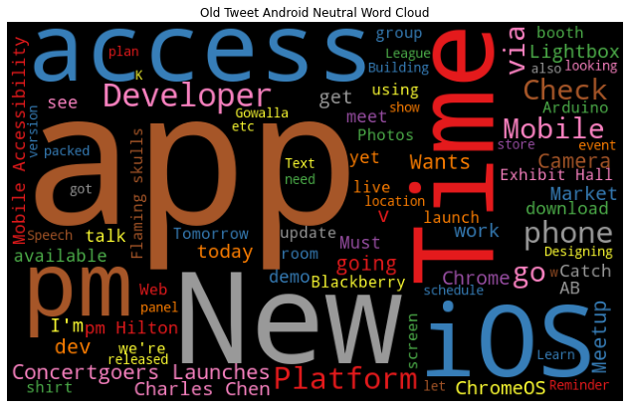
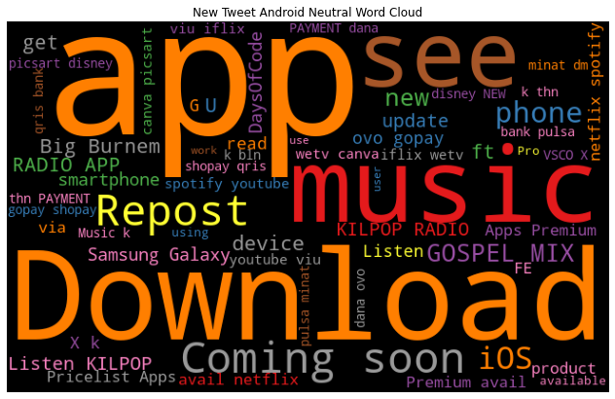
Word Cloud Comparison: Neutral Sentiment Towards Android
Old Tweet: app, New, Time, iOS, access, Platform, ChromeOS
New Tweet: app, music, Download, RADIO APP, iOS
Both old and new tweets seem to focus on Android apps, and judging form the word iOS, these tweets seem to either compare the type of apps or show the availability in both the Google Play Store and the iOS App Store.
Notes:
© Copyright PresentationGO.com – The free PowerPoint template library

Slide 16
Recommendation
I recommend using the Random Forest model with gridsearch.
This model was able to improve on the low recall score for tweets with negative sentiments while maintaining the relatively high recall scores for other tweets.
Given that the consumer's sentiment towards some of these companies have turned more negative, it could be recommended that these companies start paying more attention to their consumers to retain/improve their relationships with their customers.
Notes:
© Copyright PresentationGO.com – The free PowerPoint template library

Slide 17
Future Works
Create a timeline that displays continuous changes in public's sentiment towards these companies.
Add important events to the timelines to have a better understanding of what end consumers' wants and needs.
Add monthly/quarterly/annual earnings to show the relationship between the rate of increase in earnings to public sentiment.
Add companies that have continuously improved its relations with the end consumers and report on the changes in their earnings.

Slide 18
Thank You Q&A

Slide 19
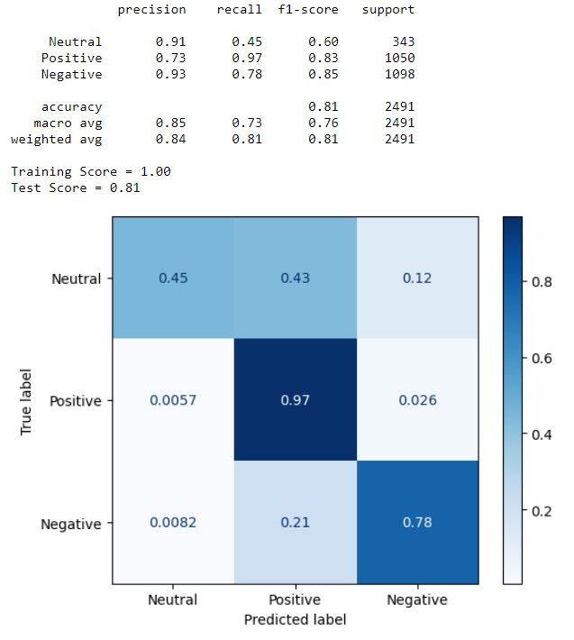

Appendx: Random Forest Base model and Pipeline (Old Tweet)
Base
Piepeline

Slide 20
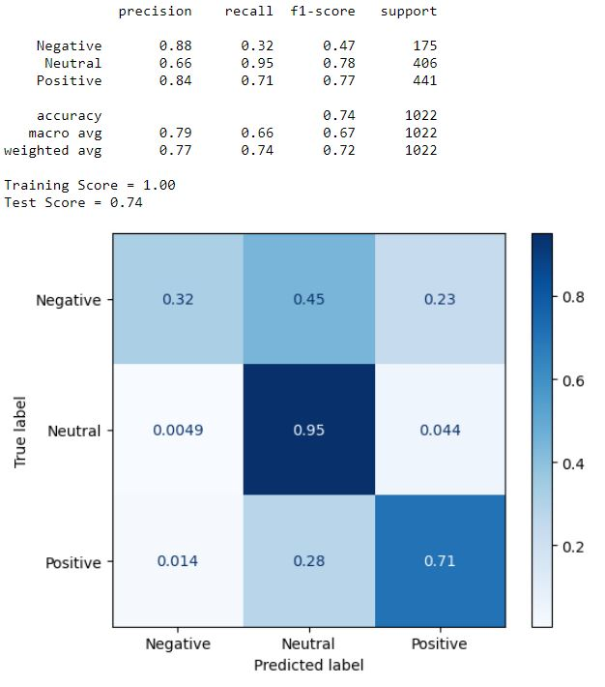
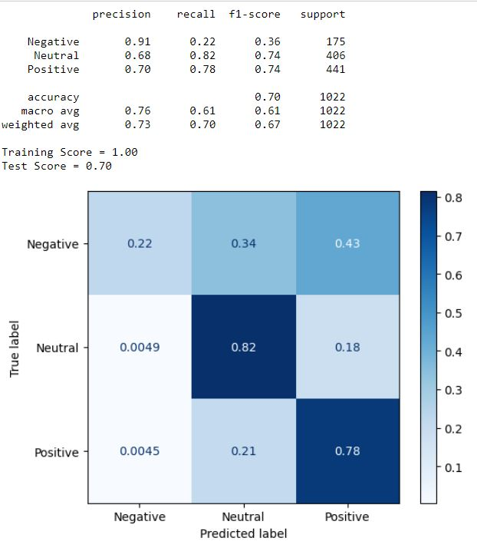
Appendx: Random Forest Base model and Pipeline (New Tweet)
Base
Piepeline

Slide 21
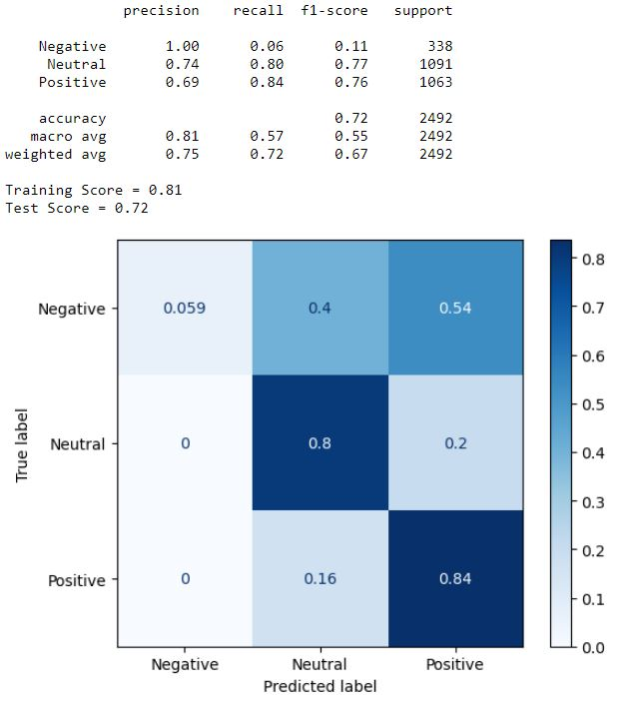
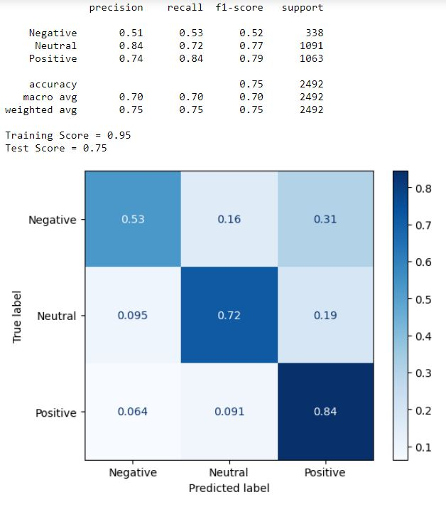
Appendx: Naïve Bayesian Base model and Grid Search (Old Tweet)
Base
Grid Search

Slide 22
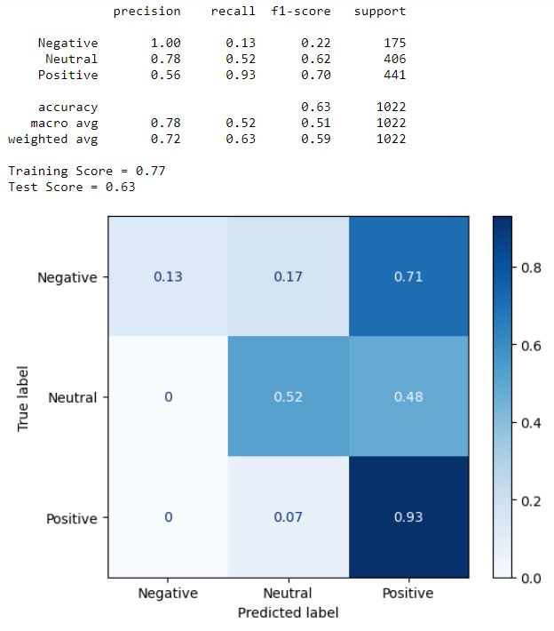
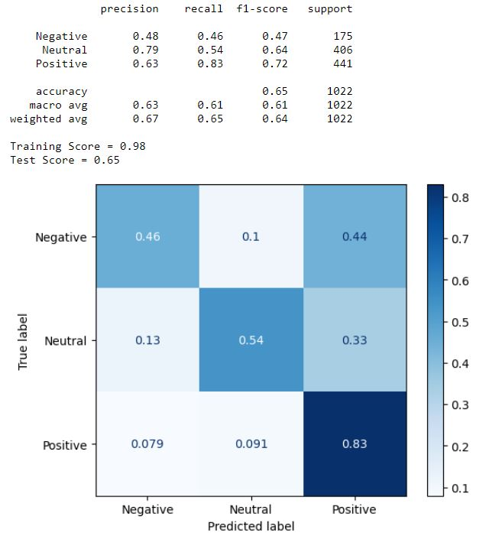
Appendx: Naïve Bayesian Base model and Grid Search (New Tweet)
Base
Grid Search

