Slide 1
Semester Long Project; Part 4
DNSC 4211

Slide 2
The Backstory:
IndiaGrowthCorp, a fast-growing company, is facing challenges in scaling their revenue operations effectively. Despite a strong product and market potential, their win/loss rates are inconsistent, and sales teams lack the tools and alignment needed to close deals efficiently. The CRO recognizes the need for a data-driven approach to optimize their GTM strategy, while the Director of Sales Enablement is struggling to equip the sales team with the right resources and training.
I was brought in to:
Diagnose Gaps: Identify inefficiencies in their sales process, pipeline management, and enablement efforts.
Align Teams: Bridge the gap between sales, marketing, and customer success to create a cohesive revenue engine.
Drive Results: Implement actionable strategies to improve win rates, shorten sales cycles, and scale revenue growth sustainably.

Slide 3
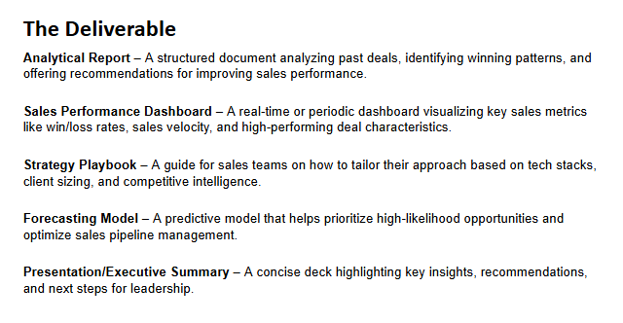

Slide 4
Bottom Line
IndiaGrowthCorp's sales inconsistencies stem from poor cross-functional alignment and lack of sales enablement, despite strong market potential.
Ideal customer targeting reveals highest win rates from smaller companies (<$1M revenue, <25K employees) and uncontested deals.
Efficiency gains can be unlocked by specializing sales efforts by channel and product, increasing win rate from 22.6% to 24.12% and projected revenue by $41.5M.
City-level strategies based on performance data inform tailored budget allocations and sales enablement plans to boost regional win rates.
Data-backed CRM and sales process optimization—including velocity-based playbooks and predictive win scoring—are key to accelerating pipeline and revenue growth past 50%.

Slide 5
SWOT
Strengths
Strong product-market fit with proven success in specific client segments (e.g., <$1M revenue firms).
High-value wins in key cities like Mumbai and Delhi, demonstrating regional growth potential.
Availability of robust sales data enabling advanced analytics and predictive modeling.
Weaknesses
Inconsistent win/loss rates due to fragmented sales processes and enablement gaps.
Low adoption and effectiveness of sales tools and collateral across teams.
Underperformance in certain cities (e.g., Pune, Chennai) and product lines (e.g., Legacy Modernization).
Opportunities
Specialization by product-channel pairing can streamline enablement and boost conversion rates.
CRM enhancements and velocity-based playbooks can significantly reduce time-to-close.
Strategic budget allocation and city-specific interventions can unlock regional revenue growth.
Threats
Aggressive revenue targets may push uncoordinated scaling without proper GTM alignment.
High iteration sales processes and slow deal velocity risk lowering close rates.
Competition in contested deals may increase loss rate if qualification and positioning aren’t refined.

Slide 6
54.20%
(84% effectiveness across models)
New win percent assuming optimized methods under TreePlan and Recommendations

Slide 7
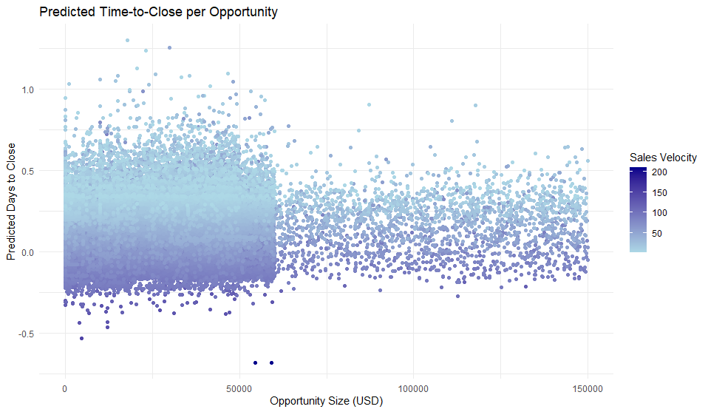
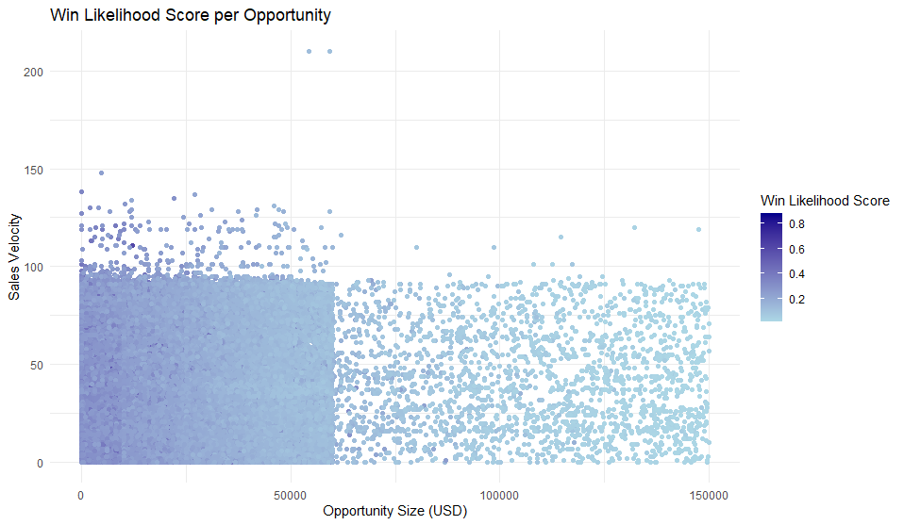
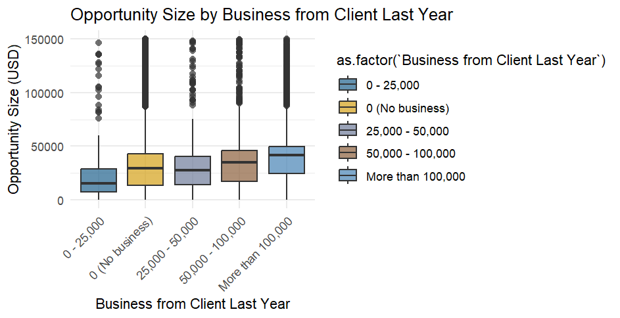
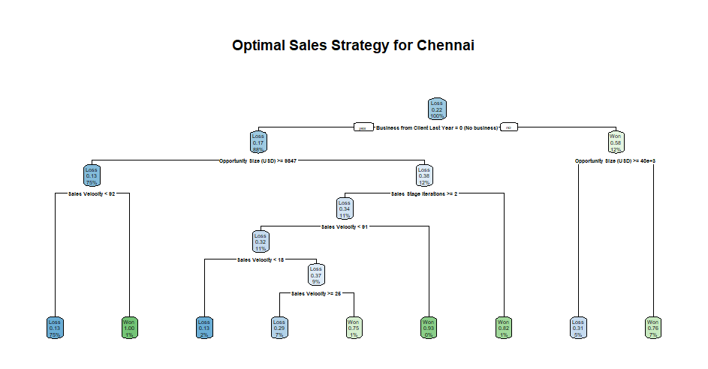
Methodology:

Slide 8
Recommendations
Sales Process
CRM
Launch Velocity-Based Playbooks for high-velocity deals (>50), aim to reduce average sales cycle by 15%.
Flag Deals with >3 Stage Iterations via dashboard alert system by May and assign manager review within 48 hours to maintain momentum.
Embed Win Probability Score in CRM by end of FY to prioritize deals >60% likelihood: improves forecast accuracy by 10%.
Create Watchlist for Deals >$75K & Velocity <30, assign weekly review task to sales leadership to fast-track decisions.

Slide 9
Appendix

Slide 10
The Backstory:
IndiaGrowthCorp, a fast-growing company, is facing challenges in scaling their revenue operations effectively. Despite a strong product and market potential, their win/loss rates are inconsistent, and sales teams lack the tools and alignment needed to close deals efficiently. The CRO recognizes the need for a data-driven approach to optimize their GTM strategy, while the Director of Sales Enablement is struggling to equip the sales team with the right resources and training.
I was brought in to:
Diagnose Gaps: Identify inefficiencies in their sales process, pipeline management, and enablement efforts.
Align Teams: Bridge the gap between sales, marketing, and customer success to create a cohesive revenue engine.
Drive Results: Implement actionable strategies to improve win rates, shorten sales cycles, and scale revenue growth sustainably.

Slide 11
My Stakeholder(s)
Chief Revenue Officer (CRO)
Oversees the entire revenue engine, including sales, marketing, and customer success.
Goals: Drive sustainable revenue growth, improve sales predictability, and scale the business.
Pain Points: Lack of pipeline visibility, misalignment across teams, and pressure to meet aggressive revenue targets.
Key Metrics: Revenue growth, win rate, average deal size, and customer lifetime value (CLV).
Focus Areas: GTM strategy, cross-functional alignment, and optimizing the sales process.
Director of Sales Enablement
Equips the sales team with tools, training, and resources to improve performance.
Goals: Increase sales productivity, reduce ramp time for new reps, and improve win rates.
Pain Points: Low adoption of tools, inconsistent use of sales collateral, and difficulty measuring enablement ROI.
Key Metrics: Ramp time, content usage, win rate, and sales cycle length.
Focus Areas: Sales training, content creation, and ensuring alignment between sales and marketing.

Slide 12
Who am I?
I am a RevOps consultant that helps companies with:
Sales Enablement
GTM Strategy
Business Development
To help IndiaGrowthCorp I will evaluate the following against their win/loss percent
Lead prospecting
Previous account size, if any
Forecasted account size
Market properties
Product fit
Location
Market Medium

Slide 13
Semester Long Project; Part 2
DNSC 4211

Slide 14
In sales, the win percentage represents the share of deals successfully closed, while the loss percentage reflects the share of opportunities that were not converted into sales. A higher win rate indicates strong sales performance and effective strategies, whereas a higher loss rate suggests missed opportunities or competitive weaknesses. These metrics help assess sales effectiveness and guide strategy improvements.
In IndiaGrowthCorp’s Niche:
Top 10%: 35% win
Bottom 10% : 15% win

Slide 15
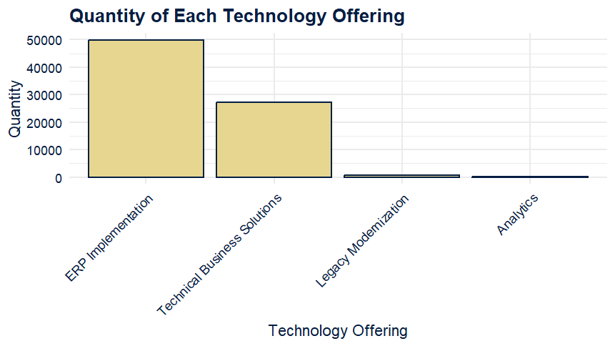
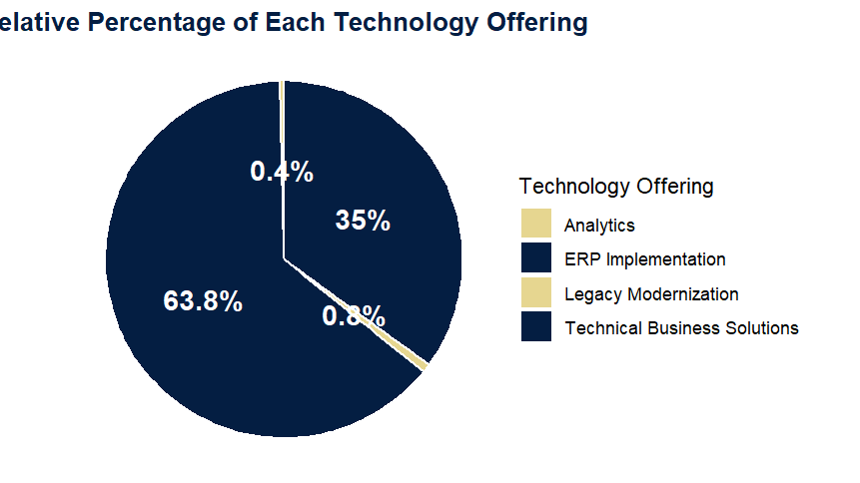
Tech Offering Sale Breakdown

Slide 16
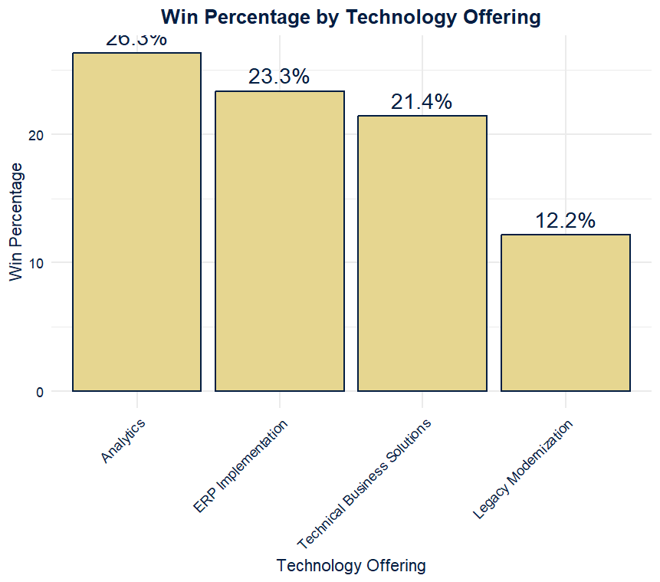
Sales Performance Per Tech Offering

Slide 17
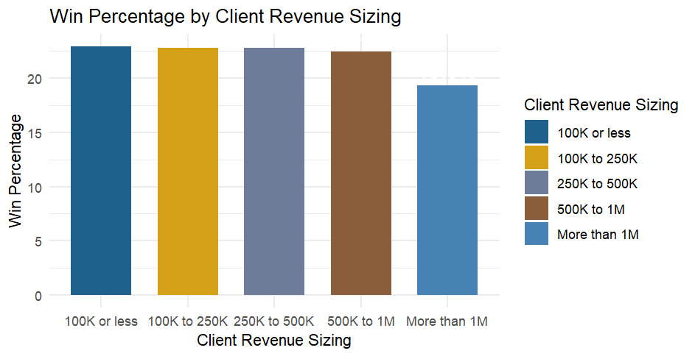
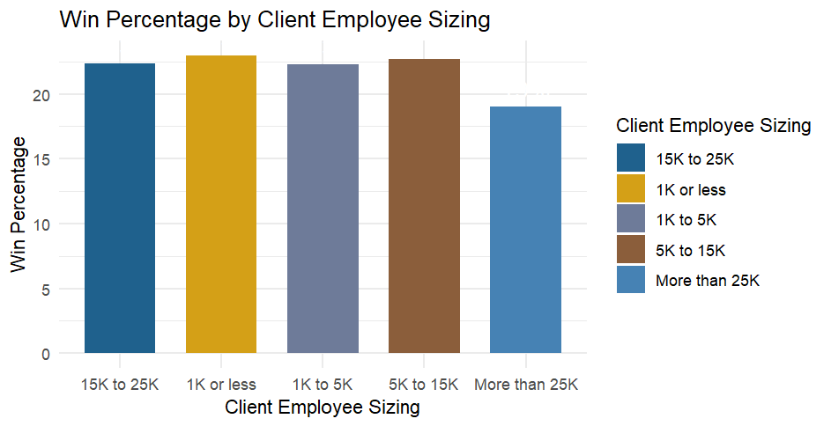
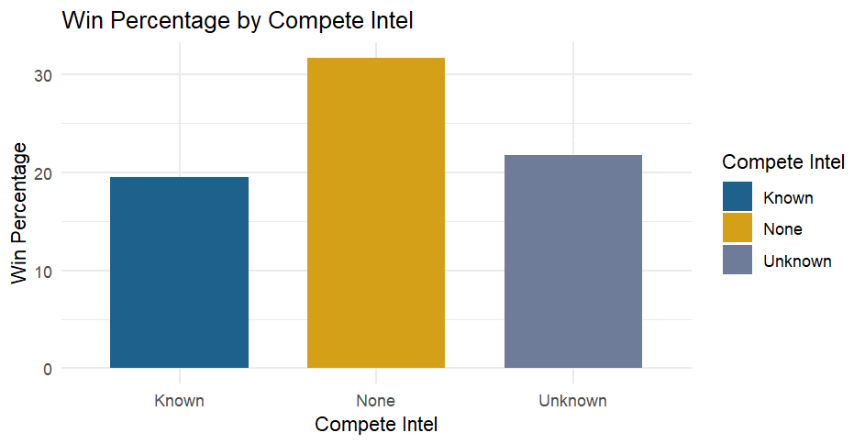
Client Info Breakdown

Slide 18
IGC’s Ideal Customer Based on Win Data
IGC’s Ideal Customer Profile
Revenue: Companies with less than $1M in revenue have the highest win rates, indicating stronger alignment with IGC’s offerings.
Employees: Firms with fewer than 25,000 employees tend to convert more successfully, suggesting a preference for mid-sized organizations.
Competitive Intelligence: Deals where no competitive intelligence is involved have the highest success rate, implying that uncontested opportunities yield better outcomes.
To maximize success, IGC should focus on targeting smaller revenue companies (<$1M) and mid-sized firms (<25K employees) while prioritizing uncontested deals, potentially by refining lead qualification and competitive positioning strategies.

Slide 19
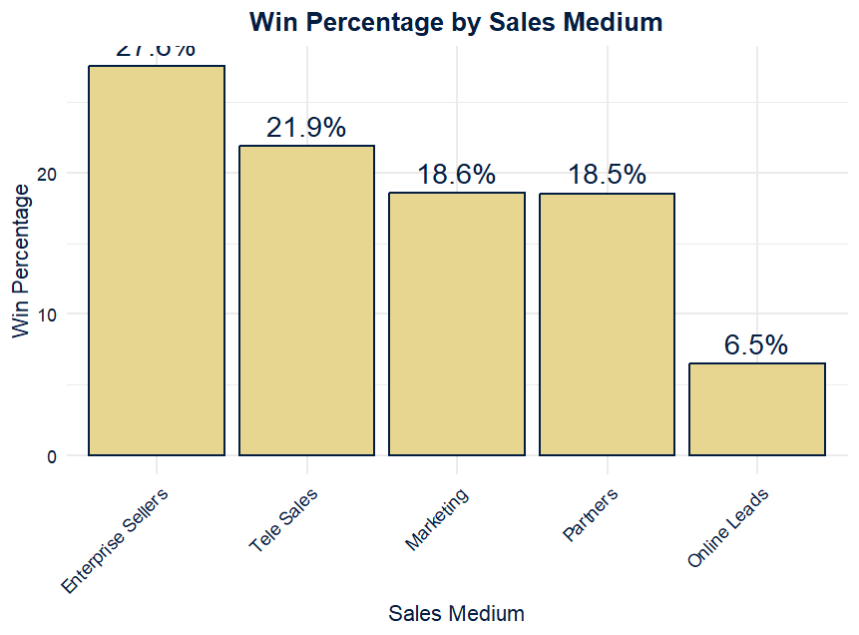
Sales Medium Success Breakdown

Slide 20
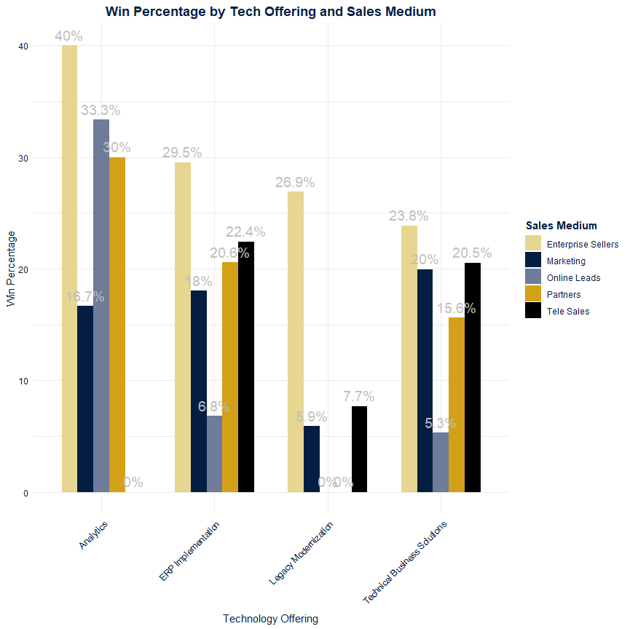
Sales Medium Success Breakdown By Offering:

Slide 21
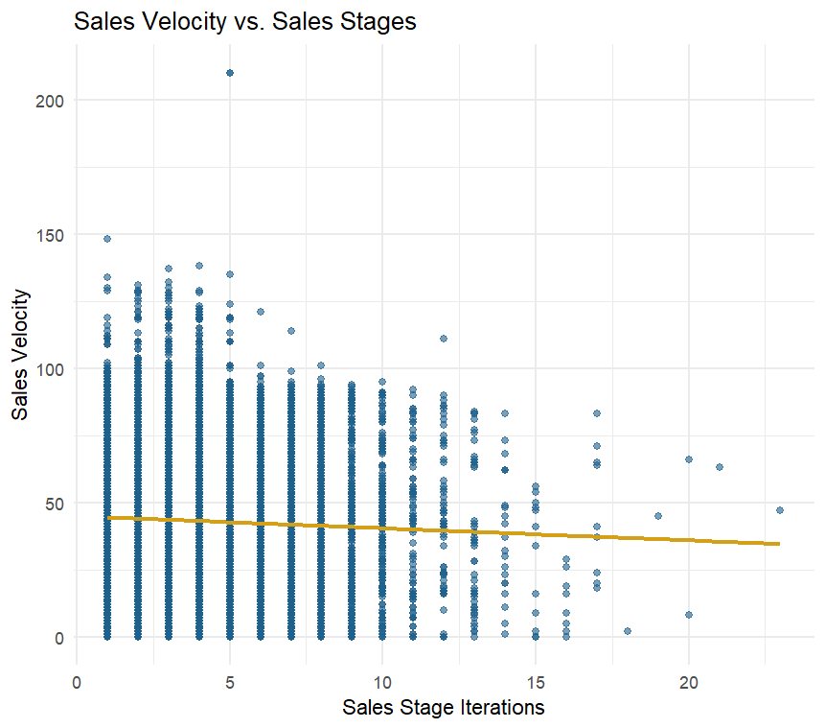
Sales Velocity vs Stage Iterations

Slide 22
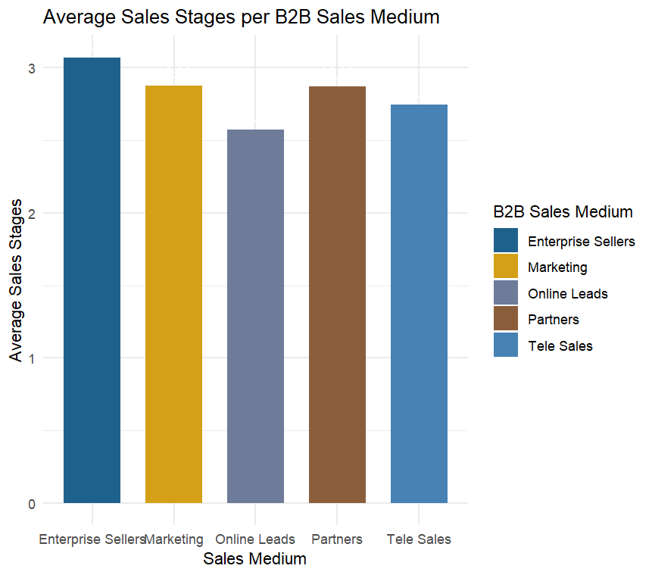
Analysis of Velocity vs Stage Iteration
WHAT THIS MEANS:
As the firm increases its sales stages, the velocity goes down. We know that a higher velocity results in a higher win rate:
Focus on Sales Mediums that have fewer stages →

Slide 23
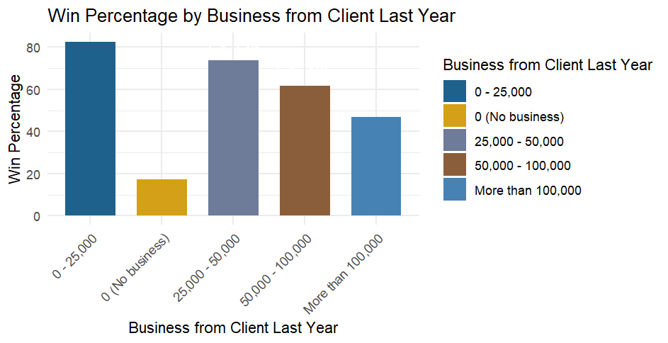
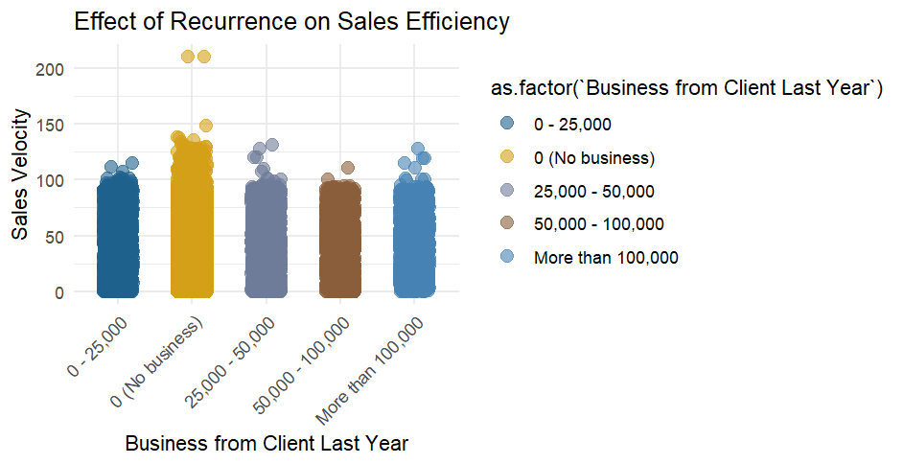
It is Cheaper and Equally Efficient (if not more) to retain customers:

Slide 24
Analysis
Our strategy is to look at how recurring business can develop and grow with IGC →
Interpreting the Data
Retention Focus: Clients with previous high spending (>100,000 USD) tend to generate larger opportunities, so prioritize loyalty programs and personalized offers to maximize their lifetime value.
Upselling Strategy: Mid-tier clients (25,000–100,000 USD) show growing opportunity sizes, indicating potential for upselling through bundled services or volume discounts to move them into the highest spending bracket.
New Client Activation: Clients with no prior business have the smallest opportunities, suggesting a need for aggressive outreach campaigns, introductory discounts, and tailored onboarding experiences to convert them into repeat buyers.

Slide 25
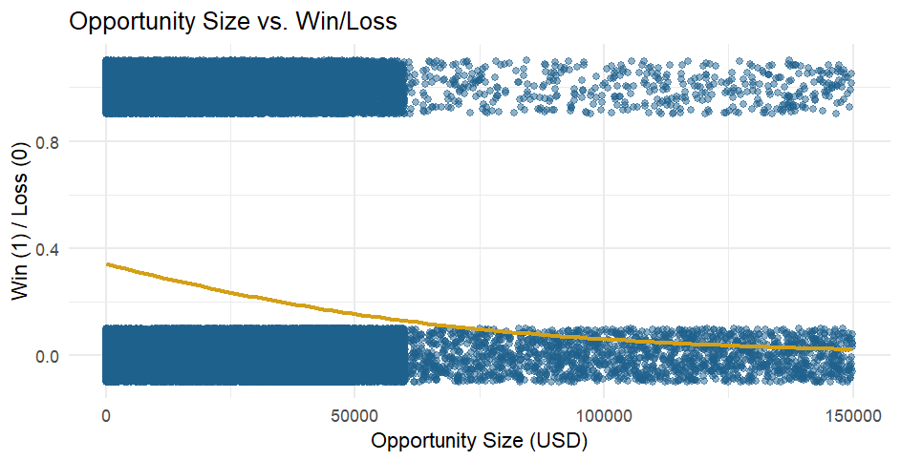
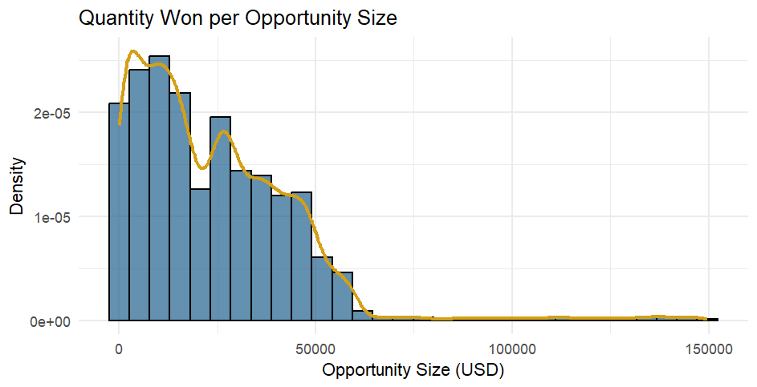
Opportunity Size: Stand-Alone
Win Percent

Slide 26
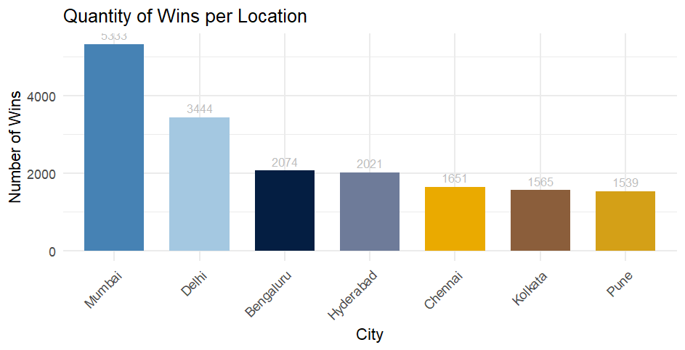
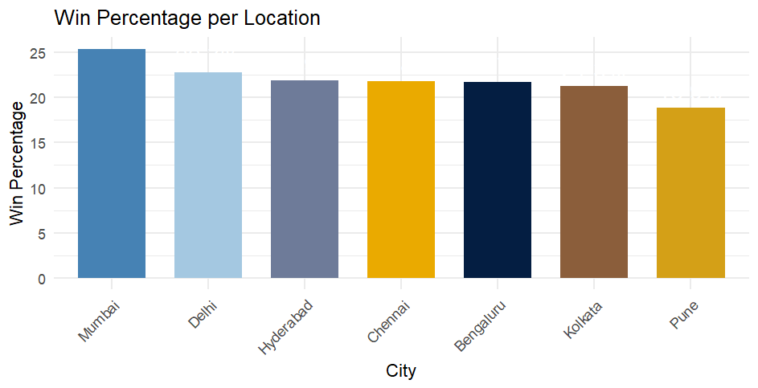
Where is ICG Selling (Best…)
Top Performers
Mumbai
Dehli
Hyperbad
Causes of Concern
Pune
Kolkata
In the Middle
Bengaluru
Chennai

Slide 27
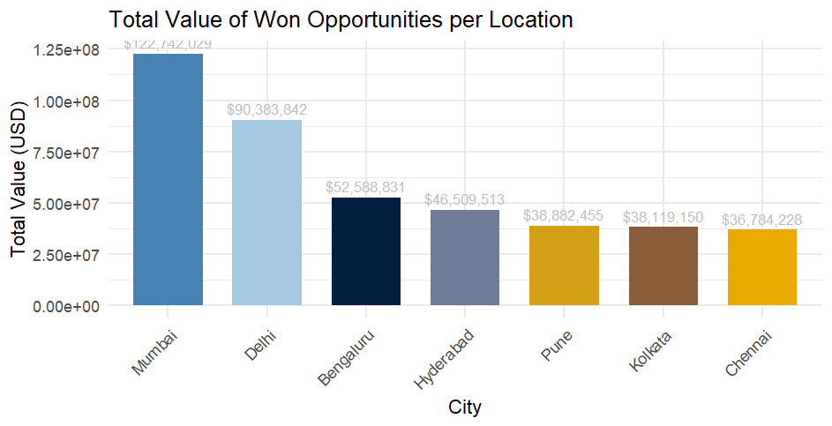
Value per Firm
Total Value of All Won Opportunities: $ 426,010,048

Slide 28
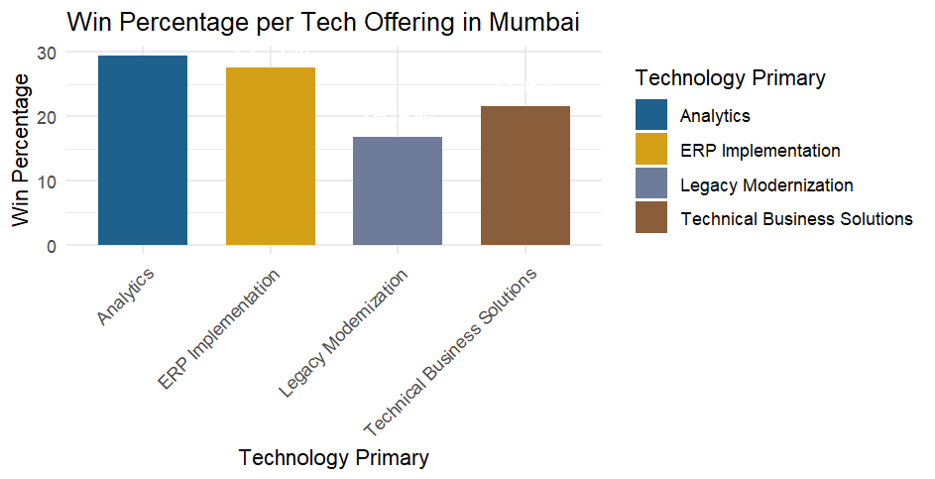
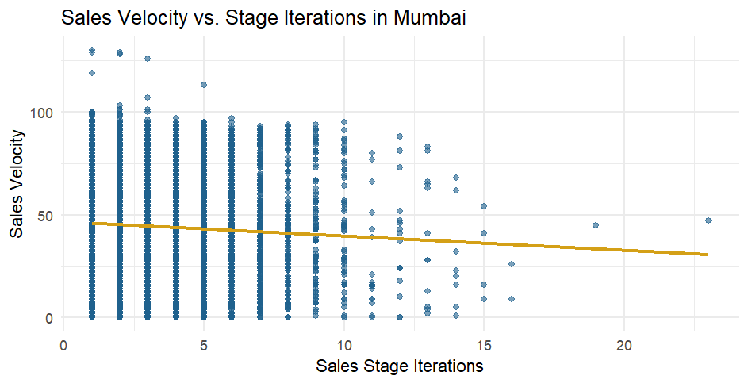
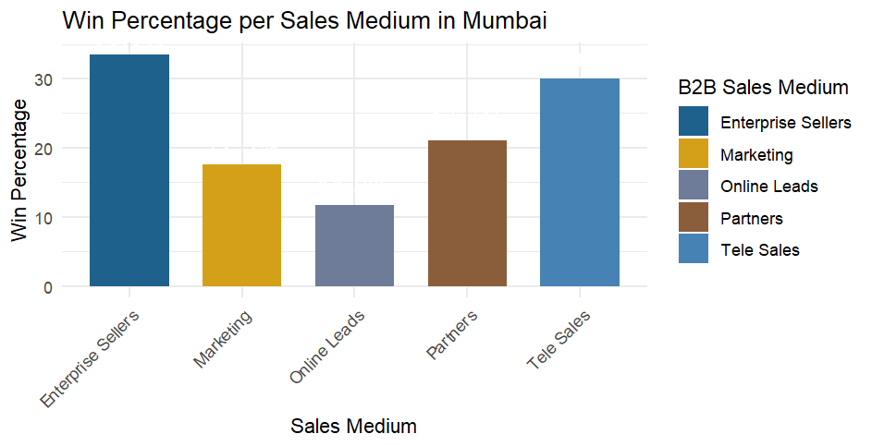
Mumbai
Average Opportunity Won in Mumbai: $ 23,015.57
Win Percentage in Mumbai:
25.37 %
Client Retention Rate in Mumbai: 63.91 %
Total Value in Mumbai:
$ 122,742,029

Slide 29
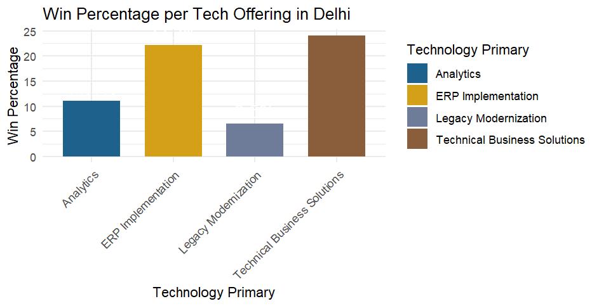
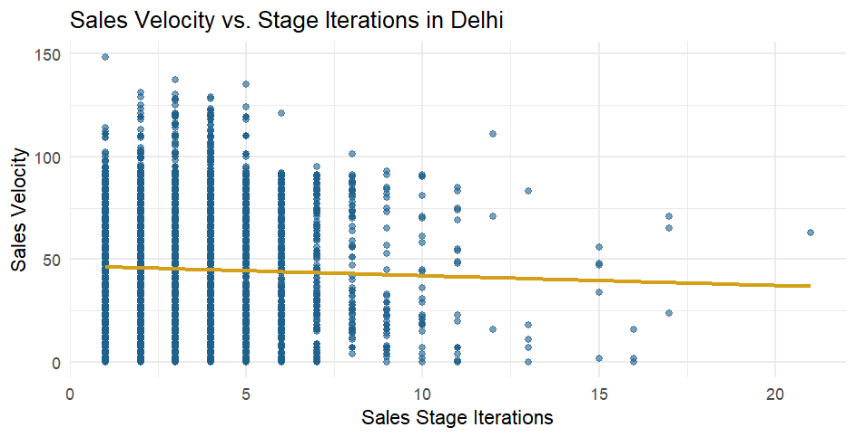
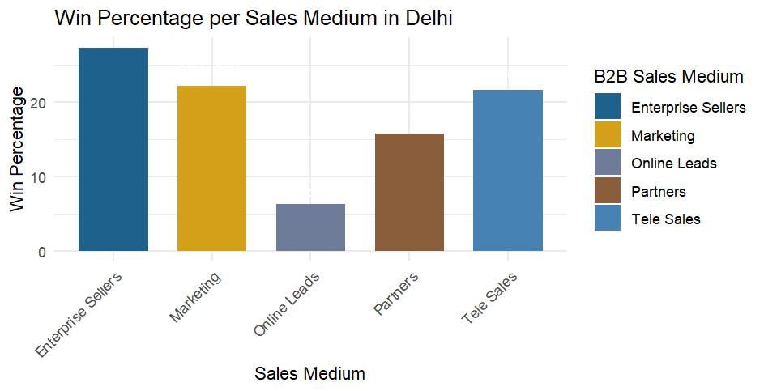
Dehli
Average Opportunity Won in Delhi: $26,243.86
Win Percentage in Delhi: 22.74%
Client Retention Rate in Delhi: 69.29%
Total Value in Delhi: $90,383,842

Slide 30
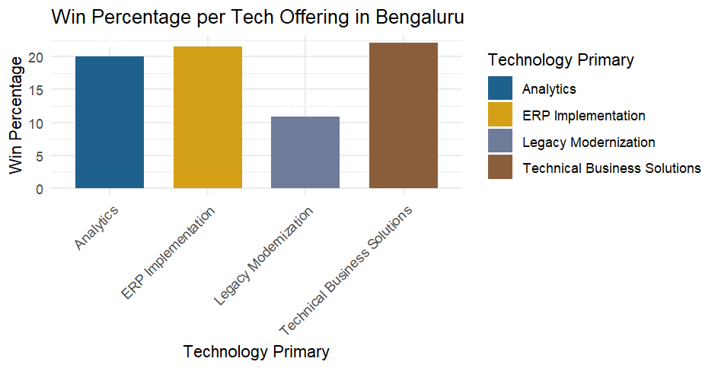
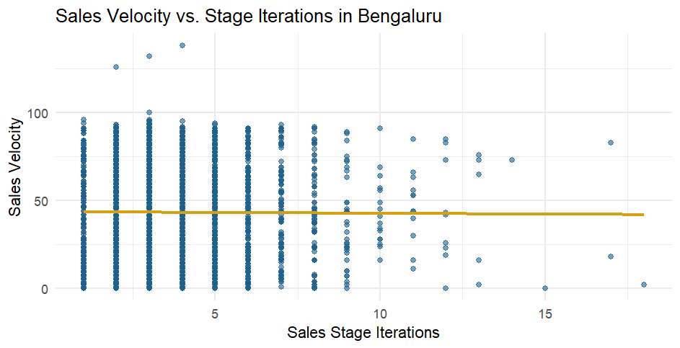
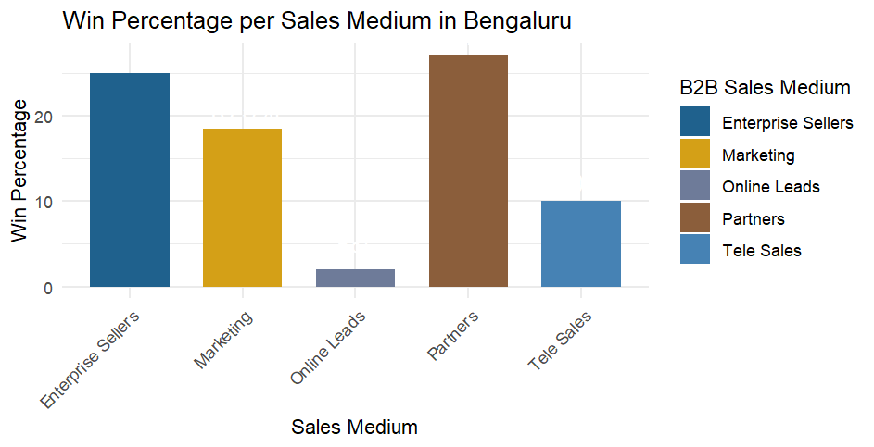
Bengaluru
Average Opportunity Won in Bengaluru: $25,356.23
Win Percentage in Bengaluru:
21.71%
Client Retention Rate in Bengaluru:
65.52%
Total Value in Bengaluru:
$52,588,831

Slide 31
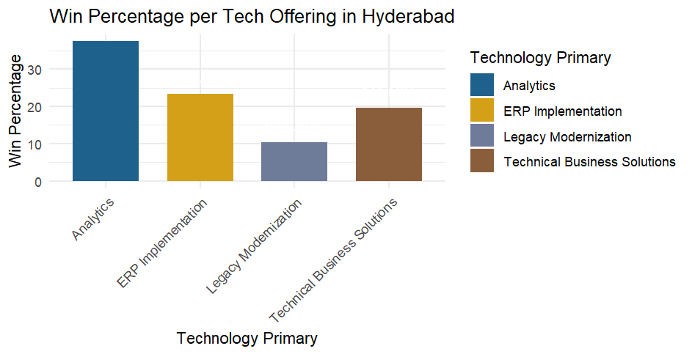
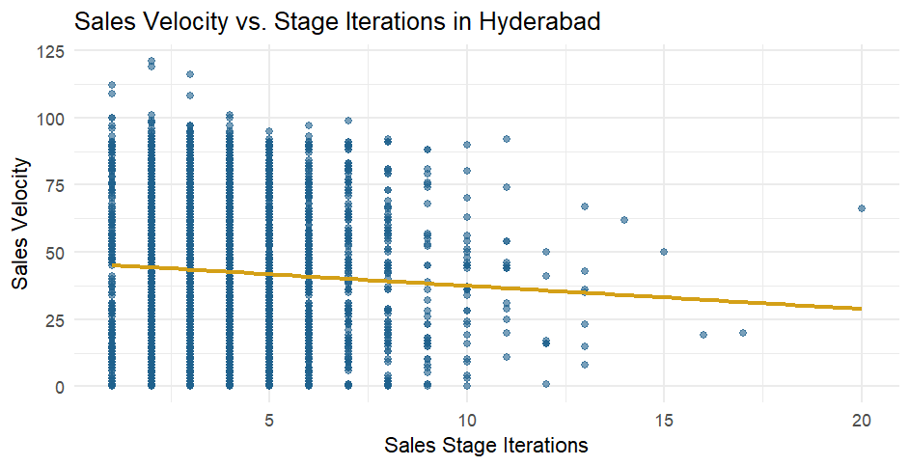
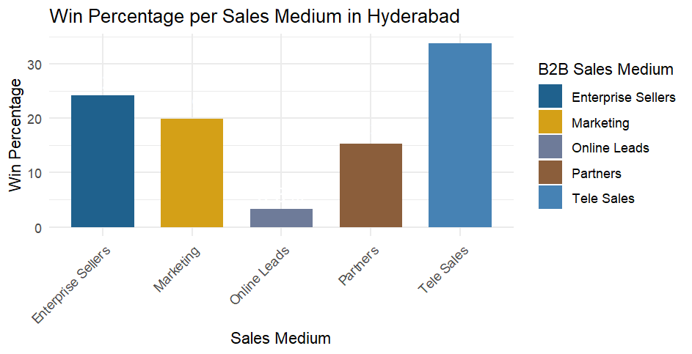
Hyderabad
Average Opportunity Won in Hyderabad: $23,013.12
Win Percentage in Hyderabad:
21.89%
Client Retention Rate in Hyderabad:
64.27%
Total Value in Hyderabad:
$46,509,513

Slide 32
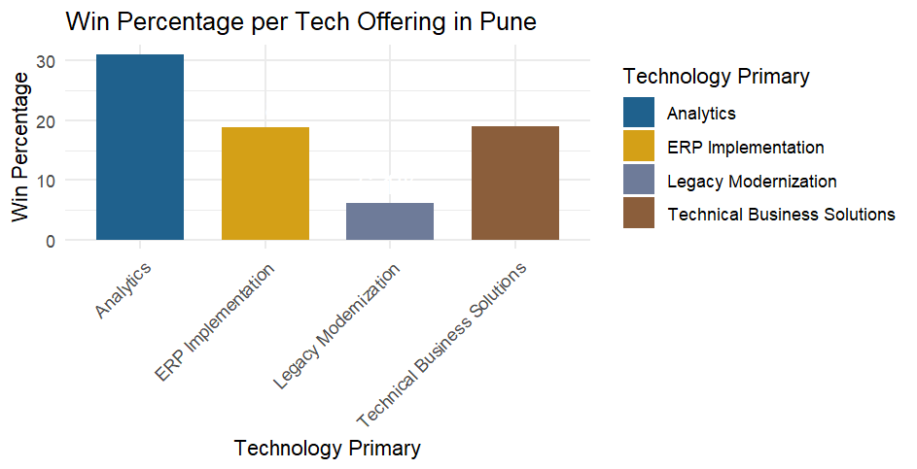
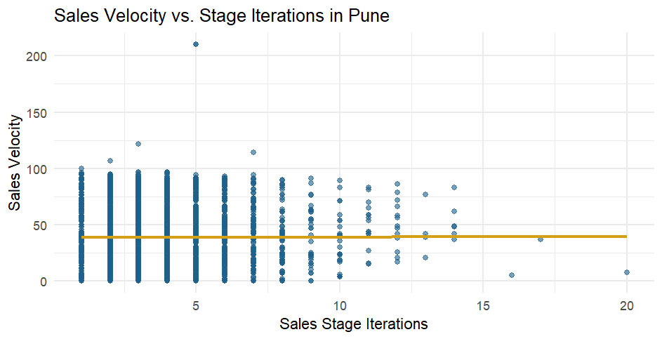
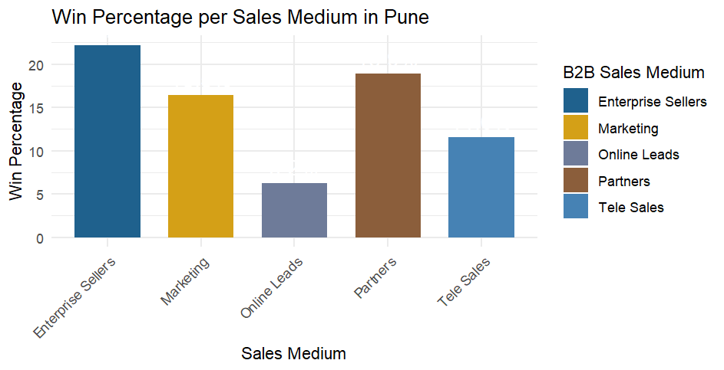
Pune
Average Opportunity Won in Pune: $25,264.75
Win Percentage in Pune:
18.88%
Client Retention Rate in Pune:
58.83%
Total Value in Pune:
$38,882,455

Slide 33
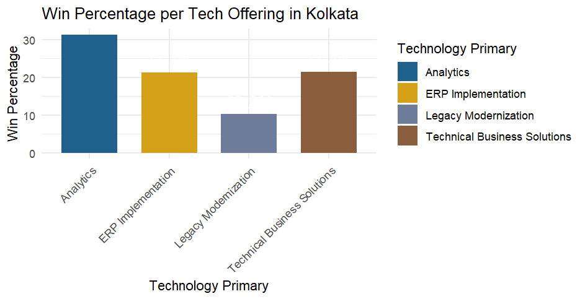
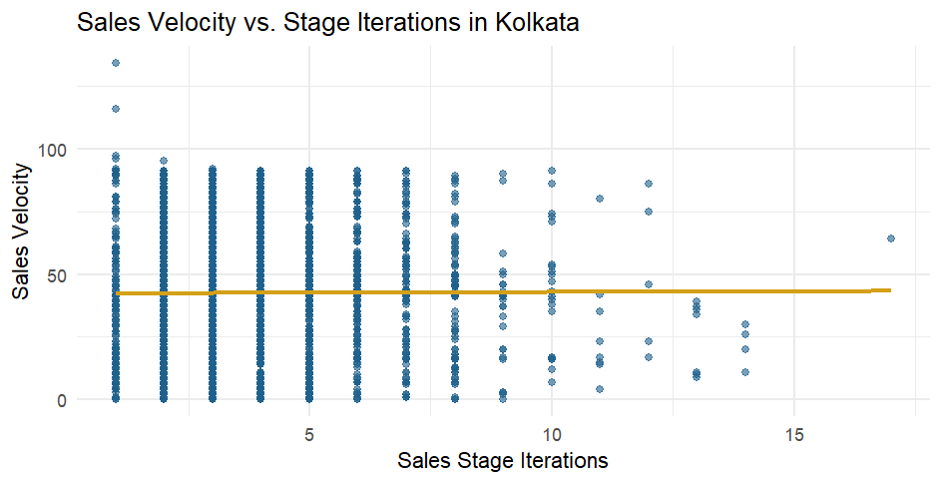
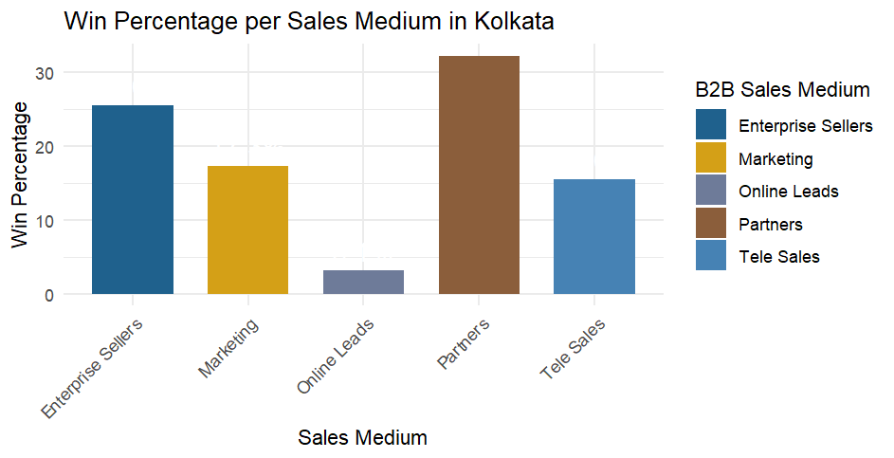
Kolkata
Average Opportunity Won in Kolkata: $24,357.28
Win Percentage in Kolkata:
21.27%
Client Retention Rate in Kolkata: 63.98%
Total Value in Kolkata:
$38,119,150

Slide 34
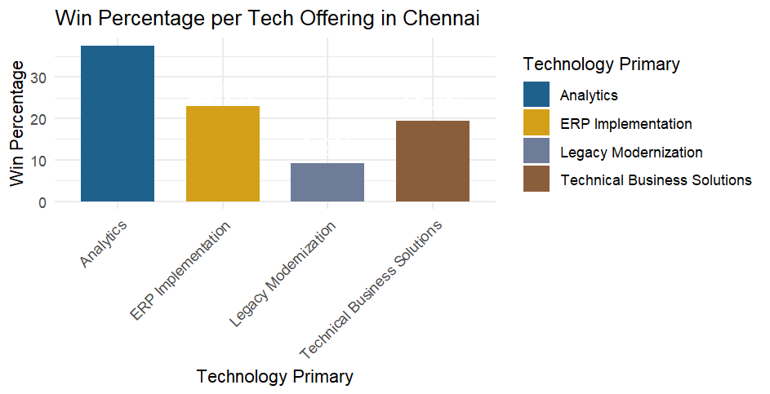
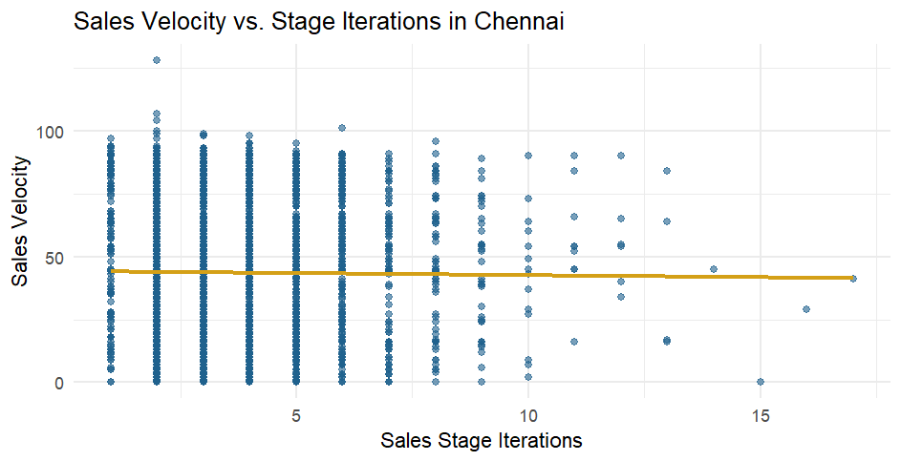
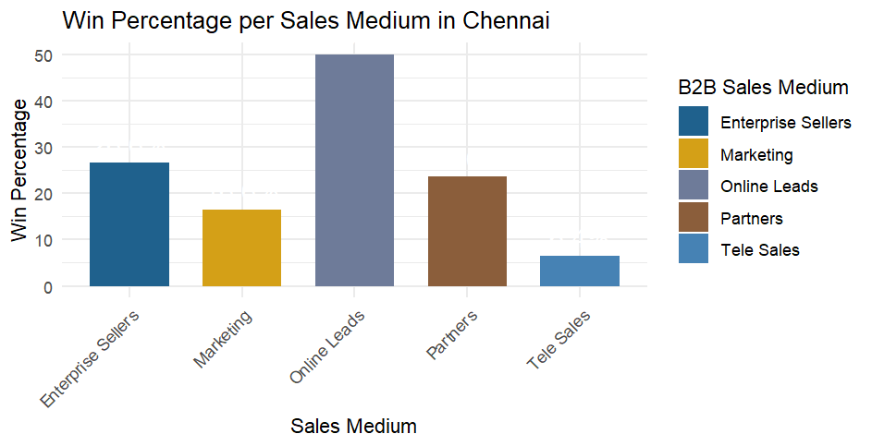
Chennai
Average Opportunity Won in Chennai: $22,279.97
Win Percentage in Chennai:
21.82%
Client Retention Rate in Chennai: 57.83%
Total Value in Chennai: $36,784,228

Slide 35
Budget Division
Total Budget: $426,010,048
Allocation per City:
Bengaluru: $53,023,434
Chennai: $37,314,806
Delhi: $89,335,893
Hyderabad: $47,375,956
Kolkata: $39,103,081
Mumbai: $119,509,736
Pune: $40,347,142
The budget is allocated using inverse performance weighting, where underperforming cities with lower win rates receive a higher share based on their relative contribution to the firm's total value.

Slide 36
Basic Recommendations
Specialization - Focus on compartmentalization in selling, especially with
high-cost channels:
Enterprise_Sellers → Analytics, ERP Implementation: 34.8%
Marketing → Technical Business Solutions, ERP Implementation: 19%
Online_Leads → Analytics, ERP Implementation: 20%
Partners → Analytics, ERP Implementation: 26.2%
Tele_Sales → ERP Implementation, Technical Business Solutions: 20.6%
This process will streamline resource usage, allow for specialized training and enablement, and increase ICG’s forecasted:
average win percent from 22.6% to 24.12%
net sales from $426,010,048 to $467,480,042.67 ($41,469,994.67)

Slide 37
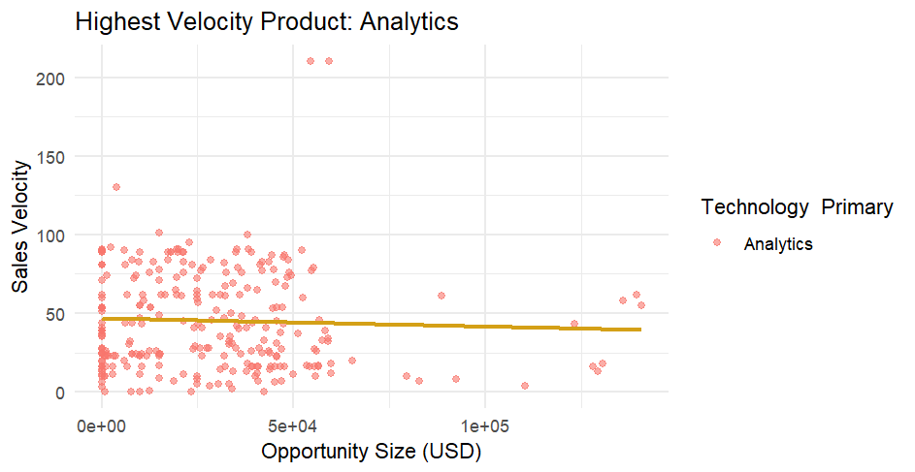
Basic Recommendations
Efficiency - Focus on the product that streamline efficiency and size.
Analytics Average Velocity - 45.3
Analytics Average Opportunity Size - $7,780,570
Allocating extra Enterprise Sellers and Partners as
well as targeting Online Leads to sell analytics will yield:
Projected New Win Percentage: 23.45% (+0.85%)
Projected New Total Sales Value: $446,162,209 (+$20M)

Slide 38
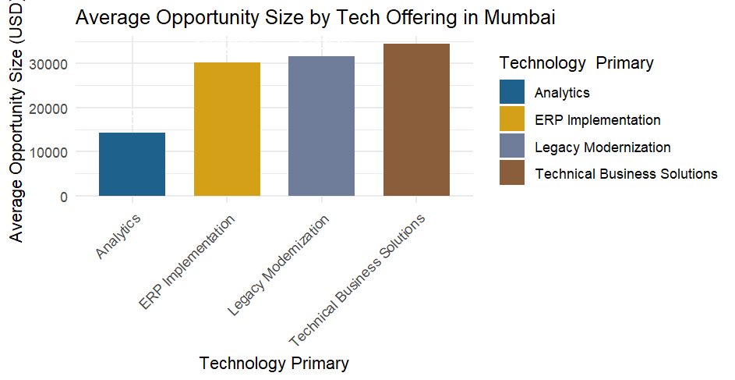
Mumbai Recommendations
Mumbai looks great. Here are our recommendations:
Budget: $119,509,736
Focus on higher retention rate products
allocate 25% of your budget towards loyalty programs, customer success operants, and sales enablement for higher retention products:
Analytics and Online Leads are the highest retention rate
sales offerings and mediums respectively. Focus 25% of
budget on sales enablement for analytics, and 25% of
budget for building out online leads.
Use the remaining 25% of your budget to refine your
enablement and sales for Technical Business Solutions, the
highest ROI product.

Slide 39
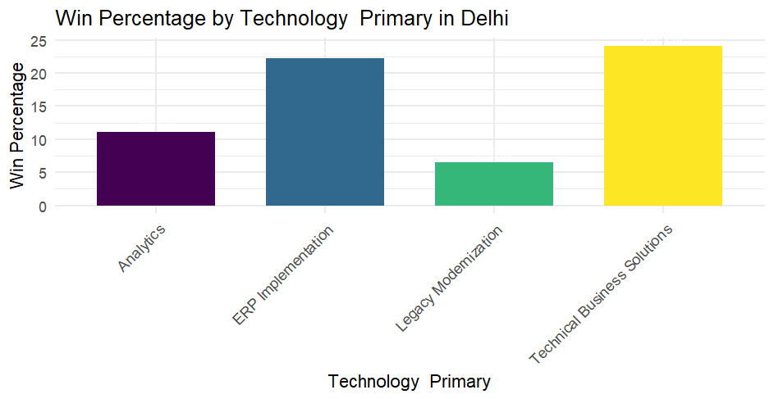
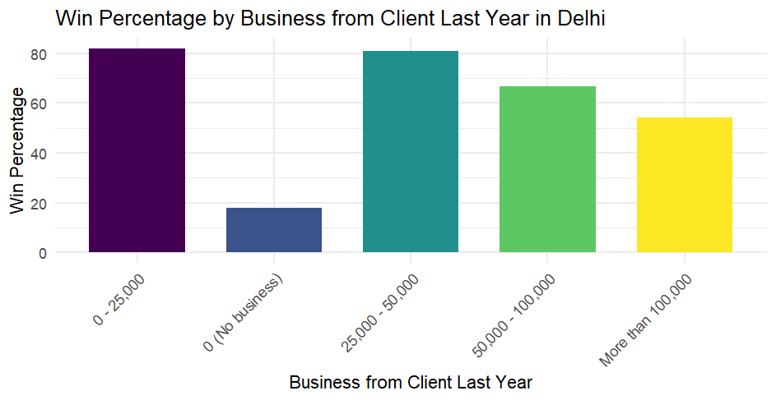
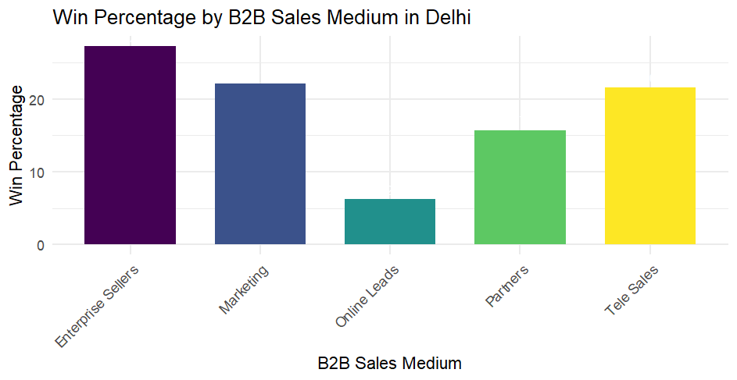
Delhi Recommendations
Across the board, Delhi has trends that follow exact company averages.
Budget: $89,335,893
Utilize 100% of this budget for sales enablement for:
Analytics & Legacy Modernization
Online Leads
Lead generation and
prospecting
Training efforts for these
struggling areas will yield
4x return on every 1% gained
in win%

Slide 40
Bengaluru Recommendations
Bengaluru is struggling with its Legacy Modernization offering dragging all other KPIs down. Focus 100% of efforts there.
Budget: $53,023,434
For Legacy Modernization:
Average Opportunity Size: $40,235.89 (Company Average: $36,148.38
Average Sales Velocity: 43.96 (Company Average: 38.40)
Average Stage Iterations: 2.83 (Company Average: 2.87) *how are you moving through deals quicker than average if they have similar stage iterations?
Insights:
To increase the win percentage for this offering, prioritize Enterprise Sellers and Partners as the primary sales mediums, focusing on high-value client targeting and streamlining sales stage iterations to accelerate deal closures.

Slide 41
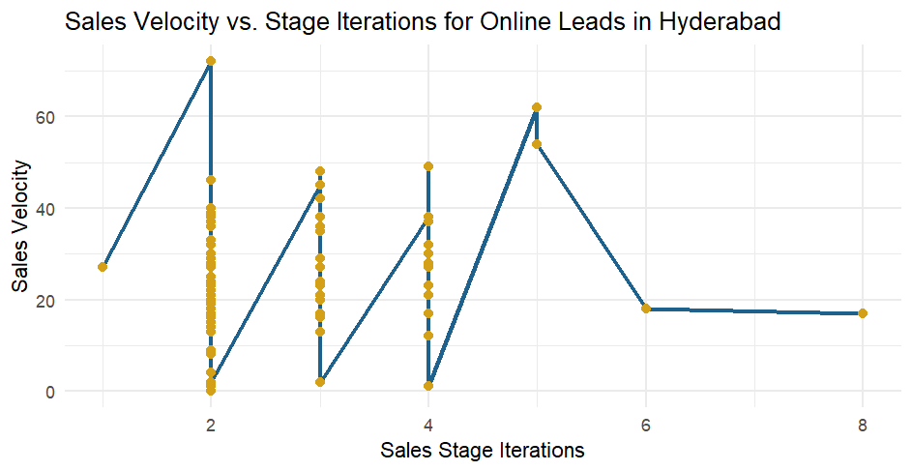
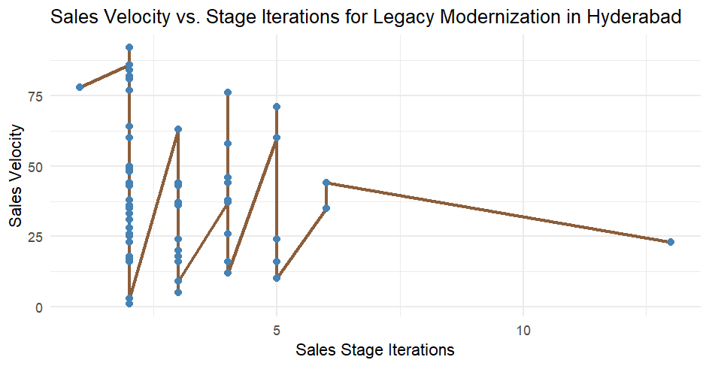

Hyderabad Recommendations
Hyperbad is struggling with its Legacy Modernization offering and Online Sales, dragging all other KPIs down. Focus 50% of efforts on each. They need to fix volatile velocity across iterations:
Budget: $47,375,956
Clear Conclusion: Between 1 and 4 stages of sales is essential. After 4 stages, the win% goes down exponentially per additional stage!

Slide 42

Pune Recommendations
Pune has some of the lowest win rates and retention rates across the board at IGC. However, Pune also demonstrates a higher velocity with more sales stages.
Budget: $40,347,142
We recommend the following NBP
strategy for clients in the pipeline:
Stages 1-5 push analytics
Stages 5-12 push ERP
Stages 12+ push Technical Business
Solutions.
*Drop Legacy Modernization entirely.

Slide 43

Kolkata Recommendations
In Kolkata, we recommend matching specific products to their best GTM Enablement partner. Their stats are exactly average and can be slightly refined for greater success.
Budget: $39,103,081
Analytics → Enterprise Sellers: 40.00%
ERP Implementation → Enterprise Sellers: 29.55%
Technical Business Solutions → Tele Sales: 20.53%
New Total Projected Win Percentage: 23.45%

Slide 44

Chennai Recommendations
Chennai can dramatically increase its win% across the board by focusing its budget on increasing retention percent.
Budget: $37,314,806
Variables and retention correlation:
1 Opportunity Size: -0.168
2 Sales Stage Iterations: 0.0820
3 Sales Velocity: 0.0105
Invest Chennai Budget in retention efforts
for retaining clients between $50k-100K+

Slide 45
Decision Trees
What to do (per city):
Step 1: Filter paths with your city
Step 2: Find high Win % leaf nodes
Step 3: Apply insights
Focus on top-performing segments
Avoid low-success paths (e.g., low velocity + many iterations)
Use previously assigned budget to invest in tech stacks, trainings, and systems to optimize key metrics
Send this document to branch managers to optimize each individual sales process
What is it?
Visual model showing how sales factors impact Win/Loss
Splits data by key variables (e.g., velocity, size, city)
How to read it:
Start at the top (root node)
Follow questions down each branch (Yes = left, No = right)
Leaf = outcome with Win %, sample size

Slide 46


Slide 47


Slide 48


Slide 49


Slide 51


Slide 52


Slide 53
54.20%
New win percent assuming optimized methods under TreePlan

Slide 54
Next Section: CRM Updates
How to streamline CRM based on data-backed insight

Slide 55
Recommendations:
Target Deals <$50K with Velocity >50
Build a lead scoring rule or report filter to prioritize deals under $50K and sales velocity over 50, where win likelihood is highest.
Create a Watchlist for Deals >$75K & Velocity <30
Flag high-value, slow-moving deals for weekly pipeline reviews. Assign sales leadership to intervene or fast-track decisions.
Embed Win Probability Score in Salesforce or HubSpot
Add a new custom field: “Predicted Win Likelihood” using the logistic regression model, and sort deal views by this score.
Build a “High-Velocity Heatmap” Dashboard
Use Tableau or Power BI to create a visual pipeline segmenting deals by velocity and opportunity size, refreshing weekly for sales team visibility.
Train Model with Region + Tech Stack by End of Q2
Schedule a model enhancement sprint to include region, tech stack, and stage as inputs. Goal: improve AUC and boost accuracy by 10%.

Slide 56
Recommendations:
Launch Velocity-Based Acceleration Playbooks
Since higher sales velocity significantly reduces time-to-close (p < 0.001), design playbooks for high-velocity leads — fast-track proposals, approvals, and support resources to close these faster.
Deprioritize Opportunity Size as a Predictor
Opportunity size is not statistically significant (p = 0.21). Don’t over-emphasize deal size when estimating close time — instead, focus on velocity and sales stage complexity.
Flag Deals with High Stage Iterations for Intervention
More sales stage iterations strongly increase close time. Set up alerts or dashboards to flag deals with >3 iterations and assign sales managers to assist with deal movement.
Localize Strategies for Pune & Chennai
City effects show Pune and Chennai close faster than others. Analyze rep practices or customer behavior in these regions and replicate successful strategies in slower markets.
Embed Time-to-Close Predictions in Pipeline Reviews
Use predicted_days_to_close as a new column in CRM dashboards. Let reps and managers sort pipeline by expected time-to-close to plan outreach and forecasting with more accuracy.

