Slide 1


Slide 2
Use in lieu of EAM header. Logos are grouped and vector, which means that any logo can be copied and pasted directly into a document and scaled.
1) Select the logo that you want to use by clicking on it; a bounding box will appear
2) Right-click and select “Copy” or hold down Ctrl+C
3) Open any Microsoft or Adobe Document and either right-click and select “Paste” or hold down Ctrl+P
4) Select the pasted logo by clicking on it; a bounding box will appear
5) Select a corner of the bounding box (a diagonal double-sided arrow will appear at the box’s corner)
6) Hold down Ctrl+Shift in order to scale the logo evenly, while holding the mouse down and either scaling the logo up or down
Logo #1- Full Color; White Bkg.
Logo Name | Logo Usage
1: Full Color, White Bkg. | 100% scale on White background documents & PPT
2: White; Color Bkg. | 100% scale on Color background documents & PPT
3: Desaturated; White Bkg. | 75-25% scale on White background documents & PPT that have additional/competing elements (e.g., text, images, etc.)
Logo #2- White; Color Bkg.
Logo #3- Desaturated; White Bkg.

Slide 3



Logo Name | Logo Usage
1: Full Color, White Bkg. | 100% scale on White background documents & PPT
2: White; Color Bkg. | 100% scale on Color background documents & PPT
3: Desaturated; White Bkg. | 75-25% scale on White background documents & PPT that have additional/competing elements (e.g., text, images, etc.)
*When in doubt, use your best judgement.

Slide 4
Use for All Print & Web Materials
How to Load Helvetica Neue:
Go to Z:\04 Program Management\EAM_Brand\Fonts
Drag and drop all of the “Helvetica” fonts onto your desktop
Double click on each font; a pop-up will appear- click “Install” in the upper left-hand corner of the pop-up
If you design a material in Helvetica Neue and will share across platforms (i.e., as a source file document across machines), you will need to save as a PDF, which will preserve the font, or as a picture (.jpg, .png, etc.). Otherwise, the font will default to another (e.g., Arial), which will change your layout and formatting.
*If you do not have sufficient privileges to install fonts, you will need to seek access from MTA IT; this is imperative if you are regularly creating material
**If you are unable to gain administrative access, or in lieu of administrative access, you can use Arial, which is pre-loaded on your machine

Slide 5
How to Use Brand Colors
Use Primary Colors for all materials, integrating accent colors where appropriate. Use accent colors sparingly.
Below swatches can be copied and pasted into documents and “eyedropped”; please see the following for eyedropper instructions in PPT, e.g.: https://support.office.com/en-za/Article/Use-eyedropper-to-match-colors-on-your-slide-d5e7a32a-da6c-4bed-9f1e-8797f07174e9
HEX & RGB values can be entered into any given application; in the application of your choice go to: Format > Fill > More Fill Colors > RGB slider values
HEX 236085
RGB (40,80,173)
HEX D2D2D2
RGB (210,210,210)
HEX FCCC0A
RGB (252,204,10)
HEX FF6319
RGB (255,99,25)
HEX 6CBE45
RGB (108,190,69)
HEX B933AD
RGB (185,51,173)
HEX 808080
RGB (128,128,128)
HEX FFFFFF
RGB (255,255,255)
HEX A7A9AC
RGB (167,169,172)
HEX EE352E
RGB (238,53,26)
HEX 00933C
RGB (0,147,60)
HEX 808183
RGB (128,129,131)

Slide 6


Slide 7




Slide 9

Use the following icons as standard and repeatable images to include in any and all EAM communications materials.
1) Select the icon that you want to use by clicking on it; a bounding box will appear
2) Right-click and select “Copy” or hold down Ctrl+C
3) Open any Microsoft or Adobe Document and either right-click and select “Paste” or hold down Ctrl+P
4) Select the pasted icon by clicking on it; a bounding box will appear
5) Select a corner of the bounding box (a diagonal double-sided arrow will appear at the box’s corner)
6) Hold down Ctrl+Shift in order to scale the icon evenly, while holding the mouse down and either scaling the icon up or down
Additional icons can be downloaded at: http://www.flaticon.com

Slide 10






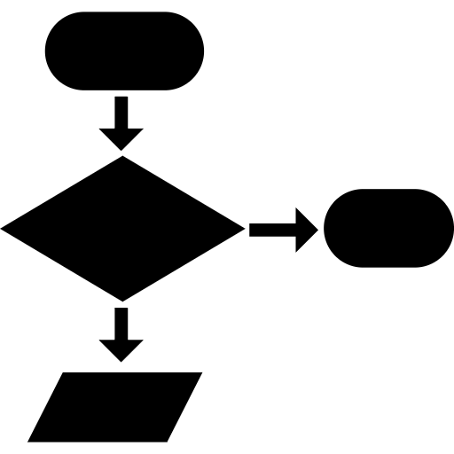


Slide 11







