Slide 1
Flyweight
Design Pattern

Slide 2
What is flyweight?
It is a structural pattern.
Aims to optimize.
Shares similar objects.

Slide 3
Problem
When you have many objects that share similar state or behavior, it can be inefficient to store all these information individually.
This can lead to high memory usage and decreased performance.

Slide 4
Solution
The Flyweight pattern suggests separating intrinsic (shared) state from extrinsic (context-specific) state.
Instead of storing all the state within each object, the common state is shared among multiple objects.
Objects store only the unique state that varies between instances.

Slide 5

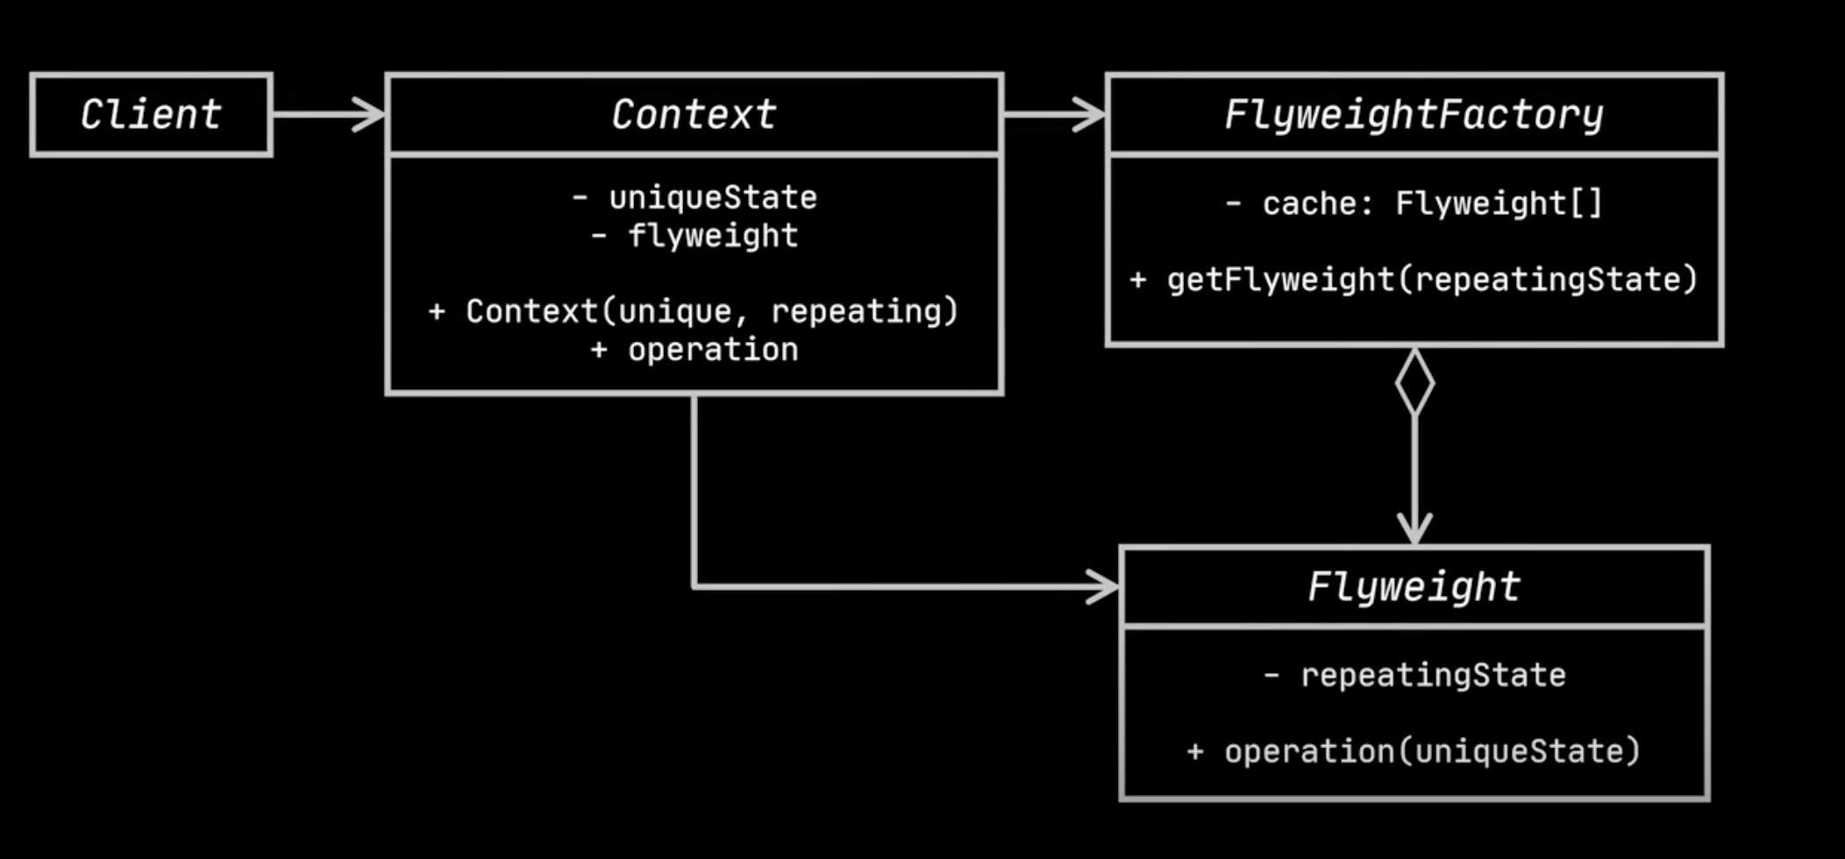
Key Components
Flyweight: Represents the shared states(intrinsic state).
FlyweightFactory: Manages the creation and storage of Flyweight objects.
Context: Stores the context specific states (extrinsic states).
Client: Uses Flyweight objects.

Slide 6
Benefits
Reduced memory usage
Improved performance

Slide 7
Drawbacks
Increased complexity
Reduced encapsulation

Slide 8
EXAMPLE
Let's check it out..

