Slide 1
FAAS: Prototype implementation
Sm Arif Ali (23m0822) Soumik Dutta (23m0826)

Slide 2
What have we tried to achieve?
We made a prototype FAAS (Function As A Service) application mimicking Google’s FAAS platform ‘Google Cloud Function’ where User can register their functions with respect to specific event trigger. And upon dispatch of the specific trigger that user defined function can be run anytime.
We also implemented S4 Bucket(Sample Simple Storage System) mimicking the Amazon’s BAAS product S3 Bucket.

Slide 3
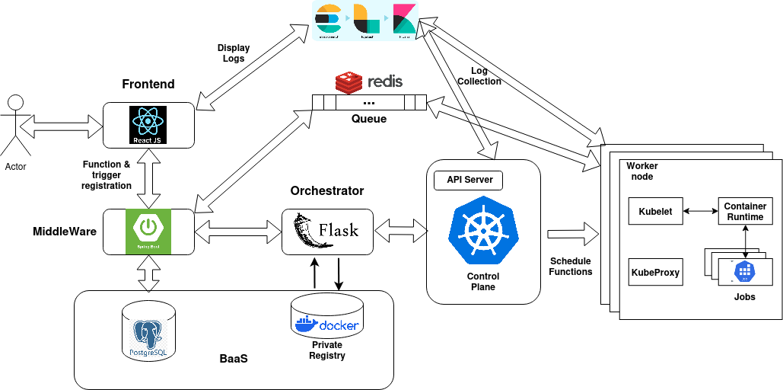
Architecture design:

Slide 4
Key Design decisions:
1. FAAS Front end: React js and Material UI
2. Middleware API Get-way : 3 Microservices: a) faas apis b) S4 bucket apis c) TestApi
3. Trigger event channel: Redis pub sub
4. Job queue: Redis queue
5. Function registry/S4 bucket datastore: Postgres DB
6. Orchestrator (Image build): Flask API
7. Dispatcher : Kubeadm + Calico CNI + cri-dockerd
8. Logging mechanism: Filebeat + Elastic cahe + Logstash + Kibana

Slide 5
Correctness
Demo of our application:
Register a function with image processing algorithm
Create bucket
Upload images into the bucket
Wait for the contents of the bucket to be processed.
Check Logs for progress.

Slide 6
Performance measure of Faas platform
1. Measurement while Pod scaleup turned OFF: Load vs Response time and Load vs Throughput
2. Measurement while Pod scaleup turned ON:
Load vs Response time and Load vs Throughput
Note: Below 3 sample functions are taken at each experiment: Testlog : Lightweight function
Testgray: IO heavy function
Testmatrix: CPU heavy function

Slide 7
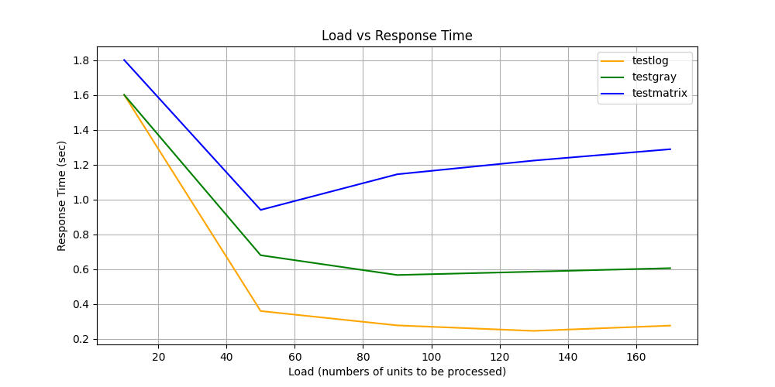
1. Measurement while Pod scaleup turned OFF:

Slide 8
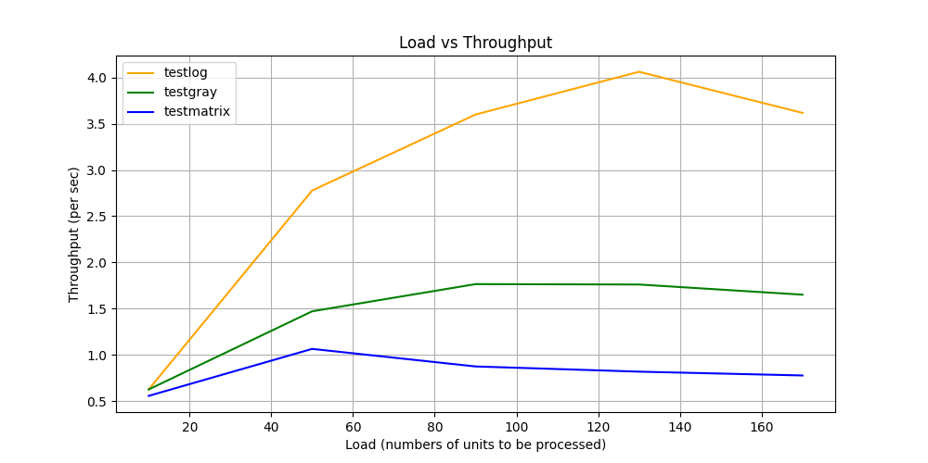
1. Measurement while Pod scaleup turned OFF:

Slide 9
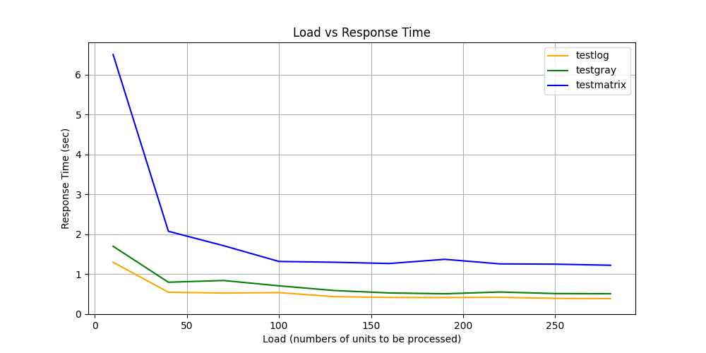
2. Measurement while Pod scaleup turned ON:

Slide 10
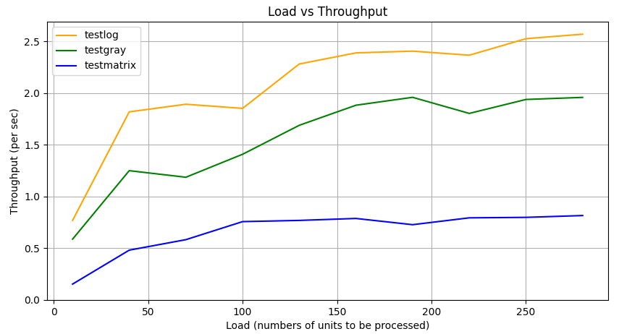
2. Measurement while Pod scaleup turned ON:

Slide 11
Inferences from the experiments:
Function response times are dependent on their execution type
CPU heavy task have higher response time, with log function being the lowest
Effort was made to speed up execution by scaling pods but couldnt get expected performance due to pods were scheduled with lower memory and cpu.
Overhead for scaling decision is also large

Slide 12
Future work
Support functions in more programming languages.
Providing BaaS as simple libraries.
Using prebuilt images of libraries commonly used in programming languages.
On the fly choosing of appropriate base image for functions.
Implementing a autoscaler like existing Horizontal Pod Autoscalar for jobs.

Slide 13
Thank you

