Slide 1

Assignment 2 : G.o.I Cybersecurity Framework through CERT-IN
Akshit Varmora 23M0832
Soumik Dutta 23M0826
Jay Gorakhiya 23M0825
PS657: Cybersecurity Management & Governance - Policy Aspects
Duration
20 mins

Slide 2
Contents
Agenda
CERT-In
Comparison with ISO/IEC 27001
Resources Required for IIT Bombay
Assessment of Resource Availability at IIT Bombay

Slide 3

Cert-In and Comparison with ISO/IEC 27001
Part
01

Slide 4
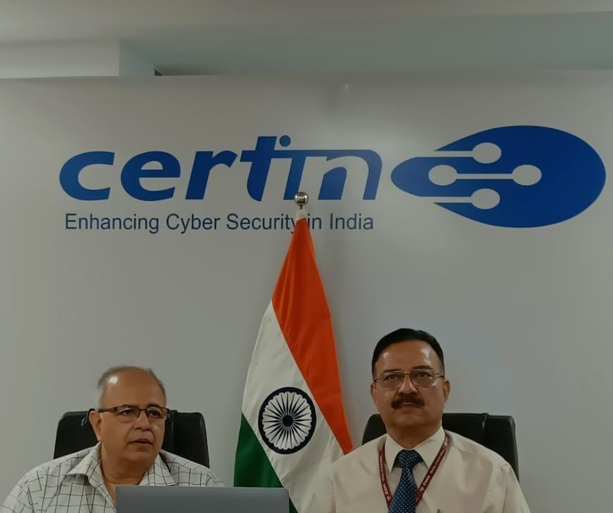
01
Understanding the CERT-In (Computer Emergency Response Team)
Established By: Ministry of Electronics and Information Technology (MeitY), in January 2004.
The Need: Driven by the rapid growth of "Digital Nagriks" (80+ crore) and rise in cyber crimes like malware, ransomware, phishing attacks targeting government infrastructure.
Objective: To ensure an "Open, Safe & Trusted and Accountable Internet" for all users in India.
The Core Idea: It is a mandatory set of basic security rules that every government office in India must follow to protect their computers and data .
https://www.cert-in.org.in/

Slide 5

02
Understanding the ISO/IEC 27001
Developed by: International Organization for Standardization (ISO) and International Electrotechnical Commission (IEC).
The Need: To help organizations meet legal and regulatory requirements, and maintain an adequate posture against information security threats globally.
Objective: To establish, implement, operate, monitor, review, maintain, and continually improve a formal Information Security Management System (ISMS) within any organization.
The Core Idea: It is a certifiable requirements standard. Utilizes the Plan-Do-Check-Act (PDCA) cycle to manage the security of information assets as a continuous lifecycle.
https://www.iso.org/standard/27001

Slide 6
03
ISO/IEC 27001 vs CERT-In Comparison
ISO/IEC 27001
CERT-In
01
An international, certifiable requirements standard for an ISMS.
Indian national operational guidance providing a prioritized baseline.
02
Process-oriented: Focuses on management processes and continuous improvement.
Prescriptive/Control-oriented: Focuses on specific technical and policy "must-dos".
03
Comprehensive but resource-intensive to establish and maintain.
Provides a minimum baseline that all entities must implement to reach resiliency.
04
Organizations choose to comply to achieve certification.
Mandatory for all Indian Government Ministries, Departments, and Entities.

Slide 7
Cert-In and Resources Required for IIT Bombay
Part
02
Notes:
Human resource:
-
-
-
Skills & experience req: technical skills
Policy knowledge
Financial budget requirements:

Slide 8
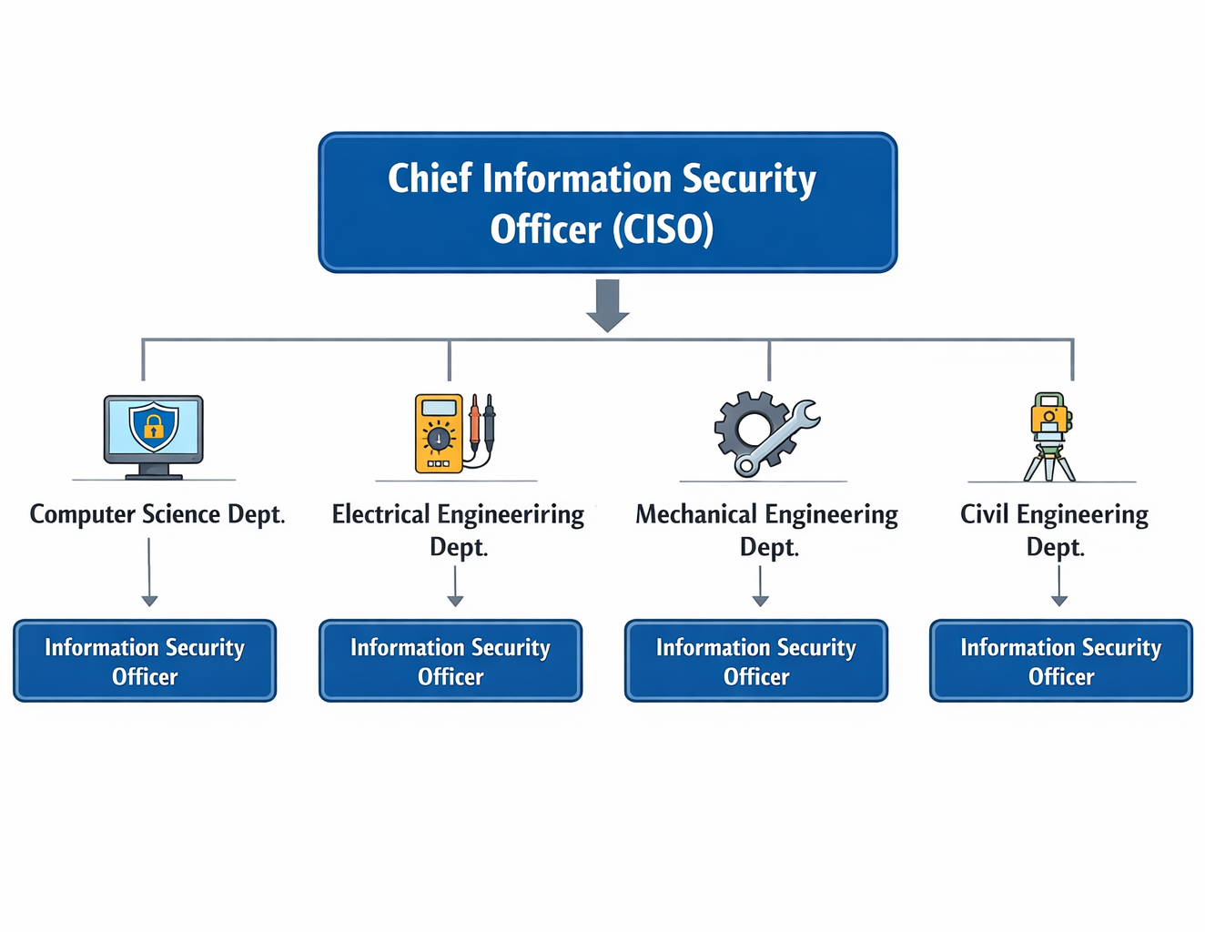
01
Human Resources for CERT-In Compliance
Appointment of a dedicated Chief Information Security Officer (CISO)
Designation of an Information Security Officer (ISO) in each department, reporting to the CISO and responsible for department-level security oversight
Formation of a cybersecurity functional team for
Daily operations
Continuous monitoring and incident response
Personnel for Staff responsible for policy enforcement and compliance management
Support from IT administrators and network engineers for implementation
Image is AI generated

Slide 9
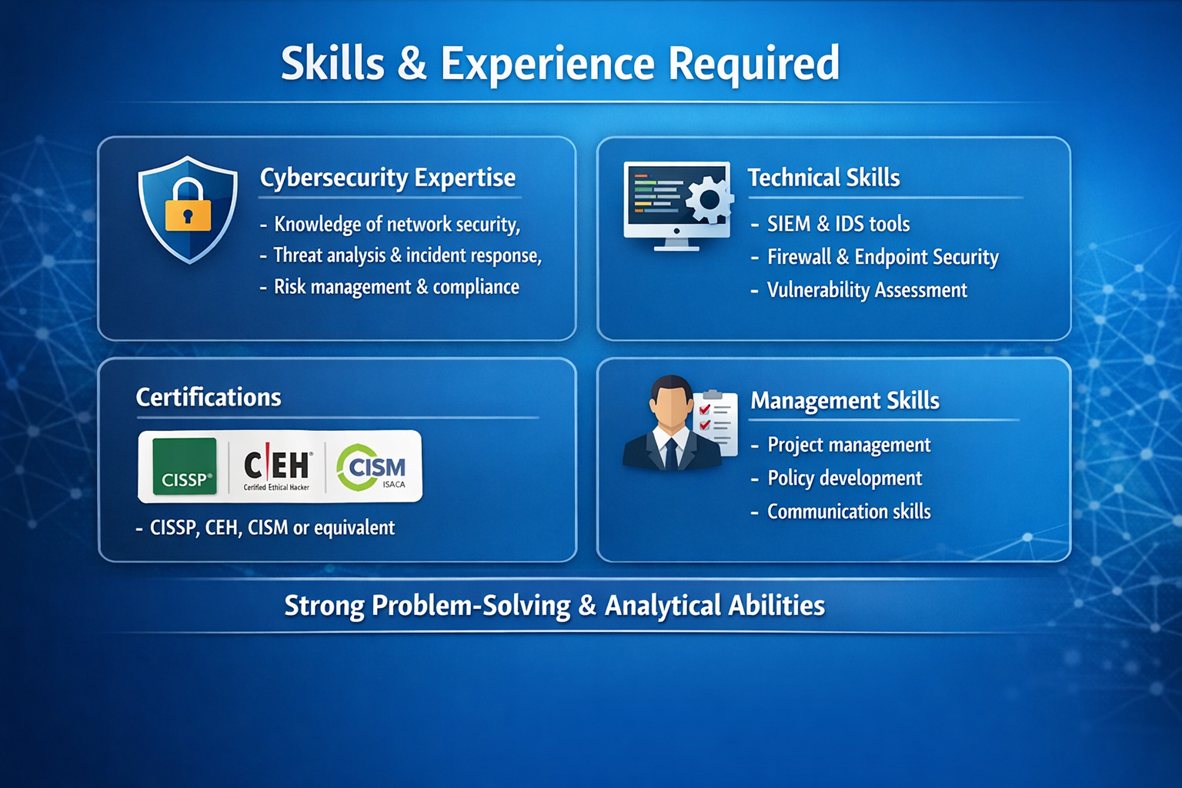
02
Skills & Experience Required
Strong knowledge of network security and system hardening
Experience in incident detection, response, and mitigation
Hands-on experience with tools such as:
Firewalls and Intrusion Detection Systems
SIEM (Security Information and Event Management)
Endpoint protection and backup systems
Understanding of risk assessment and security governance frameworks
Familiarity with compliance standards and audit processes
Image is AI generated

Slide 10
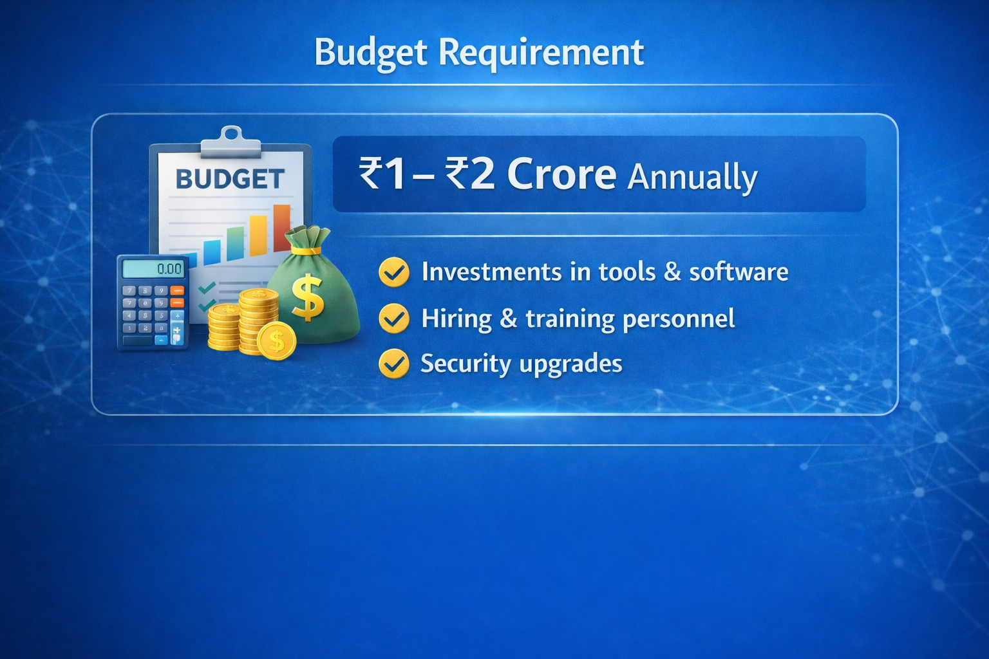
03
Financial and Resource Requirements (Estimated)
Salaries for CISO (₹20 - ₹30 LPA) and cybersecurity team members (₹10 - ₹15 LPA per member)
Investment in security infrastructure and tools
Budget for periodic internal and third-party security audits (₹10-₹25 Lakhs/year)
Costs for training programs, certifications, and awareness initiatives (₹3 -₹5 Lakhs/year)
Expenditure on backup, disaster recovery, and monitoring systems
Ongoing budget for maintenance, upgrades, and incident response readiness (₹15 - ₹20 lakhs/year)
Image is AI generated

Slide 11
Cert-In and Resources Availability at IIT Bombay
Part
03
Notes:
Cse iitb website vulnerability
In asc non admin users are used by staff for normal
prod server access is being handled by designated employee only with designated credentials.
Logs are properly maintained. (dumped and transferred to academic office)

Slide 12
01
Human Resources for CERT-In Compliance?
A dedicated Chief Information Security Officer (CISO) – NOT AVAILABLE
Designation of an Information Security Officer (ISO) – NOT AVAILABLE
Personnel for Staff responsible for policy enforcement and compliance management – NOT AVAILABLE
Formation of a cybersecurity functional team for
Daily operations – NOT AVAILABLE
Continuous monitoring and incident response
Support from IT administrators and network engineers for implementation – AVAILABLE

Slide 13
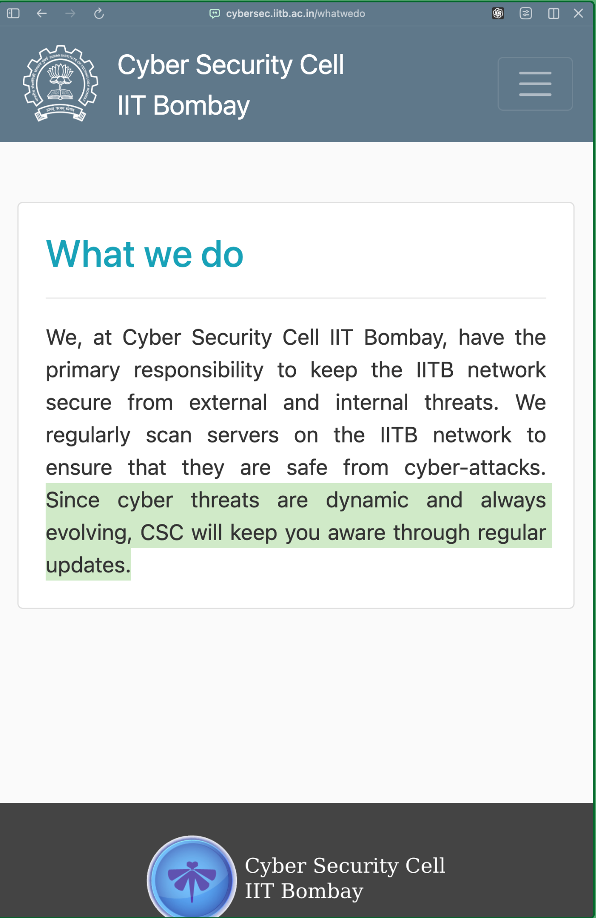
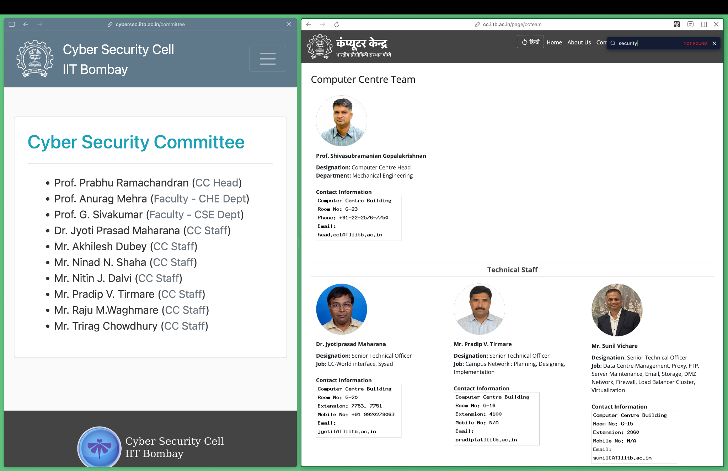
02
CC staff and Cybersecurity staff overlap

Slide 14
03
Skills required by – Cybersecurity Team (???)
Strong knowledge of network security and system hardening – AVAILABLE
Experience in incident detection, response, and mitigation – NOT AVAILABLE
Hands-on experience with tools such as:
Firewalls and Intrusion Detection Systems – NOT AVAILABLE
SIEM (Security Information and Event Management) – NOT AVAILABLE
Endpoint protection and backup systems – AVAILABLE
Understanding of risk assessment and security governance frameworks – AVAILABLE
Familiarity with compliance standards and audit processes – AVAILABLE

Slide 15
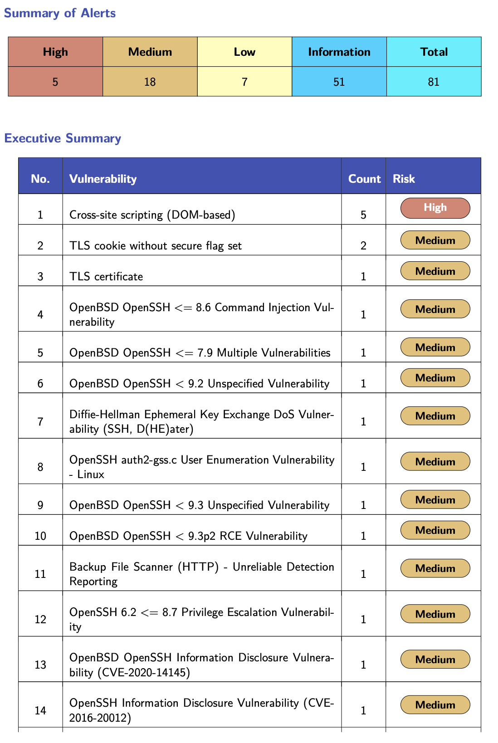

04
Incident Handling Examples
In Application Software Cell (ASC) IIT Bombay
Non admin users are used by staff for normal.
Prod server access is being handled by designated employee only with designated credentials.
Logs are properly maintained. (dumped and transferred to academic office).

Slide 16
05
Are Financial and Resources Given?
Salaries for CISO (₹20 - ₹30 LPA) and cybersecurity team members (₹10 - ₹12 LPA per member)
Investment in security infrastructure and tools
Budget for periodic internal and third-party security audits
Costs for training programs, certifications, and awareness initiatives (₹3 -₹5 Lakhs/year)
Expenditure on backup, disaster recovery, and monitoring systems
Ongoing budget for maintenance, upgrades, and incident response readiness (₹15 - ₹20 lakhs/year)
– NOT GIVEN
– NOT GIVEN
– PARTIALLY GIVEN
– PARTIALLY GIVEN
– GIVEN
– GIVEN

Slide 17

Thank you

Slide 18



Let’s discuss!
Open feedback
10’
Akshit Varmora
Soumik Dutta
Jay Gorakhiya
23M0832
23M0826
23M0825

