Slide 1
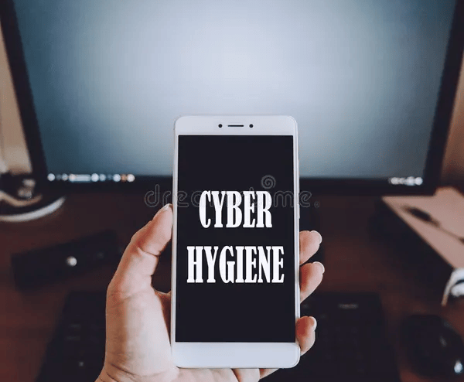


ASSIGNMENT 3
Cyber Hygiene: Policies, Effectiveness, and Challenges
Contributor
Jay Gorakhiya 23M0825
Contributor
Akshit Varmora 23M0832
Contributor
Soumik Dutta 23M0826
PS657: Cybersecurity Management & Governance - Policy Aspects

Slide 2
Cyber Hygiene Policies
PART 1

Slide 3

Educational & Behavioral Policies
Focus: Modifying citizen behavior through continuous awareness and foundational training.
Mandatory Digital Literacy: Integrate cyber-hygiene into school curriculums from a young age through programs like "Cyber Kid" and "Cyber Shikshak".
Age Restrictions: Enforce age limits for digital exposure, such as restricting social media for users under 16.
National Awareness Campaigns: Use TV, radio, and official social media (e.g., Cyber Dost, I4C MHA) for continuous, multilingual public service announcements.
Professional Training: Mandate routine phishing simulations and security awareness programs for government employees and critical sector workers.

Slide 4
Infrastructure Regulations
Focus: Shifting the security burden from the citizen to the digital architecture.
Telecom-Level Threat Filtering: Require telecom operators to actively detect and block malicious SMS headers and phishing links at the backend.
Mandatory MFA & API Standards: Enforce Multi-Factor Authentication (MFA) by default for all financial institutions and Digital Public Infrastructure (DPI).
Data Localization & Encryption: Mandate robust encryption standards for databases to protect citizen data. I.e. Implementing GDPR version.
Automated Threat Cleaning: Expand the "Cyber Swachhta Kendra" to bundle malware/botnet cleaning tools with PSU, telecom, and SME onboarding.

Slide 5
Modern Standards & Incentive Policies
Focus: Encouraging compliance by removing barriers and updating outdated security rules.
Subsidized Security Tools: Provide government-sponsored password managers and basic antivirus software for lower-income citizens.
Bug Bounties & Safe Harbor: Establish clear legal protections and expand vulnerability disclosure programs to reward citizens who report flaws in public digital services.
Adopt NIST Guidelines: Eliminate counterproductive, old-school rules like forced 30/60/90-day password rotations or arbitrary symbol requirements.

Slide 6

Indian Context
Focus: Utilizing and expanding India's existing cybersecurity and legal frameworks.
Unified Reporting: Promote the 1930 helpline, the Cyber Fraud Mitigation Centre (CFMC), and the National Cyber Crime Reporting Portal for rapid fraud response.
Telecom Hygiene: Enforce TRAI’s anti-spam rules and utilize the Sanchar Saathi/Chakshu portal to combat suspicious communications.
Data Protection Enforcement: Leverage the DPDP (Digital Personal Data Protection) Act and Data Protection Board to hold organizations legally accountable for user data.
Incentivize Compliance: Provide government incentives or tax benefits to public and private bodies that strictly adhere to these cybersecurity frameworks.

Slide 7
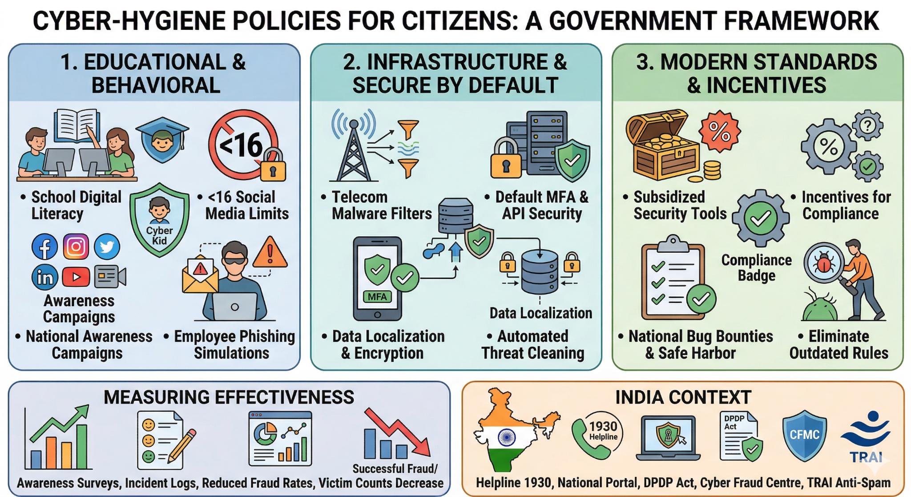

Slide 8
Measure Effectiveness of these Policies
PART 2

Slide 9
Measuring Educational & Behavioral Policies
Mandatory Digital Literacy: Aggregate data via state-level Learning Management System (LMS) APIs to track module completion and standardized pre/post-assessment quiz scores. Monitor anonymized school network web-filter logs to quantify actual reductions in high-risk browsing behaviors.
Age Restrictions: Deploy automated compliance bots ("mystery shoppers") and third-party algorithmic audits to test platform age-verification gates. Mandate API-level compliance reporting from social platforms detailing blocked sign-up attempts, and cross-reference with incident volume from national child safety hotlines.
National Awareness Campaigns: Track multi-channel digital ad telemetry (impressions, CTR) and broadcast distribution metrics. Commission recurring third-party polling to measure message recall, and correlate campaign flight dates with traffic spikes in web analytics and inbound call volume to national fraud-reporting portals.
Professional Training: Export HR/compliance dashboards to verify mandatory training completion. Deploy automated, randomized phishing simulations (e.g., via KnowBe4 or Proofpoint) to track click-to-report ratios, and query Security Operations Center (SOC) incident ticketing systems to confirm drops in actual credential-harvesting events.

Slide 10
Measuring Infrastructure Regulations
Telecom-Level Threat Filtering: Extract logs directly from Mobile Network Operator (MNO), SMS firewalls and Deep Packet Inspection (DPI) systems to quantify blocked threats. Deploy a network of "honeypot" mobile numbers to empirically measure phishing SMS bypass rates, and track SOC ticket resolution to calculate false positives.
Mandatory MFA & API Standards: Query centralized financial regulatory systems and banking Identity Providers (IdPs) to pull hard numbers on default MFA enforcement. Run automated API vulnerability scanners against institution endpoints to verify secure standards, and cross-reference with central bank fraud-loss databases to track account takeovers.
Data Localization & Encryption: Deploy Cloud Security Posture Management (CSPM) tools to automatically audit encryption-at-rest configurations across state and federal databases. Use network flow analysis and IP geolocation scripts to verify data residency, and aggregate centralized logs from certified third-party compliance audits.
Automated Threat Cleaning: Aggregate installation and scan telemetry via APIs from state-provided endpoint cleaning tools. Monitor national DNS sinkhole logs to track reductions in local IP addresses reaching out to known botnet command-and-control (C2) servers over a 6- to 12-month period.

Slide 11
Measuring Modern Standards
& Incentive Policies
Subsidized Security Tools: Integrate vendor APIs to automatically track activation codes and aggregated Monthly Active User (MAU) telemetry. Track 3-6 month retention via the government subsidy portal's renewal data, and deploy targeted citizen surveys to assess historical vs. post-adoption account compromise rates.
Bug Bounties & Safe Harbor: Implement a centralized Vulnerability Disclosure Platform (VDP) to automatically log report volume, time-to-triage, and remediation SLAs. Audit agency asset inventories to confirm VDP scope coverage, and compare platform metrics against historical incident response logs.
Adopt NIST Guidelines: Execute automated Active Directory and IAM policy audits to verify the removal of mandatory rotation and complexity rules. Query helpdesk ticketing systems (e.g., ServiceNow, Jira) to quantify drops in reset requests, and analyze SSO/SIEM logs to monitor login success vs. lockout events. Use password managers like 1Password.

Slide 12
Measuring Incident Reporting
& Cybercrime Data
The Attempt vs. Success Ratio: Use data from the National Cyber Crime Reporting Portal (NCRP). If the number of reported phishing attempts goes up, but the total financial loss from successful fraud goes down, it proves citizens are recognizing the bait but not falling for it.
Time-to-Report (TTR): Measure the average time between a citizen realizing their account is compromised and them officially reporting it. A decreasing TTR indicates that citizens know exactly what to do when a breach occurs.
Quarterly Public Dashboard: Track reporting volume, blocking rate, loss prevented, training completion, and citizen awareness.

Slide 13
Challenges implementing these Policies
(Indian Context)
PART 3

Slide 14
Social & Behavioral Challenges in India
Digital Literacy Gap: A large section of citizens still lack basic cyber-hygiene knowledge, especially first-time internet users, elderly users, and rural populations.
Linguistic Diversity: Awareness campaigns and reporting systems must work across 22 Indian languages and many local dialects, otherwise reach will remain limited.
Habit-Based Vulnerability: People often prioritize convenience over security, such as sharing OTPs, reusing passwords, or clicking unknown links.
Trust Deficit: Many citizens do not know where to report fraud, do not trust official systems, or assume recovery is impossible.
Low Awareness of Risk: Many users still treat cyber fraud as “bad luck” instead of a preventable security issue.
Notes:
Policies may exist, but citizen adoption and behavior change will be slow and uneven. Complex policies, very difficult to follow for first time users, who don’t know their way around tech etc.

Slide 15
Infrastructure & Administrative Challenges
Population Scale: Implementing and monitoring policies across a very large and diverse population is operationally difficult.
Uneven Digital Infrastructure: Urban areas may adapt quickly, but rural and low-connectivity regions may lag behind.
Inter-Agency Coordination: Effective enforcement requires coordination between telecom operators, banks, police, regulators, schools, and IT platforms.
Capacity Constraints: Many departments may lack trained cybersecurity staff, technical tools, and real-time response systems. Legacy system Integration.
Compliance Monitoring: It is hard to ensure that schools, SMEs, local institutions, and smaller service providers actually follow new standards.
Notes:
India’s scale makes enforcement difficult across telecom, banking, platforms, schools, and government systems. Even good policies can fail if institutions do not have the capacity to implement and monitor them consistently.

Slide 16
Economic, Legal & Governance Challenges
Cost of Compliance: Stronger standards like MFA, filtering, audits, and training can be costly for SMEs, schools, and small public institutions.
Privacy vs. Protection: Measures like age verification, monitoring, and telecom-level filtering may raise concerns about surveillance and misuse.
Enforcement Gaps: Rules may exist on paper, but delayed enforcement and weak accountability can reduce real impact.
Federal Complexity: Different states and institutions may vary in readiness, priorities, and execution quality.
Resistance to Change: Organizations and Individuals may resist replacing outdated practices because modern security systems require investment, training, and process change.
Notes:
India must balance stronger cybersecurity with affordability, privacy, and practical enforcement.
The real challenge is designing policies that are secure, affordable, enforceable, and rights-respecting at the same time.
Privacy vs Protection

Slide 17
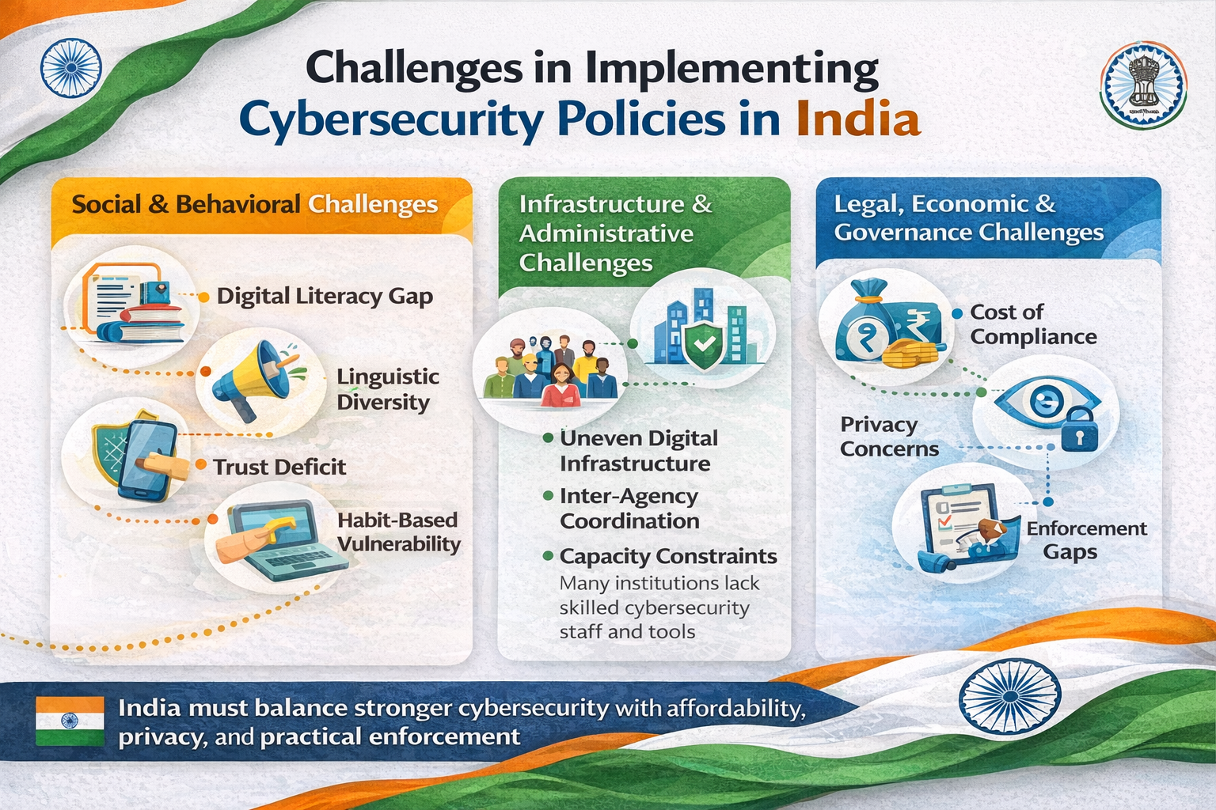
Notes:
The real challenge is designing policies that are secure, affordable, enforceable, and rights-respecting at the same time.

Slide 18

Thank you

Slide 19



Let’s discuss!
Open feedback
Akshit Varmora
Soumik Dutta
Jay Gorakhiya
23M0832
23M0826
23M0825

