Slide 1
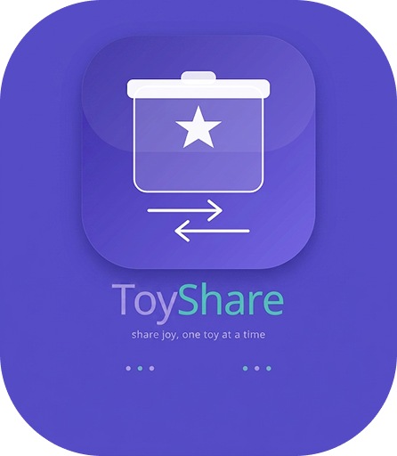
ToyShare
Share Joy, One Toy at a Time
Community Toy Lending & Sharing Platform
MADE BY
Abdullah Rehman (2023-Arid-3585)
Awais Ahmed (2023-Arid-3627)
Jamal Asghar (2023-Arid-3794)
Mohammad Zohab (2023-Arid-3853)
Rafay Akhlaq (2023-Arid-3875)
Sammar Abbas (2023-Arid-3899)

Slide 2
Problem Statement
Why ToyShare Matters
Toy Clutter
Excessive Spending
No Sharing Mechanism
Resource Waste
Children outgrow toys quickly, leading to piles of unused toys that take up space and create clutter in homes.
Parents spend excessively on new toys that children quickly lose interest in, straining family budgets.
Communities lack easy and trusted mechanisms for families to share toys with each other.
Unused toys represent a significant waste of resources and money that could benefit other children.

Slide 3

Solution Overview
How ToyShare Solves the Problem
Peer-to-Peer Platform
A trusted community platform for toy lending and exchange between families.
Borrow, Don't Buy
Borrow toys instead of buying new ones. Save money while giving toys a second life.
Two Flexible Modes
Exchange (temporary lending) and Donation (permanent gifting).
Build Community
Connect with neighbors, build trust, and create a culture of sharing in your community.
Less Clutter + More Joy + Stronger Community

Slide 4
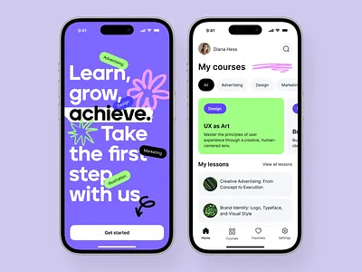
Key Features
Everything You Need to Share
User Authentication
Browse & Search
Borrow Requests
QR Verification
Secure sign-up and login with Firebase Auth. Email verification and password recovery included.
Discover available toys with powerful search and filter options by category, age, and location.
Send borrow requests with custom messages. Owners can accept, reject, or negotiate terms.
Generate and scan QR codes to verify toy exchanges securely and prevent fraud.
In-App Chat
Exchange Tracking
Rating & Reviews
Notifications
Real-time messaging between borrowers and owners to coordinate pickups and returns.
Complete history of all exchanges. Track active borrows, returns, and past transactions.
Rate and review users after exchanges. Build trust with a community reputation system.
Push notifications for borrow requests, return reminders, and community updates.
Built with Flutter + Firebase
Cross-platform mobile app with real-time backend, secure authentication, and cloud storage.

Slide 5
Technical Architecture
Modern Stack for a Modern App
Flutter Frontend
Firebase Backend
State Management
Cross-platform mobile development with a single codebase. Beautiful, natively compiled apps for iOS and Android with rich widget library and smooth animations.
Firestore NoSQL database for real-time data sync. Firebase Auth for secure authentication. Cloud Storage for toy images. Serverless architecture scales automatically.
StreamBuilder for real-time Firestore data binding. Provider pattern for clean state management across the app widget tree. Reactive UI updates.

Slide 6
App Screens Walkthrough
From Launch to Dashboard
Splash Screen
Auth Screen
Bottom Navigation
Home Dashboard
Animated logo with rotating taglines and smooth gradient background
Login and registration with email/password and Firebase Auth integration
Intuitive shell with Home, Browse, Exchanges, and Activities tabs
Stats overview, quick actions, and personalized recommendations

Slide 7
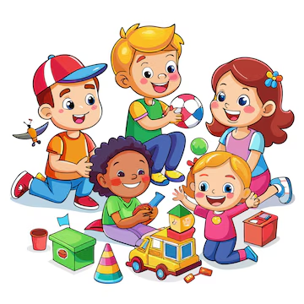
Core Screens (Part 1)
Toy Management & Discovery
01
My Toys
Manage your toy inventory — list new toys, edit details, update availability status, and remove listings. Each toy card shows photo, name, condition, and current status.
02
Browse Toys
Search and filter the community toy library. Filter by exchange type (lending vs donation), category, age group, condition, and distance. One-tap request to borrow.
03
Add Toy
Multi-step form to list a new toy: upload photos, set name and description, select condition and age group, choose lending type, and set optional fee.

Slide 8
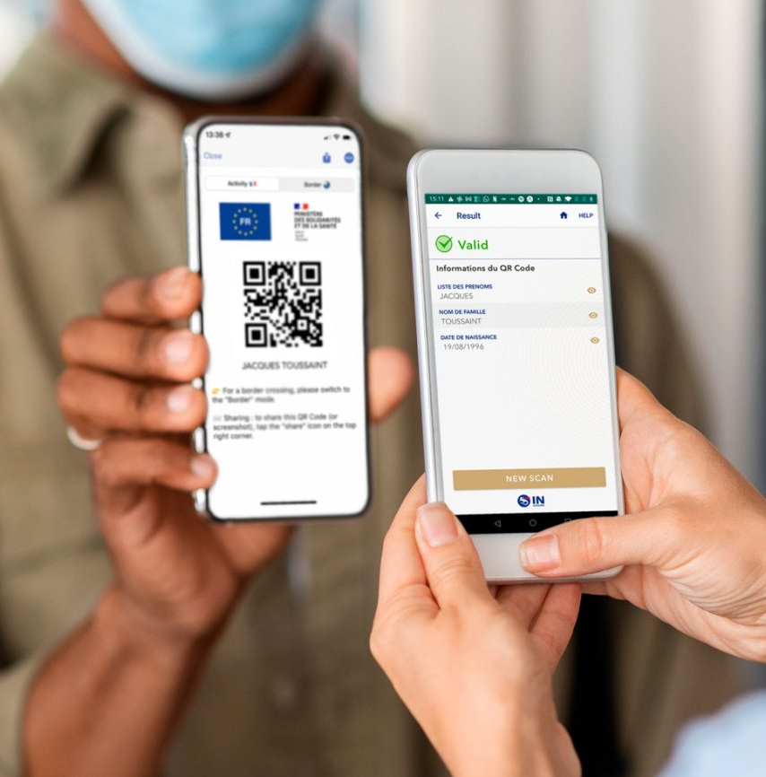
Core Screens (Part 2)
Exchanges, Chat & Verification
01
My Exchanges
Track all your active and completed exchanges in one place. View status, due dates, and borrower/owner details. Manage returns and confirm receipts.
02
Chat System
Real-time messaging tied to each exchange. Coordinate pickup times, ask questions about toys, and build trust with the community through direct communication.
03
QR Receipt
Generate unique QR codes for each exchange. Scan to verify toy handoffs and returns. Prevents fraud and creates a secure audit trail for all transactions.
04
Notifications
In-app alerts for borrow requests, exchange updates, return reminders, and dispute notifications. Stay informed without leaving the app.

Slide 9
Exchange Flow Diagram
How a Toy Exchange Works
Request
Accept
Borrow
Return
Confirm
Rate
Reject Request
Report Dispute
Happy Path Flow
Alternative Paths
The standard exchange flow ensures a smooth experience: borrower requests, owner accepts, toy is handed over via QR scan, borrower returns, owner confirms receipt, and both parties leave ratings.
Owners can reject requests with a reason. If issues arise during an exchange, either party can report a dispute. The moderation team reviews incident reports and takes appropriate action.
QR Verification at Every Step
QR codes are generated for each exchange phase, ensuring secure handoffs and creating an auditable trail for safety.

Slide 10
Lending Types
Flexible Options for Every Need
Exchange Mode
Donation Mode
Time-Based Lending
Temporary lending with a set timeframe. The owner specifies receive date and return date. An optional lending fee can be set. The borrower must return the toy by the agreed date.
Best for: Expensive toys, seasonal items, and short-term play needs.
Permanent gift with no return expected. The toy is transferred to the new family forever. A wonderful way to pass on beloved toys that your children have outgrown.
Best for: Outgrown toys, decluttering, and community giving.
Flexible duration lending by hours or days. Set a specific borrowing period — perfect for weekend playdates, party supplies, or trying out toys before committing.
Best for: Party toys, trial periods, and event-specific needs.

Slide 11
User Reputation System
Building Trust in the Community
Positive Feedback
After each exchange, both parties can leave positive feedback. Great for recognizing reliable community members.
Sarah M.
Gold Member
Negative Feedback
4.8 / 5.0
Constructive negative feedback helps maintain quality. Flag issues like late returns or damaged toys.
Rating Badges
47
98%
Visual badges on user profiles show reputation level. Bronze, Silver, Gold, and Platinum tiers.
Exchanges
Positive
Trust Score Algorithm
Recent Reviews
Calculated as positive percentage of total exchanges. Higher scores get priority in search results.
"Great lender!" — Toy returned in perfect condition, on time.
"Very responsive" — Quick replies and flexible pickup time.
Trust is the foundation of sharing. Our reputation system ensures every exchange is safe and reliable.
"Highly recommended" — My kids loved the LEGO set!

Slide 12
Safety & Moderation
Keeping the Community Safe
User Blocking
Dispute Reporting
Incident Reports
QR Verification
Blacklist feature allows users to block problematic members. Blocked users cannot view your toys, send requests, or message you. Your blacklist is private and reversible.
Report disputes directly from the exchange screen. Describe the issue, attach evidence, and our moderation team will review within 24 hours and take appropriate action.
Report lost, stolen, or damaged toys through the dedicated incident system. Insurance integration coming soon. Document everything with photos and descriptions.
Every exchange generates a unique QR code. Scanning verifies identity and creates an audit trail. Prevents fraudulent exchanges and ensures accountability.
Safety First, Always
99.7%
<24h
Multiple layers of protection ensure every exchange is secure. From QR verification to dispute resolution, we've got you covered.
Safe Exchanges
Dispute Response

Slide 13
Data Models (Firestore)
Collections Structure
Collection | Fields / Purpose | Description
users | uid, displayName, email, photoURL, createdAt, rating, trustScore | Authentication + profile information for each community member
toys | name, description, condition, category, ageGroup, images, ownerId, isAvailable, lendingType, fee | Toy listings with photos, details, and availability status
requests | toyId, requesterId, ownerId, message, status, createdAt | Pending borrow requests with custom messages from borrowers
exchanges | toyId, ownerId, borrowerId, status, startDate, endDate, qrCode, createdAt | Active and completed exchanges with QR verification codes
messages | exchangeId, senderId, content, timestamp, isRead | Chat history linked to specific exchanges between parties
notifications | userId, type, title, body, isRead, createdAt | In-app alerts for requests, returns, disputes, and updates
feedback | exchangeId, fromUserId, toUserId, rating, comment, createdAt | User reviews and ratings after completed exchanges
disputes | exchangeId, reporterId, reason, description, status, resolvedAt | Conflict resolution tickets for moderation team
blacklist | userId, blockedUserId, reason, createdAt | Blocked users list for each account (private)

Slide 14
Security & Rules
Firebase Security at Its Core
01
Authentication Required
All database reads and writes require Firebase Authentication. Anonymous users have no access. Every request is validated against the authenticated user's UID.
02
Owner-Only Permissions
Only toy owners can edit or delete their listings. Ownership is verified server-side using Firebase Security Rules comparing the request.auth.uid against the document's ownerId field.
03
Request Validation
Users cannot request their own toys. Maximum 5 active borrows per user to prevent hoarding. All requests are logged with timestamps for audit purposes.
04
Data Privacy
Personal data is never exposed publicly. Email addresses are hidden. Chat messages are only accessible to exchange participants. Blacklists are completely private.
Firebase Security Rules enforce all protections server-side. No client-side validation can be bypassed.

Slide 15
Dark Mode Support
Light & Dark Theme Comparison
Light Mode
Dark Mode
ToyShare
ToyShare
LEGO City Set
LEGO City Set
Ages 5-12 • Exchange
Ages 5-12 • Exchange
Wooden Blocks
Wooden Blocks
Ages 2-5 • Donation
Ages 2-5 • Donation
Theme toggle in settings
Adaptive colors everywhere
Persistent preference storage

Slide 16
Responsive Design
From Mobile to Desktop
Key Principles
Mobile-First
Designed for phones first, then scaled up
Adaptive Layouts
Different grid sizes per device breakpoint
Tablet
Max-Width Constraints
Adaptive 2-column grid
Content never stretches beyond readable limits
Mobile
Desktop / Web
Flutter Web Ready
Primary target
Max-width constraints, sidebar nav
Single codebase runs on all platforms
Flutter's responsive framework allows ToyShare to adapt seamlessly from small phones to large desktop monitors, ensuring a great experience on every device.

Slide 17
Key Technical Highlights
What Makes ToyShare Special
Real-Time Sync
Optimistic UI
Cloud Storage
Notifications
Animations
Firestore listeners provide instant updates across all connected devices. See new toys, messages, and requests as they happen.
UI updates immediately before server confirmation. Rollback on error. Feels instant and responsive to users.
Firebase Storage handles toy photo uploads with automatic compression, caching, and fast CDN delivery worldwide.
In-app notification service keeps users informed. Unread badges, alert banners, and notification history.
Animated transitions and micro-interactions throughout. Hero animations, page transitions, and loading skeletons.

Slide 18
Future Enhancements
Roadmap for ToyShare v2.0
Geofencing
FCM Push Notifications
Social Sharing & Invites
COMING SOON
COMING SOON
COMING SOON
Discover toys near you with location-based search. Set your preferred radius and get notified when new toys are listed nearby.
Firebase Cloud Messaging for push notifications even when the app is closed. Never miss a borrow request or return reminder.
Share interesting toys on social media. Invite friends via referral links and earn reputation badges for growing the community.
Analytics Dashboard
Parental Controls
PLANNED
PLANNED
Community insights and personal stats. Track your sharing impact, most popular toys, and community growth over time.
Age-appropriate content filtering, supervised accounts for kids, and parental approval for exchanges. Making ToyShare safe for the whole family.

Slide 19
Demo Flow
Complete User Journey from Sign-Up to Rating
1
2
3
4
5
6
7
8
Sign Up
List Toy
Request
Accept
Exchange
Return
Confirm
Rate
Toy Owner Journey
Borrower Journey
1. Sign up with email and password
2. List a toy with photos and details
4. Receive and accept a borrow request
7. Confirm toy return via QR scan
3. Browse and request a toy to borrow
5. Pick up toy and scan QR to verify
6. Return toy before due date
8. Leave a rating and review
Each exchange strengthens the community. Ratings build trust, reviews help others, and every shared toy brings joy to a new child.

Slide 20
Thank You!
Questions & Answers
GET IN TOUCH
https://github.com/sammar-abbas-shah
sammarabbas0619@gmail.com
https://www.linkedin.com/in/sammar-abbas-372359289/
Share Joy, One Toy at a Time
ToyShare Team — Abdullah Rehman, Awais Ahmed, Jamal Asghar, Mohammad Zohab, Rafay Akhlaq, Sammar Abbas

