Slide 1
Leukemia proteomics
-Zeinab Alaa
-Sammar Alaa
-Mai Mohamed
-Yasmeen Hossam
-Ahmed Ali
-Mohamed Allam

Slide 2
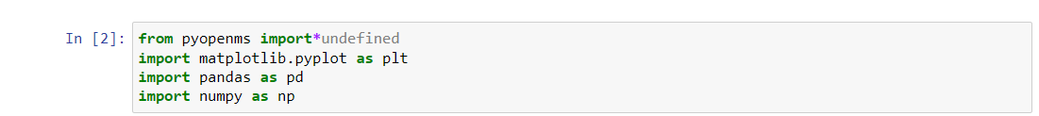
Import pyopenms

Slide 3


Load raw file.
Search for peptide in the raw file .

Slide 4
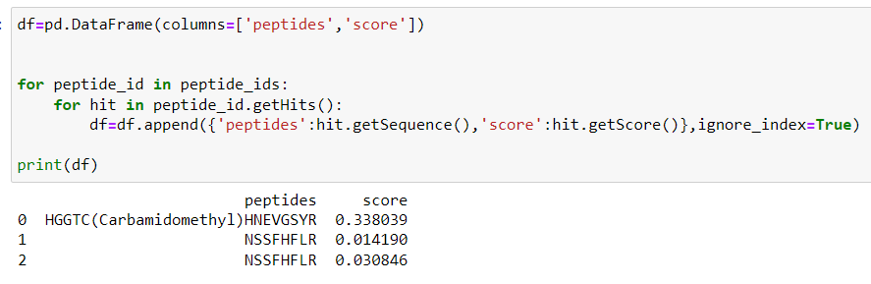

Slide 5
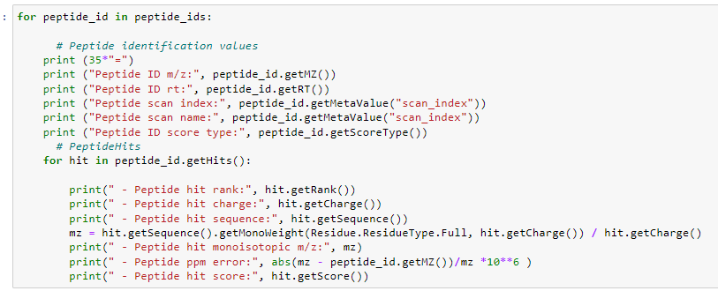

Slide 6
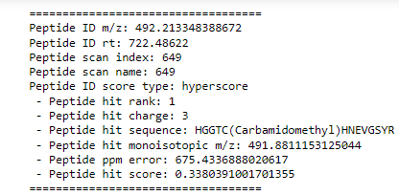

Slide 7
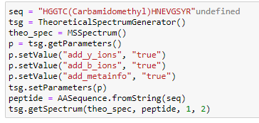
Generate theoretical spectrum of the first peptide

Slide 8
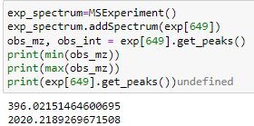
Experimental spectrum
The mass to charge of our observed spectrum ranges 396-2020

Slide 9

We filter the peaks of the theoretical spectrum to fit the range(to reduce image complexity )

Slide 10
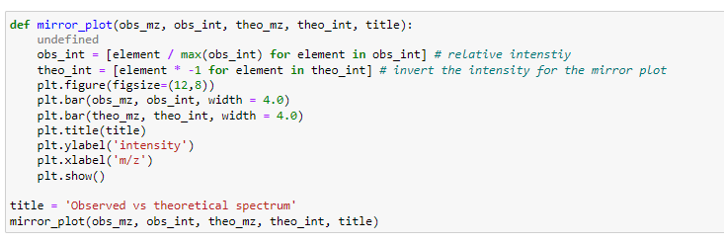
Mirror Plot

Slide 11
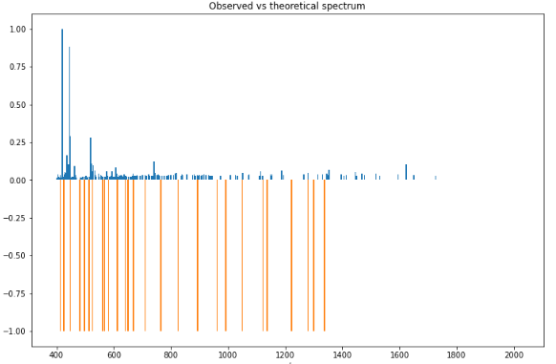

Slide 12
Thank You

