Slide 1
Exorover
By Sammarth Kumar

Slide 2
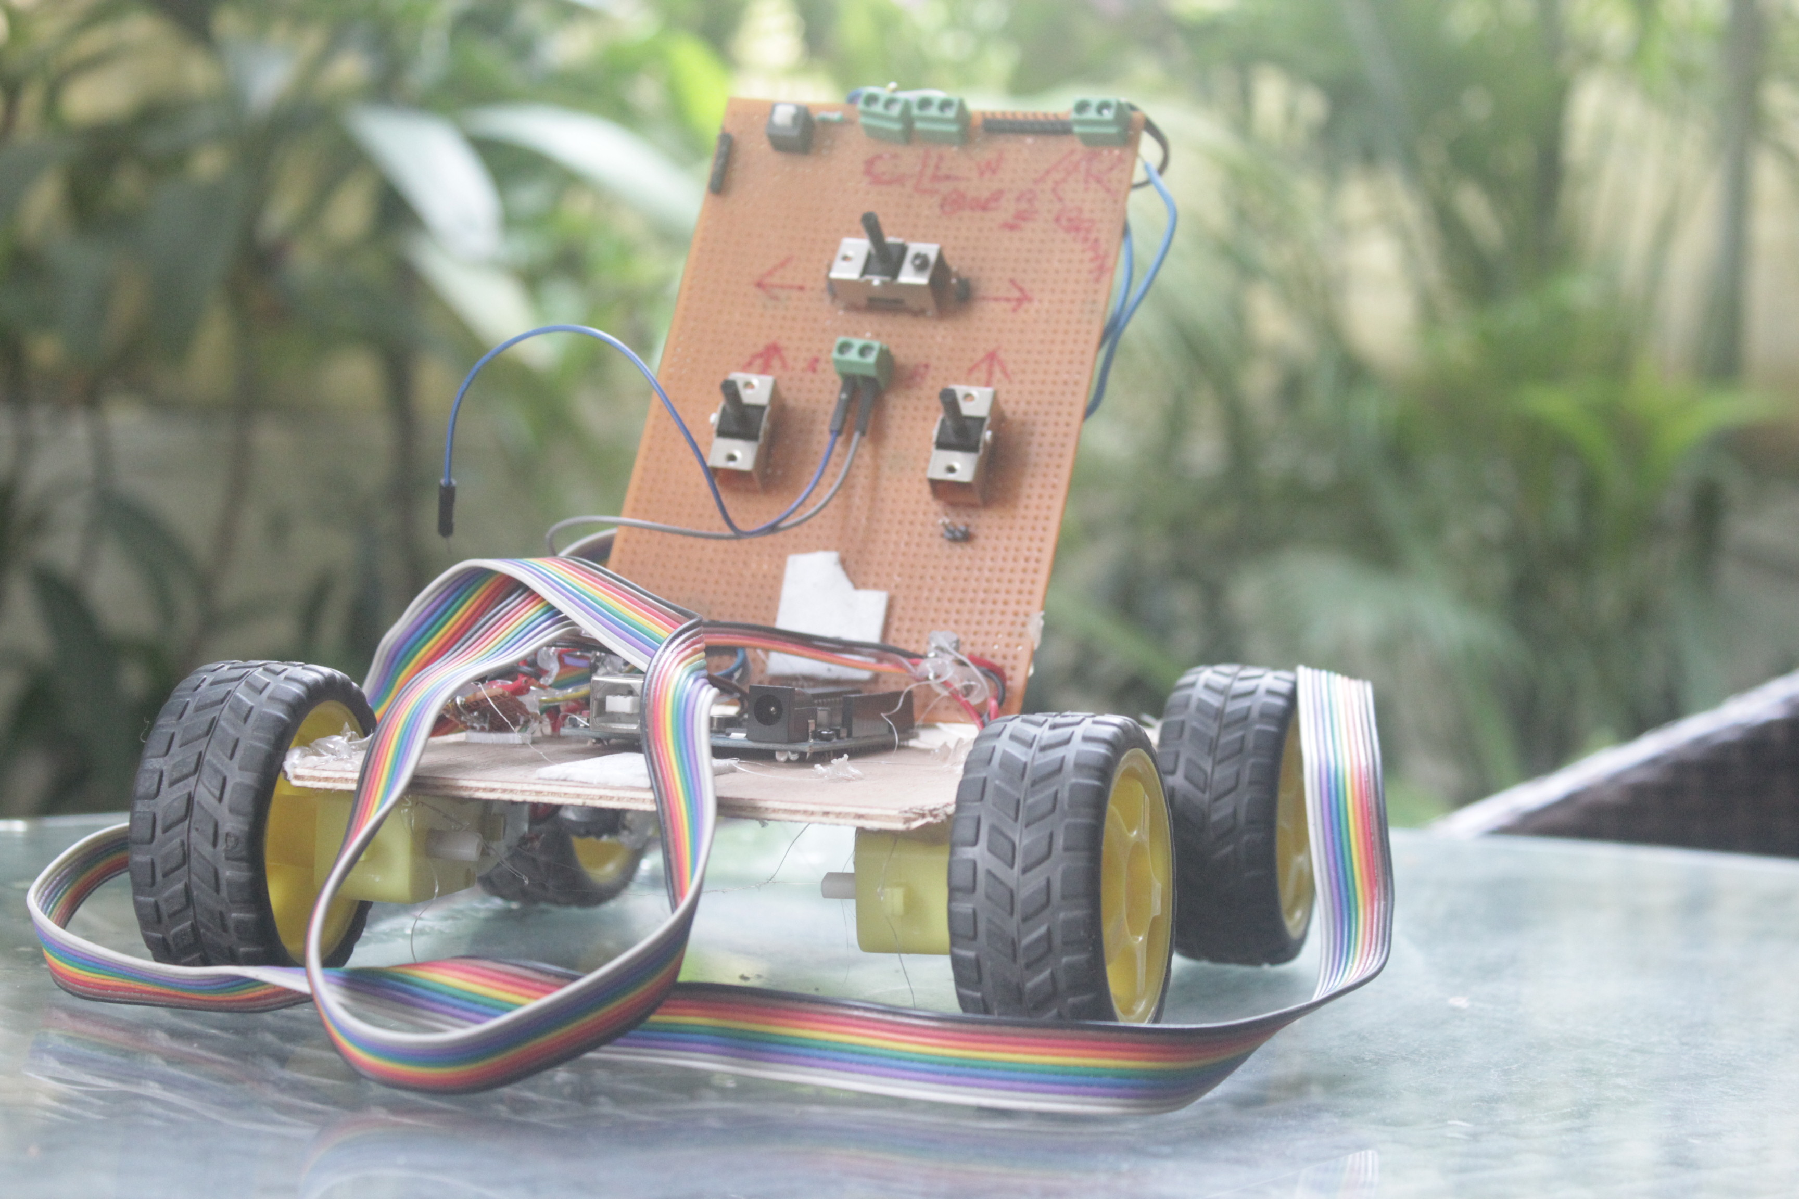
Overview
The ExoRover was built from scratch by me
It consists of 4 BO Shaft Motors, and a remote.
It can be powered by a variety of sources
It is made of reused materials
It’s energy efficient

Slide 3
Statistics
It connects to 5V voltage source
It works with 9V as well.
The motors are connected in parallel so the voltage is not divided, distributing power equally
Motors have low resistance (~0.1Ω) to avoid energy lost through heat dissipation
Due to induction, the motors generate electricity as they move. I.E. it recycles energy

Slide 4
Remote
It consists of three toggle switches
Wire sockets soldered on and connect to switches
Ports to connect power source.

Slide 5
FUTURE
Currently this is only a prototype
There is a lot of scope for improvement
Due to time constraints, I had to make a manually operated model, though I am developing a wireless rf model and writing algorithms for an artificially intelligent one, which can sense obstacles and avoid them accordingly, take pictures automatically and map its path.

