Slide 1

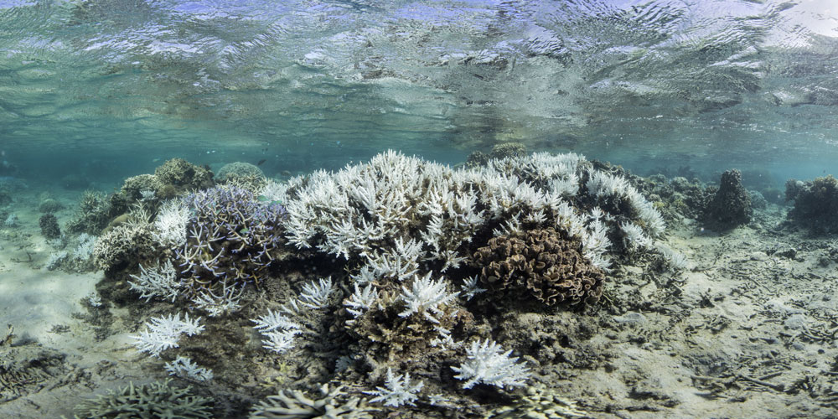
Tow less, dive smarter
A proposed manta tow and cull dive protocol
Sam Matthews
AIMS Decision Support
For discussion with GBRMPA, November 2026
Notes:
Quick one today... a proposal for how crews could use the site ranking on the water. Two changes: tow less on follow-up visits, and only make weaker-evidence dives at higher-ranked sites. Everything here is a replay of eight seasons of records, 2019 to 2026. It hasn't been trialled yet, and that's the ask at the end.

Slide 2
Most ghost dives follow weak evidence
Why was each site dived... and how often did it find nothing? 18,182 cull dives, 2019–2026
59%
of ghost dives followed a single-scar tow (1,952 of 3,308)
4–8 divers
in the water for every ghost dive
Towing is cheaper... but on active reefs much of it re-tows ground covered weeks earlier
Share of dives that found no COTS (ghost dives). Dives: open 7,273; strong 3,752; single scar 5,393; negative only 1,037; no tow 612.
Notes:
Where do ghost dives come from? Not the tows that clearly found COTS... those have a 12% ghost rate. It's the single-scar tows: 36% of those dives found nothing, and they account for 59% of all ghost dives. Each one is 4 to 8 divers in the water for nothing. Towing is cheaper, but on reefs we keep coming back to, a lot of it repeats ground we towed a few weeks earlier. So two targets: weak-evidence dives, and repeat towing.

Slide 3
Strong vs weak: write the trigger down
GBRMPA's scar analysis asked the right question... is one feeding scar enough to send divers in?
Strong
Weak
Negative
At least 1 COTS, or 2+ feeding scars, or scars 'common'
No COTS, and exactly 1 scar or scars 'present'
No COTS and no feeding scars
7.6%
12%
47%
7.2%
36%
16%
85%
44%
16%
of tows
ghost rate
> 0.04
of tows
ghost rate
> 0.04
of tows
ghost rate
> 0.04
Raise the trigger to two scars? Skipping every weak-scar dive avoids 59% of ghost dives... but misses 11% of dives above 0.04 and forgoes 10% of COTS culled. Weak evidence isn't worthless: 16% of weak-scar dives were above 0.04.
The definitions alone are still worth adopting... they make triggers consistent between crews.
Notes:
These are the definitions we used, built from what observers already record. Strong is any COTS, two or more counted scars, or scars recorded as common. Weak is a single scar. That split does most of the sorting: 12% ghost rate for strong, 36% for weak. This picks up GBRMPA's earlier analysis that moved us to counting scars... and it confirms the worry about a two-scar trigger. It would avoid most ghost dives, but miss 11% of the >0.04 dives. So weak evidence needs a second filter, not a blanket skip. Shares of tows are of 214,319 tows since 2013.

Slide 4
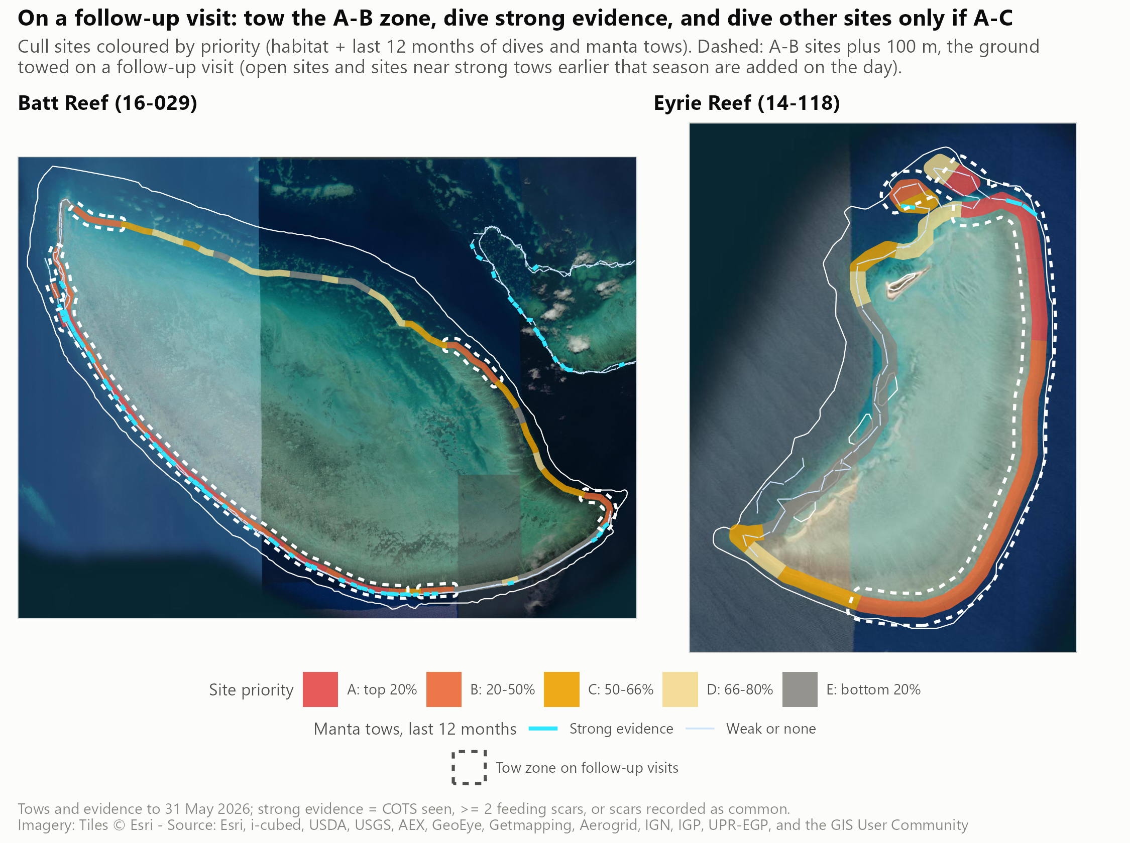
The site priority ranking: A to E, within every reef
Habitat + the last 12 months of dives and tows... a useful nudge, not a prediction
1
Habitat map
XGBoost on past cull dives at 30 m: seabed shape, coral habitat, waves
2
Recent evidence
Last 12 months: problematic dives and strong tows nearby
3
Scoring
Refitted each season on earlier seasons only
4
Classes
Ranked within the reef, refreshed before each voyage
A
B
C
D
E
top 20%
to 50%
to 66%
to 80%
last 20%
AUC 0.64 forward in time (0.58–0.74 by season); habitat alone 0.54–0.58
Notes:
GBRMPA haven't seen this yet, so briefly. Every designated cull site gets a score from two things: a habitat map, and what we've seen there in the last 12 months. Sites are ranked within their own reef, never across reefs, and split into five classes. C and D split what used to be one wide band, so there's an in-between setting. How good is it? A problematic dive outranks a non-problematic one on the same visit about 64% of the time. That's a nudge, not a prediction... most of the skill comes from recent evidence, which partly reflects where crews chose to work. On Batt, last year's strong tows sit along the western and southern edge, which is also where the A and B sites are. On Eyrie the eastern edge ranks highest.

Slide 5
The protocol: six steps, three of them new
Strong evidence still drives the dive... the ranking only decides the rest
1
NEW
2
3
NEW
Refresh the ranking
Before each voyage: maps with A–E classes and the tow zone
Dive open sites first
Keep culling until CPUE drops below 0.04
Tow
First visit: whole reef. Follow-up visit: only the zone (A–B, open, flagged earlier)
4
5
NEW
6
Dive strong evidence
Every site within 100 m of a strong tow, whatever its class
The rest: A–C only
Weak scar, negative tows or a crew call... only at A–⁠C sites
Crews can override
COTS or fresh feeding seen? Dive, and record why
Notes:
Here's the whole thing on one page. Steps 2 and 4 are what crews already do. Step 1 is ours: refresh the ranking before each voyage so earlier trips that season count. Step 3: first visit, tow the whole reef as now; on follow-up visits, tow only the zone... the A and B sites, open sites, and anything flagged by a strong tow earlier that season. Only runs of three or more tows outside the zone get skipped. Step 5 is the core change: without strong evidence, only dive A to C sites. Within A to C that stays the crew's call... adjacent sites, ground not towed for a while. D and E wait for the next visit. And step 6 makes crew judgement explicit.

Slide 6
What it would have done, 2019–2026
Replayed on eight seasons of records... using only what crews knew at the time
30%
19%
2.8%
20%
of ghost dives avoided
of low-density dives avoided
of dives above 0.04 missed
of follow-up tows saved
~124 a season
~97 a season; 13% of bottom time
~28 a season; mean CPUE 0.099, just over target
~1,400 a season; 22 more misses over 8 seasons
Same number of dives skipped at random: 24% of ghost dives avoided, 5.1% of dives above 0.04 missed (mean CPUE 0.128).
The ranking roughly halves the misses for the same cut... and the dives it does miss sit just above the threshold (median CPUE 0.069). COTS left behind are still there next visit.
Notes:
The headline numbers for the A to C dive rule, with the tow zone on follow-up visits. 30% of ghost dives and 19% of low-density dives gone, about 13% of cull bottom time. The cost: 2.8% of the >0.04 dives, about 28 a season, and they were marginal... mean CPUE 0.099, median 0.069. The zone saves about 20% of follow-up tows for 22 extra misses over eight seasons, and some of those were at A to C sites crews could still have dived. Against random: skip the same number of dives at random and you miss nearly twice as many. Both together miss 3.1% of >0.04 dives. Intervals are from resampling reef-years: ghost avoided 27–32%, >0.04 missed 2.1–3.8%.

Slide 7
Why not just skip weak evidence?
Ghost dives avoided per dive above 0.04 missed... the ranking earns its place in a targeted cut
Setting | Ghost avoided | > 0.04 missed
A–D cautious | 18% | 1.4%
A–C recommended | 30% | 2.8%
A–B aggressive | 41% | 4.5%
A–C is the sweet spot. Moving from A–D to A–C avoids 380 more ghost dives for 112 more misses... going on to A–B adds 379 for 136.
Higher is better. A–C: 4.4 (95% CI 3.6–5.8).
Notes:
This is the key comparison for GBRMPA's two-scar question. The blanket evidence rules avoid about two ghost dives per >0.04 dive missed... which is no better than skipping at random. Use the ranking to pick which weaker-evidence dives to skip, and it's four to five. A to D is the cautious option, A to B the aggressive one. A to C is the balance... the new C/D split is what makes that in-between option possible. It's a management choice, so happy to go with whichever risk appetite GBRMPA prefers.

Slide 8
Field trial: one voyage, then shadow records
One voyage can test the tow zone... it can't test the dive rule (about 2 flagged dives per voyage)
1 One live voyage
2 A season of shadow records
Choose: a voyage with at least 3 follow-up reefs
Freeze: the ranking at departure, maps issued
Tow the zone first, then the rest... same ground, different order
Flag and defer: dive flagged sites last, so outcomes are still recorded
Record: tow times, overrides and a crew debrief
Every voyage: freeze the ranking before departure
Change nothing on the water... crews do nothing new
Score afterwards from normal tow and dive records
~25 voyages (a third of a season) give a 95% chance of seeing the pattern
Go if maps arrive on time, crews apply the rules without disrupting the schedule, the zone saves time, and the rest of the reef finds no extra dives above 0.04.
Adopt the dive rule if skipped dives have fewer above 0.04 and more ghosts than kept dives (backtest: 10% vs 22% above 0.04; 44% vs 32% ghost).
Notes:
We can probably only do one voyage, and we can't double-tow without disrupting operations. So: tow the zone first, then the rest of the reef as crews would anyway. Same ground towed once, just in a different order, and we see exactly what the zone would have missed. Flagged dives get made last rather than dropped. That tests usability and real towing time... transits between zone sections will eat into the 20%. One voyage can't test the dive rule, there are only about two flagged dives on a typical voyage. The fix costs nothing: freeze the ranking before every voyage for a season and score it afterwards. Trial voyage, dates and decision thresholds still to agree.

Slide 9
Take aways
Write down strong vs weak... consistent triggers across crews
Keep diving strong evidence; rank only the rest
~4 ghost dives avoided per >0.04 dive missed... double random
Tow zone saves 20% of follow-up tows... needs a field test
The ask: one trial voyage + a season of shadow records
Notes:
To wrap up. The definitions are worth adopting on their own. The ranking's job is narrow: decide which weaker-evidence dives are worth making. That roughly doubles the ghost dives avoided per high-density dive missed. The tow zone is the weaker half... it saves boat time, not ghost dives, so it needs a field trial. The ask: one voyage to test it live, and a season of shadow recording to test the dive rule at no cost.

