Slide 1
Stylo-Compare
Honors Petition
Samuel McDowell

Slide 2
Agenda
Introduction
What’s Stylo-Compare?
Metrics
Lessons Learned

Slide 3
Introduction

Slide 4
What is Stylometry?
Using statistics to analyze text
Looks at vocabulary, lexical features, phrases, readability and more

Slide 5
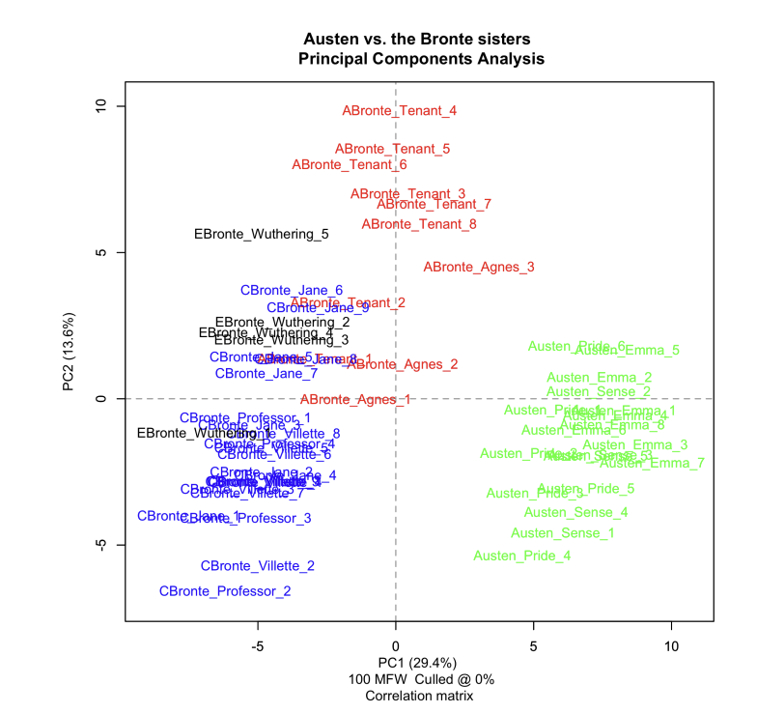
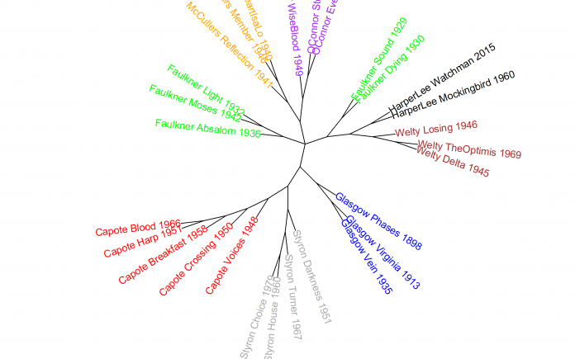
What Already Exists?

Slide 6
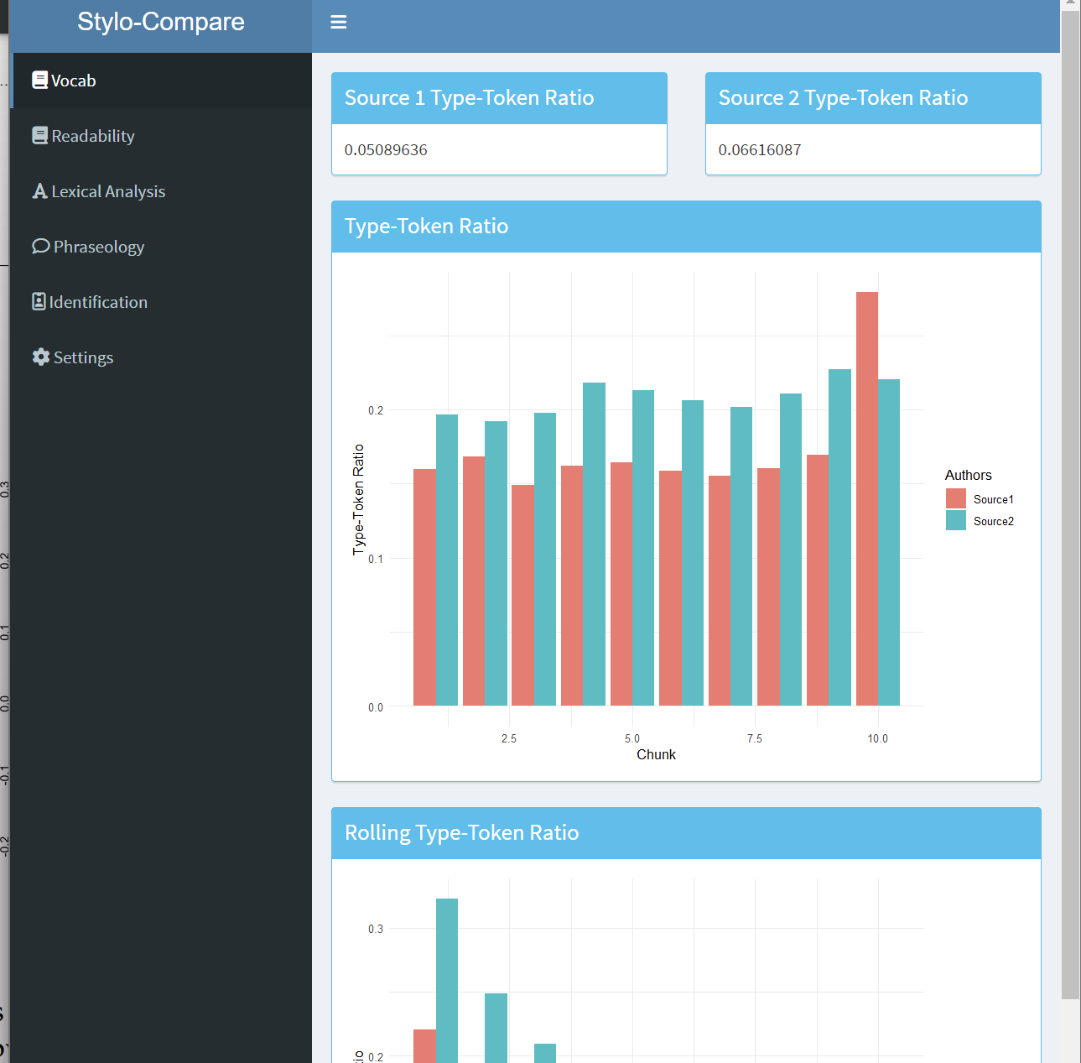
Introducing Stylo-Compare

Slide 7
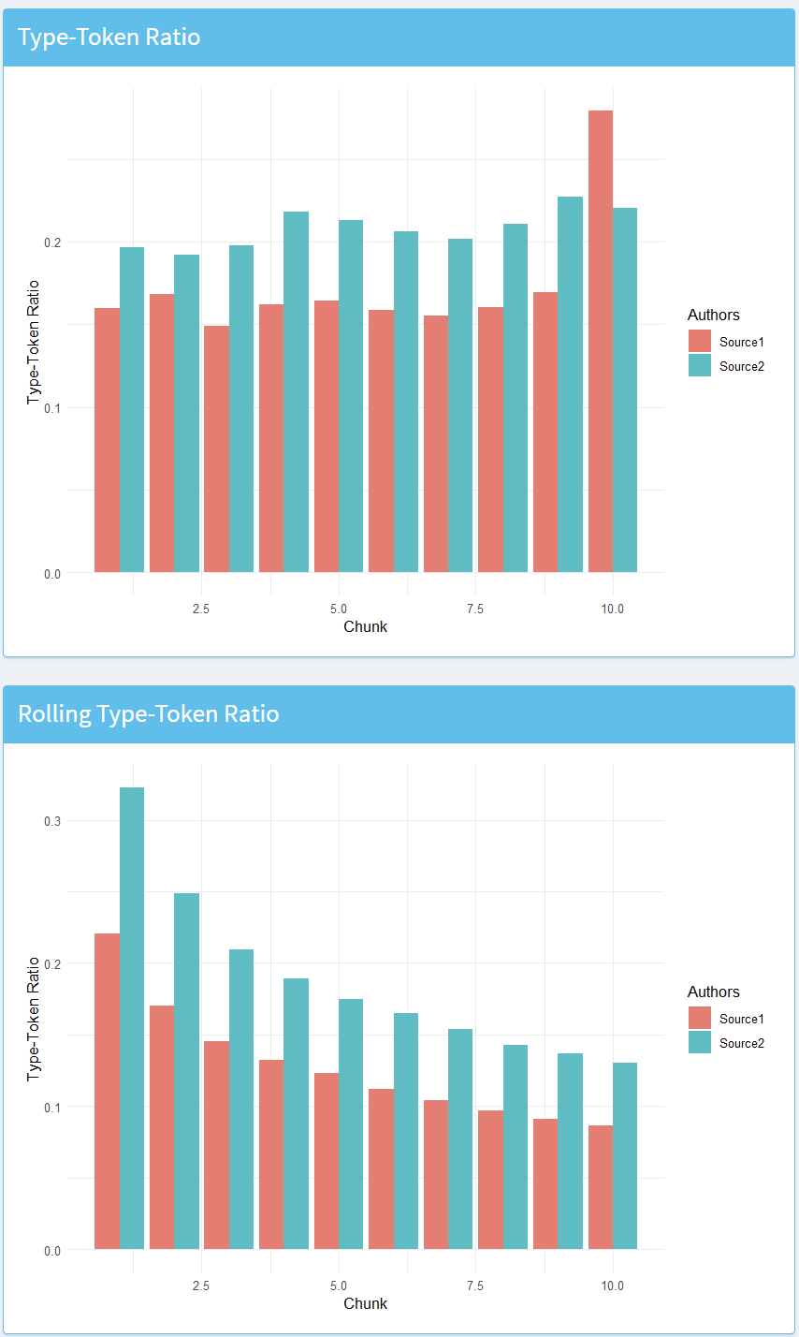
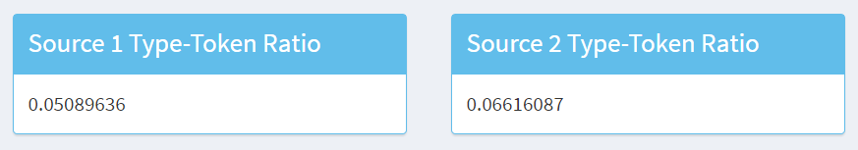
Vocabulary
Type-Token Ratio:
= (unique tokens / total tokens)

Slide 8
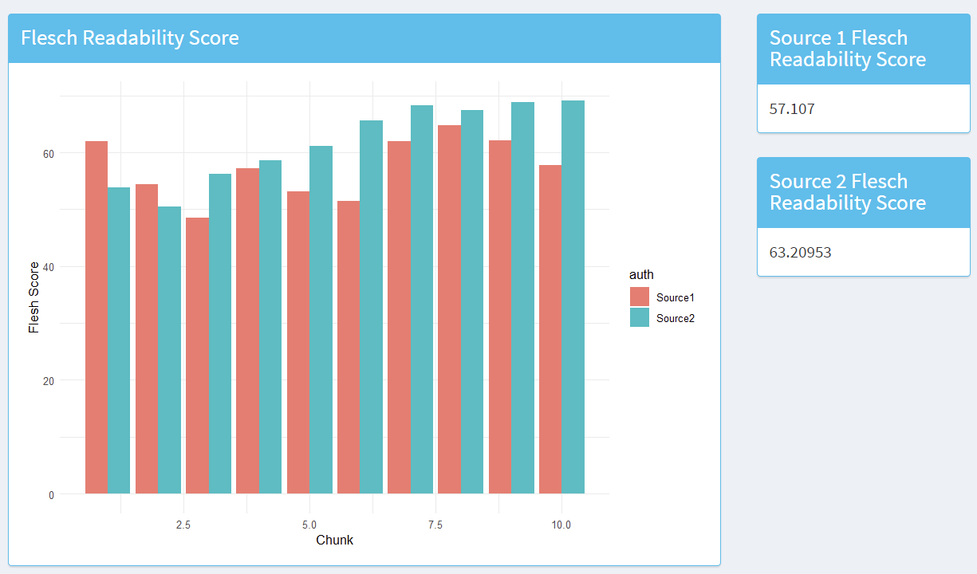
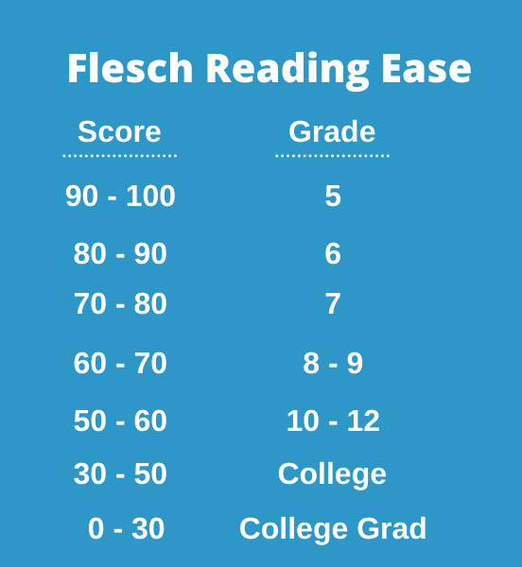
Readability
Flesh Readability Score

Slide 9
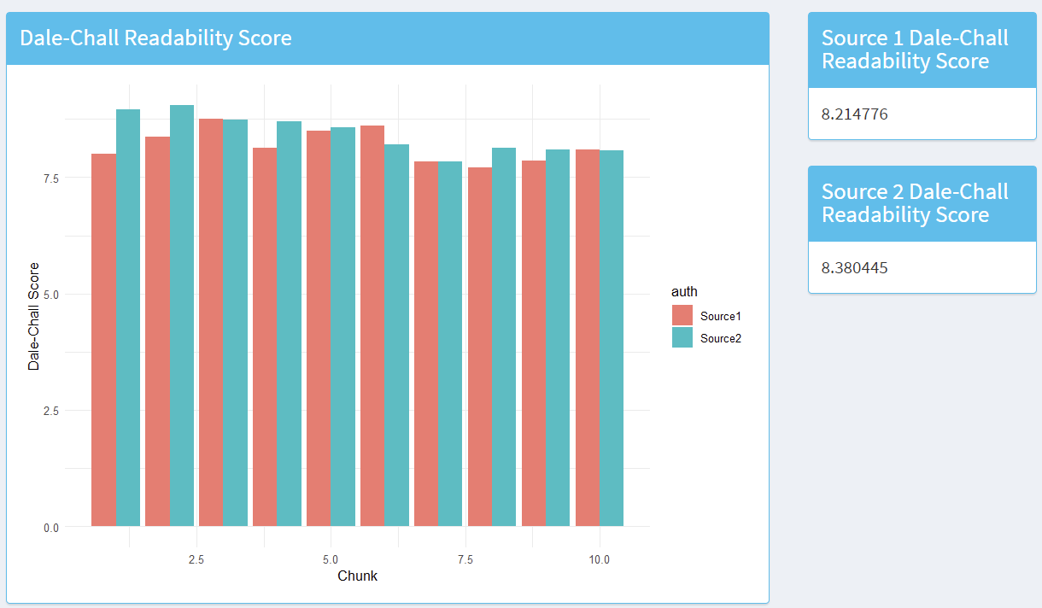
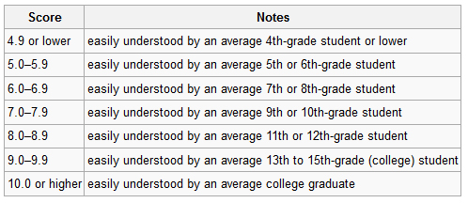
Readability
Dale-Chall Readability Score

Slide 10
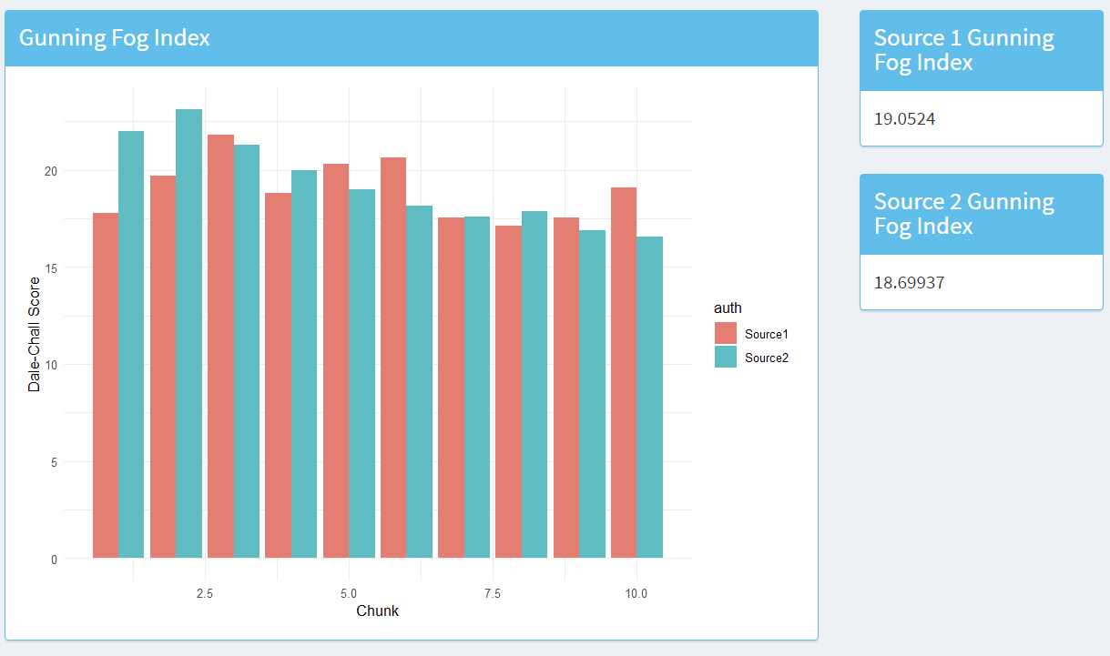
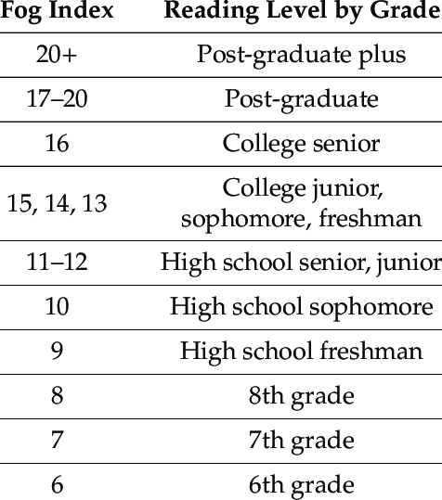
Readability
Gunning Fog Index

Slide 11
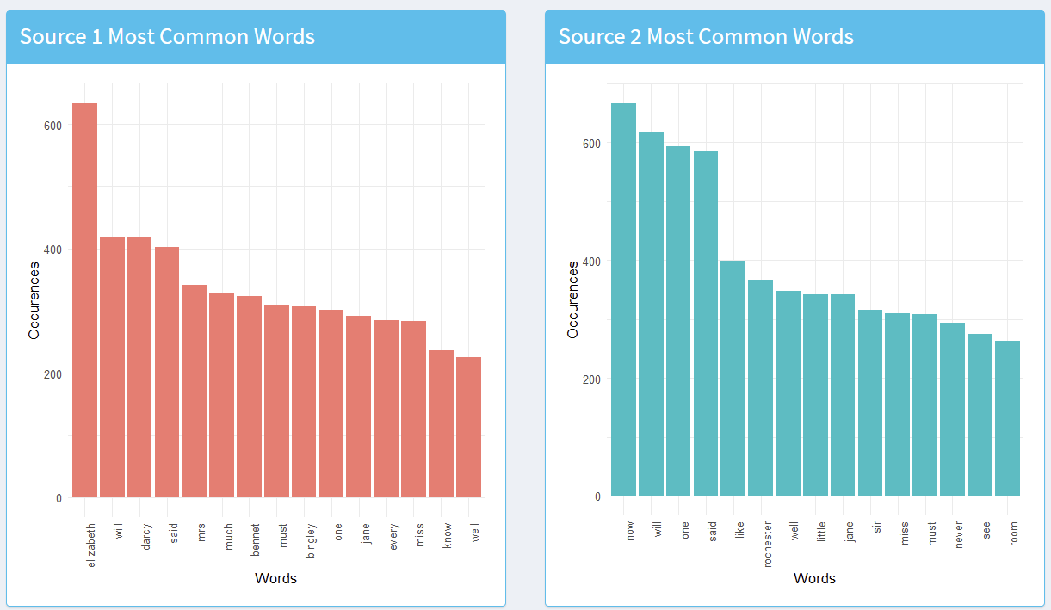
Lexical Analysis
Most Common Words

Slide 12
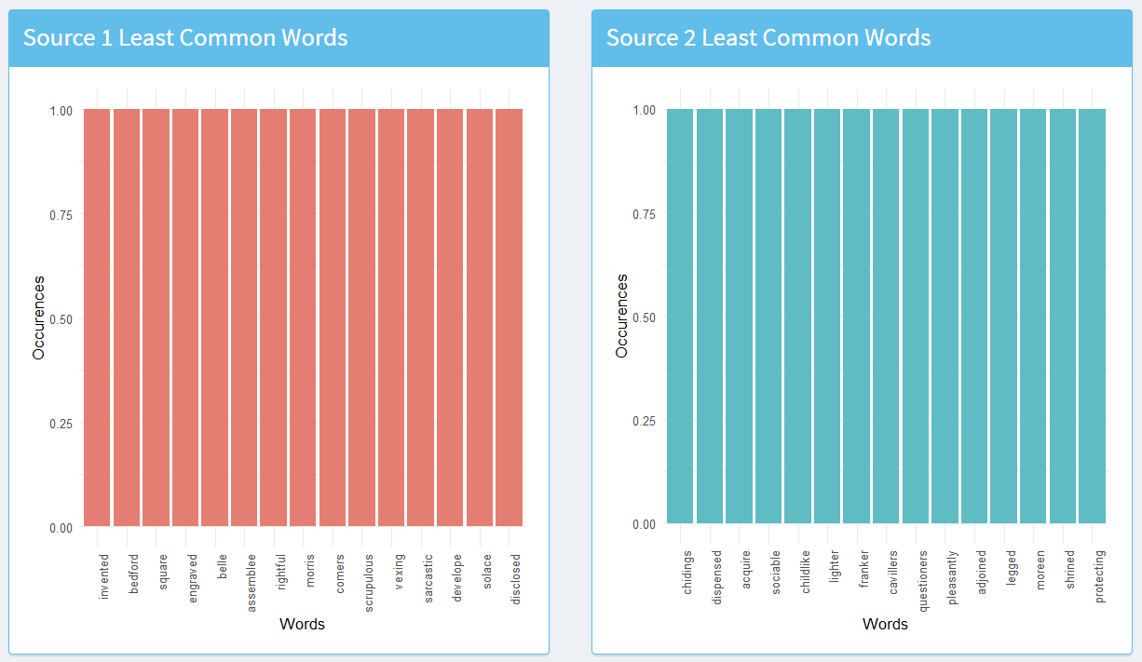
Lexical Analysis
Least Common Words

Slide 13
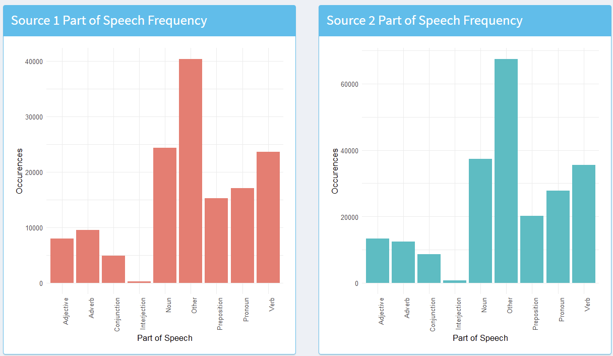
Lexical Analysis
Parts of Speech

Slide 14
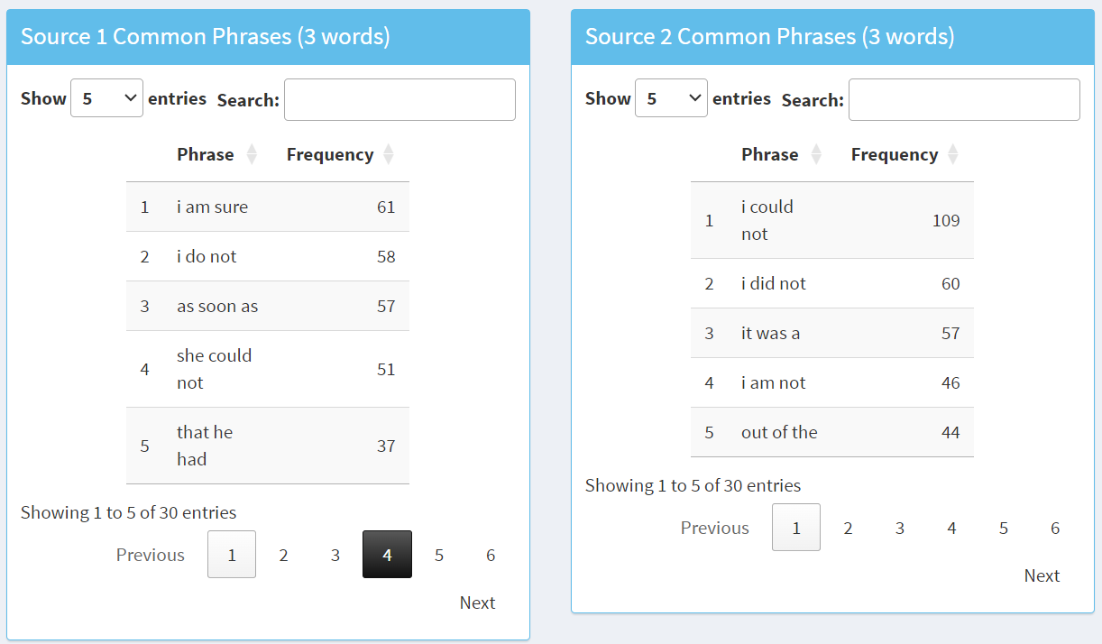
Phraseology

Slide 15
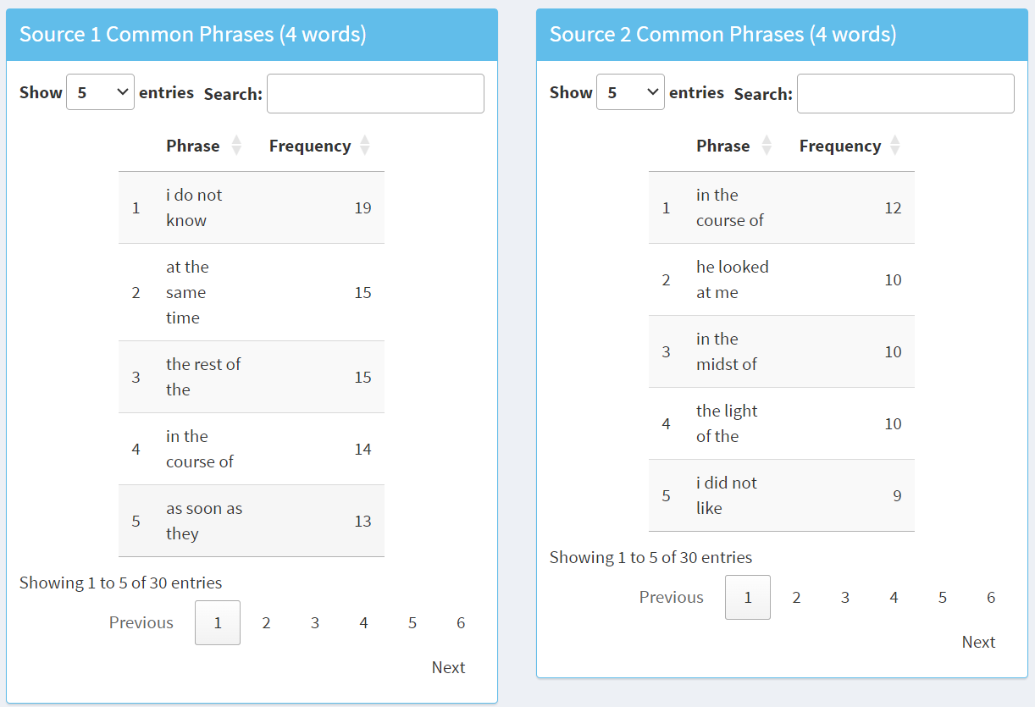
Phraseology

Slide 16
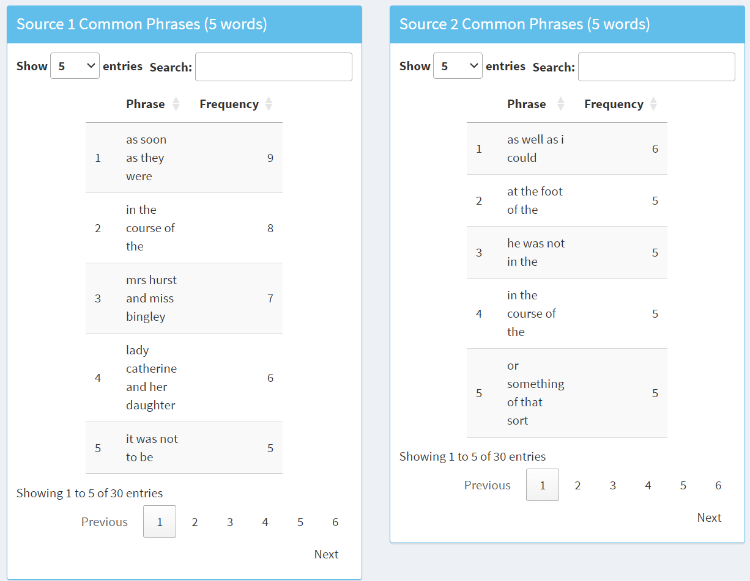
Phraseology

Slide 17
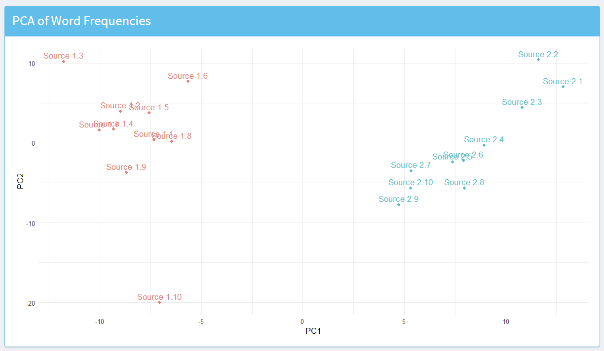
Principal Component Analysis

Slide 18
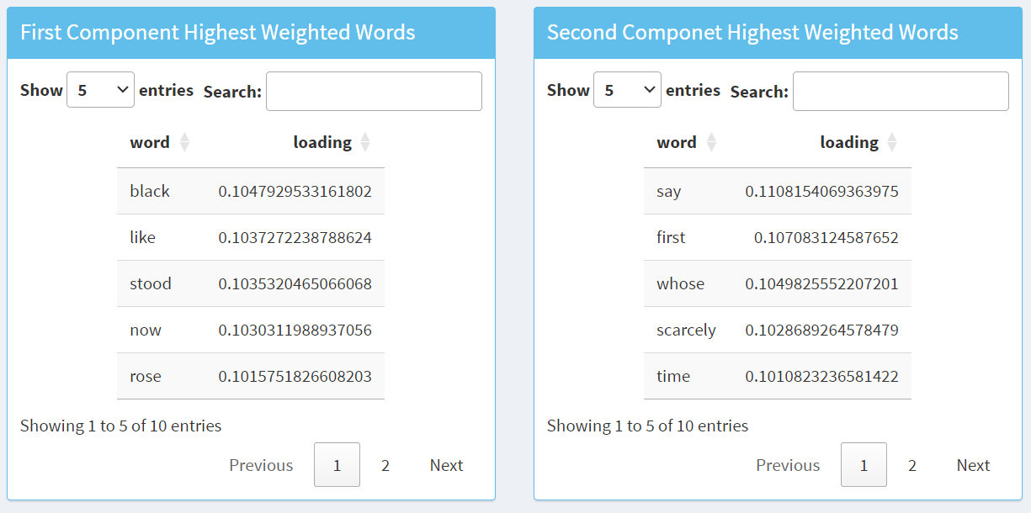
Principal Component Analysis

Slide 19
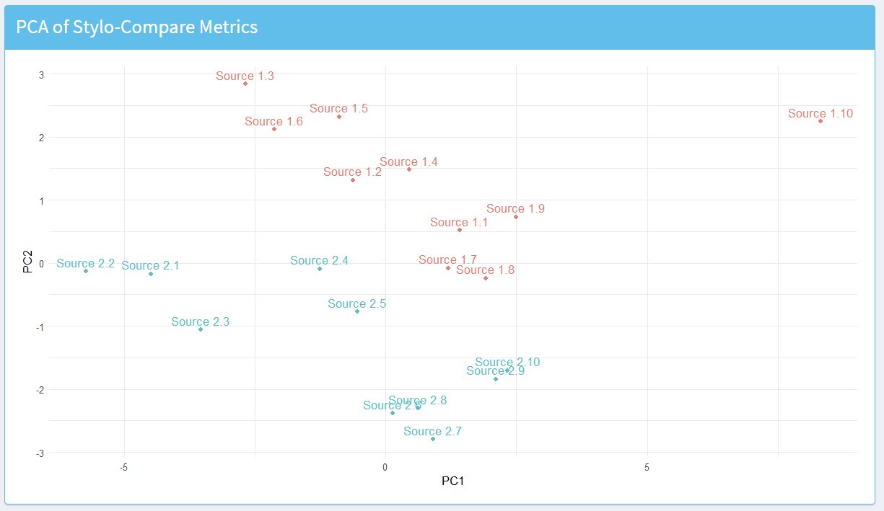
Principal Component Analysis

Slide 20
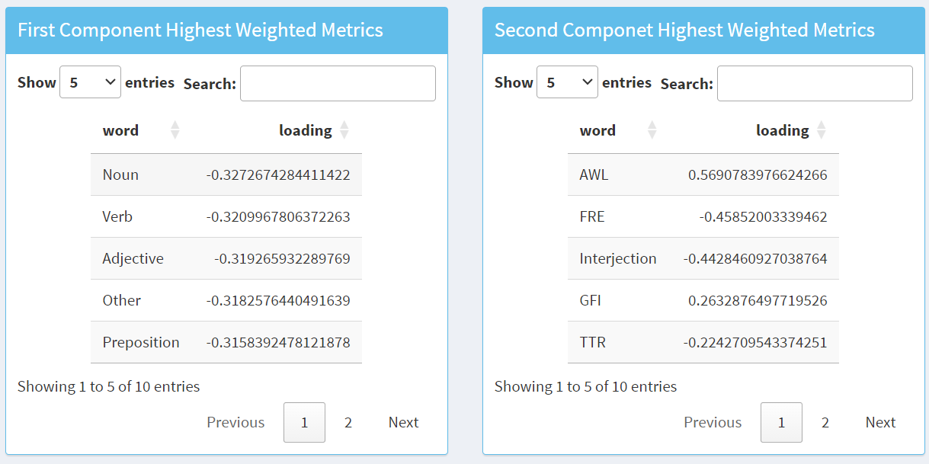
Principal Component Analysis

Slide 21
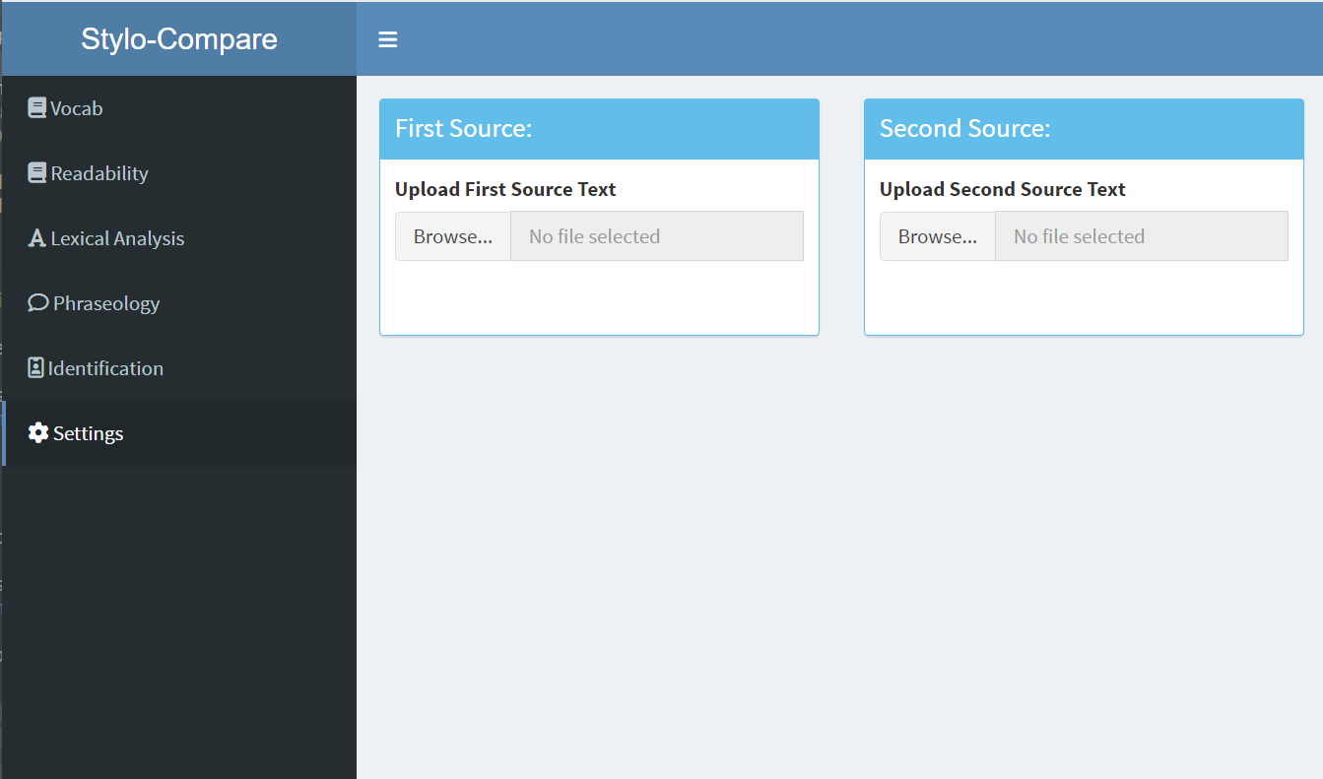
Settings

Slide 22
Lessons Learned
English is complicated
Using machine learning in live applications is slow
RShiny is awesome

Slide 23
Questions?

