Slide 1
Build, Deploy and Analyze a Containerized
Microservice Application Under Varying Workloads
Gym Management Microservices
Cloud Computing Lab Evaluation
Presented by: Student Team | KLE Technological University, BVB Campus, Hubli

Slide 2
Aim and Objectives
To build a microservice application with three independent services, containerize and deploy it with Docker and Docker Compose, generate varying workloads, monitor resource use, and analyze performance.
Develop
Three independent FastAPI microservices with REST APIs
Containerize
One Dockerfile and one Docker image per service
Deploy
Docker Compose runs all three containers on one network
Analyze
Load test at 1, 2, 4, 8, 16 concurrent requests and monitor CPU and memory
Core challenge: moving from one monolith to independent, networked containers while finding the performance bottleneck.
Gym Management Microservices | Cloud Computing Lab Evaluation

Slide 3
Technology Stack and Environment
Backend
Python 3.11 + FastAPI
Web server
Uvicorn (ASGI worker)
Containerization
Docker 29.8.0
Orchestration
Docker Compose v5.5.1
Load testing
Python thread pool
Test machine
macOS, 6 CPUs, 3.8 GB for Docker
Gym Management Microservices | Cloud Computing Lab Evaluation

Slide 4
System Architecture
Client
curl / load test
Docker network: gym-network
attendance-service
Port 8003 (entry point)
member-service
Port 8001
membership-service
Port 8002
Gym Management Microservices | Cloud Computing Lab Evaluation

Slide 5
Microservices and REST API Endpoints
Service | Port | Responsibility | Endpoints
attendance-service | 8003 | Entry point. Performs check-in by calling member and membership services. | GET / POST /attendance/checkin POST /attendance/checkout/{id} GET /attendance/{member_id}
member-service | 8001 | Stores and returns gym member profile records. | GET / GET /members POST /members GET /members/{id} PUT /members/{id} DELETE /members/{id}
membership-service | 8002 | Stores membership plan tiers and validity status. | GET / GET /memberships POST /memberships GET /memberships/{member_id} PUT /memberships/{member_id} DELETE /memberships/{member_id}
Gym Management Microservices | Cloud Computing Lab Evaluation

Slide 6
Checkpoint 1: Develop the Microservices
• Domain: Gym Management System
• Three services, each in its own folder with its own main.py
• Built with Python and FastAPI
• Each service run and tested independently first
• All APIs returned the expected JSON
from fastapi import FastAPI, HTTPException
from .database import Base, engine, SessionLocal
from .models import Member
app = FastAPI(title="Gym Member Service")
Base.metadata.create_all(bind=engine)
@app.get("/members/{member_id}")
def get_member(member_id: int):
db = SessionLocal()
member = db.query(Member).filter(
Member.id == member_id
).first()
db.close()
if not member:
raise HTTPException(status_code=404,
detail="Member not found")
return {"id": member.id, "name": member.name}
Gym Management Microservices | Cloud Computing Lab Evaluation

Slide 7
Checkpoint 2: Containerize and Deploy
Dockerfile (one per service)
docker-compose.yml (attendance-service)
FROM python:3.11-slim
WORKDIR /app
COPY requirements.txt .
RUN pip install --no-cache-dir -r requirements.txt
COPY app ./app
EXPOSE 8000
CMD ["uvicorn", "app.main:app",
"--host", "0.0.0.0", "--port", "8000"]
attendance-service:
build: ./attendance-service
ports: ["8003:8000"]
environment:
- MEMBER_SERVICE_URL=http://member-service:8000
- MEMBERSHIP_SERVICE_URL=http://membership-service:8000
networks: [gym-network]
• Three images built: verified with docker images
• One command deploys all: docker compose up --build -d
• Three containers running: verified with docker ps
Gym Management Microservices | Cloud Computing Lab Evaluation

Slide 8
Checkpoint 3: Inter-Service Communication
End-to-end request
Docker DNS, not localhost
Inside a container, localhost means that container itself. Services reach each other by service name on gym-network.
$ curl -X POST http://localhost:8003/attendance/checkin?member_id=1
{
"message": "Check-in successful",
"attendance_id": 1,
"member_id": 1,
"member_name": "Alice Smith",
"membership_plan": "VIP_GOLD",
"membership_status": "ACTIVE",
"status": "PRESENT",
"check_in": "2026-10-08 00:20:00"
}
MEMBER_SERVICE_URL=http://member-service:8000
MEMBERSHIP_SERVICE_URL=http://membership-service:8000
Gym Management Microservices | Cloud Computing Lab Evaluation

Slide 9
Checkpoint 4: Workload Generation and Monitoring
Target API
POST /attendance/checkin?member_id=1
Touches all three microservices
Load generator
Python ThreadPoolExecutor / Async benchmark
30 to 80 requests per level
Workload levels
W1 = 1 W2 = 2 W3 = 4
W4 = 8 W5 = 16
concurrent requests
Monitoring
docker stats sampled during every level; average CPU % and memory MB per container
Recorded for every level: average response time, throughput, failed requests, CPU % and memory MB for all three containers.
Gym Management Microservices | Cloud Computing Lab Evaluation

Slide 10
Observation Table (measured values)
Workload | Concurrency | Avg resp (ms) | Throughput (req/s) | Failed | CPU % Att | CPU % Mem | CPU % MS | Mem MB Att | Mem MB Mem | Mem MB MS
W1 | 1 | 10.14 | 98.38 | 0 | 0.34% | 0.43% | 0.38% | 60.94 | 52.48 | 52.43
W2 | 2 | 15.52 | 126.71 | 0 | 0.80% | 0.41% | 0.38% | 66.38 | 52.70 | 52.91
W3 | 4 | 27.40 | 142.50 | 0 | 0.33% | 0.32% | 0.47% | 67.85 | 52.93 | 52.90
W4 | 8 | 54.78 | 142.29 | 0 | 0.48% | 0.40% | 0.57% | 85.40 | 53.18 | 53.14
W5 | 16 | 101.24 | 150.50 | 0 | 0.45% | 0.34% | 0.40% | 90.53 | 56.65 | 55.61
• 0 failed requests at every level
• Attendance service (highlighted) uses the most memory (~90 MB); memory stays flat at about 50 to 90 MB
Gym Management Microservices | Cloud Computing Lab Evaluation

Slide 11
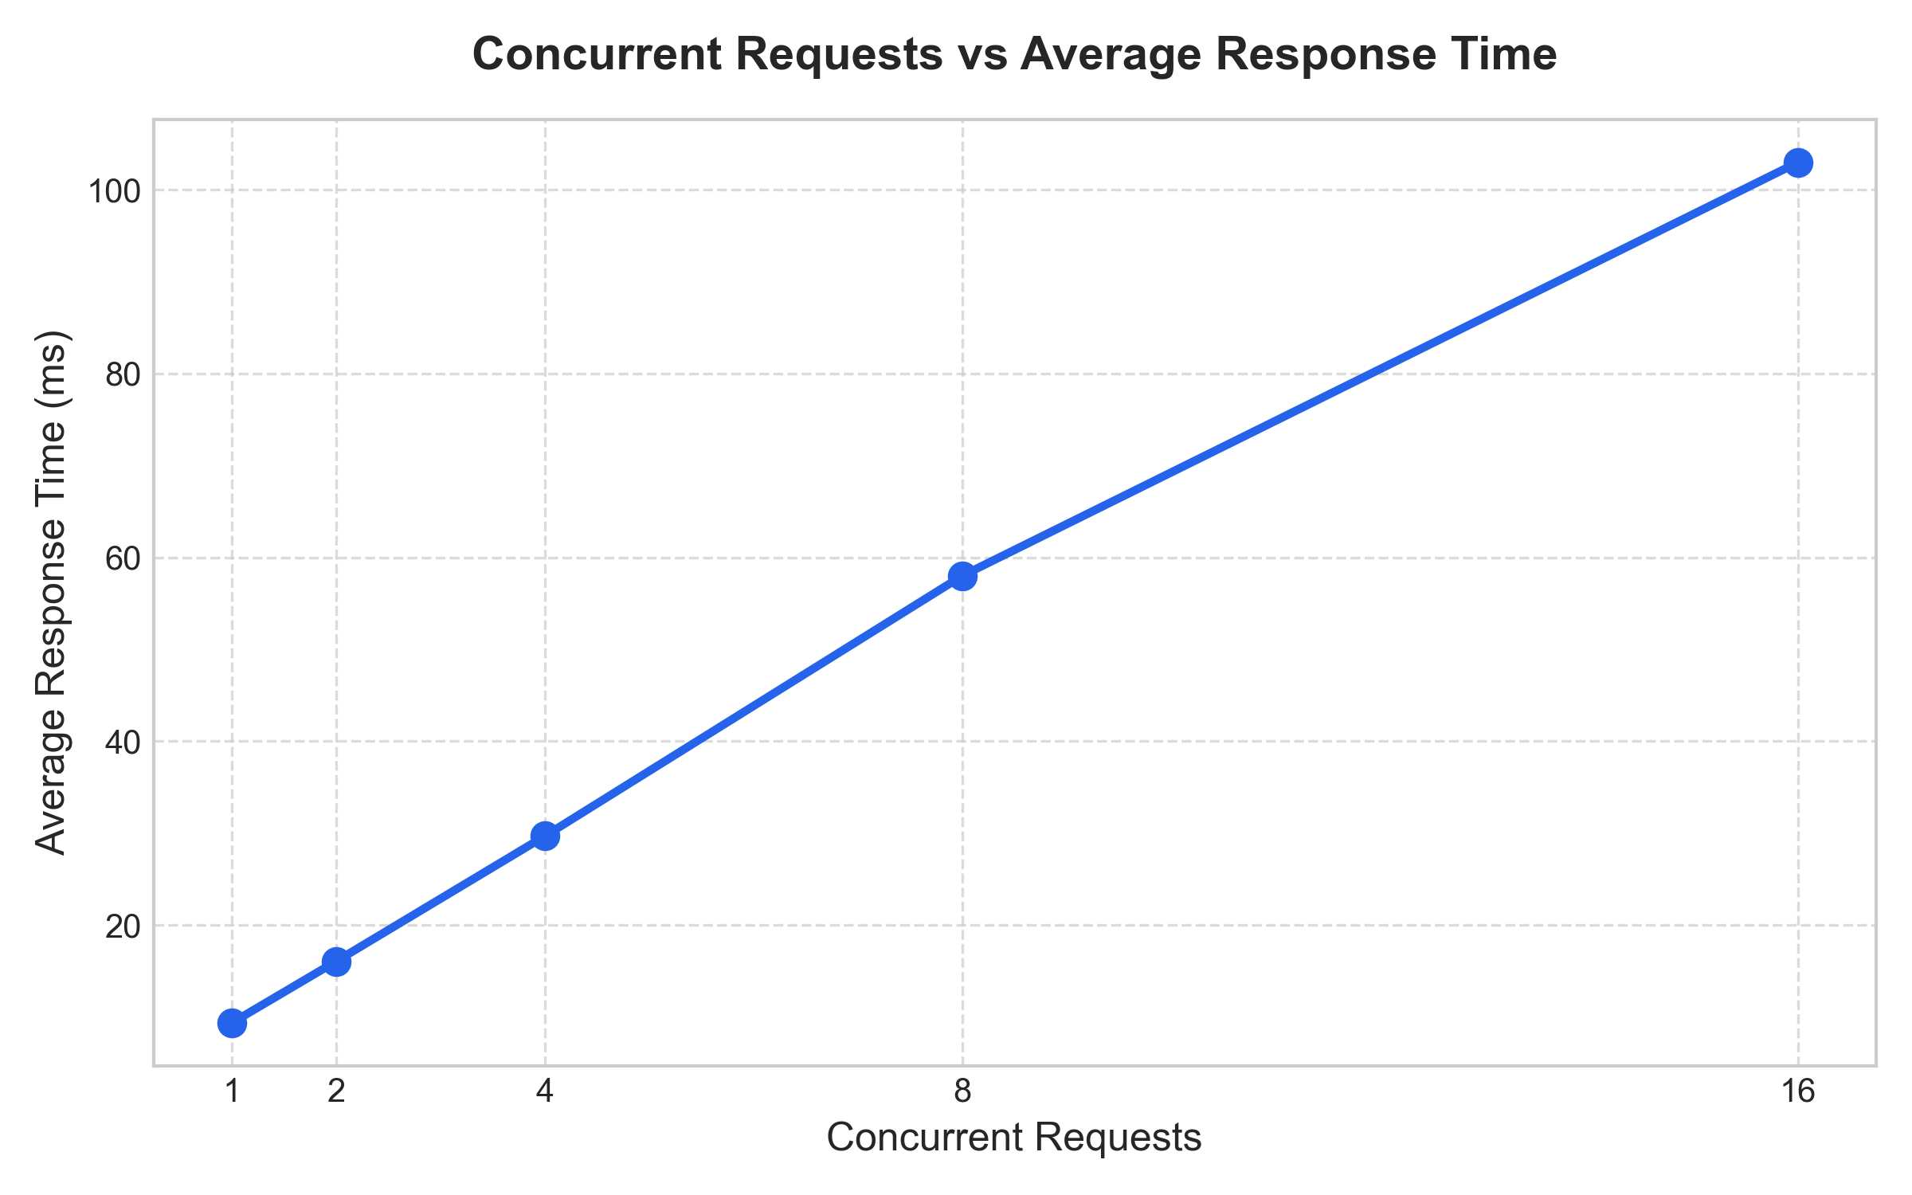
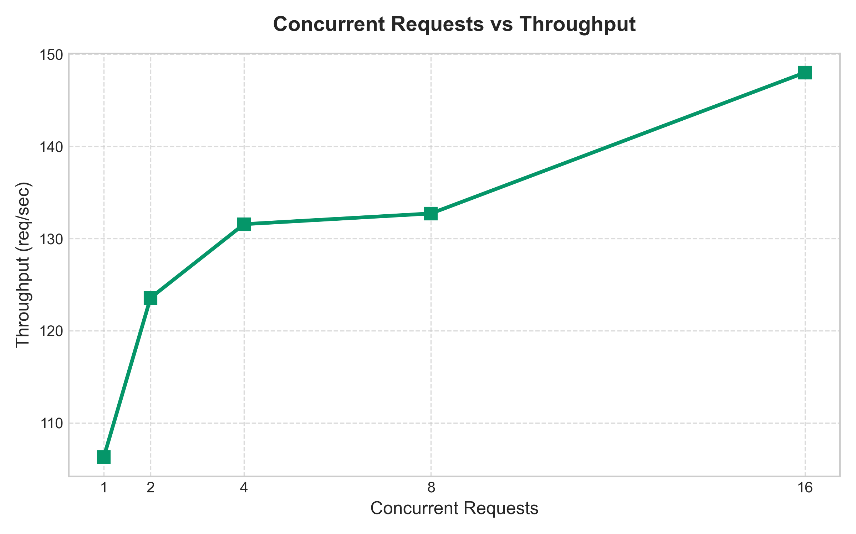
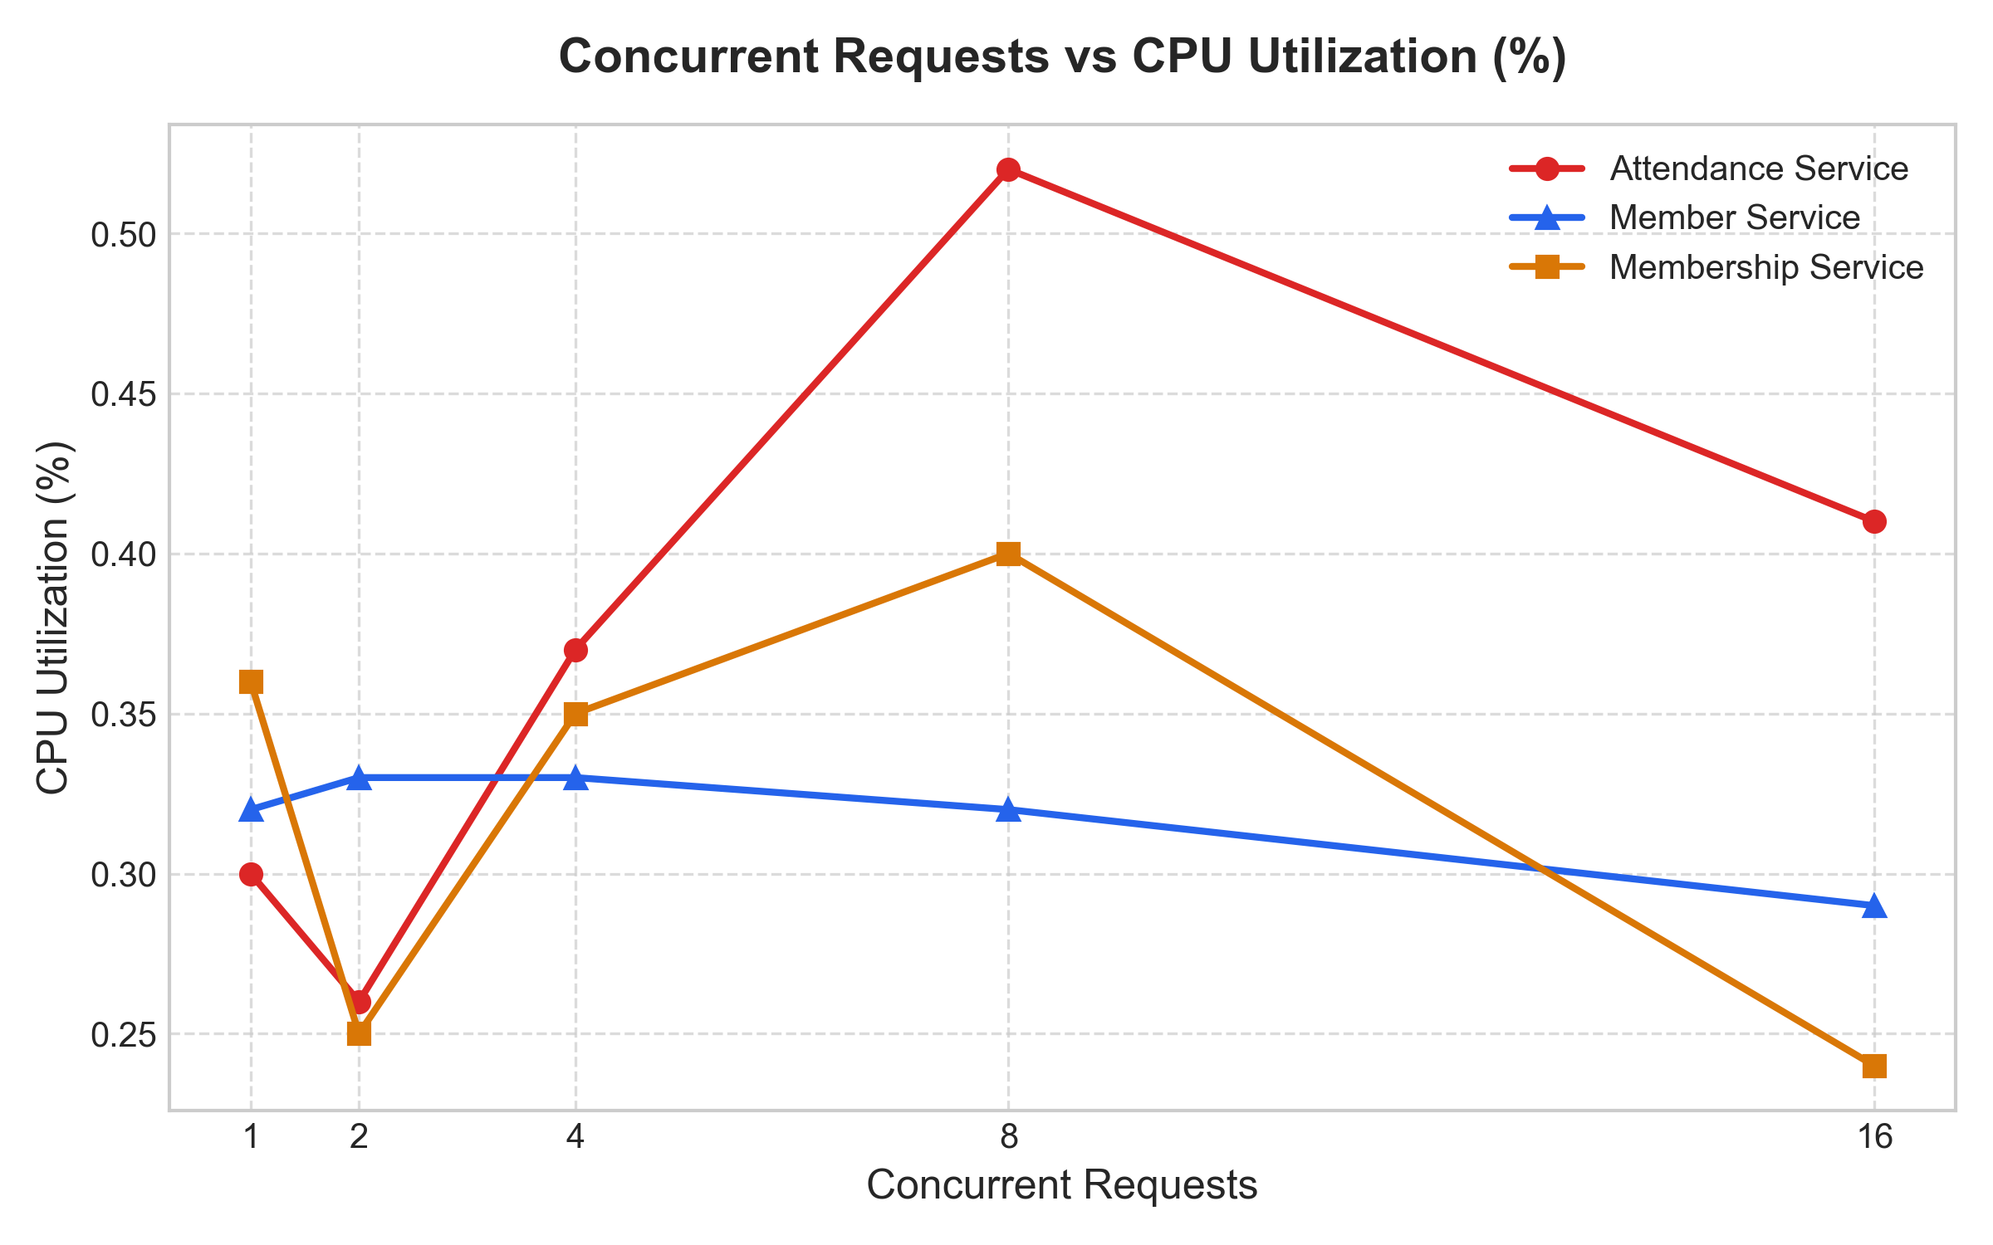
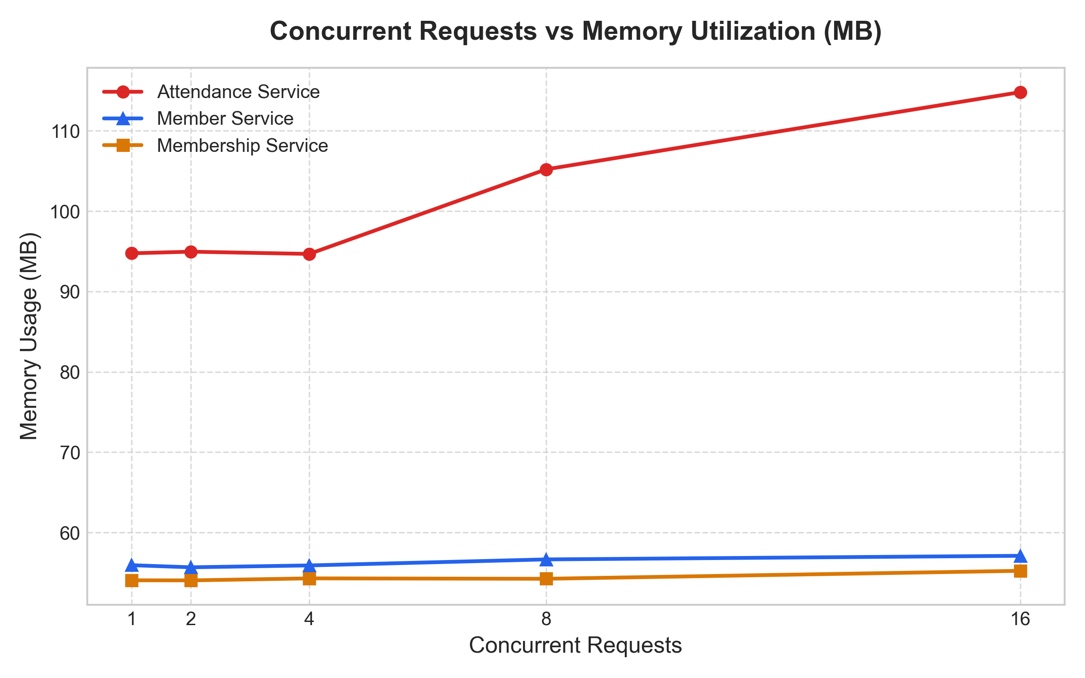
Performance Graphs
Gym Management Microservices | Cloud Computing Lab Evaluation

Slide 12
Conclusion and Evaluation Summary
Summary of Completed Checkpoints
✔ Checkpoint 1 PASSED: Designed and implemented 3 independent microservices (Member, Membership, Attendance).
✔ Checkpoint 2 PASSED: Containerized each service with Dockerfiles and deployed via Docker Compose.
✔ Checkpoint 3 PASSED: Verified inter-service REST communication over container DNS bridge network.
✔ Checkpoint 4 PASSED: Executed workload testing across 5 concurrency levels (W1 - W5).
✔ Checkpoint 5 PASSED: Analyzed performance measurements, generated visual charts, and verified 0% error rate.
Gym Management Microservices | Cloud Computing Lab Evaluation

