Slide 1

BOTTLE
Python Web Framework

Slide 2
CONTENTS
Introduction
Installation Bottle framework
“Hello World” program
Why Bottle Python web framework --Advantage of Bottle
Workflow of Bottle
Case Study
Steps to Install the Python and other resources
Result
Conclusion

Slide 3
INTRODUCTION
Bottle is a fast, simple and lightweight WSGI micro web-framework for Python. It is distributed as a single file module
and has no dependencies other than the Python Standard Library.
• Routing: Requests to function-call mapping with support for clean and dynamic URLs.
• Templates: Fast and pythonic built-in template engine and support for mako, jinja2 and cheetah templates.
• Utilities: Convenient access to form data, file uploads, cookies, headers and other HTTP-related metadata.
• Server: Built-in HTTP development server and support for paste, bjoern, gae, cherrypy or any other WSGI
capable HTTP server.

Slide 4
“Hello World” program useing Bottle framework :
from bottle import route, run
@route('/hello')
def hello():
return "Hello World!"
run(host='localhost', port=8080, debug=True)
code explaining:
1. The route() decorator binds a piece of code to an URL path.
2. The run() call in the last line starts a built-in development server.

Slide 5
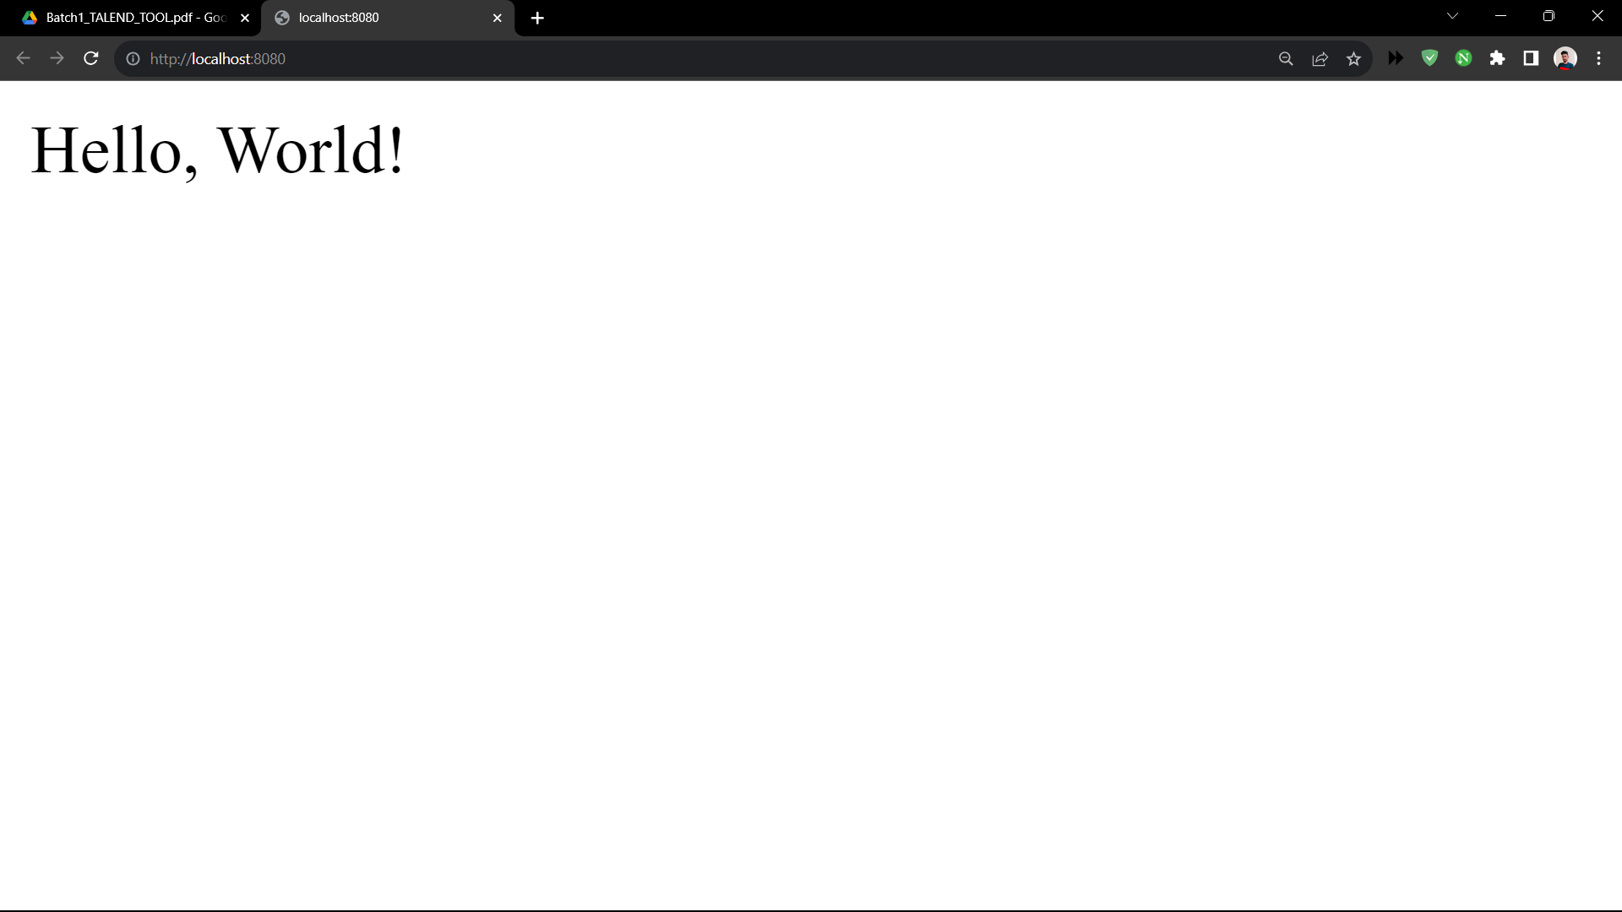
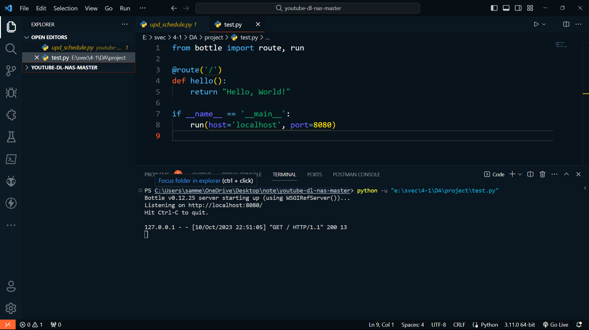

Slide 6
Advantage of Bottle :
Why Bottle Python web framework
Simplicity
Lightweight
Fast:
Embeddable
No External Templates or Databases
Good for Learning

Slide 7
Case Study
Title : YouTube Video Analysis Web Application The case study examines the development and implementation of a Bottle Python web application for YouTube video analysis, designed to empower digital marketing professionals to efficiently extract and analyse key video metrics. This study details the project's inception, scope, development process, features, and its impact on XYZ Marketing Agency, shedding light on the value it brings to the digital marketing industry.
Streamline Video Analysis: To simplify and accelerate the process of extracting and understanding YouTube video metrics for digital marketing professionals.
Provide Actionable Insights: To offer data-driven insights that help users optimize content and engage their audience more effectively.

Slide 8
Installation steps
1. Python:
Ensure you have Python installed. If not, download and install it from the official Python website: https://www.python.org/downloads/
2. Bottle:
Install the Bottle web framework using pip, the Python package manager:
>>> pip install bottle
3. yt-dlp:
>>> pip install yt-dlp >>> pip install textblob
>>> python -m textblob.download_corpora
>>> pip install pytrends
>>> pip install matplotlib note : These all packages for analysis project purpose only the main focus on the Bottle python web framework.

Slide 9
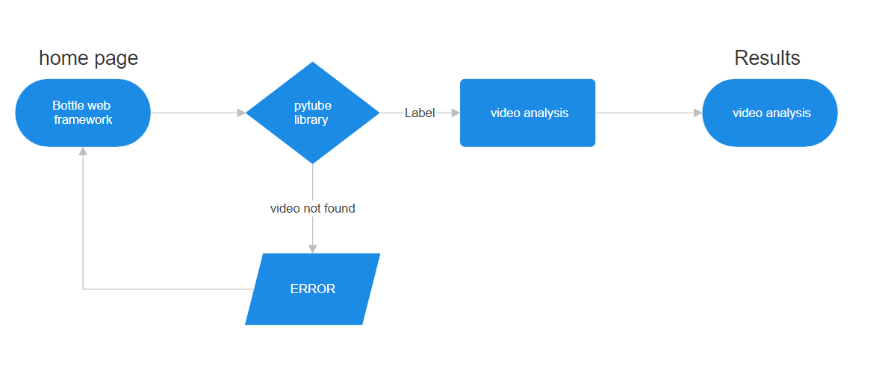
Workflow of Bottle
And also relevant packages

Slide 10
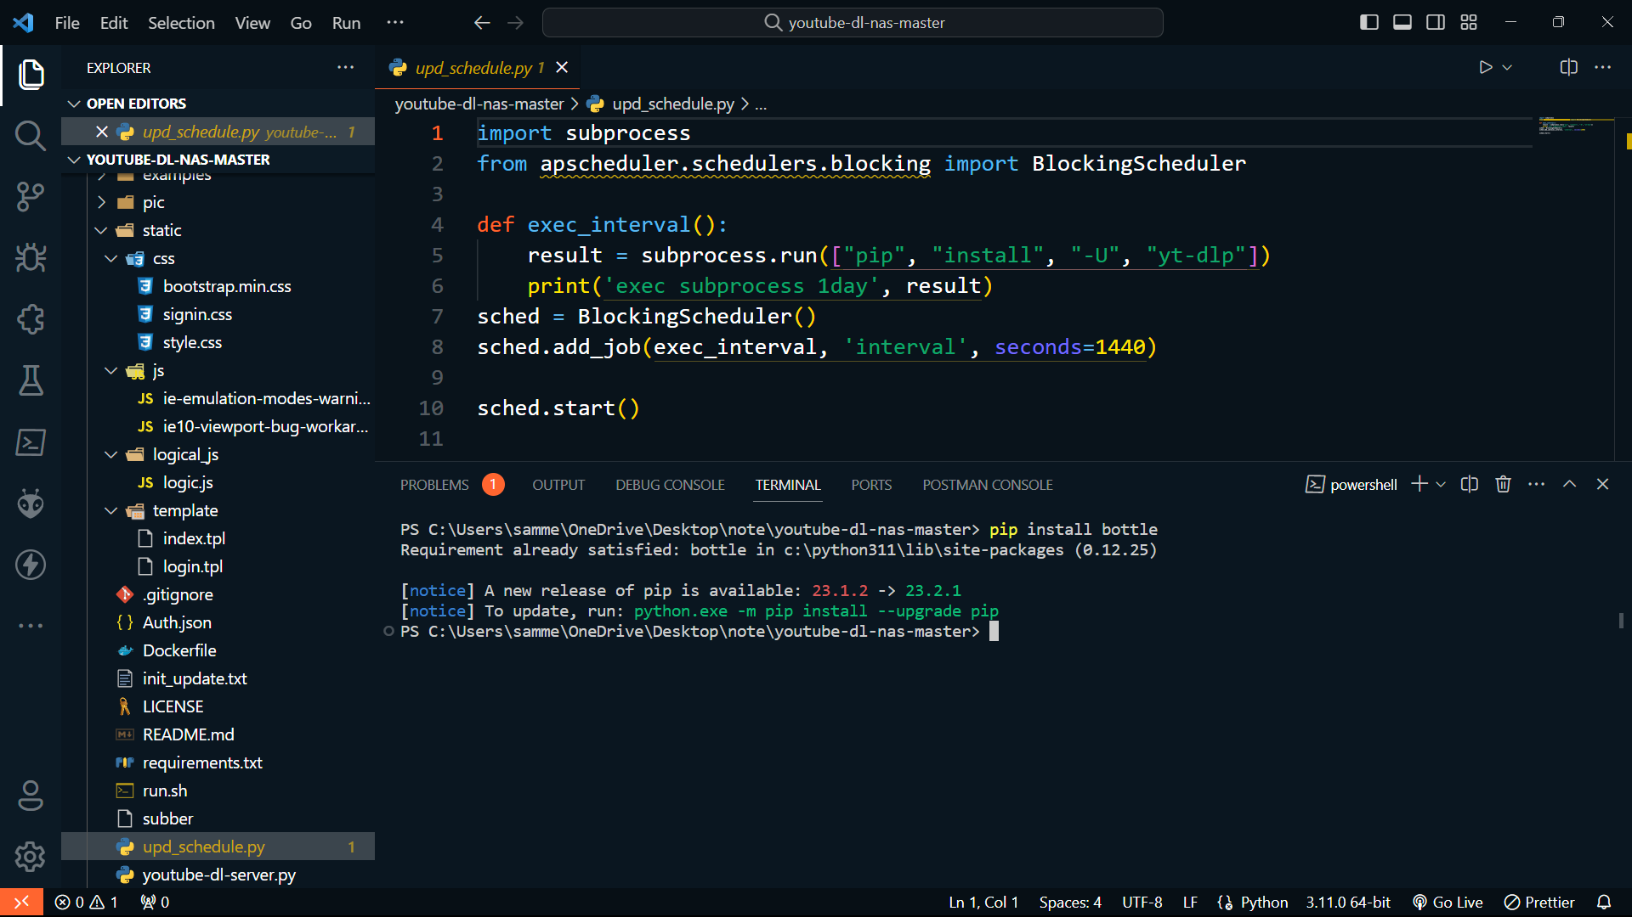
Installation Bottle framework :

Slide 11
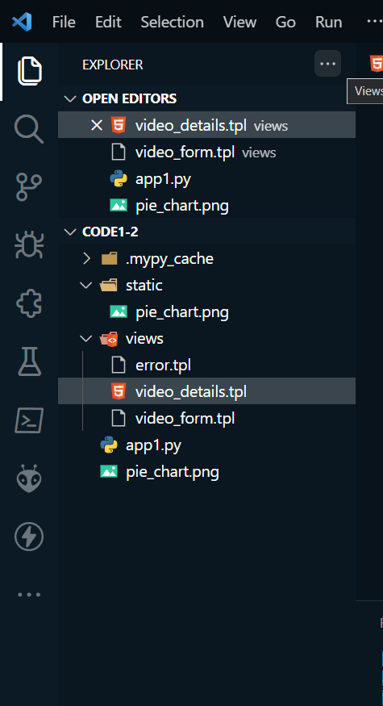
Count….
4. Template Files:
Create a directory named views in your project folder.
Save the video_form.tpl and video_details.tpl templates in the views directory.
5. Static Files:
Create a directory named static in your project folder.
Save the pie_chart.png image in the static directory.
6. Application Code:
Create an app.py file in your project directory.
Add the application code to this file.

Slide 12
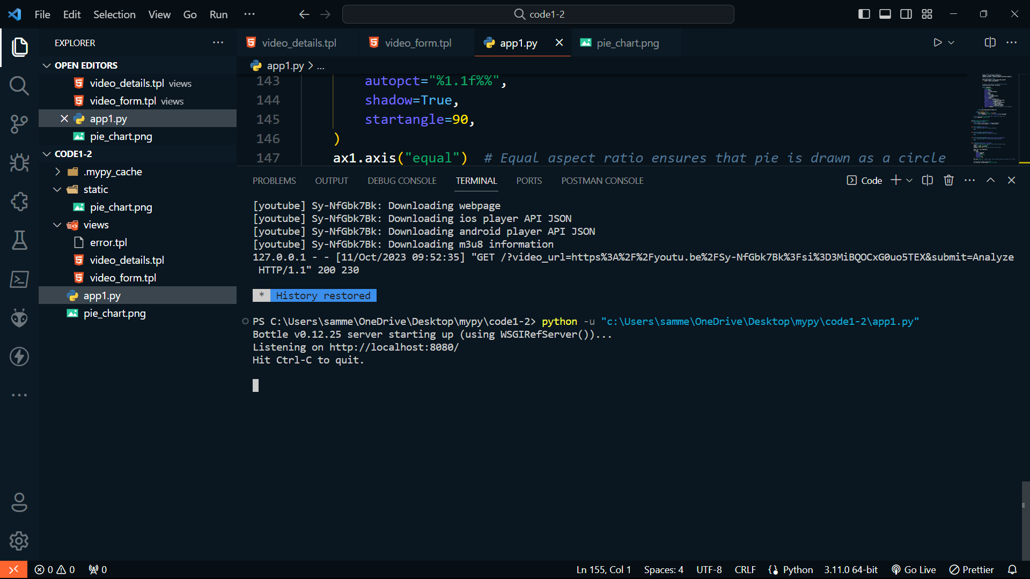
Count….
7. Run the Application:
Open a terminal or command prompt.
Navigate to your project directory.
Run the Bottle web server by executing the app.py script:

Slide 13
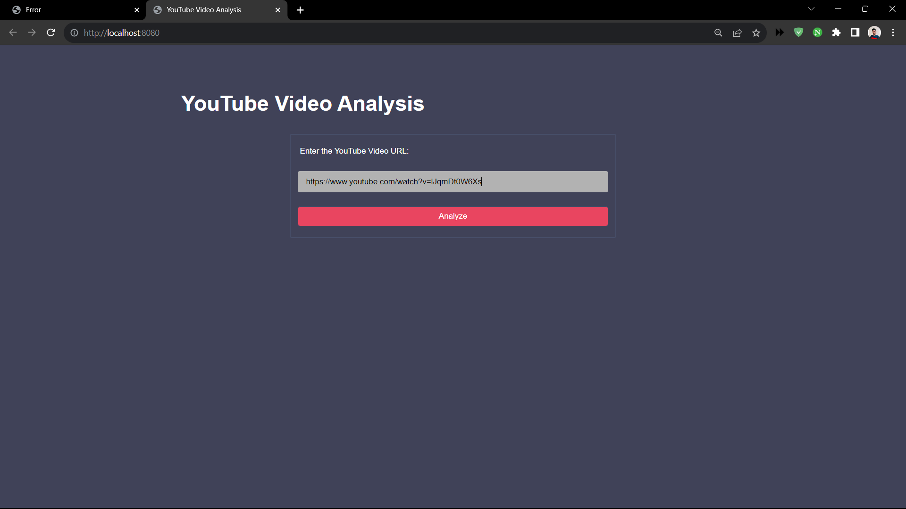
Count….
Home price of the project where we need to enter the url

Slide 14
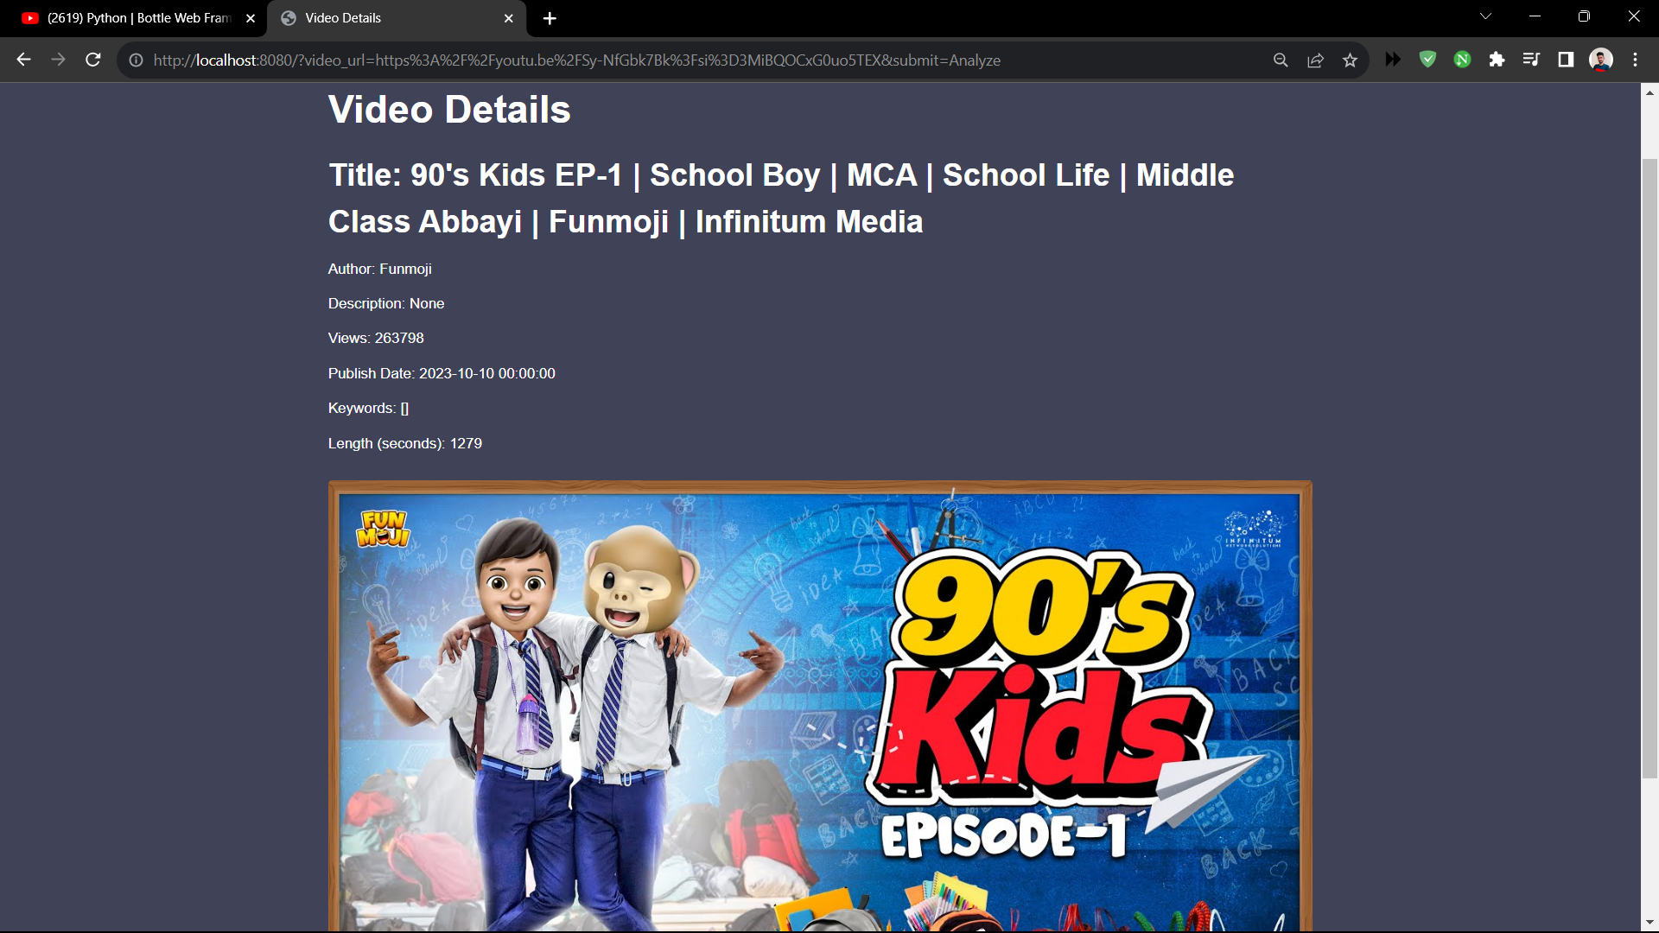
Result

Slide 15
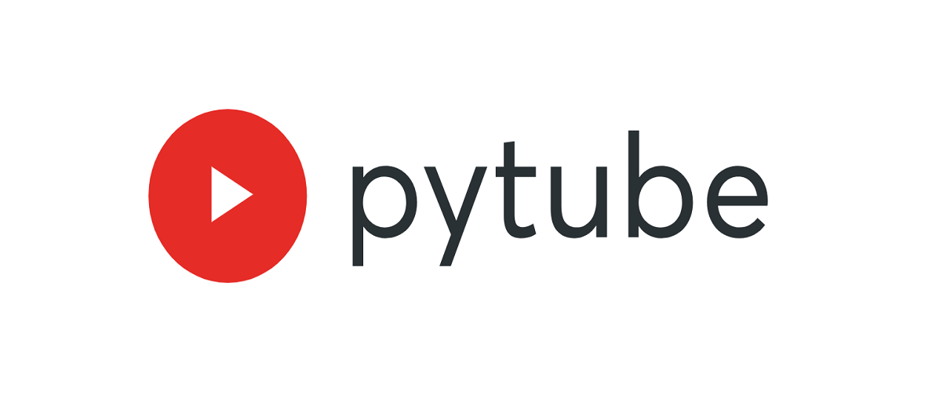
Conclusion:
The YouTube Video Analysis Web App streamlined XYZ Marketing Agency's video analysis, showcasing the power of Python, Bottle, and pytube for digital marketing solutions with room for future improvements.

Slide 16
Thank you
By –
21125A1212
21125A1213

