Slide 1

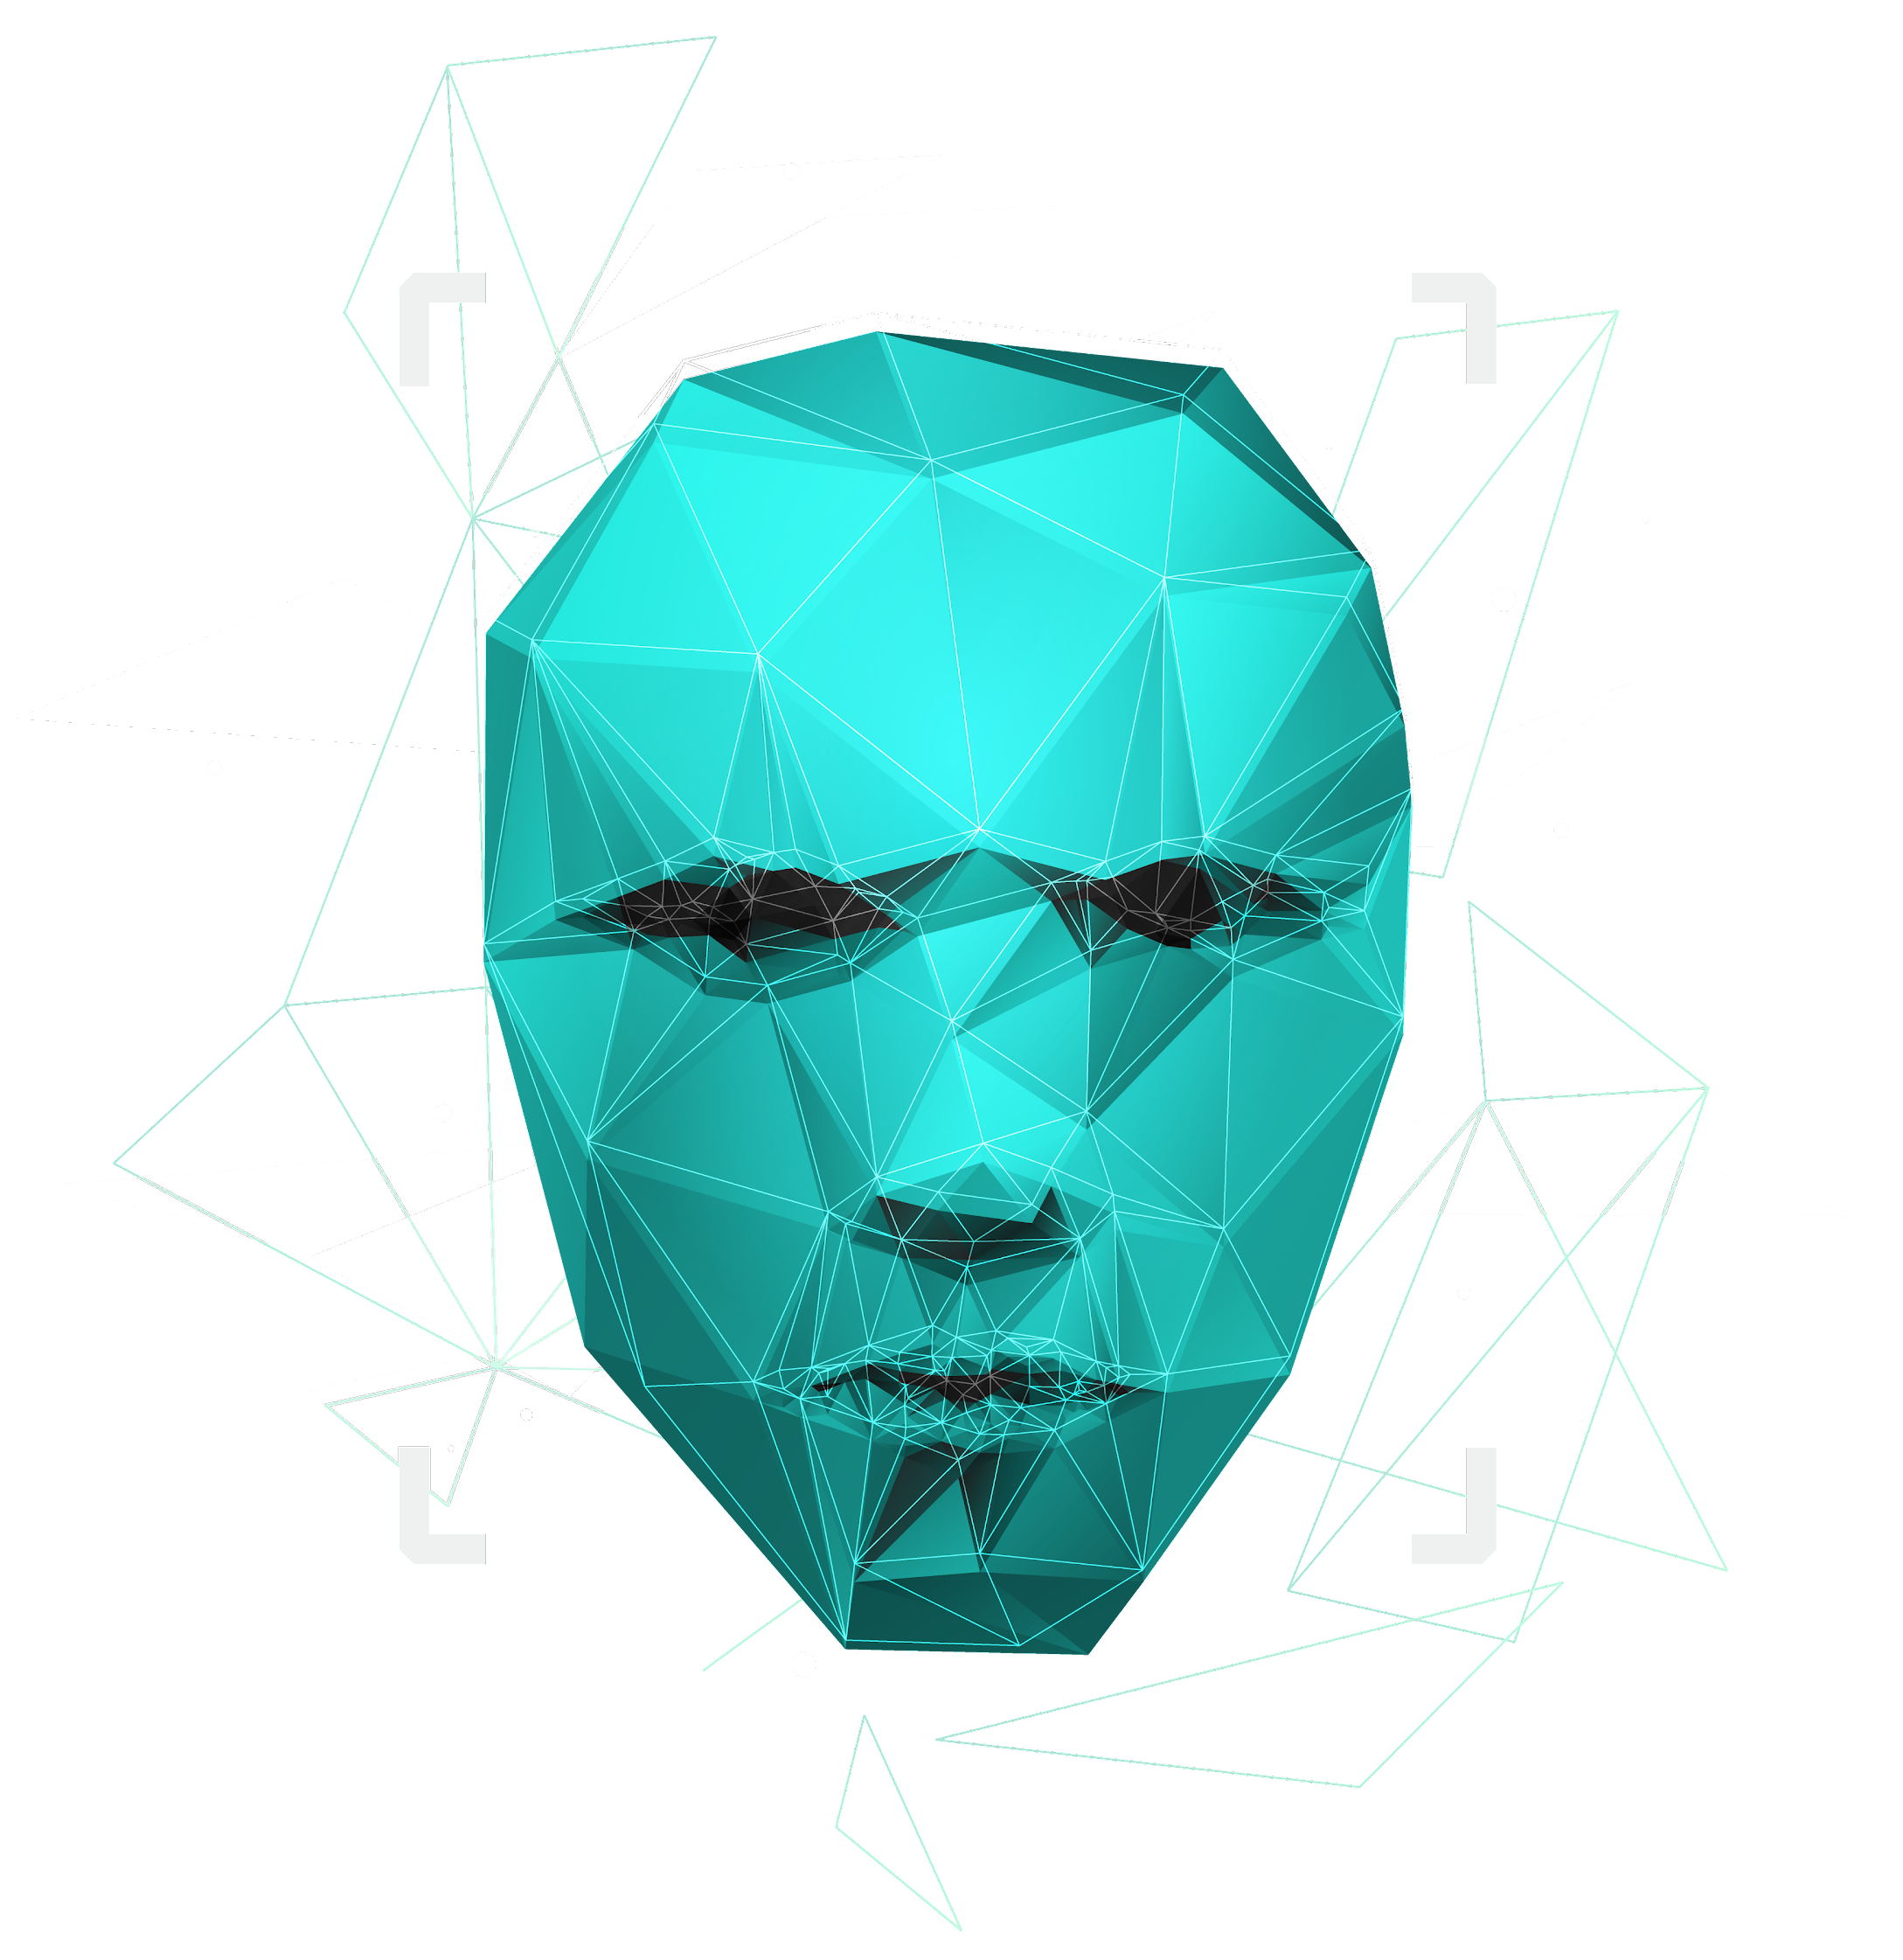
Review-2

Slide 2
Analysing methods of Neural Text Generation to refine conversations

Slide 3


TEAM MEMBERS
Mihir Antwal
Sam Methuselah
19BCE1641
19BCE1698

Slide 4

ABSTRACT
A good conversation requires balance between- Simplicity and detail, Staying on topic and changing it and Asking questions and answering them.
Although dialogue agents are commonly evaluated via human judgments of overall quality, the relationship between quality and these individual factors is less well-studied. So, we are going examine two controllable neural text generation methods-
Conditional training and
Weighted decoding
Notes:
A good conversation requires balance between-
Simplicity and detail;
Staying on topic and changing it;
Asking questions and answering them.
Although dialogue agents are commonly evaluated via human judgments of overall quality, the relationship between quality and these individual factors is less well-studied. So, we are going examine two controllable neural text generation methods
1. Conditional training and
2. Weighted decoding,
This will help us control the four important attributes of conversation: repetition, specificity, response-relatedness and question-asking. By controlling these parameters, our goal is to show how controlling
combinations of these variables can get clear improvements in human quality judgments.

Slide 5
Introduction
Notes:
Neural generation models for dialogue, despite their ubiquity in current research, are still poorly understood. Well known problems, such as the genericness and repetitiveness of responses (Serban et al., 2016a), remain without a de facto solution. Strikingly, the factors that determine human judgments of overall conversation quality are almost entirely unexplored. Most works have been limited to the next utterance prediction problem, whereas a multi-turn evaluation is necessary to evaluate the quality of a full conversation.

Slide 6
The Idea is to do both- (i) conduct a large-scale study to identify the fine-grained factors governing human judgments of full conversations, and (ii) develop models that apply the findings in practice
Notes:
The idea is to do both (i) conduct a large-scale study to identify the fine-grained factors governing human judgments of full conversations, and (ii) develop models that apply the findings in practice leading to state-of-the-art performance

Slide 7
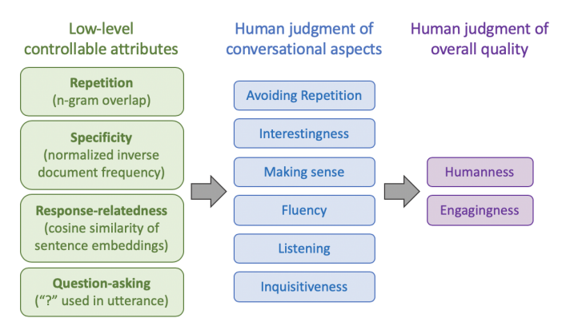
Notes:
For example, we can manipulate four low-level attributes and measure their effect on human judgments of individual conversational aspects, as well as the overall quality.. Specifically, the main focus is to identify and study eight aspects of conversation that can be measured by human judgments, while varying four types of low-level attributes namely Repetition, Specificity, Response-relatedness and Question-asking that can be algorithmically controlled in neural models

Slide 8
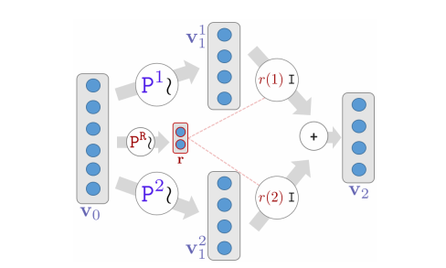
Notes:
Now, to control the lowlevel model attributes, we consider two simple but general algorithms: Conditional training, in which, as we know, the neural model is conditioned on additional control features,

Slide 9
Notes:
and the second algorithm Weighted Decoding, in which control features are added to the decoding scoring function at test time only.

Slide 10
Related Work

Slide 11

Dialogue evaluation is relatively well understood in goal-oriented tasks, where automated approaches can be coded by measuring task completion (Bordes et al., 2017; El Asri et al., 2017; Hastie, 2012; Henderson et al., 2014; Wen et al., 2017).
Researchers have proposed several approaches to control aspects of RNN-based natural language generation such as sentiment, length, speaker style and tense.
By contrast, our focus is on developing controls for, and human evaluation of, multi-turn interactive dialogue – this includes a new method to control attributes at the dialogue level rather than the utterance level.
So we require a control method that is both general-purpose (one technique to simultaneously control many attributes) and easily tunable (the control setting is adjustable after training).
Notes:
Dialogue evaluation is relatively well understood in goal-oriented tasks, where automated approaches can be coded by measuring task completion (Bordes et al., 2017; El Asri et al., 2017; Hastie, 2012; Henderson et al., 2014; Wen et al., 2017).
Researchers have proposed several approaches to control aspects of RNN-based natural language generation such as sentiment, length, speaker style and tense
In particular, several works use control to tackle the same common sequence-to-sequence problems we address here (particularly genericness and unrelated output), in the context of single-turn response generation By contrast, our focus is on developing controls for, and human evaluation of, multi-turn interactive dialogue – this includes a new method to control attributes at the dialogue level rather than the utterance level.
So we require a control method that is both general-purpose (one technique to simultaneously control many attributes) and easily tunable (the control setting is adjustable after training). Given these constraints, we study two control methods: conditional training (variants of which have been described by Fan et al. (2018); Kikuchi et al. (2016); Peng et al. (2018)) and weighted decoding (described by Ghazvininejad et al. (2017) as a general technique, and by Baheti et al. (2018) to control response-relatedness).

Slide 12
The PersonaChat dataset

Slide 13
PersonaChat is a chitchat dialogue task involving two participants (two humans or a human and a bot). Each participant is given a persona – a short collection of personal traits such as “I’m left handed” or “My favorite season is spring” – and are instructed to get to know each other by chatting naturally using their designated personas, for 6–8 turns.
Notes:
PersonaChat (Zhang et al., 2018b) is a chitchat dialogue task involving two participants (two humans or a human and a bot). Each participant is given a persona – a short collection of personal traits such as I’m left handed or My favorite season is spring – and are instructed to get to know eac The training set contains 8939 conversations and 955 personas, collected via crowdworkers, plus 1000 conversations and 100 personas for validation, and a similar number in the hidden test set. h other by chatting naturally using their designated personas, for 6–8 turns.

Slide 14
The Baseline model

Slide 15
The baseline model is a 2-layer LSTM sequence-to-sequence model with attention. On any dialogue turn, the input x to the encoder is the entire dialogue history (separated using unique speaker identifying tokens), with the model’s own persona prepended.
Notes:
Our baseline model is a 2-layer LSTM sequenceto-sequence model with attention. On any dialogue turn, the input x to the encoder is the entire dialogue history (separated using unique speakeridentifying tokens), with the model’s own persona prepended. Conditioned on this input sequence x, the decoder generates a response y.
The plan is to use the ParlAI framework and pretrain the model on a Twitter dataset then fine-tuned it on PersonaChat.

Slide 16
Controllable text generation
Notes:
Suppose we have a sequence-to-sequence model which gives the conditional probability of a response y (the model’s next utterance) given input x (the context, the persona and the dialogue history).
Contrary to most previous work, which controls at the sentence level, the proposed idea and wish is to control attributes of the output y at the dialogue level – meaning that a single control setting is used for a whole dialogue.
For example, to control questionasking, we provide a control setting at the beginning of each dialogue (e.g. 20% questions or 70% questions) rather than providing a control setting for each utterance (e.g. is a question or isn’t a question).
With this approach, the sequence-to sequence model is able to choose what value the controlled attribute should take for any particular utterance, but here we are able to choose the overall distribution. We find that this approach works well.
So let’s see the two methods – which we discussed earlier - Conditional Training (CT) and Weighted Decoding (WD) – the methods to control attributes of the output y at the dialogue level.

Slide 17
Conditional Training

Slide 18
Conditional Training is a method to learn a sequence-to-sequence model P(y|x, z), where z is a discrete control variable To train a CT model, we have to annotate every (x, y) pair in the training set with the attribute we wish to control. During training, for each example we determine the corresponding z value. Next, the control variable z is represented via an embedding. There are several possible ways to condition the sequence-to-sequence model on z – for example, append z to the end of the input sequence, or use z as the START symbol for the decoder. The most effective to concatenate z to the decoder’s input on every step.
Notes:
If the control attribute is naturally continuous (for example repetitiveness, specificity and response-relatedness), we can use z to represent bucketed ranges.
Now for a binary attribute like questionasking, z represents an overall probability
To train a CT model, we first automatically annotate every (x, y) pair in the training set with the attribute we wish to control (for example, whether y contains a question mark).
During training, for each example we determine the corresponding z value (for continuous attributes, this simply means sorting into the correct bucket and for question-asking, we train our CT model on a control variable z with 11 possible values: {0, . . . , 10}. Setting z = i means that the model should produce, on average, utterances containing ‘?’ with probability i/10. During training we should randomly assign examples to buckets such that each bucket i is trained on examples with the correct proportion of questions (i/10), and all buckets have the same amount of training examples). Next, the control variable z is represented via an embedding (each of the possible values of z has its own embedding).
There are several possible ways to condition the sequence-to-sequence model on z – for example, append z to the end of the input sequence, or use z as the START symbol for the decoder. The most effective to concatenate z to the decoder’s input on every step.

Slide 19
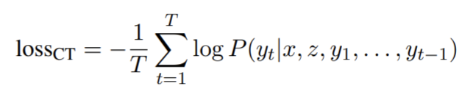
Lastly, the CT model learns to produce y = y1, . . . , yT by optimizing the cross-entropy loss:
Notes:
Lastly, the CT model learns to produce y = y1, . . . , yT by optimizing the cross-entropy loss:

Slide 20
Weighted Decoding

Slide 21
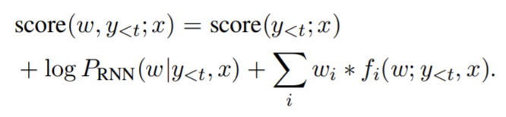
Weighted Decoding is a decoding method that increases or decreases the probability of words with certain features. The technique is applied only at test time, requiring no change to the training method. In weighted decoding, on the t^{th} step of decoding, a partial hypothesis y<t = y1, . . . , yt−1 is expanded by computing the score for each possible next word w in the vocabulary:
Notes:
Weighted Decoding (Ghazvininejad et al., 2017) is a decoding method that increases or decreases the probability of words with certain features. The technique is applied only at test time, requiring no change to the training method. A limitation of WD is that the controllable attribute must be defined at the word-level; any desired utterance-level attribute must be redefined via word-level features. In weighted decoding, on the tth step of decoding, a partial hypothesis is expanded by computing the score for each possible next word w in the vocabulary
Here, log PRNN(w|y<t,x) is the log-probability of the word w calculated by the RNN, score(y<t;x) is the accumulated score of the already-generated words in the hypothesis y<t and fi(w; y<t,x) are decoding features with associated weights wi . There can be multiple features fi (to control multiple attributes), and the weights wi are hyperparameters to be chosen
A decoding feature assigns a real value to the word w, in the context of the text generated so far y<t and the and the context x. The feature can be continuous (e.g. the unigram probability of w), discrete (e.g. the length of w in characters), or binary (e.g. whether w starts with the same letter as the last word in y<t).
A positive weight wi increases the probability of words w that score highly with respect to fi ; a negative weight decreases their probability.
The most important thing is that - The weighted decoding and conditional training can be applied simultaneously (i.e. train a CT model then apply WD at test time).

Slide 22
Thank You
Notes:
Coming to the end of the review, let me sum it up, The idea as proposed is to examine two controllable neural text generation methods, conditional training and weighted decoding, in order to control four important attributes for chitchat dialogue: repetition, specificity, response-relatedness and question-asking. Contrary to controlling at the sentence level, our plan is to control attributes of at the dialogue level. Then we went through the two methods namely- Conditional Training and Weighted Decoding. And how we can use them together ((i.e. training a CT model then apply WD at test time).
Soon enough we will be completing the remaining goals of this project which include how we are going to control the conversation attributes and the comparison of the control methods.

Slide 23
"It always seems impossible until it’s done." –Nelson Mandela

