Slide 1
REVIEW-3

Slide 2
Analysing methods of Neural Text Generation to refine conversations

Slide 3


Team Members
Mihir Antwal
Sam Methuselah
19BCE1641
19BCE1698

Slide 4
Natural Language Generation task spectrum
Machine Translation
Sentence Compression
Abstract Summarization
Story Generation
ChitChat Dialogue
Notes:
Makes errors like repetition and generic response (under certain decoding algorithms). Difficulty learning to make high-level decisions.

Slide 5
Natural Language Generation task spectrum
Machine Translation
Sentence Compression
Abstract Summarization
Story Generation
ChitChat Dialogue
Less open-ended
More open-ended
Notes:
Makes errors like repetition and generic response (under certain decoding algorithms). Difficulty learning to make high-level decisions.

Slide 6
Natural Language Generation task spectrum
Machine Translation
Sentence Compression
Abstract Summarization
Story Generation
ChitChat Dialogue
Less open-ended
Mostly world-level decisions
More open-ended
Requires high-level decisions
Notes:
Makes errors like repetition and generic response (under certain decoding algorithms). Difficulty learning to make high-level decisions.

Slide 7
Natural Language Generation task spectrum
Machine Translation
Sentence Compression
Abstract Summarization
Story Generation
ChitChat Dialogue
Less open-ended
Moslty world-level decisions
Neural LMs more successful
More open-ended
Requires high-level decisions
Neural LMs less successful
Notes:
Makes errors like repetition and generic response (under certain decoding algorithms). Difficulty learning to make high-level decisions.

Slide 8
Natural Language Generation task spectrum
Machine Translation
Sentence Compression
Abstract Summarization
Story Generation
ChitChat Dialogue
Less open-ended
Mostly world-level decisions
Neural LMs more successful
Control is less important
More open-ended
Requires high-level decisions
Neural LMs less successful
Control is more important
Notes:
Control = ability to specify desired attributes of the text at test time. We can use control to fix errors, and allow us to handle some high-level decisions.

Slide 9
Natural Language Generation task spectrum
Machine Translation
Sentence Compression
Abstract Summarization
Story Generation
ChitChat Dialogue
Less open-ended
Mostly world-level decisions
Neural LMs more successful
Control is less important
Eval is difficult
More open-ended
Requires high-level decisions
Neural LMs less successful
Control is more important
Eval is fiendish
Notes:
No automatic metric for overall quality. Dialogue is even more complex: Single-turn or multi-turn eval? Interactive or static conversation?

Slide 10
Questions
By controlling multiple attributes of generated text and human-evaluating multiple aspects of conversational quality, we aim to answer the following:
How effectively can we control the different attributes?
How do the controllable attributes affect conversational quality aspects?
Can we use control to make a better chatbot overall?
Notes:
Pretty well! But some control methods only work for some attributes.
Strongly – especially controlling repetition, question-asking, and specificity vs genericness.
Yes! But we should be careful defining "better overall".

Slide 11
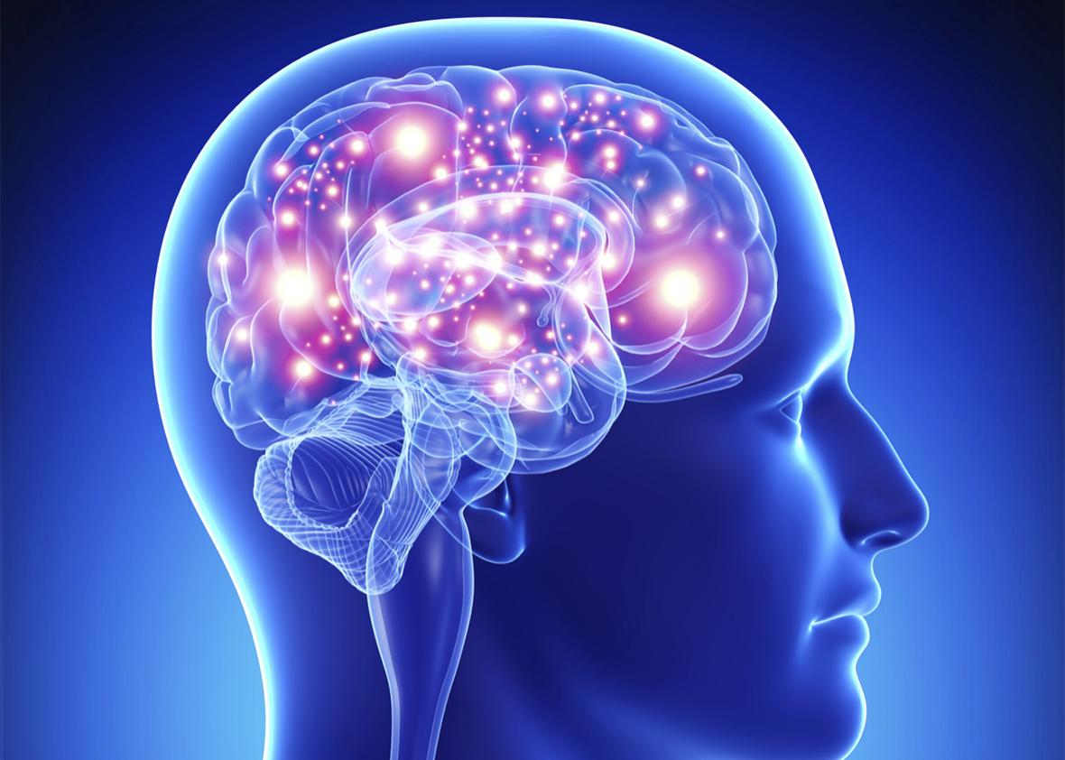

PersonaChat task
Persona:
Persona:
● I love to drink fancy tea.
● I have a big library at home.
● I'm a museum tour guide.
● I'm partly deaf.
● I have two dogs.
● I like to work on vintage cars.
● My favorite music is country.
● I own two vintage Mustangs.
Hello, how are you doing?
Great thanks, just listening to my favorite Johnny Cash album!
Nice! I'm not much of a music fan myself, but I do love to read.
Me too! I just read a book about the history of the auto industry.

Slide 12
PersonaChat task
The PersonaChat task was the focus of the NeurIPS 2018 ConvAI2 Competition.
Most successful teams built neural sequence generation systems. (Dinan et al 2019)
The winning team, Lost in Conversation, used a finetuned version of GPT.
Our baseline model is a standard LSTM-based seq2seq architecture with attention.
It is pretrained on 2.5 million Twitter message/response pairs, then finetuned on PersonaChat.
Notes:
Pretty well! But some control methods only work for some attributes.
Strongly – especially controlling repetition, question-asking, and specificity vs genericness.
Yes! But we should be careful defining "better overall".

Slide 13
Attributes we can control
Low-level controllable attributes
Repetition
(n-gram overlap)
Goal: Reduce repetition (within and across utterances)
Goal: Reduce genericness of responses (e.g. oh that's cool)
Goal: Respond more on-topic; don't ignore user
Goal: Find the optimal rate of question-asking
Specificity
(normalized inverse document frequency)
Response-relatedness
(cosine similarities of sentence embeddings)
Question-asking
(‘?’ used in utterance)
Notes:
Pretty well! But some control methods only work for some attributes.
Strongly – especially controlling repetition, question-asking, and specificity vs genericness.
Yes! But we should be careful defining "better overall".

Slide 14
Quality Aspects
Low-level controllable attributes
Human judgement of conversational aspects
Avoiding Repetition
Repetition
(n-gram overlap)
Interestingness
Specificity
(normalized inverse document frequency)
Making sense
Response-relatedness
(cosine similarities of sentence embeddings)
Fluency
Listening
Question-asking
(‘?’ used in utterance)
Inquisitiveness
Notes:
Pretty well! But some control methods only work for some attributes.
Strongly – especially controlling repetition, question-asking, and specificity vs genericness.
Yes! But we should be careful defining "better overall".

Slide 15
Quality Aspects
Low-level controllable attributes
Human judgement of conversational aspects
Avoiding Repetition
Does the bot repeat itself?
Did you find the bot interesting to talk to?
Does the bot say things that don't make sense?
Does the bot use English naturally?
Does the bot pay attention to what you say?
Does the bot ask a good amount of questions?
Repetition
(n-gram overlap)
Interestingness
Specificity
(normalized inverse document frequency)
Making sense
Response-relatedness
(cosine similarities of sentence embeddings)
Fluency
Listening
Question-asking
(‘?’ used in utterance)
Inquisitiveness
Notes:
Pretty well! But some control methods only work for some attributes.
Strongly – especially controlling repetition, question-asking, and specificity vs genericness.
Yes! But we should be careful defining "better overall".

Slide 16
Quality Aspects
Low-level controllable attributes
Human judgement of conversational aspects
Avoiding Repetition
Repetition
(n-gram overlap)
Human judgement of overall quality
Interestingness
Specificity
(normalized inverse document frequency)
Is it a person or bot?
Is it enjoyable to talk to?
Making sense
Humanness
Response-relatedness
(cosine similarities of sentence embeddings)
Engagingness
Fluency
Listening
Question-asking
(‘?’ used in utterance)
Inquisitiveness
Notes:
Note: ConvAI2 competition asked only this question. Our eval is a superset of ConvAI2's.

Slide 17
Control methods
We evaluate and compare two existing general-purpose control methods, using them to control all four controllable attributes.
Conditional Training (CT): Train the model to generate response y, conditioned on the input x, and the desired output attribute z. (Kikuchi et al 2016, Peng et al 2018, Fan et al 2018)
Weighted Decoding (WD): During decoding, increase/decrease the probability of generating words w in proportion to features f(w). (Ghazvininejad et al 2017, Baheti et al 2018)

Slide 18
Q1: How effectively can we control attributes? Attributes: repetition, specificity, question-asking, response-relatedness
Conditional Training (CT):
Weighted Decoding (WD):
Requires sufficient training examples for the attribute (repetition).
Ineffective at learning complex relationships between input and output ( response-relatedness)
Effective for: ✓ specificity, ✓ question-asking
Requires attribute to be defined at the word-level (question-asking)
Effective for: ✓ repetition, ✓ response-relatedness, ✓ specificity

Slide 19
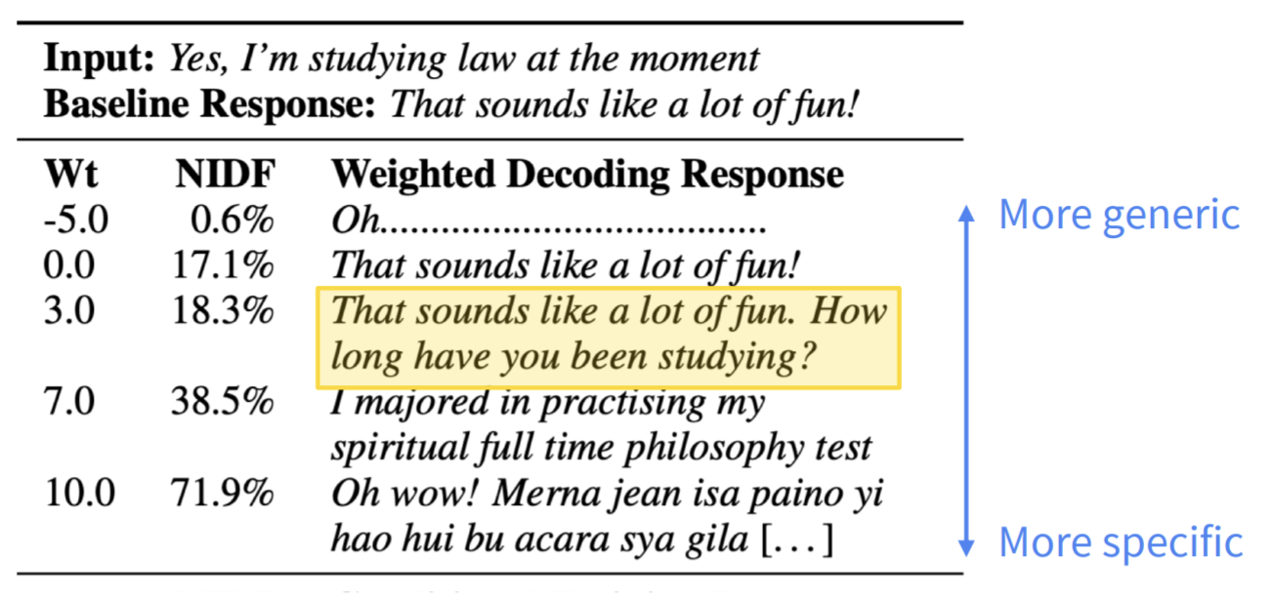
Controlling specificity (WD and CT)

Slide 20
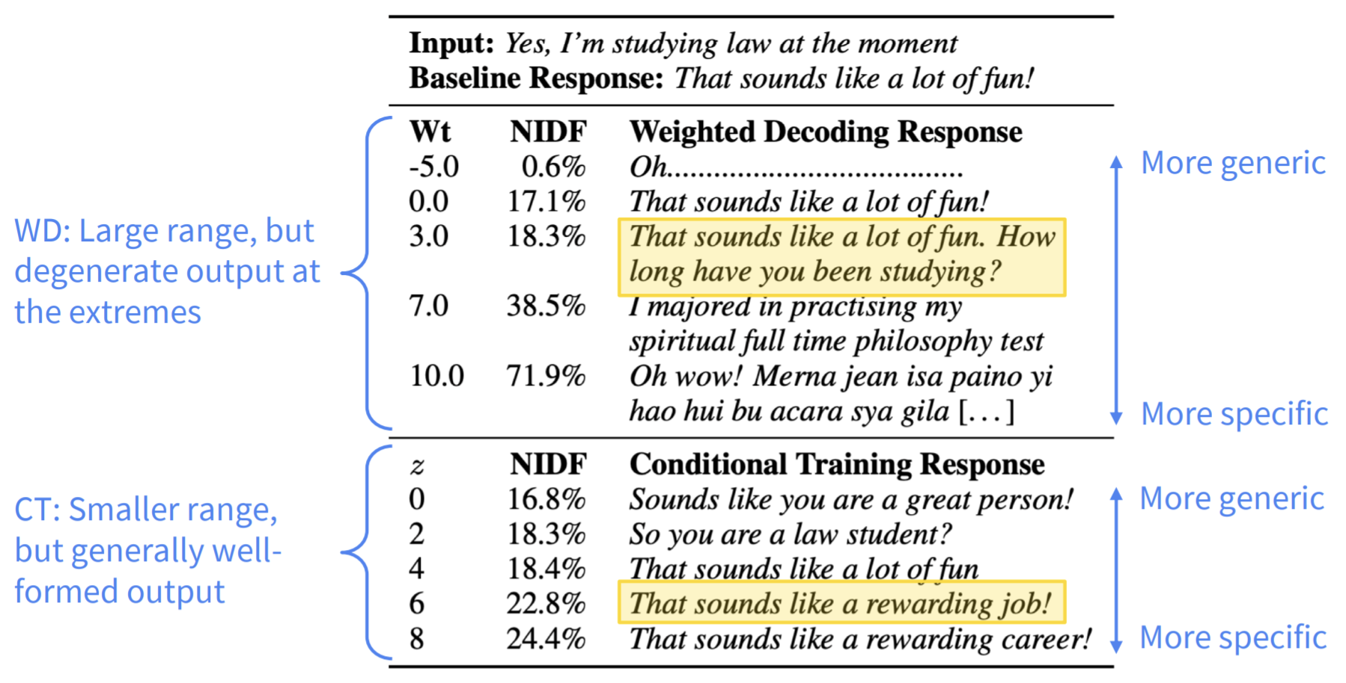

Slide 21
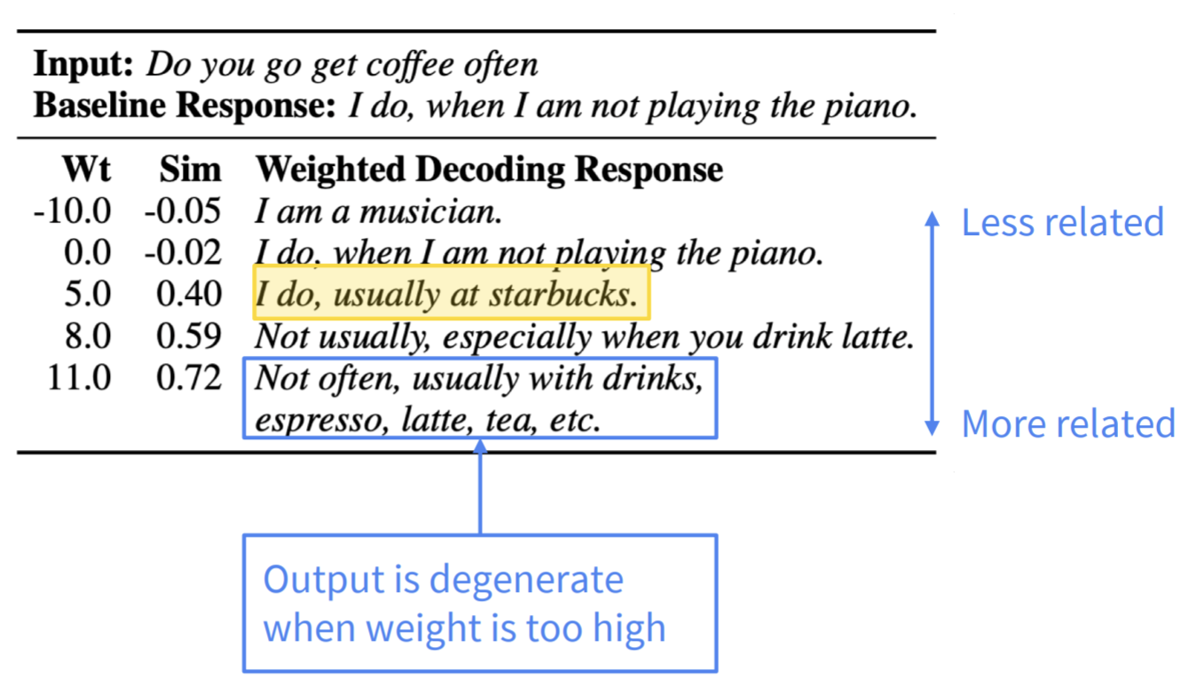
Controlling response-relatedness (WD)

Slide 22
Q2: How does control affect human eval?
Low-level controllable attributes
Human judgement of conversational aspects
Reduce n-gram repetition to human level
Repetition
(n-gram overlap)
Avoiding Repetition
Human judgement of overall quality
Interestingness
Specificity
(normalized inverse document frequency)
Making sense
Humanness
Response-relatedness
(cosine similarities of sentence embeddings)
Engagingness
Fluency
Listening
Question-asking
(‘?’ used in utterance)
Inquisitiveness

Slide 23
Low-level controllable attributes
Human judgement of conversational aspects
Avoiding Repetition
Repetition
(n-gram overlap)
Human judgement of overall quality
Interestingness
Increase specificity
(reduce genericness)
to human level
Specificity
(normalized inverse document frequency)
Making sense
Humanness
Response-relatedness
(cosine similarities of sentence embeddings)
Engagingness
Fluency
Listening
Question-asking
(‘?’ used in utterance)
Inquisitiveness

Slide 24
Low-level controllable attributes
Human judgement of conversational aspects
Avoiding Repetition
Repetition
(n-gram overlap)
Human judgement of overall quality
Interestingness
Specificity
(normalized inverse document frequency)
Making sense
Humanness
Increase response-relatedness (similarity
to last utterance)
Response-relatedness
(cosine similarities of sentence embeddings)
Fluency
Engagingness
Listening
Question-asking
(‘?’ used in utterance)
Inquisitiveness

Slide 25
Low-level controllable attributes
Human judgement of conversational aspects
Avoiding Repetition
Repetition
(n-gram overlap)
Human judgement of overall quality
Interestingness
Specificity
(normalized inverse document frequency)
Making sense
Humanness
Response-relatedness
(cosine similarities of sentence embeddings)
Engagingness
Fluency
Listening
Increase question-rate asking to 65.7% (more than baseline 50%, human 28.8%)
Question-asking
(‘?’ used in utterance)
Inquisitiveness

Slide 26
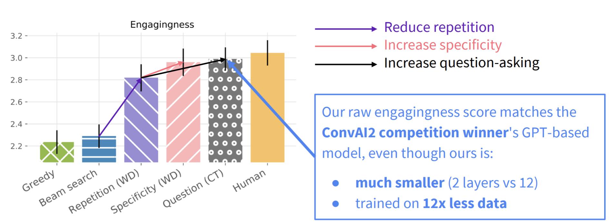
Q3: Can we make a better chatbot overall?
Yes! By controlling repetition, specificity and question-asking, we can achieve near-human engagingness (i.e. enjoyability) ratings.

Slide 27
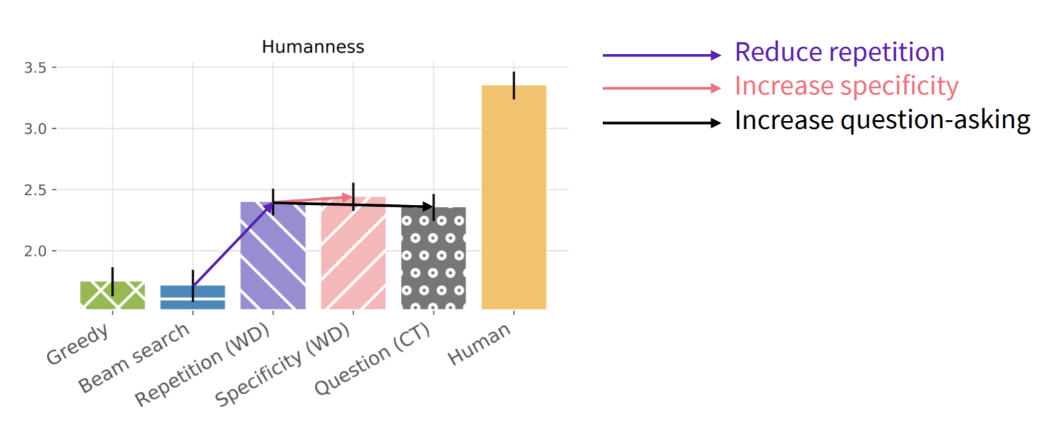
However: On the humanness (i.e. Turing test) metric, the models are nowhere near human-level!

Slide 28
Engagingness vs Humanness

Slide 29
Finding: The bots are (almost) as engaging as humans, but they're clearly non-human.
Two conclusions:
Engagingness ≠ Humanness. While both are frequently used as standalone overall quality metrics, our results show the importance of measuring more than one.
On this task, the human “engagingness” performance may be artificially low. Turkers chatting for money are less engaging than people chatting for fun. This may be why the human-level engagingness scores are easy to match.

Slide 30
Conclusions
Control is a good idea for our neural sequence generation dialogue system.
Using simple control, we matched performance of GPT-based contest winner.
Don't repeat yourself. Don't be boring. Ask more questions.
Multi-turn phenomena (repetition, question-asking frequency) are important – so need multi-turn eval to detect them.
Engagingness ≠ Humanness, so think carefully about which to use.
Paid Turkers are not engaging conversationalists, or good judges of engaging conversation. Humans chatting for fun may be better.
Problem: Manually finding the best combination of control settings is painful.

Slide 31
Thank You

