Slide 1
FOREST FIRE DETECTION

Slide 2
Team Members
Mihir Antwal
Sam Methuselah
19BCE1641
19BCE1698
IoT-
Selecting appropriate
Sensors. Connection
with NodeMCU/ESP32-
Hardware
Coding and Implementaion
Machine Learning-
Generation of dataset. Exploring and implementing prediction algorithms
Coding and Implementation

Slide 3
Abstract
Forest is considered as one of the most important and indispensable resource. However, forest fire, affected by some human uncontrolled behavior in social activities and abnormal natural factors, occurs occasionally. This project's motive is to predict the occurrence of forest fire by continuous monitoring of factors that are responsible for forest fire like temperature, smoke and flame in forests. We use latest technologies like IoT for collecting data frequently through the sensors. All these nodes containing sensors are deployed at various locations of the forest publish the data to an MQTT broker. Further the nodes can be classified as no forest fire, mild, moderate and severe based on the threshold values and fuzzy logic is applied on this data to predict the chance of occurrence of forest fire and is expressed in percentage. The client devices subscribe to MQTT broker and obtain the sensor data and result of prediction. This will help the authorities to take necessary measures to prevent it and to avoid the loss of human life.
Notes:
Forest fires are common hazards in forests that cause a lot of harm to Wildlife as well as the Environment. It could be avoided if a robust system could be deployed in forest areas to detect the fire and alert to Fire extinguishing authority to take immediate action. In this project, the intention is to build a Forest fire detection system using IoT which would detect the fire and send an emergency alert to Authority through IoT. Here a GSM/GPRS module is used to communicate with IoT sever as usually in forest areas network bandwidth is very low or not available. Hence a 2G network is preferable to communicate with the server.

Slide 4
Problem Statement
Forest fire is also called as wild fire or wildland fire is an uncontrolled fire occurring in forest areas. A Large destructive fire that spread over a forest or area of woodland which leads to damage in Wildlife, humans, property and Environment. It is essential to distinguish these sorts of flames as ahead of schedule as conceivable in order to keep the harm away from the biological framework. To combat forest fires effectively their early detection and continuous tracking is vital. This project presents one of the methods for early wild fire identification using the datasets available and the current data to predict and prevent its spread. Objective is to classify the occurrence of forest fire based on the intensity and use fuzzy logic to express the chance of occurrence of forest fire in percentage.

Slide 5
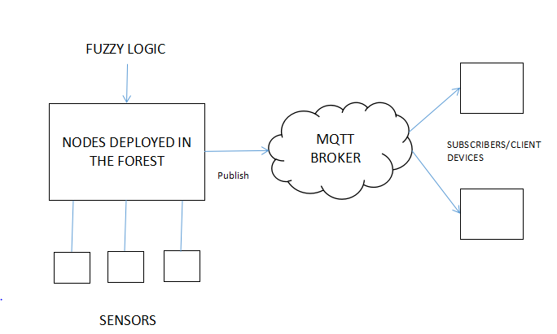
Architecture Diagram

Slide 6
SENSORS
Node MCU
MQTT broker
WIFI
NODE MCU
SENSORS

Slide 7
Modules
IoT- Get data from all the sensors and send it for evaluation
Machine Learning- Check whether the input data gives us the proper probability of a Forest Fire beforehand
API- HiveMQTT or ThingSpeak
Notes:
Arduino Nano
SIM800L GPS/GPRS Module
3.7V Li-ion Battery
Flame sensor
Dot matrix Perf board

Slide 8
Implementation
Getting the code ready for the required input data and processing
Connecting the sensors and reading data
Prediction of occurrence of forest fire using fuzzy logic
Publishing data to MQTT broker
Displaying the output

Slide 9
References
A. Chauhan, S. Semwal and R. Chawhan, "Artificial neural network-basedforest fire detection system using wireless sensor network," 2013 Annual IEEEIndia Conference (INDICON), Mumbai, 2013, pp. 1-6. doi: 10.1109/INDCON.2013.6725913
Anupam Mittal, Geetika Sharma, Ruchi Aggarwal, “Forest Fire DetectionThrough Various Machine Learning Techniques using Mobile Agent inWSN”International Research Journal of Engineering and Technology(IRJET)Volume: 03, Issue: 06, June-2016
Dutta M., Bhowmik S., Giri C. (2014) Fuzzy Logic Based Implementation for Forest Fire Detection Using Wireless Sensor Network. In:Kumar Kundu M., Mohapatra D., Konar A., Chakraborty A. (eds) AdvancedComputing, Networking and Informatics- Volume 1. Smart Innovation, Systems and Technologies, vol 27. Springer, Cham

Slide 10
Thank you!

