Slide 1
FOREST FIRE DETECTION

Slide 2
Team Members
Mihir Antwal
Sam Methuselah
19BCE1641
19BCE1698

Slide 3
Problem Statement
Forest fire is also called as wild fire or wildland fire is an uncontrolled fire occurring in forest areas It is essential to distinguish these sorts of flames as ahead of schedule as conceivable in order to keep the harm from it to biological framework. Consistently a large number of sections of land of timberland are burned to the ground. The land were woods is singed it winds up plainly difficult to develop vegetation over yonder. This is on account of soil moves toward becoming water repellent and acknowledges no more water, prompting lessening in ground water level. Common causes of wild fire are lightning, extreme hot and arid weather and human carelessness. This project presents one of the methods for early wild fire identification.
Notes:
Forest fire is also called as wild fire or wildland fire is an uncontrolled fire occurring in forest areas It is essential to distinguish these sorts of flames as ahead of schedule as conceivable in order to keep the harm from it to biological framework. Consistently a large number of sections of land of timberland are burned to the ground. The land were woods is singed it winds up plainly difficult to develop vegetation over yonder. This is on account of soil moves toward becoming water repellent and acknowledges no more water, prompting lessening in ground water level. The Global Warming Report 2008 says rapidly spreading fire as one of the real reason behind increment in an Earth-wide temperature boost. In late year 2016 more than 4000 hectares of timberland were singed in the slopes of Uttarakhand. Common causes of wild fire are lightning, extreme hot and arid weather and human carelessness. This project presents one of the methods for early wild fire identification.

Slide 4
Abstract
Forest fires are common hazards in forests that cause a lot of harm to Wildlife as well as the Environment. It could be avoided if a robust system could be deployed in forest areas to detect the fire and alert to Fire extinguishing authority to take immediate action. In this project, the intention is to build a Forest fire detection system using IoT which would detect the fire and send an emergency alert to Authority through IoT. Here a GSM/GPRS module is used to communicate with IoT sever as usually in forest areas network bandwidth is very low or not available. Hence a 2G network is preferable to communicate with the server.
Notes:
Forest fires are common hazards in forests that cause a lot of harm to Wildlife as well as the Environment. It could be avoided if a robust system could be deployed in forest areas to detect the fire and alert to Fire extinguishing authority to take immediate action. In this project, the intention is to build a Forest fire detection system using IoT which would detect the fire and send an emergency alert to Authority through IoT. Here a GSM/GPRS module is used to communicate with IoT sever as usually in forest areas network bandwidth is very low or not available. Hence a 2G network is preferable to communicate with the server.

Slide 5
Objective
The aim of this project is-
To predict the occurrences of forest fire.
To collect the physical environmental parameters of the forest through sensors using IoT.
To classify the occurrence of forest fire based on the intensity and use fuzzy logic to express the chance of occurrence of forest fire in percentage.

Slide 6
Existing system
The current satellite-imagery-based forest fire detection systems cannot detect forest fires with high precision and accuracy.
In order to prevent forest fire efficiently, we need a highly intelligent system to predict the forest fire at a higher speed and accuracy automatically.
Notes:
Forest fires are common hazards in forests that cause a lot of harm to Wildlife as well as the Environment. It could be avoided if a robust system could be deployed in forest areas to detect the fire and alert to Fire extinguishing authority to take immediate action. In this project, the intention is to build a Forest fire detection system using IoT which would detect the fire and send an emergency alert to Authority through IoT. Here a GSM/GPRS module is used to communicate with IoT sever as usually in forest areas network bandwidth is very low or not available. Hence a 2G network is preferable to communicate with the server.

Slide 7
Proposed system
To predict the forest fire based on the sensor values.
To classify it based on the values of different parameters such as temperature, smoke, flame as mild, moderate, severe or No Forest Fire.
An application is designed to display the sensor readings and the result of the classification.
The proposed system will also use fuzzy logic rules to express the chance of occurrence of the forest fire in percentage in the near future.

Slide 8
Requirements
Hardware:
NODE MCU (Microcontroller)
DHT (temperature and humidity sensor)
Smoke sensor MQ2
Flame sensor
Buzzer (Active)
Software:
Arduino IDE
ThingSpeak
PushSafer App
IFTTT

Slide 9
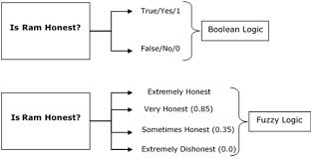
Fuzzy logic
In Boolean system truth value, 1.0 represents absolute truth value and 0.0 represents absolute false value.
But in the fuzzy system, there is no logic for absolute truth and absolute false value. But in fuzzy logic, there is intermediate value too present which is partially true and partially false.

Slide 10
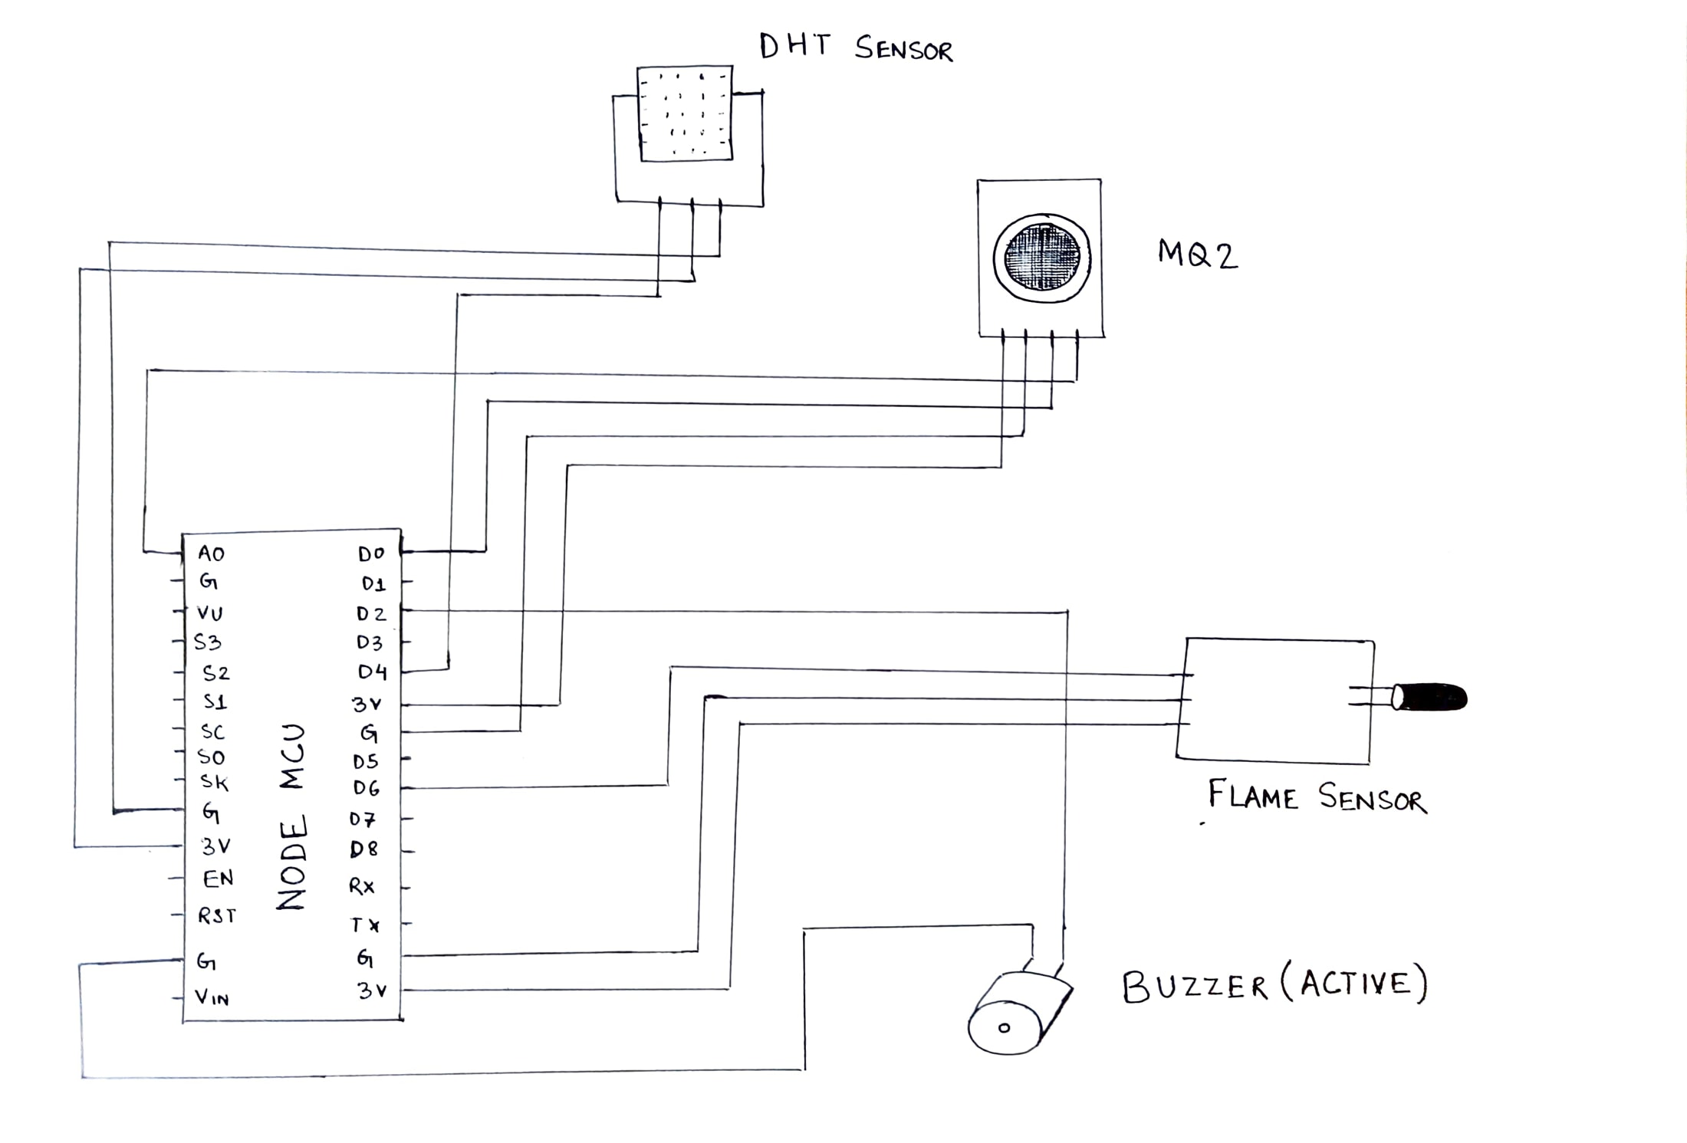
Circuit Diagram

Slide 11


Implementation

Slide 12

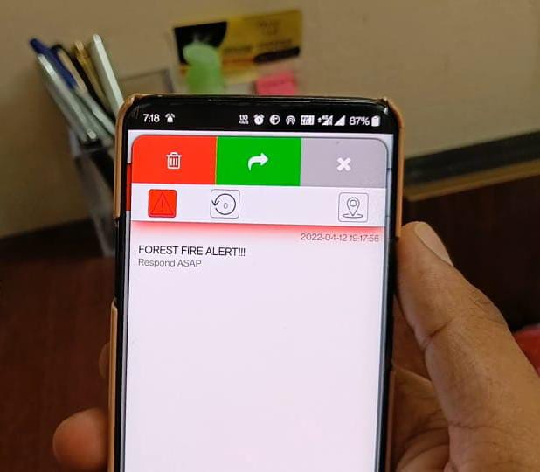

Slide 13
References
[1] A. Chauhan, S. Semwal and R. Chawhan, "Artificial neural network-based forest fire detection system using wireless sensor network," 2013 Annual IEEE India Conference (INDICON), Mumbai, 2013, pp.16,doi:10.1109/ INDCON.2013.6725913
[2] Anupam Mittal, Geetika Sharma, Ruchi Aggarwal, “Forest Fire Detection Through Various Machine Learning Techniques using Mobile Agent in WSN” International Research Journal of Engineering and Technology (IRJET) Volume: 03, Issue: 06, June-2016
[3] Dutta M., Bhowmik S., Giri C. (2014) Fuzzy Logic Based Implementation for Forest Fire Detection Using Wireless Sensor Network. In:Kumar Kundu M., Mohapatra D., Konar A., Chakraborty A. (eds) Advanced Computing, Networking and Informatics- Volume 1. Smart Innovation,Systems and Technologies, vol 27. Springer, Cham
[4] D.Vignesh Kirubaharan, A.John Clement Sunder, S.M.Ramesh, P.Dhinakar,“Forest Fire Prediction and Alert System Using Wireless SensorNetwork”International Journal of Advanced Research in Electronics andCommunication Engineering (IJARECE) Volume 3, Issue 11, November 2014

Slide 14
References
[5] G. Demin, L. Haifeng, J. Anna and W. Guoxin, "A forest fire prediction system based on rechargeable wireless sensor networks," 2014 4th IEEE International Conference on Network Infrastructure and Digital Content,Beijing, 2014, pp. 405-408.
[6] Liyang Yu, Neng Wang and Xiaoqiao Meng, "Real-time forest fire detection with wireless sensor networks," Proceedings. 2005 International Conference on Wireless Communications, Networking and Mobile Computing, 2005., Wuhan,China, 2005, pp. 1214-1217
[7] Sukumar.K, Joevivek.V, Hemalatha.T, Soman.K.P, “Prediction of forest fire using SVM – a novel approach”10th ESRI India User Conference 2009
[8] V. G. Gasull, D. F. Larios, J. Barbancho, C. León and M. S. Obaidat,"Computational intelligence applied to wildfire prediction using wireless sensor networks," Proceedings of the International Conference on, Seville, Spain, 2011, pp. 1-8.

Slide 15
Thank you!

