Slide 1


How to Use this Presentation
Present with ease and wow your audience
Customize with text and photos.
Add elements from the library or upload from your drive.
Apply page animations and transitions to emphasize ideas.
Use point forms and short sentences instate of long paragraphs
Use the PLP pitch deck guide and follow the protocol on slides
Lastly “PLEASE DELETE THIS SLIDE WHEN YOU ARE DONE!”
02

Slide 2


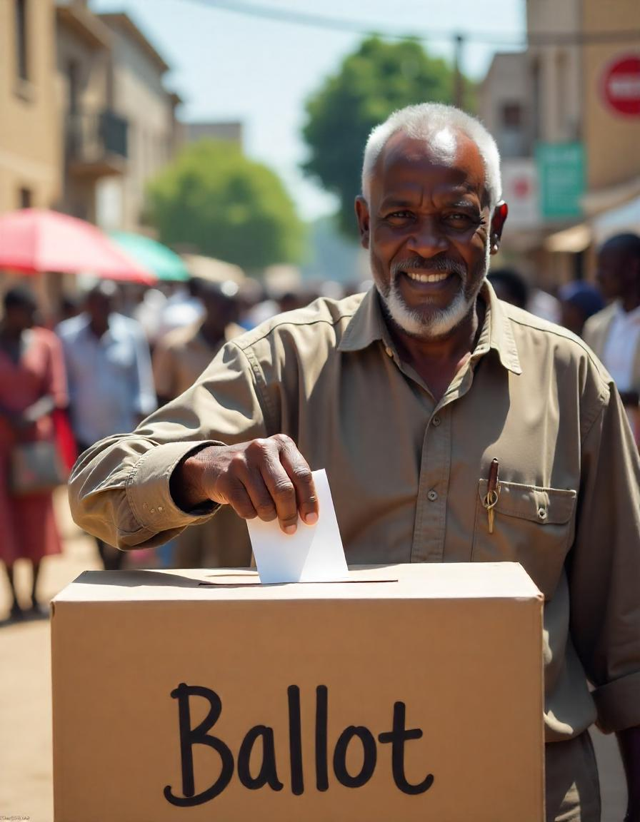
BlockChain based Voting system
01

Slide 3
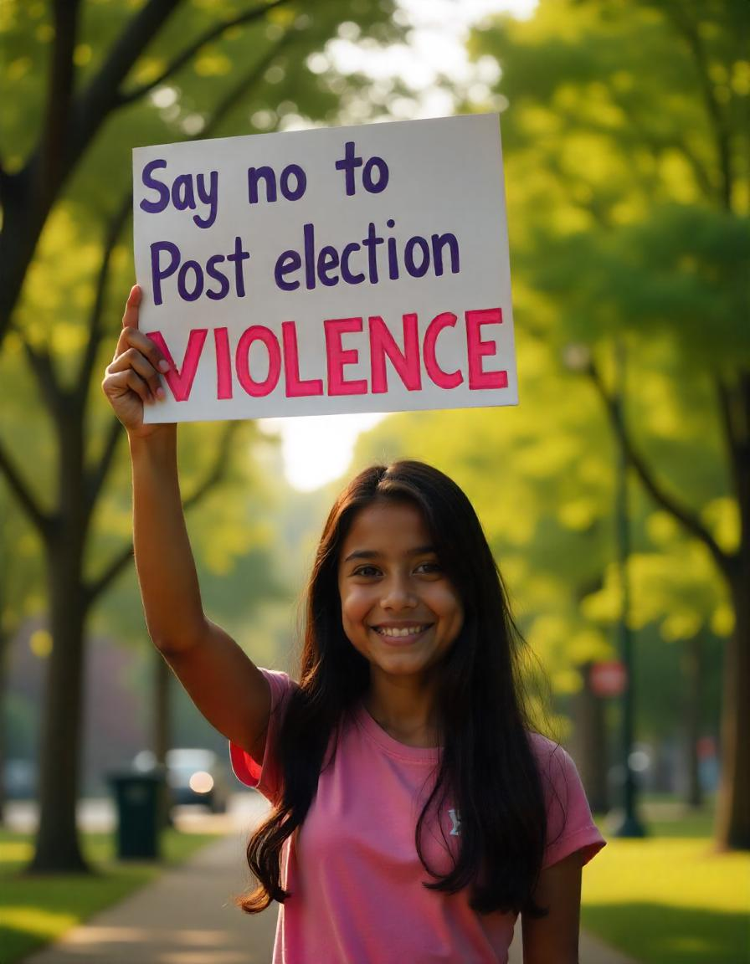

Election Irregularities, Wastage and Errors
Did you know that over 600,000 people were displaced after an election outcome in Kenya during the 2007 – 2008 general elections
Kenya has faced multiple pre and post election problems that I promise to address
Lack of trust from the public and the possibility of Rigging elections which may lead to violence
High budget allocation on resources, and time wastage on counting and queueing
Need for Voter registration for people who have a national ID already
Errors such as lack of voting materials for several regions in Kenya like it happened in 2022
10

Slide 4
Proposed Solution to Election based problems
Tamper proof system to handle registration, election casting, vote counting and tallying to prevent results doctoring
Eliminating need for middle men that bring possibility of corruption, human errors and lack of trust
The system should be able to handle multiple concurrent voting sessions hence eliminates need for queueing the whole day
Privacy of voters will be enhanced as no one will figure out which voter voted for which candidate
Transparency of tallying as Kenyans can access the tally in real time while voting continues
"The best way to predict the future is to create it." - Peter Drucker
06

Slide 5
E-Kura
Transparent and real time tallying of votes
Secure voting process
No middlemen just, smart contracts
Vote from the comfort of your home
Privacy is top notch
User-friendly interface any Device
No chance for spoilt vote or double-voting
This is not just a technology upgrade—it's a step toward restoring faith in Kenya's democracy
04

Slide 6
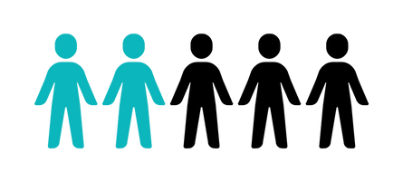


Target Market in Kenya
1 out 5
Kenyans have faith and trust in the current IEBC system
85%
Believe in the need to digitize the IEBC system
20 million +
Have smartphones and can access the internet
14

Slide 7
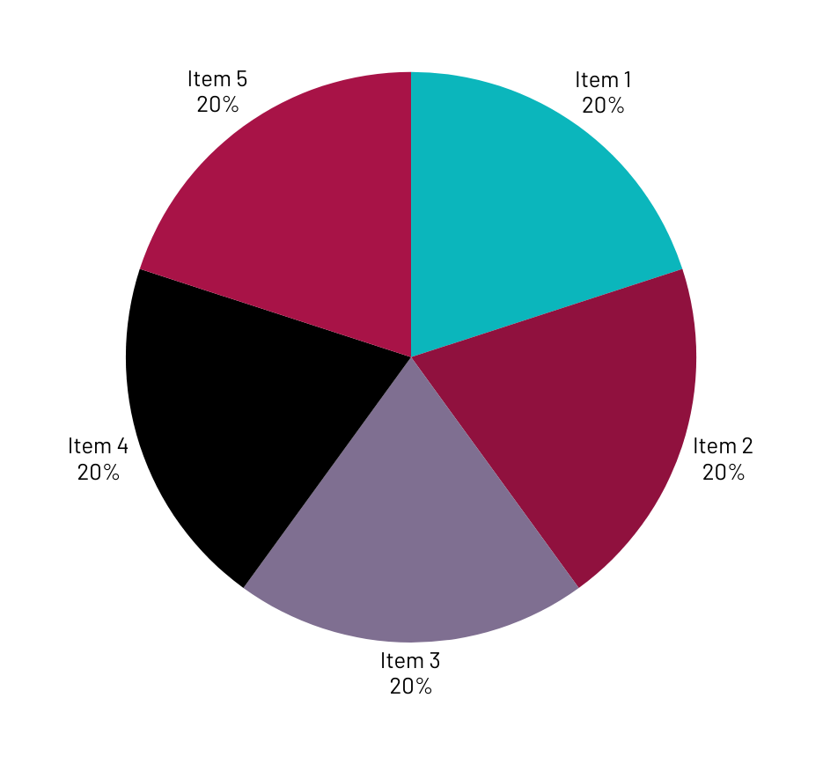
Market Size
Our blockchain based system is relevant in many organizations that require electoral justice and confidence

Slide 8
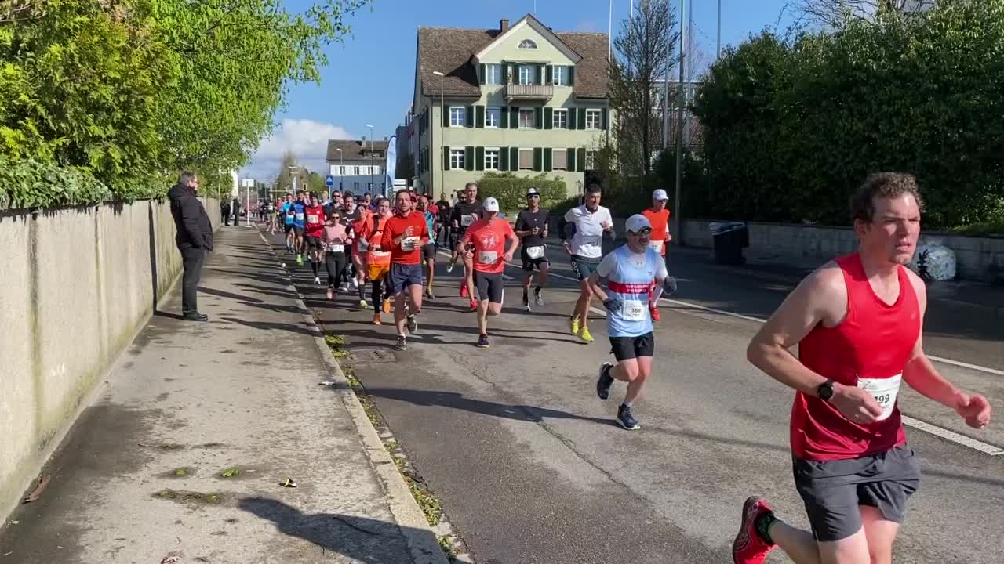
Competitors
We have the current IEBC system that requires manual counting and Data entry , tallying etc.
We have other online voting systems that have automated the processes but are highly vulnerable as they use the normal databases to store records
23

Slide 9

Competitive Advantage
What makes us unique?
Tamper proof records
Automated tallying
Transparency by live streaming the votes
Voter privacy Available on all platforms
No double voting or spoilt votes due to ignorance
Accessibility – Available in Swahili

Slide 10
Project Traction
Tasks
Month 1
Month 2
Month 3
Month 4
Month 5
Gathering requirements
Analysis
Design
Development
Testing
Prototyping
Implementation
Maintenance
23

Slide 11

Business Model
How are we making money?
We shall be charging ksh. 1000 to the state for each vote cast and ksh. 500 for voter registration. The livestreaming feature will be charged around ksh. 3.5m per hour for 48 hrs. We will also charge storage of records, bi- elections, political parties etc.
What are our profit margins?
We are looking to making very high profits from a single successful general election which is only 2 years away, we can also make more money from other elections. This guarantees us our cash back and more while also significantly cutting the cost of materials for the state and the tax payer
23

Slide 12
Go To Market
Show us how you will reach your customers
Political Parties: Engaging with all political parties to gain buy-in and show neutrality
Collaborations with Government Electoral Commissions: Partnering with institutions like the Independent Electoral and Boundaries Commission (IEBC) in Kenya to demonstrate the system's value.
Public Awareness Campaigns: Using traditional and digital media to educate citizens on the benefits and functionality of blockchain-based voting.
Press Releases and Interviews: Reaching out to national and international media outlets to highlight the system's potential to revolutionize elections.

Slide 13
transparent, fair, and accountable electoral processes, reducing corruption and election-related conflicts.
transparent, fair, and accountable electoral processes, reducing corruption and election-related conflicts.
transparent, fair, and accountable electoral processes, reducing corruption and election-related conflicts.
transparent, fair, and accountable electoral processes, reducing corruption and election-related conflicts.
transparent, fair, and accountable electoral processes, reducing corruption and election-related conflicts.
Social Impact
What SDGs is your solution addressing, write in point form
SDG 16: Peace, Justice, and Strong Institutions
Transparent, fair, and accountable electoral processes, reducing corruption and election-related conflicts.
SDG 17: Partnerships for the Goals
collaboration between governments, tech innovators, and international organizations to build robust systems for governance.
SDG 9: Industry, Innovation, and Infrastructure
Encourages the adoption of innovative technologies to strengthen institutional processes and infrastructure.
SDG 1: No Poverty
Reduces the economic burden caused by election-related violence and displacement, allowing affected communities to rebuild their lives more effectively.

Slide 14
Our Ask
We therefore humbly request for your financial support to facilitate the development, operation and maintenance of this life changing project
We wish to use the funds in acquiring resources, manpower and expertise to spearhead the development, testing, maintenance , training and deployment of this product

Slide 15
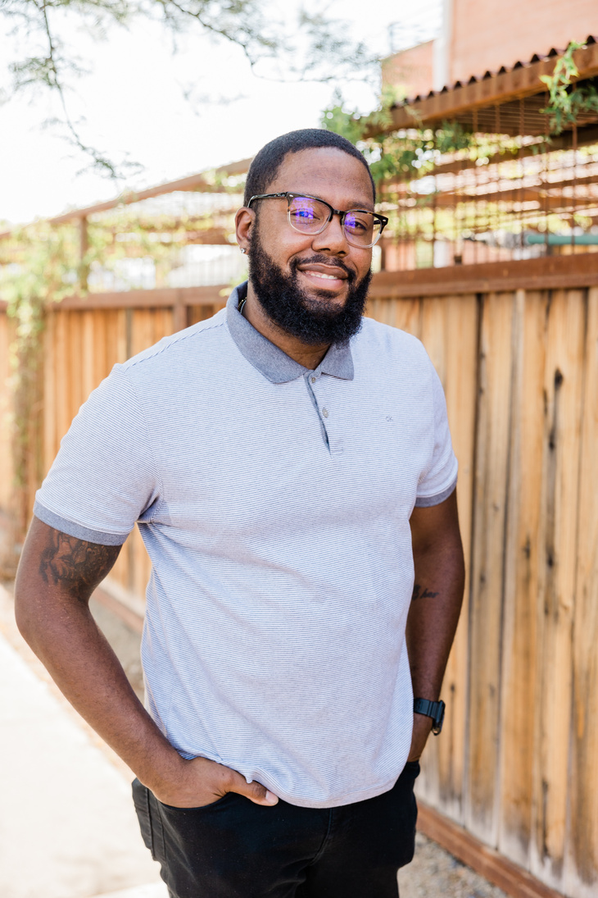


Team Members
Dev. BARASA
CEO
MACHEMBE
NYANCHOKA
PROGRAMMER
BLOCKCHAIN DEVELOPER

Slide 16




Thank you!
0725713192, sammiebarasa2002@gmail.com
17

