Slide 1
Introduction & Outline
Web Programming
Spring 2023
Yaghoub Alizadeh
Gmail: Yaghoub.al@gmail.com
Phone:+989141887195

Slide 2
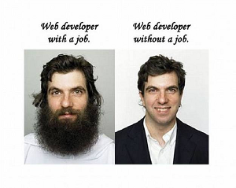
What This Course Is
Web: the major Internet technology-in-use
What are/were the problems?
How do/did we solve them?
Which protocols & languages are used?
Engineer approach
Understand existing concepts & technologies
In class
Try examples & sample projects
By yourself

Slide 3
The World-Wide Web
Original idea (Tim Berners-Lee, 1989)
Public information sharing on the Internet
Hypertext
Documents are text which can be displayed/converted to desired output
Documents can be linked to each others(Hyper link): Web!
WWW: A system of interlinked hypertext document access via the Internet
Now, much more complex/interesting applications
Notes:
HyperText Markup Language (HTML) is the basic scripting language used by web browsers to render pages on the world wide web. HyperText allows a user to click a link and be redirected to a new page referenced by that link.

Slide 4
How Does WWW Work?
Client-Server mechanism:
Web servers: Process client’s requests
File (text, image, video, …) retrieval requests
Computation/Processing (DB lookup, transaction, …) requests
Web clients: Send the requests
Browser: Interacts with client, Requests for server, Processes and displays response (rendering)
Other applications
Search engines crawlers
Use server as a processing element (distributed computing)
…
Notes:
A web crawler, crawler or web spider, is a computer program that's used to search and automatically index website content and other information over the internet

Slide 5
What Do We Want to Learn?
Client-Server mechanism
Web servers: Process client’s requests
File (text, image, video, …) retrieval requests
Computation/Processing (DB lookup, transaction, …) requests
Web clients: Send the requests
Browser: Interacts with client, Requests for server, Processes and displays response (rendering)
Other applications
Search engines crawlers
Use server as a processing element (distributed computing)
…
How? Which Technologies? Which Architectures?
How? Which Technologies? Which Languages? Which Protocols?

Slide 6
What Do We Want to Learn?
How does Gmail work?!
Login (keep me signed in)
Show emails
Read/Delete emails
Refresh the list of emails
Interactive menus
Per user customizations (themes)
…
A general (not CE) user’s view
Notes:
جي ميل به عنوان يكي از موفقترين نمونه‌هاي برنامه‌هاي كلاينت-سرور در دنياي وب

Slide 7
10 Engineering Questions
Q1) How do web server and client browser talk to each other?
Q2) How is a web page organized (components)?
Q3) How is presentation of web page described?
Q4) How does web page interact with users?
Q5) How to update a portion of web page?
Q6) How is transferred data between server & client encoded?
Q7) How does server process client’s requests?
Q8) How are complex/big web applications developed?
Q9) How does Gmail offline work?
Q10) How can other applications use Gmail?

Slide 8
Answers of the Questions
Q1) How to talk to each other? HTTP
Q2) How is a web page organized (components)? HTML
Q3) How is presentation of web page described? CSS
Q4) How does web page interact with users? JS
Q5) How to update a portion of web page? Ajax
Q6) How is transferred data encoded? XML & JSON
Q7) How does server process client’s requests? PHP
Q8) How are complex/big web applications developed? 3-Tier/Micro-service
Q9) How does Gmail offline work? HTML5
Q10) How can other applications use Gmail? Web API

Slide 9
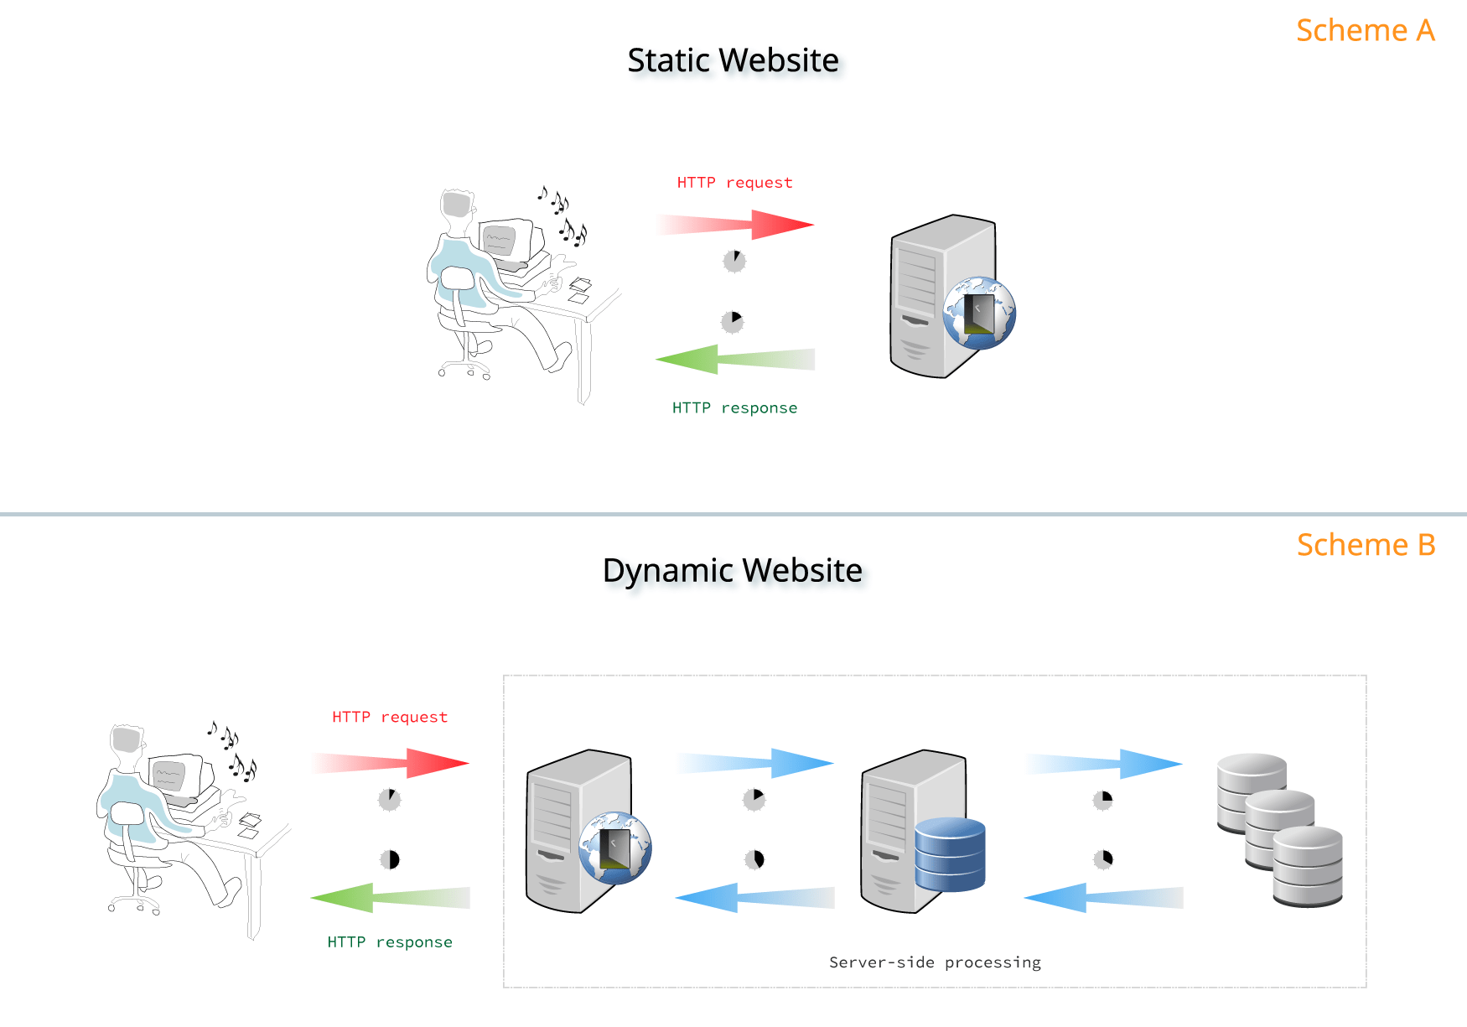
WWW: From Old to Now!!!
Notes:
این چند اسلاید میتواند در قالب شکلهایی که بهبود میابد تا به شکل نهایی برسد ارایه گردد

Slide 10
WWW: From Old to Now!!!
Static Web Pages:
Client requests a document from server
A communication protocol: HTTP (Q1)
How to display the document in browser?
Document structure definition language: HTML (Q2),
Representation of document: CSS (Q3)
Later, very later, some advance features: HTML5 (Q9)
Notes:
این چند اسلاید میتواند در قالب شکلهایی که بهبود میابد تا به شکل نهایی برسد ارایه گردد

Slide 11
WWW: From Old to Now!!!
Interactive and Dynamic web page
Needs to interact with user (e.g., event handling in web pages)
A programming language in browser: JavaScript (Q4)
Dynamic data from server (e.g., search result)
A programming language in server: PHP (Q7)
More complex processing : Java, Python, Go
Interactive & Dynamic web page
A communication mechanism between web page and server: Ajax (Q5) & XML/JSON (Q6)
Notes:
AJAX is a developer's dream, because you can:
Read data from a web server - after the page has loaded
Update a web page without reloading the page
Send data to a web server - in the background

Slide 12
WWW: From Old to Now!!!
Complex processing in server side
So many common requirements
Threading, Concurrency, Security, …
Needs an application development framework
Web Applications Architectures (Q8)
Distributed computing over web
Machine-to-Machine communication
Function invocation over web
Needs a common protocols/API (e.g., Facebook API)
Web services! (Q10)
Notes:
invocation فراخوانی

Slide 13
Syllabus
HTTP (Q1)
HTML (Q2) & CSS (Q3) & HTML5 (Q9)
JavaScript & jQuery(Q4) & Ajax (Q5)
XML + JSON (Q6)
PHP (Q7) & Web applications (Q8)
Web Services (Q10)

Slide 14
What This Course Is Not
XYZ programming language course for web
Many technologies for web development
HTML, CSS, XML, …
Many programming languages: PHP, JS, ASP, …
You are already somehow programmer
You know main programming concepts
You need to learn new syntax & new features
In depth & in detail technology review
There are so many technologies

Slide 15
Course Advantages
We study and understand technologies that are used in real life every day
We don’t discuss about pure scientific problems
An engineering course
These technologies are used in industry
Better resume: XHTML, Ajax, CSS, PHP, …
More job opportunities (more money ☺)
(Usually) Technologies are easier that sciences
No difficult concepts
High course grade if you want ☺

Slide 16
Course Possible Disadvantages
We study technologies!!!
Technologies have limited life time
Our knowledge will expire
Some programming languages & technologies may not be used 10 years later
However, most discussed technologies in this course (hopefully) will have very long life time
Web development needs many technologies
We need to learn many things

Slide 17
Assumptions on your knowledge & skills
Basic networking concepts
Protocol, Port, Header, …
Programming
Java / C
Database
SQL
Love to program
At least, you don’t hate ;-)

Slide 18
Course Policies
Textbooks & References!
Front
Jon Duckett, “HTML & CSS Design and Build Websites”
Marijn Haverbeke, “Eloquent JavaScript”
Back
Larry Ullman, “PHP for the Web”
or
Joel Murach, “mutach's PHP and MySQL”
Misc.
HTTP, HTML5, …

Slide 19
Course Policies: Grading ☹
Homework 30-35%
Midterm 30-35%
Final 40-45%

Slide 20
Course Policies: Grading ☺
Extra points
So many: Presence, HWs, Exams
Not equal weight for all HW
HW will be given as soon as possible
you will have ~3-4 weeks to do

Slide 21
Course Policies (cont’d)
If this course is an optional course for you
Please don’t take it if
Your programming skill is poor
You assume that it is passed without doing anything
You know the answers of almost the questions
But you are so busy to do homework
You need to allocate enough time for top grades
If this course is mandatory
Note that course topics is a bit wide

Slide 22
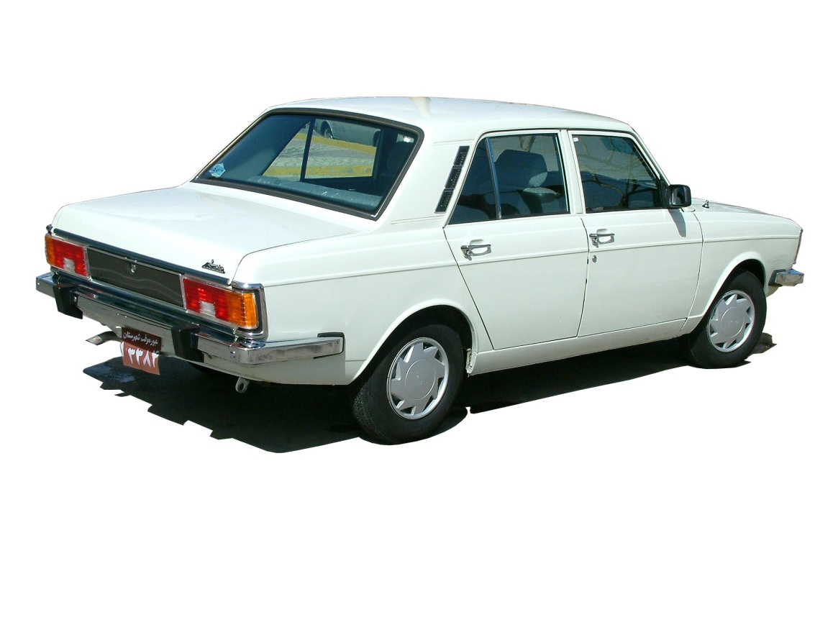
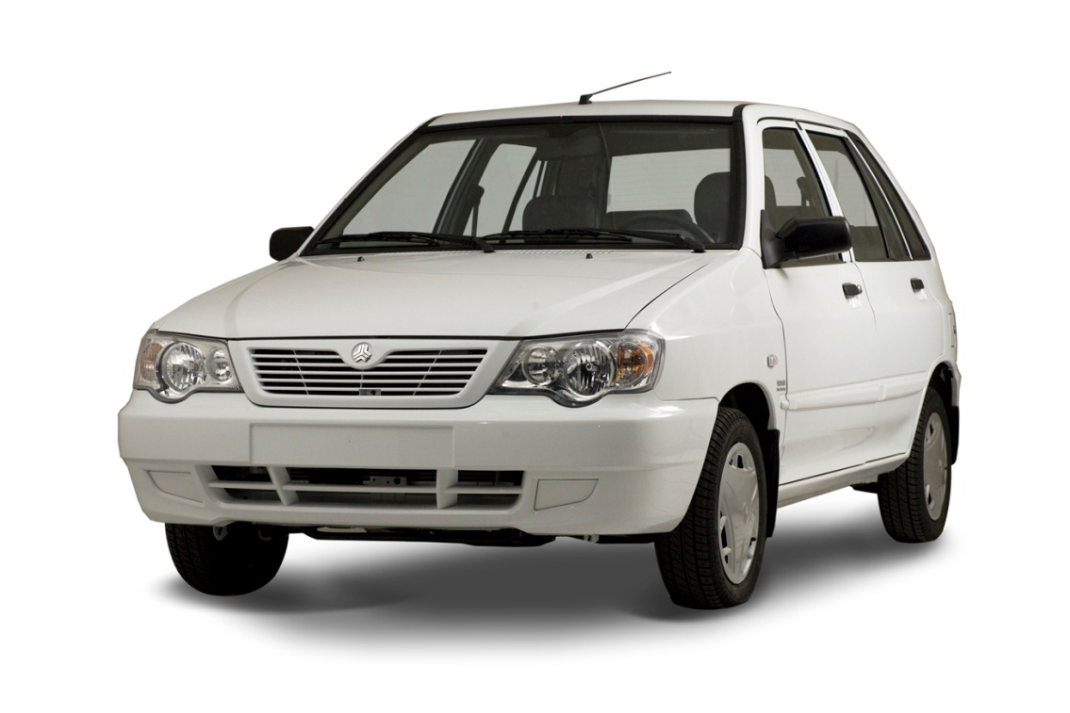
Web Development: Lectures
Slides
Slides + Examples

Slide 23
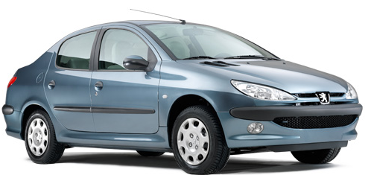
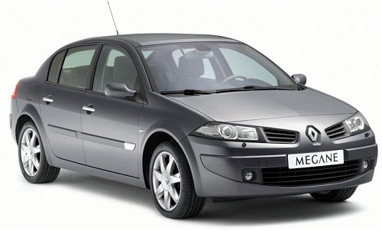
Web Development: Homework
Mandatory Parts
Mandatory Parts + Extra Parts

Slide 24
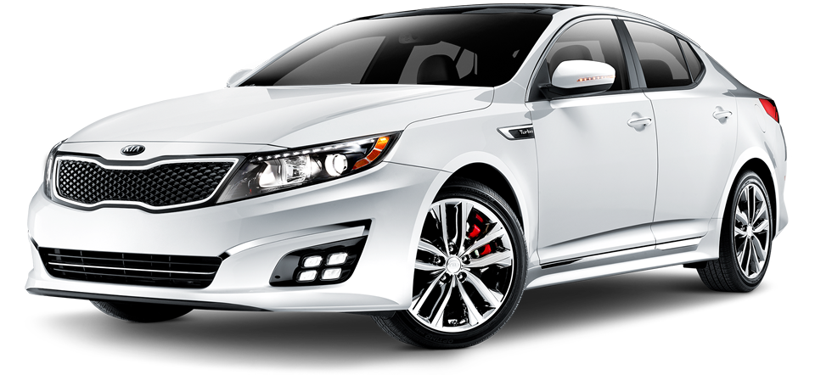

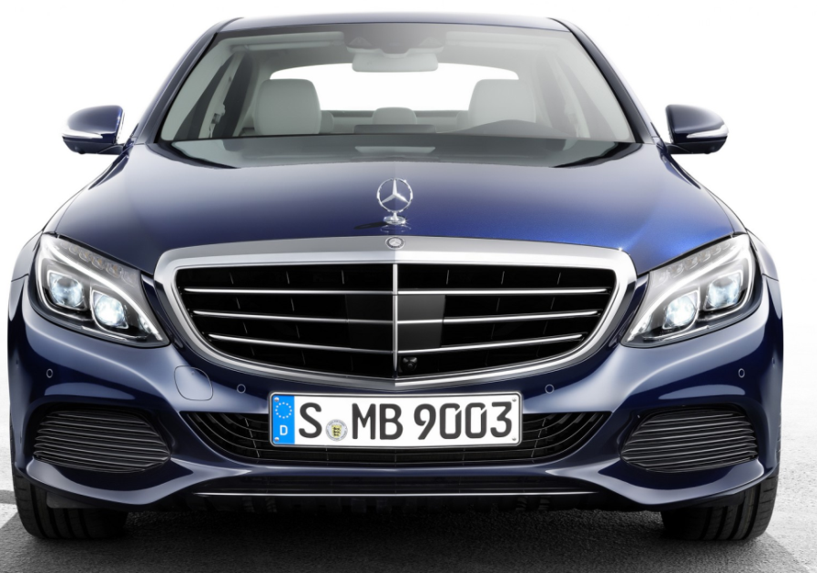
Web Development: Industry

Slide 25
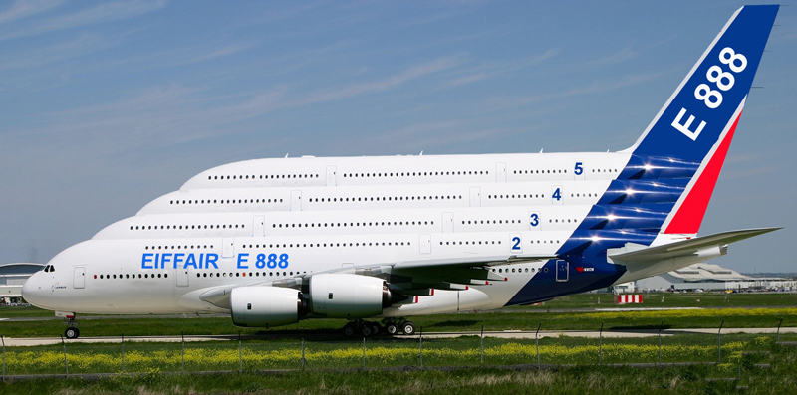
Web Development: Google, FB, …

Slide 26
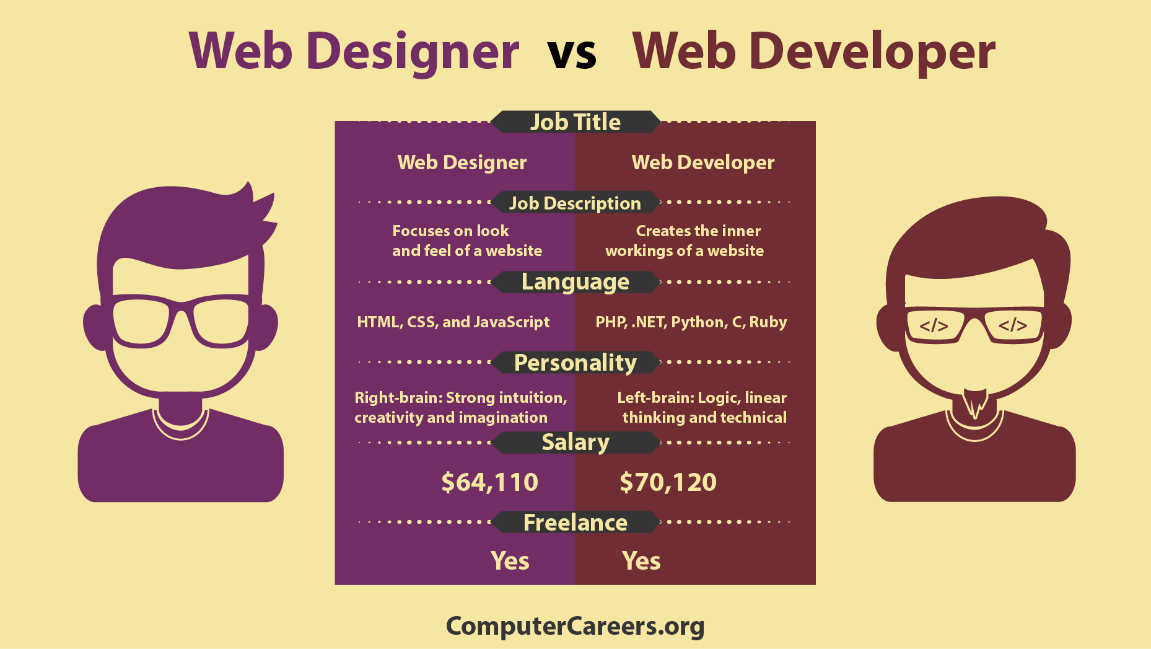
Web Designer vs Web Development

Slide 27
Type of Web Designer
UX Designers
Ensure the website is structured in a way that engages visitors and delivers a positive experience
Create human-centric designs that are based on data-driven decisions
UI Designers
Work with the layout and visual elements of a website
Also, work with design tools.

Slide 28
The main goal of the course
Learn and Enjoy
Web Development

