Slide 1
(X)HTML
Web Programming
Spring 2023

Slide 2
Questions
Q2) How is a web page organized?
Q2.1) What language is used for web pages?
Q2.2) What are major parts of a web page?
Q2.3) How to organize text?
Q2.4) How to insert link?
Q2.5) How to insert images?
Q2.6) How to insert tables?
Q2.7) How to get data from user?
Q2.8) Syntax / Semantic error?

Slide 3
Outline
Introduction
(X)HTML
Body
Head
HTML in Practice

Slide 4
Outline
Introduction
XHTML
Body
Head
XHTML in Practice

Slide 5
Introduction
Remark: The idea of WWW is document sharing
Main question: How to define the structure of document?
Text, tables, figures, link, …
In 1980s
Binary formats? Useless
Different machines, no popular graphical desktops, no such popular format such as PDF, Doc, …
Text format
It is okay, everyone knows ASCII
But how to describe structure, layout, and formatting?
Add meaning to each part of text using special predefined markup, E.g., It is heading, It is paragraph, It is table …

Slide 6
Introduction (cont’d)
HTML (Hyper Text Markup Language)
A language to define structure of web docs
Tags specify the structure
HTML
Was defined with SGML
Is not a programming language
Cannot be used to describe computations
HTML does/should not specify presentation
Font family, style, color, …
Cascading Style Sheet (CSS) is responsible for presentation
Notes:
standard generalized markup language

Slide 7
Introduction (cont’d)
HTML 1 (Berners-Lee, 1989): very basic, limited integration of multimedia
1993, Mosaic added many new features (e.g., integrated images)
HTML 2.0 (IETF, 1994): tried to standardize these & other features
1994-96, Netscape & IE added many new, divergent features
HTML 3.2 (W3C, 1996): attempted to unify into a single standard
HTML 4.0 (W3C, 1997): attempted to map out future direction
XHTML 1.0 (W3C, 2000): modified to conform to XML standards
HTML 5 (Web Hypertext Application Technology Working Group, W3C): New version of HTML4, XHTML 1.0

Slide 8
Outline
Introduction
Tags
XHTML
Body
Head
XHTML in Practice

Slide 9
HTML Basics: Tags
XHTML is a text document collecting elements
Element: (usually) a tag pair (opening & closing) + content between them
E.g., <h1>This is header</h1>
Not all tags have content
Tags specify markups for the content
Tags
<tagname>: opening (start) tag
</tagname>: closing (end) tag
<tagname />: self-closing tag

Slide 10
HTML Basics: Attributes
Each tag can have some attributes
Attributes customize tags
<tagname attrib1=“setting” attrib2=“setting” …>
…
</tagname>
Core attributes can be used for most of elements
id: A unique identifier to element starting with "A-Z"
class: Assign a class to the element, multiple classes are allowed
title: Assign a title, the behavior depends on element

Slide 11
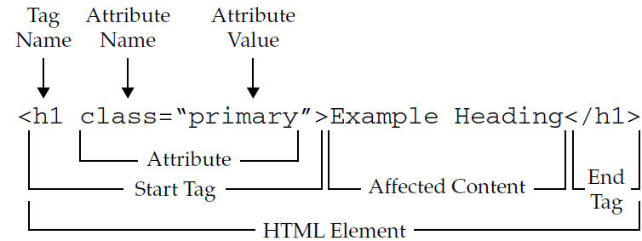
HTML Basics: Tag & Attribute & Element

Slide 12
HTML Processing
HTML is just a text file; How does it work?
It is processed by applications for a specific purpose!
Search engine objectives:
Analyze page, extract elements, prioritize, ranking, …
Each tag has meaning, used for ranking
E.g., paragraphs are not as important as headings
Web browser objectives:
Display the document to client
Rendering
Generate layout for the document
Display elements

Slide 13

HTML Processing: Rendering
The processing of displaying HMTL in browser
Not all tags are to be displayed
E.g. most tags in <head>
For example define style in <head>
For tags which should be displayed
Tags by themselves are not displayed
Each tag has its own default presentation
If tag has content, the presentation is applied to content
E.g. <i>This is italic</i>

Slide 14

HTML Processing: Rendering
If tag has not content, the presentation is displayed (if it is needed)
E.g. <br />

Slide 15
HTML Processing: Rendering (cont’d)
Block-level: Line break before & after elements
Each block-level element by default consumes a line
No other element can be the left/right of the element
The next block-level goes underneath of this block
Examples: Paragraphs: <p>, Headings: <h1>,…, <h6>, Lists: <ul>, <ol>, <dl>, Blocks: <pre>, …
Inline: No line break before or after
The next inline elements goes right after this element
Example: Text, <b>, <i>, <em>, <strong>, …

Slide 16
HTML Processing: Rendering (cont’d)
Web browsers by default start placing elements from left-top corner
In-line elements are placed from left to right
A new line is created for each block-level element
Contents are wrapped inside elements
Web browsers ignore
Comments
<!-- … -->
Tags that don’t recognize
More than single whitespaces
E.g., Multiple newlines + tabs + spaces → single space

Slide 17
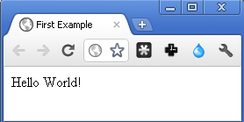
The “Hello World” Example
<!-- This is the “Hello World” Example -->
<html>
<head>
<title>First Example</title>
</head>
<body>
<p> Hello
World! </p>
</body>
</html>

Slide 18
Nested Tags
Nested Tags
Tree of elements
Parent & Child relationship
<html> </html>
<head> </head>
<body> </body>
<title> </title> other stuff <p></p> <br /> <table></table>
This is some text!

Slide 19
Special Characters/Symbols
Some characters and symbols are encoded
Because cannot be used directly in text files
E.g.,
Character | Coding | Number code
‘<’ | &lt; | &#60;
‘>’ | &gt; | &#62;
‘&’ | &amp; | &#38;
‘ ’ | &nbsp; | &#160;
‘©’ | &copy; | &#169;
‘λ’ | &lambda | &#955;

Slide 20
Outline
Introduction
(X)HTML
Body
Head
XHTML in Practice

Slide 21
XHTML
HTML is an application of Standard General Markup Language (SGML)
XHTML is an application of Extensible Markup Language (XML)
W3C: “a reformulation of the three HTML 4 document types as applications of XML 1.0”
XML is more restricted that SGML
XHTML has more restrictions vs. HTML
XHTML is more well-defined

Slide 22
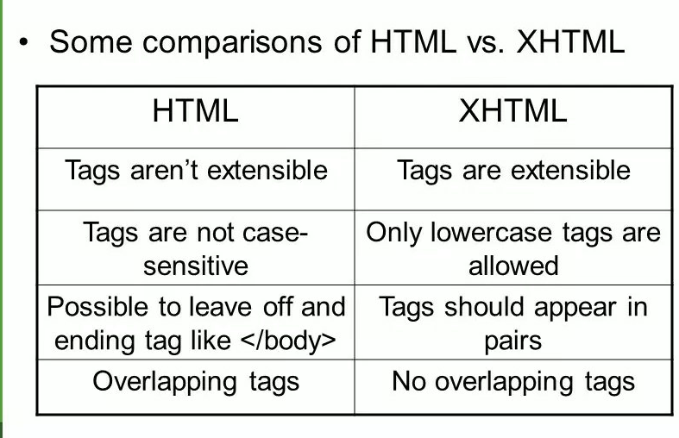
XHTML vs HTML

Slide 23
XHTML Rules (vs. HTML)
All tags have ending (closing) tags
Some tags are self closing <br />
Tags cannot be overlapped
<b><i>test</b></i>
Who is parent? Who is child?!
All tags are lowercase
Attributes’ value must be in double quotation
Browsers ignore unknown tags and attributes
Layout (styles) are separated from markup
Markup is used for meaning & structure

Slide 24
XHTML Skeleton
<?xml …>
<!DOCTYPE …>
<html …>
<head>
</head>
<body>
</body>
</html>
HEAD contains setup information for the browser & the web page, e.g., the title for the browser window, style definitions, JavaScript code, …
BODY contains the actual content to be displayed in the Web page

Slide 25
Document Types
There are three versions of XHTML
Transitional XHTML: Deprecated features from HTML 4.1 are allowed
Strict XHTML: No deprecated feature from HTML is allowed
Frameset XHTML: Mainly used to create frames
The version is specified by DOCTYPE tag
For transitional:
<!DOCTYPE html PUBLIC "-//W3C//DTD XHTML 1.0 Transitional//EN" "http://www.w3.org/TR/xhtml1/DTD/xhtml1-transitional.dtd">
For strict:
<!DOCTYPE html PUBLIC "-//W3C//DTD XHTML 1.0 Strict//EN" "http://www.w3.org/TR/xhtml1/DTD/xhtml1-strict.dtd">
For frameset:
<!DOCTYPE html PUBLIC "-//W3C//DTD XHTML 1.0 Frameset//EN" "http://www.w3.org/TR/xhtml1/DTD/xhtml1-frameset.dtd">
Status of tags in DOCTYPEs: http://www.w3schools.com/tags/ref_html_dtd.asp

Slide 26
XHTML Document Template
<?xml version="1.0" encoding="utf-8"?>
<!DOCTYPE html PUBLIC "-//W3C//DTD XHTML 1.0 Strict//EN" "http://www.w3.org/TR/xhtml1/DTD/xhtml1-strict.dtd">
<html xmlns="http://www.w3.org/1999/xhtml">
<head>
<meta http-equiv="Content-Type" content="text-html; charset=utf-8" />
<title> ... </title>
</head>
<body> ... </body>
</html>

Slide 27
Outline
Introduction
XHTML
Body
Heading & Paragraph
Lists & Definitions
Images & Tables
Links
Forms
Head
XHTML in Practice

Slide 28
<body> </body>
The content of the document to be shared on Internet
To display for user in web browser
To be searched and ranked by search engines
Which contents
General contents (you have seen in books/newspapers/ …)
Text
Table
Image
Web contents
Links
Forms
Multimedia

Slide 29
Text Elements
Headings
Paragraphs
Lists
Definitions
Spaces
Line break
Text presentation (italic) & Meaning (strong)

Slide 30
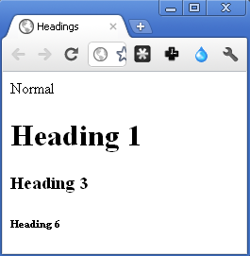
Text: Headings
XHTML offers 6 levels of heading
<h1> <h2> … <h6>
<h1> is the largest heading
<h6> is the smallest heading
Bock-level element
Normal
<h1> Heading 1 </h1>
<h3> Heading 3 </h3>
<h6> Heading 6 </h6>

Slide 31
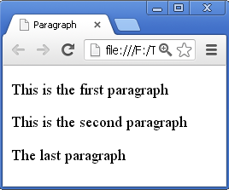
Text: Paragraphs
<p> </p> is to create paragraphs
Creates a line break and vertical spaces
Alignment (left, …) is controller by text-align in CSS
A block-level element
<p>This is the first paragraph</p>
<p>This
is
the second paragraph</p><p>The last
paragraph</p>

Slide 32
Text: Lists & Definitions
Unordered list: <ul> </ul>
typically rendered as a bulleted list
Ordered list: <ol> </ol>
typically rendered as a numbers list
Definition list: <dl> </dl>
encloses a list of groups of terms and descriptions

Slide 33
Text: Lists & Definitions
List elements:
Unordered & Ordered list: <li> </li>
Definition list:
Entity: <dt> </dt> Definition: <dd> </dd>
Lists can be nested
List: Block level elements

Slide 34
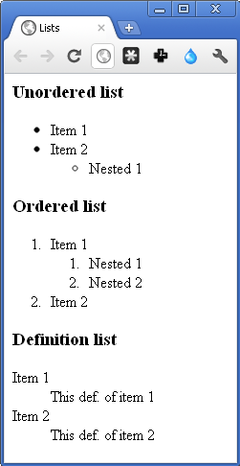
Text: Lists & Definitions (cont’d)
<h3>Unordered list</h3>
<ul>
<li> Item 1 </li> <li> Item 2 </li>
<ul>
<li> Nested 1</li>
</ul>
</ul>
<h3>Ordered list</h3>
<ol>
<li> Item 1 </li>
<ol>
<li> Nested 1 </li> <li> Nested 2 </li>
</ol>
<li> Item 2 </li>
</ol>
<h3>Definition list</h3>
<dl>
<dt>Item 1 </dt> <dd> This def. of item 1 </dd>
<dt>Item 2 </dt> <dd> This def. of item 2 </dd>
</dl>

Slide 35
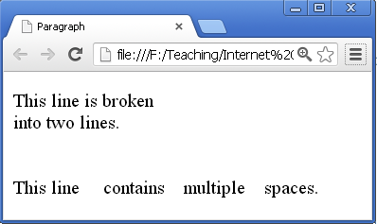
Text: Line break & Spaces
Remark: By default line break and spaces are ignored
To add line break: <br />
To add space: &nbsp;
Preserving white spaces: <pre> </pre> :
The text will be displayed exactly as written in the HTML source code.
<p>
This line is broken<br />into two lines.
<br />
<br /><br />
This line &nbsp;
&nbsp;&nbsp; contains &nbsp;
&nbsp; multiple &nbsp;
&nbsp; spaces.
</p>

Slide 36
Text: Presentation & Meaning
Physical appearance for web browsers
Bold, Italic, Underline, Superscript, Fonts, size, color, …
In older versions, controlled by HTML tags
In XHTML, these are deprecated
Controlled by CSS
We will see later
Logical meaning for search engines
Emphasize, Code, Variable, Citation, …

Slide 37
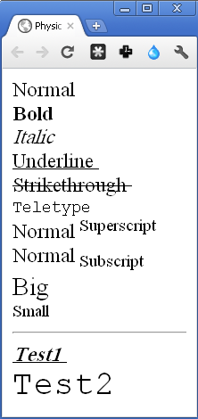
Text: Physical Appearance
Normal <br />
<b> Bold </b> <br />
<i> Italic </i> <br />
<u> Underline </u> <br />
<s> Strikethrough </s> <br />
<tt> Teletype </tt> <br />
Normal<sup> Superscript </sup> <br />
Normal<sub> Subscript </sub> <br />
<big> Big </big> <br />
<small> Small </small> <br />
<hr />
<b> <i> <u> Test1 </u> </i> </b> <br />
<big> <big> <big> <big> <tt> Test2 </tt> </big> </big> </big> </big> <br />

Slide 38
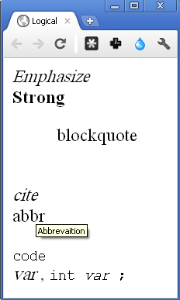
Text: Logical Meaning
Used to add meaning/implication to elements
Search engines understand the meaning and use in page ranking
The meaning is not important for web browser
Change the appearances which are similar to some physical tags
E.g. <em> is like to <i>
<em> Emphasize </em> <br />
<strong> Strong </strong> <br />
<blockquote> blockquote </blockquote> <br />
<cite> cite </cite> <br />
<abbr title="Abbreviation"> abbr </abbr><br />
<code> code </code> <br />
<var> var </var>, <code>int<var>var</var> ; </code>
Notes:
The <cite> tag defines the title of a creative work (e.g. a book, a poem, a song, a movie, a painting, a sculpture, etc.).
<p><cite>The Scream</cite> by Edward Munch. Painted in 1893.</p>

Slide 39
Tables
Tables are created by <table> </table>
Each row is created by <tr> </tr>
Each column inside a row is created by <td> </td>
Heading of column is by <th> </th>
Block-level element

Slide 40
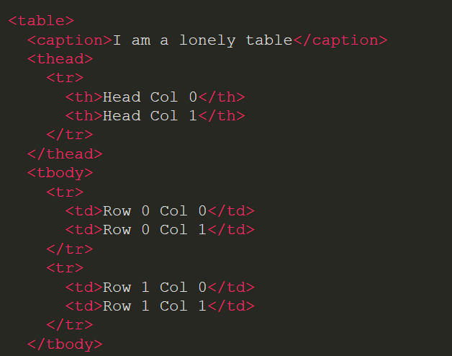
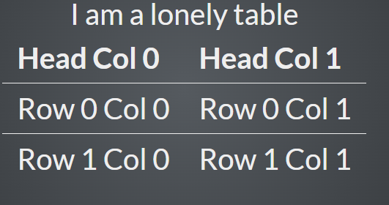
Tables

Slide 41
Images
Images are inserted in the page by
<img src="URL" alt="text" height="number" width="number" align="alignment"/>
src: address of file (local or remote)
alt: alternative message shown if image cannot be displayed
align: alignment of image with respect to text line (deprecated, is controller by CSS)
There is no caption for images!!!
Images are inline elements

Slide 42
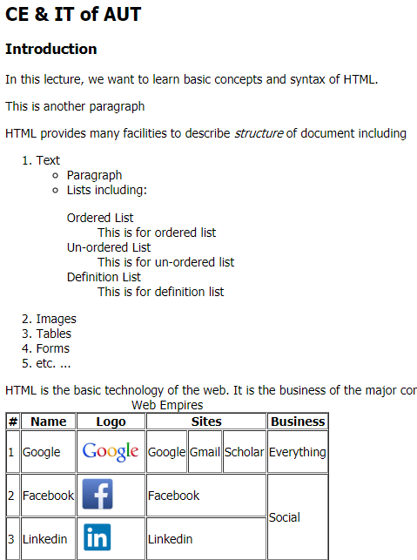
General Document Contents Summary
h1-h6
p
ul
em
ol
dl
dt
dd
tr
table
td
img

Slide 43
Links
The most important feature of web
Hyperlink (anchor) → the Web
<a href="URL">link name</a>
When scheme is not give in the URL & base is not set in <head>, it is assumed as a file in current domain
href=“http://www.google.com” → open Google
href=“www.google.com” → open a file in current directory named www.google.com
href=“/www.google.com” → open a file in the root directory named www.google.com

Slide 44
Links (cont’d)
For paths in current domain, similar to filesystem, paths can be
Absolute: Path starts from web server root directory
href=“/1/2/3.jpg”
Relative: Path starts from current directory
href=“./1/2/3.jpg”

Slide 45
Links (cont’d)
Scheme can be every supported protocol
E.g. mailto for sending email
E.g. javascript to run code
By default links are opened in the same window, to open link in new window
Attribute targe="_blank"
Everything between <a> </a> is considered as link name
Avoid spaces after <a> and before </a>

Slide 46
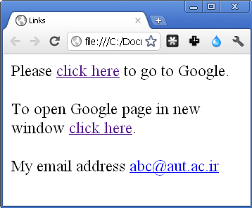
Links (cont’d)
<body>
Please <a href="http://www.google.com">click here</a> to go to Google. <br /><br />
To open Google page in new window <a href="http://www.google.com" target="_blank">click here</a>. <br /><br/>
My email address <a href="mailto:abc@aut.ac.ir">abc@aut.ac.ir</a>
</body>

Slide 47
Links (cont’d)
#frag part in URL is used to jump middle of a large document
Step one: assign an ID/name to the part (The id is case sensitive)
<a id="SctionResult">Results</a>
<a name="SctionResult">Results</a> (not used anymore)
<h2 id="SctionResult">Results</h2>
Step two: create link using #frag feature
To see result <a href="#SctionResult">click here</a>
Notes:
there are two ways to jump to a fragment identifier and both aren't obsolete (name and id ) ( except <a> element : name is obsolete for the <a> element)

Slide 48
Forms
Forms are used to get information from user
XHTML is only responsible to gather the information
It is not responsible to process
Data are processed by server side scripts
However, some preprocessing can also be performed in client side
Major form components
The form element
Inputs
Text input, Checkboxes and radio buttons, Select boxes, File select
Buttons
submit, cancel, …

Slide 49
Forms (cont’d)
Forms : get information from user
HTML is only responsible to gather the information:
No process
Process by server side scripts
May some preprocessing by java script in client side

Slide 50
Forms (cont’d)
Forms are created by <form> :
Each form must have action and method attributes
action is a URL
Server side script that process the data
method is a HTTP method used to send data
get: User input data is sent through the query part of URL by HTTP GET method
post: User input data is sent as the body of HTTP message by HTTP POST method

Slide 51
Forms (cont’d)
A from is composed of input elements
Each component has type, name, and value attributes
type specifies the type of component
name is the name of the component
value (except buttons)
If not empty, is the default value
On submission, name=value (user input or default) of the components in the form are sent to server (using the action method: POST, GET)
Server processes the values according to the names
It must know the names

Slide 52
Forms: Text Input
Single-line text
type="text"
Password (instead of real input, other character is shown)
type="password"
Multi-line text
Instead of <input>, we use <textarea> </textarea>
cols & rows specifies # of columns & rows
name=value of component is sent to server
Password in plain text format!!!

Slide 53
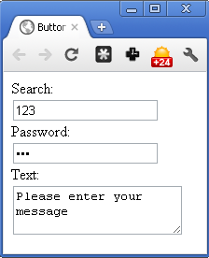
Forms: Text Input (cont’d)
<form action="http://127.0.0.1" method="get">
Search:
<input type="text" name="txtSearch" value="" size="20" maxlength="64" /> <br />
Password:
<input type="password" name="pass" value="" size="20" maxlength="64" /> <br />
Text:
<textarea name="inputtext" cols="30" rows="3">Please enter your message</textarea>
</form>

Slide 54
Forms: Checkbox
type="checkbox"
If checked, its name=value is sent to server
User cannot change/enter value
The value attribute is needed in some cases
If not given, it is assumed “on”
To be checked by default
checked="checked"
To draw border around a group of components
<fieldset> </fieldset>
To assign name to the group
<legend> </legend>

Slide 55
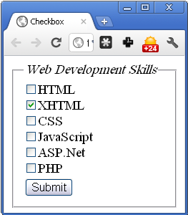
Forms: Checkbox (cont’d)
<form action="http://www.google.com" method="get">
<fieldset>
<legend><em>Web Development Skills</em></legend>
<input type="checkbox" name="skill_1" value="html"/>
HTML<br />
<input type="checkbox" name="skill_2"value="xhtml" checked="checked"/>XHTML<br />
<input type="checkbox" name="skill_3“ value="CSS"/>
CSS<br />
<input type="checkbox" name="skill_4" value="JavaScript"/>JavaScript<br />
<input type="checkbox" name="skill_5“
value="aspnet" />ASP.Net<br />
<input type="checkbox" name="skill_6"/>
PHP <br />
<input type="submit" value="Submit" />
</fieldset>
</form>

Slide 56
Forms: Radio Buttons
type="radio"
Only one of button can be selected in a group of buttons with the same name
name=value of the selected button will sent
Again, user cannot change/enter the value
If the value attribute is missing, the default value is “on”
The value attribute is (almost always) needed
The name is the same for all choices!!!

Slide 57
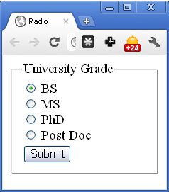
Forms: Radio Buttons (cont’d)
<form action="www.aut.ac.ir" method="get">
<fieldset>
<legend>University Grade</legend>
<input type="radio" name="grade" value="B" /> BS <br />
<input type="radio" name="grade" value="M" /> MS <br />
<input type="radio" name="grade" value="P" /> PhD <br />
<input type="radio" name="grade" value="PD" /> Post Doc <br />
<input type="submit" value="Submit" />
</fieldset>
</form>

Slide 58
Forms: Select Boxes
The same functionality of radio buttons
However, to save spaces
Created by
<select name="selname"> </select>
Options are given by <option value="val"> text </option>
slename=val of the selected item is sent to server
User cannot enter value; If the value attribute is missing, the “text” is assumed as the value

Slide 59
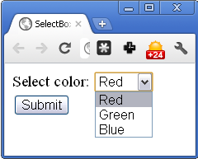
Forms: Select Boxes (cont’d)
<form action="http://127.0.0.1/" method="get" name="frmColors">
Select color:
<select name="selColor">
<option value="r">Red</option>
<option value="g">Green</option>
<option value="b">Blue</option>
</select>
<input type="submit" value="Submit" />
</form>

Slide 60
Forms: File Input
In <input>
type="file"
accept= A MIME type to specify default acceptable file format
In <form>
method="post"
enctype="multipart/form-data"
To encode file as MIME message

Slide 61
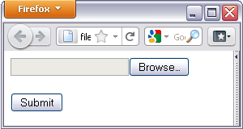
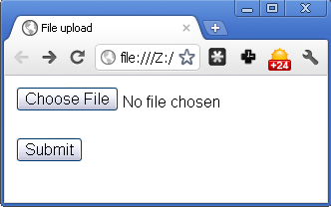
Forms: File Input (cont’d)
<form action="http://127.0.0.1" method="post" name="fromImageUpload" enctype="multipart/form-data">
<input type="file" name="fileUpload" accept="image/*" />
<br /><br />
<input type="submit" value="Submit" />
</form>

Slide 62
Forms: Buttons
Buttons: <input type=“T” value=“L”/>
To submit data to server: type="submit"
To reset all inputs to default values: type="reset"
To run client side script: type="button"
Attribute value is the label of button
Using image as a button
type="image" src="image path" alt="text"
Attribute name is required if more than same type button in a form

Slide 63
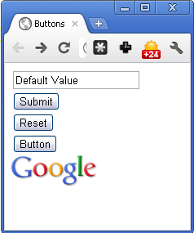
Forms: Buttons (cont’d)
<form action="http://127.0.0.1/" method="get">
<input type="text" name="input" value="Default Value" /> <br />
<input type="submit" value="Submit" /> <br />
<button type="reset"> Reset</button> <br />
<input type="button" value="Button" /> <br />
<input type="image" src="google_logo.gif" />
</form>

Slide 64
Real Examples
Capture form submission
GET
POST

Slide 65
Form Summary
Form: <form action=“” method=“”>
Button: <input type="button"> or <button>
Text:
<input type="text" …
<input type="password" …
<textarea …
Checkbox: <input type="checkbox" …
Radio: <input type="radio" …
Select box: <select name= … and <option value=
File: <input type="file" …

Slide 66
Multimedia
XHTML (HTML 4) does not support multimedia
Browser plug-ins need to be used
Flash
QuickTime
…
Next version of HTML (HTML 5) supports multimedia without any plug-in
We will see later

Slide 67
div & span
<div> is a general block-level element
To create an element without any presentation
To group some existing block-level elements
<span> is a general inline element
Used to create an inline element without any presentation
Behavior & Presentation of <span> & <div> are controlled by JavaScript & CSS
Nested <div> are used to define structure of complex pages, e.g., Gmail

Slide 68
Outline
Introduction
XHTML
Body
Head
XHTML in Practice

Slide 69
<head> </head>
The elements (usually) not for displaying
Mainly, the info in head is not for user
This element is additional information (Meta Data) for Web browsers: How to render the page
CSS rules definitions and inclusions
JavaScript codes and etc.
Search engines: Control the ranking of the page
Keywords for the page
Extra description for the page

Slide 70
<head> </head> (cont’d)
<title>: Page title
Browser dependent
Usually displayed as the browser window name
<title>My page Title</title>
<base>: Base URL for all links (href in a, src in img, …) in the document, e.g.,
<base href="http://www.abc.com"/>
<a href="test.html">link1</a> → http://www.abc.com/test.html
<a href="http://test.html">link2</a> → http://test.html

Slide 71
<head> </head> (cont’d)
<meta>: Information about the document
HTTP parameters, Search engine optimization (keywords), Description, …
Represents metadata that cannot be represented by other HTML meta-related elements
<meta> attributes:
(name, content)
name can be anything, e.g., author, description, ...
If the name attribute is set, the meta element provides document-level metadata, applying to the whole page.

Slide 72
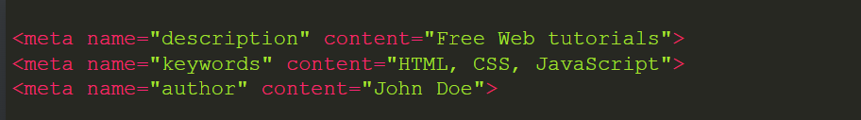
<head> </head> (cont’d)
Name:
author: the name of the document's author.
description: a short and accurate summary of the content of the page. Several browsers, like Firefox and Opera, use this as the default description of bookmarked pages.
generator: the identifier of the software that generated the page.
keywords: words relevant to the page's content separated by commas

Slide 73
<head> </head> (cont’d)
(http-equiv, content) is the name of a HTTP header field (Content-Type, Expire, Refresh, …)
provides an HTTP header for the information/value of the content attribute
Usually is not processed by web-server
Browser simulates the behavior of the effect of the header
<meta http-equiv="expires" content="6 April 2020 23:59:59 GMT" />
<meta http-equiv="refresh" content="10" />
<meta http-equiv="Content-Type" content="text/html"/>
</head>

Slide 74
<head> </head> (cont’d)
<script>: Introduce scripts used in the document
The script can be internal (defined in the document) or external (somewhere on web)
We will discussed in next lectures
<style>: Enclose document-wide styles
CSS rules
Either internal or external
We will discussed in the next lecture
<link>: To link some other documents to this HTML file
External CSS, Favicon, …

Slide 75
Outline
Introduction
XHTML
Body
Head
HTML in Practice

Slide 76
HTML Semantic Tags
Many HTML tags have semantic meaning
Semantic tags convey some information about the type of content inside them.
Semantic tags make it clear to the browser what the meaning of a page and its content is.
They also help search engines, ensuring that the right pages are delivered for the right queries.

Slide 77
HTML Semantic Tags
head
body
header
nav
main
section
article
aside
footer
code
Notes:
The HTML <footer> element represents a footer for its nearest sectioning content or sectioning root element. A footer typically contains information about the author of the section, copyright data or links to related documents.The HTML <header> element represents introductory content, typically a group of introductory or navigational aids. It may contain some heading elements but also a logo, a search form, an author name, and other elements.
The HTML <nav> element represents a section of a page whose purpose is to provide navigation links, either within the current document or to other documents. Common examples of navigation sections are menus, tables of contents, and indexes.

Slide 78
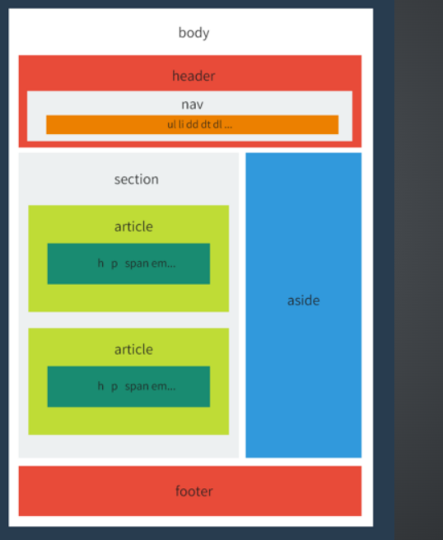
HTML Semantic Tags
Example

Slide 79
HTML Remarks
HTML is open source
We can find how others do amazing things in web
Learning by reading others’ codes
Copy/Past is strictly prohibited (copyright)
HTML is not a programming language
No compiler or interpreter
So, what happen if there is an error ….
Depends on browser
Developer should check with multiple browsers

Slide 80
HTML Development Toolbox
A HTML editor (http://en.wikipedia.org/wiki/List_of_HTML_editors)
A simple text editor
Notepad
Atom
And etc …
HTML source code editor (syntax highlight, …)
E.g. Aptana, WebStorm ….
WYSIWYG editors (you have not work with tags)
E.g. MS. FrontPage, Word (export to HTML), …
A rendering software
Common browsers

Slide 81
HTML Debugging
Browser reads HTML document
Parses it → tree
Document Object Model (DOM) tree
Shows how browser interprets your HTML file
Google Chrome “Inspect element”
Firefox
Developer edition

Slide 82
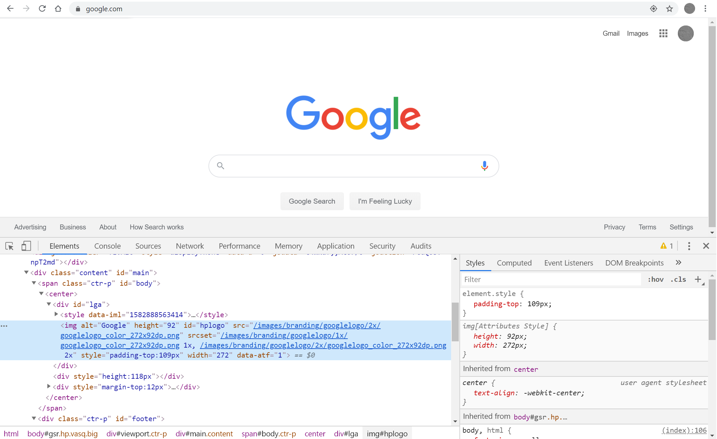
Chrome

Slide 83
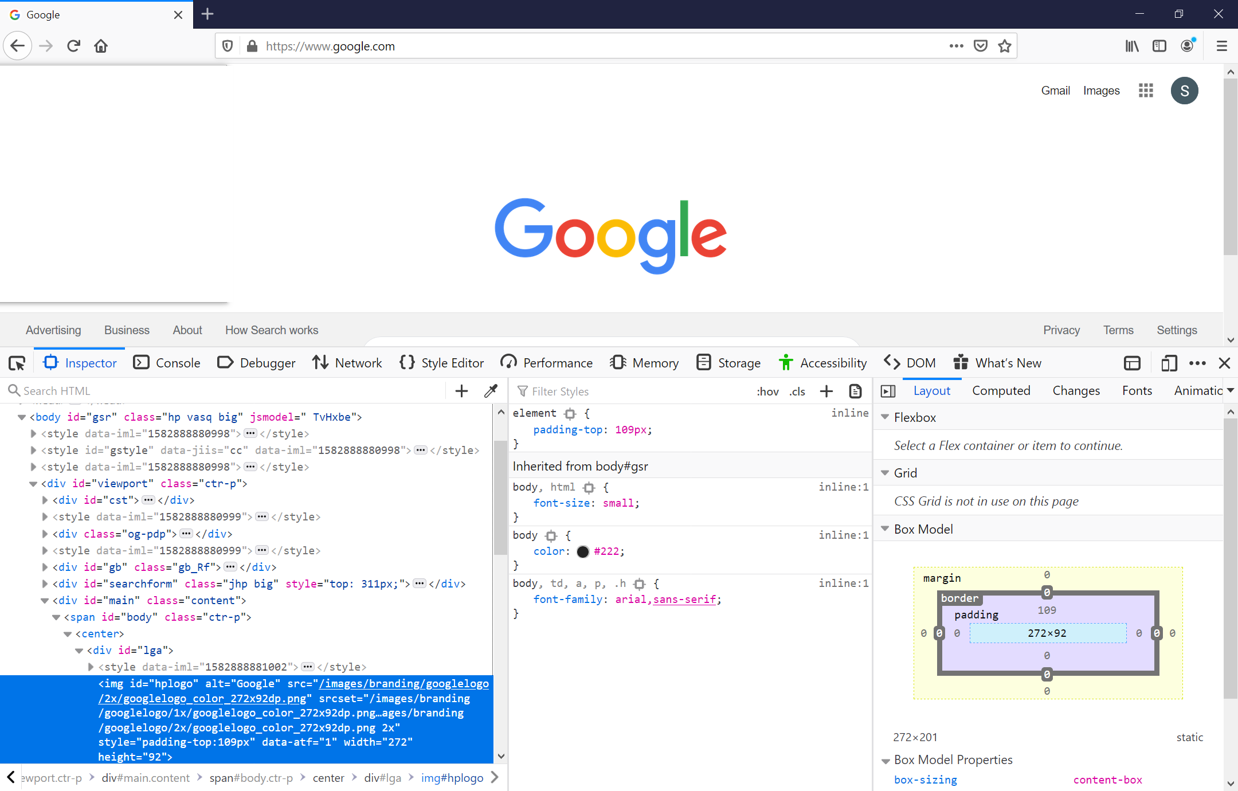
Firefox

Slide 84
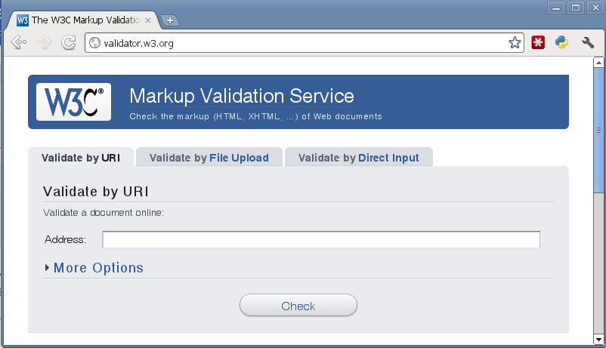
HTML Validation
validator.w3.org

Slide 85
Answers
Q2.1) What language is used for web pages? HTML
Q2.2) What are major parts of a web page? <head> & <body>
Q2.3) How to organize text? <p>, <hx>, <ol>, <ul>, …
Q2.4) How to insert link? <a href=""></a>
Q2.5) How to insert images? <img src="" />
Q2.6) How to insert tables? <table><tr><td></td></tr></table>
Q2.7) How to get data from user? <form action="" method=""> <input type=""> <file>… </form>
Q2.8) Syntax / Semantic error? Validation

Slide 86
What is the Next?! HTML5
The new generation of HTML
Published on 28 October 2014
More lax syntax
Emphasize semantic web
Built-in multi-media support
Built-in graphical API
Drag & Drop
Cross-platform mobile applications
Web Workers, WebSocket, Web Storage, …
…

Slide 87
References
Prof. Bahador Bakhshi's Internet Eng. Course's Slides
Chapters 1-8 of “HTML & CSS: Design and build Websites”
Additional References
https://www.w3schools.com/html/default.asp

