Slide 1
CSS
Web Programming
Spring 2023
CE Department, Amirkabir University of Technology

Slide 2
Questions
Q3) How is presentation of web page described?

Slide 3
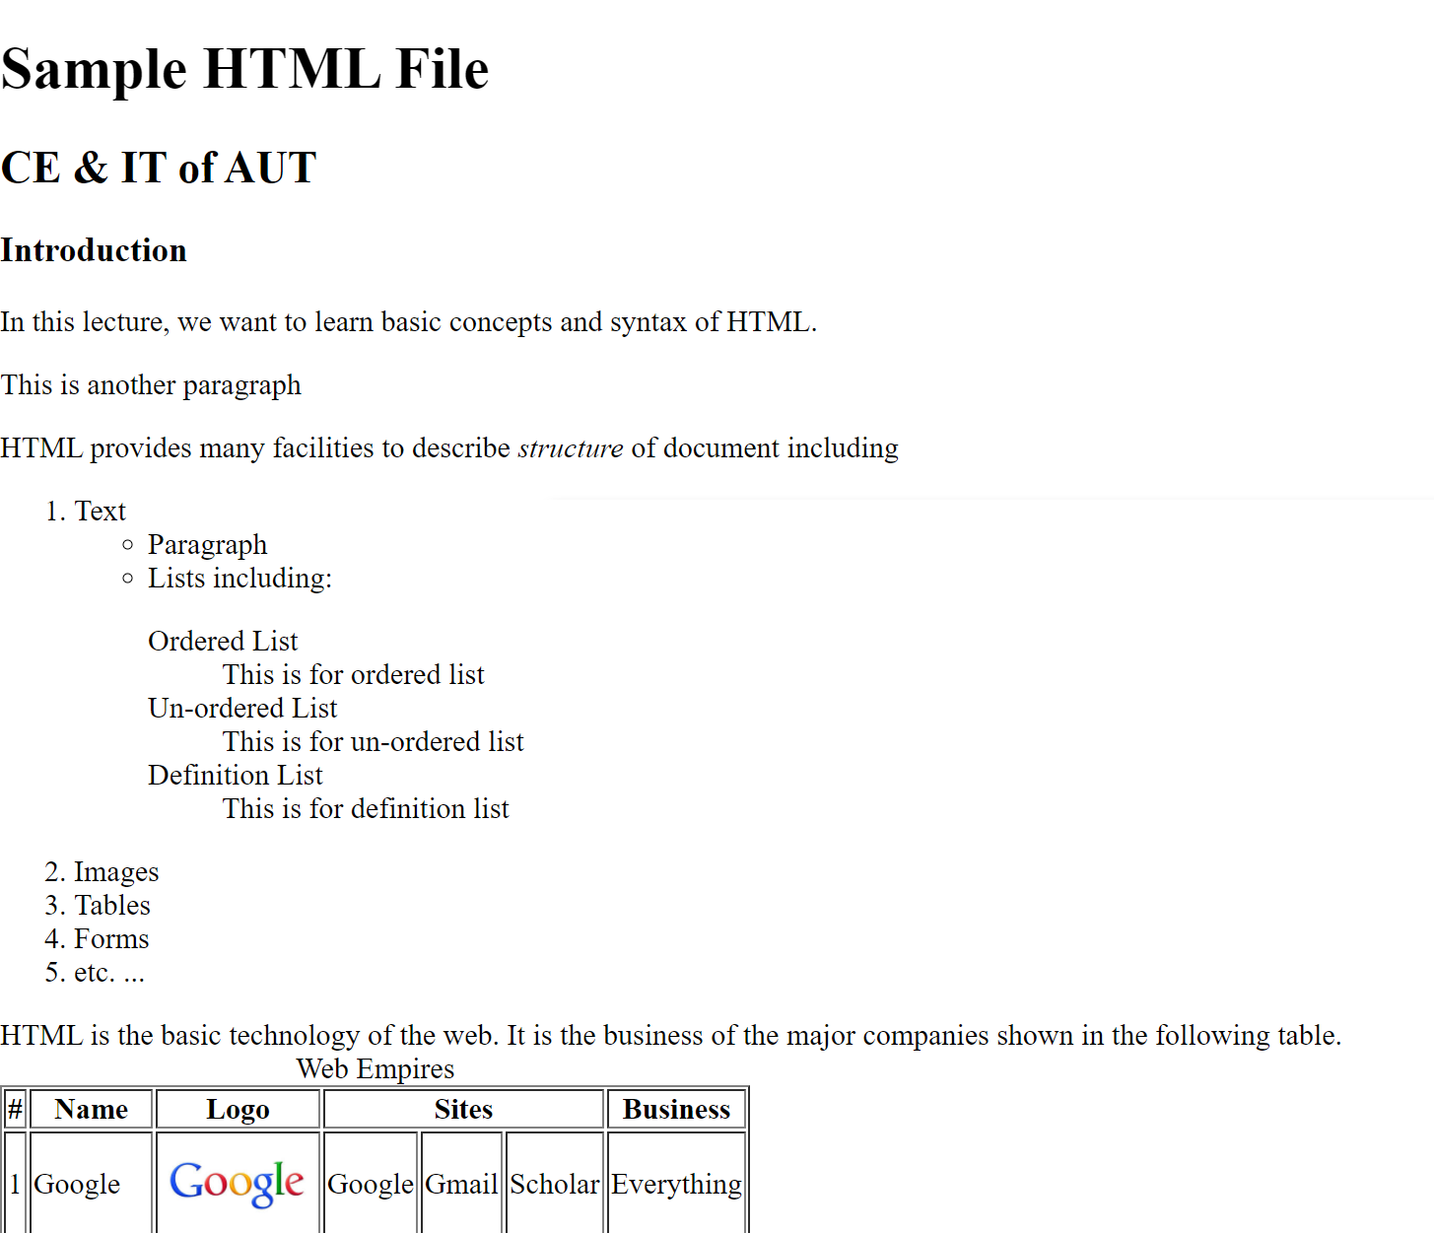
HTML

Slide 4
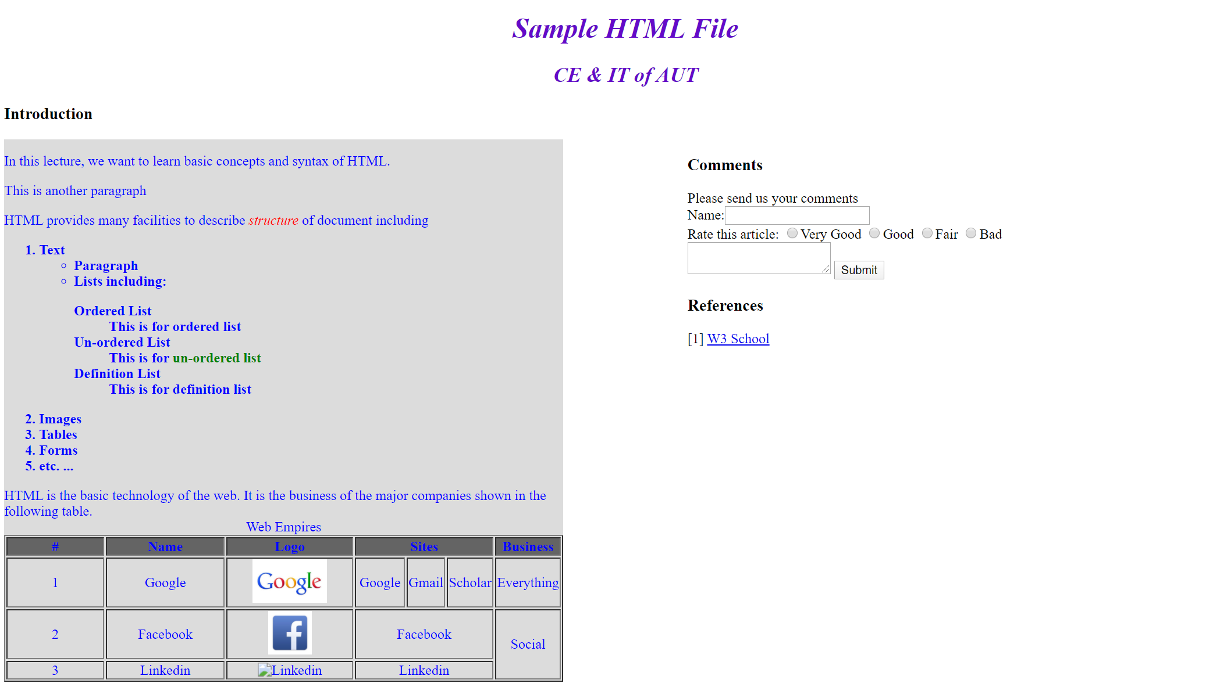
HTML + CSS

Slide 5
Questions
Q3) How is presentation of web page described?
Q3.1) Why not use HTML tags?
Q3.2) How to select elements?
Q3.3) How to modify presentation?
Q3.4) How are rules cascaded?
Q3.5) How are element positioned?

Slide 6
Outline
Introduction
Style Types
Selectors
Cascading
Box-Model
Layout Design
Miscellaneous
CSS Tools

Slide 7
Outline
Introduction
Style Types
Selectors
Cascading
Box-Model
Layout Design
Miscellaneous
CSS Tools

Slide 8
Introduction
HTML: Structure of web pages; moreover
HTML elements have a default presentation
Some elements and attributes are used for presentation (physical formatting)
<em><font size=10 color=red> test </font></em>
No reusability
Tremendous repeated formatting tags
Structure and Formatting mixed up mess

Slide 9
Introduction (cont’d)
(in HTML) Separation between
Content & Structure
Presentation
Content & Structure are specified by XHTML tags
Cascading Style Sheet (CSS) defines the presentation and style of web pages
How elements are presented in web pages!!
Override the default presentation of elements
CSS is optional, if presentation is not specified, browser uses its own default presentation for HTML elements

Slide 10
Introduction (cont’d)
HTML
<h1> Test </h1>
Rendering
Test
CSS
h1 {color: green}
Browser
Documents on Web Server

Slide 11
Introduction (cont’d)
Created by Hakon Wium Lie of MIT in 1994
The W3C standards (CSS 1,2,3,4) to control visual presentation of web pages
Uses a different syntax than HTML/XHTML
A different language
Works with the common visual browsers
Greatly simplifies visual design, site management and content maintenance

Slide 12
Introduction (cont’d)
Advantages
Reuse styling rules in multiple pages
Make easier site management
Saves time
More control over layout
Styles + JavaScript → dynamic presentation
Multiple presentation of the same content
Media dependent presentation

Slide 13
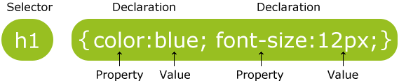
CSS Styles
Styles are defined by rules
Selector + Declaration block (property + value)
General structure of style rules
Selector1, …, SelectorN{
Property1: Value1, …, ValueN;
Property2: Value2, …, ValueN;
…
/* This is comment */
}
Notes:
Selectors can be grouped
Some time multiple value can be used for example in fonts!

Slide 14
Selectors
Tag based
Class based
ID based
DOM tree based
Attribute based
…
We will discuss later in more details

Slide 15
Sample Properties
Font:
font-family
font-size
font-style
Text:
text-align
color
letter-spacing (cm, px, …) (T H I S)
word-spacing (cm, px,…) ( THIS IS SPACE)
Background:
background-color
background-image

Slide 16
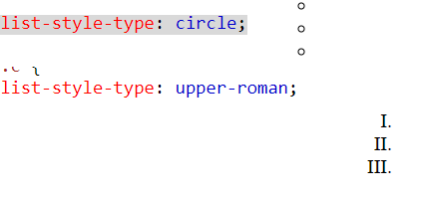
Sample Properties (cont’d)
Table:
spacing
color
alignment
List:
style
style-image
‌Box Model:
border-color, border-style, border-width
width, …
background-color, …
Complete list: http://www.w3.org/style/css/

Slide 17
Values
Values depend on property
Predefined keywords
left, right, italic, none, …
Color
red, green, blue, …
#XXYYZZ where 00 <= XX,YY,ZZ <=FF
rgb(XX, YY, ZZ) where 0 <= XX,YY,ZZ <=255
Size & Length & Font-size & …
Absolute: cm, in, mm, pt, px, …
Relative (to its normal): %, em, ex, rem, vw, vh, vmin, vmax, … (we discuss later)
Complete list: https://www.w3.org/TR/css3-values/

Slide 18
Outline
Introduction
Style Types
Selectors
Cascading
Box-Model
Layout Design
Miscellaneous
CSS Tools

Slide 19
Inline Styles
Add styles to each tag within HTML file!!!
Used to format a single HTML element
Selector is implicitly specified
Style is given as an attribute
<h1 style="color:red; font-family: sans-sarif">Test Heading 1</h1>
Why?!!
Hard to update
Violates structure-style separation
(Only for) Styling exceptional elements

Slide 20
Internal (embed) Styles
A style is used in the entire HTML file
Used to control style of elements (e.g., all h1) in a single web page
<head>
<style type="text/css">
h1 {color: red;
font-family: sans-serif;}
</style>
</head>
Notes:
The default value is type ="text/css", which indicates that the content is CSS.

Slide 21
External Styles
A text file containing style rules
Used to control style in multiple web pages
Example
A text document with .css extension contains
h1, h2, h3, h4, h5, h6 {
color: #FF0000;
font-family: sans-serif;
}

Slide 22
External Styles (cont’d)
External style file is used in XHTML web page through linking it to the web page
<head>
<title>External CSS</title>
<link href="external_css.css" rel="stylesheet" type="text/css" />
</head>
Notes:
A rel="stylesheet" value specifies that the stylesheet file will be loaded into the current page.

Slide 23
External Styles Advantages
Avoid repeating styles for each page
It is easier to update whole site
CSS can be cached independent of HTML
Different style sheets can be attached to the same document
Personalized & Customization & Media dependent
A style sheet can import and use styles from other style sheets

Slide 24
Media Depended Presentation
Web page presentation can be depended on media
<style type="text/css" media="screen">
<link rel="stylesheet" href="style.css" media="all">
Available media types
All : Used for all media type devices
Screen : Used for computer screens, tablets, smart-phones etc.
Print : used for printers

Slide 25
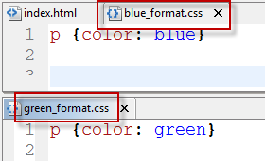
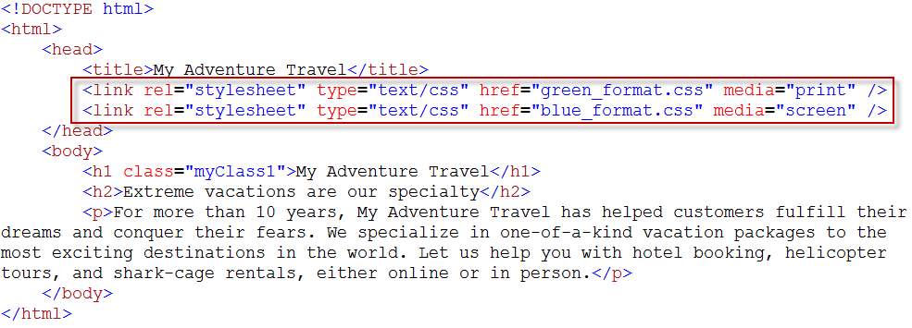
Media Depended Presentation

Slide 26
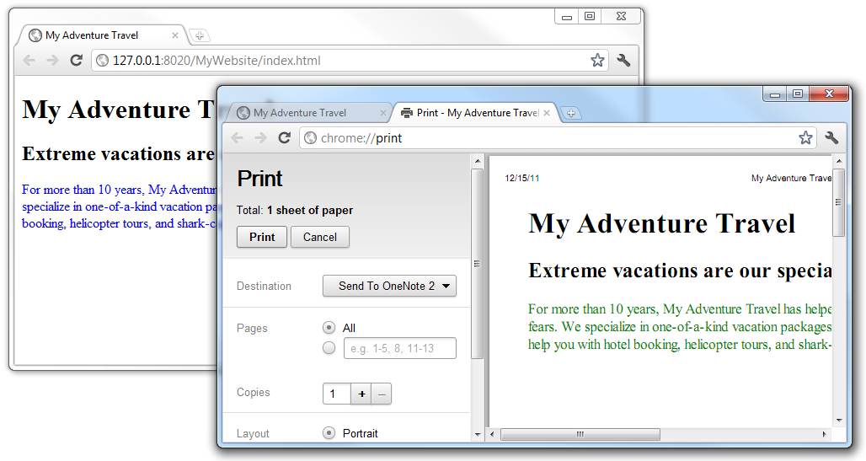
Media Depended Presentation

Slide 27
Outline
Introduction
Style Types
Selectors
Cascading
Box-Model
Layout Design
Miscellaneous
CSS Tools

Slide 28
CSS Selectors
*: universal selector (all elements)
HTML Tags
Attribute based
Special attributes
Class based: per-class style
ID based: per-element styles
In combination with tag names
In general attribute name, value, …
DOM tree based
Child & Descendant, Sibling, …
Pseudo-class & Pseudo-element
We may not need all these selectors at the beginning; however, they are powerful tools that simplify complex CSS rules

Slide 29
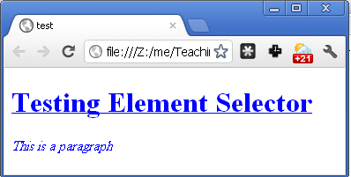
Element Selector
<head>
<style type="text/css">
* {color: blue}
h1 {text-decoration: underline}
p {font-style: italic}
</style>
</head>
<body>
<h1> Testing Element Selector </h1>
<p> This is a paragraph </p>
</body>

Slide 30
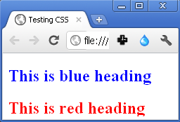
id Selector
Assign ID to elements
<h2 id="blue_heading"> This is blue heading </h2>
<h2 id="red_heading"> This is red heading </h2>
Define style for each ID
#blue_heading {color:blue;}
#red_heading {color:red;}

Slide 31
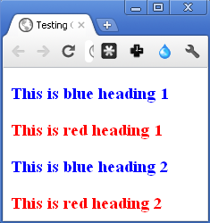
class Selector
Assign class to element
<h3 class="blue_heading"> This is blue heading 1</h3>
<h3 class="red_heading"> This is red heading 1</h3>
<h3 class="blue_heading"> This is blue heading 2</h3>
<h3 class="red_heading"> This is red heading 2</h3>
Define style of each class
.blue_heading {color:blue;}
.red_heading {color:red;}

Slide 32
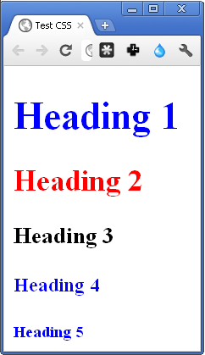
Combined Element & Class Selector
<style type="text/css">
.all {color: blue;}
h2.all {color: red;}
h3.all {color: black;}
</style>
<h1 class="all"> Heading 1 </h1>
<h2 class="all"> Heading 2 </h2>
<h3 class="all"> Heading 3 </h3>
<h4 class="all"> Heading 4 </h4>
<h5 class="all"> Heading 5 </h5>

Slide 33
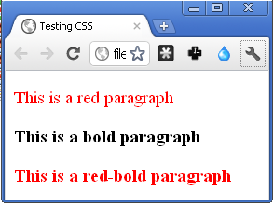
Multiple Classes
<style type="text/css">
.red {color:red;}
.bold {font-weight:bold;}
</style>
<body>
<p class="red"> This is a red paragraph </p>
<p class="bold"> This is a bold paragraph </p>
<p class="red bold"> This is a red-bold paragraph </p>
</body>

Slide 34
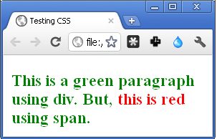
<div> and <span> in CSS
HTML:
<div class="green_color">
This is a green div. But, <span id="red_color"> this is red </span> using span.
</div>
CSS:
.green_color {
color:green;
font-weight:bold;}
#red_color {color:red;}
Notes:
The div (division) element is a generic block-level element, most often used to divide page content into blocks. A block element is a page element that starts a new line and has a width equal to the entire page or the parent container.
The span element is a generic inline element, typically used to apply styling to a portion of inline content. An inline element does not start a new line and only takes up as much space on the page as its content

Slide 35
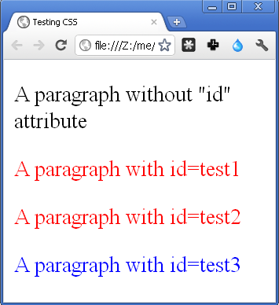
Attribute Selector
<p> A paragraph without "id" attribute </p>
<p myid="test1"> A paragraph with id=test1 </p>
<p myid="test2"> A paragraph with id=test2 </p>
<p myid="test3"> A paragraph with id=test3 </p>
CSS Part:
p[myid] {color:red}
p[myid="test3"] {color:blue}

Slide 36
Pseudo-Classes
HTML elements have states
(Almost) all elements: mouse over, clicked, …
<a>: Normal (Unvisited), Visited, …
Pseudo-classes are used to style the states
active, first-child, last-child, …
E.g. (in below example order is important)
a:link {color:#FF0000} /* unvisited link */
a:visited {color:#00FF00}
a:hover {color:#FF00FF}
a:active {color:#FFFFFF} /* selected link */
Notes:
First-child: select any that is first element (for example firs <p> between all <p>s
a:hover MUST come after a:link and a:visited in the CSS definition in order to be effective.
a:active MUST come after a:hover in the CSS definition in order to be effective.

Slide 37
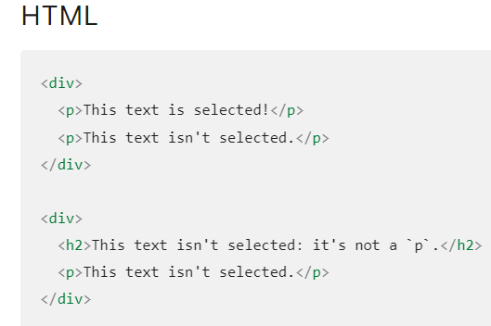
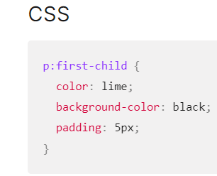
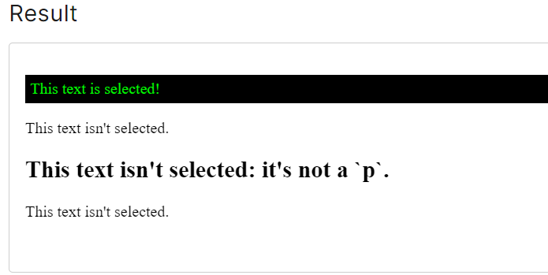
Pseudo-Classes
Notes:
First-child: select any that is first element
a:hover MUST come after a:link and a:visited in the CSS definition in order to be effective.
a:active MUST come after a:hover in the CSS definition in order to be effective.

Slide 38

Pseudo-Elements
first-letter (in heading & paragraph)
p:first-letter {font-size: 200%;}
p::first-letter {font-size: 200%;} (in CSS3)
first-line (in paragraph)
p:first-line {color: red;}
selection : selector matches the portion of an element that is selected by a user.
::selection {
color: red;
background: yellow;}

Slide 39
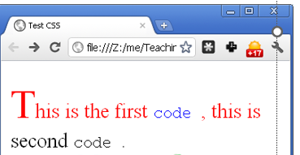
Pseudo-Classes/Elements (cont’d)
<style type="text/css">
p code:first-child {color: blue;}
p:first-letter {font-size: 200%;}
p:first-line {color: red;}
</style>
<p> This is the first <code> code
</code>, this is second <code>
code </code>. <br />
</p>

Slide 40
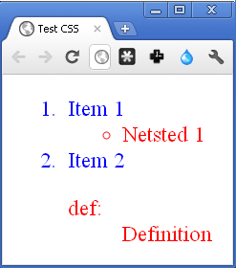
DOM based: Child Selector
When we want to select elements which are inside other elements
To select a (direct) child of parent
parent > child {property: value;}
<style type="text/css">
ol {color: red;}
ol > li {color: blue;}
</style>
<ol>
<li> Item 1 </li>
<ul> <li> Netsted 1</li> </ul>
<li> Item 2 </li>
<dl> <dt> def: <dt> <dd> Definition </dd>
</dl>
</ol>
Notes:
Document Object Model)

Slide 41
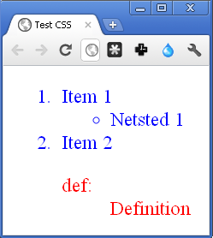
DOM based: Descendant Selector
To select descendant of a tag
tag descendant {property: value;}
<style type="text/css">
ol {color: red;}
ol li {color: blue;}
</style>
<ol>
<li> Item 1 </li>
<ul> <li> Netsted 1</li> </ul>
<li> Item 2 </li>
<dl> <dt> def: <dt> <dd> Definition </dd>
</dl>
</ol>

Slide 42
DOM based: Sibling Selector
When we want to select elements which are next to other elements
To select tag2 which is immediate successive sibling of tag1
tag1 + tag2 {property: value;}
To select tag2 which is a successive sibling of tag1
tag1 ~ tag2 {property: value;}

Slide 43
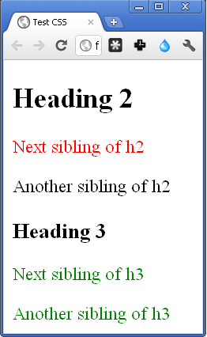
Sibling Selector
h2+p {color:red;}
h3~p {color:green;}
<h2> Heading 2 </h2>
<p> Next sibling of h2 </p>
<p> Another sibling of h2 </p>
<h3> Heading 3 </h3>
<p> Next sibling of h3 </p>
<p> Another sibling of h3 </p>

Slide 44
CSS Selectors Summary
*: universal selector (all elements)
HTML Tags: h1, …, h6, p, li, table, tr, …
Class: .
ID: #
General attribute: []
Child: >
Descendant: (space)
Sibling: + ~
Pseudo-class: active, hover, …
Pseudo-element: first-child, before, after, …

Slide 45
Outline
Introduction
Style Types
Selectors
Cascading
Inheritance
Conflict & Overriding
Box-Model
Layout Design
Miscellaneous
CSS Tools

Slide 46
Cascading
Browser Default
External-1
External-n
Internal-1
Internal-n
Assuming there is not any conflicting style and external styles are linked before internal styles in the head
Inline
User

Slide 47
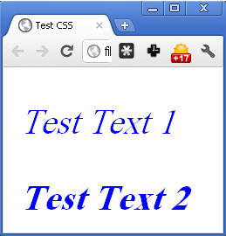
Cascading (cont’d)
test.css file :
p {font-style: italic;}
Html file:
<head>
<link href="test.css"
rel="stylesheet"
type="text/css" />
<style type="text/css">
p {color: blue;}
</style>
</head>
<body>
<p> Test Text 1</p>
<p style="font-weight: bold;"> Test Text 2 </p>
</body>

Slide 48
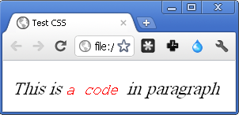
Inheritance
HTML document is interpreted as a tree
DOM tree
Children inherit some styles from their parent
Not all properties, e.g. border
<style type="text/css">
p {font-style: italic;}
code {color: red;}
</style>
<p>This is <code> a code </code> in paragraph </p>

Slide 49
Conflicting Styles & Overriding
What happen if multiple style rules specify different values for the same property of an element?
External style: p {color: red}
Internal style: p {color: blue}
They are conflicting
What is the final rule?
It depends on
Rule types, order, …
Specified by the overriding algorithm

Slide 50
Overriding
In general,
Priority 1: more specific
Inline > ID > Class > Element (Tag) > Div/Span
Priority 2: more closer to the element if they are specific as the same as each other (e.g., both are id selector)
Inline > Internal
Inline > External
Internal <?> External
The style that comes after the other (when define in head)
styles override more general styles
Children’s style overrides parent’s style
Notes:
Override: neglect
اولویت inline بیشترین است در اولویت اول (در خود داخل تگ نوشته شده است.)

Slide 51
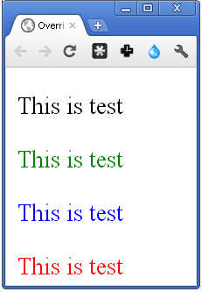
Overriding (cont’d)
<style type="text/css">
p{color: red;}
p.c{color: blue;}
p#i{color: green;}
</style>
<p class="c" id=" i "
style="color: black;"> This is test </p>
<p class="c" id="i"> This is test </p>
<p class="c"> This is test </p>
<p> This is test </p>

Slide 52
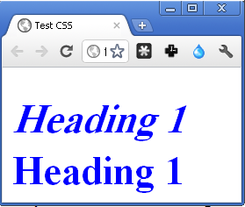
Overriding (cont’d)
To prevent overriding, add !important
When an “!important” rule is used on a style declaration, this declaration will override any other declarations
h1{font-style: italic;
color: blue !important}
<h1> Heading 1 </h1>
<h1 style="font-style: normal;
color=red">Heading 1</h1>

Slide 53
Outline
Introduction
Style Types
Selectors
Cascading
Box-Model
Layout Design
Miscellaneous
CSS Tools

Slide 54
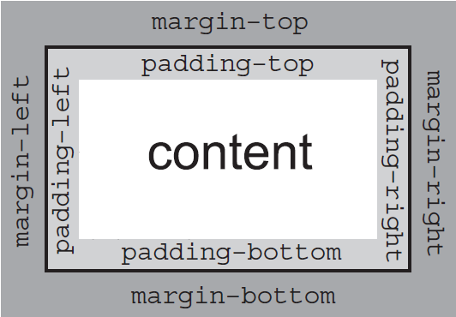
CSS Box Model
Each HTML element is a box
Content
Padding
Border
Margin
border-right
border-top
border-left
border-bottom

Slide 55
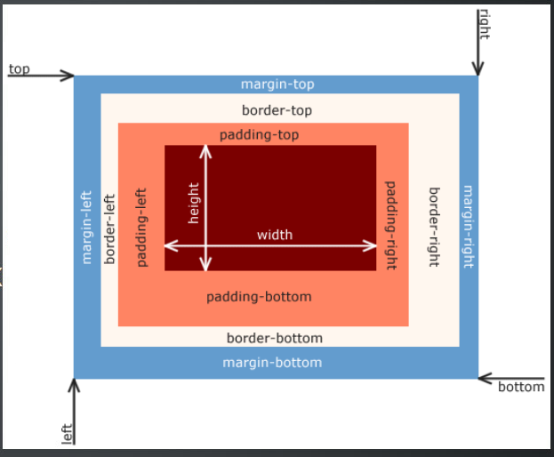
CSS Box Model

Slide 56
CSS Box Model Properties
Borders
Color, Width, Style, …
Individual (for each left,bottem,right,top) or altogether
Spaces (Padding & Margins)
Individual or altogether
Content
Dimensions
Background
Color
Image

Slide 57
CSS Box Model (cont’d)
Border
border-left, border-right, border-bottom, border-top
border: All borders
border-X-color, border-X-style, border-X-width
Padding
padding-left , padding-right , padding-top , padding-bottom
padding: All padding
Margin
margin-left , margin-right , margin-top , margin-bottom
margin: All margins
Centering block elements margin-left: auto; margin-right: auto;
Content (dimensions)
width, height, max-width, …

Slide 58
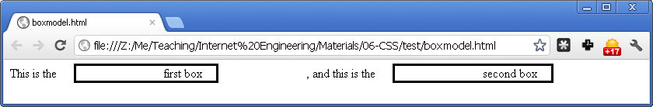
CSS Box Model (cont’d)
.box { border-style:solid; <!-- displaying a single, straight, solid line) -->
border-width:3px; <!– solid box width) -->
border-color:black; ; <!– solid box color) -->
margin-left:0.5cm; ; <!– solid box margin from left) -->
padding-left:1cm; <!– inside of slolid box and where inside text start ) -->
margin-right:3cm;
padding-right:0.5cm; }
This is the <span class="box">first box</span>, and this is the <span class="box">second box</span>

Slide 59
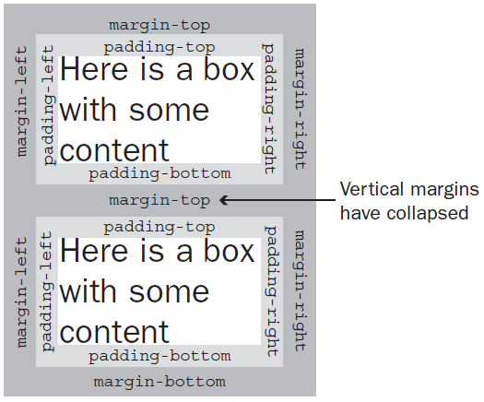
Vertical Margin Collapse
When a bottom margin of one element meets the top margin of another, only the larger of the two will show
This only applies to vertical margins; the same is not true for left and right margins

Slide 60
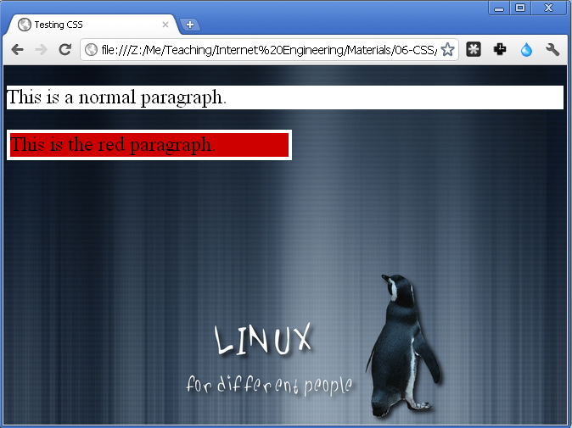
Content: Background
background-image & background-color
<style type="text/css">
body{
background-image: url("linux.jpg");
font-size: 3em;
}
p {background-color: white;}
p#red{
width: 50%;
border-style: solid;
border-width: 8px;
border-color: white;
background-color: #CF0000;
}
</style>
<p> This is a normal paragraph. </p>
<p id="red"> This is the red paragraph. </p>
Notes:
P Width:50% : p percent of browser window (Resize the browser window to see the effect)

Slide 61
Content: Background Image (cont’d)
Background image repetition
background-repeat
repeat (default)
no-repeat
repeat-x
repeat-y
Avoid background image scrolling
background-attachment: fixed
Background image position
background-position: X Y

Slide 62
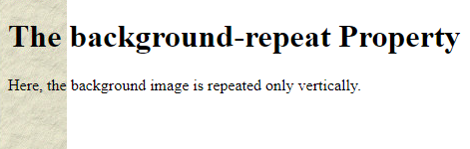
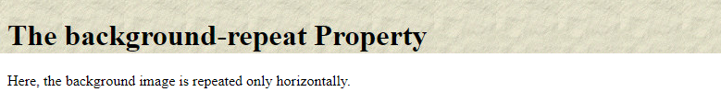
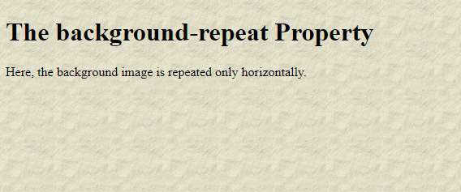
Content: Background Image (cont’d)

Slide 63
Block vs. Inline
Block-level elements:
The default height is the height of the content
The default width is the length of the page
We can set height & width in CSS
Flow top to bottom
All block-level elements appear on their own line

Slide 64
Block vs. Inline (cont’d)
Inline elements:
The height is the height of the content
The width is the width of the content
We cannot set the height & width in CSS
Flow left to right
Inline elements appear on the same line unless the line wraps or there’s an explicit line break

Slide 65
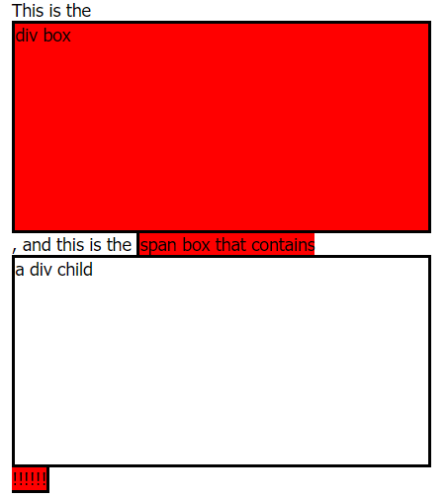
Block vs. Inline (cont’d)
.box{
border-style:solid; border-width:3px; border-color:black;
width: 10cm; height: 5cm; background-color:red;
}
.test{
border-style:solid; border-width:3px; border-color:black;
width: 10cm; height: 5cm;
}
<body>
This is the <div class="box">div box</div>, and this is the <span class="box"> span box that contains <div class="test">a div child</div> !!!!!!</span>
</body>

Slide 66
Outline
Introduction
Style Types
Selectors
Cascading
Box-Model
Layout Design
Miscellaneous
CSS Tools

Slide 67
Layout Design = Element Positioning
Three positioning schemes
Normal
Block-level elements flow from top to bottom
Inline elements flow from left to right
Specified position
Element is taken out from normal flow
It is placed in the specified position
Float
Elements is taken out from normal flow
It is placed as far right/left as possible to previous element

Slide 68
Specified Positioning
Positioning of block-level element can be specified using the position property
property | value | description
position | static | default position = Normal
 | relative | offset from its normal static position
 | absolute | a fixed position within its containing element
 | fixed | a fixed position within the browser window
 | Sticky | this is basically a hybrid between relative and fixed position
top, bottom, left, right | positions of box's corners

Slide 69
STATIC Positioning
The default position of HTML elements is static.
Static elements are positioned according to the normal flow of the page.
They are not affected by top, left, bottom, and right values

Slide 70
Relative Positioning
A relative positioned element is positioned relative to its normal position
The reserved space (box model: content + padding + margin) for the element is still preserved in normal flow
Position is specified by top, left, right, bottom properties, e.g.,
top: +20px → move the element 20px downward
top: -20px → move the element 20px upward
bottom: +20px → move the element 20px upward
bottom: -20px → move the element 20px downward
left: -20px → move the element 20px left

Slide 71
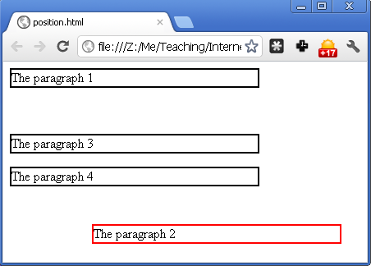
Relative Positioning Example
p{ border-style:solid; border-width:2px;
border-color:black; width:300px; }
#m{
position:relative; left:100; top:150;
border-color:red;
}
<p>The paragraph 1</p>
<p id="m">The paragraph 2</p>
<p>The paragraph 3</p>
<p>The paragraph 4</p>

Slide 72
Absolute Positioning
An absolute position element is positioned relative to the first parent element that has a position other than static
If no such element is found, the containing block is <html>
Absolute positioned elements are removed from the normal flow
The document and other elements behave like the positioned element does not exist (no space for content, padding, margin)
The positioned elements can overlap other elements
Position is specified by top, left, right, bottom properties
Notes:
در اینجا دیگر مارجین و پدینگ و کانتنت فاصله خاصی نمیگیرند.

Slide 73
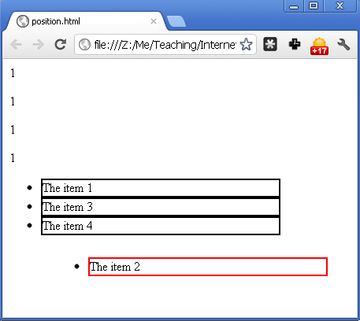
Absolute Positioning Example
ul{position:relative;}
li{border-style:solid; border-width:2px;
border-color:black; width:300px;
}
#m{position:absolute; left:100; top:100;
border-color:red;
}
<p>1</p><p>1</p><p>1</p><p>1</p>
<ul>
<li>The item 1</li>
<li id="m">The item 2</li>
<li>The item 3</li>
<li>The item 4</li>
</ul>

Slide 74
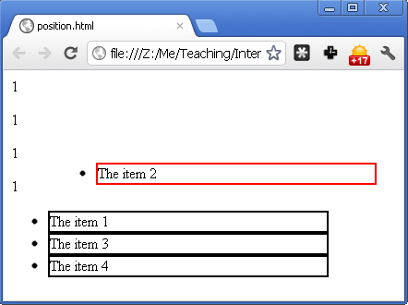
Absolute Positioning Example
ul{position:static;}
li{border-style:solid; border-width:2px;
border-color:black; width:300px;
}
#m{position:absolute; left:100; top:100;
border-color:red;
}
<p>1</p><p>1</p><p>1</p><p>1</p>
<ul>
<li>The item 1</li>
<li id="m">The item 2</li>
<li>The item 3</li>
<li>The item 4</li>
</ul>

Slide 75
Fixed Positioning
An element with fixed position is positioned relative to the browser window
→ Its position does not change by scrolling the page or minmize/maximize page
Very useful for menus
These elements are removed from the normal flow
The document and other elements behave like the fixed positioned element does not exist (no content, padding, margin)
Fixed positioned elements can overlap other elements
Position is specified by top, left, right, bottom properties

Slide 76
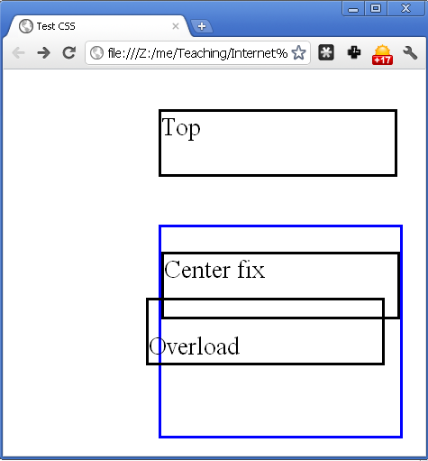
Positioning Example
<style type="text/css">
#top {position: absolute; left: 100px; top: 10px;}
#centerfix {position: fixed; left: 100px; top:100px;}
#overlap {position: relative; left:-10px; top:-30px;}
p {border-style: solid; width:150px; height:40px; }
div {border-style: solid; border-color: blue;}
</style>
<p id="top"> Top </p>
<div id="centerfix">
<p> Center fix </p>
<p id="overlap"> <br />
Overload </p>
</div>

Slide 77
Sticky Positioning
This one is somehow a combination of relative and fixed positions.
A sticky element acts like it's relatively positioned until it's scrolled to a certain threshold. After that, its position becomes fixed (e.g. after scrolling for 20px, it will be fixed on the page).
You must at least specify one of top, left, bottom or right for sticky to work.
Show in w3c

Slide 78
Controlling Overlap Order
Elements can overlap other elements
When positioned out of the normal flow
The z-index specifies the stack order of an element
Positive or negative stack order
Larger value → foreground
If two positioned elements overlap without a z-index:
the element positioned last in the HTML code will be shown on top
z-index only works on positioned elemnts:
absolute, relative, fixed, sticky

Slide 79

Controlling Overlap Order
<style type="text/css">
img {position:absolute; left:0px;
top:0px; z-index:-1;}
h1 {color:red;}
</style>
</head>
<body>
<h1>This is a Linux</h1>
<img src="linux.jpg”/>

Slide 80
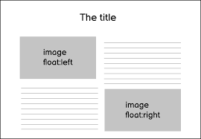
Float Design
Specifies how an element should float.
Element is pushed left or right as far as possible in the row that it would be positioned in when the normal flow is used
Float outer edge touches containing block edge or outer edge of another float elements

Slide 81
Float Design
Content (text) of other elements wraps around it
Float elements do not fill a row individually even if are block-level
No break before/after block-level elements
Configured using
float: left | right | none

Slide 82
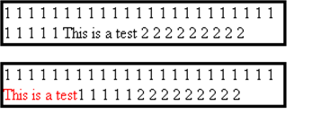
Basic Float Example
Style section code :
.float{float:left;}
Html section code :
<p> 1 … 1 <span>This is a test</span> 2 … 2 </p>
<p> 1 … 1 <span class="float">This is a test</span> 2 … 2 </p>

Slide 83
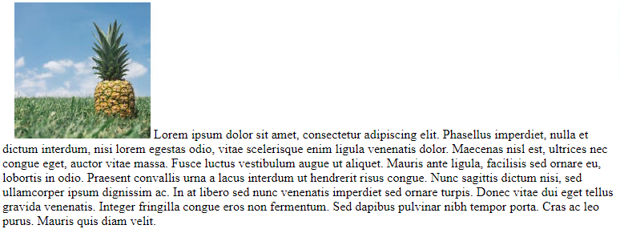
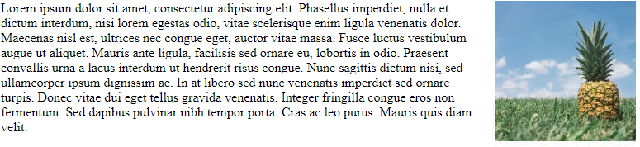
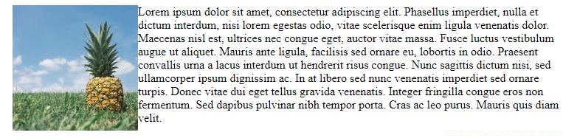
Basic Float Example
No float
Float :right
Float :left

Slide 84
Clearing around Float Elements
Remark: Contents of other elements wrap around previously positioned float object
To stop wrapping content of an element around a float object, the normal element must have clear attribute
clear attribute can be set to left , right, or both
Setting clear attribute of element to left (right)
My content does not wrap around any float object that is in left (right) side of me
In other words, the content of the element is rendered if the float object wouldn't be float
Applicable only for block-level elements

Slide 85
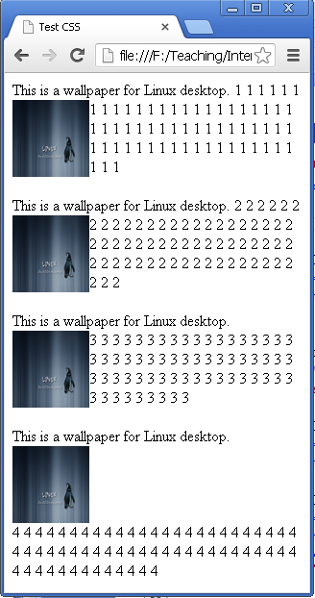
Clear Example
.float{float:left;}
.clear{clear:left;}
<div> This is a wallpaper for Linux desktop.<img class="float" src="linux.jpg" width="80pt" height="80pt" /> <span> 1…1 </span> </div>
<div>
This is a wallpaper for Linux desktop.<img class="float" src="linux.jpg" width="80pt" height="80pt" /> <span class="clear"> 2…2 </span> </div>
<div> This is a wallpaper for Linux desktop.<img class="float" src="linux.jpg" width="80pt" height="80pt" /> <div> 3…3 </div> </div>
<div> This is a wallpaper for Linux desktop.<img class="float" src="linux.jpg" width="80pt" height="80pt" /> <div class="clear"> 4…4</div> </div>

Slide 86
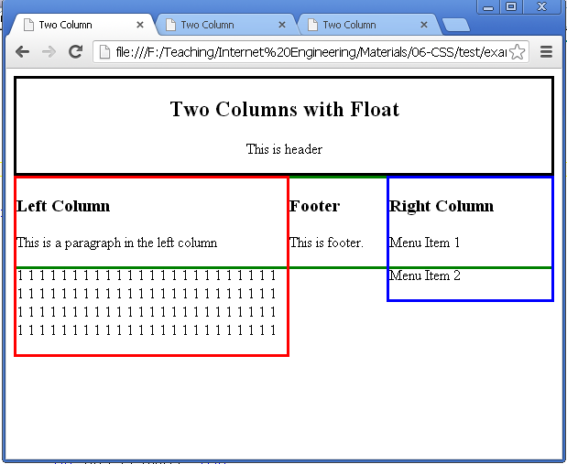
Sample Application of Float & Clear
#head {border: 3px black solid; }
#left {border: 3px red solid; float: left; width: 50%; }
#right {border: 3px blue solid; float: right; width: 30%; }
#footer {border: 3px green solid; }
<div id = "head" style="text-align: center">
<h2>Two Columns with Float</h2>
<p> This is header </p>
</div>
<div id = "left">
<h3>Left Column</h3>
<p> This is a paragraph in the left column </p>
<p> 1 … 1 </p>
</div>
<div id = "right">
<h3>Right Column</h3>
<p>Menu Item 1</p> <p>Menu Item 2</p>
</div>
<div id = "footer">
<h3>Footer</h3>
<p> This is footer. </p>
</div>

Slide 87
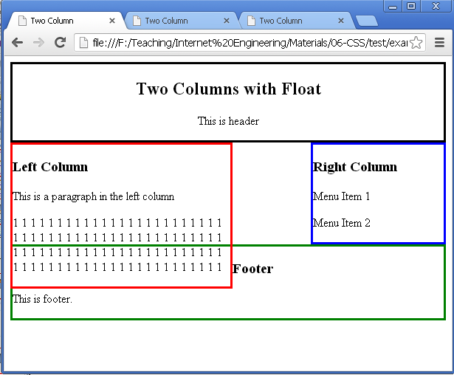
Sample Application of Float & Clear
#head {border: 3px black solid; }
#left {border: 3px red solid; float: left; width: 50%; }
#right {border: 3px blue solid; float: right; width: 30%; }
#footer {border: 3px green solid; }
<div id = "head" style="text-align: center">
<h2>Two Columns with Float</h2>
<p> This is header </p>
</div>
<div id = "left">
<h3>Left Column</h3>
<p> This is a paragraph in the left column </p>
<p> 1 … 1 </p>
</div>
<div id = "right">
<h3>Right Column</h3>
<p>Menu Item 1</p> <p>Menu Item 2</p>
</div>
<div id = "footer">
<h3>Footer</h3>
<p> This is footer. </p>
</div>
clear: right;

Slide 88
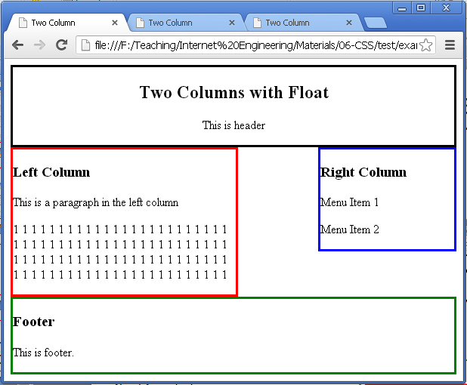
Sample Application of Float & Clear
#head {border: 3px black solid; }
#left {border: 3px red solid; float: left; width: 50%; }
#right {border: 3px blue solid; float: right; width: 30%; }
#footer {border: 3px green solid; }
<div id = "head" style="text-align: center">
<h2>Two Columns with Float</h2>
<p> This is header </p>
</div>
<div id = "left">
<h3>Left Column</h3>
<p> This is a paragraph in the left column </p>
<p> 1 … 1 </p>
</div>
<div id = "right">
<h3>Right Column</h3>
<p>Menu Item 1</p> <p>Menu Item 2</p>
</div>
<div id = "footer">
<h3>Footer</h3>
<p> This is footer. </p>
</div>
clear: both;

Slide 89
Display Property
Displaying elements are mainly influenced by the “display” property
inline: no break after or before, no width/height
block: break after and before, fill a line, width/height are modifiable
inline-block: inside is formatted as block-level box, the element formatted as an inline-level box
Are like inline but can have a width and a height
Some other values too
flex (https://www.w3schools.com/css/css3_flexbox.asp)
grid (https://www.w3schools.com/css/css_grid.asp)

Slide 90
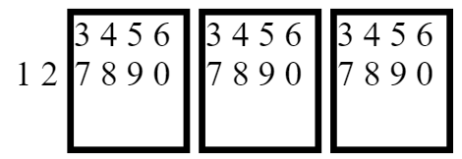
inline-block Display Example
<style type="text/css">
.inline{display: inline; }
.inlineblock{
display: inline-block;
width: 50px ; height: 60px ;
border-style: solid; border-width: 3px ;
}
</style>
<div class="inline">1</div>
<div class="inline">
<span>2</span>
<div class="inlineblock">3 4 5 6 7 8 9 0</div>
<div class="inlineblock">3 4 5 6 7 8 9 0</div>
<div class="inlineblock">3 4 5 6 7 8 9 0</div>
</div>

Slide 91
Outline
Introduction
Style Types
Selectors
Cascading
Box-Model
Layout Design
Miscellaneous
CSS Tools

Slide 92
Element Sizing
Absolute values (Useful?!)
cm centimeters
mm millimeters
in inches (1in = 96px = 2.54cm)
px pixels (1px = 1/96th of 1in)
pt points (1pt = 1/72th of 1in)
Relative values
em Relative to the font-size of the element
rem Relative to font-size of the root element
vw / vh Relative to 1% of the width / height of the viewport
vmin / vmax Relative to 1% of viewport's smaller / larger dimension (between width and height dimension of viewport)
% Relative to the parent element
Notes:
Rem : for example if the root element font is is 16px, an element with the value 1rem will also equal 16px.

Slide 93
Element Sizing: Example
<html><head><style type="text/css">
div{border-style:solid; border-width:1px; border-color:black; }
#parent{ width:15cm; font-size:2rem; }
#cm{ width:10cm; } #mm{ width:10mm; } #in{ width:10in; }
#px{ width:10px; } #pt{ width:10pt;} #em{ width:10em; }
#rem{ width:10rem; } #vw{ width:10vw; } #vh{ width:10vh; }
#vmin{ width:10vmin; } #vmax{width:10vmax; } #percentage{ idth:10%; }
</style>
</head>
<body>
<div>none</div>
<div id="cm">cm</div> <div id="mm">mm</div> <div id="in">in</div>
<div id="px">px</div> <div id="pt">pt</div>
<div id="parent">
<div id="em">em</div> <div id="rem">rem</div> <div id="vw">vw</div>
<div id="vh">vh</div> <div id="vmin">vmin</div> <div id="vmax">vmax</div>
<div id="percentage">%</div>
</div>
</body> </html>

Slide 94
Element Sizing
Responsive Design is the practice of making sure your content looks good on all screen sizes.
Everything in the website including layouts, fonts and images should automatically adapt to the user's device.

Slide 95
Media Query (for RWD)
Apply conditional rules according to media
@media mediatype and (media-feature)
{ CSS-rules; }
mediatype : category of device
all: All devices
print: Print preview mode
Screen: Devices with screens
Speech: Screen readers
media-feature : characteristic of the browser
height, resolution, etc

Slide 96
Media Query Example
<html> <head>
<style type="text/css">
@media screen and (max-width: 600px) {
div.example { display: none; }
body{ background-color: blue; }
}
</style> </head>
<body>
<div class="example">I am an example div</div>
<div>I am NOT an example div</div>
<div class="example">I am an example div</div>
</body> </html>

Slide 97
CSS Functions
CSS functions are used as a value for various CSS properties, e.g.,
Color: rgb(), rgba(), usl(), …
Content: url(), image(), …
Variables & Calculation: var(), calc(), …
Transformation: scale(), skew(), rotate(), …
List: https://www.quackit.com/css/functions/

Slide 98
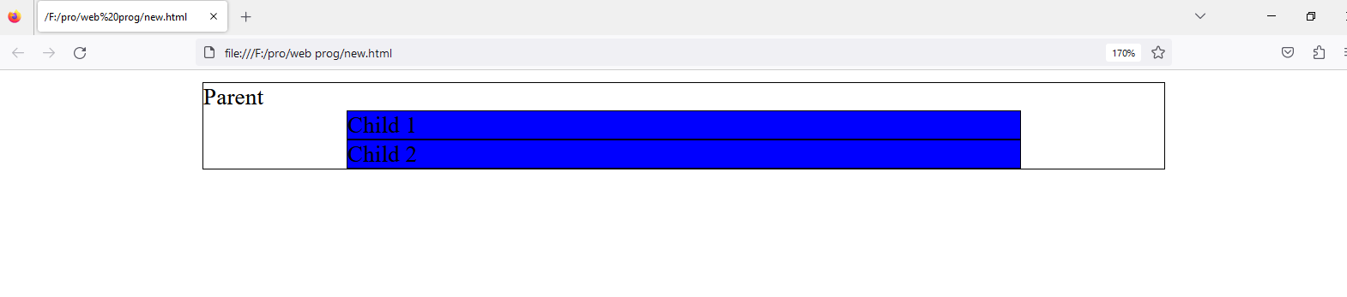
CSS Functions Example
<html><head> <style type="text/css">
body{ --main-bg-color: blue; <! – parameter--> --scale: 70; ; <! parameter--> }
div{ border-style:solid; border-width:1px;
border-color:black; margin-left: auto; margin-right: auto;
}
.parent{ width: calc(1vw * var(--scale)); }
.child{ background-color: var(--main-bg-color); width: 70%; }
</style> </head>
<body>
<div class="parent">
Parent
<div class="child">Child 1</div>
<div class="child">Child 2</div>
</div>
</body></html>

Slide 99
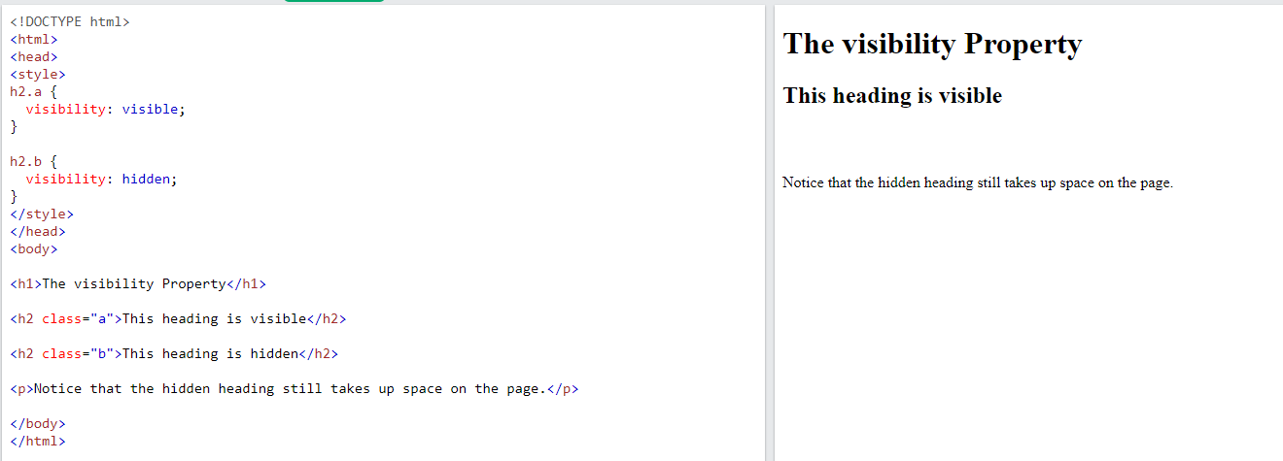
HIDDEN ELEMENTS
visibility:hidden
It is not visible but gets up it’s original space whereasOn the fly CSS modification
display:none
It is hidden and takes no spaceGoogle Chrome

Slide 100
Outline
Introduction
Style Types
Selectors
Cascading
Box-Model
Layout Design
Miscellaneous
CSS Tools

Slide 101
CSS Tools
Validation
W3C validator
Firefox add-ones
Chrome “inspect element”
On the fly CSS modification
Firefox Web Developer CSS Editor
Chrome “inspect element”

Slide 102
Answers
Q3.1) Is it by HTML tags?
No, it is the responsibility of CSS
CSS = Presentation rules + Cascading
Q3.2) How to select elements?
Name, Class, Id, DOM based, pseudo, …
Q3.3) How to modify presentation?
Value of so many attributes (color, font, size, …)
Q3.4) How are rules cascaded?
External to inline, Inheritance in DOM, Conflict resolving algorithm
Q3.5) How are element positioned?
Box Model + Normal, Specified (relative, absolute, fixed) & Float

Slide 103
What is the Next?! CSS3 (& CSS4)
The next standard of CSS
CSS3 is split up into modules
About 30 modules
CSS 4 has more modules
The CSS4 specification is still under development
Many of the new CSS3 properties have been implemented in modern browsers
http://w3schools.com/cssref/css3_browsersupport.htm
Some modules are in level 4
Notes:
There were speculations around CSS4 coming. But it is still not a thing. According to officials, The CSS working group is now working on Selector Level 4. It has new proposed features and selectors.
These new introductions were supposed to come out as CSS4 but It’s not CSS4. It will be level 4 of a single specification.

Slide 104
(Sample) CSS3 Modules
2D Transforms
Manipulation of content in two dimensions, such as rotating, scaling, and skewing objects
3D Transforms
Extends 2D Transforms to manipulate elements in a three-dimensional space
Animations
To modify CSS property values over time, such as position or color, to create animated layouts

Slide 105
(Sample) CSS3 Modules
Backgrounds and Border
Multiple backgrounds, a variety of background properties for positioning and sizing, new border properties with images and shadows
Web Fonts
Defines downloadable fonts
Multi-column Layout
Defines how to flow text into many columns

Slide 106

CSS3 Examples
Text shadowing
h1 {text-shadow: 5px 5px 5px #FF0000;}
Web font
<style type="text/css">
@font-face{
font-family: myFirstFont;
src: url('sansation_light.ttf')
}
div {font-family:myFirstFont;}
</style>
<div>Using the new font</div>

Slide 107


CSS3 Examples: 2D Transformation
<div>Hello. This is a DIV element.</div>
<div id="div2">Hello. This is a DIV element.</div>
transform:rotate(30deg);
transform:scale(2,4);

Slide 108

CSS3 Examples: Multi-Column
<style type="text/css">
.newspaper {column-count:3;}
</style>
<body>
This is a multi-column div.
<div class="newspaper">
1 2 3 4 5 6 7 8 9 10 11 12 13 14 15 16 17 18 19 20 21 22 23
24 25 26 27 28 29 30 31 32 33 34 35 36 37 38 39 40
</div>
</body>

Slide 109
Homework
Homework 2: HTML + CSS

Slide 110
References
Chapters 10-16 of “HTML & CSS: Design and build Websites”
http://www.w3schools.com/css/default.asp
http://www.w3schools.com/css3/default.asp
https://www.w3schools.com/css/css_rwd_intro.asp

