Slide 1
XML + JSON
Web Programming
Spring 2023
Yaghoub Alizadeh
CE Department, Amirkabir University of Technology

Slide 2
Questions
Q6) How to define the data that is transferred between web server and client?
Q6.1) Which technologies?
Q6.2) Is data correctly encoded?
Q6.3) How to access the data in web pages?
Q6.4) How to present the data?
2

Slide 3
Outline
Introduction
Documentation & Validation
Processing (using JavaScript)
Conclusion
3

Slide 4
Introduction
HTML + CSS + JavaScript → Interactive Web pages
Web server is not involved after page is loaded
JavaScript reacts to user events
However, most web applications needs data from server after the page is loaded
A mechanism to communication: AJAX , Fetch
A common (standard) format to exchange data
(Almost) Always the data is structed
4
Notes:
AJAX stands for Asynchronous JavaScript And XML. It is the use of the XMLHttpRequest object to communicate with servers in a nutshell. It can send and receive data in a variety of formats such as JSON, XML, HTML, and text files. XML (the ‘x’ from AJAX refers to XML) is now being replaced by JSON (JavaScript Object Notation). It has some built-in structures like arrays, but parsing and writing is much faster. Even though devs use AJAX with JSON instead of AJAX with XML, the name of the concept remains AJAX (AJAX stands for Asynchronous JavaScript And XML). To implement AJAX with JSON we usually wrap it in an API like jQuery’s $ .get ().
Both ajax and fetch are for asynchoronous resquests to a server and fetching data without reloading page. However fetch is newer api that is simpler and cleaner syntax compated to ajax. .

Slide 5
Introduction (cont’d)
In general (not only in web) to store or transport data, we need a common format, to specify the stucture of data; e.g.,
Documents: PDF, DOCx, PPTx, ...
Objects: Java Object Serialization/Deserialization
How to define the data structure?
Binary format (similar to binary files)
Difficult to develop & debug, machine depended, …
Text format (similar to text files)
Easy to develop & debug, human readable, ...
5

Slide 6
Outline
Introduction
XML (very old but still usable)
Documentation & Validation
Processing (using JavaScript)
Conclusion
6

Slide 7
XML
W3C’s approach
XML: eXtensible Markup Language
A meta-markup language to describe data structure
In each application, a markup language (set of tags & attributes) are defined
<course>
<title> IE </title>
<num> 48 </num>
<teacher> Hassani</teacher>
<students>
<student><name>Ali</name> <fam>Hassani</fam>
<id> 1111 </id></student>
…
</students>
</course>
7

Slide 8
XML (cont’d)
XML: a subset of SGML
Standard Generalized Markup language(SGML)
Expensive, complex to implement
Goals: generality while simplicity and usability
Simplifies SGML by:
leaving out many syntactical options and variants
XML = SGML − {complexity, document perspective} + {simplicity, data exchange perspective}
XML is text based and platform independent
8

Slide 9
XML Document Content (Markups)
Three markup types in XML:
1) Elements
Tag + Attributes
Content
Parsed Character Data
Unparsed Character Data (CDATA)
2) Comments
3) Processing instructions
9
Notes:
CDATA sections can be used to “block escape” literal text when replacing prohibited characters with entity references is undesirable. CDATA sections can appear inside element content and allow < and & character literals to appear. A CDATA section begins with the character sequence <![CDATA[ and ends with the character sequence ]]>. Between the two character sequences, an XML processor ignores all markup characters such as <, >, and &. The only markup an XML pro-cessor recognizes inside a CDATA section is the closing character sequence ]>. The character sequence that ends a CDATA section ]]> must not appear inside the element content. Instead, the closing greater-than character must be escaped using the appropriate entity &gt;. CDATA sections cannot be nested.

Slide 10
XML Elements
XML element structure
Tag + Attribute + Content
<tagname attribute=“value”>
Content
</tagname>
No predefined tag
If content is not CDATA, is parsed by parser
Attributes mainly used for metadata, e.g., ID, class
10

Slide 11
XML Elements’ Attributes
Tags (elements) are customized by attribute
No predefined attributes
<os install="factory">Windows</os>
<os install="user">Linux</os>
11

Slide 12
Processing Instructions
Processing instructions pass information (instruction) to the application that processes the XML file
They are not a part of user data
<?Target String ?>
Common usage
<?xml-stylesheet href="URL" type="text/xsl"?>
XML Declaration is a special PI
<?xml version="1.0" encoding="UTF-16"?>
XML Declaration is always first line in file
12
Notes:
Href : link to xsl file -----XSL: (eXtensible Stylesheet Language) is a styling language for XML.
XSLT stands for XSL Transformations.

Slide 13
Basic XML Document Structure
<?xml version="1.0" encoding="UTF-16"?>
<root-tag>
<inner-tags>
Data
</inner-tags>
<!-- Comment -->
</root-tag>
13

Slide 14
Example
<?xml version="1.1" encoding="UTF-8" ?>
<notebook>
<name>ThinkPad</name>
<model>X230</model>
<spec>
<hardware>
<RAM>8GB</RAM>
</hardware>
<software>
<OS>Linux, Ubuntu 18.04 </OS>
</software>
</spec>
</notebook>
14

Slide 15
Example (CDATA)
<?xml version="1.1" encoding="UTF-8" ?>
<operator>
<mathematic>
+ - * / %
</mathematic>
<comparison>
<![CDATA[
< <= == >= > !=
]]>
</comparison>
</operator>
15

Slide 16
XML Syntax Rules
Start-tag and End-tag, or self-closing tag
Tags can’t overlap
XML documents can have only one root element
White-spaces are preserved
&, <, > are represented by &amp; &lt; &gt;
16

Slide 17
XML Namespaces
In XML, element names are defined by developers
Results in a conflict when trying to mix XML documents from different XML applications
XML file 1
<table>
<tr>
<td>Apples</td> <td>Bananas</td>
</tr>
</table>
XML file 2
<table>
<name>Dinner Table</name>
<width>80</width> <length>120</length>
</table>

Slide 18
XML Namespaces
Name conflicts in XML can easily be avoided by using a qualified names according to a prefix
Qualified name is the prefixed name
Prefix is the namespaces
Step 1: Namespace declaration
Defines a label (prefix) for the namespace and associates it to the namespace identifier
URI/URL is used to be universally unique
Step 2: Qualified name
namespace prefix: local name

Slide 19
XML Namespaces
<?xml version="1.0"?>
<ceit:course
xmlns:ceit="http://ceit.aut.ac.ir">
<ceit:department>
<ceit:name>
Computer Engineering &
Information Technology
</ceit:name>
</ceit:department>
<ceit:name>
Internet Engineering
</ceit:name>
</ceit:course>
Actual name of this tag of parser: http://ceit.aut.ac.ir:department

Slide 20
Default Namespaces
<alltables>
<table xmlns="http://www.w3.org/TR/html4/">
<tr>
<td>Apples</td> <td>Bananas</td>
</tr>
</table>
<table xmlns="http://www.dinnertable.com">
<name>Dinner Table</name>
<width>80</width>
<length>120</length>
</table>
</alltables>

Slide 21
XML vs. HTML
Tags
HTML: Predefined fixed tags
XML: No predefined (meta-language)
User defined tags & attributes
Purpose
HTML: Information display
XML: Data structure & transfer (which is displayed)
Rules’ strictness
HTML (not XHTLM): loose
XML: strong/strict rule checking
21

Slide 22
XML in a General Application
XML by itself does not do anything
XML just describes the structure of the data
Other applications parse XML and use it
XML document
Apache Xerces, Browsers, PHP, …
XML processor
(aka. XML Parser)
SAX, DOM
application
22

Slide 23
XML Technology Components
Data structure (tree) representation
XML document (a text file)
Validation & Conformance
Document Type Definition (DTD) or XML Schema
Element access & addressing
XPath, DOM
Display and transformation
XSLT or CSS
Programming, Database, Query, …
23

Slide 24
Outline
Introduction
JSON
Documentation & Validation
Processing (using JavaScript)
Conclusion
24

Slide 25
JSON
JavaScripters’ approach
JSON: JavaScript Object Notation
Data is represented as a JS object
Standards: RFC 8259, ECMA-404
{ "title": “IE”,
"num": 48,
"teacher": “Hassani”,
"students":
[
{ "name": “Ali”, "fam": “Hassani”, "id": 1111 },
{ "name": “Hassan”, "fam": “Hosseini”, "id": 2222 },
…
]
}
25

Slide 26
JSON Syntax
Data is in name-value pairs
Field name in double quotes, followed by a colon, followed by a value
In JSON, the keys must be strings
Data is separated by commas
Data types: string, number, object, array, boolean, and null
Curly braces hold objects {}
Square brackets hold arrays []
26

Slide 27
Why to Study JSON: Benefits
Simplify data sharing & transport
JSON is text based and platform independent
JSON is simple, efficient, and popular
Extensive libraries to process JSON
To validate, to present, …
In web application, data separation from HTML
E.g., table structure by HTML, table data by JSON
JSON ←→ JS Objects
27

Slide 28
Outline
Introduction
Documentation & Validation
Processing (using JavaScript)
Conclusion
28

Slide 29
Documentation & Validation
Assume that application A exchange data with application B
How does A’s developer document the data format?
How does the receiver know the structure of the data?
In English?
By samples?
How can the receiver validate the data?
29

Slide 30
Valid Data
Syntax
Syntax rules
E.g., all XML tags must be closed
E.g., all keys must be double quoted in JSON
Syntax error → parser fails to parse the file
Symantec (structure)
Application specific rules
E.g. student must have ID
Error → the application fails
30

Slide 31
How to Validate structure?
Method 1: Application specific programs need to check structure of data
Different applications → different programs
Change in data structure → code modification
Method2: General validator + reference document
Reference document
Tag/key names, attributes, tree structure, tag relations, …
Different reference documents
XML: XML Schema , XML DTD (Document Type Definition), …
JSON: JSON Schema
31

Slide 32
Reference Based Validation
parser
interface
XML/JSON data
Parser
Validator
Application
DTD / Schema / …
32

Slide 33
The Reference Documents Usage
The Reference document is the answer of
Documentation
It describes the structure of data which is human readable
Interaction
The description is machine readable
Validation
There are validators to validate the data based on it
33

Slide 34
Outline
Introduction
Documentation & Validation
XML
Processing (using JavaScript)
Conclusion
34

Slide 35
DTD
DTD defines the structure and the legal elements and attributes of an XML document.
DTD is not popular and it is some how deprecated but it is not officially deprecated
35

Slide 36
XML Schema
XML Schema describes the structure of an XML file
Also referred to as XML Schema Definition (XSD)
XML Schemas benefits (DTD disadvantages)
Created using basic XML syntax (DTD has its own syntax)
Validate text element content based on built-in and user-defined data types (DTD does not fully support data type)
Similar to OOP
Schema is a class & XML files are instances
Schema specifies
Elements and attributes, where and how often
Data type of every element and attribute
36

Slide 37
XML Schema (cont’d)
XML schema is itself an XML-based language
Has its own predefined tags
Two categories of data types
Simple: Cannot have nested elements or attribute (i.e., itself is a leaf or attribute)
Primitive: string, Boolean, integer, float, ...
Derived: byte, long, unsignedInt, …
User defined: restriction of base types
Complex: Can have attribute or/and nested elements
37

Slide 38
XML Schema (cont’d)
Simple element declaration
<xs:element name="a name" type="a type" />
Complex element declaration
<xs:element name="a name">
<xs:complexType>
<xs:sequence> or <xs:all> or <xs:choice>
<xs:element name .../>
</xs:sequence> or </xs:all> or </xs:choice>
</xs:complexType>
</xs:element
38

Slide 39
XML Schema (cont’d)
Complex element declaration:
xs:all when all child elements must be present, independent of order.
xs:sequence when child elements must be present per their occurrence constraints and order does matters.
xs:choice when one of the child element must be present.
39

Slide 40
XML Schema (cont’d)
The number of occurrence
minOccurs & maxOccurs
Can be used in
element: the number of the element in the xml file
<xs:element name="foo" maxOccurs="10"> <xs:complexType> <xs:sequence> …
The element “foo” can be at most 10 times
<sequence> and <choice>: number of repetition of children
<xs:element name="foo"> <xs:complexType>
<xs:sequence minOccurs="3"> …
Children must be repeated at least 3 times under a single “foo” element
The element “foo” cannot be more than one (default value of maxOccurs)
40

Slide 41
XML Schema (cont’d)
Notes on minOccurs & maxOccurs
Using the xs:all indicator
minOccurs & maxOccurs indicator can only be 0 or 1
The default value for minOccurs and maxOccurs is 1
To set maxOccurs > 1, we should set minOccurs too
To allow an element to appear an unlimited number of times, use the maxOccurs="unbounded" statement
41

Slide 42
XML Schema Example: note.xsd
<?xml version="1.0"?>
<xs:schema xmlns:xs="http://www.w3.org/2001/XMLSchema">
<xs:element name="note">
<xs:complexType>
<xs:sequence>
<xs:element name="to" type="xs:string"/>
<xs:element name="from" type="xs:string"/>
<xs:element name="date" type="xs:date"/>
</xs:sequence>
</xs:complexType>
</xs:element>
</xs:schema>
**<xs:schema>: elements and data types used in the schema come from the link name space
42

Slide 43
XML Schema Example: note.xml
<?xml version="1.0"?>
<note xmlns:xsi="http://www.w3.org/2001/XMLSchema-instance" xsi:schemaLocation="note.xsd">
<to>Ali</to>
<from>Reza</from>
<date>1391/1/1 </date>
</note>
*** xmlns:xsi : declares a standard namespace prefix (xsi) for a core namespace used in XSD
The xmlns attribute is required in XHTML, invalid in HTML 4.01, and optional in HTML5.
43

Slide 44
Any # of children in any order
<?xml version="1.0"?>
<xs:schema xmlns:xs="http://www.w3.org/2001/XMLSchema">
<xs:element name="bar">
<xs:complexType>
<xs:choice minOccurs="0" maxOccurs="unbounded">
<xs:element name="child1" type="xs:string" />
<xs:element name="child2" type="xs:string" />
<xs:element name="child3" type="xs:string" />
</xs:choice>
</xs:complexType>
</xs:element>
</xs:schema>
44
Notes:
It seems that in “XML Schema 1.1” the maxOccurs = 0|1 limitation is removed from the “all”
44

Slide 45
Attributes for Complex Elements
Schema
<xs:element name="bar">
<xs:complexType>
<xs:all>
<xs:element name="child1" type="xs:string"/>
<xs:element name="child2" type="xs:string"/>
</xs:all>
<xs:attribute name="lang" type="xs:string"/>
</xs:complexType>
</xs:element>
XML
<bar lang="a">
<child1>1</child1> <child2>2</child2>
</bar>
45

Slide 46
Attributes for Simple Elements
Schema
<xs:element name="bar">
<xs:complexType>
<xs:simpleContent>
<xs:extension base="xs:string">
<xs:attribute name="lang"
type="xs:string" />
</xs:extension>
</xs:simpleContent>
</xs:complexType>
</xs:element>
XML
<bar lang="123123">abc</bar>
46

Slide 47
XML Validation Tools
Online validators
validator.w3.org
www.xmlvalidation.com
XML tools & commands
xmllint commands in Linux
xmllint xmlfile --schema schema
XML libraries
LibXML2 for C
Java & C# XML libraries
47

Slide 48
Outline
Introduction
Documentation & Validation
JSON
Processing (using JavaScript)
Conclusion
48

Slide 49
JSON Schema
JSON schema is JSON also
The JSON document being validated or described we call the instance, and the document containing the description is called the schema
{} : This accepts anything, as long as it’s valid JSON.
The most common thing to do in a JSON Schema is to restrict to a specific type. The type keyword is used for that.
{ "type": "string" }
49

Slide 50
JSON SCHEMA
DECLARING A JSON SCHEMA: Since JSON Schema is itself JSON, it’s not always easy to tell when something is JSON Schema or just an arbitrary chunk of JSON.
The $schema keyword is used to declare that something is JSON Schema (optional)
{"$schema": "http://json-schema.org/draft-07/schema#" } {"$schema": "http://json-schema.org/draft/2019-09/schema#"}
{"$schema": "http://json-schema.org/draft-07/schema#" } {"$schema": "http://json-schema.org/draft/2019-09/schema#"}
50

Slide 51
JSON SCHEMA
$id : include an $id property as a unique identifier for each schema(best practice).
For now, just set it to a URL at a domain you control, for example:
JSON Schema includes a few keywords such as title, description, default, examples that aren’t strictly used for validation, but are used to describe parts of a schema
The default keyword specifies a default value for an item
{ "$id": "http://yourdomain.com/schemas/myschema.json" }
51

Slide 52
JSON Schema
Sample Structure:
{
$schema: http://json-schema.org/schema#
$id: URL
"title": “String”
"description": “String”
"type": string, integer, number,
object, array, boolean, null
type specific descriptions/settings
}
schema
Version
Documentation
Documentation
52

Slide 53
(Some) Type Specific Descriptions
String
Length: minLength , maxLength
Content: pattern (restrict particular regular expression (regex)), format (Date, time, IP, …)
Integer, Number (either integers or floating point numbers)
Range: minimum, maximum, multipleOf, …
Object
properties (optional): key-value pairs of an object
The value of properties is an object, where each key is the name of a property and each value is a JSON schema used to validate that property.
53
Notes:
multiple of مضرب

Slide 54
(Some) Type Specific Descriptions
Object (contd.)
\
additionalProperties(true/false):control the handling of extra stuff:
properties whose names are not listed in the properties keyword.
By default any additional properties are
required (a list of members):
takes an array of zero or more strings.
{
"type": "object",
"properties": {
"number": { "type": "number" },
"street_name": { "type": "string"},
"street_type": { "type": "string",
"enum": ["Street", "Avenue","Boulevard"]
}
}
}
54
Notes:
multiple of مضرب

Slide 55
(Some) Type Specific Descriptions
Object (contd.)
Array : for ordered elements
In JSON, each element in an array may be of a different type
Members: items (required type of items),contains (optional item types) , additionalItems(true/false)
Length: minItems, maxItem
{
"type": "object",
"properties": {
“name": { "type": “string" },
“email": { "type": "string"},
“address": { "type": "string“}
},
"required": ["name", "email"]
}
55
Notes:
multiple of مضرب

Slide 56
(Some) Type Specific Descriptions
Array : for ordered elements
In JSON, each element in an array may be of a different type
List validation is useful for arrays of arbitrary length where each item matches the same schema. (for example for array of integer)
For this kind of array, set the items keyword to a single schema that will be used to validate all of the items in the array.
Members: items (required type of items) , additionalItems(true/false)
Length: minItems, maxItem ( Number of items in array)
{
"type": "array",
"items": { "type": "string" }
}
56
Notes:
multiple of مضرب

Slide 57
JSON Schema Example 1
{"$schema": "http://json-schema.org/schema#",
"title": "Product",
"type": "object",
"properties": {
"id": {
"type": "number",
"description": "Product identifier"
},
"name": { "type": "string" },
"price": { "type": "number", "minimum": 0 },
"tags": {
"type": "array",
"items": { "type": "string" }
},
"stock": {
"type": "object",
"properties": {
"warehouse": { "type": "number" },
"retail": { "type": "number" }
}
}
}
}
{
"id": 1,
"name": "Foo",
"price": 123,
"tags": [
"Bar",
"Eek"
],
"stock": {
"warehouse": 300,
"retail": 20
}
}
57

Slide 58
JSON Schema Example 2
{
"title": "a",
"type": "object",
"properties": {
"b": {
"type": "array",
"items": {
"type": "object",
"properties": {
"d":{
"type": "string"
}
}
},
"minItems": 2,
"maxItems": 100
},
"c": {
"type": "number",
}
},
"required": ["b"],
"additionalProperties": false
}
{
"b": [
{"d": "d1"},
{"d": "d2"},
{"z": "d3",
"x":1111}
],
"c":123
"z":123
}
Error
58

Slide 59
JSON Schema Example 2
{
"title": "a",
"type": "object",
"properties": {
"b": {
"type": "array",
"items": {
"type": "object",
"properties": {
"d":{
"type": "string"
}
}
},
"minItems": 2,
"maxItems": 100
},
"c": {
"type": "number",
}
},
"required": ["b"],
"additionalProperties": true
}
{
"b": [
{"d": "d1"},
{"d": "d2"},
{"z": "d3",
"x":1111}
],
"c":123
"z":123
}
59

Slide 60
JSON Schema Validator
Validators available
As Online tools
http://jsonschema.net/
https://www.jsonschemavalidator.net/
As programming languages libraries
Standalone tools
https://json-schema.org/implementations.html
60

Slide 61
Outline
Introduction
Documentation & Validation
Processing (using JavaScript)
XML
Conclusion
61

Slide 62
XML Processor: Parsers
There are two basic types of XML parsers:
Tree (DOM)-based parser:
Whole document is analyzed to create a DOM tree
Advantages: Multiple & Random access to elements, easier to validate the structure of XML
Event-based parser (Simple API for XML(SAX)):
XML document is interpreted as a series of events
When a specific event occurs, a function is called to handle it (we will see it later in PHP)
Advantages: less memory usage and no wait to complete → faster
62

Slide 63
XML Parsing in Browser
Web browsers have built-in XML parser
XML parser output: XML DOM
XML DOM is accessible through JavaScript
DOMParser can parse an input XML string
How to get XML file in Java Script?
Using AJAX
Input from user, …
63

Slide 64
XML DOM
XML DOM is similar to HTML DOM
A tree of nodes (with different types: element, text, attr, …)
Nodes are accessed by getElementsByTagName
Nodes are objects (have method & fields)
DOM can be modified, e.g., create/remove nodes
However
There is not predefined attributes link id/class
getElementById or similar methods are not applicable
Since XML is not for presentation
Nods have not event handler functions
Nodes have not style field
64

Slide 65
XML DOM (cont’d)
Each node have
parentNode, children, childNodes, …
Access to value of a node
In the DOM, everything is a node (with different types)
Element nodes do not have a content value
The content of an element is stored in a child node
To get content of a leaf element, the value of the first child node (text node) should got
More on : https://www.javatpoint.com/xml-dom
65

Slide 66
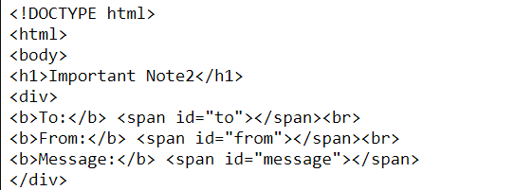
Example1: Message Parser
HTML Part
66

Slide 67
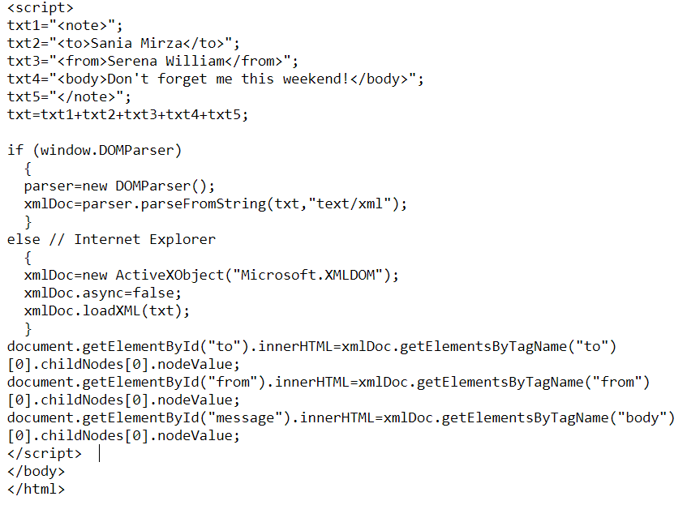
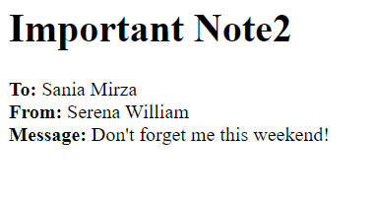
Example1: Message Parser
Java Script
Output
67

Slide 68
Example2: Message Parser
<body>
Enter Your XML:<br />
<textarea name="inputtext1" cols="70" rows="10"><root><msg><from>ali</from><to>reza</to><body>
halamkhobe</body></msg><msg><from>hassan</from><to>helia
</to><body>How are u</body></msg></root> </textarea>
<input type="button" onclick="parseXML()" value="Parse" /> <br />
<div id="outputdiv" style="border-style:solid; border-width:1px; width:70%;"></div>
</body>
68

Slide 69
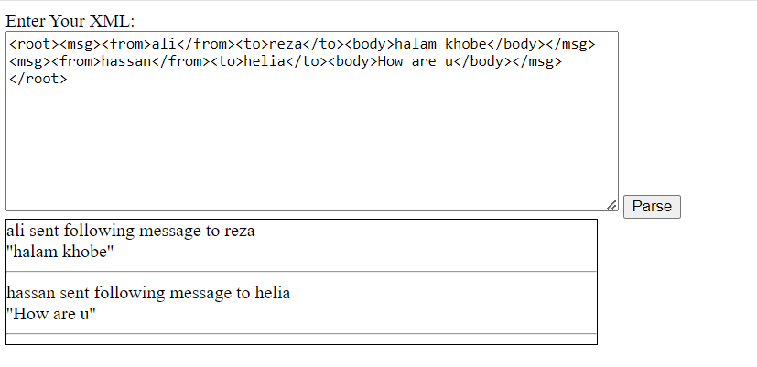
Example2: Message Parser
function parseXML(){
output = "";
input = document.getElementsByName("inputtext1")[0].value;
parser = new DOMParser();
xmlDoc = parser.parseFromString(input,"text/xml");
messages = xmlDoc.getElementsByTagName("root")[0].children;
for(i=0; i < messages.length; i++){
msg = messages[i];
fromText = msg.getElementsByTagName("from")[0].childNodes[0].nodeValue;
toText = msg.getElementsByTagName("to")[0];.childNodes[0].nodeValue;
bodyText = msg.getElementsByTagName("body")[0];.childNodes[0].nodeValue;
output = output + fromText +" sent following message to " + toText + "<br /> ''" + bodyText +"''<hr />"
}
document.getElementById("outputdiv”).innerHTML = output;
}
69

Slide 70
Outline
Introduction
Documentation & Validation
Processing (using JavaScript)
JSON
Conclusion
70

Slide 71
JSON in JavaScript
The JSON object, has two very useful methods to deal with JSON-formatted content
JSON.parse() takes a JSON string and transforms it into a JavaScript object
JSON.stringify() takes a JavaScript object and transforms it into a JSON string
myObj = { a: '1', b: 2, c: '3' };
myObjStr = JSON.stringify(myObj);
console.log(myObjStr);
console.log(JSON.parse(myObjStr));
71

Slide 72
JSON in JavaScript
The JSON object, has two very useful methods to deal with JSON-formatted content
JSON.parse() takes a JSON string and transforms it into a JavaScript object
JSON.stringify() takes a JavaScript object and transforms it into a JSON string
myObj = { a: '1', b: 2, c: '3' };
myObjStr = JSON.stringify(myObj); console.log(myObjStr); console.log(JSON.parse(myObjStr));
72

Slide 73
JSON Syntax (cont’d)
Object field access by .
myObj = { "name":"John", "age":30, "car":null }; x = myObj.name;
Object field access similar to array
myObj = { "name":"John", "age":30, "car":null }; x = myObj["name"];
Looping on Object
myObj = { "name":"John", "age":30, "car":null }; for (x in myObj) { y = x;
...
73

Slide 74
Example: Message Parser
<body>
Enter Your JSON:<br />
<textarea name="inputtext2" cols="70" rows="10">
{"type": "object", "properties": { "messages": { "type": "array",
"items": { "type": "object", "properties": { "from": { "type": "string" }, "to": { "type": "string" }, "body": { "type": "string" }}}}}}
</textarea>
<input type="button" onclick="parseJSON()" value="Parse" /> <br />
<div name="outputdiv2" style="border-style:solid; border-width:1px; width:70%;"></div>
</body>
74

Slide 75
Example: Message Parser
function parseJSON(){
output = "";
input = document.getElementsByName("inputtext2")[0].value;
jsonData = JSON.parse(input);
for(i = 0; i < jsonData.messages.length; i++){
msg = jsonData.messages[i];
output += msg.from + " sent the following message to " + msg.to + "<br /> ''" + msg.body +"''<hr />";
}
document.getElementsByName("outputdiv2")[0].innerHTML = output;
}
75

Slide 76

Example: Message Parser
Enter your JSON:
{
"messages": [
{
"from": "Dudu",
"to": "Bubu",
"body": "Hello"
}
]
}
76

Slide 77
Outline
Introduction
Documentation & Validation
Processing (using JavaScript)
Conclusion
77

Slide 78
Answers
Q6.1) Which technology?
Text based!
XML: A markup met-language with user defined tags
JSON: Object notation
Q6.2) Is data correctly encoded?
XML Validation: DTD and Schema
JSON Schema
Q6.3) How to access the data in web pages?
Parse XML to DOM, we know how to work with DOM
Parse JSON into JS objects
78

Slide 79
What are the Next?!
XSL
XSLT (XSL Transform) - transforms XML into other format
XPath - a language for navigating XML documents
XML’s applications
SVG (Scalable Vector Graphics)
Defines graphics in XML format
Other related technologies in data exchange
Protocol Buffers (Google), Thrift (Apache & FB), YAML (YAML Ain't Markup Language)
79

Slide 80
References
Prof. Bahador Bakhshi's Internet Eng. Course's Slides
“Beginning XML,” chapters 1-5 & chapter 8
http://w3schools.com/xsl/default.asp
https://json-schema.org/understanding-json-schema/
https://json-schema.org/learn/
80

