Slide 1
HTML5
Web Programming
Spring 2023
Yaghoub Alizadeh
CE Department, Amirkabir University of Technology

Slide 2
Questions
Q9) What are the new futures in web pages?
In other words, why new version of HTML?
Q9.1) Search engines don’t show my page!
Q9.2) I don’t want use Flash for multimedia!
Q9.3) Why JS for form validation every time?
Q9.4) Cookies are good, but I need more!!
Q9.5) Can I implement games under web?!
Q9.6) I want use elements on page as objects!
Q9.7) How does the Gmail off-line work?

Slide 3
Outline
Introduction
Page Structure
Multimedia
Forms
Storage
Drag & Drop
Canvas
Other Features

Slide 4
Outline
Introduction
Page Structure
Multimedia
Forms
Storage
Drag & Drop
Canvas
Other Features

Slide 5
Introduction
HTML5 is the next generation of HTML
HTML5 is standardized
Most browsers have some HTML5 support
HTML5 is a cooperation between the World Wide Web Consortium (W3C) and the Web Hypertext Application Technology Working Group (WHATWG)
In 2006, they decided to cooperate and create a new version of HTML
In 2014, HTML5 was released as a W3C Recommendation

Slide 6
HTML5 Goals
Fill the HTML 4 gaps for new modern web apps
New features should be based on HTML, CSS, DOM, and JavaScript
Reduce the need for external plugins like Flash, …
Standardize common elements
More markup to replace scripting
Standardize common usage & applications
Better error handling

Slide 7
HTML5 Standard Status
W3C Recommendations
Note status
People at W3C start discussing some issues
Working Draft
W3C invites comments
Candidate Recommendation
Bugs, issues, …
Recommendation
2004 | WHATWG started
2008 | W3C Working Draft
2012 | W3C Candidate Recommendation
28 Oct. 2014 | W3C Recommendation

Slide 8
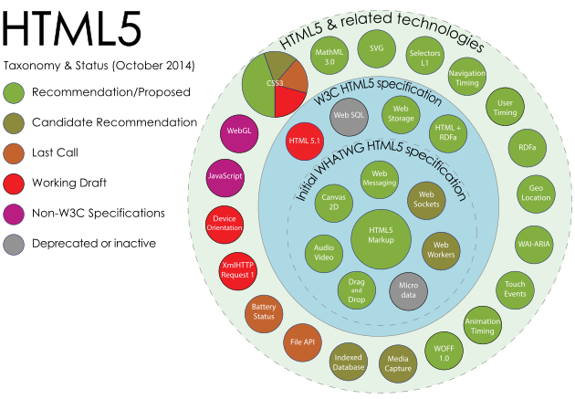
HTML5 New Features
Image source: Wikipedia

Slide 9
HTML5 Document Type & Encoding
HTML5 is not based on XML or SGML
However, browsers need to see <!DOCTYPE …>
To work in standard compliance mode
HTML5 (dummy) Document type
It is dummy because does NOT determine a DTD!
<!DOCTYPE html>
Character encoding
<meta charset="utf-8">
Notes:
DOCTYPE یک تگ نیست دستورالعمل است که در html5 ضروری است و نشان میدهد مرورگر این فایل را که میخواند html است چه نسخه ای و یا xhtml است (تا تمامی قابلیتهایی که در کد است رندر گردد)
عدم تعریف: عدم نمایش درست در مرورگرهای مختلف، نامعتبر بودن از نظر اعتبارسننجی در نتیجه رتبه سایت در search engineها پایین میاد

Slide 10
HTML5 Document Type & Encoding
Html 4.01 Strict:
<!DOCTYPE HTML PUBLIC “-//W3C//DTD HTML 4.01//EN” “http://www.w3.org/TR/html4/strict.dtd”>
Html 4.01 Traditional:
<!DOCTYPE HTML PUBLIC “-//W3C//DTD HTML 4.01 Transitional//EN” “http://www.w3.org/TR/html4/loose.dtd”>
xHtml 1.0 Stric:
<!DOCTYPE html PUBLIC “-//W3C//DTD XHTML 1.0 Strict//EN” “http://www.w3.org/TR/xhtml1/DTD/xhtml1-strict.dtd”>
Notes:
در 4.01 Strict HTML، مرورگرها از استاندارد یک فایل با نام strict.dtd پیروی می کنند و طبق آن، استفاده از Cascading Style Sheets یا همان CSS برای کدنویسی استاندار، مجاز بوده و توصیه شده. استفاده از متون در خارج از چارچوب تگ های استاندارد، استفاده از عناصری مانند bgcolor، استفاده از برخی تگ های HTML مانند Font و… به لحاظ استاندارد در این DTD مجاز نیست (document type defincation)
HTML 4.01 Traditional DTD : طراح از قابلیت های جدید HTML استفاده نمیکند، زیرا مرورگر بازدید کنندگان سایت ممکن است از شیوه قالب دهی صفحات (CSS) پشتیبانی نکند. در مقایسه با استاندارد HTML Strict محدودیت کمتری دارد (بالایی های قابل استفاده هستند) . البته تا آنجا که می شود بهتر است از CSS به جای استایل html استفاده شود
استاندارد XHTML 1.0 Strict تقریبا در اکثر موارد با HTML 4.01 Strict یکسان است.

Slide 11
HTML5 Syntax
HTML5 syntax is very lax
These are equivalent
<meta CHARSET=utf-8 >
<meta charset="utf-8" />
<META charset="utf-8" >
Following tags are not required!!!
Document is successfully validated without them
<html> <head> <body>
Notes:
Lax سهل انگار

Slide 12
Some New Global Attributes
Attribute | Value | Description
contenteditable | true false inherit | Specifies whether a user can edit the content of an element or not
draggable | true false auto | Specifies whether a user is allowed to drag an element or not
hidden | hidden | Specifies that an element should be hidden
spellcheck | true false | Specifies if the element must have its spelling and grammar checked
Example : <p contenteditable="true">This is an editable paragraph.</p>

Slide 13
Outline
Introduction
Page Structure
Multimedia
Forms
Storage
Drag & Drop
Canvas
Other Features

Slide 14
Page Structure
In XHTML (HTML4), page is organized by divs
Assign meaningful ID or Class for divs
E.g., header, navigation, footer, content, …
This approach is ad-hoc
HTML5: new tags for the common divs
<header>, <nav>, <footer>, …
These new elements are to emphasize semantic web rather than new presentation style!
HTML is not just presentation
Each page portion has its own meaning
Semantic web & better search engines
HTML5 recommends the usage of these tags

Slide 15
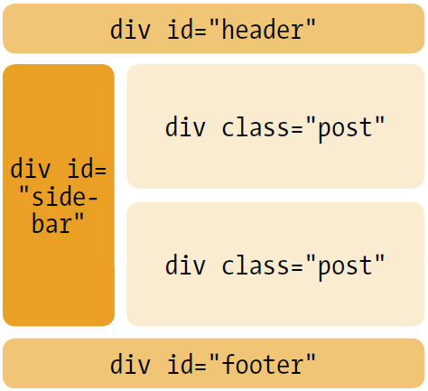
XHTML Based Page Design
A sample weblog
id & class to divs
CSS to arrange divs
Search engines do not understand the meaning of each div
Footer is as important as header!

Slide 16
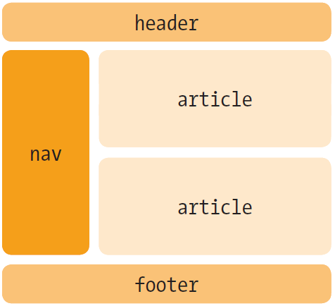
HTML5 Based Page Design
The weblog using HTML5 semantic tags
Browsers do not
have default style for
the new tags
Use CSS
display:block
…
Now, search engine
knows that header >>
article >> footer
Better page ranking!

Slide 17
Sample HTML5 Page Structure
Header
Figure
Navigation
Aside
Section
Image, etc. …
Article
Article
Article
Footer
caption
Footer
Example: http://netstream.ru/htmlsamples/html5-blog/index.html

Slide 18
HTML5 Page Structure Tags
header
Represents a group of introductory
section
Represents a generic document section
article
Represents an independent piece of content of a document, such as newspaper article
aside
Represents an independent piece of content of a document, such as a blog entry

Slide 19
HTML5 Page Structure Tags
hgroup
Groups multiple headers, title and subtitle in the header
footer
Represents a footer for a section
nav
Represents a section intended for navigation
figure
Used to associate a caption together with some embedded content
<img> is used to insert (source) the image
<figcaption> provides caption to the figure

Slide 20
Outline
Introduction
Page Structure
Multimedia
Forms
Storage
Drag & Drop
Canvas
Other Features

Slide 21
HTML5 Multimedia
Before HTML5, there hasn't been a standard multimedia on web
Most videos are shown through a plugin
However, not all browsers have the same plugins
HTML5 specifies a standard way to include multimedia contents (video or audio) on web
<video> element to insert video
<audio> element to play audio sound
<source> element to source the content

Slide 22
HTML5 Video
Video element:
<video width="320" height="240" controls="controls">
. . .
Your browser does not support video tag. </video>
If height and width are set
Required space is reserved on page load
Without these attributes, no space is reserved, Page layout will change during loading
The control attribute adds video controls, like play, pause, and volume

Slide 23
HTML5 Video (Cont’d)
The video file is specified by <source> in <video>
<source src="URL" type="codec type" />
Three codecs: Ogg, MPEG 4, WebM
However, Not all browsers support all formats
Firefox, Opera, and Chrome: Ogg, WebM
Internet Explorer, Chrome, and Safari: MPEG4
The <video> element allows multiple <source>
The browser will use the first recognized format
To cover all the major browsers, use two <source> elements: MPEG4 and Ogg or WebM

Slide 24
HTML5 Video (Cont’d)
<video width="320" height="240" controls="controls"> <source src="movie.mp4" type="video/mp4" /> <source src="movie.ogg" type="video/ogg" /> Your browser does not support video tag. </video>

Slide 25
Video Attributes
Attribute | Value | Description
autoplay | autoplay | The video will start playing as soon as it is ready
controls | controls | Video controls should be displayed
height | pixels | Sets the height of the video player
loop | loop | Video will start over again, every time it is finished
muted | muted | Audio output of the video should be muted
poster | URL | An image to be shown while the video is downloading, or until the user hits the play button
width | pixels | Sets the width of the video player

Slide 26
HTML5 Audio
Three formats: Ogg, WAV, MP3
Ogg: Firefox, Opera, Chrome
MP3: IE9, Chrome, Safari
<audio controls="controls"> <source src="song.ogg" type="audio/ogg" /> <source src="song.mp3" type="audio/mpeg" /> Your browser does not support audio element. </audio>
control, multiple source, and content text is similar to <video> element

Slide 27
HTML5 Audio (cont’d)
Attribute | Value | Description
autoplay | autoplay | Audio will start playing as soon as it is ready
controls | controls | Audio controls should be displayed (such as a play/pause button etc).
loop | loop | Audio will start over again, every time it is finished

Slide 28
(Some) Media Events
Attribute | Description
oncanplay | When a file is ready to start playing (when it has buffered enough to begin)
onemptied | When something bad happens and the file is suddenly unavailable (like unexpectedly disconnects)
onended | When the media has reach the end (a useful event for messages like "thanks for listening")
onerror | When an error occurs when the file is being loaded
onloadstart | When the file begins to load before anything is actually loaded
onpause | When the media is paused either by the user or programmatically
onplay | When the media is ready to start playing
onplaying | When the media actually has started playing
onvolumechange | When the volume is changed which (includes setting the volume to "mute")

Slide 29
Outline
Introduction
Page Structure
Multimedia
Forms
Storage
Drag & Drop
Canvas
Other Features

Slide 30
Forms Current & Future
One of the problems with HTML 4 forms is that they are just dumb fields
Validation is required on the server, of course
But we have to duplicate it in the user’s browser with JavaScript
If browsers had built-in validation for some of the most common data types → ☺
HTML5 defines new input elements

Slide 31
HTML5 New Input Types
New input types in HTML5
Type | Description
url | The input value is a URL
email | The input value is one or more email addresses
date | The input value is a date
month | The input value is a month
week | The input value is a week
time | The input value is of type time
number | The input value is a number
range | The input value is a number in a given range
color | The input value is a hexadecimal color, like #FF8800

Slide 32
HTML5 New Input Types (cont’d)
Support of the new types
Opera & Chrome have (almost) full support
Limited support by other browsers
Automatic validation by browser, usually
email & url & number are checked
date, week, month, range, color are selectable only from valid options
Backward compatibility
Unsupported types are treated as type="text"

Slide 33
HTML5 New Input Types (cont’d)
Support of the new types
Opera & Chrome have (almost) full support
Limited support by other browsers
Automatic validation by browser, usually
email & url & number are checked
date, week, month, range, color are selectable only from valid options
Backward compatibility
Unsupported types are treated as type="text"

Slide 34
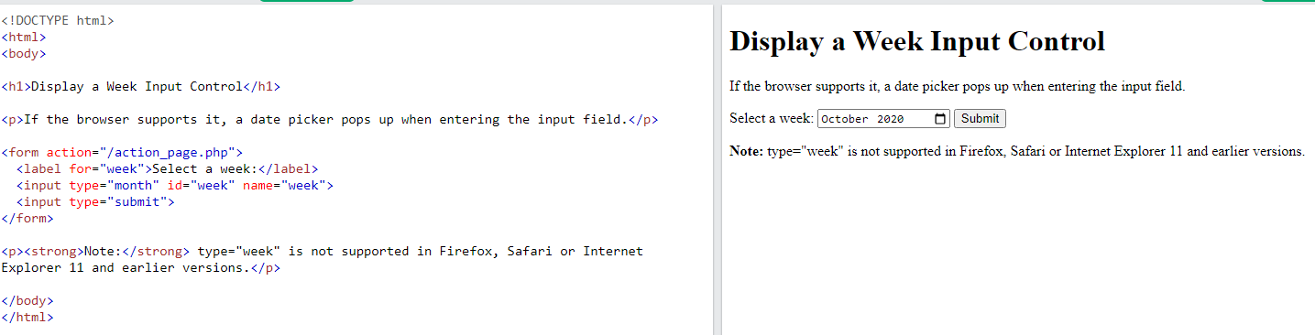
HTML5 New Input Types (cont’d)

Slide 35
HTML5 New Input Types Attributes
Input data in number & range can be controlled
Points: <input type="number" name="points" min="1" max="10" step="2"/>
Attribute | Value | Description
max | number | Specifies the maximum value allowed
min | number | Specifies the minimum value allowed
step | number | Specifies legal number intervals step="3", legal numbers could be -3,0,3,6)
value | number | Specifies the default value

Slide 36
HTML5 New Input Types Attributes
pattern: regular expression
The pattern that input should match with
Country DNS Domain: <input type="text"
name="country_code" pattern="[A-z]{2}" />
required: required
Input field must be filled out before submitting
autofocus: autofocus
Field should automatically get focus when a page is loaded
placeholder: content
The content is shown to user but it is NOT the value of input

Slide 37
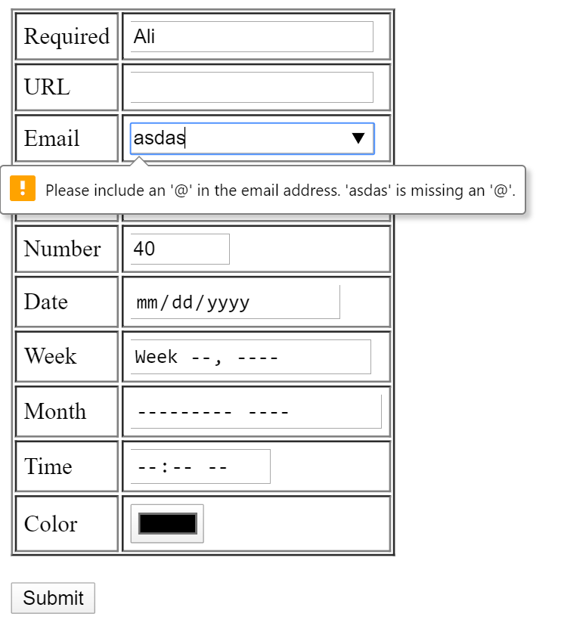
HTML5 Forms Examples

Slide 38
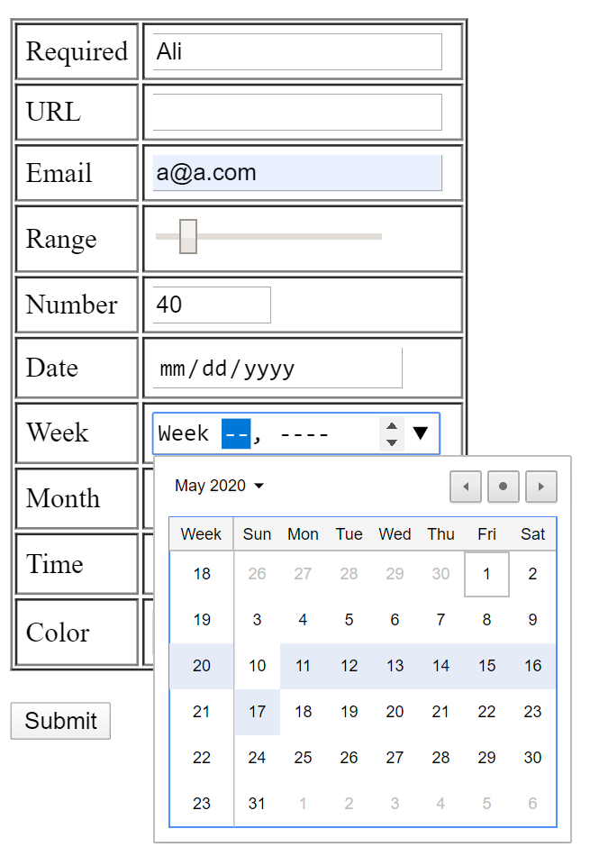
HTML5 Forms Examples

Slide 39
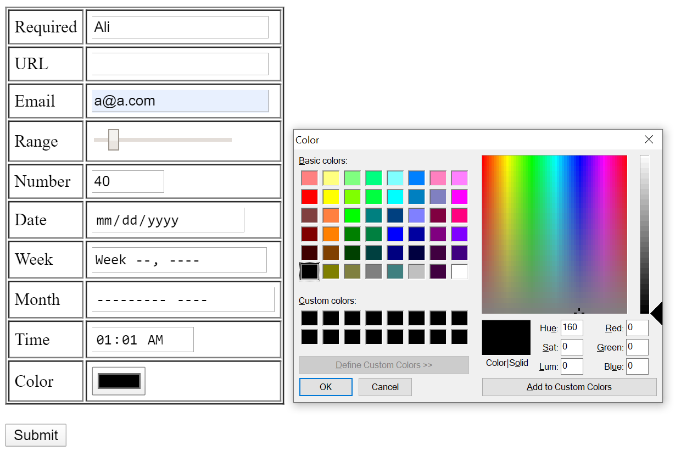
HTML5 Forms Examples

Slide 40
HTML5 New Input Types Attributes
list: datalist
A list of options for an input field
For text, url, email, …
web page: <input type="url" list="url_list" name="link" />
<datalist id="url_list"> <option label="W3Schools" value="http://www.w3schools.com" /> <option label="Google" value="http://www.google.com" /> <option label="Microsoft" value="http://www.microsoft.com" />
</datalist>

Slide 41
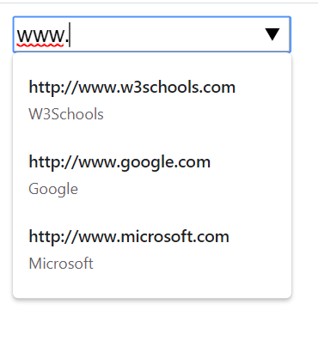
HTML DataList Example

Slide 42
HTML5 Forms Association
In HTML4, input elements must be inside a form to be associated with it
In HTML5, input elements can be associated with forms using form attribute
<form id="foo">
...
</form>
<textarea form="foo"></textarea>

Slide 43
Outline
Introduction
Page Structure
Multimedia
Forms
Storage
Drag & Drop
Canvas
Other Features

Slide 44
Storing Data on the Client
Store data on user side (client, browser)
Earlier, this was done with cookies
Not suitable for large amounts of data
By default, passed on by EVERY request to server
Making it very slow and inefficient
HTML5 offers two new objects for storing data on the client
localStorage: stores data with no time limit
sessionStorage: stores data for one session

Slide 45
Storing Data on the Client
HTML5 data storage
Data is not passed on by every server request
Used in client side only when asked for
To store large amounts of data (~ 2-5MB configurable) in client side without affecting website's performance
Completely client-side web application!
Stores as filesystem resources for the application
Per-site data is stored in different areas
A website can only access data stored by itself
Chrome: Per-Domain, Firefox: Per-Directory

Slide 46
sessionStorage
To store the data for one session
Data is deleted when session finishes
Typically, when the browser tab is closed!
How to create and access sessionStorage:
<script type="text/javascript"> sessionStorage.lastname="Karimi";
var name = sessionStorage.lastname;
</script>

Slide 47
sessionStorage Example
Count page visits in current session
<script type="text/javascript"> if (sessionStorage.pagecount){
sessionStorage.pagecount =
Number(sessionStorage.pagecount) + 1; } else{
sessionStorage.pagecount = 1;
} document.write("Visits "+ sessionStorage.pagecount + " time(s).");
</script>
Notes:
Try Clickcount.

Slide 48
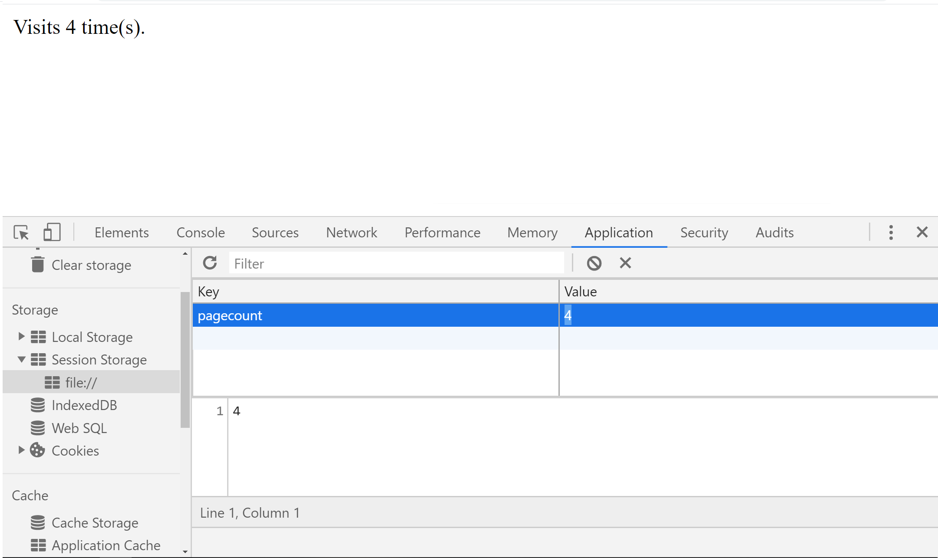
sessionStorage Example
Notes:
Refresh the page to see the counter increase

Slide 49
localStorage
The localStorage Object
Stores data with no time limit
The data will be available the next day, week, …
How to create and access a localStorage:
<script type="text/javascript">
localStorage.lastname="Karimi";
var name = localStorage.lastname;
</script>
How to remove/clear localStorage:
<script type="text/javascript">
localStorage.removeItem(lastname);
localStorage.clear();
</script>

Slide 50
localStorage Example
<script type="text/javascript">
function saveNote(){
var note = document.getElementById("mynote");
localStorage.note=note.innerHTML;
}
function loadNote(){
var note = document.getElementById("mynote");
if(localStorage.note){ note.innerHTML = localStorage.note; }
else{ note.innerHTML = "My Note"; }
}
</script>
=====================
<body onload="loadNote()">
Insert your note here
<div id="mynote" style="border-style:solid; background-color:yellow; width: 50%;" contenteditable="true"> </div>
<input type="button" value="Save Note" onclick="saveNote()">
</body>

Slide 51
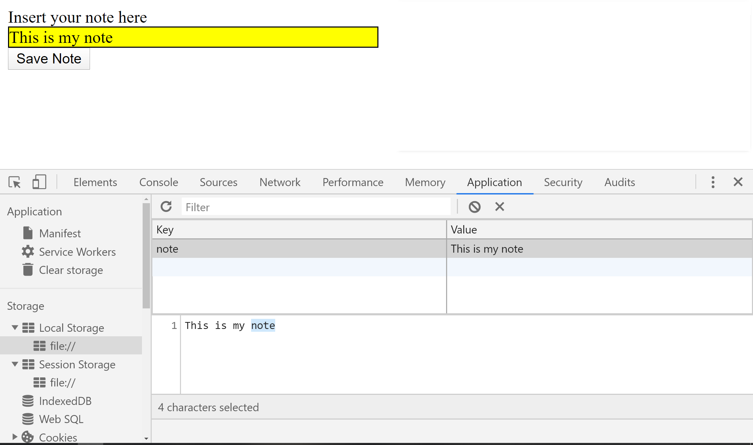
localStorage Example

Slide 52
Larger Client Side Storage
IndexedDB
API for a transactional local database of JSON objects collections with indices
JSON objects similarly to NoSQL databases
API uses indexes to enable high-performance searches of this data
The API is asynchronous
Operations are transactions + success/failure callback functions

Slide 53
Outline
Introduction
Page Structure
Multimedia
Forms
Storage
Drag & Drop
Canvas
Other Features

Slide 54
Drag & Drop
HTML5 supports drag-and-drop operations
Move elements & text around the browser window using mouse, e.g.,
Move items into a shopping cart
Customize page layout!!
From HTML5 point of view
By default, all links, text, image are draggable
To make an element draggable:
<div id="ID" draggable="true"> </div>

Slide 55
Drag & Drop: Events
ondragstart event
Occurs in draggable elements when users start dragging them
ondragenter event
Occurs in a drop target when a draggable move over that target
ondragover event
Occurs in a drop target while users drag a draggable element over that target
If the drop is to be accepted, then this event (dragover) has to return false
If true is returned → Drop is cancelled

Slide 56
Drag & Drop: Events
ondrop event
Occurs in a drop target while users drop a draggable element onto that target
To prevent further processing by browser → return false
ondragend event
Occurs in draggable elements when users stop dragging them

Slide 57
Drag & Drop: Data Management
Dragging objects == Carrying data
To access the data, we use event object
When an objected is dragging → an event
event is an object that is passed to all event-handlers (we use anywhere)
It contains useful information (e.g., data, mouse location, …)
event.dataTransfer contains the data
To get the data: event.dataTransfer.getData
Data depends on element
e.g., Text: text, Image: source, link: href
To set data: event.dataTransfer.setData(type, data)
Customize the transferred data

Slide 58
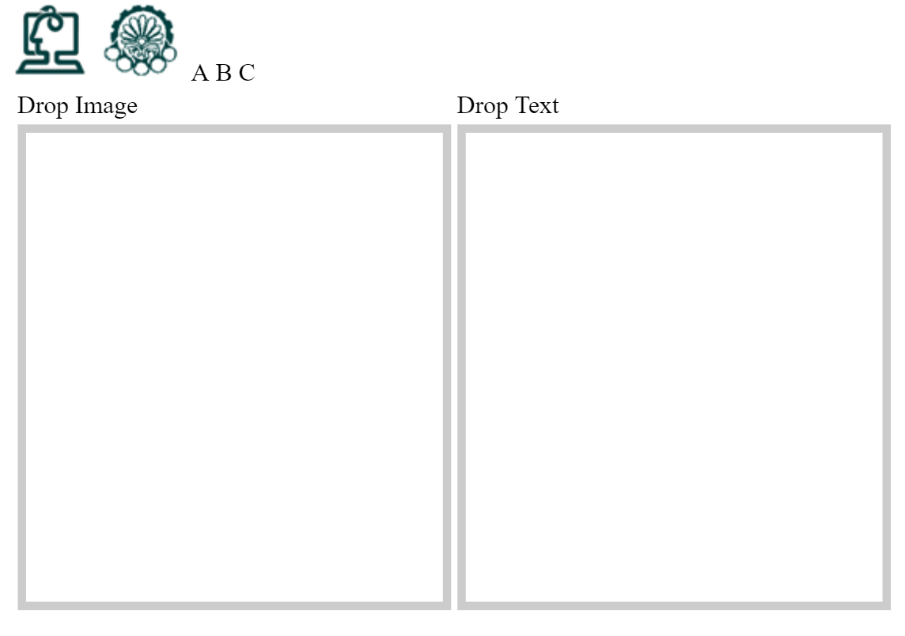
Drag & Drop Example

Slide 59
Drag & Drop Example (cont’d)
<styمث> .d {width: 300px; height: 200px;
padding: 10px; border: 1px solid black;}</style>
<body onload="init(); init2()">
<img src="ceit.png" alt="CEIT" ondragstart="ds()" ondragend="de()" />
<img src="aut.png" alt="AUT" />
<span id="txt" contenteditable="true"> A B C</span>
<table>
<tr> <td>Drop Image</td> <td> Drop Text</td> </tr>
<tr> <td> <div class="d" id="drop"> </div> </td>
<td> <div class="d" id="drop2"> </div> </td>
</tr>
</table>
<span id="msg2"> </span> <br />
<span id="msg3"> </span> <br />
</body>
Notes:
The contenteditable attribute specifies whether the content of an element is editable or not

Slide 60
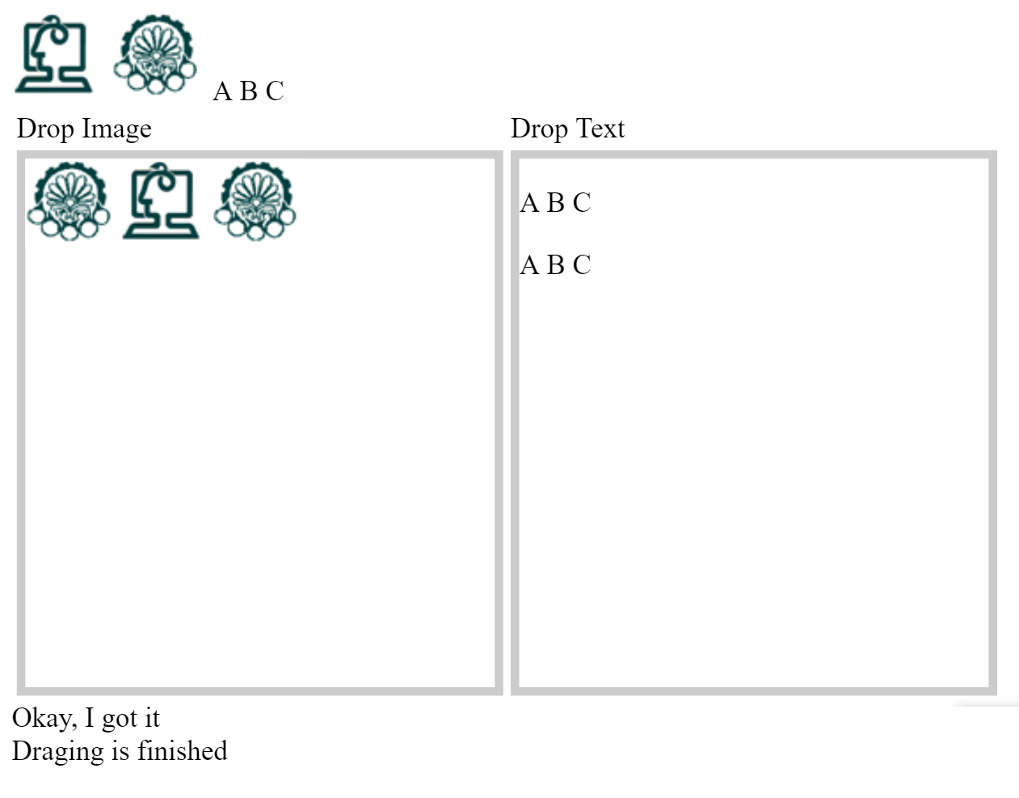
Drag & Drop Example (cont’d)

Slide 61
Drag & Drop Example (cont’d)
function init(){
var drop = document.getElementById("drop");
drop.ondrop = function (event) {
this.innerHTML += "<img src='"+event.dataTransfer.getData('Text')+"' alt='xyyyyyzzz' />";
document.getElementById("msg2").innerHTML = "Okay, I got it";
return false;
};
drop.ondragover = function(){ return false; };
drop.ondragenter = function(){
document.getElementById("msg2").innerHTML =
"I am ready to get the dragged object"; };
}
function init2(){
var drop = document.getElementById("drop2");
drop.ondrop = function (event) {
this.innerHTML += "<p>" + event.dataTransfer.getData("Text") + "</p>";
return false;
};
drop.ondragover = function(){ return false; };
}

Slide 62
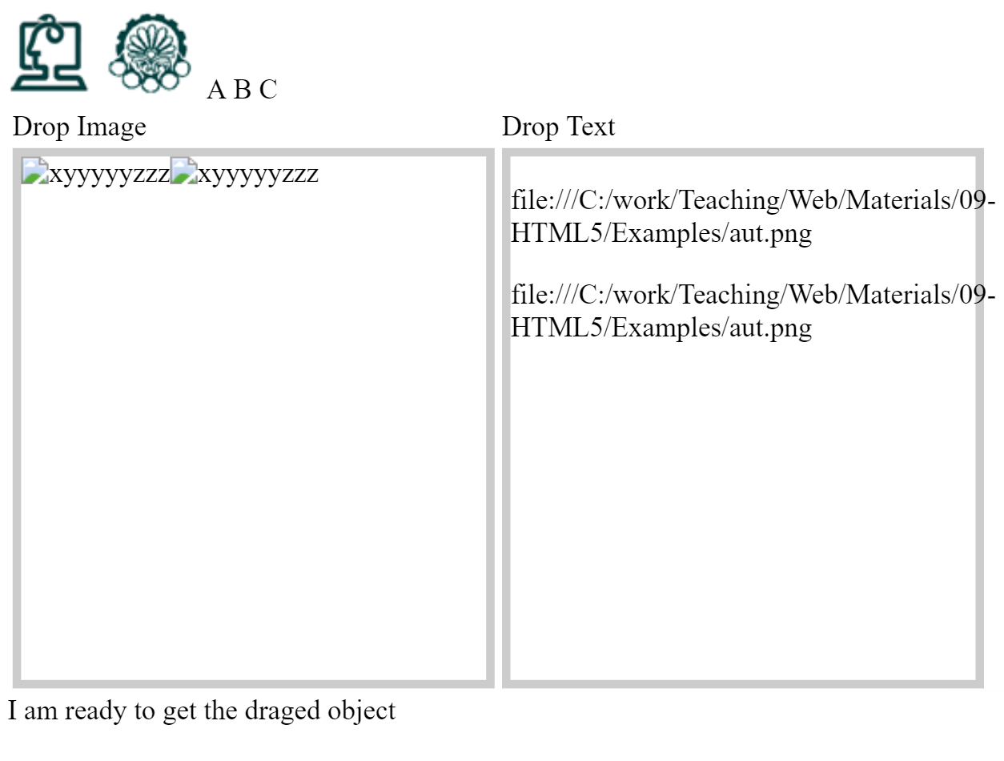
Drag & Drop Example (cont’d)

Slide 63
Drag & Drop Example (cont’d)
<span id="txt" ondragstart="ds2(event)" contenteditable="true"> A B C</span>
function ds2(event){
event.dataTransfer.setData('Text’, "2000"); }

Slide 64
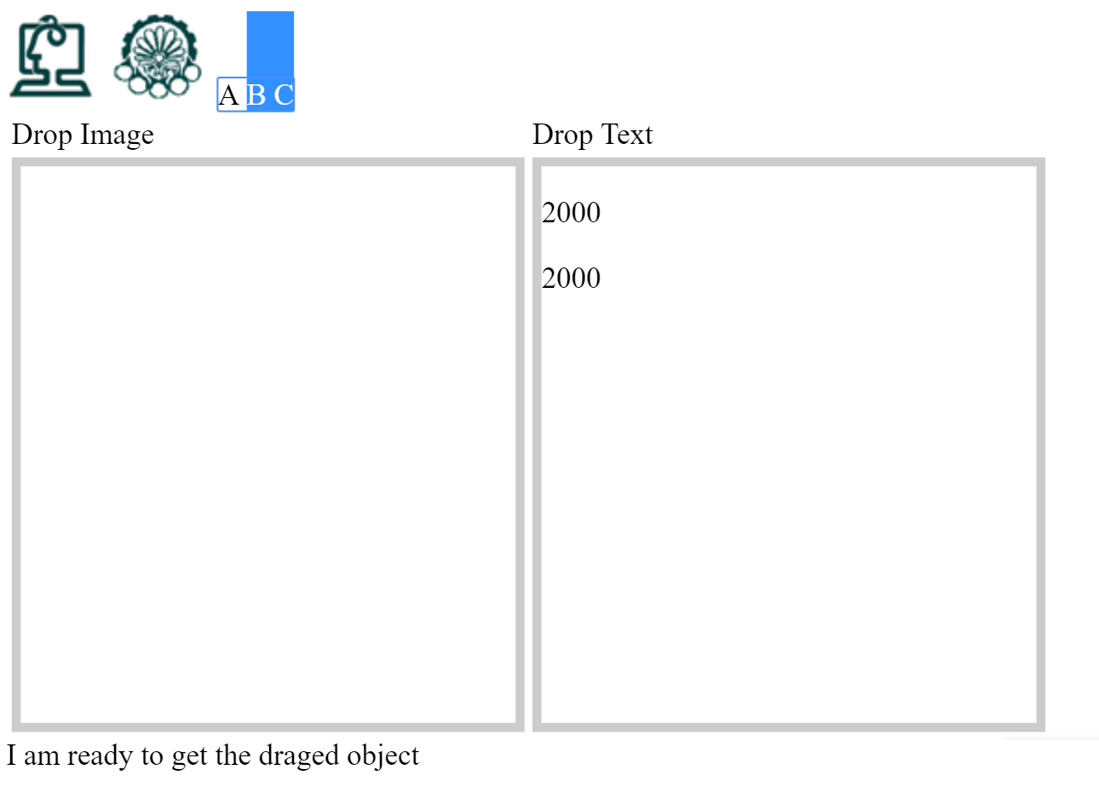
Drag & Drop Example (cont’d)

Slide 65
Dragging Objects Out of Web Page
E.g.: Drag file from browser to download accelerator
Only the dragstart and dragend events fire when the drag-and-drop process begins and finishes.
All other events are omitted because the drop point is outside of the web browser
The information stored in event.dataTransfer will then be transferred to your operating system
It is then up to the desktop or application to interpret that data correctly

Slide 66
Dragging Objects Into Web Page
E.g., upload file
Only the dragenter, dragover, and drop events fire when dragging something from your desktop into your web page.
All other events are omitted because the drag start point is outside of the web browser
The information being brought into your web page can be read using event.dataTransfer.getData(),
The information is set by operating system/application
Can be a path to the local file

Slide 67
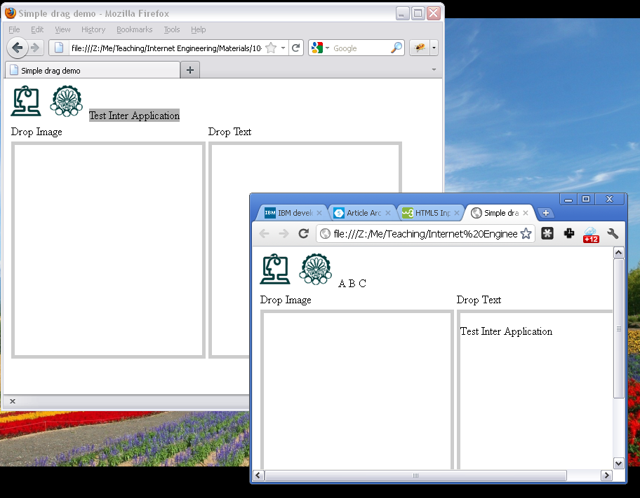
Drag & Drop Example (cont’d)

Slide 68
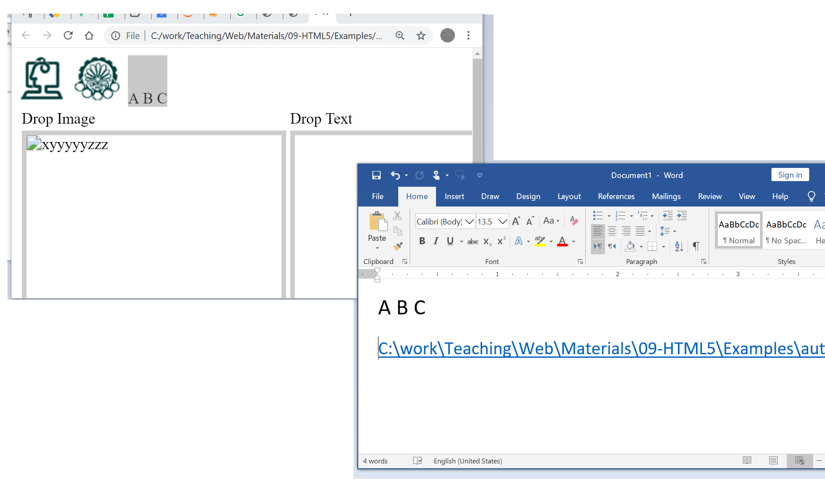
Drag & Drop Example (cont’d)

Slide 69
Outline
Introduction
Page Structure
Multimedia
Forms
Storage
Drag & Drop
Canvas
Other Features

Slide 70
Canvas
The canvas element provides an API for 2D drawing lines, fills, images, text, and so on
A canvas is a rectangular area, and we can control every pixel of it
Nothing by itself
JavaScript uses Canvas to draw graphics
<canvas id="canvas_id" width="200" height="100">
Your browser does not support Canvas
</canvas>
Notes:
Show the example here

Slide 71
Canvas (cont’d)
These height and width attributes are not the same as the CSS height and width properties
These are the number of pixels in the canvas
To read or change these attribute values
canvas.height and canvas.width
Or
ctx.canvas.height and
ctx.canvas.width,
JavaScript variables

Slide 72
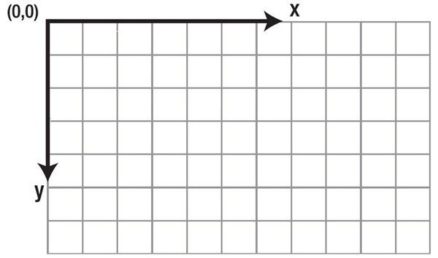
Canvas (cont’d)
Canvas axis

Slide 73
Access to Canvas
Access to the canvas in JavaScript function
var canvas =
document.getElementByID("canvas_id");
var ctx = canvas.getContext("2d");
A really huge API to draw lines, … using the ctx object
Notes:
The getContext function is the function that you use to get access to the canvas tags 2D drawing functions. As of April 2014, there are two types of context that are available to you: 2d and webgl . These provide you with the API that you use to draw on the canvas

Slide 74
Canvas API: Drawing Processes
Two general kinds of shapes (states)
Filled
Flooding the area within a closed shape with a color
Stroke
Drawing a line or a border with a specific thickness and color along a path, shape, or text
Global settings
Styling
ctx.fillStyle = "rgb(R, G, B)";
ctx.strokeStyle = "rgb(R, G, B)";
Line width
ctx.lineWidth = 5;

Slide 75
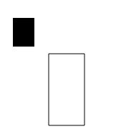
Canvas API: Shapes
Simple shapes in canvas are rectangles
ctx.fillRect(X, Y, W, H);
ctx.strokeRect(X, Y, W, H);
ctx.fillRect(50,50,30,40);
ctx.strokeRect(100,100,50,100);

Slide 76
Canvas API: Shapes
Complex shapes are created by path
Path is an invisible line, can be filled or stroked
A new path: ctx.beginPath()
Move the pen: ctx.moveTo(X,Y)
Line: ctx.lineTo(X,Y)
Arc: ctx.arc(X,Y,R,sAngle,eAngle,anticlock);
Close the path: ctx.closePath()
Notes:
دستور لاین : کشیدن خط و در انتهای آن ایستادن
دستور move to : حرکت به یک مکان خاص و از انجا کشیدن

Slide 77
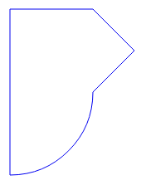
Canvas API: Complex Shapes (Out of Scope)
ctx.beginPath();
ctx.strokeStyle = "rgb(0, 0, 240)";
ctx.arc(200,200,100,0,90 * TO_RADIANS,0);
ctx.lineTo(200, 100);
ctx.lineTo(300, 100);
ctx.lineTo(350, 150);
ctx.closePath();
ctx.stroke();

Slide 78
Canvas API: Colors (Out of Scope)
Color options: solid color, gradient, or pattern
Assign value to fillStyle or strokeStyle attribute
Solid color: CSS-like color syntax: red, #ff0000, or rgb(255,0,0)
Gradient color
gradient = ctx.createLinearGradient(x0,y0,x1,y1)
Creates a linear gradient that contains gradient colors that change from (x0,y0) to (x1,y1).
gradient = ctx.createRadialGradient(x0,y0,r0,x1,y1,r1)
Creates a radial gradient that contains gradient colors that change from (x0,y0) and a radius of r0, outward to (x1,y1) and a radius of r1.
The output of these function is a gradient object that first must receive at least two addColorStop() calls before it is assigned to fillStyle or strokeStyle
Notes:
A gradient is a design element made up of colors that gradually fade into one another

Slide 79

Canvas API: Colors (Out of Scope)
gradient = ctx.createLinearGradient(0, 0, 300, 300);
gradient.addColorStop(0, "#F00");
gradient.addColorStop(1, "#00F");
ctx.fillStyle = gradient;
ctx.fillRect(10, 10, 900, 450);

Slide 80
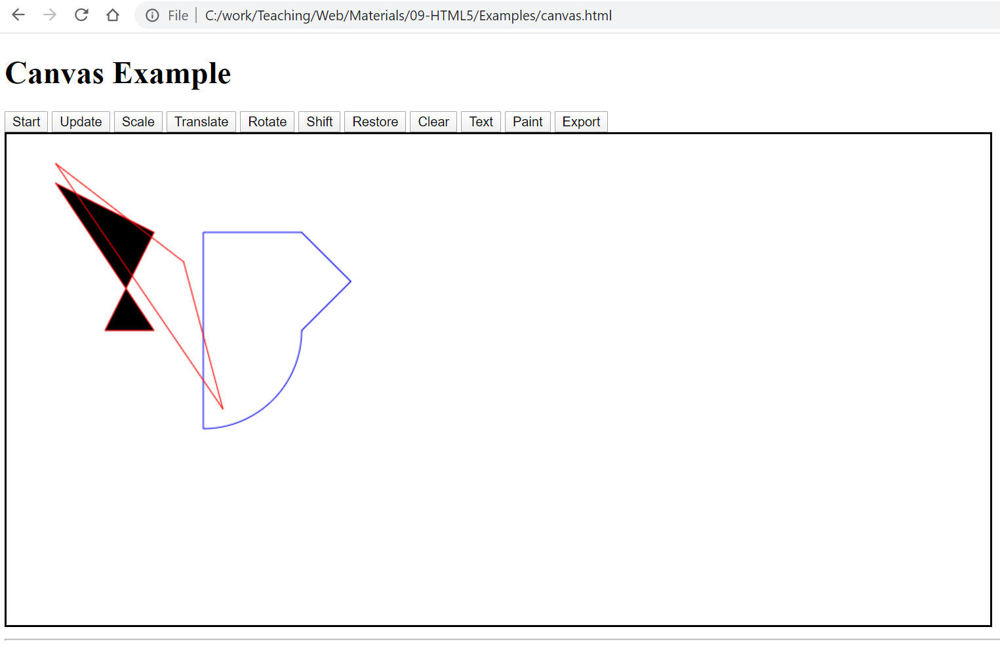
Example (Out of Scope)

Slide 81
Canvas API: Text Drawing
To place a single line of text, using a single font configuration, anywhere in the canvas
ctx.fillText(text,x,y,maxWidth)
ctx.strokeText(text,x,y,maxWidth)
Draws text in the current color at (x,y) using a solid fillStyle/strokeStyle setting
An optional maxWidth size determines how much text should actually be drawn.
metrics = ctx.measureText(text): Measures text in the current font to determine the width it would occupy without actually drawing it
Notes:
The measureText() method returns an object that contains the width of the specified text, in pixels. Tip: Use this method if you need to know the width of a text, before writing it on the canvas.

Slide 82
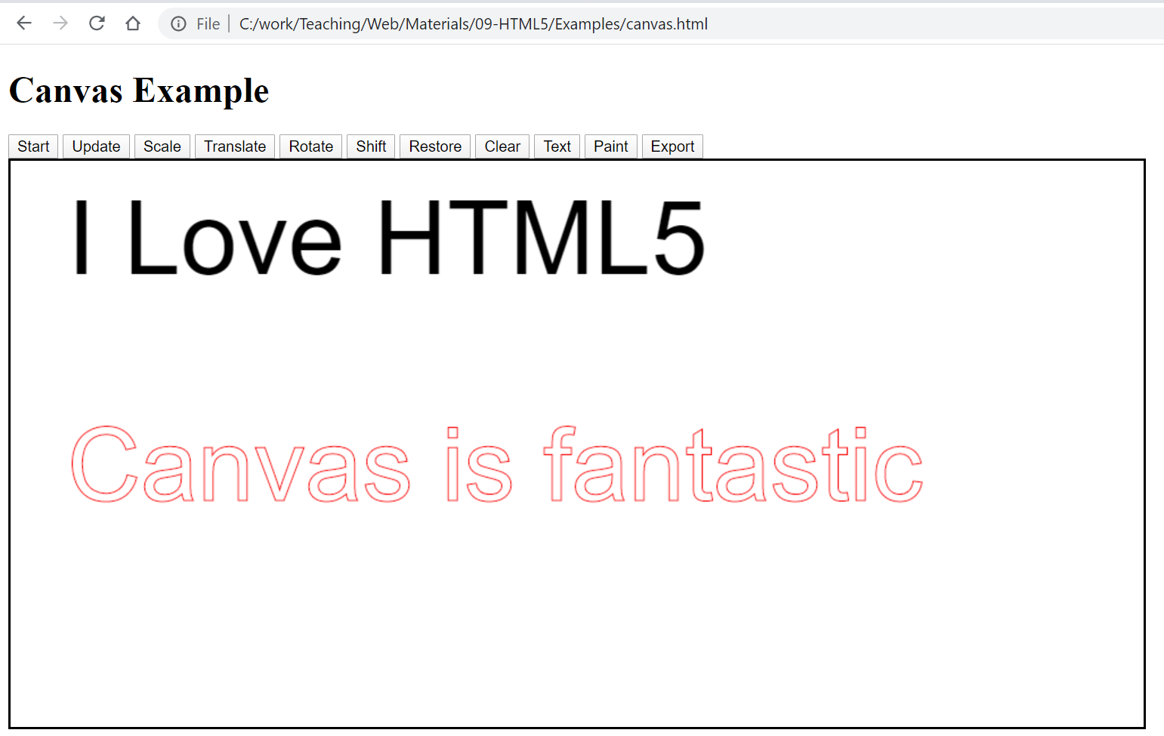
Example

Slide 83
Canvas API: Insert Image
Put image in canvas
var img=new Image();
img.src="URL";
cxt.drawImage(img,0,0);

Slide 84
Save & Restore
To save and restore canvas state
Not the drawings
ctx.save(): push state on stack
ctx.restore(): pop sate from stack
Save & Restore drawing
imagedata=
ctx.getImageData(X,Y,width, height);
ctx.putImageData(imagedata, X, Y);

Slide 85
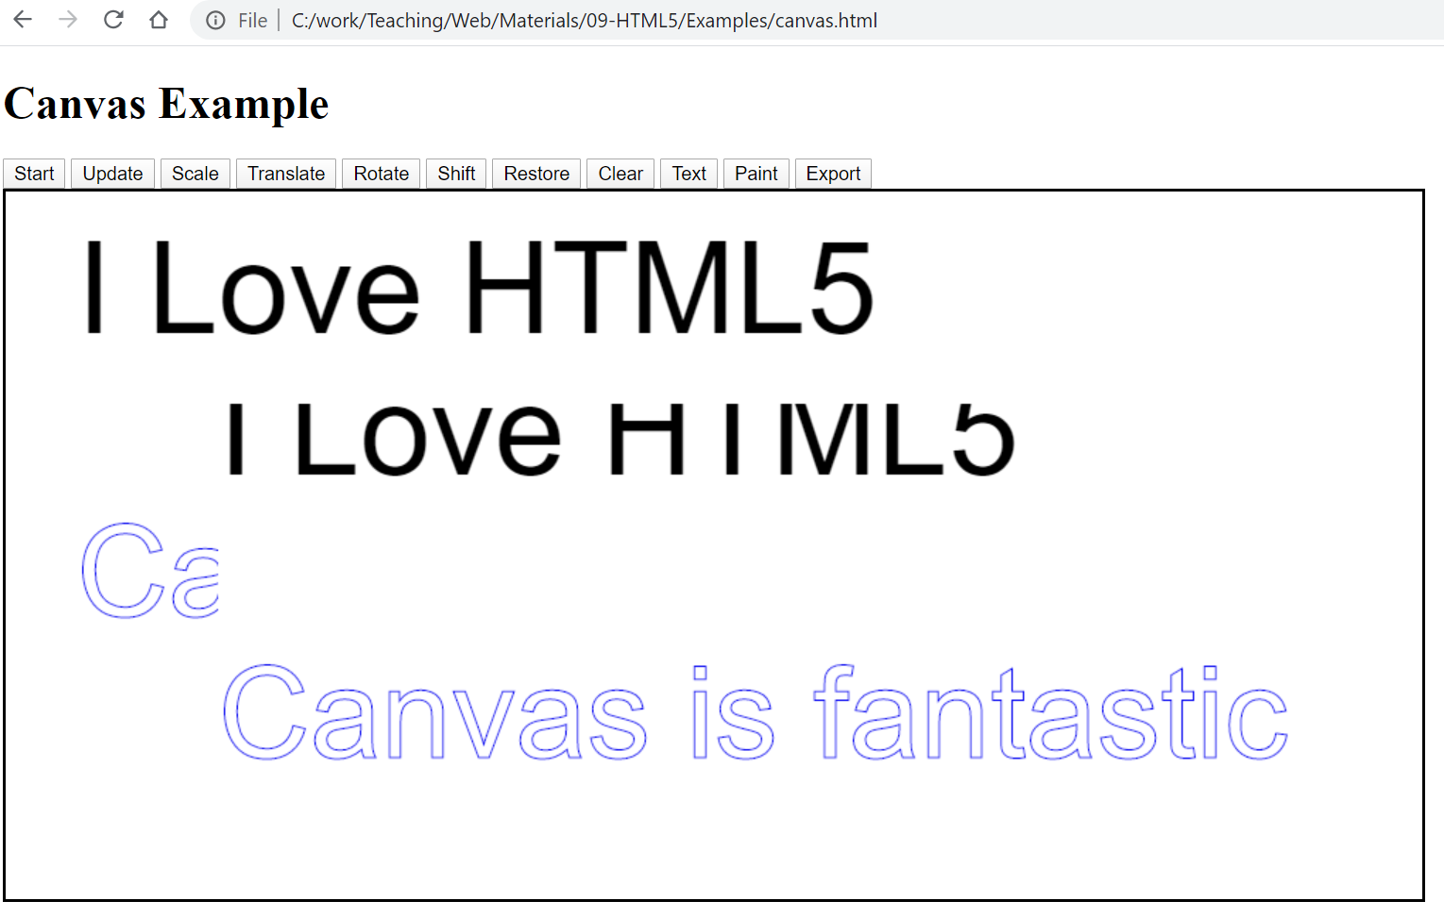
Example

Slide 86
Save Canvas as Image
Canvas can be saved using “Data URL”
A new kind of URL which is defined by HTML5
var canv = document.getElementById("canvas");
imageurl = canv.toDataURL("image/png");
imageurl contains the image in PNG format
An easy way to save it
canimg = document.getElementById("canvasimage");
canimg.innerHTML='<image src="'+imageurl+'">'

Slide 87
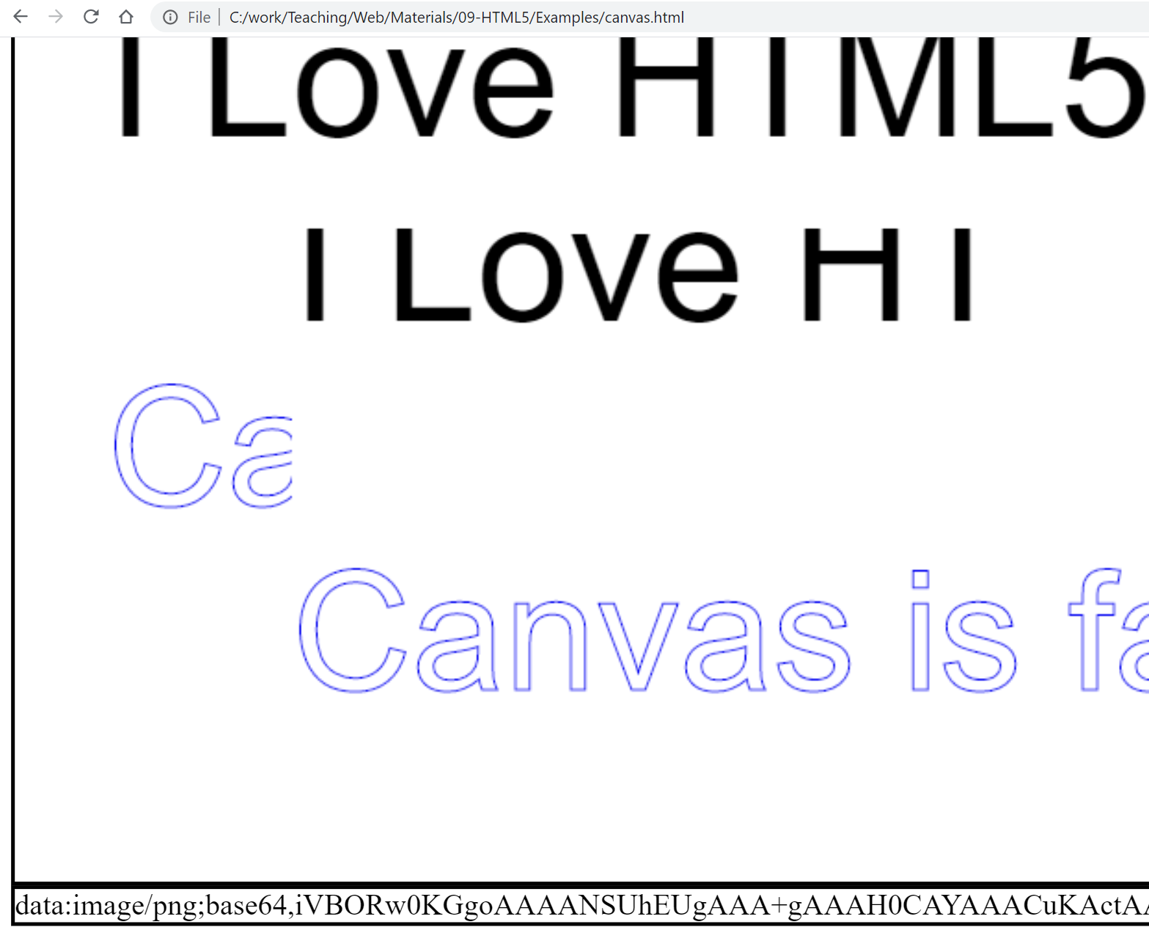
Example

Slide 88
Outline
Introduction
Page Structure
Multimedia
Forms
Storage
Drag & Drop
Canvas
Other Features

Slide 89
Offline Web Applications
Example: Offline Gmail
Browser should cache what application needs when it does not connect to server
In the simplest case, when the application does not connect to server, browser serves the needed file from its cache
Application specifies what needs to be cached
<html lang="en" manifest="files.manifest">

Slide 90
Offline Web Applications
files.manifest:
CACHE MANIFEST
CACHE:
file1.html
file2.js
FALLBACK:
neededfile.html fallback-replacement.html
NETWORK:
*
File which should be cached
Files which cannot be cached, but can be replaced by other files in offline mode
Files which should not be cached, if application is in online mode, they are retrieved from server

Slide 91
WebSocket
Ajax is a mechanism to generate a HTTP request from web page (pull data from server) → the stateless mechanism
How to receive data from server (push data to client)?!
E.g., chat: we don’t send request but we get data
Can be seen as stateful mechanism
We need to listen a (TCP) socket in webpage!!
HTML5’s solution is the WebSocket
var socket = new WebSocket('ws://server:port/')
socket.send(): To send data
socket.onmessage(event): To receive data
accessible from event.data
We need a WebSocket server to handle the messages
This mechanism is not for directly browser-to-browser communication
Notes:
Web socket is based on tcp instead of http
User server connection with a single tcp ports(over a single socket and is exposed via a JavaScript interface in HTML 5 )
Ajax based on http

Slide 92
File-API
This is different from uploading files by <file>
Simple example in form:
<input type="file" id="myfile" name="myfile“>
<input type="file" onchange="readFiles(event)" >
(Do you remember?!)
By File-API:
We read the file in browser! We have access to file content
File API enables JavaScript inside HTML5 pages to load and process files from the local file system
Via the HTML5 file API it is possible for JavaScript to process a file locally, e.g. compress, encode or encrypt and etc
But there are some security concerns.

Slide 93
File-API
If browser supports
reader = new FileReader()
Different method to read files
readAsText: Output is string
readAsDataURL: Output is a data URL
Extended version of drag-and-drop to access the content of files in browser
E.g., drag files from desktop to web page
In fact, it is not part of HTML5 but related!
Notes:
**.readAsDataURL() return a URL representing the file's data as a base64 encoded string..// will return a string that can be pasted into the url attribute of an HTML tag (e.g.: src= in an img). For an img tag, that will effectively display the image just like if src was an address to the file that was read
** .readAsText() return the file's data as a text string. //usually for reading text file
*The client implementation of FileReader() must make sure that "all files that are being read by FileReader objects have first been selected by the user." (W3C File API , 13. Security Considerations: http://www.w3.org/TR/FileAPI/#security-discussion).

Slide 94
JS Runtime Model
JavaScript has a runtime model based on an event loop
Responsible for executing the code, collecting and processing events, and executing queued sub-tasks
Stacks : Function calls form a stack of frames.
Heap :Objects are allocated in a heap which is just a name to denote a large (mostly unstructured) region of memory.
Queue :A JavaScript runtime uses a message queue, which is a list of messages to be processed. Each message has an associated function that gets called to handle the message.
Notes:
https://developer.mozilla.org/en-US/docs/Web/JavaScript/EventLoop (runtime: when cpu run machine codes)
“Stack is a linear data structure whereas Heap is a hierarchical data structure. Stack memory will never become fragmented whereas Heap memory can become fragmented as blocks of memory are first allocated and then freed. Stack accesses local variables only while Heap allows you to access variables globall”
A JavaScript runtime uses a message queue, which is a list of messages to be processed. Each message has an associated function which gets called in order to handle the message. At some point during the event loop, the runtime starts handling the messages on the queue, starting with the oldest one. To do so, the message is removed from the queue and its corresponding function is called with the message as an input parameter. As always, calling a function creates a new stack frame for that function's use. The processing of functions continues until the stack is once again empty; then the event loop will process the next message in the queue (if there is one).

Slide 95
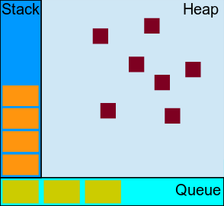
JS Runtime Model

Slide 96
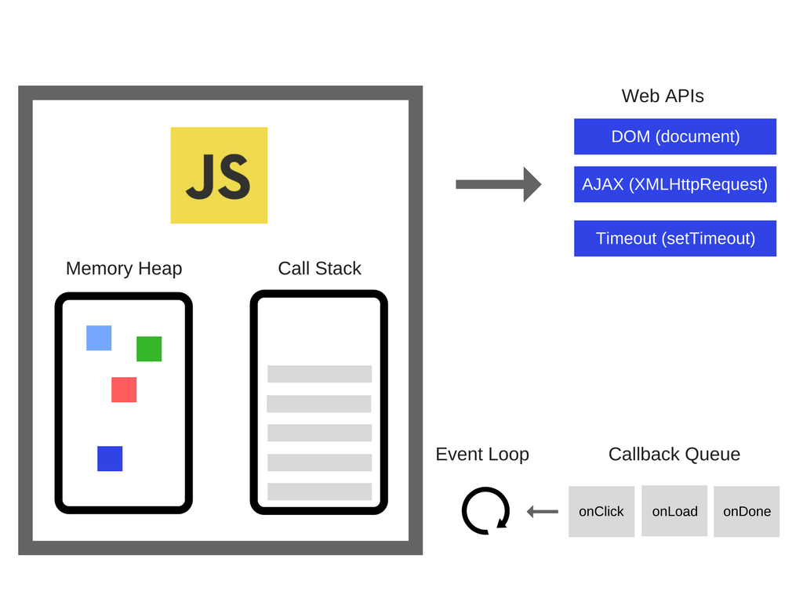
JS Runtime Model
Notes:
Web API provided by browser not js engine

Slide 97
JS Runtime Model
Notes:
Web API provided by browser not js engine
The setTimeout() method calls a function after a number of milliseconds
setTimeout توسط Web API در اختیار ما هست که به ما اجازه میده تسک ها رو بدون بلاک شدن ترد اصلی برنامه،به تاخیر بندازیم.

Slide 98
JS Runtime Model
Notes:
Web API provided by browser not js engine
The setTimeout() method calls a function after a number of milliseconds
setTimeout توسط Web API در اختیار ما هست که به ما اجازه میده تسک ها رو بدون بلاک شدن ترد اصلی برنامه،به تاخیر بندازیم.

Slide 99
JS Runtime Model
Notes:
Web API provided by browser not js engine
The setTimeout() method calls a function after a number of milliseconds
setTimeout توسط Web API در اختیار ما هست که به ما اجازه میده تسک ها رو بدون بلاک شدن ترد اصلی برنامه،به تاخیر بندازیم.

Slide 100
JS Runtime Model
Notes:
Web API provided by browser not js engine
The setTimeout() method calls a function after a number of milliseconds
setTimeout توسط Web API در اختیار ما هست که به ما اجازه میده تسک ها رو بدون بلاک شدن ترد اصلی برنامه،به تاخیر بندازیم.

Slide 101
JS Runtime Model
Notes:
Web API provided by browser not js engine
The setTimeout() method calls a function after a number of milliseconds
setTimeout توسط Web API در اختیار ما هست که به ما اجازه میده تسک ها رو بدون بلاک شدن ترد اصلی برنامه،به تاخیر بندازیم.

Slide 102
Web-Workers API
When executing scripts in an HTML page, the page becomes unresponsive until the script is finished.
JS is Single Thread
Two Operation in single time is not possible (for example: change Dom and high complexity computation Simultaneously)
Solution: Workers
JS codes out of main thread and run in background and does not stop main thread.
Some codes could not run in worker thread:
Change Dom or some methods of windows object and etc ..
But you can put web socket or saving data in indexed DB

Slide 103
Web-Workers API
Communication between workers and main Thread: Messaging
postMessage Method: send message
Event: receive message
Web workers: good option for CPU intensive task
How to define it:
example= new Worker("demo_workers.js")
how to use it: example
Add an "onmessage" event listener to the web worker.
example.onmessage = function(event){
…..
};

Slide 104
Web-Workers
Multi-threading inside web pages
To run JavaScript in parallel on a web page, without blocking user interface
Multi-threading → Race condition !!!
Thread safety is always a big challenge
Accessing shared data from multiple threads
To be thread-safe, web-works cannot access to data which is shared by the main page
One of the shared data is DOM → Web-workers does not access to DOM!!!
So, if we cannot access to DOM, what/how can we do?
Web-Workers work by message passing
JS in main page creates a web-worker
The code of the worker is given by another JS file
JS in main page post & get messages from the worker
Notes:
https://auth0.com/blog/speedy-introduction-to-web-workers/

Slide 105
Answers
Q9.1) Search engines don’t show my page!!!
Organize your page by semantic tags!!
Q9.2) I don’t want use Flash for multimedia?
Ok! HTML5 has built in support
Q9.3) Why JS for form validation every time?
Instead of HTML4 + JS use HTML5 forms
Q9.4) Cookies are good, but I need more!!
HTML5 storage is for you
Q9.5) Can I implement games under web?!
Simple games! Yes, use canvas for drawing
Q9.6) I want use elements on page as objects!
At least you can drag & drop them in a page!!
Q9.7) How does the Gmail off-line work?
It uses HTML5 off-line!!

Slide 106
What are the Next?!
WebGL
API for rendering interactive 3D computer graphics and 2D graphics within any compatible web browser
Touch Events
Set of events that represent points of contact and changes of those points with respect to DOM elements displayed upon it
Geo Location
API is used to get the geographical position of a user
MathML (mathematical markup language)
Describing mathematical notations, integrating mathematical formulae into Web pages

Slide 107
References
Dr.Bakshi Slides
Bruce Lawson and Remy Sharp, “Introducing HTML5”
http://www.w3schools.com/html5/

