Slide 1
PHP
Web Programming
Spring 2023
Yaghoub Alizadeh
CE Department, Amirkabir University of Technology

Slide 2
Questions
Q7) How does server process client’s requests?
Q7.1) How to code in server side?
Q7.2) Which language? Syntax?
Q7.3) How can I get valid user’s data in server?
Q7.4) Can I read/write access to HTTP headers
Q7.5) The users must login to access the site!
Q7.6) Can I use databases? How?

Slide 3
Outline
Introduction to PHP
PHP Basic
Input Data Handling
HTTP Headers
Cookies & Session Management
Database
XML & JSON
Error Handling

Slide 4
Outline
Introduction to CGI
Introduction to PHP
PHP Basic
Input Data Handling
HTTP Headers
Cookies & Session Management
Database
XML & JSON
Error Handling

Slide 5
Introduction
HTML/XHTML content is static
JavaScript & Ajax make pages more dynamic, but the content is almost static
Dynamic content
Pages that look differently depending on the user who visits, status, processing requests, …
E.g. Search engines, web mails, …
Web applications (hotel booking, web search applications, …) is not possible using only HTML/XHTML, CSS and JS; why?

Slide 6
Typical Web based Application (e.g., Gmail)
We need server side active code to perform actions & generate (dynamic) content

Slide 7
Overview of Server-Side Scripting
1) Web client sends a HTTP request to server
2) Web server determines how to retrieve the requested resource according configuration
3) Runtime environment does for example
Parses incoming request, generate outgoing response
Interpreting/executing the server-side scripts
Maintaining sessions

Slide 8
Overview of Server-Side Scripting
4) Runtime environment runs the requested script
Identifies the code sections inside HTML
Runs the code and grabs the output
Provides session & other status information
Generated output and HTML are assembled together which is the response to client
5) The HTTP response is sent to the web client by web server

Slide 9
Overview of Server-Side Scripting
A web server is a computer program that serves web pages to users
Responsible for accepting requests from clients, processing them, and returning the requested web page.
Typically used to host websites and run other type of applications such as PHP in Server side.
Server side programming needs to be run inside Web servers.

Slide 10
Overview of Server-Side Scripting
A web server is a computer program that serves web pages to users
Responsible for accepting requests from clients, processing them, and returning the requested web page.
Typically used to host websites and run other type of applications such as PHP in Server side.
Server side programming needs to be run inside Web servers.
Apache, Nginx, Microsoft IIS and etc

Slide 11
Embed vs. External Server Side Code
External code
A separated program: C, C++, …
Server runs it and sends its output back to client
Embed code
Scripting inside the HTML
Embed programming interface within server
Which is called when server see the scripting directions
Examples
Java Server Pages (JSP): Compiled and served by a JSP server
Python
PHP (the most common language)

Slide 12
PHP Introduction
PHP stands for
Originally: “Personal Home Pages”
Now: “PHP: Hypertext Preprocessor”
Widely-used scripting language
Specially suited for web development
Server side scripting → Dynamic Content
Typically runs on a web server that takes PHP as input and gives out HTML pages as output

Slide 13
PHP Features
One of the top five
A syntax similar to C and Java
Connects with 20+ databases
Version 5+ supports OOP
Multi-platform compatible
Linux & Windows & Wide range of web servers
Rich library: Over 1000 built-in functions
Easy to learn

Slide 14
PHP Scripts
Typically file ends in .php
Set by the web server configuration
PHP scripts run when sent a GET/POST request to them
Mixed in HTML, separated with <?php ?> tag
Or <? ?> tag
Can be placed anywhere in the document
PHP commands can make up an entire file, or can be contained in html
Server recognizes embedded script and executes
Result passed to browser, source isn't visible

Slide 15
PHP in Action
Web server solution stack:
LAMP (Linux, Apache, MySQL, PHP)
WAMP(Windows, Apache, PHP, MySQL)
MAMP (MAC, Apache, PHP, MySQL)
XAMP (Cross Platform)
And etc.
Installation
From source:
Apache: http://httpd.apache.org/
PHP: http://www.php.net
MySQL: http://www.mysql.com/
15

Slide 16
The PHP “Hello World”: Server Side
<!DOCTYPE html>
<html>
<head>
</head>
<body>
<?php
print "<h1>Hello World</h1>";
?>
</body>
</html>
Sent to client in “copy mode”
Parsed and output is sent to client in “interpret mode”

Slide 17
The PHP “Hello World”: Client Side
<!DOCTYPE html>
<html>
<head>
</head>
<body>
<h1>Hello World</h1>
</body>
</html>

Slide 18
The PHP “Hello World-2”: Server Side
<!DOCTYPE html>
<html>
<body>
<?php
$i=10;
?>
<p>Hello World</p>
<?php
print "<h2>i = ".$i."</h1>\n";
?>
</body> </html>
Sent to client in “copy mode”
Parsed and output is sent to client in “interpret mode”

Slide 19
The PHP “Hello World-2”: Client Side
<!DOCTYPE html>
<html>
<body>
<p>Hello World</p>
<h2>i = 10</h1>
</body> </html>

Slide 20
Outline
Introduction to CGI
Introduction to PHP
PHP Basic
Input Data Handling
HTTP Headers
Cookies & Session Management
Database
XML & JSON
Error Handling

Slide 21
Syntax
The syntax of PHP is very similar to C/C++/Java
PHP & C/C++ Similarities:
Case-sensitive for variables
Required semicolon after each statement
Commenting // /* */
Compound statements: { }
Operators: Assignment, Arithmetic, Comparison, and Logical operator are the same
Loop: for, while, do-while
Conditionals statements: if, else, switch-case

Slide 22
Syntax (cont’d)
PHP & C/C++ Differences:
Variables begin with $ sign
No explicit declaration of variable types
Functions
Defined by function keyword
Functions-within-a-function is allowed
Case-insensitive function names
Single line commenting is also allowed by #
Strings are enclosed in " " and also ' '
Operators:
comparison by <>, ===, !==, concatenation by .
Loop by foreach($array as $var)
Conditional statements by if-elseif-else

Slide 23
Syntax (cont’d)
foreach example:
<?php
$colors = array("red", "green", "blue", "yellow");
foreach ($colors as $value) {
echo "$value <br>";
}
?>

Slide 24
Scope of Variables
The scope of a variable defined within a function is local to that function
A variable defined in the main body of code has a global scope but it is NOT available inside functions!!!
To use global variables in functions, it is referenced "global" keyword
Static variables are also supported by the static keyword

Slide 25
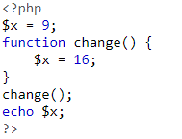
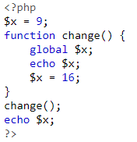
Scope of Variables
Examples:
9
916

Slide 26
Arrays
Similar to C/C++/… the index of array can be an integer number
Numeric array
Similar to JS the index of array can be everything
Associative array
Mapping between key (index) and value
Similar to other languages array containing one or more arrays
Multidimensional array
Arrays can also be created by array function

Slide 27
Arrays (cont’d)
Numeric arrays
$cars[0]="Saab"; $cars[1]="Volvo"; $cars[2]="BMW"; $cars[3]="Toyota";
$cars=array("Saab","Volvo","BMW","Toyota");
Associative arrays
$ascii["A"]=65; $ascii["B"]=66; $ascii["C"]=67
$ascii = array("A"=>65, "B"=>66, "C"=>67);
Multidimensional arrays
$std=array("one"=>array("Ali", 1122, 20), "two"=>array("Hossein", 1133, 15));

Slide 28
Arrays (cont’d)
Array Example:
<?php
$age = array("Peter"=>"35", "Ben"=>"37", "Joe"=>"43");
foreach($age as $x => $val) {
echo "$x = $val<br>";
}
?>
=>: This means that what is on the left side of it will have a corresponding value of what is on the right side of it in array context.

Slide 29
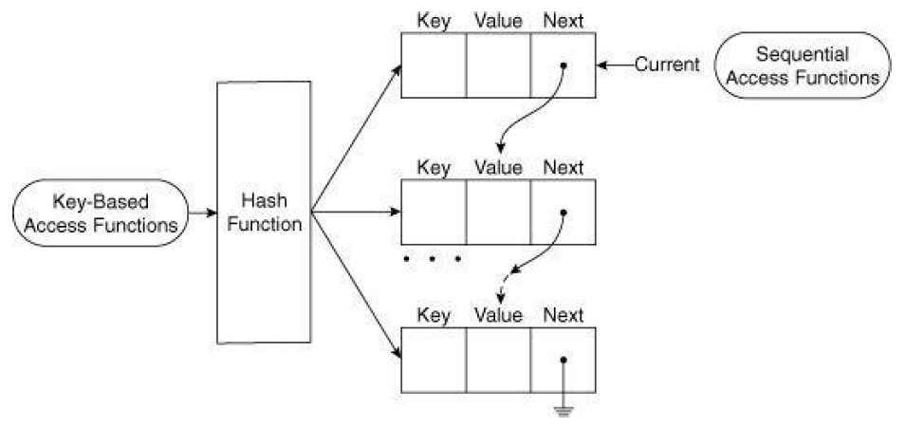
Array Internal Implementation
In fact, array is a mapping between keys and values
$keys = array_keys($array);
$values = array_values($array);

Slide 30

Array Internal Implementation
<?php
$a=array("Volvo"=>"XC90","BMW"=>"X5","Toyota"=>"Highlander");
print_r(array_keys($a));
?>
Output:

Slide 31
Super Global Arrays
Several predefined variables in PHP are “superglobals”
Available in all scopes throughout a script
No need to have global $variable; declaration
Maintained by PHP runtime environment
$GLOBALS: All global variables, the variable names are the keys of the array
$_GET: Variables passed in URL’s query part
$_POST: Variables passed by HTTP POST
$_FILES: Uploaded file information
$_COOKIE: Cookies sent by HTTP cookie header
$_REQUEST: Contains $_GET, $_POST and $_COOKIE
$_SESSION: Session variables
Notes:
این متغیرها همیشه و در تمام محدوده‌ها (Scopeها) در دسترس هستند.
<?php
$x = 75;
$y = 25;
function addition() {
$GLOBALS['z'] = $GLOBALS['x'] + $GLOBALS['y'];
}
addition();
echo $z;
?>

Slide 32
Super Global Arrays (cont’d)
$_SERVER: Information such as headers, server & client
Examples of the important keys
'SERVER_ADDR': The IP address of the server
'SERVER_NAME': The name of the server host
'SERVER_PORT': The port of web server
'REQUEST_METHOD': The HTTP request method
'HTTP_USER_AGENT': Contents of the HTTP User-Agent
'REMOTE_ADDR': The IP address of client
…
Complete list: php.net/manual/en/index.php

Slide 33
Input & Output in Web Applications
Console I/O
Console output of script is gathered by PHP runtime then passed to web server & finally sent to client
(Usually) No console input (stdin)
Input is given by web server to PHP scripts
Usually, the input is the values got from client using Forms, Ajax, …
Will be discussed later
File I/O: Access to files for read/write
Can also be used for socket
Database: Connect and read/write database

Slide 34
Output: echo & print & var_dump
<?php
$foo = 25; // Numerical variable
$bar = "Hello"; // String variable
echo $bar."\n"; // Hello
echo $foo,$bar,"\n"; // 25Hello
echo "5x5=".$foo."\n"; // 5x5=25
echo "5x5=$foo\n"; // 5x5=25
echo '5x5=$foo\n'; // 5x5=$foo\n
print "\n"; // newline
print "Output is ".$foo; // Output is 25
var_dump($foo); // int(25)
?>
Notes:
The function var_dump() displays structured information (type and value)

Slide 35
Filesystem Operations
PHP filesystem operations are similar to C
fopen(), fgetc(), fputc(), fread(), fwrite(), fseek(), rewind(), flock(), fclose()
fopen opens URL of supported protocols
file://
http://, ftp://, …
To open binary files safely: b
fopen($fileName, "rb").

Slide 36
Filesystem Operations (Security)
To increase security of web-servers, the fopen function may be disabled
So, none of the previous functions can be used ☹
Alternative functions (limited functionalities)
file_get_contents: To read file content into a string
file_put_contents: To write a string into a file

Slide 37
OOP in PHP vs. Java: Similarities
Concepts all are the same
Class and Object
Instantiation, Constructor, Destructor
Properties and Methods
Inheritance
Method Overriding
Access control
Public, Private, Protected
Static members

Slide 38
OOP in PHP vs. Java: Differences
The concepts are implemented in interpreted language (no type) + different keyword
Class definition: class {}
Object instantiation & deletion: new, unset
Properties declaration: var
If no access modifier is used
Method declaration: function
Access to properties/methods: ->
This object: $this
Needed to access properties in methods
Notes:
https://www.w3schools.com/php/php_oop_access_modifiers.asp
Access modifier : Properties and methods can have access modifiers which control where they can be accessed.
There are three access modifiers:
public - the property or method can be accessed from everywhere. This is default
protected - the property or method can be accessed within the class and by classes derived from that class
private - the property or method can ONLY be accessed within the class

Slide 39
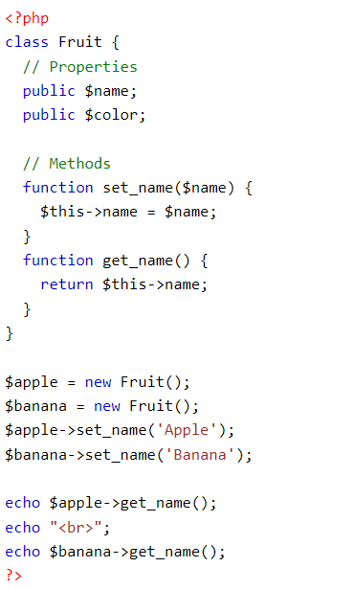
OOP in PHP vs. Java: Differences
Simple example:

Slide 40
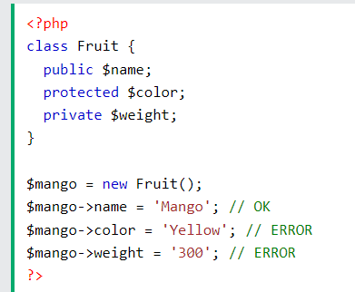
OOP in PHP vs. Java: Differences
Constructor: __construct
Destructor: __destruct
Public, Protected, Private, Static: public, protected, private, static
Notes:
Static methods(function) can be called directly - without creating an instance of the class first.
Static properties can be called directly - without creating an instance of a class.
Abstract :Abstract classes and methods are when the parent class has a named method, but need its child class(es) to fill out the tasks.
An abstract class is a class that contains at least one abstract method. An abstract method is a method that is declared, but not implemented in the code.
Extend: The extends keyword is used to derive a class from another class. This is called inheritance. A derived class has all of the public and protected properties of the class that it is derived from.

Slide 41
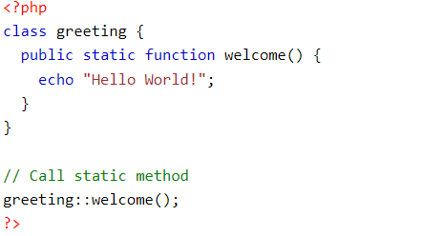
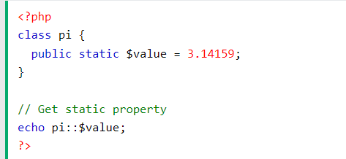
OOP in PHP vs. Java: Differences
Public, Protected, Private, Static: public, protected, private, static
Static methods(function) can be called directly - without creating an instance of the class first.
Static properties can be called directly - without creating an instance of a class.

Slide 42
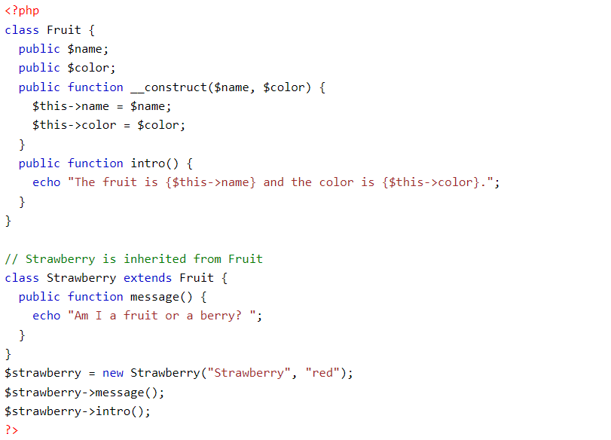
OOP in PHP vs. Java: Differences
Inheritance: extends, abstract
Extends: An inherited class is defined by using the extends keyword.
Notes:
Abstract :Abstract classes and methods are when the parent class has a named method, but need its child class(es) to fill out the tasks.
An abstract class is a class that contains at least one abstract method. An abstract method is a method that is declared, but not implemented in the code.
Extend: The extends keyword is used to derive a class from another class. This is called inheritance. A derived class has all of the public and protected properties of the class that it is derived from.

Slide 43
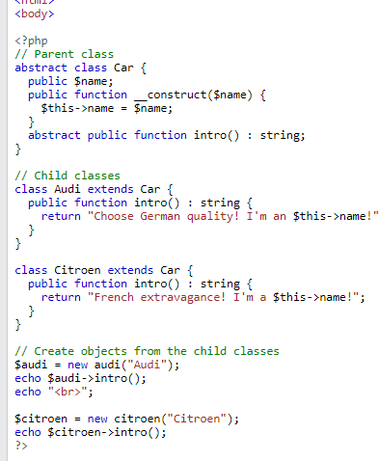

OOP in PHP vs. Java: Differences

Slide 44
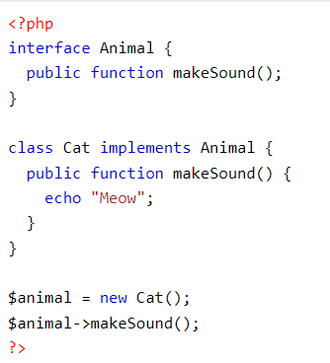
OOP in PHP vs. Java: Differences
Interfaces: interface, implements
Interface are similar to abstract classes. The difference between interfaces and abstract classes are:
Interfaces cannot have properties, while abstract classes can
All interface methods must be public, while abstract class methods is public or protected
All methods in an interface are abstract, so they cannot be implemented in code and the abstract keyword is not necessary

Slide 45
PHP Includes
Complex server side processing → lot of PHP codes
Break processing into multiple files (team working)
Avoid mixing HTML design & PHP
Four functions to insert code from external files
include(): Try to insert file, continues if cannot find it
include_once("A"): does not include “A” if it is already included even by other included before
require(): Try to insert external file, dies if cannot find it
require_once(): does not include if file is already included
The included code is interpreted & run (if is not function)
An implementation of server side include (SSI)
<html> <body> <?php include("header.php"); ?>

Slide 46
PHP in Web Applications

Slide 47
PHP in Web Applications (cont’d)
What do we implement by PHP?
Redirection
HTTP header modification
Input data
Receive data from HTML forms
Login & Logout
Session management
Ajax request processing
XML & JSON
Database access
Error handling

Slide 48
Outline
Introduction to CGI
Introduction to PHP
PHP Basic
Input Data Handling
HTTP Headers
Cookies & Session Management
Database
XML & JSON
Error Handling

Slide 49
PHP in Web Applications

Slide 50
Input Data Handling
One of the main functionalities of server side scripting is to process user input data, e.g.
Save data on server
Login & Sessions
Query from database server
…
Input data from forms/Ajax/API/ …
GET method
POST method
File upload

Slide 51
Input Data Handling (cont’d)
Major steps of input data handling:
1) Read the data
How to read the URL query part? Post data? File?
2) Check presence & existence
Is variable set? Is it empty?
3) Validation
Is data valid? Correct format?
4) Processing
Application dependent, e.g., query to DB, ….

Slide 52
1) Reading Submitted Data
Main feature: data sent in “URL Query Part” or “Packet Body” are automatically available to PHP scripts by the run-time environment
Does not matter HTML form or Ajax or …
The PHP pre-assigned $_GET and $_POST variables are used to retrieve the data
The predefined $_REQUEST variable contains the contents of $_GET, $_POST, $_COOKIE
The $_REQUEST variable can be used to collect form data sent with both GET and POST methods

Slide 53
1) Reading Submitted Data (cont’d)
$_GET, $_POST, and $_REQUEST are associative arrays
Key is the name attribute of input element in a form
Value is the value of the input element in a form
HTML
<form method="GET" action="index.php">
<input type="text" name="grade" value="">
</form>
PHP
$g = $_GET["grade"];
Notes:
Draw a figure to show the relation between forms in client side and the arrays in the server side, the data flow and the role of the “PHP Runtime Environment”

Slide 54
2) Checking Input Presence/Existence
isset($var) is false if variable is set with a value and that value should not be null.
i.e., either $var does not exist or is never assigned a value
Use this function to check if a check box, radio button, or select box list has a value
empty($var) is true if $var is 0, empty string, NULL, or FALSE
Use this function to check if a text field, password field, or text area has a value that is not an empty string
These input fields are always set → isset does not work!
Notes:
Out put of empty and isset is 0 or 1 . 0 is false and 1 true

Slide 55
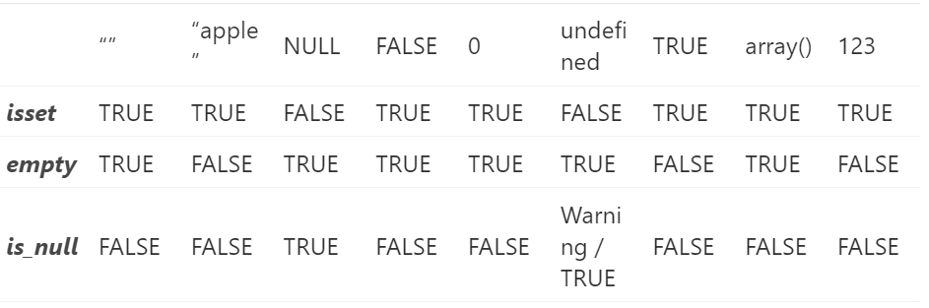
2) Checking Input Presence/Existence
Notes:
is_null() is to check whether a variable is defined as null.

Slide 56
Form Processing Example
<form method="post" action="form1.php">
Submit By Post!!
<fieldset>
<legend>University Grade</legend>
<input type="radio" name="grade" value="BS" /> BS
<input type="radio" name="grade" value="MS" /> MS
<input type="radio" name="grade" value="PhD" /> PhD
</fieldset>
<fieldset>
<legend><em>Web Development Skills</em></legend>
<input type="checkbox" name="skill_1" value="html" />HTML
<input type="checkbox" name="skill_2" value="xhtml" />XHTML
<input type="checkbox" name="skill_3" value="cs" />CSS
<input type="checkbox" name="skill_4" value="js" />JavaScript
<input type="checkbox" name="skill_5" value="aspnet" />ASP.Net
<input type="checkbox" name="skill_6" value="php" />PHP
</fieldset>

Slide 57
Form Processing Example (cont’d)
Favorite Programming Language:
<select name="lang">
<option value="c">C</option>
<option value="java">Java</option>
<option value="awk">AWK</option>
</select>
<input type="submit" value="Submit" />
</form>
<form method="get" action="form2.php">
<fieldset>
<legend> Submit by GET </legend>
Title: <input type="text" length="20" name="title"/>
Name: <input type="text" length="20" name="name" />
Family: <input type="text" length="20" name="fam" />
<input type="submit" value="Submit" />
</fieldset>
</form>

Slide 58
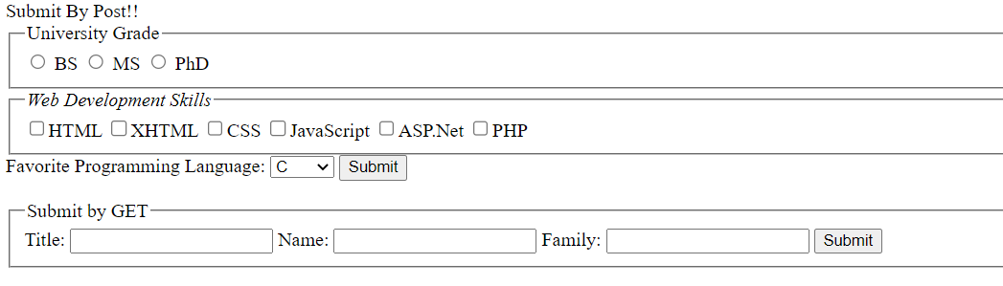
Form Processing Example (cont’d)

Slide 59
Form Processing Example (cont’d)
FORM1.PHP:
$grade = $_POST["grade"];
$lang = $_POST["lang"];
if(isset($grade))
echo "You are ". $grade;
else
echo "I don't know your grade";
echo "<br />";
echo "You are master in ";
for($i = 1; $i < 7; $i++)
if(isset($_POST["skill_".$i]))
echo $_POST["skill_".$i]. " ";
echo "<br />";
echo "You love ". $lang;

Slide 60
Form Processing Example (cont’d)
FORM2.PHP
$name = $_GET["name"];
$fam = $_GET["fam"];
$title = $_GET["title"];
if((! empty($name)) && (! empty($fam)) && (! empty($title))){
echo "A message by GET <br />";
echo "<h2> Welcome " . $title ." ". $name ." ". $fam ." </h2>";
}

Slide 61
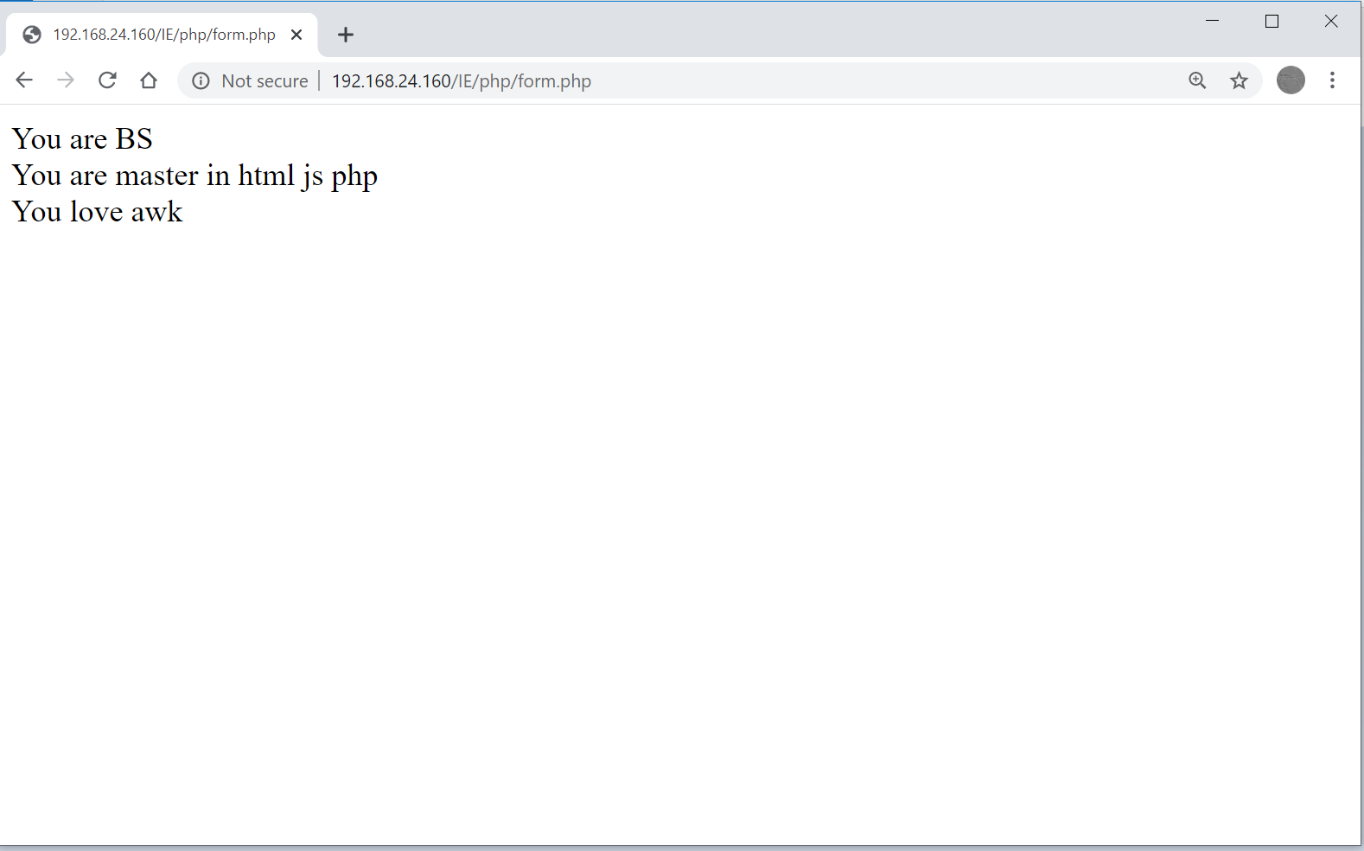
Form Processing Example (cont’d)

Slide 62
File Upload Handling
$_FILES is a two dimensional array stores data of uploaded files from a client
The first key in $_FILES is the name attribute of the input element with type="file"
Second key is a parameter of the file
$_FILES[file_name]["name"] - the name of the file
$_FILES[file_name]["type"] - the type of the file
$_FILES[file_name]["size"] - the size in bytes of the file
$_FILES[file_name]["tmp_name"] - the name of the temporary copy of the file stored on the server
$_FILES[file_name]["error"] - the error code resulting from the file upload
Notes:
Draw a figure to show data flow and explain the role of “PHP Runtime Environment”

Slide 63
File Upload Handling (cont’d)
When file is uploaded successfully, it is stored in a temporary location in the server
The temporary copied files disappears when the script ends
To save (move) the temporary file
move_uploaded_file($_FILES["file"] ["tmp_name"], "permanent location");

Slide 64
File Upload Example
<form action="http://127.0.0.1/IE/php/form.php" method="post" name="uploadFrom" enctype="multipart/form-data">
<fieldset>
<input type="file" name="myfile" /> <input type="submit" value="Submit" />
</fieldset>
</form>

Slide 65
File Upload Example (cont’d)
if(isset($_FILES["myfile"])){
if($_FILES["myfile"]["error"] > 0){
echo "Error: " . $_FILES["myfile"]["error"] . "<br />";
}
else{
echo "Upload: " . $_FILES["myfile"]["name"] . "<br />";
echo "Type: " . $_FILES["myfile"]["type"] . "<br />";
echo "Size: " . ($_FILES["myfile"]["size"] / 1024) . " Kb<br />";
echo "Temp Store: " . $_FILES["myfile"]["tmp_name"] . "<br />";
if (file_exists("upload/" . $_FILES["myfile"]["name"])){
echo $_FILES["myfile"]["name"] . " already exists. ";
}
else{
move_uploaded_file($_FILES["myfile"]["tmp_name"],"upload/" .
$_FILES["myfile"]["name"]);
echo "Stored in: " . "upload/" . $_FILES["myfile"]["name"];
}
}
}

Slide 66
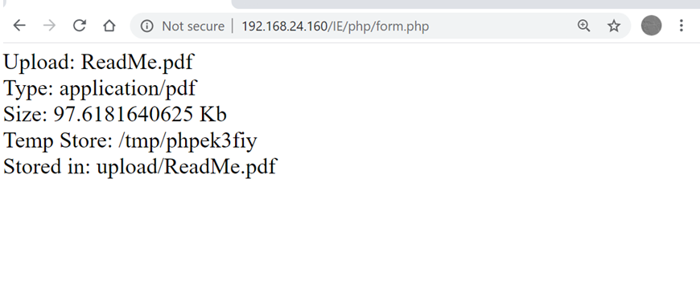
File Upload Example (cont’d)

Slide 67
3) Input Data Validation
Be very very careful about input data
Maybe they are coming from bad guys
There is a HTML form corresponding to PHP
On client side, we (developers) try to validate input data by JavaScript
We cannot fully & completely validate the data
What happen if attacker want to inject code/data
He does not use our forms
No data validation on client side
Server side data validation is required

Slide 68
PHP Filters
PHP filters to make data filtering easier
Two kinds of filters:
Validating filters:
Are used to validate user input
Strict format rules (like URL or E-Mail validating)
Returns the expected type on success or FALSE on failure
Sanitizing filters:
To allow or disallow specified characters in a string
Remove the invalid characters
Always return a valid output (that maybe empty)
Notes:
Sanitizing تمیز سازی

Slide 69
PHP Filters (cont’d)
Filters are applied by these functions:
filter_var(variable, filter, options): Filters a single variable
$i = 10;
$j = filter_var($i, FILTER_VALIDATE_INT);
if($j)
echo “Data is valid\n";
else
echo " Data is not valid\n";
EX.1
$email = "john.doe@example.com";
if (filter_var($email, FILTER_VALIDATE_EMAIL)) {
echo("$email is a valid email address");
} else {
echo("$email is not a valid email address");
}
EX.2
Notes:
Options:Optional. Specifies one or more flags/options to use. Check each filter for possible options and flags

Slide 70
PHP Filters: Filtering a Variable
$i = 10;
$fdata = array("options"=>array("min_range"=>15, "max_range"=>50));
$j = filter_var($i, FILTER_VALIDATE_INT, $fdata);
if($j)
echo “In a range";
else
echo "Out of range";
$i = 10; ----→ Out of range
$i = 20 ----→ In a range

Slide 71
PHP Filters (cont’d)
Filters are applied by these functions:
filter_var_array(array of variables, array of filters): Filter several variables with a set of filters
$data = array("int"=>10, "float"=>30.1);
$filter = array("int"=>array("filter"=>FILTER_VALIDATE_INT, "options"=>array("min_range"=>0)), "float"=>array("filter"=>FILTER_VALIDATE_FLOAT));
$valid = filter_var_array($data, $filter);
var_dump($valid);
Output: array(2) { ["int"]=> int(10) ["float"]=> float(30.1) }

Slide 72
PHP Filters: Filtering an Array of Variables
$data = array("int"=>"a1z0", "float"=>30.1);
$valid = filter_var_array($data, $filter);
var_dump($valid);
$data = $cars=array("10","Volvo","20","Toyota");
$valid = filter_var_array($data, FILTER_VALIDATE_INT);
var_dump($valid);
Output: array(2) { ["int"]=> bool(false) ["float"]=> float(30.1) }
Output: array(4) { [0]=> int(10) [1]=> bool(false) [2]=> int(20) [3]=> bool(false) }

Slide 73
PHP Filters (cont’d)
Each filter has a unique id (integer number)
FILTER_VALIDATE_INT → 257
FILTER_VALIDATE_FLOAT → 259
Filtering functions decide based on the value
A filter can have options and flags
E.g., for FILTER_VALIDATE_INT
Option: max_range and min_range
Flag: FILTER_FLAG_ALLOW_OCTAL
Flag and options are passed using associative arrays with keys "options" & "flags"

Slide 74
Filtering Input Data
Filters are applied by these functions:
filter_input(type, variable, filter): Get one input external variable from (e.g. from form input) given type and filter it, e.g. INPUT_GET, INPUT_POST, … (validate user input from insecure source such as input form.)
filter_input_array(type, filters): Get several input variables and filter them with specified filters
<?php
if (!filter_input(INPUT_GET, "email", FILTER_VALIDATE_EMAIL)) {
echo("Email is not valid");
} else {
echo("Email is valid");
}
?>

Slide 75
Filtering Input Data
Types:
INPUT_GET, INPUT_POST, INPUT_COOKIE, …
To (optionally) apply a filter F on an input with name N with type T and get valid data
filter_input(T, N, F)
To (optionally) apply filter F on array of inputs with type T
filter_input_array(T, F)
Output specified by the keys in the filter

Slide 76
Filtering Input Data Example
Assume: URL:/filter.php?ip=192.168.0.1&address=http://wwww.abc.com
$valid_address = filter_input(INPUT_GET, "address", FILTER_VALIDATE_URL);
$filter = array("address"=>array("filter"=>FILTER_VALIDATE_URL), "ip"=>array("filter"=>FILTER_VALIDATE_IP));
$valid_get = filter_input_array(INPUT_GET, $filter);

Slide 77
Extracting Valid Data
Sanitize filters generate valid data from input
FILTER_SANITIZE_EMAIL
FILTER_SANITIZE_NUMBER_FLOAT
FILTER_SANITIZE_NUMBER_INT
FILTER_SANITIZE_URL
…
echo filter_var("a b c", FILTER_SANITIZE_ENCODED);
a%20b%20c
echo filter_var("ab123ca", FILTER_SANITIZE_NUMBER_INT);
123
Notes:
The FILTER_SANITIZE_ENCODED filter removes or encodes special characters

Slide 78
Implementing Custom Filter
Filter type FILTER_CALLBACK is used to register a custom filter
function convertSpace($string){
return str_replace("_", " ", $string);
}
$string = "PHP_Scripting_is_fun!";
echo filter_var($string, FILTER_CALLBACK, array("options"=>"convertSpace"));

Slide 79
Outline
Introduction to CGI
Introduction to PHP
PHP Basic
Input Data Handling
HTTP Headers
Cookies & Session Management
Database
XML & JSON
Error Handling

Slide 80
PHP in Web Applications

Slide 81
HTTP Headers
Both HTTP request and response headers are accessible in PHP
PHP scripts can get HTTP request headers
PHP scripts can set HTTP response headers
Request headers
Are extracted by php runtime environment
Filled in the $_SERVER superglobal array
'REQUEST_METHOD', 'REQUEST_TIME', 'HTTP_ACCEPT', 'HTTP_ACCEPT_CHARSET', 'HTTP_HOST', 'HTTP_REFERER', 'HTTP_USER_AGENT', ...
Notes:
$_SERVER['REQUEST_METHOD'] Returns the request method used to access the page (such as POST)
$_SERVER['REQUEST_TIME'] Returns the timestamp of the start of the request (such as 1377687496)
$_SERVER['HTTP_ACCEPT'] Returns the Accept header from the current request . Accept is part of http headers sended by client (eg. browser, crawler...).
$_SERVER['HTTP_HOST'] Returns the Host header from the current request
$_SERVER['HTTP_REFERER'] Returns the complete URL of the current page (not reliable because not all user-agents support it)

Slide 82
HTTP Request Headers
<?php
echo $_SERVER['REQUEST_METHOD'];
echo "<br>";
echo $_SERVER['HTTP_HOST'];
echo "<br>";
echo $_SERVER['HTTP_REFERER'];
echo "<br>";
echo $_SERVER['HTTP_USER_AGENT'];
echo "<br>";
echo $_SERVER['HTTP_ACCEPT'];
?>

Slide 83
HTTP Response Headers
headers_list(): Return a list of headers to be sent to the web client (Return a list of response headers sent)
PHP scripts can modify HTTP response headers, to
Redirect the web client to another URL
Send a different HTTP status code
Tell client whether to cache the current document or not
Tell client what language is used in the current document
Change the content type of the current document
You can use PHP to dynamically create text file, CSV file, image, ...
header(): Set a raw HTTP header
Headers will be sent when actual output is generated

Slide 84
HTTP Response Headers Examples
header() must be called before any actual output is sent!
Redirecting
<?php
header("Cache-Control: no-cache");
header('Location: http://www.google.com/');
exit(); // Return immediately
?>
Other Status Code
<?php
header("HTTP/1.0 404 Not Found");
?>
<html> <!-- Content of the error page --> </html>

Slide 85
Outline
Introduction to CGI
Introduction to PHP
PHP Basic
Input Data Handling
HTTP Headers
Cookies & Session Management
Database
XML & JSON
Error Handling

Slide 86
PHP in Web Applications
Notes:
Web server does not see the user, it gets an HTTP request. How does it make sure that this request is from authenticated user?

Slide 87
Main Questions
Sample application: Student A want to check his course grades on the portal
Q1: Is this client the “Student A”?
User authentication
Q2: Are these requests from the client who is authenticated as the “Student A”?
User/Request identification
Q3: How to store temporary data between login & logoff of the client (e.g., name, login state, …)
Session management

Slide 88
User Authentication
Different mechanisms for authentication
HTTP authentication header (No secure and rarely usable)
1) Server built-in functionality for authentication
Proper server configuration
No server side scripting
2) Server side scripting to use the HTTP headers
Pure HTML
Without HTTP Authentication headers
Using HTML forms + Server side scripting

Slide 89
HTTP Based Authentication 1
HTTP support authentication: Basic & Digest modes
Modern web servers have built-in support for HTTP authentication, Configure server
To set “WWW-Authentication” header
To check user/pass (using a password file)
PHP scripts have read/write access to HTTP headers
At the first access, set “WWW-Authentication”
header() function
In the following accesses to this directory or subdirectories check user/pass
Which are sent automatically by browser

Slide 90
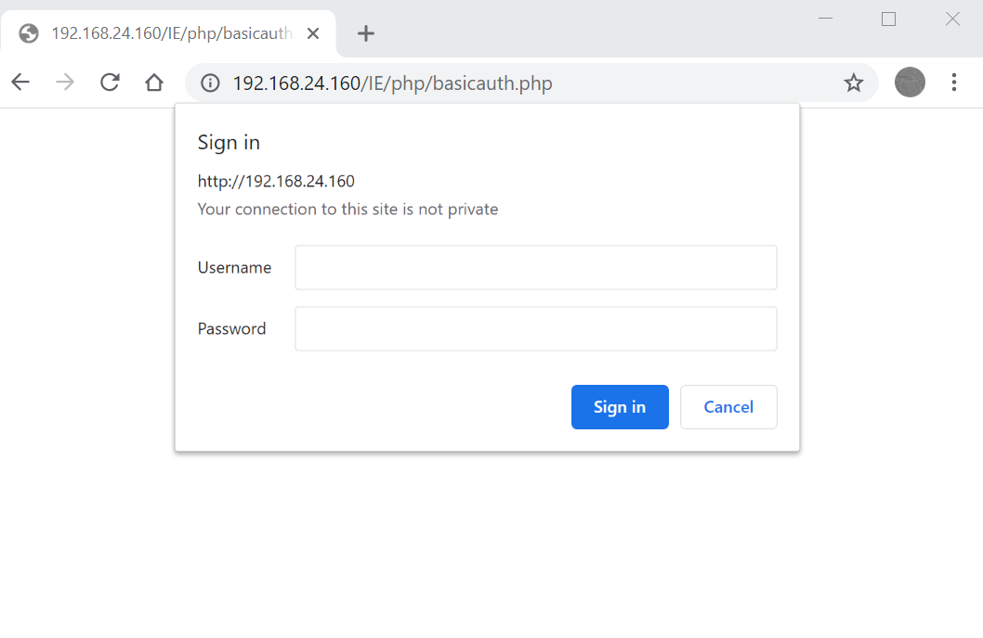
HTTP Authentication Exampl

Slide 91
HTTP Basic Authentication in PHP
<?php
function prompt(){
header('WWW-Authenticate: Basic realm="Protected Page"');
header('HTTP/1.0 401 Unauthorized');
die('You must enter a valid username & password');
}
function checkpass($name,$pass){
if((strcmp($name,"abc") == 0) && (strcmp($pass,"123") == 0))
return TRUE;
else
return FALSE;
}
if(!isset($_SERVER['PHP_AUTH_USER'])){
prompt();
}
Notes:
*https://www.php.net/manual/en/features.http-auth.php:
*It is possible to use the header() function to send an "Authentication Required" message to the client browser causing it to pop up a Username/Password input window. Once the user has filled in a username and a password, the URL containing the PHP script will be called again with the predefined variables PHP_AUTH_USER, PHP_AUTH_PW, and AUTH_TYPE set to the user name, password and authentication type respectively. These predefined variables are found in the $_SERVER array. Only "Basic" and "Digest" authentication methods are supported.
*According to the RFC 7235, the realm parameter is reserved for defining protection spaces (set of pages or resources where credentials are required) and it's used by the authentication schemes to indicate a scope of protection.

Slide 92
HTTP Basic Authentication in PHP
else{
if(!checkpass($_SERVER['PHP_AUTH_USER'],
$_SERVER['PHP_AUTH_PW']) == TRUE)
prompt();
}
?>
<!DOCTYPE html>
<html>
<head></head>
<body>
<h2>You have singed in successfully</h2>
</body>

Slide 93
HTTP Authentication Solution
How to authenticate the user
user/pass are asked by browser from user
How to authenticate the subsequent requests
The “authorization” header is sent automatically by the browser for all request (all access tofiles) in this session
Server can check it to allow/deny access
How to store temporary data
Besides, cookies can be used
However, they are saved in client side (insecurity) and are sent in every request (insecurity + overhead)

Slide 94
HTTP Authentication Issues
Lack of encryption (in basic), and weak encryption (in digest)
1) All pages that need authentication should be in the same directory (HTTP authentication works for directories)
3) No logout mechanism
Authorization header is a session data (maintained by browser)
When is the data destroyed?
In modern tab based browsers → When the browser window is closed not when the tab is closed
Even if tab is closed & browser is not restarted → Authenticated
How to clear authorization data?
Is not easy!
Client side scripting (on page close) (trick & hack)
4)The authentication window to get user/pass

Slide 95
Solution for HTTP Authentication Issues
Don’t use the HTTP Authentication ;-)
Instead
Get user/pass by a HTML form
Check user/pass in server side by PHP
If user/pass is not correct → Error & Redirect to login
If user/pass is correct → Show this page, then ???
HTTP authentication mechanism ensure that the subsequent requests are from the authenticated user. How can we do it by PHP?
Cookies are the solution

Slide 96
Cookies for User Identification
After successful authentication of user, set cookies to identify the authenticated user
Set-Cookies: login=true
Set-Cookies: Name=Ali Hassani
Set-Cookies: ID=11111
In the following requests
If (login != true) → Error
Else
Say welcome to “Ali Hassani”
lookup DB for “11111” & show result

Slide 97
Cookies in PHP: Reading Cookies
Access to cookies
Cookies are saved on client side
Sent back to server by browser
Cookies are available in PHP using the $_COOKIE superglobal array
Key is the name of cookie
Value is the value (content) of the cookie
Check presence: isset($_COOKIE["key"])

Slide 98
Cookies in PHP: Setting Cookies
Setting cookies
setcookie(name,value,expire,path,domain)
Name & Value are required
Expire (second), Path & Domain are optional
They are validated by browser!!!
Must come before any output: i.e., before <html>
/* Permanent (up to 10 hours) cookie */
setcookie("id", "100", time()+36000);
/* Session cookie */
setcookie("name", "Ali");
/* Remove cookie */
setcookie("code", "", -1);

Slide 99
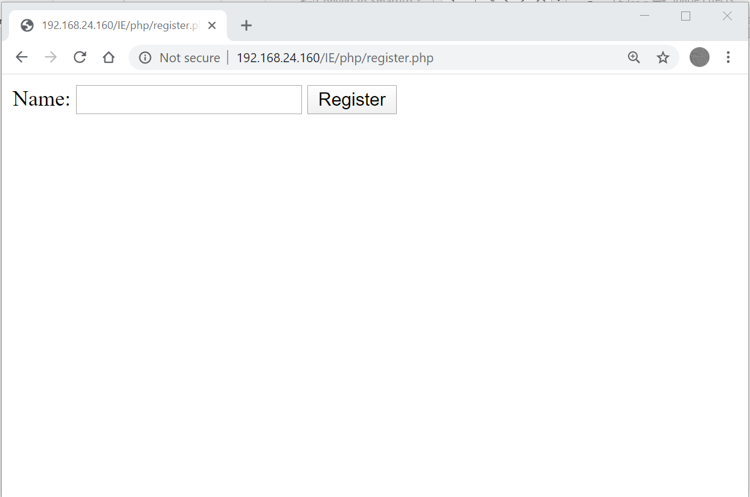
Cookies in PHP Example

Slide 100
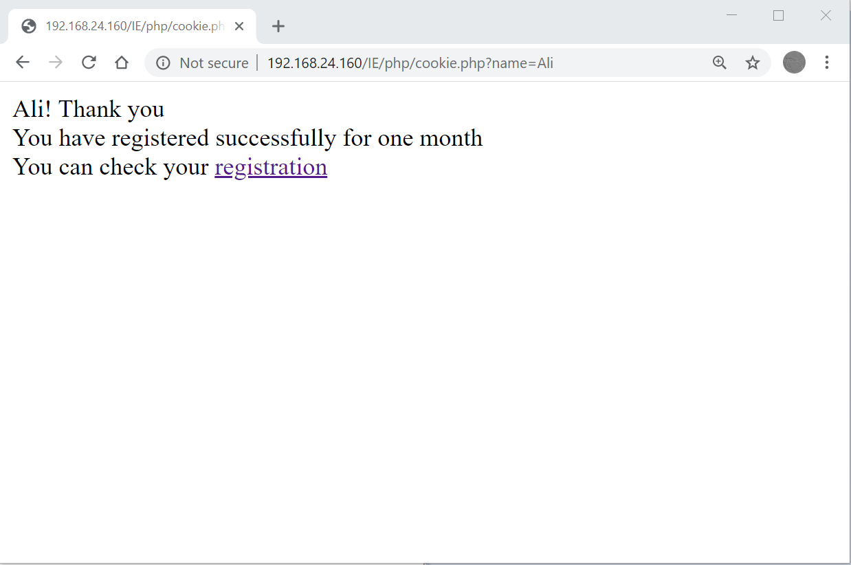
Cookies in PHP Example

Slide 101
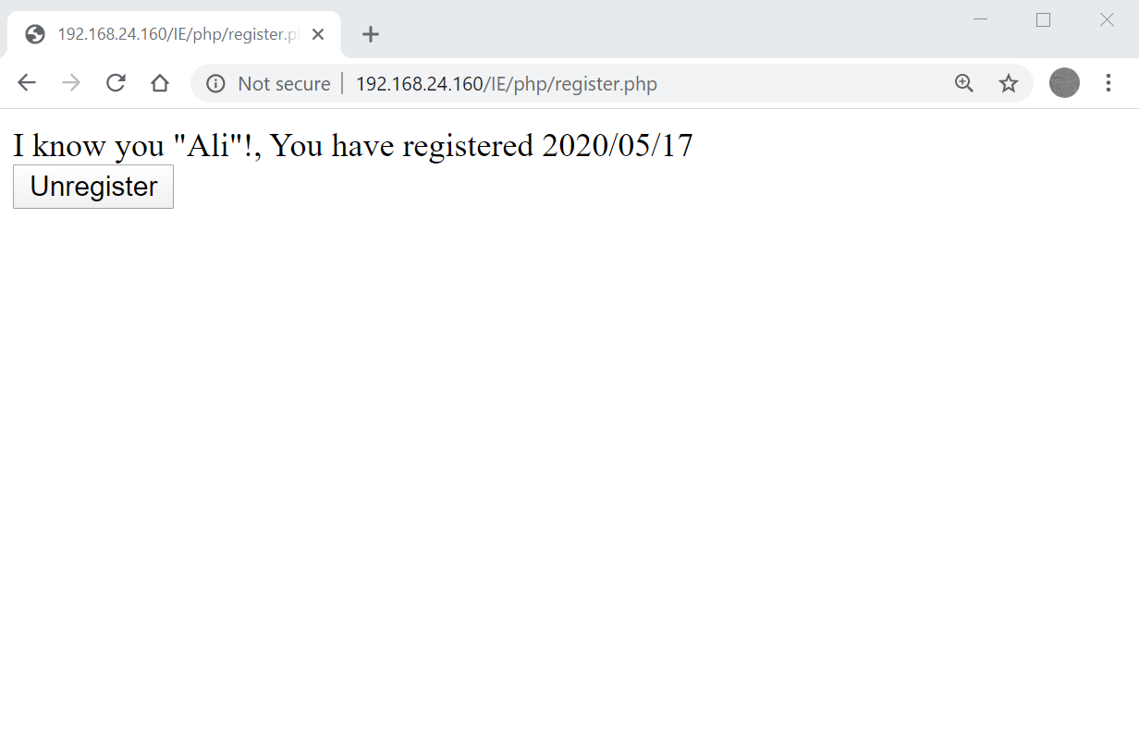
Cookies in PHP Example

Slide 102
Cookies in PHP Example: register.php
<body>
<?php
if(isset($_COOKIE["regtime"])){
echo "I know you \"". $_COOKIE["username"] ."\"!,
You have registered ". $_COOKIE["regtime"] . "<br />";
echo "<form method='get'
action='http://127.0.0.1/IE/php/cookie.php'>
input type='submit' name='unregister' value='Unregister' />
</form> ";
}
else{
echo"<form method='get'
action='http://127.0.0.1/IE/php/cookie.php'>
Name: <input type='txt' name='name' />
<input type='submit' value='Register' />
</form> ";
}
?>
</body>

Slide 103
Cookies in PHP Example: cookie.php
<?php
$register = -1;
$name = "";
if(strlen($_GET["unregister"]) > 0){
setcookie("username", "", -1);
setcookie("regtime", "", -1);
$register = 0;
}
elseif(strlen($_GET["name"]) > 0){
$name = $_GET["name"];
$expire = time()+30*24*60*60;
setcookie("username", $name, $expire);
setcookie("regtime", date("Y/m/d"), $expire);
$register = 1;
}
?>
<html>
<head>
</head>

Slide 104
Cookies in PHP Example: cookie.php
<body>
<?php
if($register == 1){
echo $name."! Thank you <br />";
?>
You have registered successfully for one month <br />
You can check your <a href="register.php">registration</a>
<?php
}
else if($register == 0){
echo "You have unregistered successfully, Hope to see you again <br />";
echo "Do you want to <a href='register.php'>register</a> again <br />";
}
?>
</body>
</html>

Slide 105
Cookies Issues
Security! $_COOKIE["login"]=true ??!!
Need to save data/state for client in server side
E.g. login statue, current purchased items in e-shopping, name & ID of students, …
We do NOT want to use cookies, because of
Security, Overhead, Performance, …
Solution
Create a (simple) database (i.e., key-value pairs) in server side (e.g., hash map, vector, …) for each client
Data should be associated to client
Server should identify clients
User cookies are the key of the database

Slide 106
PHP Sessions: Solution for Cookies Issues
PHP Session: The Cookies + The (simple) Database
A PHP session variable stores information about settings/states for a user session
To solve the "stateless HTTP" problem
By allowing to store user information on the server for later use
Works by creating a unique id (ID) for each session and store variables based on this ID
ID is stored in a session cookie & sent back to client

Slide 107
PHP Sessions (cont’d)

Slide 108
PHP Sessions in Action
Every page that uses session data must be proceeded by the session_start()
Creates new session or retrieves info. from the (simple)DB
How does it know what it should do?
Must come before anything sent to client, before <html>
Session variables are then set and retrieved by accessing the global $_SESSION
When we don’t need the session data (e.g. logoff)
Remove an specific variable: unset($_SESSION["key"])
Delete whole session data: session_destroy()
Notes:
Unset will destroy a particular session variable whereas session_destroy() will destroy all the session data for that user including cookies from client’s browser.

Slide 109
PHP Sessions: Example 1
<?php #session1.php
session_start();
$_SESSION["cnt"] = (isset($_SESSION["cnt"])) ? $_SESSION["cnt"] + 1 : 1;
?>
<html> <head> </head><body>
You have visited this page <?php echo $_SESSION["cnt"]; ?> times.
<form method="GET" action="http://127.0.0.1/IE/php/reset.php">
<input type="submit" name="reset" value="Reset" />
</form>
</body> </html>
======================================================
<?php #reset.php
session_start();
unset($_SESSION["cnt"]); // session_destory()
?>
<html> <head></head> <body>Your counter is reset</body></html>

Slide 110
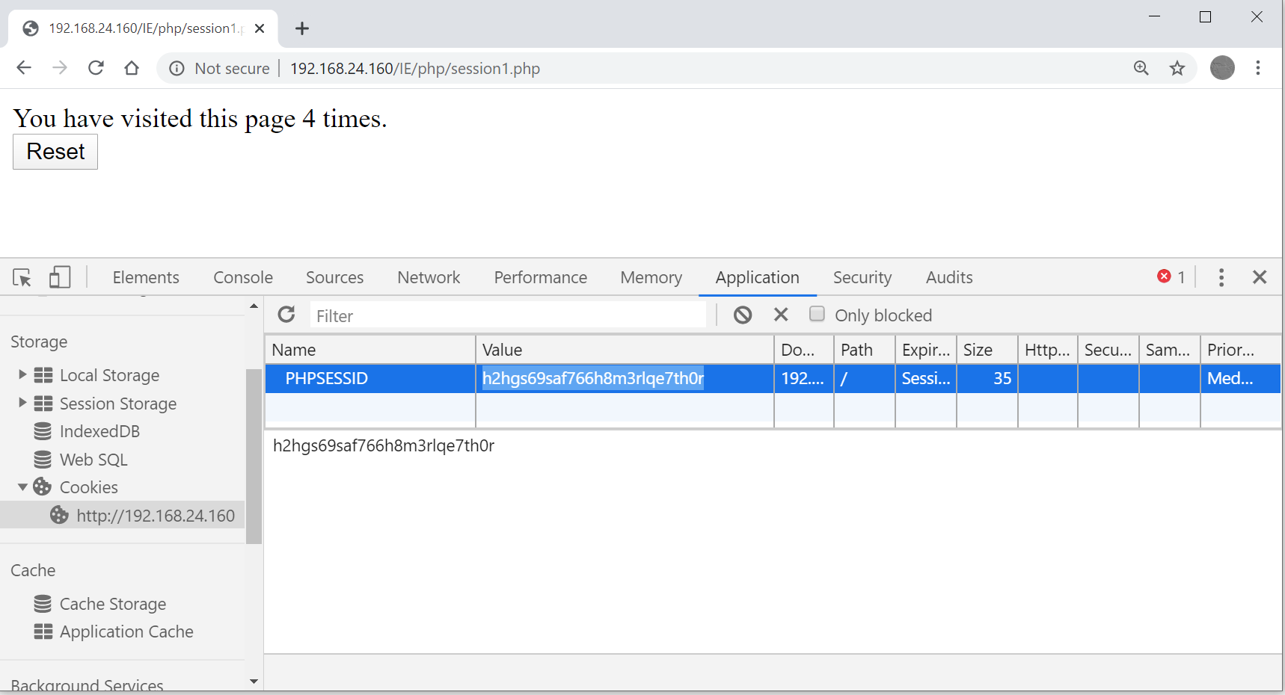
PHP Sessions: Example 1 (cont’d)
Notes:
PHPSESSID is a session cookie that is used to identify a user's session on a website. It is commonly used in PHP-based web applications to store a unique identifier for a user's session on the server. When a user visits a website that uses PHP sessions, a PHPSESSID cookie is sent to the user's browser and is stored on the user's computer. The server uses this cookie to identify the user's session and retrieve the appropriate data for that session. The PHPSESSID cookie is typically set to expire when the user closes their web browser.

Slide 111
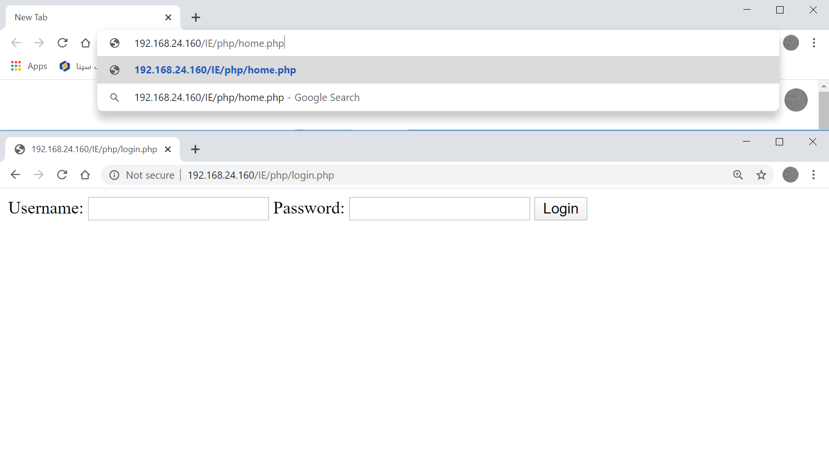
PHP Sessions: Example 2 (cont’d)

Slide 112
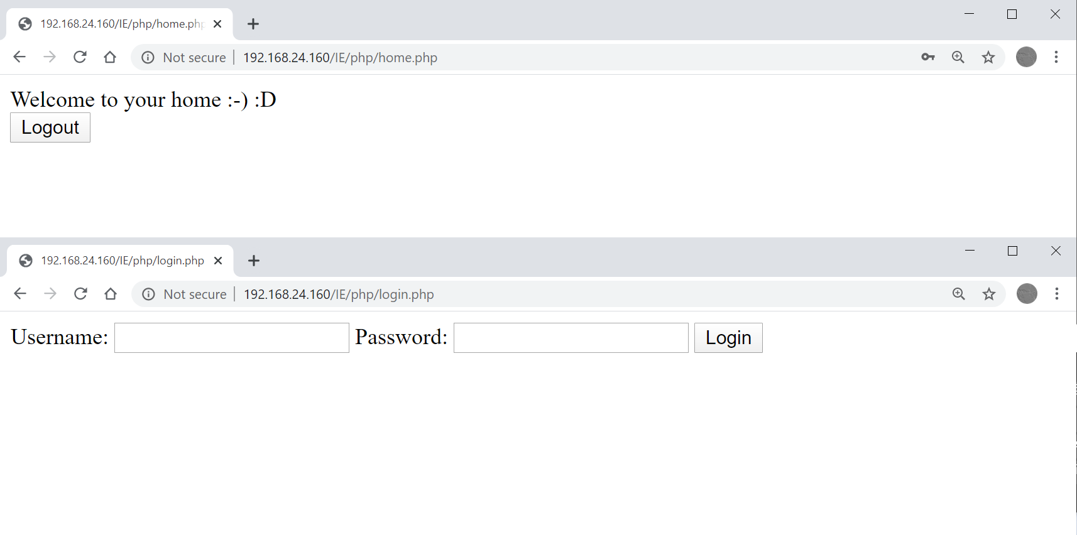
PHP Sessions: Example 2 (cont’d)

Slide 113
PHP Sessions: Example 2 (cont’d)
login.php
Check user/pass
Setup session
Redirect to home.php
home.php
Access to the session
Check authentication
Logout using logout.php
logout.php
Destroy session

Slide 114
PHP Sessions: Example 2: login.php
<?php session_start(); ?>
<html> <head></head> <body>
<?php
$name=$_REQUEST["user"]; $pass=$_REQUEST["pass"];
if(isset($_SESSION["auth"]) && $_SESSION["auth"]){ #signed user
?>
You have already signed in, go to your <a href="home.php">home</a>
<?php
}
elseif((strlen($name)>0)&&(strlen($pass)>0)){ #correct sign in
if((strcmp($name,"ali")==0) && (strcmp($pass="123")==0)){
echo "correct pass";
$_SESSION["auth"] = True;
header("Location: home.php");
}
else{ echo "Incorrect pass"; }
else{
?>
<form method="GET" action="login.php">
Username: <input type="text" name="user" />
Password: <input type="password" name="pass" />
<input type="submit" value="Login" />
</form>
<?php } ?>
</body>

Slide 115
PHP Sessions: Example 2: home.php
<?php
session_start();
if(!(isset($_SESSION["auth"]) && $_SESSION["auth"]))#unsigned user
header("Location: login.php");
?>
<html> <head>
<script type="text/javascript">
function logout(){
xmlhttp=new XMLHttpRequest();# open(method, url, async)
xmlhttp.open("GET", "logout.php", false);
xmlhttp.send("");
}
</script>
</head>
<body onunload="logout()">
<body>
Welcome to your home :-) :D
<form action="logout.php" method="GET">
<input type="submit" value="Logout" />
</form>
</body></html>
Notes:
The onload attribute fires when an object has been loaded. onload is most often used within the <body> element to execute a script once a web page has completely loaded all content (including images, script files, CSS files, etc.). However, it can be used on other elements as well (see "Supported HTML tags" below)

Slide 116
PHP Sessions: Example 2: logout.php
<?php
session_start();
session_destroy();
header("Location: login.php");
?>

Slide 117
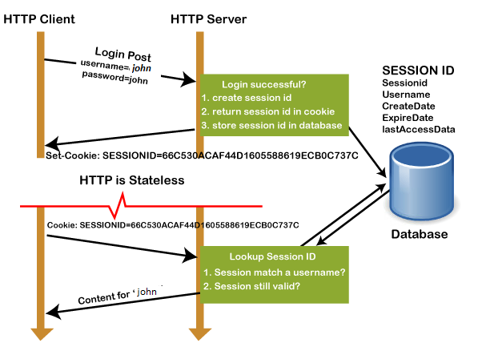
Session vs. Cookies
Session overview:
the client request to the server via GET or POST method.
The sessionID is created on the server, save in db and return the sessionID with a cookie as a response to the client.
Cookie with sessionID stored on
the browser is sent back to the
server. The server matches this
id with the saved sessionID and
sends a response HTTP200

Slide 118
Session vs. Cookies
Sessions use cookies
The “Session ID” cookie
However, data is saved in server side (is not sent to client)
Less overhead on client
Less bandwidth for data transmission
More secure
Client (and also hackers) does know what you are saving
Harder to hijack the session, compare
setcookie("login", 1);
$_SESSION[login] = 1;

Slide 119
Session Parameters: Global Settings
Session related parameters are configured in “php.ini”
session.name: Name of the session (used as cookie name)
session.cookie_lifetime: Lifetime of cookie send for browser
session.cookie_path: The path for which the cookie is valid
session.gc_maxlifetime: Lifetime of session in server side, it is collected by GC
Notes:
session. gc_maxlifetime specifies the number of seconds after which data will be seen as 'garbage' and potentially cleaned up. Garbage collection may occur during session start (depending on session . آزاد کردن حافظه

Slide 120
Session Parameters: Per Script
void session_set_cookie_params(int $lifetime, string $path, string $domain, bool $secure=false, bool $httponly=false)
The effect of this function only lasts for the duration of the script. Thus, you need to call this function for every request and before session_start()is called
Default value of $path is '/'. To prevent session ID from being discovered by other PHP scripts running in the same domain, you should set $path to the subfolder where your scripts are stored
Notes:
session.cookie_httponly bool
Marks the cookie as accessible only through the HTTP protocol. This means that the cookie won't be accessible by scripting languages, such as JavaScript. This setting can effectively help to reduce identity theft through XSS attacks (although it is not supported by all browsers).
Path on the domain where the cookie will work. Use a single slash ('/') for all paths on the domain.
domain
Cookie domain, for example 'www.php.net'. To make cookies visible on all subdomains then the domain must be prefixed with a dot like '.php.net'.
session.cookie_secure specifies whether cookies should only be sent over secure connections. Defaults to off.

Slide 121
When does a PHP Session Expire?
PHP Session is a relation between
Session ID Cookie in Client side
Session Data Base in Server side
So, session is not accessible
Session ID cookie is destroyed
Browser restarts, delete cookie, …
Session is destroyed
Intentionally: logout, automatic (ajax based) logout, …
Accidently:
Server restart
Long inactive session are collected by garbage collector
Avoiding over utilizing server memory

Slide 122
Outline
Introduction to CGI
Introduction to PHP
PHP Basic
Input Data Handling
HTTP Headers
Cookies & Session Management
Database
XML & JSON
Error Handling

Slide 123
PHP in Web Applications

Slide 124
Databases in PHP
Many databases; here, MySQL
Fast review of databases’ basics
Database, Table, Row, …
Database creation
Database modification
Database query
MySQL in PHP
Database connection
Modification & Query
SQL injection

Slide 125
Relational Database Basic Concept
Relational database
Database server contains multiple databases
Each database consists of multiple tables
Each table is defined by its columns (& types)
Each row is a data record
A column is the primary key
A unique identifier for each record
We use Structured Query Language (SQL) for database management
A famous SQL based database → MySQL
Free, Open source, and multiplatform

Slide 126
SQL Commands: Create Table
CREATE TABLE students(
name VARCHAR(55), num INT(3),
grade DECIMAL(2,2),
primary key(num)
);
Types
TEXT, CHAR(size), VARCHAR(maxsize), INT(maxsize), DECIMAL(maxsize, precision) , DATE(), YEAR(),….
For primary key
id INT AUTO_INCREMENT, primary key(id)
Notes:
Varchar: Used to store strings of variable length

Slide 127
SQL Commands (cont’d)
Inserting data
INSERT INTO tabelname (column1, …) VALUES (val1, …);
INSERT INTO students(name,grade,num)
VALUES ("Ali", 15.23, 1122);
Querying data
SELECT columnname FROM table WHERE condition
SELECT * FROM students WHERE grade=20
Conditions by comparison & logical
=, !=, <, <=, >, >=, …
AND, OR

Slide 128
SQL Commands (cont’d)
Updating records
UPDATE tablename SET col1=val1, col2=val2, … WHERE condition
UPDATE student SET grade=20 WHERE name=‘Ali’;
Deleting a record from a table
DELETE FROM tablename WHERE condition;
E.g. clear the students table
DELETE FROM students;
Deleting a table
DROP TABLE tablename;
Real Example
Notes:
create database testDB;
use testDB;
show tables;
create TABLE books(name VARCHAR(100), price INT, author VARCHAR(100));
show tables;
INSERT INTO books(name, price, author) VALUES("IE", 1, "BB");
INSERT INTO books(name, price) VALUES("NM", 2);
SELECT * from books;
UPDATE books SET author="XYZ" where name="NM";
SELECT * from books;
DELETE from books WHERE price=1;
SELECT * from books;
DROP TABLE books;
show tables;
DROP DATABASE testDB;

Slide 129
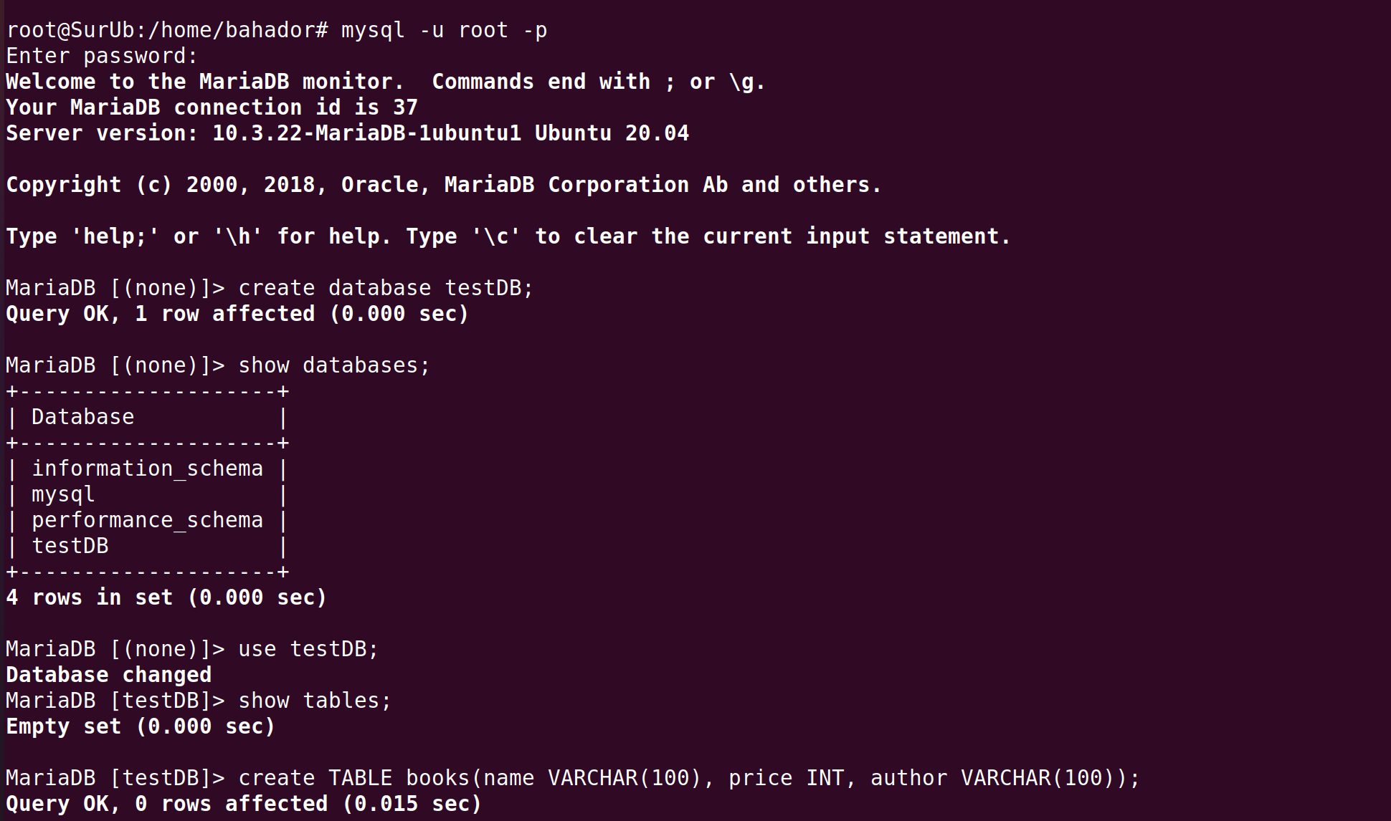
SQL Examples

Slide 130
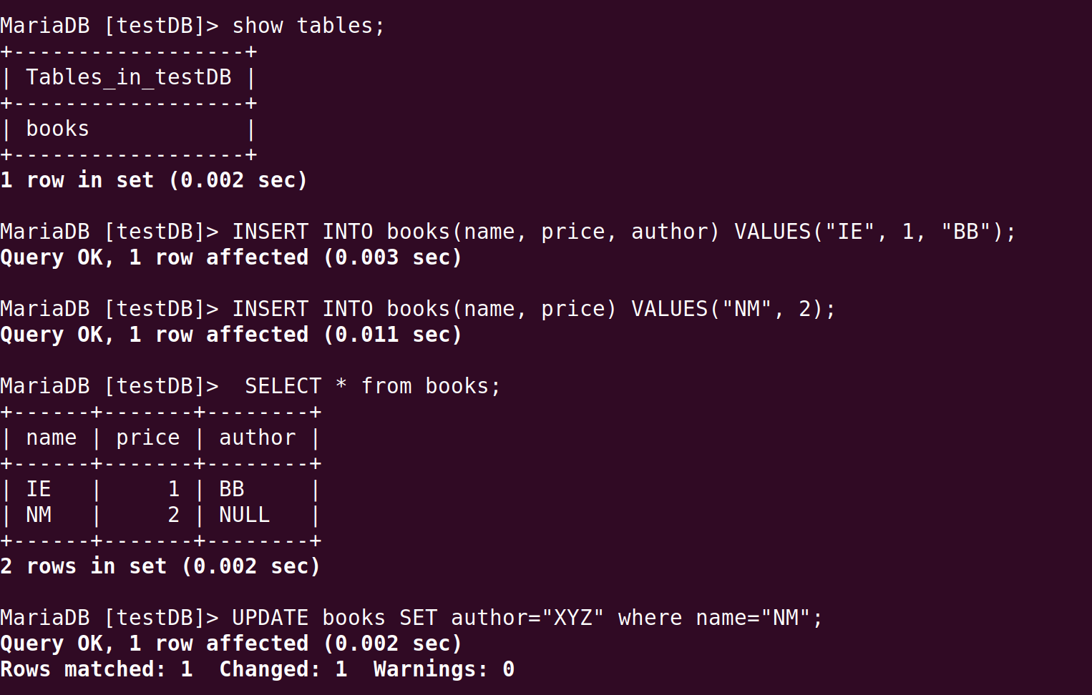
SQL Examples (cont’d)

Slide 131
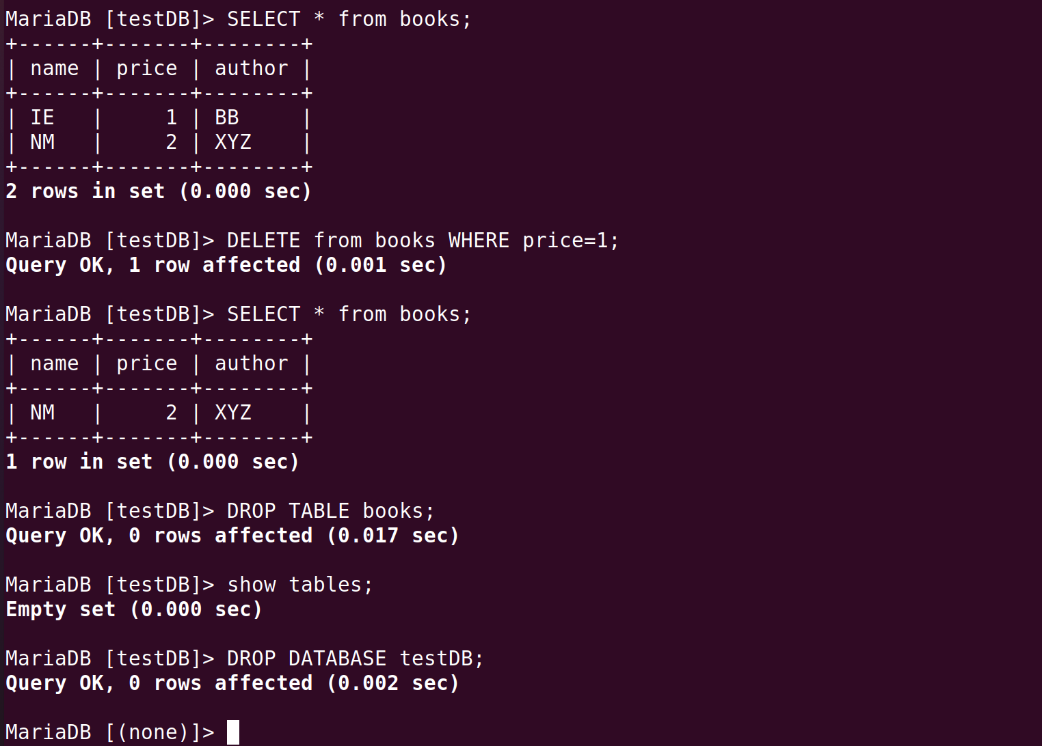
SQL Examples (cont’d)

Slide 132
MySQL in PHP
There are two interfaces (API) to access MySQL in
The Old API
Functions start by mysql_
Now deprecated, will be removed
However, very popular, lot of web applications based on
The New Improved Extension
Available in two modes
Procedural mode: functions start by mysqli_
Very similar to the old API, with minor differences & new features
Object oriented mode
The same functions but as a method of objects

Slide 133
MySQL in PHP (cont’d)
In general, all APIs follow the same concept to work with MySQL DB
Functions & Parameters are different
The steps of the follow
Connect to the database server
Select the database in the server
Send SQL queries to the tables of the database
Process the result (typically as an array)
Close the connection

Slide 134
MySQL in PHP: Connecting & Selecting
The first step to work with MySQL
1) Connecting to the MySQL server
2) Selecting database
Required for all operations on database
$mysqli = mysqli_connect("server address", "username","password", "DB name") or die(mysqli_connect_error());
We don’t want to continue if it fails

Slide 135
MySQL in PHP: SQL Commands
SQL commands are send by mysqli_query($mysqli,"SQL Command")
Syntax is the SQL
E.g., Create table in the selected database
mysqli_query($mysqli, "CREATE TABLE students(
id INT AUTO_INCREMENT,
primary key(id),
name VARCHAR(50),
stdnum INT(8))");

Slide 136
MySQL in PHP: Query & Closing
Query result is processed by mysqli_fetch_*
E.g., mysqli_fetch_assoc()
$result = mysqli_query($db, "SELECT name, grade from ...");
while($row = mysqli_fetch_assoc($result)){
$std_name = $row['name'];
$std_grade = $row['grade'];
}
mysqli_free_result($result);
Close database connection:
mysqli_close($mysqli)
Notes:
mysqli fetch_assoc() :Fetch a result row as an associative array:
mysqli fetch_array() Fetch a result row as a numeric array and as an associative array:

Slide 137
MySQL Example
Database: students
Table: IE
(name, fam, grade, num)
datainput.html: HTML form to insert data
dbinsert.php: Insert data to DB
datasearch.html: HTML form to query
dbsearch.php: Run the query and show result

Slide 138
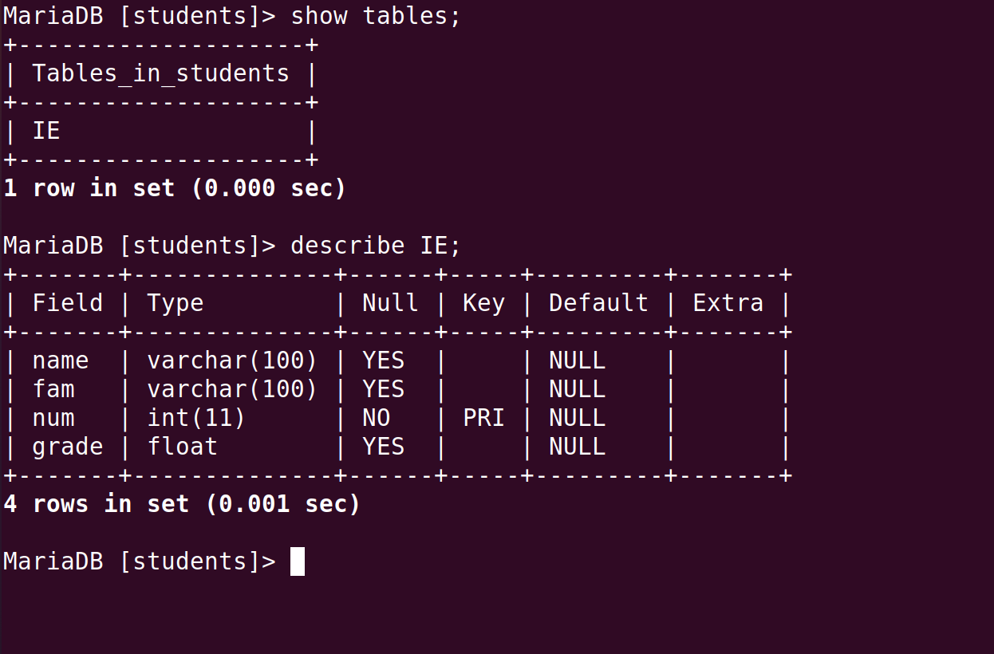
MySQL Example (cont’d)

Slide 139
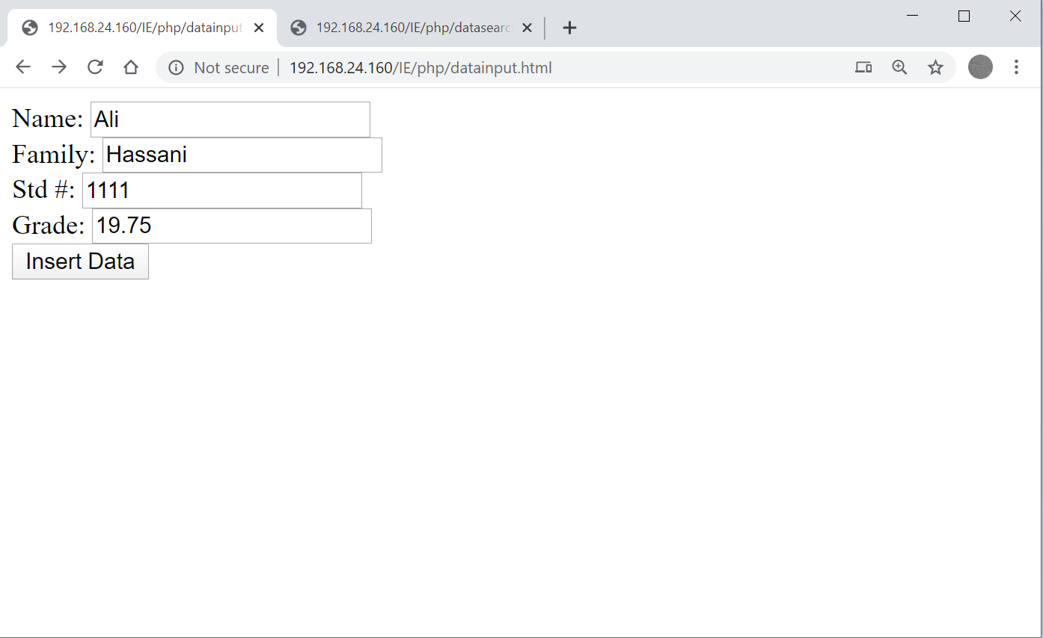
MySQL Example (cont’d)

Slide 140
Example: datainput.html
<html>
<head>
</head>
<body>
<form action="http://127.0.0.1/IE/php/dbinsert.php" method="GET">
Name: <input type="text" name="n" /><br />
Family: <input type="text" name="f" /><br />
Std #: <input type="text" name="i" /><br />
Grade: <input type="text" name="g" /><br />
<input type="submit" value="Insert Data" />
</form>
</body>
</html>

Slide 141
Example: dbinsert.php
<?php
$name = $_REQUEST["n"]; $famanme = $_REQUEST["f"];
$grade = $_REQUEST["g"]; $num = $_REQUEST["i"];
if((strlen($num) > 0) && (strlen($famanme) > 0) && (strlen($grade) > 0) && (strlen($num) > 0)){
$db = mysqli_connect("127.0.0.1", "root", "12345678", "students") or die(mysqli_connect_error());
$result = mysqli_query($db, "INSERT INTO IE(name, fam, num, grade) VALUES('$name', '$famanme', '$num', '$grade');") or die(mysqli_error($db));
mysqli_close($db);
echo "Data has been inserted successfully <br />";
}
else{
echo "Wrong Input";
}
?>

Slide 142
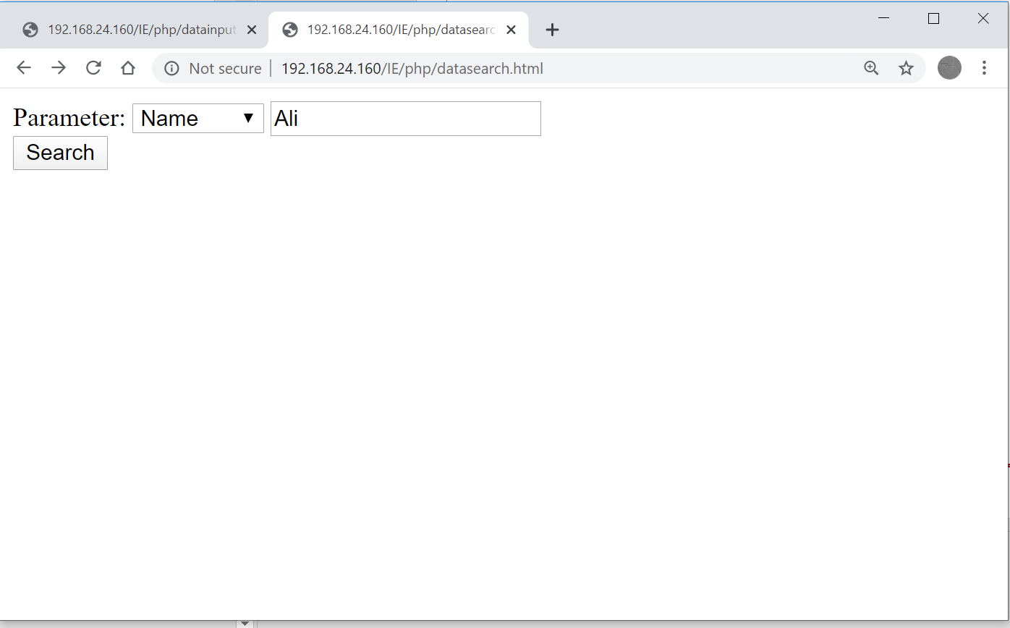
MySQL Example (cont’d)

Slide 143
Example: datasearch.html
<html>
<head>
</head>
<body>
<form action="http://127.0.0.1/IE/php/dbsearch.php" method="GET">
Parameter:
<select name="col">
<option value="name">Name</option>
<option value="fam">Family</option>
<option value="grade">Grade</option>
<option value="num">Student #</option>
</select>
<input type="text" name="query" /> <br />
<input type="submit" value="Search" />
</form>
</body>
</html>

Slide 144
Example: dbsearch.php
<?php
$column = $_REQUEST["col"]; $value = $_REQUEST["query"];
if((strlen($column) > 0) && (strlen($value) > 0)){
$db = mysqli_connect("127.0.0.1", "root", "12345678", "students") or die(mysqli_connect_error());
$result = mysqli_query($db, "SELECT name,fam,num,grade FROM IE WHERE $column='$value' ORDER BY grade DESC");
while($row = mysqli_fetch_assoc($result))
echo "Name: ", $row["name"], ", Family: ", $row["fam"], ", Std #: ", $row["num"], ", Grade: ", $row["grade"], "<br />";
mysqli_free_result($result);
mysqli_close($db);
}
else{
echo "Wrong Input";
}
?>
Notes:
Descending order always goes from the largest value to the smallest value.

Slide 145
Outline
Introduction to CGI
Introduction to PHP
PHP Basic
Input Data Handling
HTTP Headers
Cookies & Session Management
Database: SQL Injection
XML & JSON
Error Handling

Slide 146
SQL Injection
Technique that malicious user (attacker) can inject (unexpected & harmful) SQL commands into SQL statements via web pages
Compromise user security
Get confidential information
Compromise web application integrity
Alert the database
One of the most common approach to attack web applications

Slide 147
SQL Injection Example
Two tables in “injection” DB
account (id, pass, name, balance)
private (c1, c2)
Three forms to search the DB
Only ID based
ID & Pass
Multiple IDs
Two PHP scripts
Single query for form #1 & #2
Multi query for form #3
Notes:
CREATE TABLE private(c1 INT, c2 INT);
INSERT INTO private(c1, c2) values(1,2);
INSERT INTO private(c1, c2) values(3,4);

Slide 148
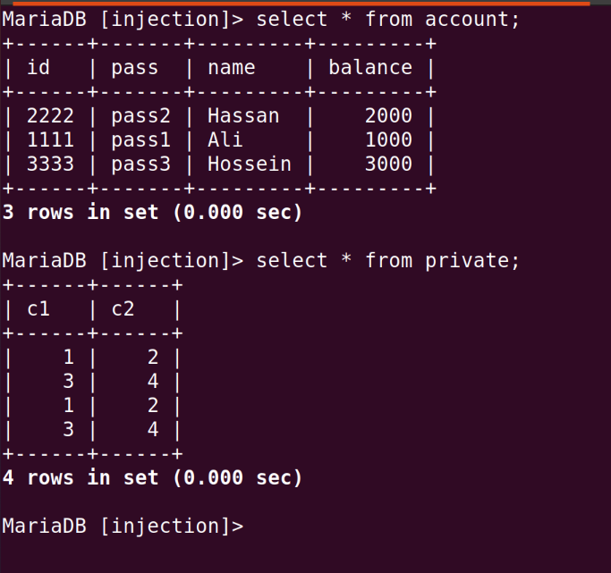
SQL Injection Example (cont’d)

Slide 149
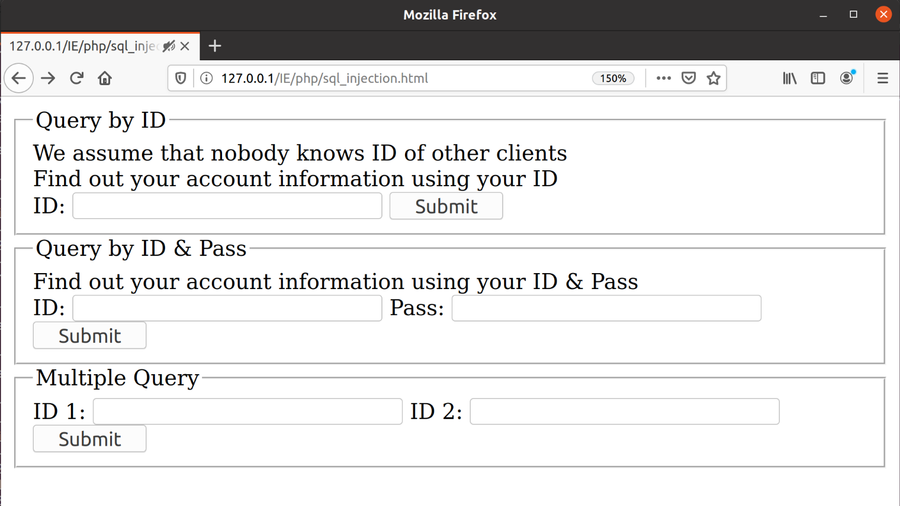
SQL Injection Example (cont’d)

Slide 150
SQL Injection Example (cont’d)
SQL statement in single query script
$query = 'SELECT * FROM account WHERE id='.$user_id;
Or
$query = 'SELECT * FROM account WHERE id='.$user_id.' and pass="'.$password.'"';
SQL statement in multi query script
$query = 'SELECT * FROM account WHERE id='.$user_id1.';';
$query .= 'SELECT * FROM account WHERE id='.$user_id2.';';

Slide 151
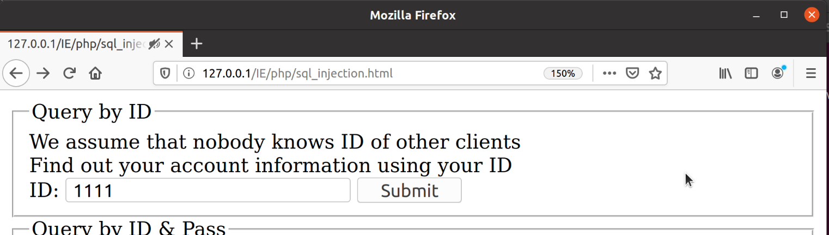
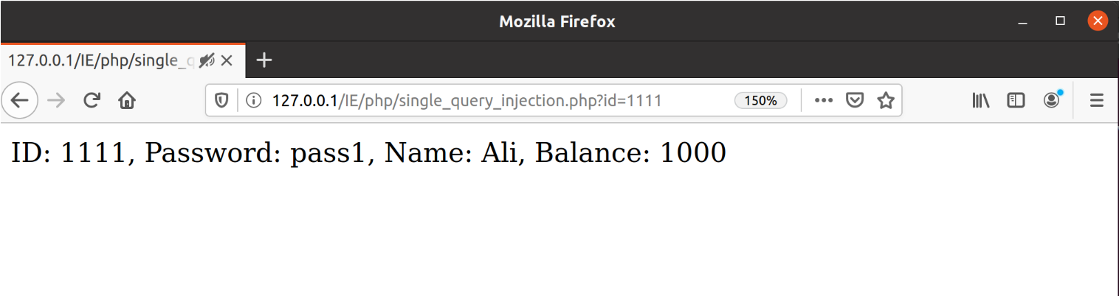
SQL Injection Example (cont’d)

Slide 152
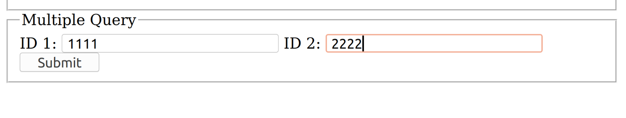
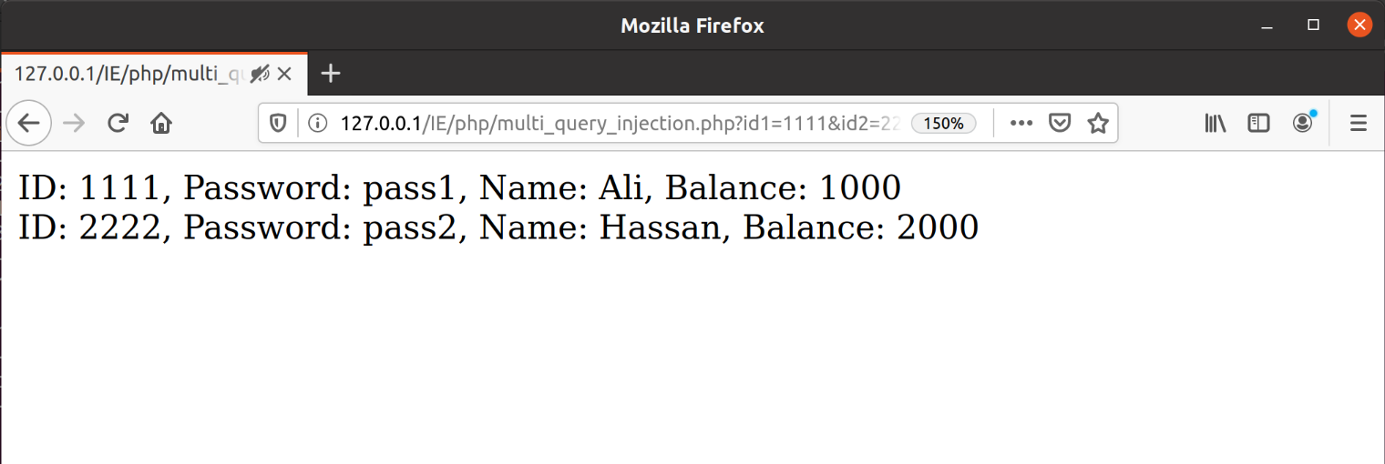
SQL Injection Example (cont’d)

Slide 153
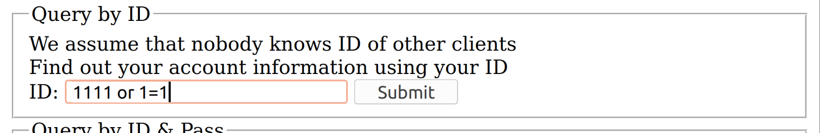
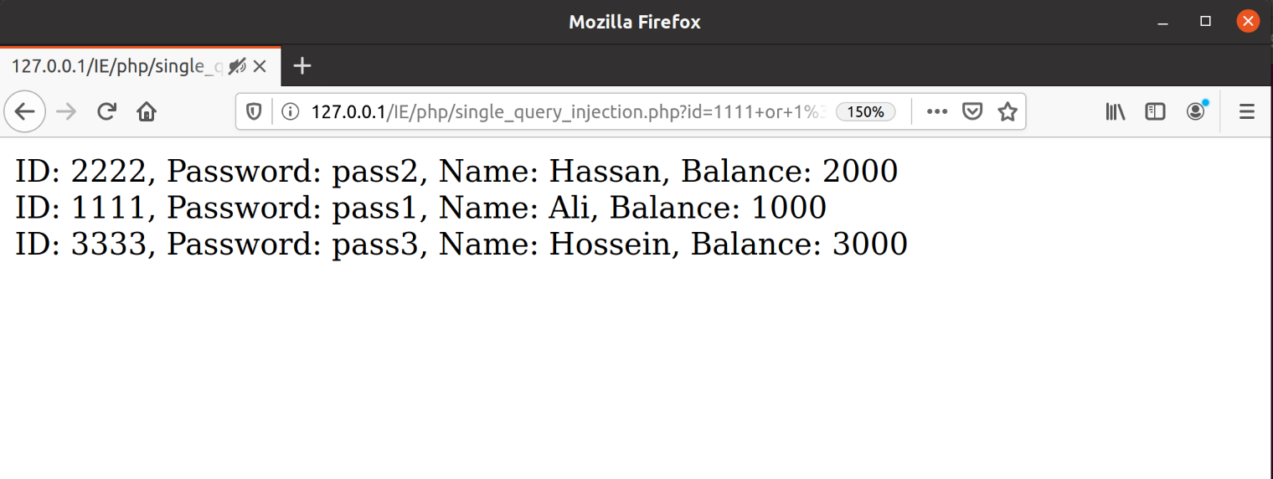
SQL Injection Example (cont’d)
Notes:
id='.$user_id.' and pass="'.$password.'"';

Slide 154
SQL Injection Example (cont’d)
When ID is 1111 or 1=1 then
$query = 'SELECT * FROM account WHERE id='.$user_id;
Will be
$query = 'SELECT * FROM account WHERE id=1111 or 1=1’;
Which is always true!!!

Slide 155
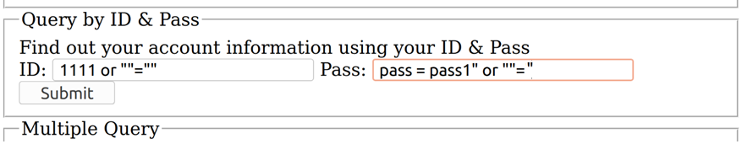
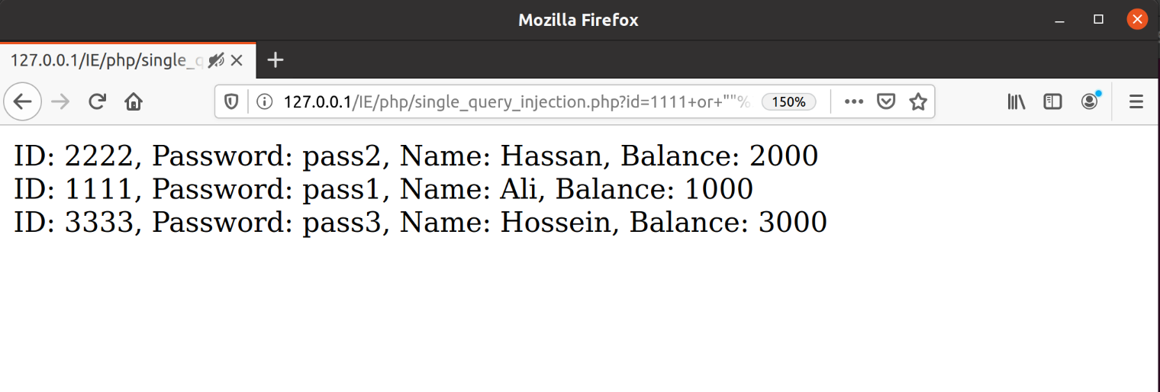
SQL Injection Example (cont’d)
Notes:
The SQL below is valid and will return all rows from the "Users" table, since OR ""="" is always TRUE.
id='.$user_id.' and pass="'.$password.'"'; ➔ id=1111 or ""="" AND Pass =pass1 or ""=""

Slide 156
SQL Injection Example (cont’d)
$query = 'SELECT * FROM account WHERE id='.$user_id.' and pass="'.$password.'"';
Will be
$query = 'SELECT * FROM account WHERE id=1111 or ““=“” and pass=“pass1”or “”=“”’;
Which is always true!!!

Slide 157
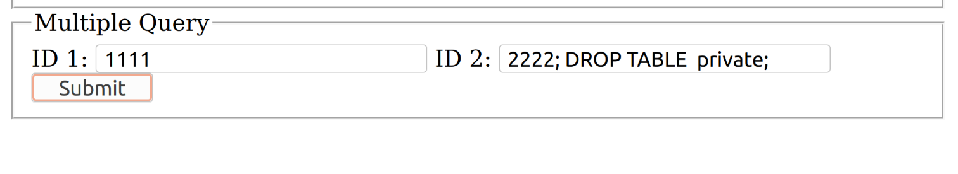
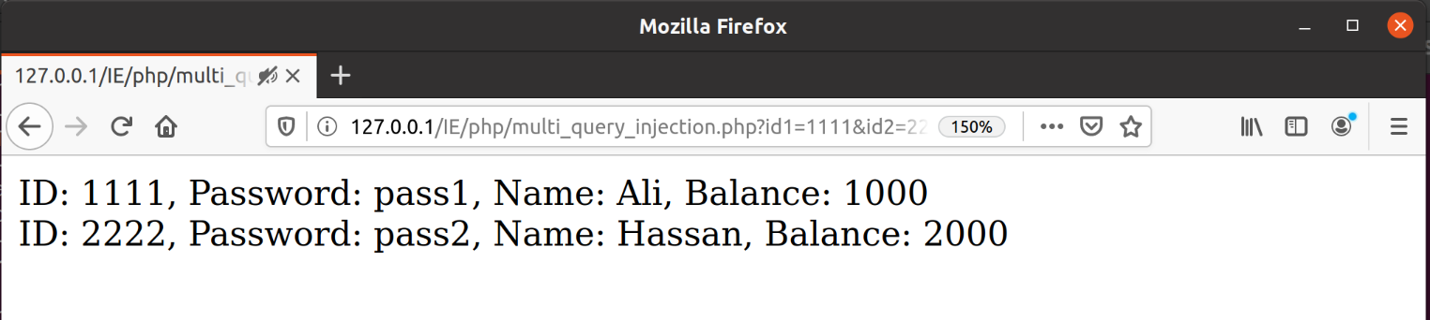
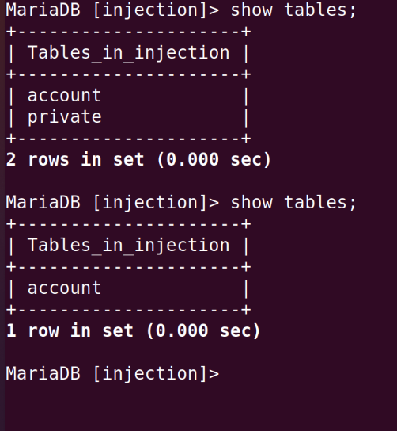
SQL Injection Example (cont’d)

Slide 158
SQL Injection Mitigation
Prevent the malformed inputs
Basic tool: PHP Filters
However, it is not a complete solution, e.g.,
ID should be int
Filter by FILTER_VALIDATE_INT
Password is string
Filter by ???!!

Slide 159
Preventing SQL Injection
Parameterized queries by preparing statements
Preparing stage
Statement template is sent to server
Server checks syntax & initialize internal resources for execution
Variable binding & Execution stage
Value of variables are sent
Server creates statement from the template & the bounded variables & executes it

Slide 160
Preventing SQL Injection (cont’d)
1) Preparing template (statement)
$stmt = mysqli_prepare($db, "SELECT id, pass, name, balance FROM account WHERE id=?");
2) Binding variables
mysqli_stmt_bind_param($stmt, "i", $user_id);
#guide:(i=int,d=float,s=string,..)
3) Executing the statement
mysqli_stmt_execute($stmt);

Slide 161
Preventing SQL Injection (cont’d)
4) Binding the results
A variable per column in the output
mysqli_stmt_bind_result($stmt, $ids, $passs, $names, $balances);
5) Fetching output from the result
while (mysqli_stmt_fetch($stmt)) {
printf("ID: %s, Password: %s, Name:
%s, Balance: %s\n", $ids, $passs,
$names, $balances);
}

Slide 162
Preventing SQL Injection Example
Query by ID
$stmt = mysqli_prepare($db, "SELECT id, pass, name, balance FROM account WHERE id=?")
mysqli_stmt_bind_param($stmt, "i", $user_id)
Query by ID and Password
$stmt = mysqli_prepare($db, "SELECT id, pass, name, balance FROM account WHERE id=? and pass=?")
mysqli_stmt_bind_param($stmt, "is", $user_id, $password) #is:sting and int

Slide 163
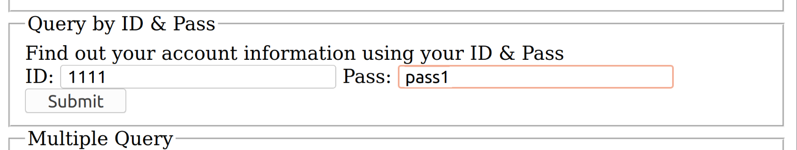
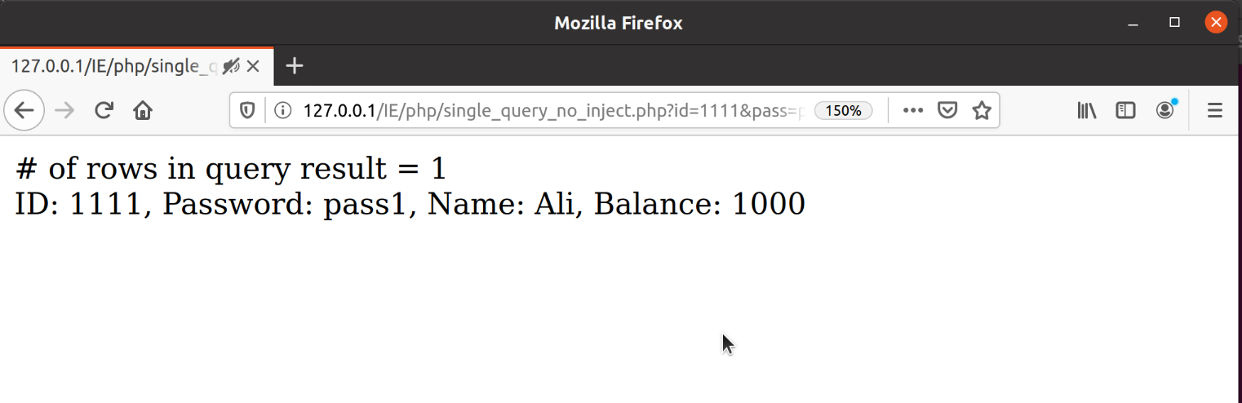
Preventing SQL Injection Example

Slide 164
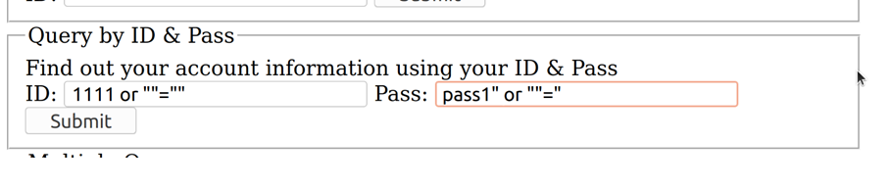
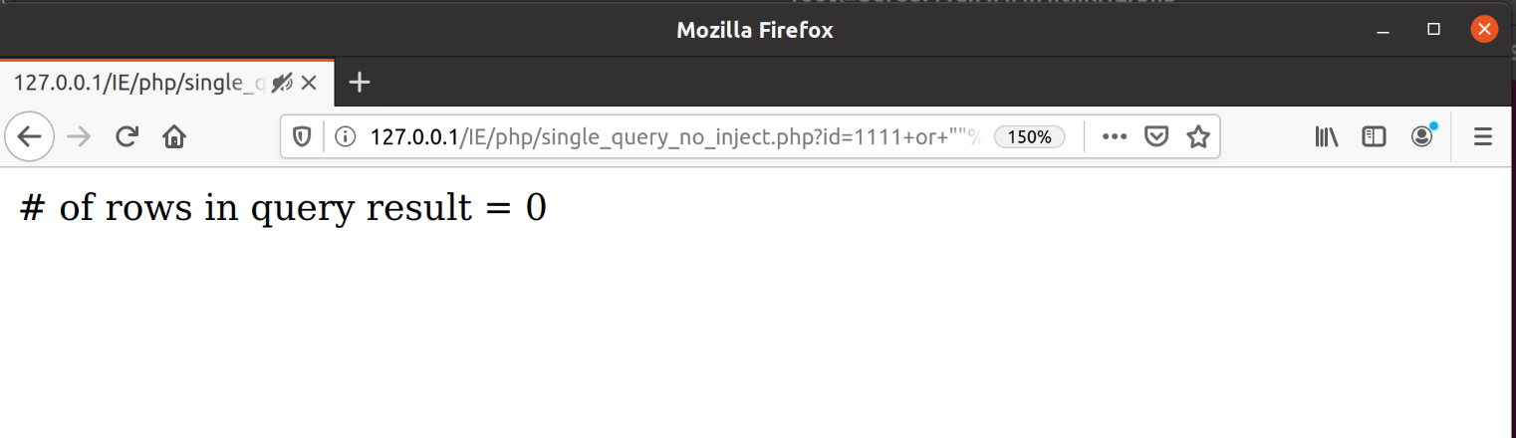
Preventing SQL Injection Example

Slide 165
Preventing SQL Injection Example
When ID is 1111 or ""="" and Pass is pass1 or ""=" then
mysqli_stmt_bind_param($stmt, "is", 1111 or ""="", pass1 or ""=")
The query will be
SELECT * FROM account WHERE id=1111 and pass = "pass1 or ""="";
Which is false!

Slide 166
Outline
Introduction to CGI
Introduction to PHP
PHP Basic
Input Data Handling
HTTP Headers
Cookies & Session Management
Database: ORM
XML & JSON
Error Handling

Slide 167
ORM?!!!
How much easy to work with DB
A lot of SQL commands inside PHP ☹
Request from team leader
“Change DB from MySQL to Mongo/…”
What?!!! Replace all the SQL commands? ☹☹
Problem: The lake of DB abstraction
Solution: Add the DB abstraction
DBAL: Database Abstraction Layer
ORM: Object Relational Map
Notes:
Dbal: abstract for sql command
Orm: map da tables to object in code. Intract with db using objected oriented programming techniques rather tha n raw sql queries.

Slide 168
Object Relational Mapping
ORM is the mapping of the properties of POD (Plain Old Data) objects to columns of DB
Each table in represented as an class
Each row is represented as an object
Get/Set the object Read/Update the row
Without any SQL command!!! ☺
Object
book {id, title, published}
DB: Table ‘book’

Slide 169
PHP ORM
Many libraries and frameworks
Google it
One of the most simple & easy to use
RedBeanPHP
No installation, just a php file added to your script
Support multiple DBs
All DB operation through object manipulation
Creates tables, Adds columns, Changes Types, …
on the fly

Slide 170
Outline
Introduction to CGI
Introduction to PHP
PHP Basic
Input Data Handling
HTTP Headers
Cookies & Session Management
Database
XML & JSON
Error Handling

Slide 171
PHP in Web Applications

Slide 172
JSON in PHP
How to exchange JSON data between the client and a PHP server.
PHP object/array to JSON object conversion
json_encode()
Keys in JSON are the variable names of array or the key of the array
Object’s methods, private and protected member are excluded
JSON objects to PHP object conversion
json_decode(): PHP object can also be converted to arrays

Slide 173
JSON in PHP Example
<?php
class Book{
private $name;
function set_name($name){
$name = $this->name;
}
function get_name(){
return $this->name;
}
protected $author;
var $publish;
var $price;
}

Slide 174
JSON in PHP Example
$book = new Book();
$book->set_name("PhP How to ...");
$book->price = 1;
$json_obj = json_encode($book);
echo "JSON: $json_obj \n";
$php_obj = json_decode($json_obj);
var_dump($php_obj);
$new_book=array("name" => "Another How to", "price" => 10);
$new_json_obj = json_encode($new_book);
echo "JSON: $new_json_obj \n";
$new_php_obj = json_decode($new_json_obj);
var_dump($new_php_obj);
?>

Slide 175
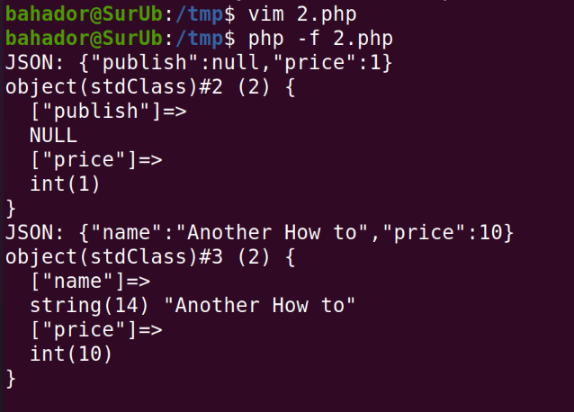
JSON in PHP Example

Slide 176
XML in PHP
Extensive XML support in PHP
Different libraries to read/parse/write XML
Create XML
XMLWriter: To create XML files easily
XML_Serializer: Serialize everything as XML
Parse XML
DOM library: Access to XML tree structure
Expat: An event based parser
Notes:
XmlSerializer knows how to serialize an object to xml. XmlTextWriter knows how to write xml to a stream or file. Two distinct and unrelated operations
XML_Serializer serializes complex data structures like arrays or object as XML documents. This class helps you generating any XML document you require without the need for DOM

Slide 177
XML in PHP Example
<?php
//include class file
include("XML/Serializer.php");
//create object
$serializer = new XML_Serializer();
//create array to be serialized
$xml = array( "book" => array(
"title" => "Oliver Twist",
"author" => "Charles Dickens"));
//perform serialization
$result = $serializer->serialize($xml);
//check result code and display XML if success
if ($result === true) {
echo $serializer->getSerializedData();
}
?>

Slide 178
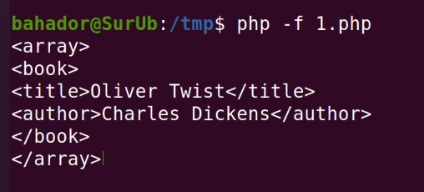
XML in PHP Example

Slide 179
XML in PHP (cont’d)
There are two basic types of XML parsers:
DOM(Tree)-based parser:
XML is transformed into a tree structure
Whole document is analyzed to create tree
Easy to use by getElement… functions; but is not useable for large files & stream
Event-based parser:
Focus on XML content, not their structure
XML document is interpreted as a series of events
When a specific event occurs, a function is called to handle it
More programming effort, but useable for stream & less memory
** You can study more on : https://riptutorial.com/php/topic/780/xml

Slide 180
Outline
Introduction to CGI
Introduction to PHP
PHP Basic
Input Data Handling
HTTP Headers
Cookies & Session Management
Database
XML & JSON
Error Handling & Debugging

Slide 181
PHP in Web Applications

Slide 182
Error Handling
Error handling is very important in PHP
HTTP server is the open door of the server/network
Inputs come from Internet (Hackers)
HTTP server by itself is (almost) secure
HTTP server runs PHP codes →A security hole in PHP → Access to server
Simple default error handling in PHP
An error message with filename, line number and a message describing the error which is
configured in php.ini
Displayed: client can see, should not used in final release
Log: server log, useful for debugging & server monitoring
…
Per script
error_reporting(E_ALL);
ini_set('display_errors', 'On');
ini_set('log_errors', 'On');

Slide 183
Error Handling (cont’d)
die() function to stop running the script
$file = fopen("data.txt", "r");
if($file == null)
die("Cannot open file");
Or
$file = fopen("data.txt", "r") or die("Cannot open file");
Surpassing errors by @ operator
Don’t send error messages to client (security)
$x=10; $y=0; $z=@($x/$y);

Slide 184
Custom Error Handling
A special function is called when an error occurs
error_function(error_level, error_message, error_file, error_line, error_context)
error_level: Required, specifies the error report level for the user-defined error.
error_message: Required, specifies the error message for the user-defined error
error_file: Optional, specifies filename in which the error occurred
error_line: Optional, specifies line number in which the error occurred
error_context: Optional, specifies an array containing every variable, and their values, in use when the error occurred

Slide 185
Custom Error Handling (cont’d)
After creating Error Handling function, decide when this should trigger:
Custom error handler registration
set_error_handler("functionName", Level);
Level
If omitted → all levels of errors
1 (E_ERROR): Fatal run-time errors
2 (E_WARNING): Non-fatal run-time errors
8 (E_NOTICE): Run-time notices
256 (E_USER_ERROR): Fatal user-generated error
512 (E_USER_WARNING): Non-fatal user-generated warning
…

Slide 186
Error Handling (cont’d)
In addition to system generated errors, user can trigger (generate) errors
trigger_error("Error Message", Level);
Message is a required custom message
Level is optionally specifies error level
E_USER_ERROR
E_USER_WARNING
E_USER_NOTICE
If omitted → E_USER_NOTICE
Notes:
In a script where users can input data it is useful to trigger errors when an illegal input occurs. In PHP, this is done by the trigger_error() function.

Slide 187

Error Handling Example
<?php
//error handler function
function customError($errno, $errstr) {
echo "<b>Error:</b> [$errno] $errstr<br>";
echo "Ending Script";
die();
}
//set error handler
set_error_handler("customError",E_USER_WARNING);
//trigger error
$test=2;
if ($test>=1) {
trigger_error("Value must be 1 or below",E_USER_WARNING);
}
?>
***output**

Slide 188
Exception Handling
PHP 5 introduced OOP
Exception handling (using exception objects) is another approach to handle problems
Exception handling in PHP is very similar to Java
throw exception & try-catch mechanism
Define custom exceptions by new classes
If an exception is not caught, a fatal error will be issued with an "Uncaught Exception" message
set_exception_handler() sets a user-defined function to handle all uncaught exceptions

Slide 189
Exception Handling Example
<html>
<body>
<?php
class customException extends Exception {
public function errorMessage() {
$errorMsg = 'This is my error message, Exception has been throwed by this message: "' . $this->getMessage() .'"';
return $errorMsg;
}
}
try{
$msg = "I am throwing an exception";
throw new customException($msg);
}
catch(customException $e){
echo $e->errorMessage();
}
?>
</body>
</html>

Slide 190
Outline
Introduction to CGI
Introduction to PHP
PHP Basic
Input Data Handling
HTTP Headers
Cookies & Session Management
Database
XML + JSON
Error Handling

Slide 191
Answers
Q7.1,2) ) How to code in server side ?Which language? Syntax?
PHP, it is very similar to C/Java, but it is interpreted language
ASP.NET and etc
Q7.3) How can I get valid user’s data in server?
Super global arrays: $_GET, $_POST, $_REQUEST, …
Validation mechanisms: Validating & Sanitizing
Q7.4) Can I read/write access to HTTP headers
Yes, header() to write, $_SERVER to read
Q7.5) The users must login to access the site!
Okay, use PHP session + Authentication
Q7.6) Can I use data base? How?
Yes, depends on you DB, MySQL is easy to use!!

Slide 192
What are the Next?!
PHP Frameworks
Laravel
Phalcon
Symfony 2
Zend
Codelgniter
Session Management
Session cookie vs Token(JWT)
Notes:
Session: server creates a session for user when login and store id in server db or file and send it to user browser cookie. Server user this id to identify user . User send id for each request and server validate it.
JWT: server generate a jwt token containing information about user and sign it with secret key. Token sent back to client and store in local storage or cookie. Client send token for each request. Server validate token’s signature and decode info to authenticate user. Jwt does not need to store jwt token but session need to store session id. Jwt can use local storage and cookie in client side but session use just cookie.jwt does not need to save state. Jwt more scable since it does not need session storage.

Slide 193
References
Dr.Bakhshi slides
Reading Assignment: Chapter 9 of “Programming the World Wide Web”
PHP Manual from www.php.net
http://www.w3school.com/php
Matt Zandstra, “Sams Teach Yourself PHP in 24 Hours”

