Slide 1
Journal Of Computing For Professionals (JCP) Universal Relation Database
Samuel Wong, Hannah Jones, Jeel Patel, William Fletcher, Patricia Reisman

Slide 2
Purpose: Provide a highly functional Database
to store the content of JCP journals
Planning:
We chose the Relational Database Model, due to cheapness, ease of learning, and ease of representing core and associate data.
We further chose the Universal Relation design paradigm as instructed by our customer, Dr. Ray Hashemi.
Lastly, we implemented our Database using the open source MySQL version of Structured Query Language. It is free to use, and has a lot of support due to its ubiquity.
Notes:
Wondering whether we should spell Cheap as CHEEP to mess with him

Slide 3
Analysis Phase: Semantic Rules
We analyzed the journals and developed thirty semantic rules to model the entities.
We interfaced with our client to discern whether certain aspects of the journal needed to be modeled, ultimately scrapping page numbers and the pictures associated with the student profiles.
We split our initial rules out into rules that would model multivalued and rules that would model single valued relationships.
Notes:
Left out Page numbers due to where we were at with the project at that time, and with the approval of our business client.
Left out student profile pictures as our database is not multimedia and therefore cannot store images.
Semantic Rules:
A Journal has a volume number, an issue number, and an issue date.
A Journal has several Articles.
A Journal has several Events.
A Journal has several Conferences.
A Journal has several Job Listings.
A Journal has several Student Profiles.
An Article has a title, an abstract, and content.
An article has several Article Authors.
An article has several References.
An article has several keywords.
An Article Author has an employer, affiliation, and a name.
A Reference has a title, page index, release date, location, and source.
A Reference has several reference authors.
An Event has a name, a start date, an end date, a location, a contact name,a contact address, contact email, a contact fax, and a contact telephone number.
An Event has several sponsors.
A Conference has a name, start date, end date, location, a coordinator.
A Conference has several Members.
A Conference has several sets of Conference Contact Information.
A Conference has several sponsors.
A Conference has several guidelines.
A Conference has several topics of interests.
A Conference has several Conference Paper Submission Dates.
A Conference Paper Submission Date has a type and a calendar date.
Conference Contact Information has a name, type, address, email, fax number, and telephone number.
A Member has a name, type, affiliation, and country.
A Job Listing has several qualifications.
A Job Listing has an employer, location, salary information, status, title, open date, close date, job description, a contact name, a contact address, a contact email, a contact fax, and a contact telephone number.
A Student Profile has a name, city, state, country, and backstory.
A Student Profile has several degrees.
A Degree has degree level, completion year, and degree type.

Slide 4
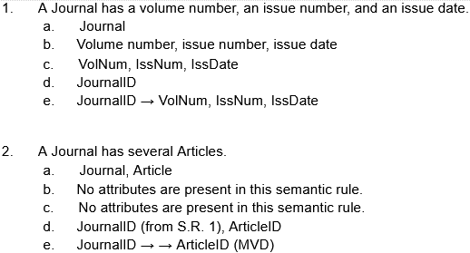
Analysis Phase: Semantic Rules
Example Semantic Rule to Functional Dependency:
Notes:
Here is one of our semantic rules that we converted to a Functional Dependency.
For each semantic rule (S.R.):
a. Identify entities that are in the S.R.
b. Identify attributes that are in the S.R.
c. Assign a name to each attribute
d. Choose entity identifiers: if there is an attribute that can serve as the entity identifier, then we use that; Otherwise, we create an attribute that has a unique value for the entity to serve as entity identifier
e. Write the Functional Dependency representing the S.R. using the following framework:
Entity identifier(s) → All attributes separated by “,”
If the rule is a Multivalued Dependency, this is indicated with (MVD)

Slide 5
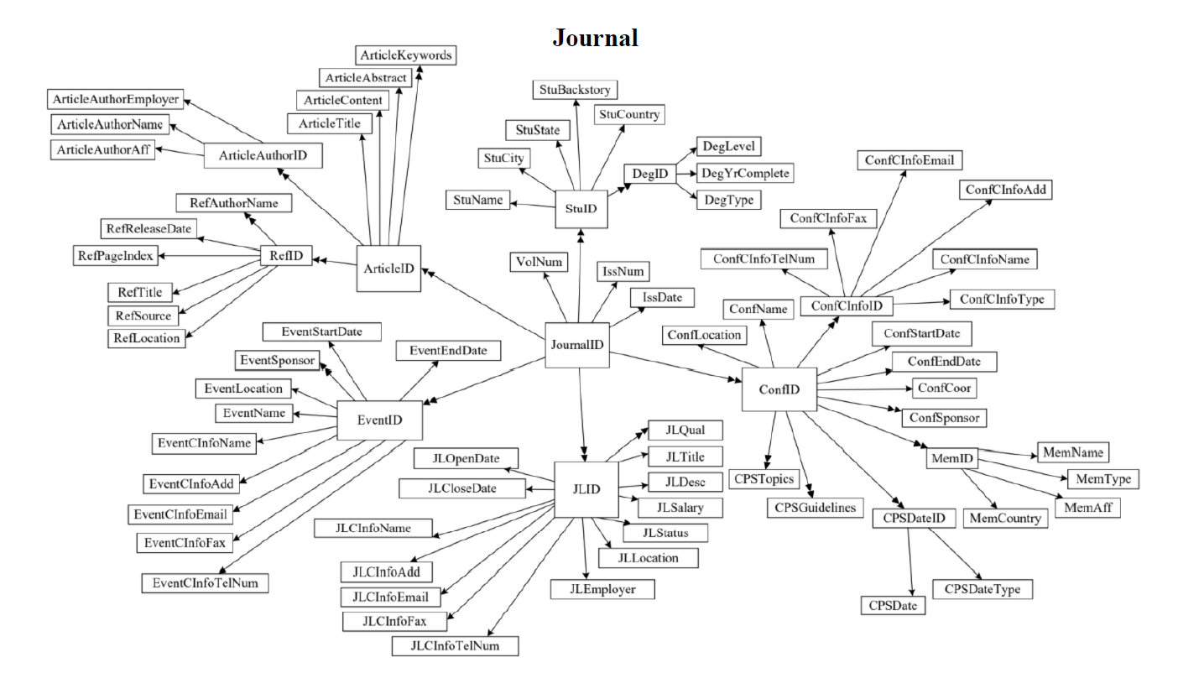
Design Phase: Creation and reduction of Universal Relation
Notes:
We analyzed our database, and developed a series of thirty semantic rules that we believe could be used to accurately represent the JCP journals.
Via Universal Relation, we converted each rule into a Functional Dependency.
All Functional Dependencies were then converted into the following Universal Relation.
We chose at random potential attributes of this relation until finding one that allows us to reach all other attributes, choosing that attribute as primary Key. If we had not found a single attribute that could do that, we would have followed our result with any two attributes, and so on.
Attribute: JournalID.
Note that this design did not have any possible reduction, as all attributes are already dependent on the primary key by default.

Slide 6
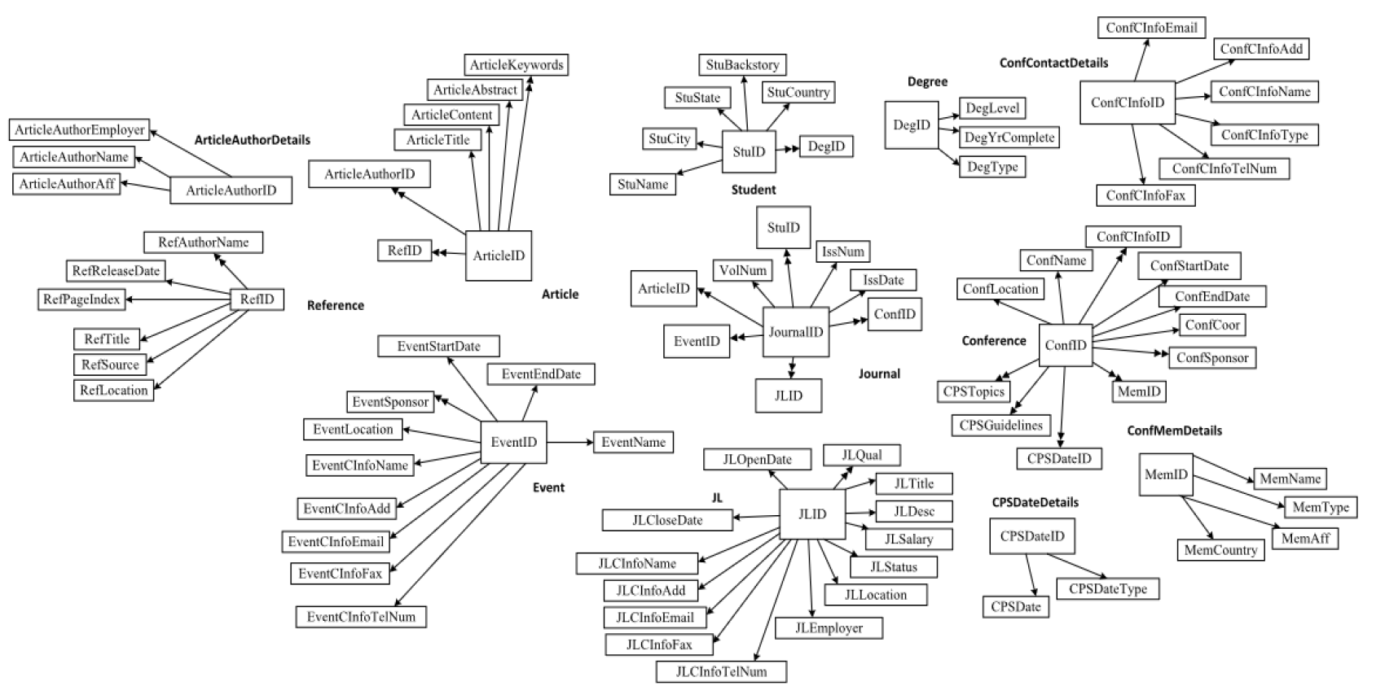
Design Phase: Normalization of Universal Relation to Boyce-Codd Normal Form (3NF & BCNF)
Notes:
We took our initial relation, and normalized it to third normal form by decomposing into thirty relations.
We identified that our initial diagram was already in first normal form, as all attributes are atomic by definition of relation, and second normal form, as it is in first normal form and also all non-key attributes are already fully functionally dependent on the primary key.
We then decomposed it into a new set of relations in order to normalize to third normal form, ensuring that each relation is in second normal form, and all attributes are non-transitively dependent on the primary key.
At this stage, we checked that each relation was in BCNF. Since all determinants were candidate keys in every relation, we concluded that we had reached BCNF.

Slide 7
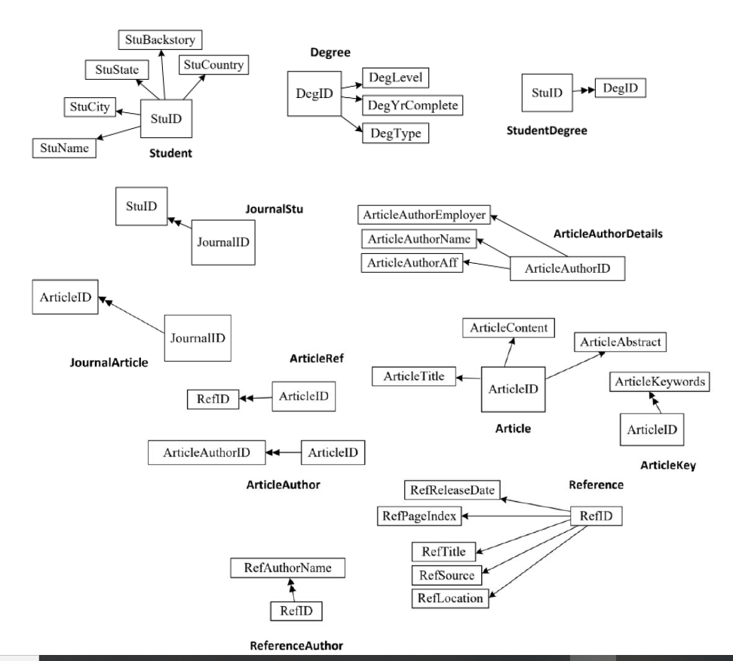
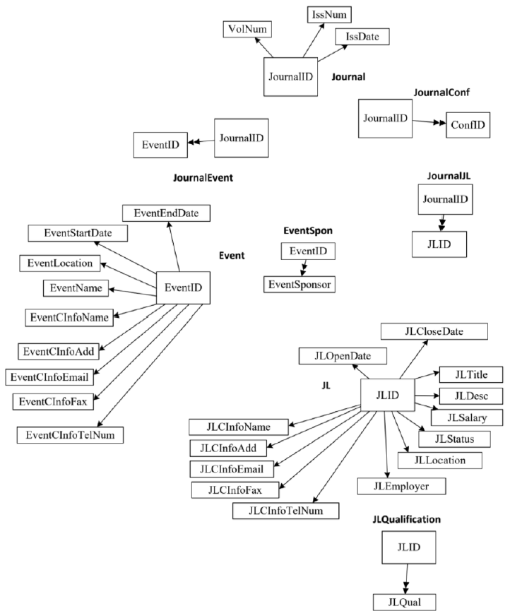
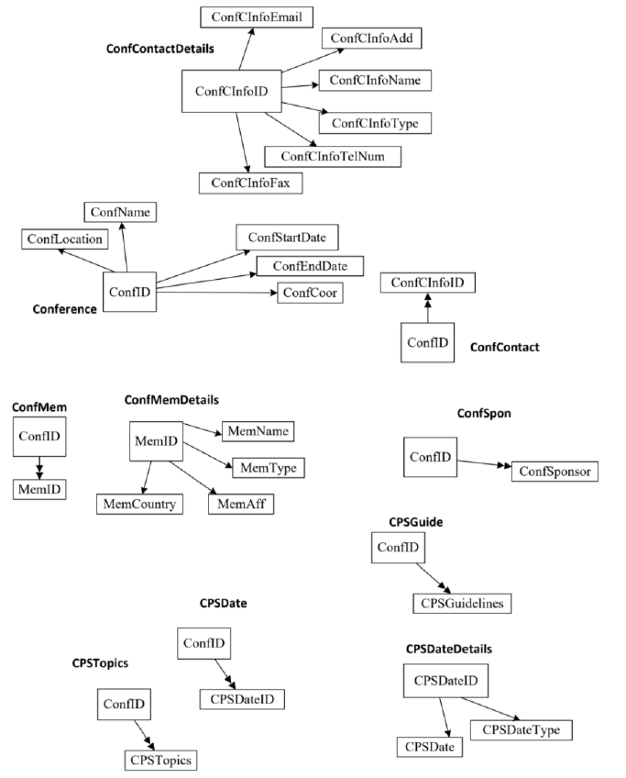
Design Phase: Normalization of Universal Relation to 4th Normal Form
Notes:
We then identified all multivalued attributes to prepare to normalize to fourth normal form. To avoid needing to verify each tuple against the definition:
For Relation R with attribute X that determines multivalues of Y, all X is super key of R, we simply decomposed each of these relations to trivial Multivalued Dependencies.
When each multivalued dependency had been trivialized, we concluded that we had successfully normalized to fourth normal form.
This finally resulted in thirty relations.

Slide 8
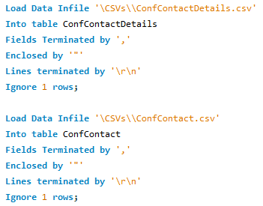
Implementation Phase: MySQL
We aggregated data as CSV files, then imported to the database.
This ensured greater uniformity and accuracy of data.
Notes:
After completing our Database Design, the team implemented the design in MYSQL. MySQL is an inexpensive and scalable database solution with excellent support and online documentation.
To populate the database, we used a combination of scripts and manual input to write a CSV file for each relation. We then used the import csv function of MySQL to import all of the data to our database.

Slide 9
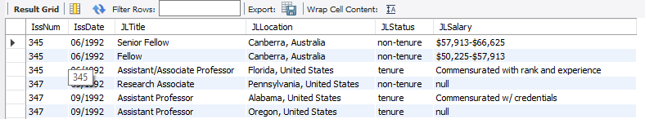
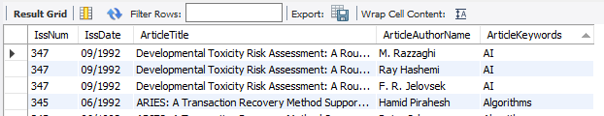
Implementation Phase: MySQL
Job Hunter View:
Researcher View:
Notes:
We then created two views, one for researchers to gather information regarding articles, and one for job hunters.
-Could talk about other views needed here if need be.

Slide 10
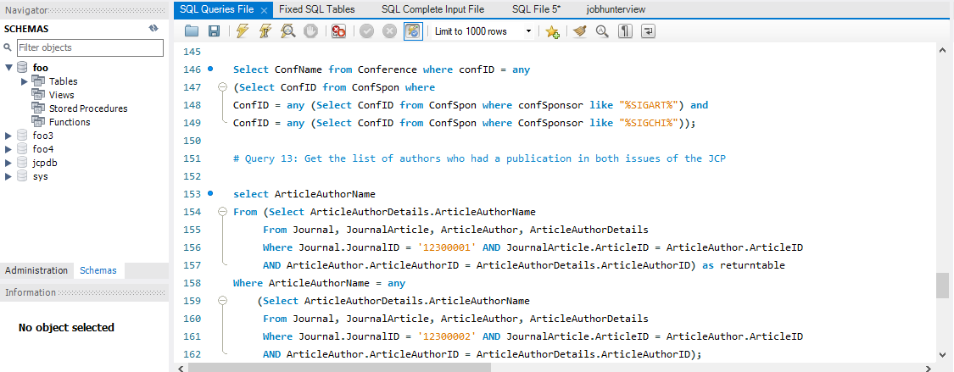
Maintenance Phase
Notes:
Finally, we performed several queries on our database to select, delete, update, and insert information to the database. During this phase we had to rework some of our previous design decisions, and others we simply mitigated mistakes due to lack of time. For instance, we had modeled conference events in the Calendar of Events and conferences in the Calls for Papers as separate relations, since the conferences in the calls for papers had significantly more attributes. However, this made retrieval of conference information from both relations a challenge without using inefficient join statements. We compromised by using two sets of queries for these types of relations.
-
While this may be considered a negative, it allowed us to easily delineate between events that do and do not have calls for papers associated with them, making any potential queries for those entities far simpler than otherwise.

Slide 11
Conclusion:
We were able to convert all core entities into SQL code.
Our design made some compromises, but those were in order to obtain optimization in other places.
The final result is a database that is well structured, avoids uncontrolled redundancy by design, and avoids concerns with multivalued dependencies.
Notes:
In conclusion, while some of our queries were more difficult than others, we believe that our final resulting database is well designed, highly optimized, and simple to understand. Our solution of designing a universal relation that already is reduced and in 2NF from the beginning allows our database to be inherently traceable and transparent.

