Slide 1
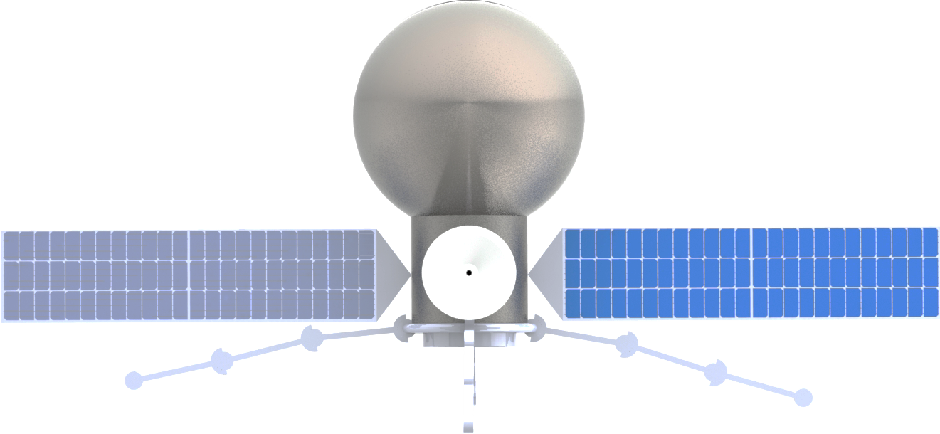








Fuel Tank
Hub
$$\hat{x}$$
$$\hat{y}$$
$$\hat{z}$$
High-Gain Antenna
$$\hat{w}$$
Solar Cells
$$\hat{w}$$
$$\hat{l}$$
$$\hat{h}$$
$$\hat{l}$$
$$\hat{h}$$
Docking Port

Slide 2




$$\hat{x}$$
$$\hat{y}$$
$$\hat{z}$$

Slide 3
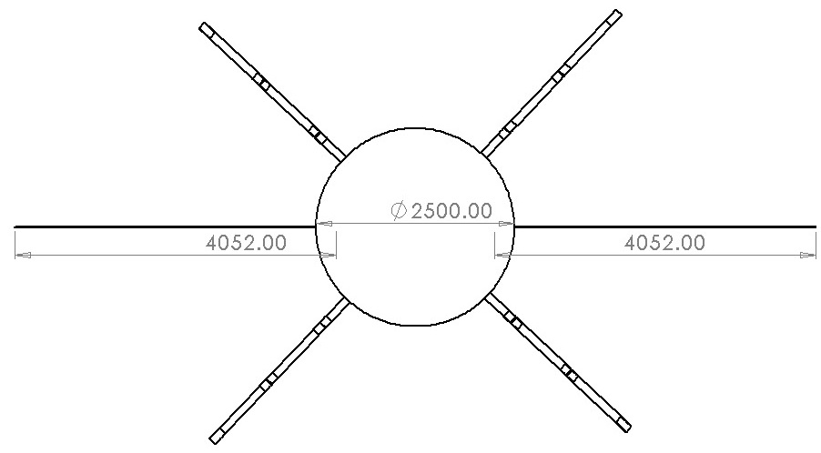

Slide 4
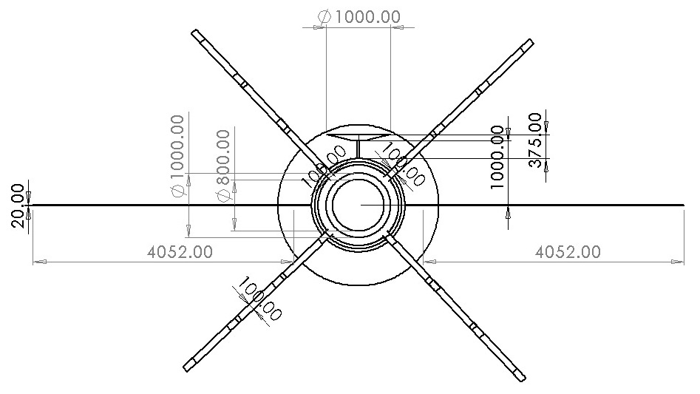

Slide 5
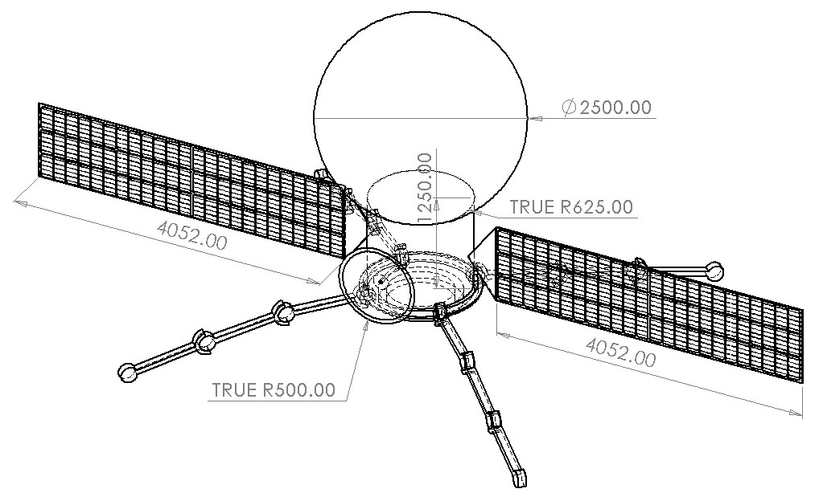

Slide 6







$${\hat{θ}}_{(1)}$$
$$\hat{x}$$
$$θ_{(3)}$$
$$θ_{(2)}=0$$
$${\hat{θ}}_{(2)}$$
$$θ_{(1)}$$
$${\hat{θ}}_{(1)}$$

Slide 8
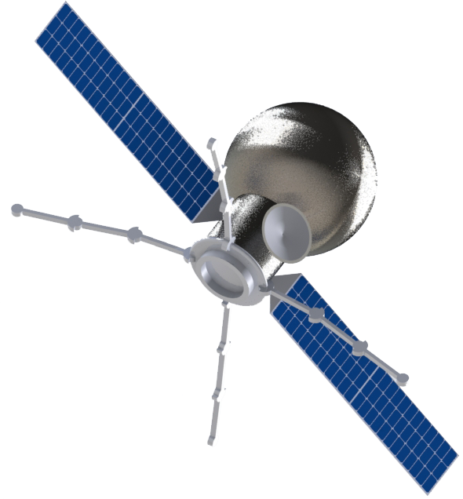
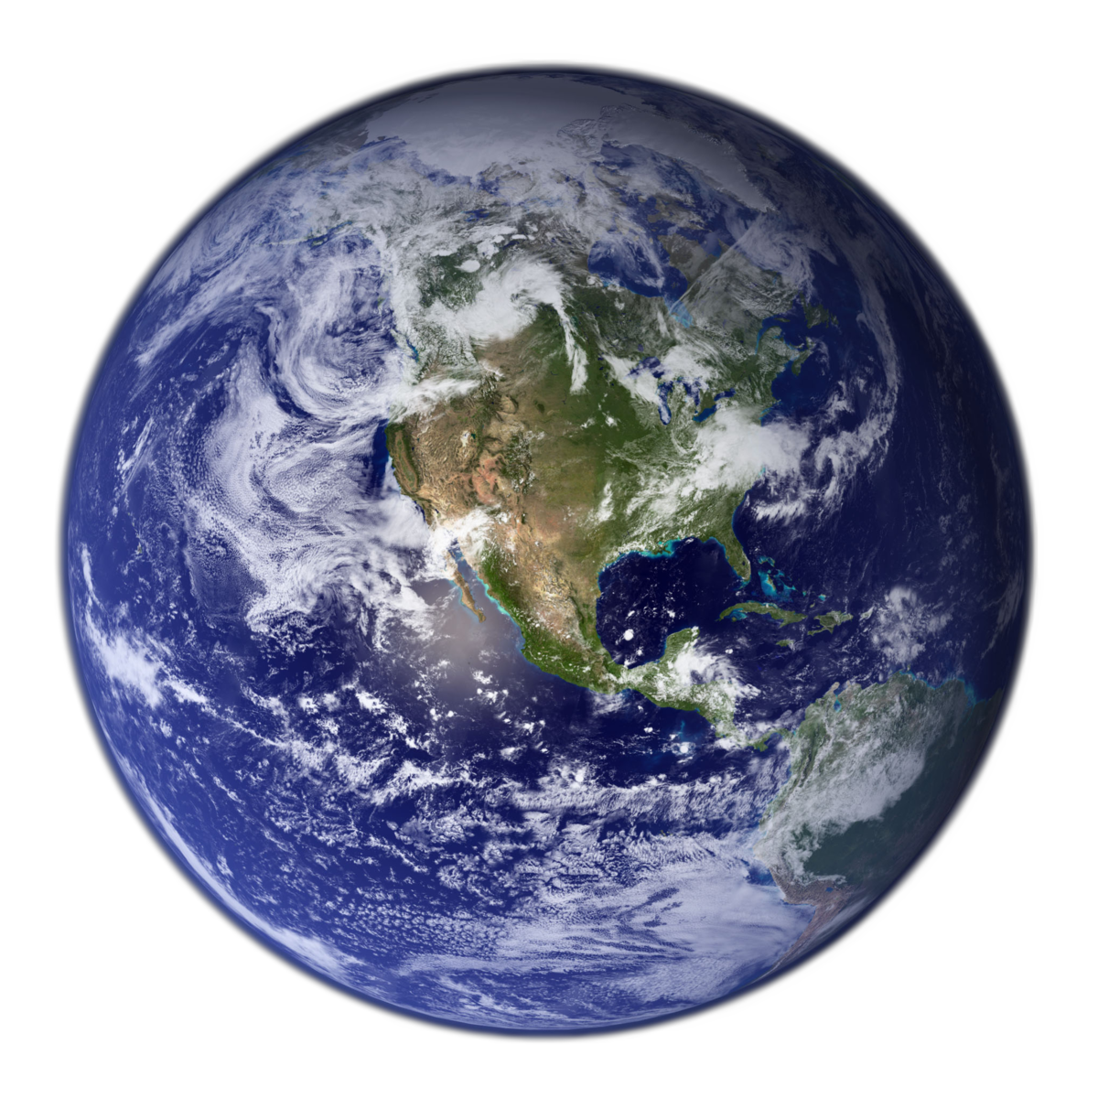










$$\hat{z}$$
$$\hat{y}$$
$$\hat{x}$$
$$\hat{z}$$
$${\hat{n}}_{3}$$
$$\hat{z}$$
$${\hat{n}}_{1}$$
$${\hat{n}}_{2}$$
$$−\hat{x}$$
$$\hat{z}$$

Slide 9
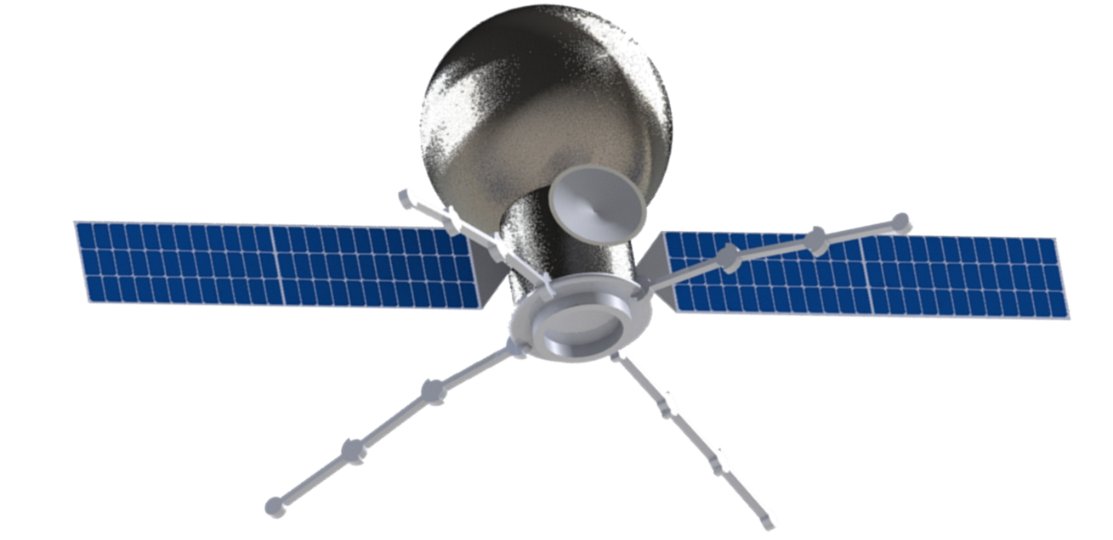






$${\hat{x}}_{P}$$
$${\hat{x}}_{B}$$
$${\hat{z}}_{B}$$
$${\hat{z}}_{P}$$
$${\hat{y}}_{P}$$
$${\hat{y}}_{B}$$

Slide 10
class Spacecraft():
ORBIT STATE REPRESENTATION
ATTITUDE STATE REPRESENTATION
Spacecraft.states
*XYZ coordinates in ECI (J2000) frame
Spacecraft.attBN
Spacecraft.ohmBN
*Body to inertial attitude (coordinate agnostic)
*Body to inertial angular velocity (body-frame)
*Mutually updated for state consistency
Spacecraft.elements
Spacecraft.attBR
Spacecraft.ohmBR
*Equivalent orbital elements (osculating)
*Body to reference attitude (coordinate agnostic)
*Body to reference angular velocity (body-frame)
ORBIT PROPAGATION METHODS
ATTITUDE PROPAGATION METHOD
Spacecraft.propagate_orbit(self, dt)
Spacecraft.propagate_attitude(
self, dt, torque)
*Keplerian-only analytical two-body propagator
Spacecraft.propagate_orbit(
self, t, dt, integrator='RK4')
*Torque as a 3x1 vector applied in body-frame coordinates
*Numerical propagator (default RK4), with references to own force models

Slide 11
RCV
RCV
RCV
RCV
RCV
RCV
RCV
RCV
1
2
3
4

Slide 12
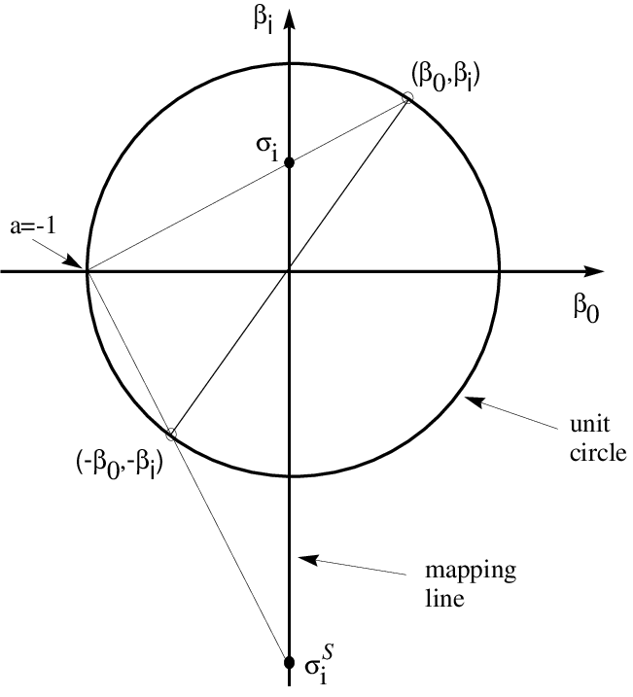
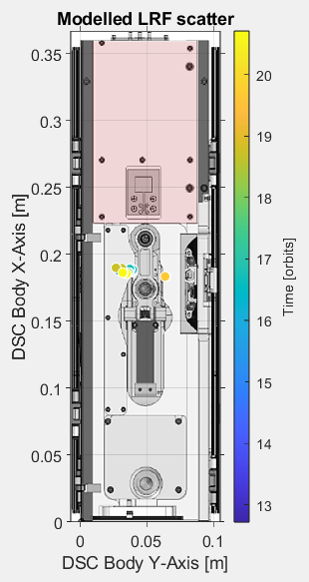




With hat error
$$q_{i}$$
$$(q_{0},q_{i}),$$
$$q_{0}$$
$$(−q_{0},−q_{i}),$$

Slide 13
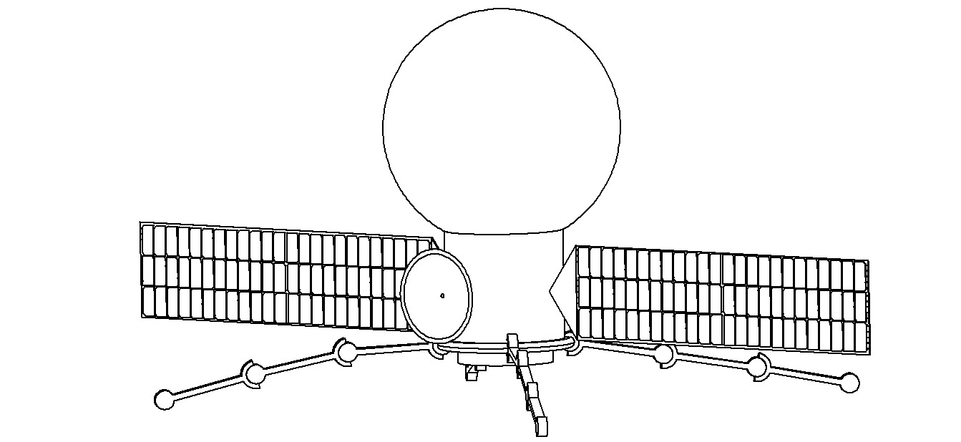
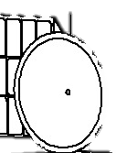



40cm radius,
10cm height,
Ti-6Al-4V
$${\hat{x}}_{P}$$
$${\hat{y}}_{P}$$
$${\hat{z}}_{P}$$

Slide 14



$$\hat{R}={\hat{x}}_{B}$$
$$\hat{T}={\hat{y}}_{B}$$
$$\hat{N}={\hat{z}}_{B}$$

Slide 15
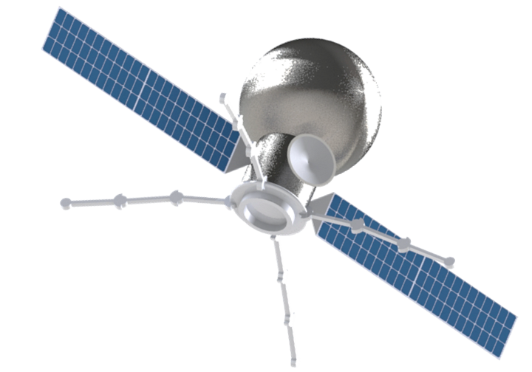








$${\hat{y}}_{B}$$
$$\hat{R}$$
$${\hat{x}}_{B}$$
$$\hat{T}$$
$${45}^{o}$$
$${45}^{o}$$
$$\hat{N}$$
$${\hat{z}}_{B}$$

