Slide 1
Open AI Documentation, Capabilities Part 2
Sam Miller

Slide 2
Introduction

Slide 3
Image Generation
Images API

Slide 4
Introduction
3 basic use cases
Creating images from text
Editing existing images from text
Varying existing image
DALLE 3 / DALLE 2

Slide 5
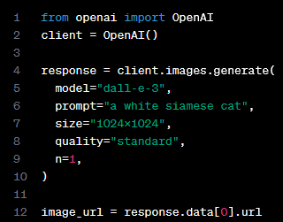
Image Generation
Image generation

Slide 6
Vision

Slide 7
Introduction

Slide 8
Text-to-Speech

Slide 9
Introduction
Audio API
TTS
6 voices
Output files include: mp3, opus, aac, flac, pcm, wav

Slide 10
Speech-to-Text

Slide 11
Introduction

Slide 12
Moderation

Slide 13
Overview
Category | Description
Hate
Hate/threatening | Hate content that also includes violence
Harassment | Content that
Harassment/threatening | Harassment that includes violence
Self-harm
Self-harm/intent
Self-harm/instructions
Sexual
Sexual/minors
Violence
Violence/graphics
Automated content moderation
Endpoint: v1/moderations
Tip: use chunks of text < 2k characters

Slide 14
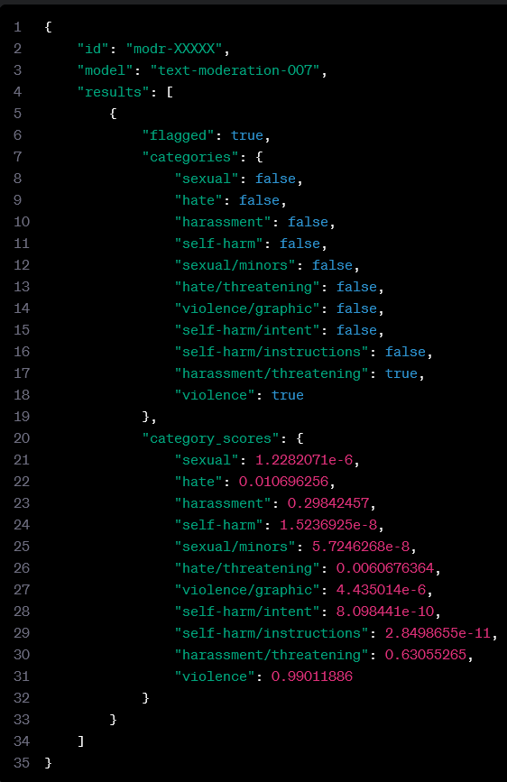
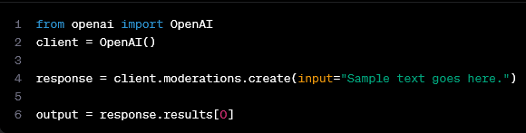
Quickstart
flagged
categories
category_scores

