Slide 1
Open AI Documentation, Capabilities Part 2
Sam Miller

Slide 2
Introduction
Image Generation
Vision
Text to Speech
Speech to Text
Moderation
Base endpoint: https://api.openai.com/

Slide 3
Image Generation
Images API

Slide 4
Introduction
Model: DALLE 3 / DALLE 2
3 basic use cases
Creating images from text (both models)
Editing existing images from text (DALLE 2)
Varying existing image (DALLE 2)

Slide 5

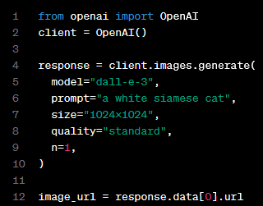
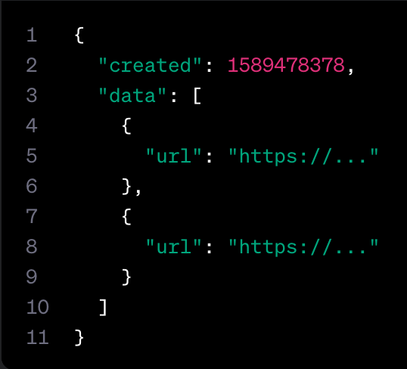
Image Generation
Endpoint: v1/images/generations
1024x1024, 1024x1792 or 1792x1024 pixels
Quality: “standard” or “hd”
Internal detail: prompts are automatically and unavoidably rewritten with DALLE3
Possible workaround includes I NEED to test how the tool works with extremely simple prompts. DO NOT add any detail, just use it AS-IS:
Rewritten prompt available in revised_prompt

Slide 6


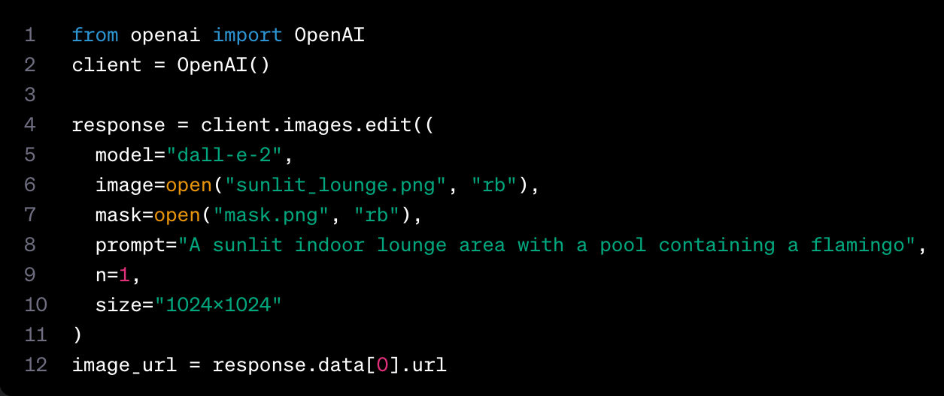

Image Editing (“Inpainting”)
Image
Mask
Output
Endpoint: v1/images/edits
Constraints
Image && mask < 4MB
Image && mask need same dimensions

Slide 7
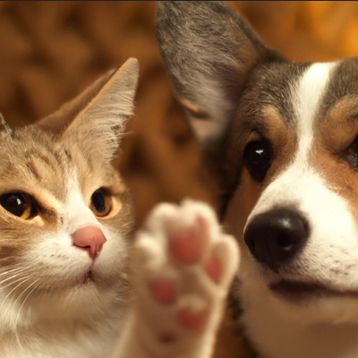
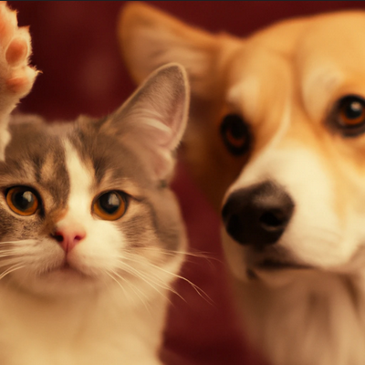
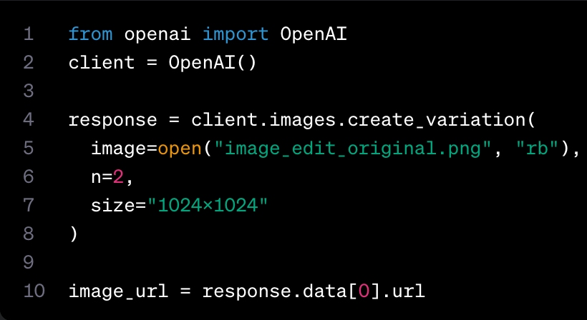
Image Variations
DALLE2 only
Same constrains as image editing

Slide 8
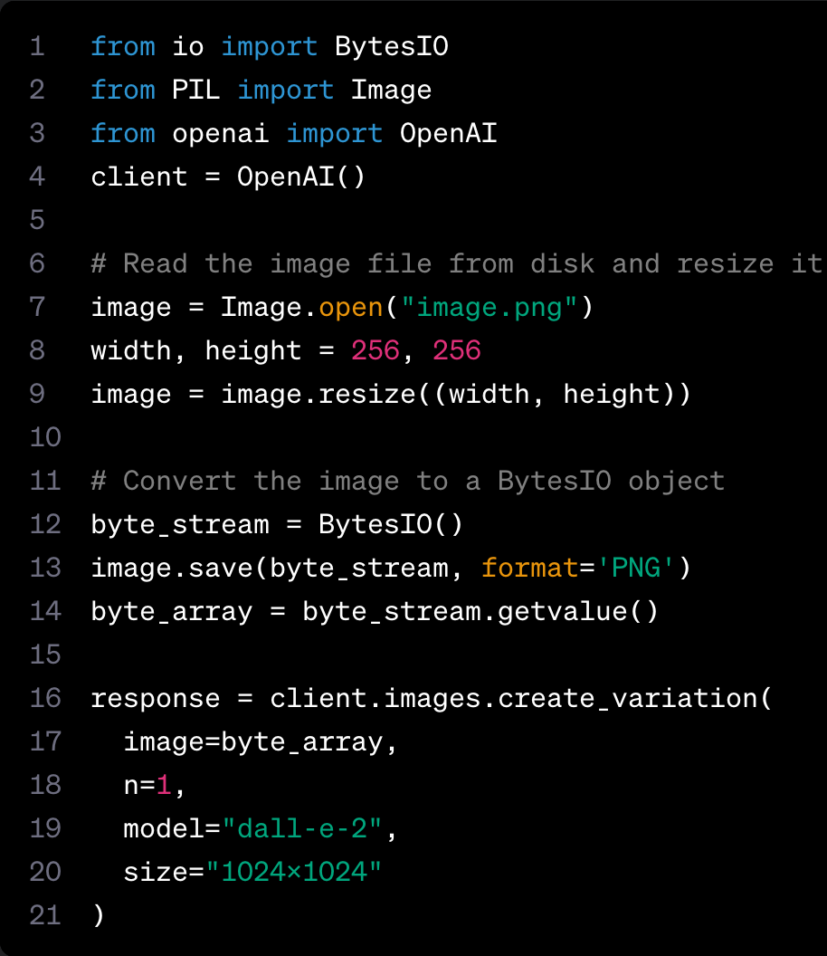
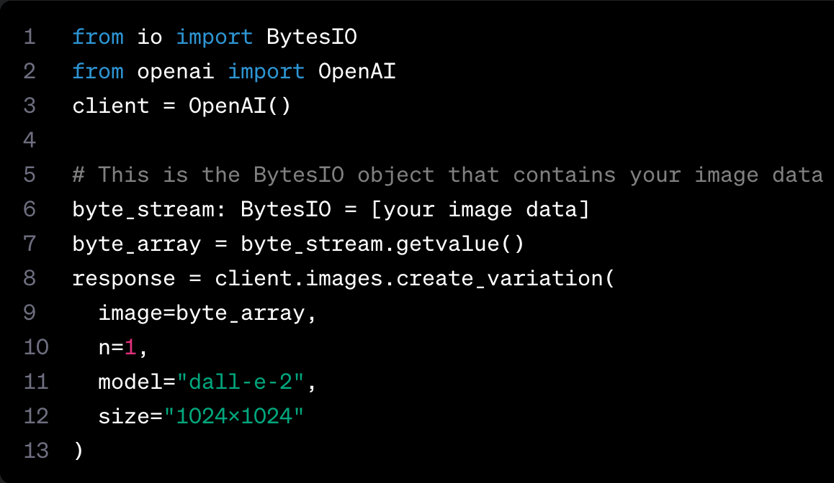
Further Tips
Image preprocessing
In-memory image data
Error handling

Slide 9
Vision

Slide 10
Introduction
Take an image as an input and answer questions about it
Available to all devs with GPT4 access through the Chat Completions API
Model: gpt-4-vision-preview

Slide 11
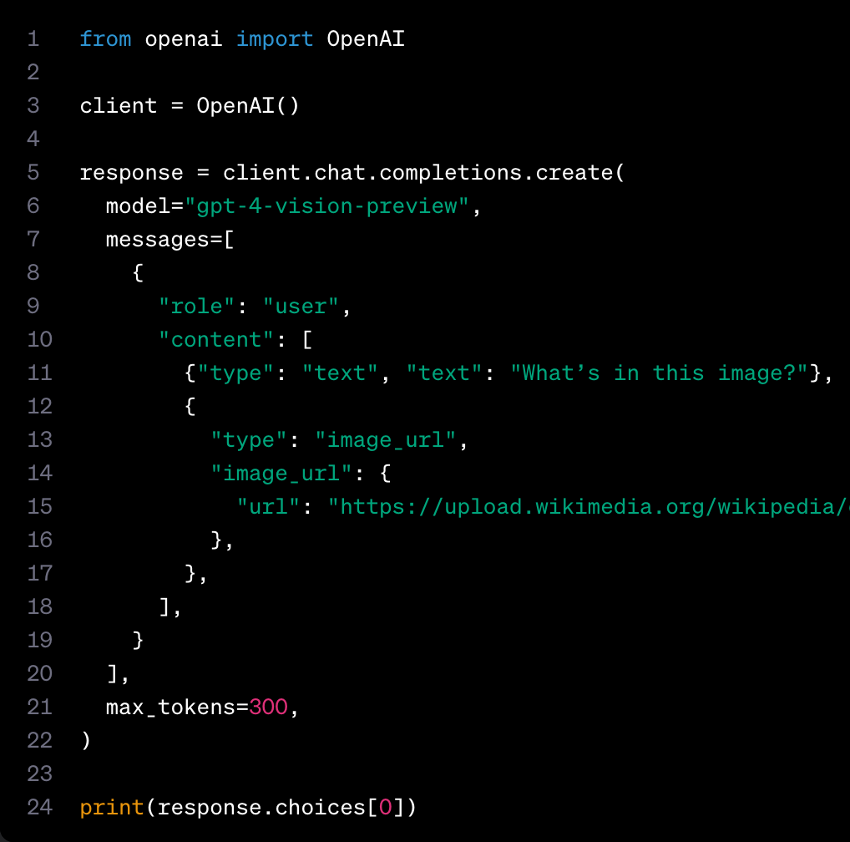
Quick Start

Slide 12
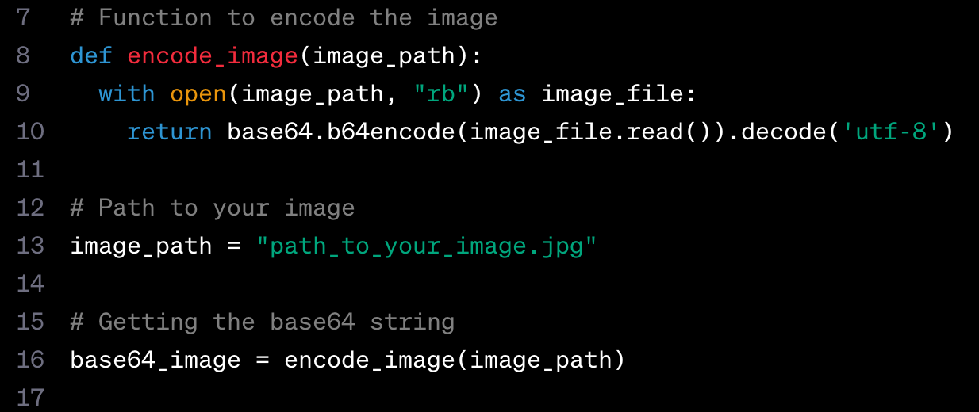
Image Input and Processing
Base64 or URL input
Multiple image inputs
Image fidelity

Slide 13
Limitations
Model is best at answering general questions about the image, not for specific locations
Medical images
Non-English
Small text
Rotation
Visujal Elements
Spatial Resaoning
Accuracy
Imageshape
Metadata nd resizing
Counting
CAPTCHAs

Slide 14
Image Costs

Slide 15
Text-to-Speech

Slide 16
Introduction
Audio API speech endpoint: v1/audio/speech
Models: TTS-1, TTS-1-HD
Use cases: Narration, audio in multiple languages, streaming real-time audio output
Output files include: mp3, opus, aac, flac, pcm, wav

Slide 17
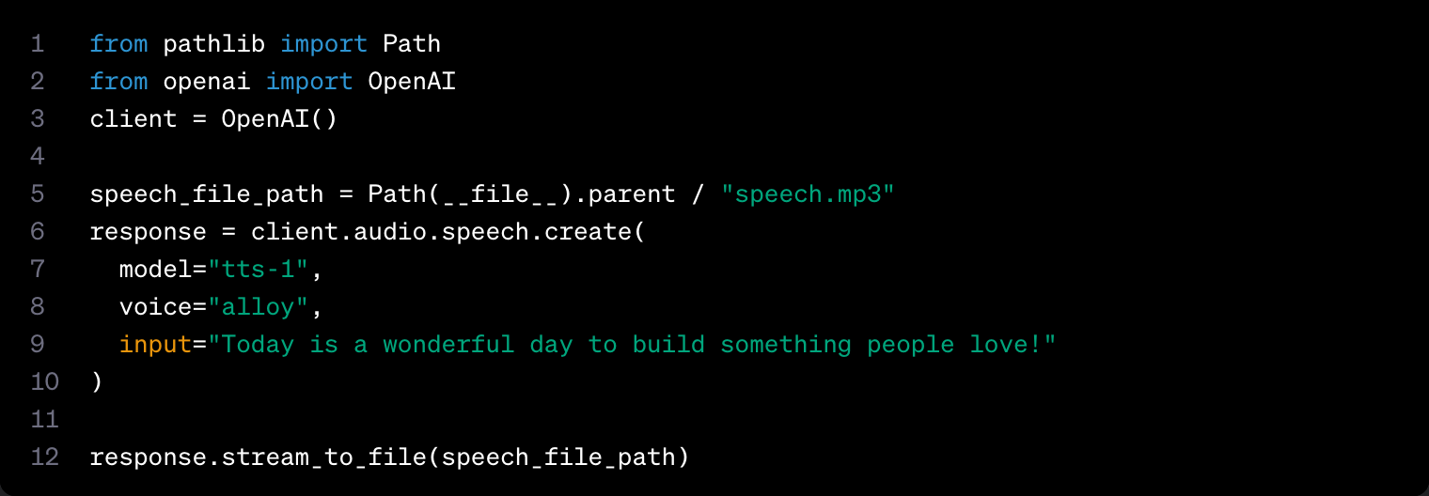
Quick Start

Slide 18
Voice options
sss

Slide 19
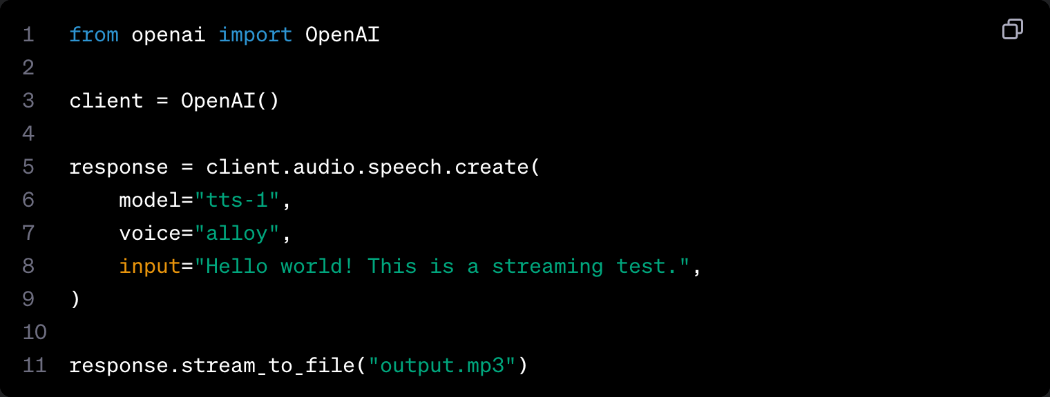
Use Case: Real-Time Audio Streaming

Slide 20
Speech-to-Text

Slide 21
Introduction
Two endpoints
Transcriptions:
Transcribe audio in whatever language
Translations:
Translate and transcribe audio into English
Based on Whisper model
Constraints:
File < 25 MB
File type is mp3, mp4, mpeg, mpga, m4a, wav, or webm

Slide 22
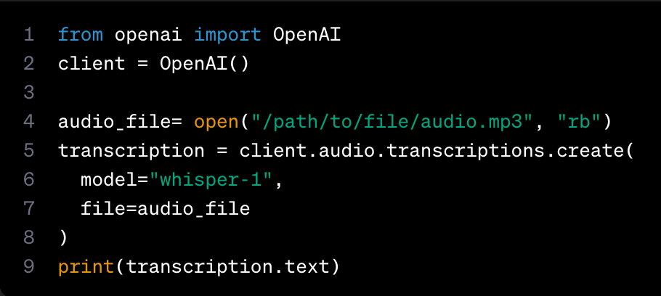
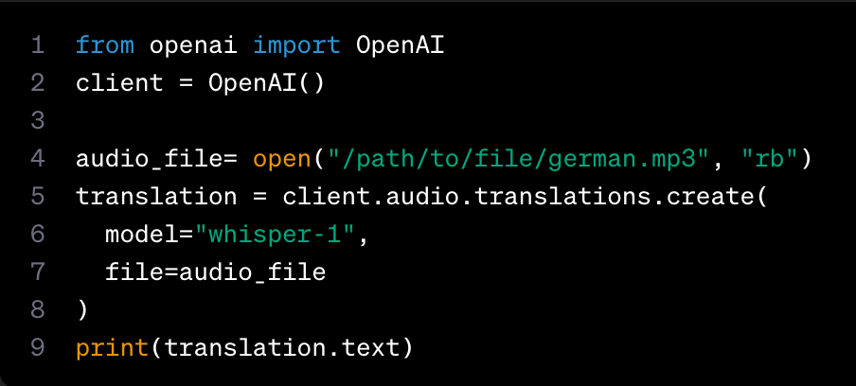
Quick Start

Slide 23
Moderation

Slide 24
Overview
Category | Description
Hate | Hate that targets specific demographics
Hate/threatening | Hate content that also includes violence
Harassment | Harassment that is directed towards anyone
Harassment/threatening | Harassment that also includes violence
Self-harm | Content that promotes self-harm like suicide, cutting, etc..
Self-harm/intent | Self-harm content that also includes intent
Self-harm/instructions | Self-harm content that is encouraging and may include instructions
Sexual
Sexual/minors
Violence
Violence/graphics
Automated content moderation
Endpoint: v1/moderations
Tip: use chunks of text < 2k characters

Slide 25
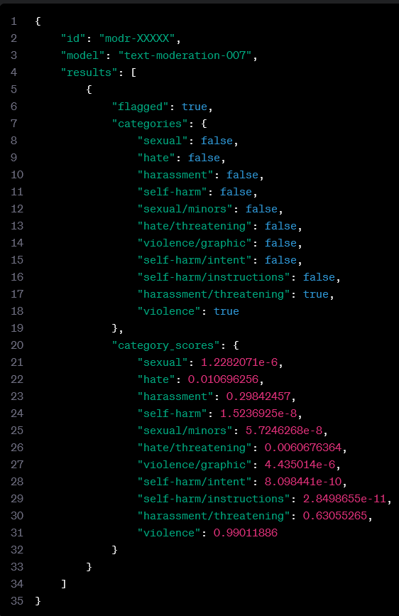
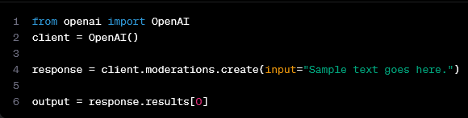
Quick Start
flagged: does this content meet any of the criteria for moderation in categories?
categories: does this content fall into any of the aforementioned categories?
category_scores: category scores as predicted by the model (scaled 0-1)

