Slide 1
Open AI Documentation, Capabilities Part 2
Sam Miller

Slide 2
Overview
Image Generation
Vision
Text to Speech
Speech to Text
Moderation
Base endpoint: https://api.openai.com/

Slide 3
Image Generation

Slide 4
Introduction
Model: DALLE 3 / DALLE 2
3 basic use cases
Creating images from text (both models)
Editing existing images from text (DALLE 2)
Varying existing image (DALLE 2)

Slide 5
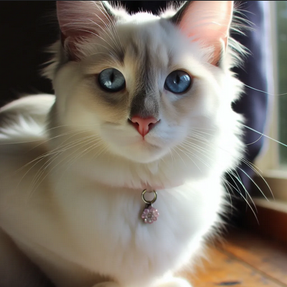
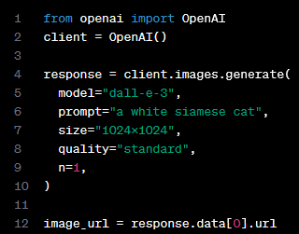
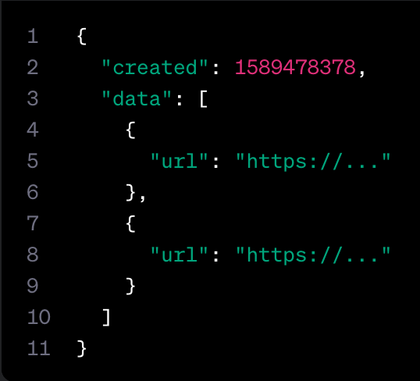
Image Generation
Endpoint: v1/images/generations
Required: prompt
Optional: model, n, quality, response_format, size, style, user
Returns: list of image objects
Quality: “standard” or “hd”
1024x1024, 1024x1792 or 1792x1024 pixels
Internal detail: prompts are automatically and unavoidably rewritten with DALLE3
Possible workaround includes “I NEED to test how the tool works with extremely simple prompts. DO NOT add any detail, just use it AS-IS” prompt
Rewritten prompt available in revised_prompt

Slide 6
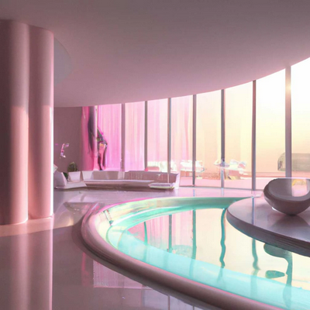
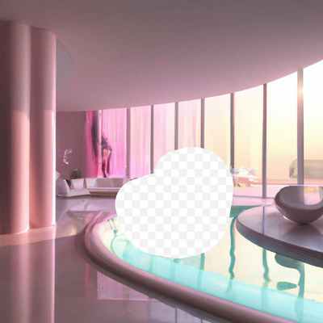
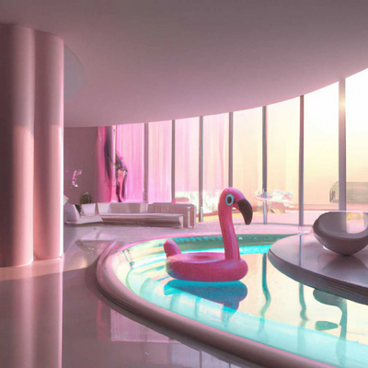
Image Editing (“Inpainting”)
Image
Mask
Output
Endpoint: v1/images/edits
Required: image, prompt
Optional: mask, model, n, size, response_format, user
Returns: list of image objects
Constraints
Image && mask < 4MB
PNGs only, square dimensions
Image && mask need same dimensions

Slide 7
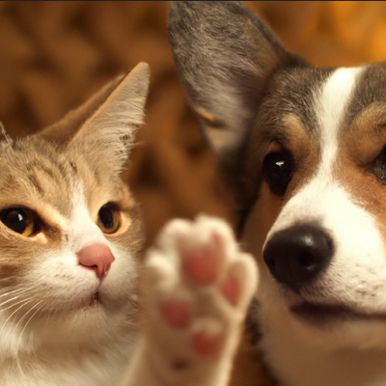
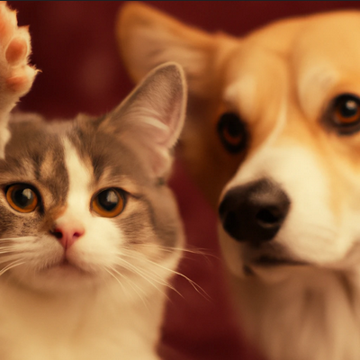
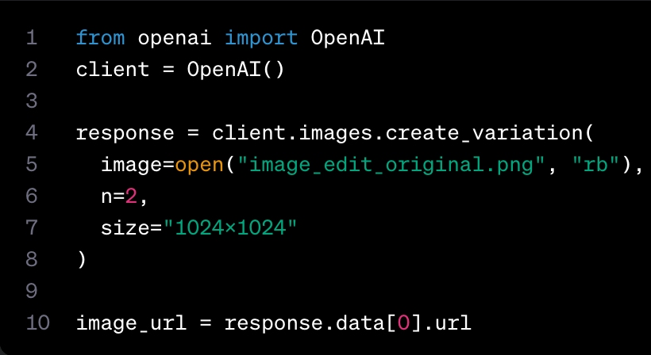
Image Variations
Requires: image
Optional: model, n, response_format, size, user
Returns: list of image objects
DALLE2 only
Similar constrains to image editing
Image must be square

Slide 8
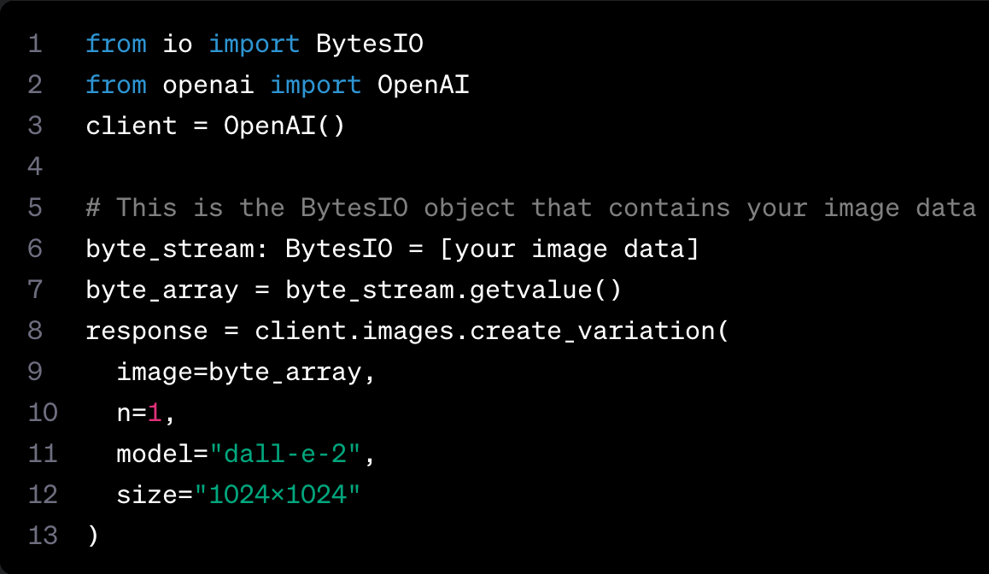
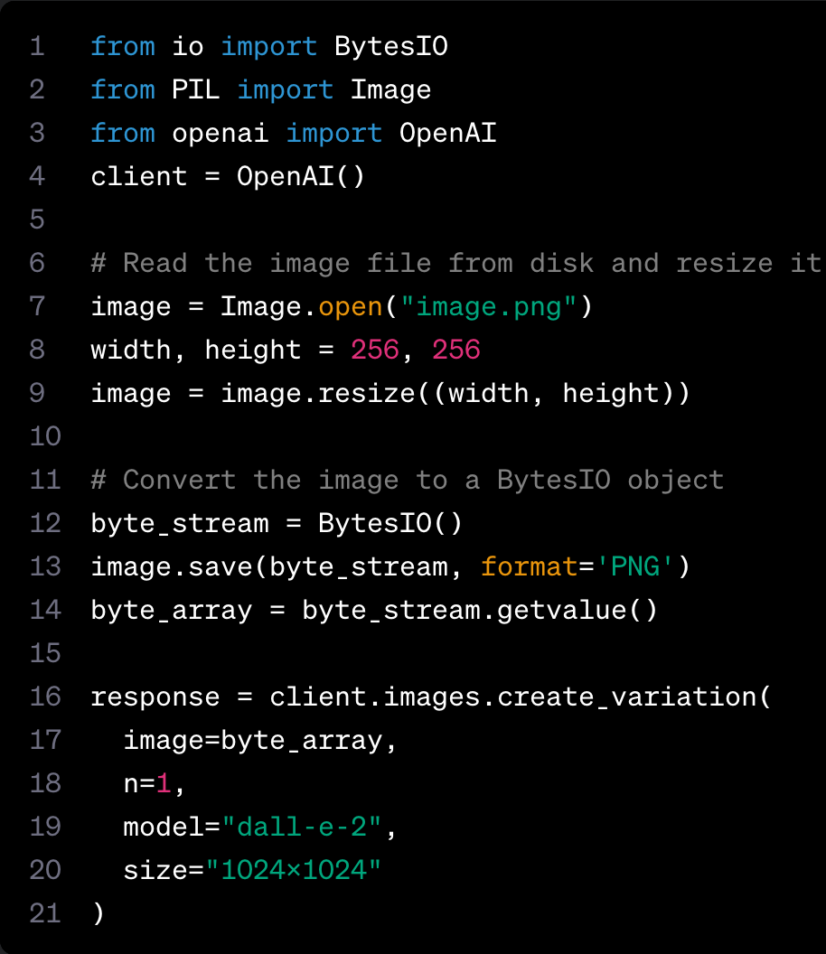
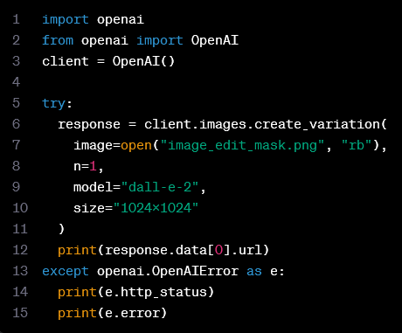
Further Tips
In-memory image data
Image preprocessing
Error handling

Slide 9
Vision

Slide 10
Introduction
Take an image as an input and answer questions about it
Available to all devs with GPT4 access through the Chat Completions API
Model: gpt-4-vision-preview

Slide 11
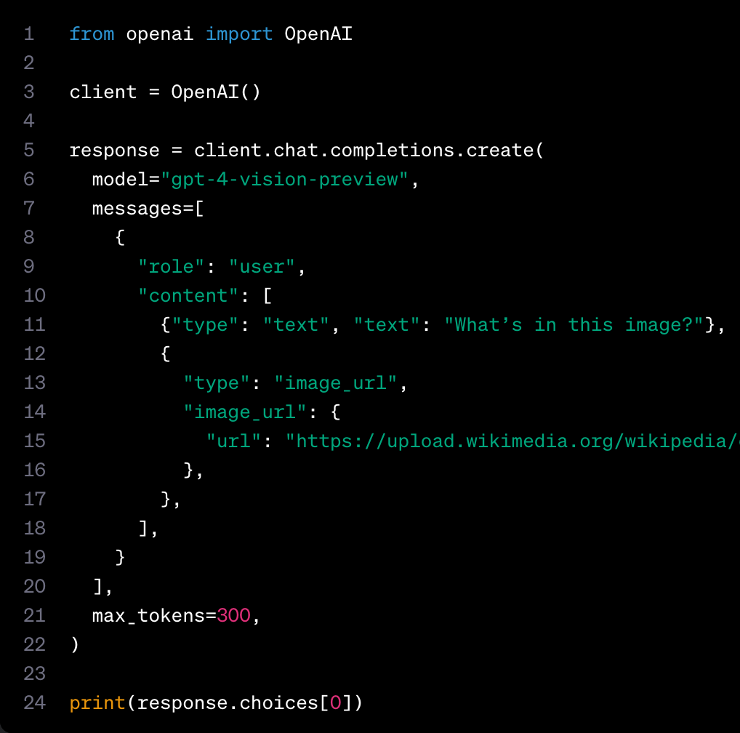
Key Features and Quick Start
Supports base64 / URL image input
Supports multiple image inputs
Detail level control: “low”, “high”, “auto”
Answers general questions about what is present in images

Slide 12

Image Costs
Image inputs are charged in tokens
Cost $∝$ detail and size
“low”: 85 tokens
“high”: (85 + 170 * # of 512px squares in scaled image) tokens
Example: 1024 x 1024 square image, detail: “high”
No resize
Shortest size == 1024 px, image scaled down to 768 x 768
Comprised by 4 512 px squares
Cost = 170 * 4 + 85 = 765 tokens

Slide 13
Limitations
Model is best at answering general questions about the image, not for specific locations
Cannot generate images
Cannot fine tune images
Cannot understand image metadata
Medical images
Non-English
Small text
Rotation
Visual Elements
Spatial Reasoning
Accuracy
Image shape
Metadata and resizing
Counting
CAPTCHAs

Slide 14
Text-to-Speech

Slide 15
Introduction
Audio API speech endpoint: v1/audio/speech
Requires: model, input, voice
Optional: speed, response_format
Returns: audio file content
Models: TTS-1, TTS-1-HD
Controls audio quality
Use cases: Narration, audio in multiple languages, streaming real-time audio output
Output files include: mp3, opus, aac, flac, pcm, wav
*AI-generated voice disclosure required*

Slide 16
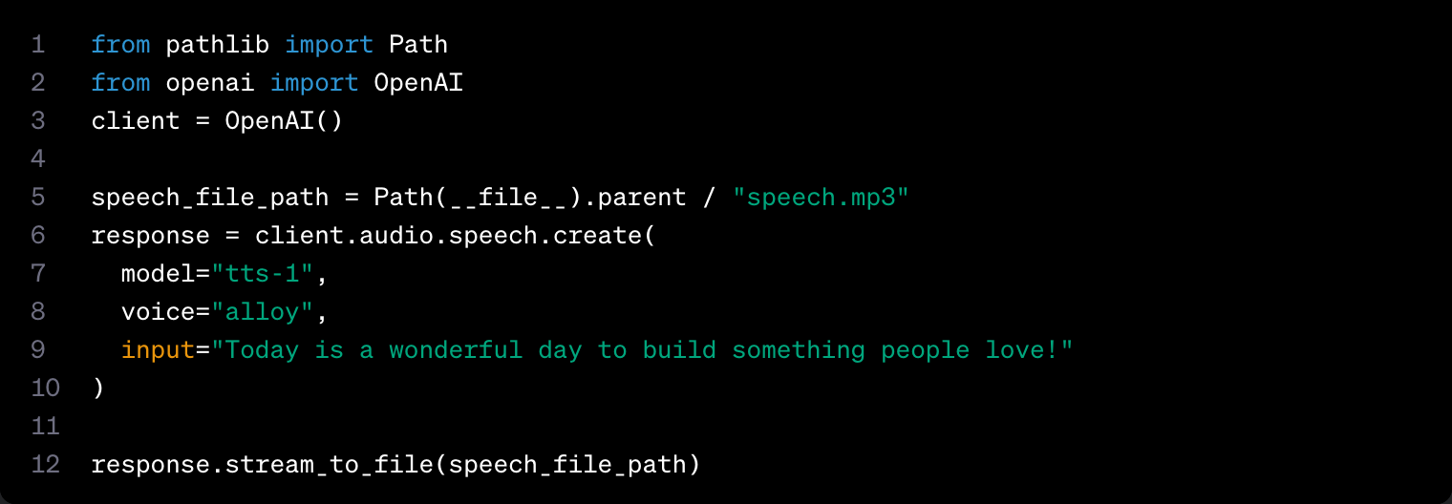
Quick Start

Slide 17
Voice options
https://platform.openai.com/docs/guides/text-to-speech/
Alloy
Echo
Fable
Onyx
Nova
Shimmer

Slide 18
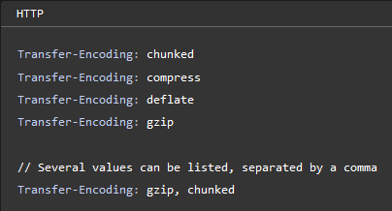
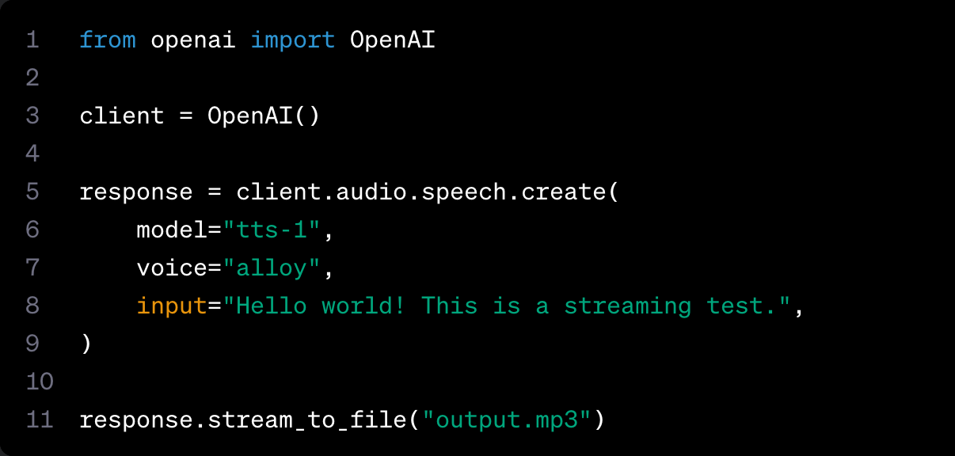
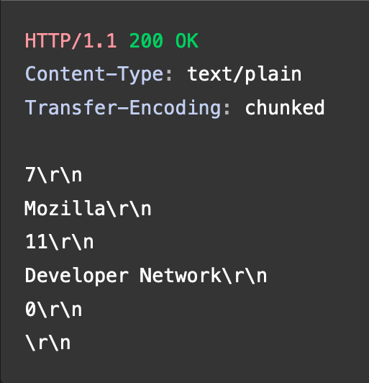
Use Case: Real-Time Audio Streaming

Slide 19
Speech-to-Text

Slide 20
Introduction
Two endpoints
Transcriptions: v1/audio/transcriptions
Transcribe audio in whatever language
Translations: v1/audio/translations
Translate and transcribe audio into English
Model: Whisper
Constraints:
File < 25 MB
File type is mp3, mp4, mpeg, mpga, m4a, wav, or webm

Slide 21
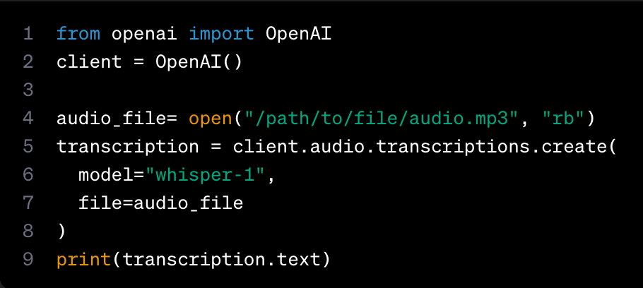
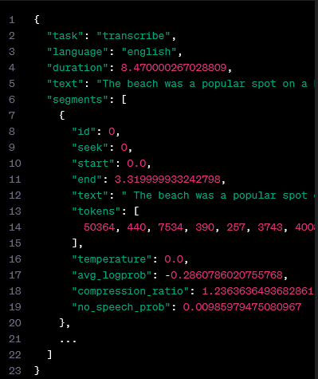
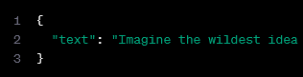
Transcription
Parameters
Required: file, model
Optional: language, prompt, response_format, temperature, timestamp_granularities
Returns: JSON with raw text or transcription object

Slide 22
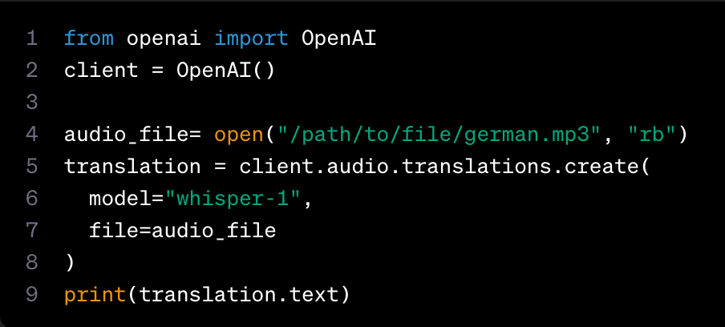
Translation
Input: audio file
Output: English translation

Slide 23
Improving Reliability: Prompting
Improve transcript quality
Capitalization
Punctuation
"Hello, welcome to my lecture."
Acronyms
"The transcript is about OpenAI which makes technology like DALL·E, GPT-3, and ChatGPT with the hope of one day building an AGI system that benefits all of humanity"
Filler words
"Umm, let me think like, hmm...”
Language representation
First 244 tokens of prompt considered

Slide 24
Moderation

Slide 25
Overview
Category
Hate
Hate/threatening
Harassment
Harassment/threatening
Self-harm
Self-harm/intent
Self-harm/instructions
Sexual
Sexual/minors
Violence
Violence/graphics
Automated content moderation
Model: text-moderation-stable, text-moderation-latest
Endpoint: v1/moderations
Required: input
Optional: model
Returns: moderation object
Tip: use chunks of text < 2k characters

Slide 26
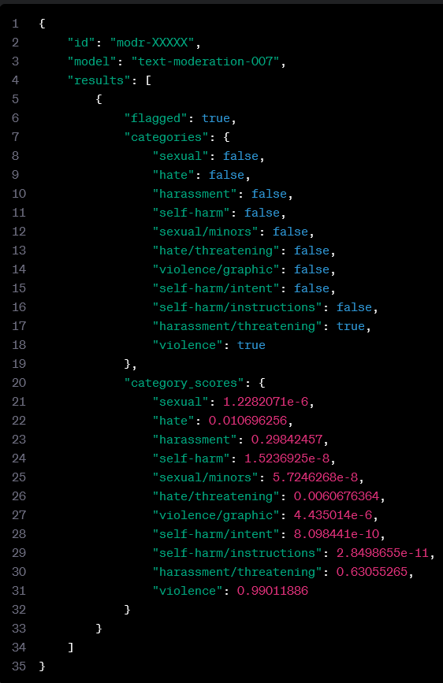
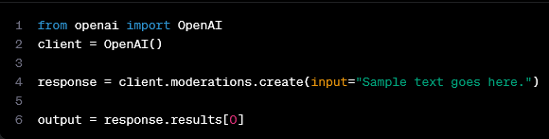
Quick Start
flagged: does this content meet any of the criteria for moderation in categories?
categories: does this content fall into any of the aforementioned categories?
category_scores: category scores as predicted by the model (scaled 0-1)

