Slide 1
Employment & Poverty In The United States
Presented By: The Data Vikings

Slide 2
Meet The Team
Jake Uhl
BA in Chemistry
Before Dev10: Engineering Technician
Favorite Data Topic: SQL Database & Python
Kendra Johnson
BS - Computer Science
Minor: Mathematics
Austin Peay State University
Favorite Topic: Python/Pandas, SQL, Power Bi
Sam Moe
BA in Computer Science - University of Minnesota
Favorite Topic: SQL & Power Bi

Slide 3
Overview
Introduction
Data Flow
Questions (Part 1)
Machine Learning
Conclusion & Acknowledgments
Dashboard
Questions (Part 2)

Slide 4
Introduction
Employment = income / occupations / unemployment rates
Poverty = rates / threshold
Analysis at three different levels:
National
State
County

Slide 5
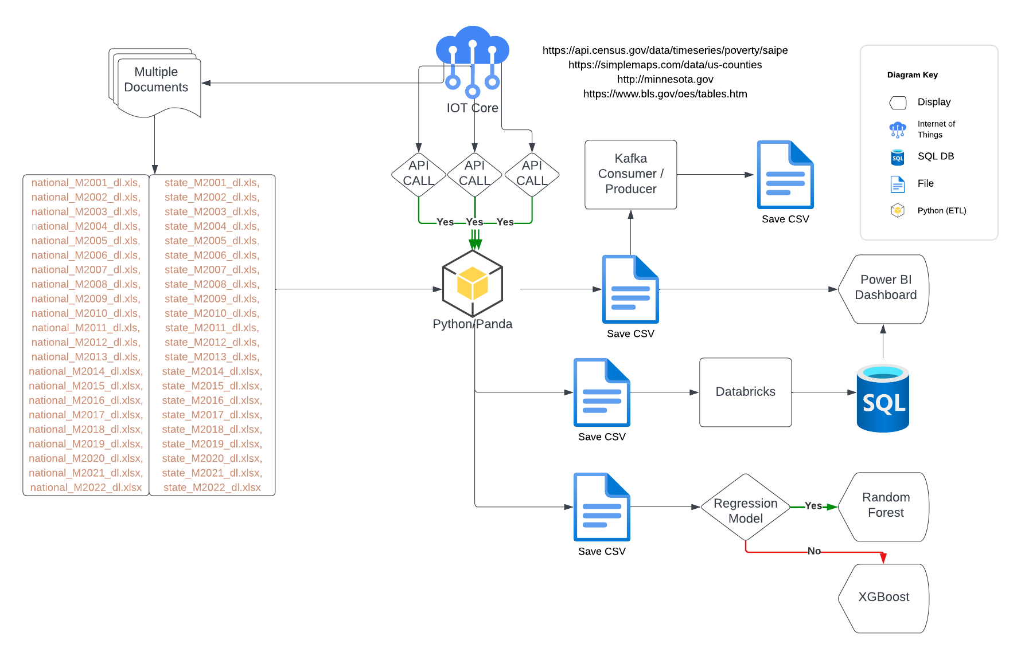
Data Flow

Slide 6
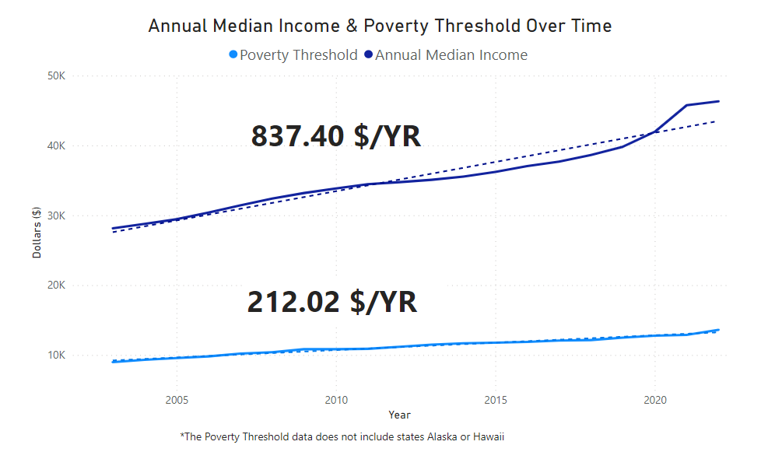
National Level - How does median income compare to the poverty threshold over time?

Slide 7
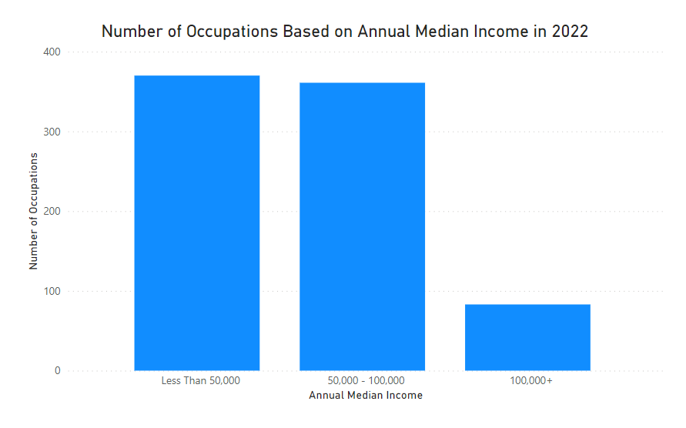
National Level - In the year 2022, how many occupations have an annual median income of 100k plus?

Slide 8
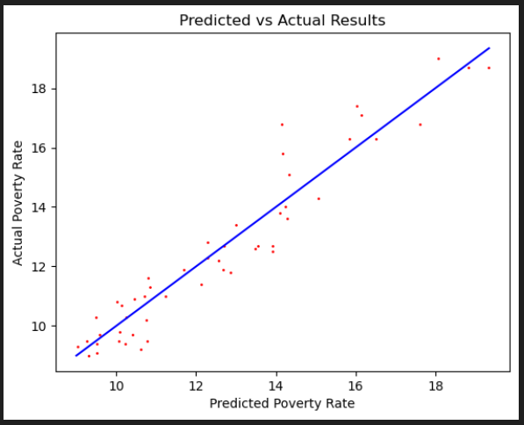
Machine Learning: Random Forest Regression
Linear Regression -> XGBoost -> Random Forest
Random Forest Regression - 1000 Estimators
53 Features:
Location Quotient - ratio of an occupation’s share of employment for a given area
Total Employees
Jobs per 1000 people
Each of the 50 States
Performance
Training Accuracy (R²): 98.3%
Testing Accuracy (R²): 91.8%
Out-of-bag Score: 87.9%
Location, location, location

Slide 9
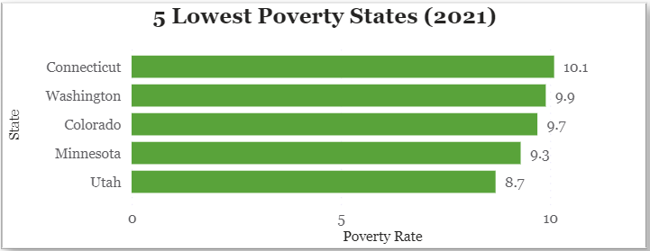
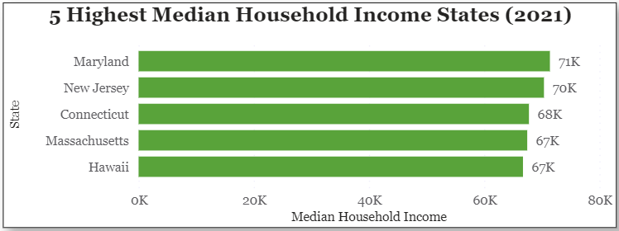
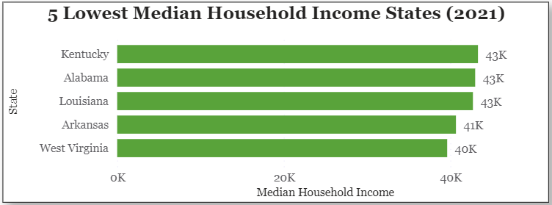
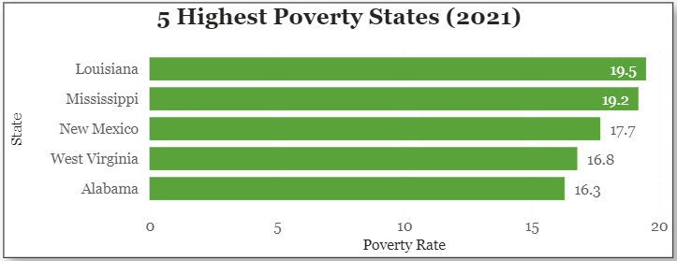
Poverty and Income at the State Level

Slide 10
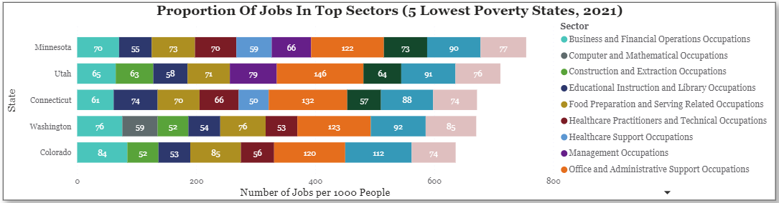
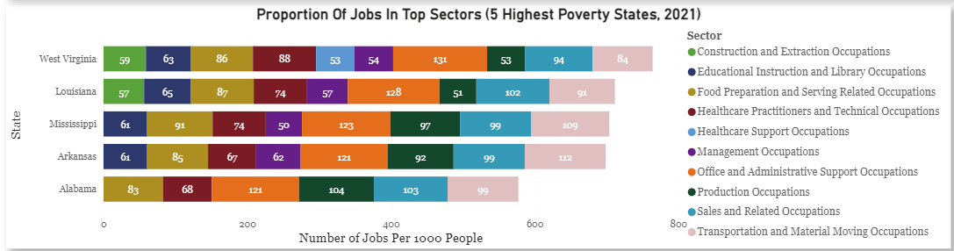
Job Sectors in States With Lowest and Highest Poverty

Slide 11
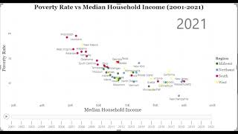
Time Series: Poverty vs Household Income (2001-2021)

Slide 12
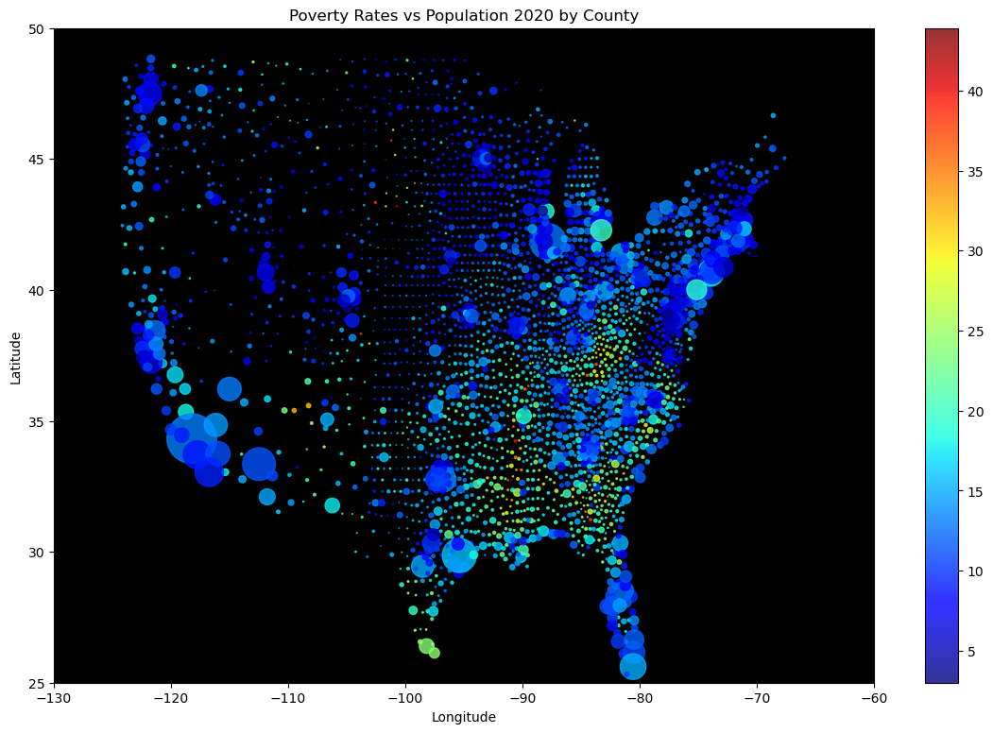
Median Incomes by
Top/Bottom 3 Poverty Rates
Poverty Rates by
Top/Bottom 3 Median Incomes
Do income levels dictate poverty levels?
County, State | PR | Med HH Income
Ziebach County, South Dakota | 43.9 | $31,599
Issaquena County, Mississippi | 43.3 | $32,675
Todd County, South Dakota | 42.5 | $31,256
Los Alamos County, New Mexico | 3.3 | $111,724
Loudoun County, Virginia | 3.2 | $155,362
Douglas County, Colorado | 3.0 | $122,290
County, State | PR | Med HH Income
Loudoun County, Virginia | 3.2 | $155,362
Santa Clara County, California | 6.6 | $139,462
Fairfax, Virginia | 5.3 | $132,509
McDowell County, Kentucky | 31.8 | $26,582
Owsley County, Kentucky | 30.6 | $25,997
Buffalo County, South Dakota | 32.8 | $22,901

Slide 13
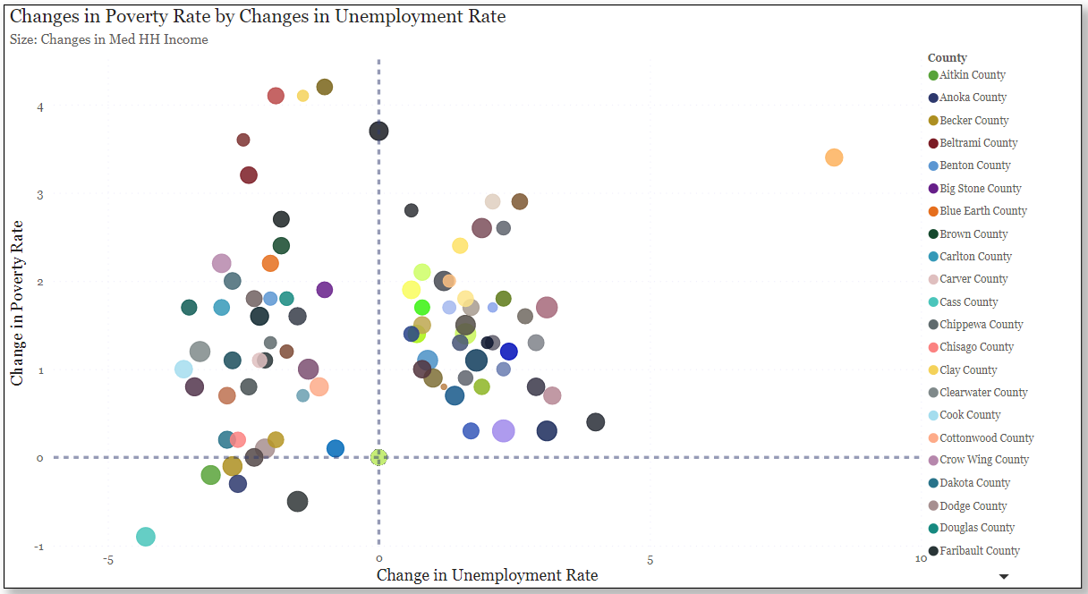
Are the poverty rates rising proportionally to unemployment rates?

Slide 14
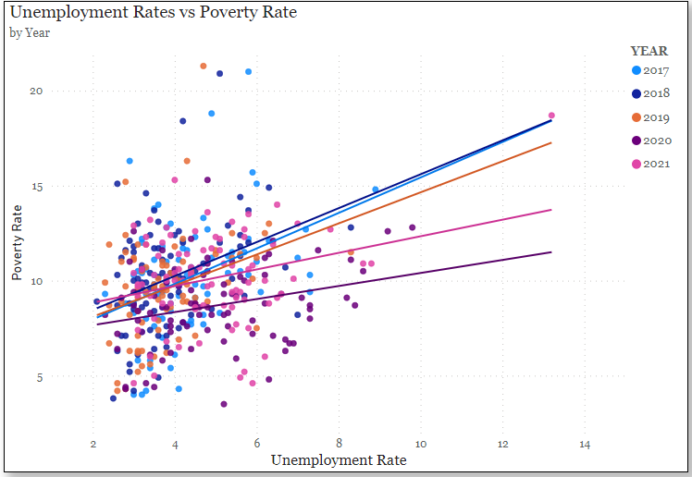
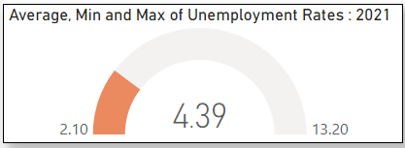
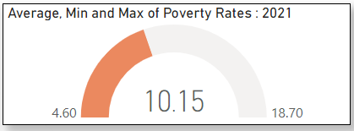
Deep Dive into Minnesota County Data
Mahnomen County
18.7 Poverty Rate
13.2 Unemployment Rate
Carver County
4.6 Poverty Rate
3.0 Unemployment Rate

Slide 15
Conclusion + Suggestions
Conclusions:
Increases in income do not necessarily mean decreases in poverty.
Location was the most powerful factor in predicting poverty rates.
Areas with high poverty tend to have different proportions of employment in different sectors than areas with low poverty.
Lower unemployment does not necessarily mean lower poverty (Minnesota)
Suggestions for future analysis:
State and local governments -> taxes, social programs
Socioeconomic factors -> Housing market, local economic output
Health factors -> access to healthcare, rates of preventable diseases

Slide 16
Acknowledgements
A special thanks to all of our instructors:
Heather Robbins
Will Sutton
Ben Leboutillier
Beth Campbell
Thank you all for taking time out of your Friday to listen to our presentation.
We hope everyone enjoyed our presentation! Please visit our GitHub repository for more a more detailed look at our capstone project: https://github.com/sammoe60/data-vikings

Slide 17
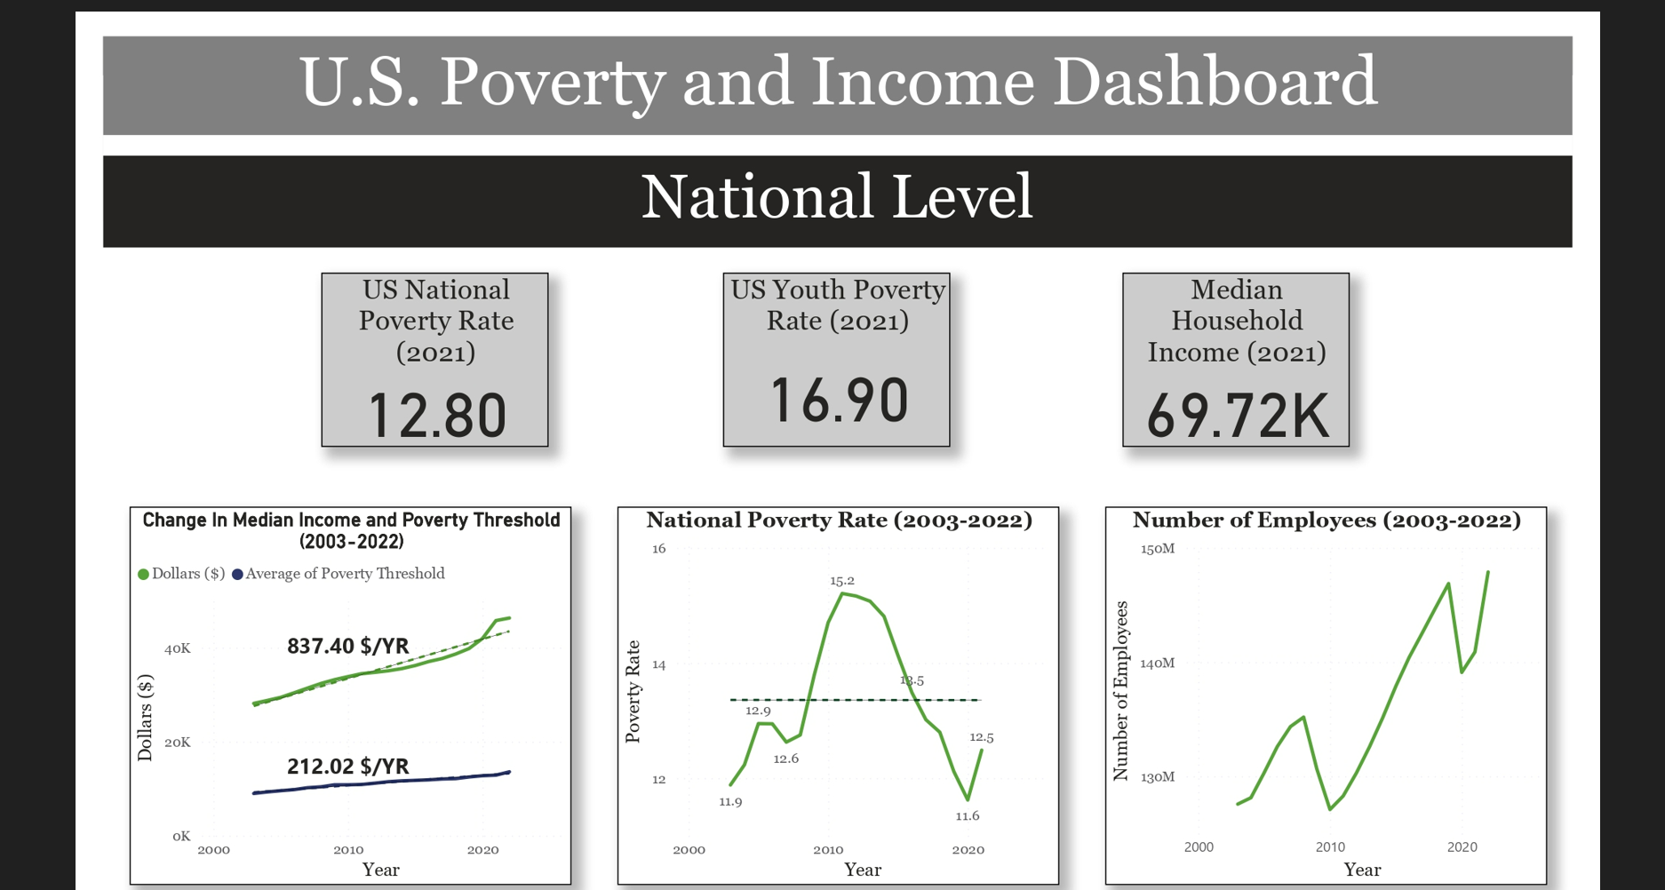
Power BI Dashboard

Slide 18
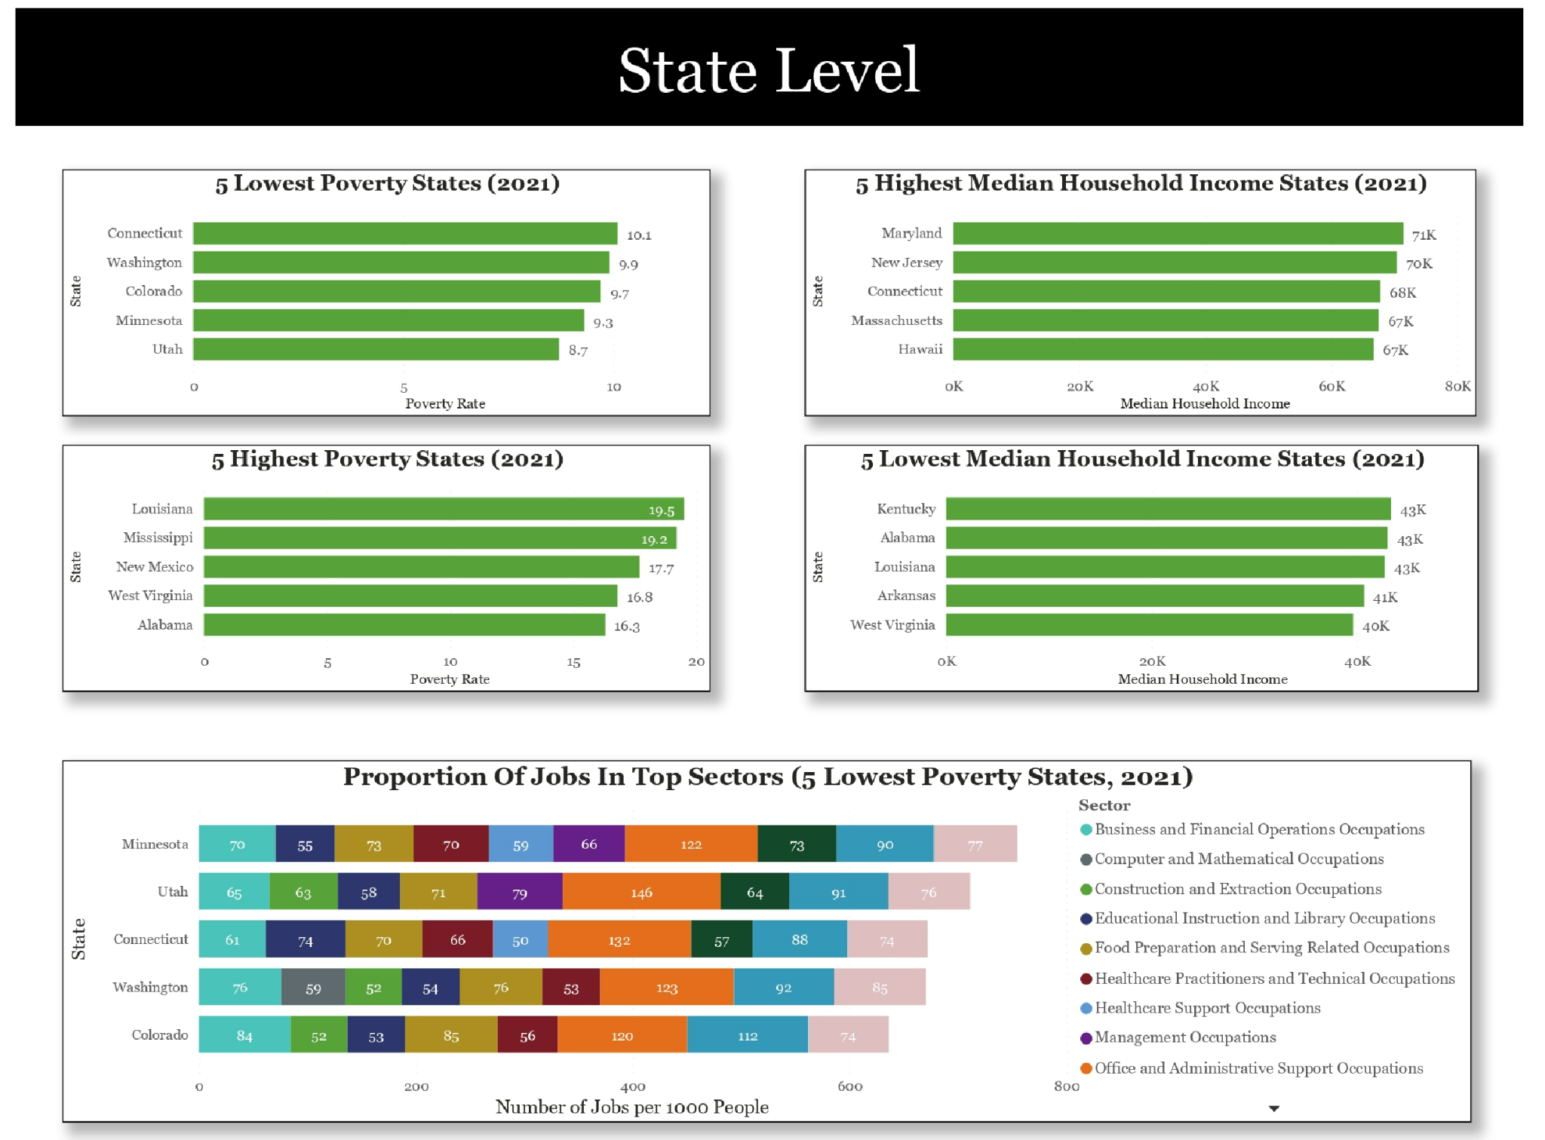

Slide 19
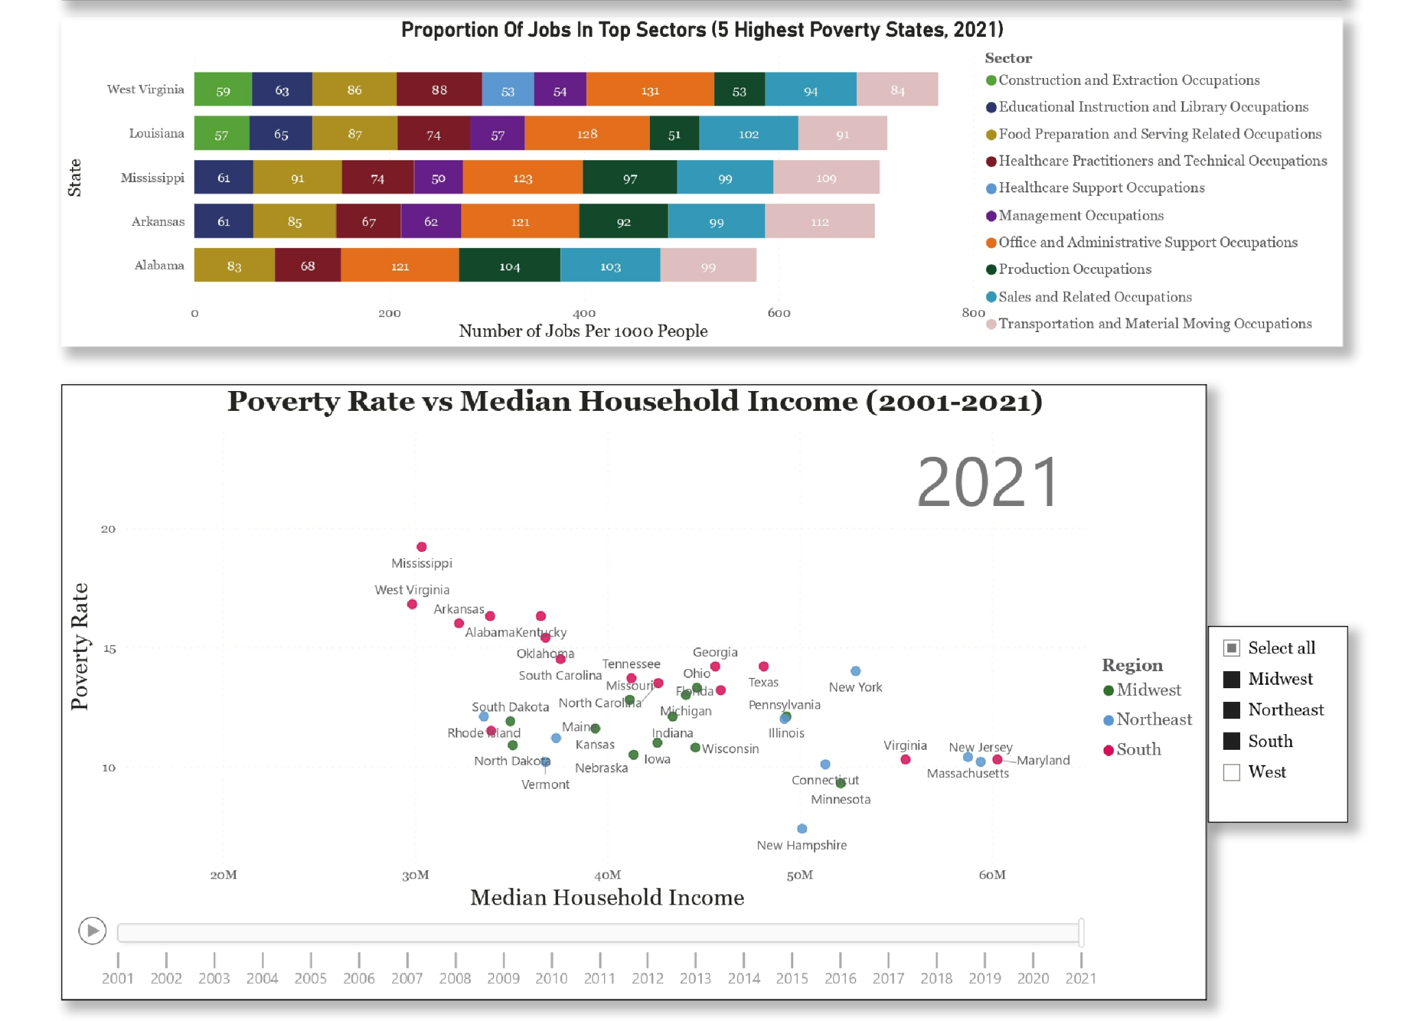

Slide 20
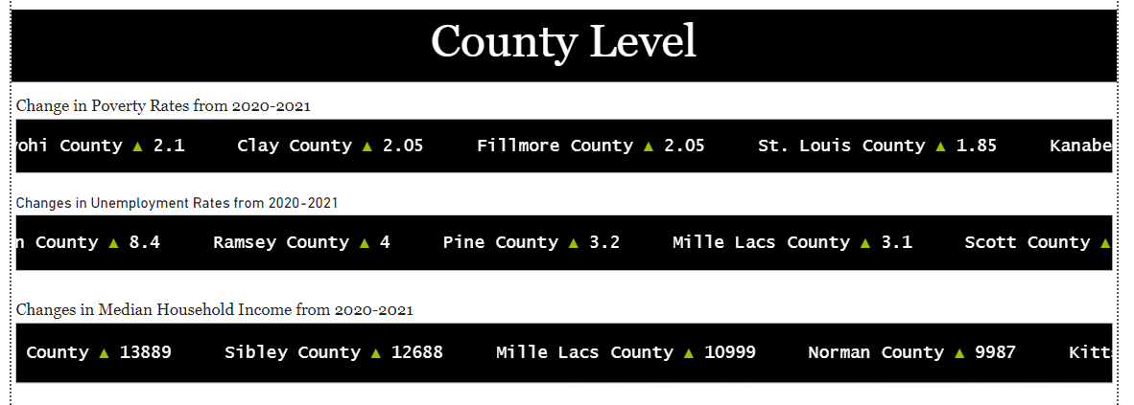

Slide 21
