Slide 1
CLINICO PATHOLOGICAL CASE PRESENTATION
Name:

Slide 2
PATIENT HISTORY
The child aged 8 years was born with light skin and silvery hair. When she was 5 years, she developed hyperpigmentation of sun exposed parts. She has on and off episodes of fever and infections approximately every monthly once.

Slide 3
ON EXAMINATION
Hypopigmentation of the whole body
Silvery hair- light coloured with metallic sheen
Hyperpigmentation of sun exposed areas
Chicken pox residual scars present prominently over face
Hypertrichosis
Repeated infections

Slide 4
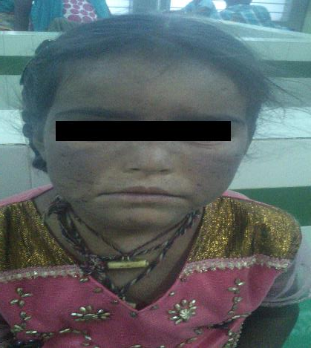

Slide 5
OPHTHALMOLOGY
Photophobia present
Pallor present

Slide 6
 | Right eye | Left eye
Lids | Similar changes on eye lids Minimal blepharitis | Similar changes on eye lids Minimal blepharitis
Conjunctiva | Pale | Pale
Cornea | Clear | Clear
Sclera | Pale | Pale
Anterior chamber | Normal and clear | Normal and clear
Pupil | 4mm in diameter Round, regular, reacting to light | 4mm in diameter Round, regular, reacting to light
Iris | Diffuse hyperpigmentation | Diffuse hyperpigmentation
Lens | Clear | Clear

Slide 7
Per abdomen examination
Distended, tense abdomen
Hepatomegaly- firm, non tender and rounded margins
Splenomegaly

Slide 8
PROVISIONAL DIAGNOSIS
Partial Albinism

Slide 9
INVESTIGATIONS
Complete Blood Count
Peripheral blood smear
Bone marrow examination
MPO staining
Hematology

Slide 10
COMPLETE BLOOD COUNT (Abnormal values)
Hemoglobin-6.5g/dL
RBC Count-2.4million/cumm
Nucleated RBCs-50 cells/cumm
PCV-21.1%
PCHC-30.8g/dL
Platelet count-0.14lakhs/cumm

Slide 11
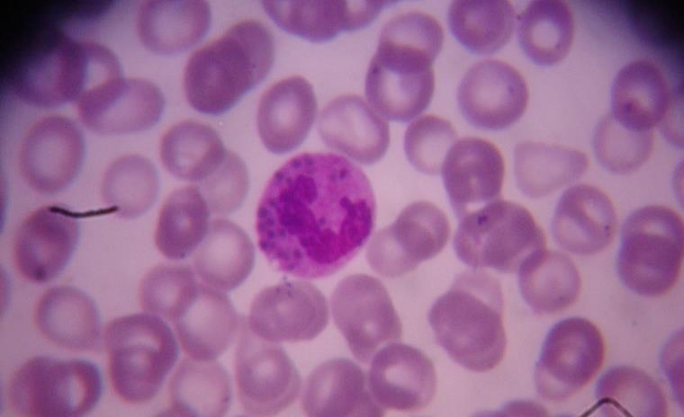
PERIPHERAL BLOOD SMEAR
A Neutrophil showing coarse granules in the cytoplasm

Slide 12
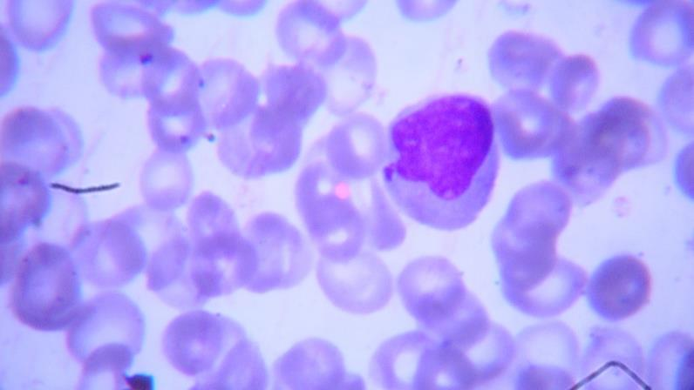
A monocyte showing coarse granules in the cytoplasm

Slide 13
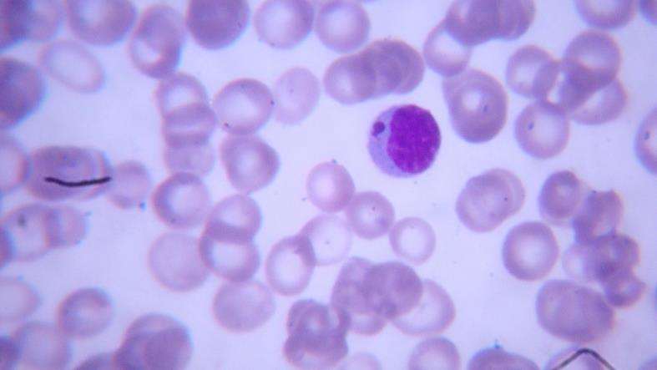
A Lymphocyte showing coarse granules in the cyroplasm

Slide 14
Report
RBCs showing mild anisocytosis. Majority are normocytes showing severe hypochromia. No parasites, no inclusions, no immature cells.
WBCs are decreased in number. Predominant cells are lymphocytes(90%). Occasional bilobed neutrophils (Pelger-Huet cells) with large coarse granules are seen in cytoplasm. No immature cells.
Platelets are decreased in number, seen discretely, and show normal morphology.

Slide 15
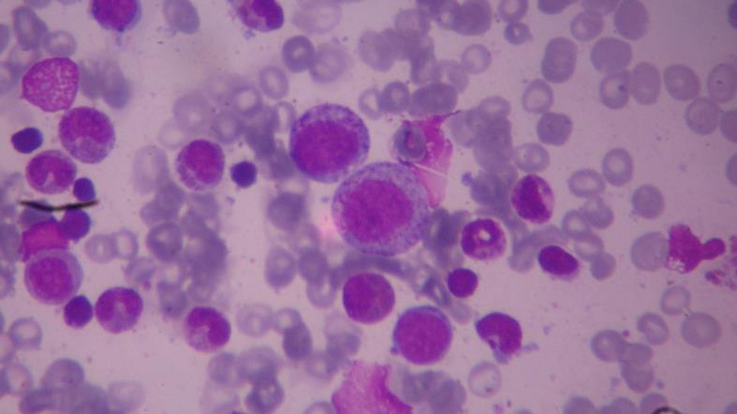
BONE MARROW EXAMINATION
Myeloid lineage cells showing coarse grey blue granules in the cytoplasm

Slide 16
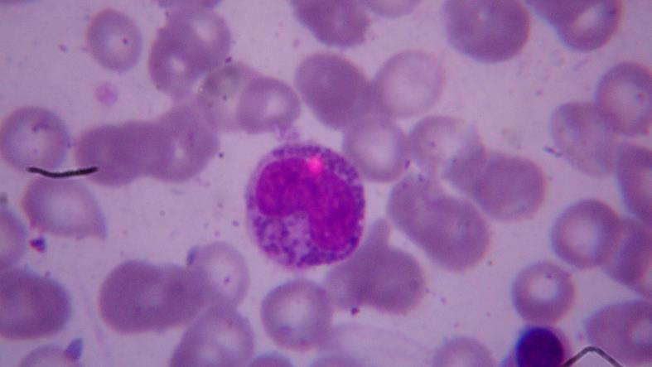

Slide 17
Report
Erythropoiesis: Appears normoblastic showing all stages of erythropoiesis.
Myelopoiesis: Appears normal in number. Myelocytes, metamyelocytes, and band forms show coarse grey blue granules in the cytoplasm and there are also monocytic series of cells few of them showing vacoulization.
Megakaryopoeisis: Appears normal in number
No tumour cells, No granulomas are seen.

Slide 18
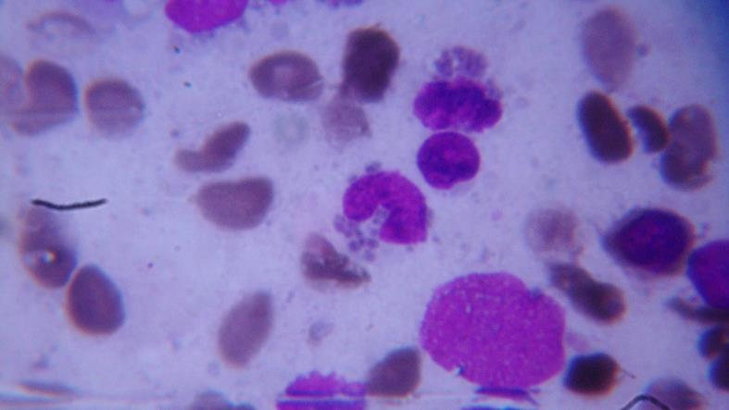
Special Staining: MPO Staining

Slide 19
Hematology
PT: 22.4sec (Control:11.8sec)
INR Ratio: 2.0
PTT: 62.8sec (Control: 28.0sec)
Normal values
PT:11-16sec
INR Ratio:0.9-1.3
PTT: 22-34sec

Slide 20
DIFFERENTIAL DIAGNOSIS
Chediak Hegashi syndrome
Griscelli syndrome
Hermansky Pudlak syndrome
Wistkott Aldrich syndrome
Waardenburg syndrome

Slide 21
Griscelli Syndrome
Partial cutaneous and ocular albinism
Variable cellular and humoral immunodeficiency
Variable neurological involvement
Accelerated phase
Large pigment clumps in the hair shaft
But NO GRANULES IN NEUTROPHILS

Slide 22
Hermansky-Pudlak syndrome
Ocular and cutaneous albinism
Bleeding diathesis(due to platelet dysfunction)
Deposition of lipofuschin in various organs- Hepatosplenomegaly
But NO GIANT GRANULES OR RECURRENT INFECTIONS

Slide 23
Wistkott Aldrich syndrome
Immune deficiency
Thrombocytopenia
Recurrent bacterial infections
But, NO HYPOPIGMENTATION OR GIANT GRANULES IN NEUTROPHILS.

Slide 24
Waardenburg syndrome
Depigmentation of hair, skin and irides
But NO IMMUNODEFICIENCY
AND NO GIANT GRANULES

Slide 25
FINAL DIAGNOSIS
Hypopigmented skin and silvery hair
Pale conjunctiva and sclera
Photophobia
Hyper pigmented iris
Repeated infections
Prolonged bleeding
Accelerated phase of – Hepatosplenomegaly, Pancytopenia, susceptibility to infections
Giant peroxidase positive granules in Neutrophils.

Slide 26
CHEDIAK HEGASHI
SYNDROME
THANK YOU

