Slide 1
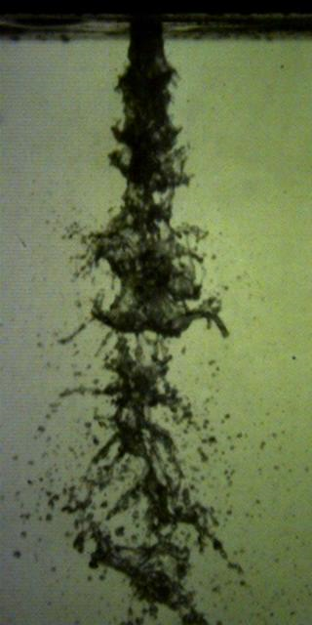
Jet Flow Field
Effect of Bubble Size and Gas-to-Liquid Ratio on the Velocity Distribution of an Effervescent Jet
^{Samuel Johnson}
Under Direction of Professor Thomas Shepard
University of St. Thomas, St. Paul, Minnesota
This research was made possible in part by the Undergraduate Research Opportunities Program
Introduction
Small Bubble Sizes (0.258mm)
Methods
The goal of this research is to document how velocity of an effervescent jet is affected by distance, bubble size and gas-to-liquid ratio (GLR) within a jet.
Air was injected perpendicular to liquid flow and recorded with a high-speed video. Controlling the amount of air injected allowed for manipulation of the GLR and bubble sizes of each jet flow trial.
GLRs ranged from 0.0006 to 0.0023, and bubble diameters of 0.258(mm) and 1.748(mm).
High-speed video was captured of different GLRs
Large bubble 3.83x bigger
200 Frames from video were imported into a MATLAB based PIV program.
Frame-by-frame vector analysis was performed on lines that spanned the jet flow three, five, and seven diameters (of the jet nozzle) away from the jet nozzle.
Radial and axial velocity vector data at each diameter was imported into Microsoft Excel and further data analysis was performed.
Histograms for selected radial and axial velocities were created in Excel.
1D*
3D*
5D*
7D*
*Approximations
Large Bubble Sizes (1.748mm)
Conclusions
Radial (u) flow activity is essentially constant
As measurements trend further away from the jet nozzle, axial (v) velocities become more widely distributed.
As fluid particles spread out in space, they start to travel slower
It’s difficult to compare Large Bubble trials vs Small Bubble trials with different analysis parameters
Thank you
Thank you to Dr. Shepard for allowing me this opportunity to partake in undergraduate research. Special thanks to Aleksey Garbaly for collecting extensive jet flow footage.
Thank you to Saint Thomas Engineering for making remote research possible.
References:
Dr. Luiz Lourenco, “Jet Flow Field”, FAMU-FSU, 1999

