Slide 1
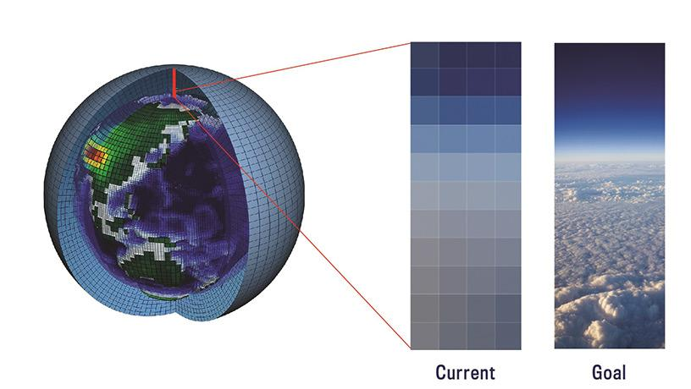
Image By: Meghan Moran and photo credit: Juan Botella

