Slide 1
IN PURSUIT OF HAPPYNESS
Navigating Life in IIT Delhi
A Game by:
Samyak Jain (2020CS50667)
Viraj Agashe (2020CS10567)

Slide 2
Theme
It’s Rendezvous all over again! But wait, it’s not all fun and games - You’ve got a ton of responsibilities to take care of to ensure RDV’22 goes off smoothly.
Your mission, should you choose to accept it – complete the given set of tasks before the Pronite comes around, while keeping up your own happiness happyness.
Oh, and before we forget – your rival for that POR next year’s going to be trying to do so as well. Of course, you don’t want them to get all the credit for a successful RDV, do you?
Good luck!

Slide 3
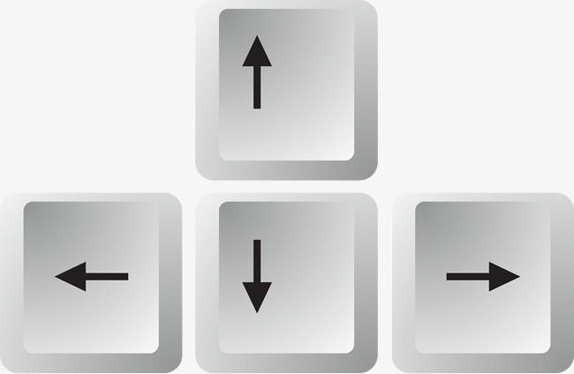








Controls
For Movement
(Left-Right-Up-Down)
Activate Yulu
(At Yulu Stand)
Deactivate Yulu
(At Yulu Stand)
Deactivate Yulu
(At Yulu Stand)
Open Tasks
Collect Item
(At Task Site)
Deposit Item
(At Task Site)
Open Tasks
Open Inventory
Close Interfaces

