Slide 1
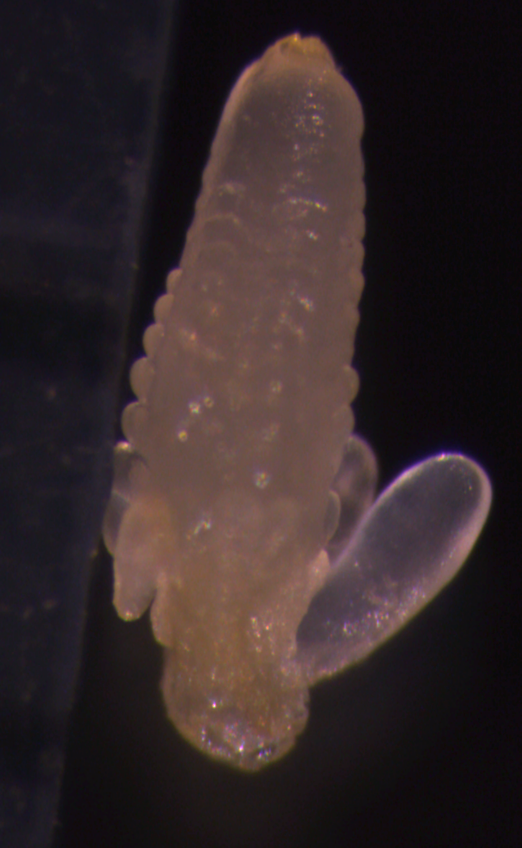

Sequenced male gametophyte developmental stages
TP
Tassel primordia
(pre-meiosis)
MS
Microspore
(post-meiosis)
MP
Mature pollen
SC
Sperm cell
Also SC
0.1mm
0.1mm
DAPI stained MS
Isolation/separation
by Percoll gradient
1µM
DAPI stained MP
Dye cycle green stained SC
Isolation by Percoll cushion
1mm
Diploid
Haploid

Slide 2
RNA Libraries for Sequencing - preparation
Samples
TP
Total RNA isolation
TRIzol®
or
Phenol (SC)
Poly-A RNA isolation
Streptavidin
magnetic beads (NEB)
Poly-A RNA library prep
PrepX mRNA Library
(Wafergene Biosystems)
MS
MP
MP
SC
Unbound RNA
(supernatant)
TP = Tassel primordia
MS = Microspore
MP = Mature pollen
SC = Sperm cell
= Vegetative nucleus
RNA size selection
small RNA)
(~18-28nt)
15% TBE-Urea gel
Small RNA library prep
NEBNext®

