Slide 1

InterMine is a powerful open source data warehouse system, created specifically for integrating and analyzing complex biological data. Benefiting from over a decade of data warehousing experience and input from a wide range of research collaborators, InterMine is still in active development. InterMine features include:
Sophisticated data integration facilities
Fast, flexible querying
User-friendly web interface and analysis tools
Extensive set of APIs and web tools
Highly developed and extensible system

Slide 2
LegFed InterMines
JCVI and NCGR have been developing mines for LegFed:
MedicMine Medicago truncatula (developed along with ThaleMine)
BeanMine Phaseolus vulgaris, from LIS chado
SoyMine Glycine max, from SoyBase+
PeanutMine Arachis duranensis + Arachis ipaensis, from PeanutBase+
LegumeMine combines above
CowpeaMine soon: with genetics from UC-Riverside
These mines are all cross-linked via the “friendly mine” interface.

Slide 3
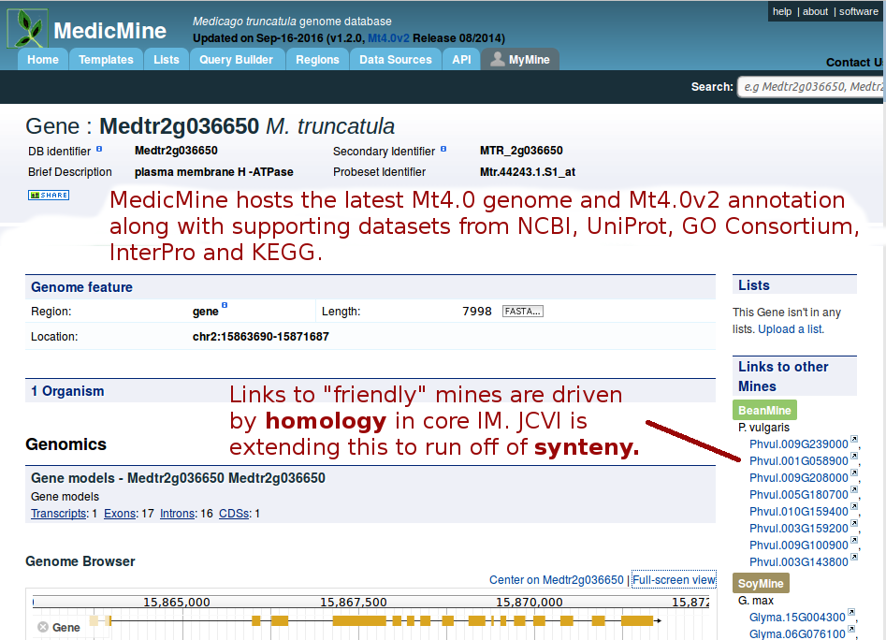
MedicMine enhancements 1

Slide 4
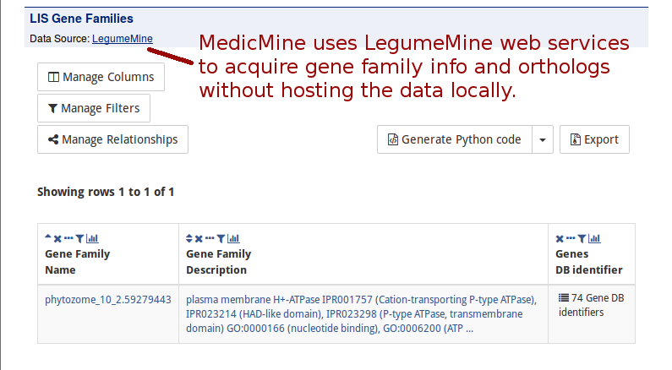
MedicMine enhancements 2

Slide 5
NCGR mine enhancements
Chado data importers (for LIS data)
Genetic data extensions (markers, QTLs, genetic maps, etc.)
Genetic data visualization (linkage group diagrams, genotyping)
Shared motif search (e.g. upstream gene flanking regions)
Expression heat maps
Note: core InterMine does not contain genetic data.

Slide 6
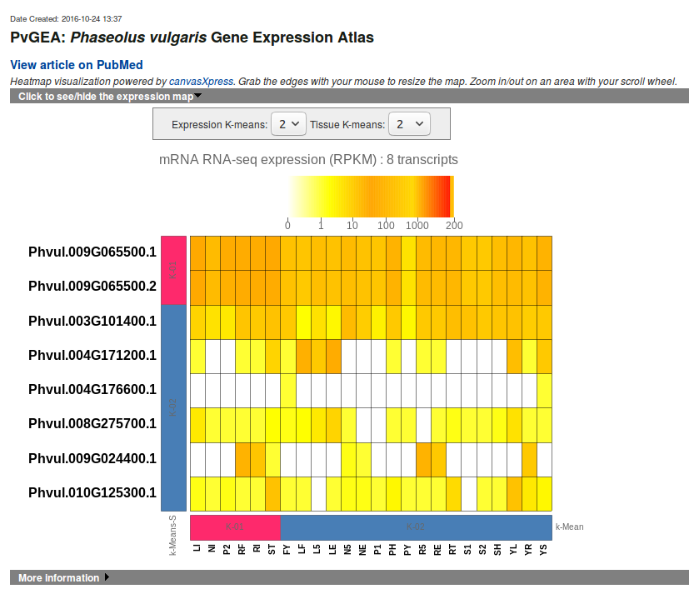
Heat maps have K-means clustering

Slide 7
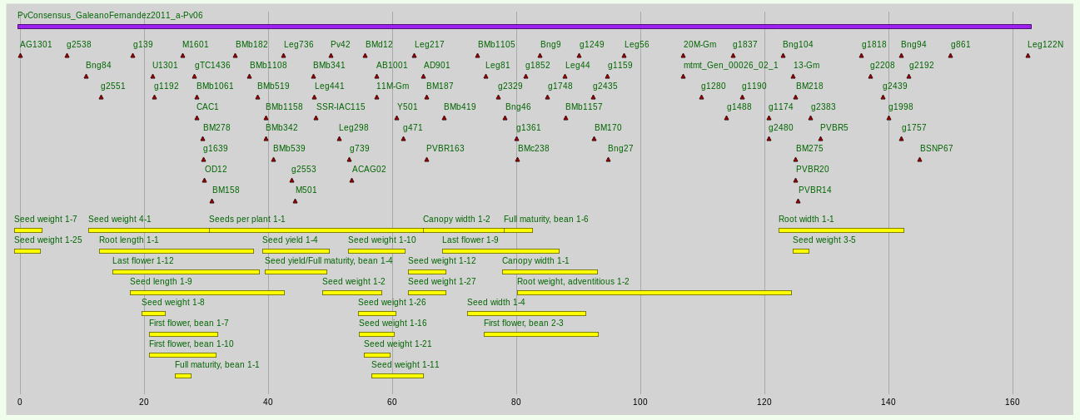
LG diagrams show markers and QTLs

Slide 8
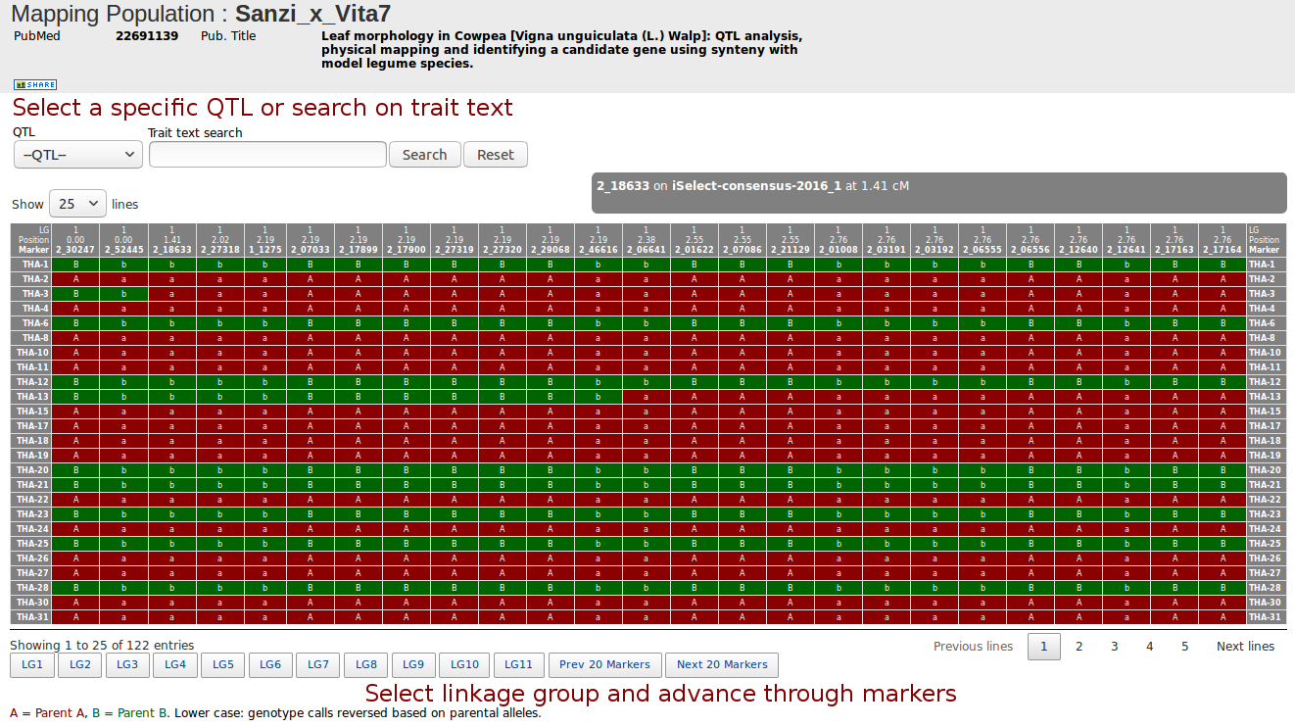
Mapping experiment → genotyping matrix

Slide 9
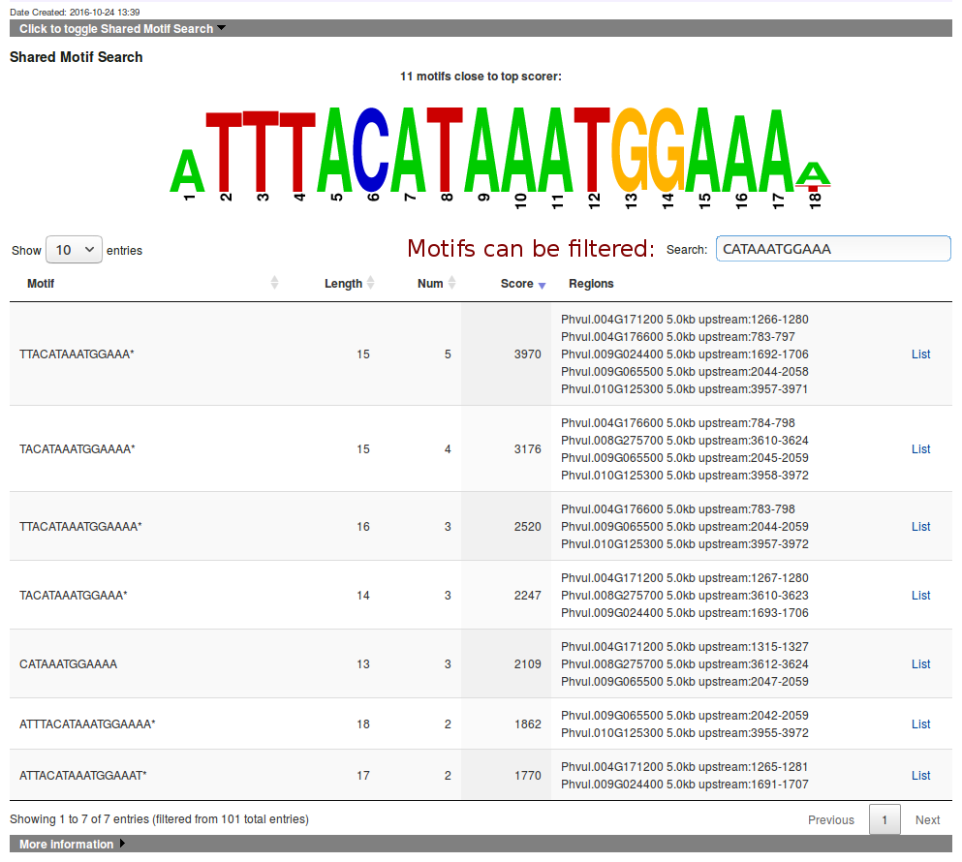
Shared motif search = realtime analysis

Slide 10
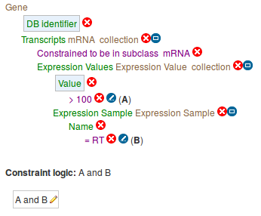
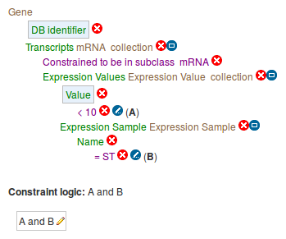
Example: intersect lists from queries
Question: which Pv genes express highly in root tips (RT) but poorly in shoot tips (ST) in the 2nd trifoliate stage?
RT > 100 RPKM query ST < 10 RPKM query

Slide 11
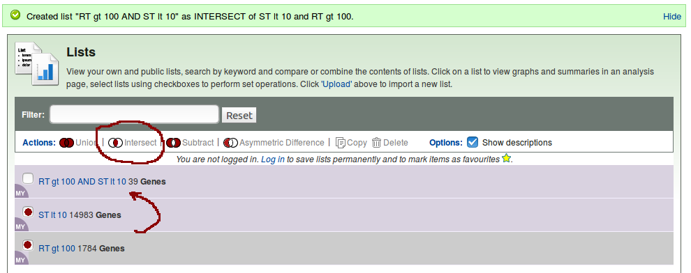
Intersect resulting lists
Intersection of query lists results in 39 genes

Slide 12
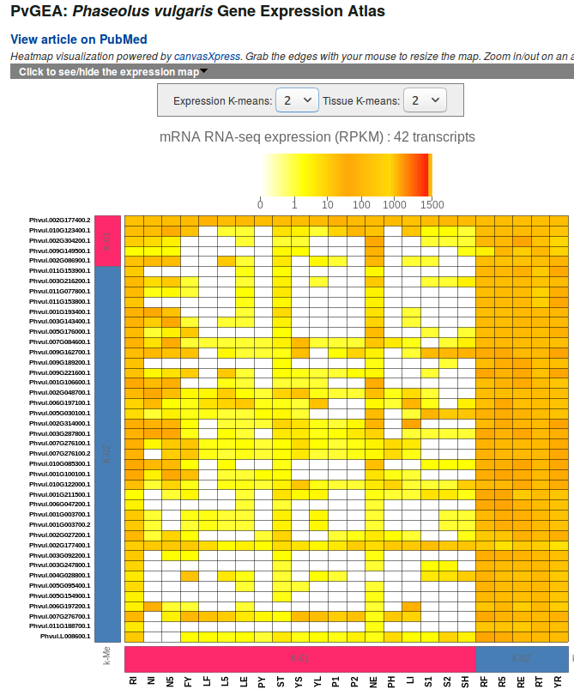
View resulting list → “list analysis page”
List analysis page includes a heat map, plus standard IM analyses like GO term enrichment, chromosome histogram

