Slide 2
Identifying the 'root' Causes of Propagation in Submitted Incident Reports
Tom Millar (US-CERT)
Adam Shostack (Microsoft Corp.)
Sam Perl (SEI CERT Division)

Slide 3
Session Goals
Reasons to embark upon a root cause effort
Different possible deliverables
Running a pilot
Why you would run a pilot

Slide 4
Outline - 45 Minutes
Project Context
(Tom Millar US-CERT)
About Broad Street
(Adam Shostack, Microsoft Corp.)
Summary & Results
(Sam Perl, SEI CERT Division)
Disclaimers
Questions

Slide 5
DHS Disclaimer
This presentation is intended for informational and discussion purposes only.
The Department of Homeland Security (DHS) does not provide any warranties of any kind regarding this information. In no event shall the United States Government or its contractors or subcontractors be liable for any damages, including but not limited to, direct, indirect, special or consequential damages, arising out of, resulting from, or in any way connected with this information, whether or not based upon warranty, contract, tort, or otherwise, whether or not arising out of negligence, and whether or not injury was sustained from, or arose out of the results of, or reliance upon the information.
The display of the DHS official seal or other DHS visual identities, including the US-CERT or ICS-CERT name or logo shall not be interpreted to provide any person or organization the authorization to use the official seal, insignia or other visual identities of the Department of Homeland Security, including US-CERT and ICS-CERT. The DHS seal, insignia, or other visual identities shall not be used in any manner to imply endorsement of any commercial product or activity by DHS, US-CERT, ICS-CERT or the United States Government. Use of the DHS seal without proper authorization violates federal law (e.g., 18 U.S.C. §§ 506, 701, 1017), and is against DHS policies governing usage of its seal.
This presentation is Traffic Light Protocol (TLP): WHITE. Recipients may share TLP: WHITE information without restriction, subject to copyright controls. For more information on the TLP, see http://www.us-cert.gov/tlp.
DHS does not endorse any commercial product or service, including any subjects of analysis. Any reference to specific commercial products, processes, or services by service mark, trademark, manufacturer, or otherwise, does not constitute or imply their endorsement, recommendation, or favoring by DHS.

Slide 6
The Scene: Late Winter, 2013.
US-CERT, part of DHS, is working on updating the incident reporting guidelines for its primary constituents (federal government agencies). Attack vectors are particularly difficult to categorize in ways that are both accurate and useful.
Microsoft has a taxonomy for software exploitation;
US-CERT has a corpus of incident reports;
SEI’s CERT has analysts who are working on data discovery from those incident reports.

Slide 7
Microsoft Section Legal Notice
© 2014 Microsoft. Distributed under Creative Commons Attribution-Noncommercial-No Derivative Works 4.0. This document is provided “as-is” and is for informational purposes only. Information expressed in this document, including URL and other internet Web site references, may change without notice. You bear the risk of using it. This document does not provide you with any legal rights to any intellectual property in any Microsoft product. MICROSOFT MAKES NO WARRANITES, EXPRESS, IMPLIED, OR STATUTORY, AS TO THE INFORMATION IN THIS DOCUMENT.

Slide 8
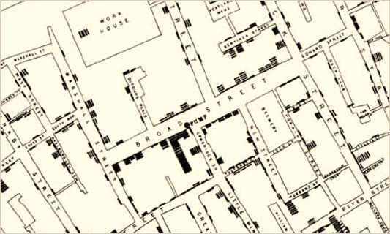
Broad Street Taxonomy
Notes:
Where did Broad Street come from?
Why did you create it?
How did Microsoft use it?
What impact did it have?
How would someone else use it?
Where can I get help?

Slide 9
The Broad Street taxonomy
Design
Understanding the taxonomy (v2.8)

Slide 10
Taxonomy design
Design focuses on software owners ability to fix problems
Compare/contrast other taxonomies
Yes/no questions to facilitate consistency between categorizers
Requires some training (generally < 30 minutes or so)
Categorizing should take 15 seconds with the right data
(Getting the right data can take hours of forensics/searching)
Flowchart with links seems like the easiest presentation
Inclusion of (I’m unsure/Hard to categorize/Other) is part of evolving taxonomy

Slide 11
What’s being categorized?
Originally, how malware got onto a system (Microsoft SIR v11)
We’re currently exploring the limits of “incident” categorization
Moving towards “how did an attacker gain control?”
Taxonomy does not yet cover things like physical access, abuse of credentials
Thus, we can’t say “compromises”
Excluded from current design: DDoS, misuse, policy violations
This answer is understood to be imprecise as we explore

Slide 12
Understanding the taxonomy
14 slides, one per box in the flowchart
Each explains/discusses the question & idea behind it

Slide 13
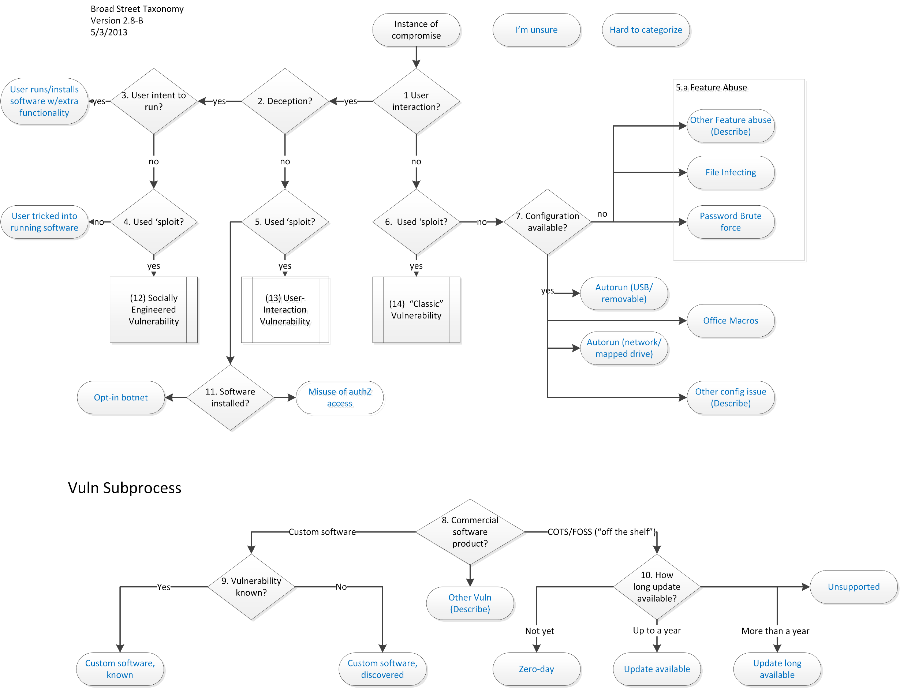

Slide 14
Vulnerability subprocess

Slide 15
1. User interaction
Does the user perform some action that results in a compromise?
Another way to phrase: If no one is logged in, can the attack work?

Slide 16
2. Deception
Was someone convinced they will:
Get a benefit from the action? (or)
Be penalized if they don’t act?
Often via “social engineering” where the user knows the action could be risky
Examples
Website saying “you need a codec to see…”
Email saying “run the attachment to see your tax statement”
Related: “Does the user click through a warning?”
Used in earlier versions
Taxonomy shouldn’t change if developer removes all the warnings

Slide 17
3. User intent to run software
Does the user know the action they’re taking will result in new software running/being installed?
Yes: Endpoint “User installs/runs software (with unexpected functionality)”
This includes both extra functionality, and running a completely different program
Question not about “does the user know that the file will open in a program” but that new software will run or be installed
Deceptive filenames imply the person does not know
For example, a subject of “I love your picture!” with a file of IMG2043-JPG.zip which then contains a .scr would (likely) result in a confused person, but not user-intent to run the SW
Common question: “Isn’t this a Trojan Horse?”
One of two main types of Trojan Horse (see also q.4)
Anti-malware industry now defines trojan as malware unable to spread on its own
Notes:
http://about-threats.trendmicro.com/us/malware/worm_phorpiex.jz

Slide 18
4. Deserves a CVE?/Sploit?
Also “Was an exploit used?” carries the same meaning
Avoids debate over meaning of “vulnerability”
Works for those who regularly work with CVEs
If no, “User tricked into running software”
Examples: Document.pdf.exe, Document.exe.pdf (with RLO or similar)
This is the 2nd classic type of Trojan
If yes, socially engineered vulnerability
Possible further categorization in the vulnerability subprocess

Slide 19
5. Deserves a CVE?/Sploit?
(Same general discussion)
If yes, “user-interaction vulnerability”
If no, see 11

Slide 20
11. Software Installed?
Not all compromise require exploit or confusion
User installed “Low Orbit Ion Canon” software to participate in attacks
Machine now remotely controllable
“Opt-in botnet” phrase via Gunter Ollman
Not all compromises require software installation
Credential theft/remote access

Slide 21
6. Deserves a CVE?/Sploit?
(Same general discussion), leads to “classic exploit”
Note we got here without the user-interaction branch

Slide 22
7. Configuration Available?
Does the OS contain a configuration switch that would stop the attack?
Yes covers things like
Autorun
Office Macros
Other config (describe)
No (“feature abuse”) is things like:
File infecting viruses
Password brute force (“net use”)
Other feature abuse (describe)
Notes:
Copy over RDS per http://www.microsoft.com/security/portal/threat/encyclopedia/Entry.aspx?Name=PWS%3aWin32%2fZbot

Slide 23
8/10 Commercial Software product?
8 is intended to cover generally available software (COTS, FOSS, GOTS)
10 covers if an update is available
Answers from “not yet” through “unsupported”
Up to a year & over a year are data driven choices based on exploit kits
http://javatester.org/version.html may be helpful
Only reachable through 4/5/6 (“Deserves a CVE”)
Thus avoids disputes over should it be patched
“Not a bug, it’s a feature” brings it to [7, no, feature abuse]

Slide 24
9. Vulnerability known
Issues discovered by owner/operator/creator of the software
Fixes take time to develop and test
Often not prioritized
“How would an attacker find that?”
Issues discovered by an attacker
Question raised by Verizon RISK team

Slide 25
Examples
An email attachment called `ForRecruitment.xls'
Requires user interaction to function (1, yes), deceives the receiver (2, yes), but the user does not intend to run it (3, no), and uses a vulnerability of the type that's covered in the CVE (4, yes). As such, this is categorized with Broad Street as a `Socially Engineered Vulnerability. Depending on the vulnerability, it could be further categorized.
Codec Installers Malware masquerading as a video codec.
(1, yes), (2, yes), (3, yes) `User runs sw'
Bonus-details.pdf.exe with an icon implying that it is a pdf
(1, yes), (2, yes), (3, no), (4, no) `User tricked'
4. Exploit code on a well-known website
Regardless of how the exploit code arrives (hacking, 3rd party legitimately referenced) (1, yes), (2, no (the user knows and trusts the site)), (5, yes) `User-interaction vulnerability‘
Low Orbit Ion Canon is a tool used for DDoS
(1, yes), (2, no), (5,no) `Opt-in botnet'
rlogin -froot Passing a parameter of `-froot' to rlogin leads to a root login. (CVE-1999-0113) `Classic Vuln'

Slide 26
“I’m unsure”/“Hard to categorize”
We should draw out additional information
Why unsure:
Cleaned up
System re-install or other evidence destruction
Can’t find evidence
Logging turned off
Incident too old
Root cause not established for other reasons (please explain)
Hard to categorize:
Don’t understand this taxonomy
Multiple root causes
Other (please explain)

Slide 27
Examples (2)
`File infecting virus' `Traditional' le infecting viruses that tamper with the stored versions of executable files.
`Password brute force' Use of rlogin, ssh or smb to login, in a system which does not allow conguration of the password feature.
`Autorun USB' A USB drive or other device with an `autorun.inf‘ file in its root which is executed.
`Office Macros' Systems which are compromised due to code running when a document opens, such as the `Melissa' email worm.
`Barnacleware‘
(One of our collaborators used this entertaining term for software that comes with extras.)
To the extent that those extras are not disclosed to the user installing the software, and to the extent that the extras lead to the machine being compromised, then (1, yes), (2, yes), (3, yes) `User runs sw' applies.

Slide 28
Using the Taxonomy on Incident Reports
A collaboration between US-CERT, Microsoft, and CMU SEI CERT

Slide 29
Copyright 2014 Carnegie Mellon University This material is based upon work funded and supported by Department of Homeland Security under Contract No. FA8721-05-C-0003 with Carnegie Mellon University for the operation of the Software Engineering Institute, a federally funded research and development center sponsored by the United States Department of Defense. Any opinions, findings and conclusions or recommendations expressed in this material are those of the author(s) and do not necessarily reflect the views of Department of Homeland Security or the United States Department of Defense. References herein to any specific commercial product, process, or service by trade name, trade mark, manufacturer, or otherwise, does not necessarily constitute or imply its endorsement, recommendation, or favoring by Carnegie Mellon University or its Software Engineering Institute. NO WARRANTY. THIS CARNEGIE MELLON UNIVERSITY AND SOFTWARE ENGINEERING INSTITUTE MATERIAL IS FURNISHED ON AN “AS-IS” BASIS. CARNEGIE MELLON UNIVERSITY MAKES NO WARRANTIES OF ANY KIND, EITHER EXPRESSED OR IMPLIED, AS TO ANY MATTER INCLUDING, BUT NOT LIMITED TO, WARRANTY OF FITNESS FOR PURPOSE OR MERCHANTABILITY, EXCLUSIVITY, OR RESULTS OBTAINED FROM USE OF THE MATERIAL. CARNEGIE MELLON UNIVERSITY DOES NOT MAKE ANY WARRANTY OF ANY KIND WITH RESPECT TO FREEDOM FROM PATENT, TRADEMARK, OR COPYRIGHT INFRINGEMENT. This material has been approved for public release and unlimited distribution. This material may be reproduced in its entirety, without modification, and freely distributed in written or electronic form without requesting formal permission. Permission is required for any other use. Requests for permission should be directed to the Software Engineering Institute at permission@sei.cmu.edu. Carnegie Mellon® and CERT® are registered marks of Carnegie Mellon University. DM-0001254

Slide 30
SEI CERT Division Role
Attempt to use the Broad Street Taxonomy on incident tickets received by US-CERT
Collective Initial Worries
Tickets are from different teams.
Information is collected using different incident response processes and procedures.
How do reporters submit tickets that describe compromises?

Slide 31
Incident Tickets
Malicious Code accounted for 26.5% of Federal incident tickets in 2011.
Incidents Reported to US-CERT by Federal Agencies in FY 2011*
Incidents Category | Incident Tickets | % of Total
Unauthorized Access | 6,985 | 15.9%
Denial of Service | 30 | 0.1%
Malicious Code | 11,626 | 26.5%
Improper Usage | 8,416 | 19.2%
Scans, Probes, and Attempted Access | 2,942 | 6.7%
Under Investigation / Other | 13,890 | 31.6%
* Table 2 of FY 2011 report to Congress on the implementation of the Federal Incident Management Act of 2002

Slide 32
Sample Selection
We selected ‘malicious code’ as the most likely candidate for compromises.
26 tickets from Malicious Code, mostly with subcategory Virus/Trojan/Worm/Logic Bomb
We then threw in ‘investigation’ just to see…
11 tickets from investigation
Total sample - 37 incident tickets

Slide 33
Step 1 - Find Compromises
Was there a system compromise?
Are we even encountering system compromises in the same way as Broad Street?
Answer: Similar to Broad Street
How are compromises being reported to us?
1 per ticket? Other structure?
Answer: Multiple compromises per ticket
Will we find ‘compromises’ in tickets that do not have a ‘malicious code’ label?
Answer: Yes, surprise!

Slide 34
System Compromise Results
Out of 37 total tickets,
25 reported at least one compromise, for a total of
36 compromised systems.
* Linked to other tickets in other categories

Slide 35
Step 2 - Categorize Compromises
Follow the taxonomy and consult the Broad Street training materials.
Find information in Malware catalogues, threat reports, behavior analysis summaries, vendor patch information, NVD, etc.
When vulnerabilities are involved, follow the Broad Street Vulnerability Sub-Process.

Slide 36
Broad Street Categorization Results
Able to apply Broad Street to 72% of tickets with compromises
(with some assumptions)

Slide 37
Causes of System Compromises
^{Causes of Compromises}
^{But Are They Zero Day?}
Broad Street Category | Broad Street Path | Compromises | % of Total
12 Socially Engineered Vuln. | 1. User Interaction? = Yes 2. Deception? = Yes 3. User Intent to run? = No 4. Used Exploit? = Yes | 23 | 64%
13 User Interaction Vuln. | 1. User Interaction? = Yes 2. Deception? = No 5. Used Exploit? = Yes | 3 | 8%
User Tricked into Running Software | 1. User Interaction? = Yes 2. Deception? = Yes 3. User Intent to run? = Yes 4. Used Exploit? = No | 1 | 3%
Other Config Issue | 1. User Interaction? = No 6. Used Exploit? = No 7. Configuration available = Yes | 0 | 0%
Insufficient Data | NA | 9 | 25%
Total |  | 36 | 100%
Vulnerability Result | Compromises | % of Total
Definitive 0day | 3 | 8%
Possibly 0day * | 23 | 64%
Update available for less than 1 year | 0 | 0%
Update (long) available for greater than 1 year | 0 | 0%
Insufficient Data | 9 | 25%
No vulnerability | 1 | 3%
Findings: Lots of user interaction; lots of deception, and lots of exploits. Zero Day is complicated…

Slide 38
Observations
Many required User Interaction, Deception, and exploits.
83% were from exploit kit activity.
Hard to determine from reported categories alone
Results may vary. Our sample was much smaller than their sample.
The task helped us to plan data improvements.
A taxonomy, more structured fields, improve collecting of impact, etc.
For vulnerability data, collecting a compromised machine’s patch status is important.

Slide 39
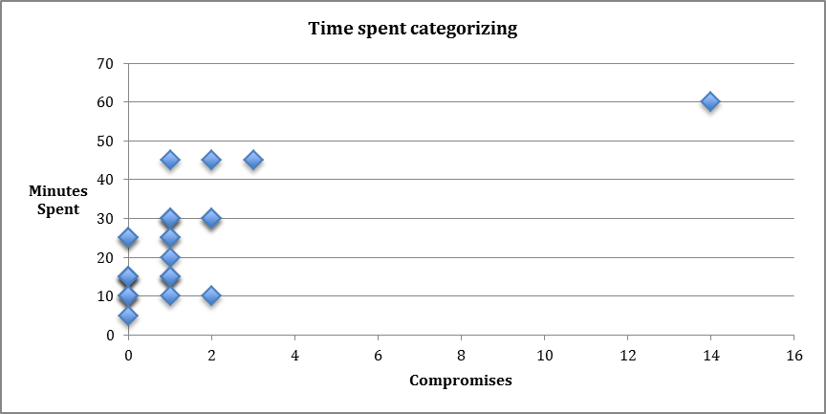
How Long to Perform?
The ‘first encounter’ with a threat costs the most, but subsequent compromises often cost much less.
Analyst familiarity with Broad Street increases with each ticket and reduces time.
The amount of missing data affected how long it took to characterize tickets.
Tickets missing data were 5 - 45 minutes (often with no conclusion), depending upon complexity and type of missing data.
Total for 37 tickets was about 10.5 hours of analysis time.

Slide 40
What Kinds of Assumptions?
Some tickets first attributed a threat and assigned a large number of compromises to it.
Assumption: Applied Broad Street to the first ticket and assigned the outcome to the rest.
Tickets reporting exploit kit infections without host activity details were problematic.
It was best when more specific host activity data was reported in each ticket.
Then the Broad Street Taxonomy could be used to obtain a more specific count.

Slide 41
Disclaimers & Final Remarks

Slide 42
Disclaimers
DHS does not endorse Broad Street.
The SEI CERT Division does not endorse Broad Street.
Microsoft provides Broad Street for informational purposes only (see legal notice)

Slide 43
Final Remarks
Call to action!
Try it out on your own data.
If only to separate cause and effect
If you re-use this, please come back and tell us what you did and why!

Slide 44
Questions?

Slide 45
Backup

Slide 46
This section also covered by Microsoft legal notice

Slide 47
Zoo: What’s hard to categorize
A zoo is a collection of animals, and allows us to look at real examples of the sorts of things we might want to categorize
Everything in the taxonomy has real world examples that can be looked at
Expanding the taxonomy requires several instances “in the zoo” so we can discuss what the salient characteristics are

Slide 48
Is it custom SW or GA?
Newschoolsecurity.com XSS in modified Modernist Wordpress theme file, downloaded 693 times.

Slide 49
Wateringhole vs mass compromise
What characteristics let you differentiate between a random and targeted compromise?
In what way does it change your prevention or detection?
Examples (for discussion purposes)
Hasbro http://threatpost.com/toy-maker-hasbros-site-serving-drive-by-download-attacks/103893
National Vuln Database http://yro-beta.slashdot.org/story/13/03/14/1244205/us-vulnerability-database-yanked-over-malware-infestation
What about extraneous victims?

Slide 50
Exploit kits
Technical action:
Starts with targeted attack based on browser
If fails, tries social engineering
Will skew #s towards 0day
Often detected based on IDS signature
Sometimes intersect with user deception/no user intent to run
For example, “We have also seen this delivery method initiated through email; an email is spammed out containing a link that, when clicked, sends the victim to a compromised website hosting an exploit pack.” http://nakedsecurity.sophos.com/zeroaccess2/#Distribution

Slide 51
What to do when it’s N systems?
For example, one “incident” involves 20 systems
For example:
Original root cause is user tricked, malware then spreads by exploit
Is the incident root cause user tricked, or mixed?
Depends on what you’re trying to measure
Any of “user tricked”, “user tricked (1); exploit (19)
Wasn’t a goal/capability for original project

Slide 52
Supply Chain Issues
Nitol
“a Microsoft study which found that cybercriminals infiltrate unsecure supply chains to introduce counterfeit software embedded with malware for the purpose of secretly infecting people’s computers.”
http://blogs.technet.com/b/microsoft_blog/archive/2012/09/13/microsoft-disrupts-the-emerging-nitol-botnet-being-spread-through-an-unsecure-supply-chain.aspx

Slide 53
Other configuration

Slide 54
Other feature abuse
DDoS amplification?

Slide 55
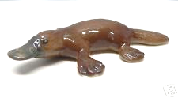
Duck billed platypii
Strange things to mull over

Slide 56
File dropped in root
Bladabindi.B spreads through a file name “! My picture.scr” dropped in the root of a share
Does not use autorun, lnk vulns, or anything that causes execution
Adam thinks that might be a case of “user tricked into running software:
User interaction, yes
Deception, yes (it’s not your picture)
User intent to run (probably not thinking that .scr is executable)
Sploit used? No
http://www.microsoft.com/security/portal/threat/encyclopedia/entry.aspx?Name=Trojan:MSIL/Bladabindi.B

Slide 57
Browser/protocol/platform trickiness

