Slide 1

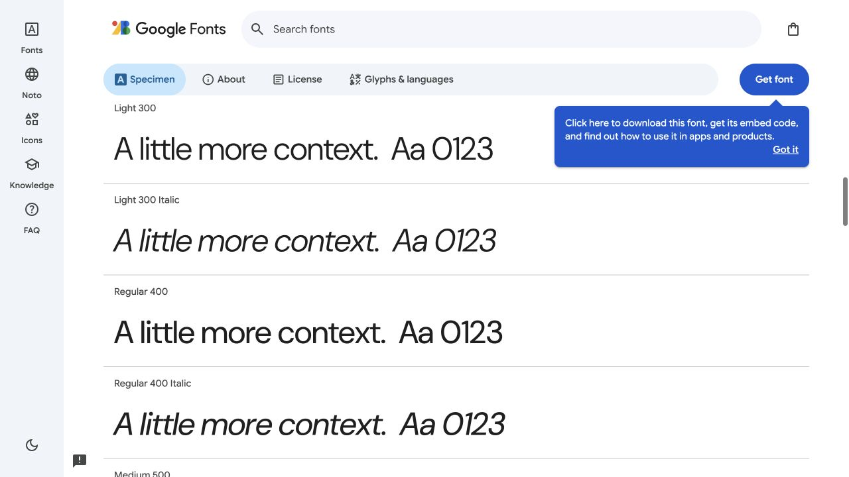
Typography
Print hierarchy and screen readability
Used: two type roles
Large serif headings introduce each section. Smaller sans serif labels and excerpts keep the tasks clear and easy to read.
SCREEN / DM SANS
Used: space to read
The rounded shapes fit a personal introduction. I kept DM Sans for labels, forms, and source excerpts.
I tightened gaps between related controls, while leaving quotes room to read. Each passage stays beside its source and date.
HEADINGS / GEORGIA
What would you like to share?
Left out: display styles
PRINT / PENGUIN
The book’s all-caps title works on a cover. I kept sentence case in forms and source passages for easier reading.
The title stands out through weight and spacing. I borrowed that clear hierarchy.
I chose Georgia for the main headings to give the app more character. DM Sans keeps the detailed reading familiar.
Knowbody / P3 visual study / 1 of 2
Notes:
References and attribution:
Penguin book cover: https://www.indesignskills.com/inspiration/fonts-for-book-covers/ (image shown for visual criticism). Design context: https://designmuseum.org/penguin-books
DM Sans by Colophon Foundry: https://fonts.google.com/specimen/DM+Sans . Browser specimen uses sample text entered for this study.
Georgia heading is my own type trial, not a sourced image.
Implementation: web/style.css pairs Georgia main and brief headings with DM Sans controls and source text. Comparison quotes remain 16px with generous line spacing. Slide annotations use Arial for portable presentation rendering.
The reference subject matter is not part of Knowbody.

Slide 2
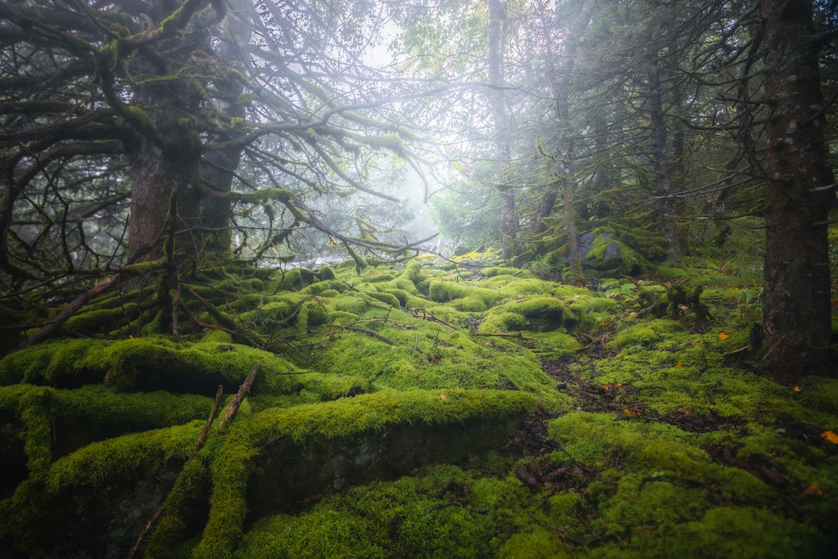
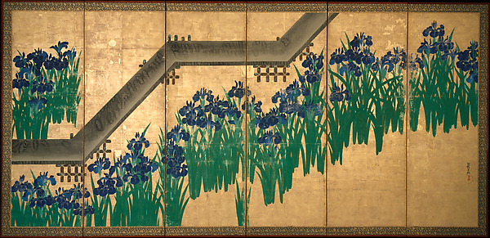
Color
Dark greens, soft backgrounds, and a small amount of emphasis
Used: shared sage area
One pale sage area holds both offers with equal space. Dark green marks actions and initials, giving the exchange more presence.
Used: a quiet canvas
PAINTING / OGATA KŌRIN
A few pale leaves sit at the edges of an off-white canvas. Text stays dark, and clear field borders keep controls visible.
The plant silhouettes suggested simple decoration. I left out the gold and blue so the exchange stays quiet.
PHOTOGRAPH / DANIIL SILANTEV
I kept the deep greens and pale light, then simplified the foliage into faint corner shapes.
Used: neutral limits
Unreadable pages and missing dates stay neutral. Rust marks input errors. Text labels explain every state without relying on color.
Main action | Quiet grouping | Page background | Main text | Input error
#264B3C | #EDF1E6 | #F8F8F4 | #242824 | #8D3624
Knowbody / P3 visual study / 2 of 2
Notes:
References and attribution:
Daniil Silantev, Moss-covered forest floor with tall trees: https://unsplash.com/photos/y0VQWlV71os . Unsplash photograph used for this educational visual study.
Ogata Kōrin, Irises at Yatsuhashi (Eight Bridges), after 1709. The Metropolitan Museum of Art, object 39664, public domain: https://www.metmuseum.org/art/collection/search/39664 . Image: https://images.metmuseum.org/CRDImages/as/web-large/DT231.jpg
The hex values are adapted interface colors, not exact sampled colors.
Implementation: web/style.css and web/App.vue. Sparse abstract leaves use #E5E9DE on #F8F8F4, the sheet uses #FBFAF6, and both offers share #EDF1E6. Dark green marks actions and initials; rust marks input errors. Photographic foliage and a repeating print were explored and rejected because they distracted from the exchange. Unavailable and unshared states use neutral badges and explicit text.

