Slide 1
FEDERAL UNIVERSITY OF TECHNOLOGY OWERRI / DEPARTMENT OF SOFTWARE ENGINEERING
Multi-Criteria
Student–Tutor Matchmaking
Weighted scoring, hard availability and load-aware fairness — validated against an exact optimum.
CANDIDATE
CANDIDATE
SUPERVISOR
Anumudu Udochukwu Samuel
Obi Michael Chimaobi
Engr. Dr. A. I. Erike
REG 20211259202
REG 20211265722
DEPT. OF SOFTWARE ENGINEERING
NESTJS
REACT 19
POSTGRESQL
DRIZZLE ORM
TYPESCRIPT
FINAL YEAR PROJECT DEFENCE · B.TECH (HONS) SOFTWARE ENGINEERING · JULY 2026

Slide 2
01 / PROBLEM DEFINITION
Four defects break tutor matching today
DEFECT 01 — THE DEFAULT BEHAVIOUR
DEFECT 02
01
Recurring calendar clashes
A weekly timetable with no contiguous overlap is booked anyway — the same clash returns next week.
Subject-only filtering
DEFECT 03
Winner-takes-most tutors
Platforms match on the subject line and a free time slot, then stop. Teaching style, language, budget and track record never enter the decision.
Ranking floods a few popular profiles while qualified tutors sit idle, then churn off the platform.
DEFECT 04
Matches nobody can explain
IGNORED TODAY: STYLE / LANGUAGE / BUDGET / TRACK RECORD
A failed pairing costs a paying family real money, and neither side can see why it happened.
STUDENT-TUTOR MATCHMAKING / B.TECH SOFTWARE ENGINEERING / FUTO OWERRI
02

Slide 3
02 / AIM AND RESEARCH QUESTIONS
One engine that scores, allocates and proves itself
01
Score
RQ1
A composite model over academic fit, learner preference and schedule availability.
Does composite scoring beat deployed-style baselines?
RQ2
02
Allocate
Does capacity-aware assignment win under contention?
A capacity-aware engine that reacts to live tutor load instead of a frozen ranking.
RQ3
03
Prove
How far is the greedy engine from the exact optimum?
Validation against an exact min-cost-flow oracle and three deployed-style baselines.
RQ4
What does fairness cost in match quality?
STUDENT-TUTOR MATCHMAKING / B.TECH SOFTWARE ENGINEERING / FUTO OWERRI
03

Slide 4
03 / LITERATURE AND THE RESEARCH GAP
Nothing reviewed scores, schedules and balances at once
WHAT EXISTS TODAY
WHAT THIS WORK ADDS
MCDM prices trade-offs
One decision
Weighted multi-criteria scoring resolves conflicting criteria using explicit weights.
Compatibility, hard availability and load balancing resolved in a single pass.
Static matching only
Exact fairness
Greedy bipartite matching carries a proof — for the static variant alone.
The fairness term stays exact at run time through lazy recomputation.
Content, not people
Measured honestly
Educational recommenders recommend resources, almost never human tutors.
Every claim checked against an exact oracle and three baselines, 30 times.
THE GAP
No reviewed system combines all three objectives in one decision — and none reports what its allocation actually beat.
STUDENT-TUTOR MATCHMAKING / B.TECH SOFTWARE ENGINEERING / FUTO OWERRI
04

Slide 5
04 / SYSTEM DESIGN
Three tiers — the algorithm sits in a pure domain layer
TIER 1
React client with student, tutor and admin portals · intake, booking and allocation oversight.
REACT 19 / TAILWIND
Presentation
TIER 2 — THE ENGINE
Composite scorer · binary max-heap allocator · lazy fairness recompute. Pure TypeScript with zero framework imports.
PURE TYPESCRIPT / PORTABLE
Domain layer
TIER 3
NestJS services over Drizzle ORM and PostgreSQL · typed schema, recurring slots, auditable placement log.
NESTJS / DRIZZLE / POSTGRES
Persistence
DESIGN DECISION
The engineering rules live in one importable module — the API and the offline benchmark harness run byte-identical logic.
STUDENT-TUTOR MATCHMAKING / B.TECH SOFTWARE ENGINEERING / FUTO OWERRI
05

Slide 6
05 / METHODOLOGY · COMPOSITE SCORING
Four weighted sub-scores become one comparable number
score(s,t) = αA + βP + γS + δF
per pair
WEIGHTS SUM TO 1 · SUB-SCORES IN [0,1] · DEFAULT δ = 0.05
A(s,t)
P(s,t)
S(s,t)
Academic fit
Preference fit
Schedule fit
Subject and specialisation agreement, exam type and a grade-gap penalty.
Delivery-style similarity, budget fit with decay, region or online format.
Contiguous weekly overlap between requested and free slots; fragments fail.
EXACT 1.0 / RELATED 0.7 / UNKNOWN 0.5
WITHIN BUDGET = 1.0
NO OVERLAP = 0
F(t)
Fairness is the term that changes behaviour: a full tutor drops down the heap, an idle tutor is lifted back into circulation.
(1 − load/cap)^1.15 + 0.05
STUDENT-TUTOR MATCHMAKING / B.TECH SOFTWARE ENGINEERING / FUTO OWERRI
06

Slide 7
06 / METHODOLOGY · GREEDY ENGINE
Lazy recompute keeps fairness exact as seats fill
1
2
3
4
5
Filter
Score
Pop
Refresh
Report
Subject, level, exam type and spare capacity must all pass.
Eligible pairs are scored and pushed onto a max-heap.
The best pair is assigned; one seat is consumed.
Only that tutor’s stale pairs are rescored.
Unplaced students leave with a reason code.
WHY LAZY BEATS STATIC SORTING
2.28 s
A tutor’s fairness score goes stale the moment a seat is taken. Re-sorting every candidate after each placement is wasted work — re-pushing one tutor’s affected pairs keeps the term exact at a fraction of the cost.
Mean time to score 208,336 candidate pairs — 5,000 students, 500 tutors, O(n² log n).
STUDENT-TUTOR MATCHMAKING / B.TECH SOFTWARE ENGINEERING / FUTO OWERRI
07

Slide 8
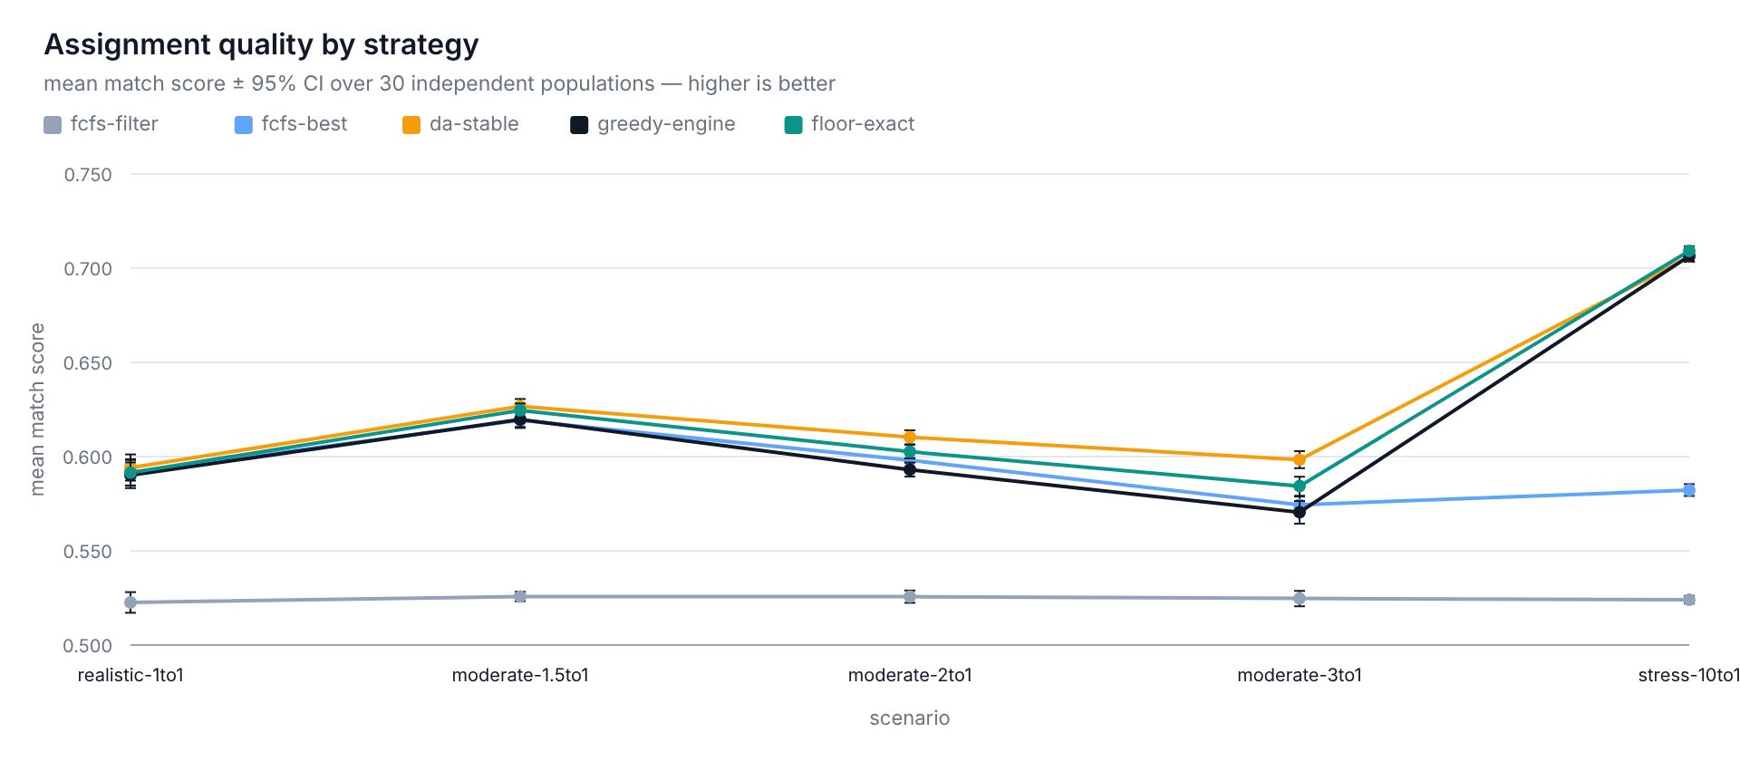
07 / RESULTS · MATCH QUALITY
Scoring lifts match quality at every contention level
+0.07 to +0.18
Scoring beats filter-only matching
Mean-score gain at every contention ratio, p < 0.0001 across 30 independent populations.
0.506 vs 0.391
Fairer loads where capacity is slack
Jain’s fairness index at 1:1 — sessions spread across tutors instead of stacking one profile.
FIG F1 · MEAN SCORE BY STRATEGY, 95% CI
SO WHAT: SCORING WINS EVERYWHERE
METHOD: 30 INDEPENDENT SYNTHETIC POPULATIONS PER SCENARIO · 95% CONFIDENCE INTERVALS · PAIRED SIGN TESTS · EXACT MIN-COST-MAX-FLOW ORACLE AS THE REFERENCE
STUDENT-TUTOR MATCHMAKING / B.TECH SOFTWARE ENGINEERING / FUTO OWERRI
08

Slide 9
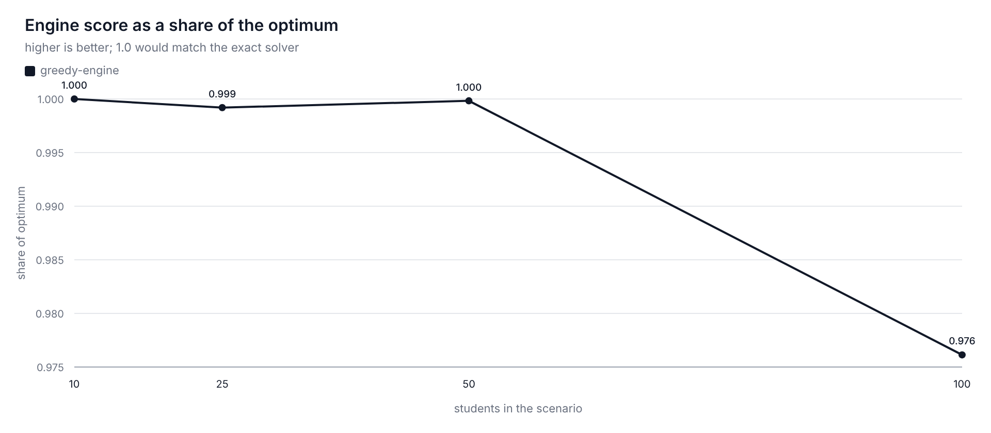
08 / RESULTS · OPTIMALITY AND RUNTIME
Reaches 98.5–99.7% of the exact optimum — 17× faster at 5,000 students
SCALE AND RUNTIME
Greedy engine vs exact solver
COHORT S/T
ENGINE
ORACLE
1,000 / 100
169 ms
266 ms
2,000 / 200
316 ms
1,811 ms
5,000 / 500
1,619 ms
27,228 ms
16.8×
FASTER AT 5,000 STUDENTS. THE ORACLE ABANDONS AT 2,000 UNDER CONTENTION.
FIG F5 · ENGINE SCORE AS A SHARE OF THE EXACT OPTIMUM, BY SIZE
STATED LIMIT — NOT HIDDEN
The worst-served student still sits about 0.02 below the achievable floor. The defect is structural, and closing it costs ≤ 0.0003 per student.
STUDENT-TUTOR MATCHMAKING / B.TECH SOFTWARE ENGINEERING / FUTO OWERRI
09

Slide 10
09 / CONCLUSION
Four questions answered — one structural limit stated openly
RQ1
RQ2
RQ3
RQ4
Yes, decisively
Wins under contention
98.5 – 99.7%
Fairness is affordable
+0.067 to +0.182 mean score over filter-only FCFS at every ratio, p < 0.0001.
Level at 1:1 (p = 0.86), then +0.019 at 3:1 and +0.124 at 10:1.
of the oracle’s static total after repair; coverage within 0.0011 of optimal.
0.012–0.023 mean-score cost at 2–3:1; the worst-student floor costs ≤ 0.0003.
CONTRIBUTION TO KNOWLEDGE
WHAT COMES NEXT
A scoring-and-availability model whose fairness term stays exact at run time — plus two claims rescoped honestly when the evidence did not hold.
A learned compatibility model with fairness kept exogenous, equity profiles per region and subject, and this protocol re-run on real assignment history.
Thank you — we welcome your questions
EVERY FIGURE REGENERATES: pnpm run eval:all
STUDENT-TUTOR MATCHMAKING / B.TECH SOFTWARE ENGINEERING / FUTO OWERRI
10

