Slide 1
Parking Space
Reservation System
A cloud-based high-concurrency reservation system built on GCP
Sam Nguyen · Probation Project · 2026

Slide 2
01
Project overview & requirements
80 parking spaces · 1,000 users competing every evening at 8 PM
System requirements
Technical requirements
1,000 users competing simultaneously — FCFS controlled by backend
Each vehicle can only reserve one parking space
Simple deposit function — no withdrawal needed
Handle duplicate reservations from high concurrency + autoscaling
User login with encrypted passwords (AES / RSA)
Cloud SQL — SSL only, Private IP
Services: Cloud Run, Cloud SQL, KMS
Simple frontend — not the focus
Stress test: 1,500 TPS × 3 consecutive minutes (k6)

Slide 3
02
Changes after feedback
01
02
Remove parking-outbox
PULL → PUSH mode
Avoid over-architecture — API publishes to Pub/Sub directly. Simpler flow.
Cloud Run is stateless and request-driven. PUSH lets Pub/Sub trigger HTTP requests → Cloud Run scales naturally, cost goes to zero when idle.
03
04
Ordering key for FCFS
More aggressive caching
Pub/Sub ordering key space:{id}:{date} — all messages for the same space are delivered sequentially.
Redis handles user info, space availability, and duplicate detection — DB is only touched for the final write.

Slide 4
03
What happens under high concurrency?
1,000 users hit the reserve endpoint simultaneously at 8 PM
1
2
3
DB overload
Race condition
High latency
1,500 concurrent requests hit the database directly. Connection pool exhausted in seconds → requests timeout → 500 errors cascade.
Two users check slot availability at the same time — both see "available" → both reserve → one slot confirmed twice. FCFS is broken.
Every request queries DB — even those that will be rejected. Unnecessary load drives P95 to 15s+ under stress.
Request time out, 500 internal sever
2 users confirmed for space #1
Fail stress test

Slide 5
04
Redis cache strategy
Redis acts as the first line of defence — most requests never touch the database
Cache-aside
Handle fail fast
Idempotency key
- App checks Redis first.
+ On hit → return immediately.
+ On miss → read from DB → write to Redis
- DB is never the default path.
Early rejection at Redis
After worker confirms a slot
Redis updated immediately.
All remaining message validate against Redis first -> reject instantly
Prevent double process
User clicks reserve → save key in Redis
User clicks again → key exists → rejected immediately
Key will release after transaction done
Result: The vast majority of requests are rejected directly at Redis — no DB query needed. Connection pool stays healthy under full load.

Slide 6
05
First Come First Served
Ordering key space:{id}:{date} — messages for the same space are always delivered in order
Timeline — space:5:2026-06-14
Wait for ACK
User A — 20:00:00.001
Pub/Sub does not deliver the next message until the current one is ACKed (HTTP 200). Two reservations for the same space are never processed in parallel.
Published first → msg #1
User B — 20:00:00.002
Published second → msg #2
User C — 20:00:00.003
Published third → msg #3
Result
User A (20:00:00.001) is always confirmed first. User B and C are rejected naturally by validate on cache.
Pub/Sub delivers in order:
msg #1 → ACK
msg #2 waits
msg #3 waits

Slide 7
06
Connection pool sizing
Balanced across services to stay within Cloud SQL limits while handling peak load
parking-api
parking-worker
Memory: 2 GB
CPU: 1
Memory: 1 GB
CPU: 1
Min: 3 / Max: 6
Concurrency: 300
Min: 1 / Max: 2
Concurrency: 100
Hikari pool: 10
Hikari pool: 30
300 × 6 = 1,800 concurrent > 1,500 TPS
30 × 2 = 60 DB connections
10 × 6 = 60 DB connections
Cloud SQL max connections: 150 Total used (60 + 60): 120 / 150

Slide 8
07
Known limitations & workarounds
ß
Limitation
Current workaround
Suggested solution
No real-time notification
Frontend polling + cache
WebSocket / SSE
When the worker confirms or cancels a reservation, there is no push notification back to the user. WebSocket / SSE not implemented due to time constraints.
Frontend polls GET /api/user/info periodically. Response is fully cached in Redis — all polling hits cache only, zero DB queries.
Worker publishes status update to a dedicated channel. Server pushes confirmation or cancellation directly to the connected client — no polling needed.

Slide 9
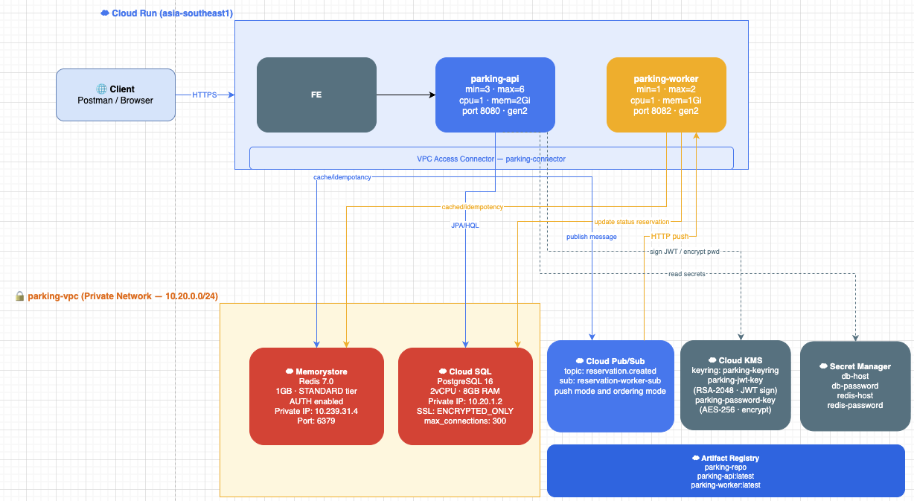

Slide 10
10
Stress test with k6
1,000 users competing simultaneously · 1,500 TPS · 4 consecutive minutes
Expected
Actual base on my latest time
Only 80 reservations succeed — all others rejected
P99 < 3,000ms
P95 < 2,000ms
No 5xx server errors
Reserved OK
80 / 80
P95
357 ms
P99
491 ms
Server errors (5xx)
0

Slide 11
11
How I worked with AI
Dual-agent setup — AI covered every role a team would normally fill
Dual-agent setup
AI as team member
Claude reviewed, suggested, and cross-checked, Cursor - implemented code. Two AIs reviewing each other before committing.
Pair-Programmer · Reviewer · Troubleshooter · Researcher · Tech Writer — one tool, all roles.
What AI helped with
Code flow management
Idea → Code → Debug → Infra commands → Refactor → Docs → Research → Stress test analysis
AI tracked context across sessions — architecture decisions, changes, and the reasoning behind each implementation.

Slide 12
12
Strengths & challenges
Working with AI — what worked well and what required extra attention
Strengths
Challenges
Speed — from idea to working code in hours
Context limit — long sessions lose early context
Research — complex concepts explained instantly
Confident but wrong — must always verify output
Debug — root cause identified faster than solo search
Theory vs reality — GCP config needed manual fix
Always available for answer
Prompt quality- verify output

Slide 13
13
Lessons learned
01
Simple over complex
02
End-to-end GCP ownership
Any design can work — but keep it simple and maintainable. Don't over-engineer what doesn't need to be complex.
Deployed a full project on GCP — from infrastructure setup to debugging, monitoring, and optimising resource costs in production.
03
AI as a work partner
04
Open to feedback
Used AI throughout — ideation, pair coding, review, debugging, documentation, and research. Solo project, but never working alone.
Solo project, but embracing feedback openly led to better ideas and the right direction. The team's input made it more complete.

Slide 14
Thank you
Questions & answers
https://github.com/samnguyen-eng
Probation Project · 2026

