Slide 1
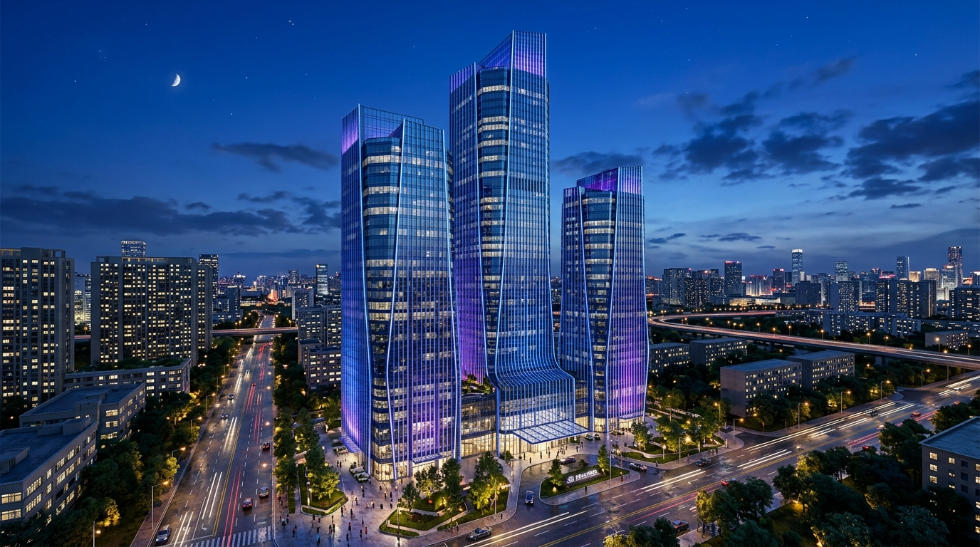

CeEst ERP
LIVE DEMONSTRATION
One operating record.
Complete estate control.
Property management, facilities operations and staff performance—connected from transaction to report.
RECORD → ACT → VERIFY → REPORT
Live demonstration • August 2026

Slide 2
CeEst ERP
01
PROPERTY • FACILITY • PERFORMANCE
DEMO STORY
From property record to management evidence
A focused 25–30 minute journey—not a tour of every menu.
01 RECORD
02 PLAN
03 EXECUTE
Property, tenant, asset and service masters
Billing schedules, PPM and compliance calendars
Tasks, tickets, work orders and collections
04 VERIFY
05 MEASURE
06 REPORT
Approvals, evidence, SLA and audit trail
KPIs, trends, ageing and performance
Tenant, manager and landlord outputs
PROOF
Every dashboard number is traceable to an underlying transaction and responsible person.

Slide 3
CeEst ERP
02
PROPERTY • FACILITY • PERFORMANCE
COMMAND CENTRE
Start with today’s operating priorities
Companion gives each manager one place to see what needs attention now.
◷
Due today
!
Needs attention
✓
Team delivery
✦
Quartermaster AI
Planned maintenance, inspections, lease events and assigned tasks.
Overdue actions, SLA risks, expiring compliance and approvals.
Assignments, progress, evidence and staff performance.
Contextual assistance, summaries and operational guidance.
• Open with the manager’s current property already selected.
• Use one alert as the bridge into the live workflow.
• Return here at the end to show the action is now reflected.
PROOF
The ERP behaves as an operating command centre, not a passive database.

Slide 4
CeEst ERP
03
PROPERTY • FACILITY • PERFORMANCE
PROPERTY FOUNDATION
A complete, property-scoped operating record
Property → buildings/areas → units → tenants → services → assets.
▦
Property & buildings
⌂
Units & billing schedule
◎
Tenant & lease
Identity, address, ownership, building hierarchy, lettable area, utilities, documents and contacts.
Unit use, floor, area, parking, recurring charges, deposits and utility applicability.
Application, contacts, assigned unit, commencement, expiry, escalation and approvals.
All module tabs inherit the selected property—no portfolio totals inside a property workspace.
PROOF
One trusted structure eliminates duplicate setup and enables automatic downstream billing and reporting.

Slide 5
CeEst ERP
04
PROPERTY • FACILITY • PERFORMANCE
PROPERTY MANAGEMENT
Tenancy and billing are configured once
The unit defines what can be billed; the lease defines when rent becomes due.
1 Configure the unit
2 Create the tenancy
3 Generate invoices
Rent basis, service charge, utilities, parking and deposits belong to the unit billing schedule.
Select the unit, capture lease dates and escalation, then inherit applicable charges automatically.
The engine checks readiness and produces separate rent and utility invoices—payable together.
Demo action: open one active tenant and explain the source of each charge before opening invoicing.
PROOF
Billing is driven by tenancy and unit data—not rebuilt manually at month-end.

Slide 6
CeEst ERP
05
PROPERTY • FACILITY • PERFORMANCE
COLLECTIONS
From invoice to receipt, allocation and arrears
A clear financial trail for manager, landlord and tenant.
INVOICE
→
PAYMENT
→
RECEIPT
→
ALLOCATION
→
ARREARS
→
REPORT
• Show billed, collected and outstanding for the selected property and period.
• Open the tenant statement or receipt to prove document quality and traceability.
• Explain reminders and recovery actions without overstating unconfigured payment integrations.
PROOF
The manager can explain every balance and the tenant can access the same supporting documents.

Slide 7
CeEst ERP
06
PROPERTY • FACILITY • PERFORMANCE
SERVICE CHARGE
Plan, allocate, reconcile and explain
Connect operational requirements to the annual service charge budget.
1
Schemes
2
Budget lines
3
Allocation
4
Reconciliation
Define period, allocation basis and applicable units.
Security, cleaning, utilities, repairs and management costs.
Apportion by area, equal share or configured driver.
Compare budget with actual expenditure and explain variance.
Use historical averages or projected quantities and rates—then preserve the approval and audit trail.
PROOF
Service charge planning is linked to real operational requirements and actual expenditure.

Slide 8
CeEst ERP
07
PROPERTY • FACILITY • PERFORMANCE
TENANT SELF-SERVICE
A tenant can act—not only view
Invoices, receipts, lease information, notices and maintenance requests in one secure portal.
₭
Financial self-service
!
Report an issue
✓
Track progress
View invoices, balances, receipts and payment history.
Capture category, priority, description and unit context; receive a traceable reference.
See open requests, updates, documents and closure evidence.
Live proof: submit a low-risk issue, note the reference, then continue the same record in Facility Management.
PROOF
A tenant request becomes a property-scoped operational transaction—not an email or informal phone call.

Slide 9
CeEst ERP
08
PROPERTY • FACILITY • PERFORMANCE
FACILITIES OPERATIONS
Turn a reported defect into controlled work
Ticket → triage → SLA → assignment → evidence → verification → closure.
REPORT
→
TRIAGE
→
ASSIGN
→
EXECUTE
→
VERIFY
→
CLOSE
• Time-stamped severity and SLA target
• Responsible staff member or approved service provider
• Photos, notes, costs and verification evidence
• Escalation and notifications when thresholds are at risk
PROOF
Every maintenance action has ownership, evidence, elapsed time and a measurable outcome.

Slide 10

CeEst ERP
09
PROPERTY • FACILITY • PERFORMANCE
ASSET LIFECYCLE
Every critical asset has a passport and a plan
From onboarding to preventive maintenance, condition history and replacement decisions.
• Specification, location, condition, criticality and warranty
• Service history, documents and next planned maintenance
• 12-month PPM calendar with due, completed and overdue work
• Inspections, compliance renewals and recurring-failure visibility
PROOF
The asset register is operational: it drives schedules, work, compliance and lifecycle decisions.

Slide 11
CeEst ERP
10
PROPERTY • FACILITY • PERFORMANCE
SERVICE ARCHITECTURE
Define WHAT before assigning WHO
Service Profiles remain stable while providers, contracts and performance can change.
SERVICE
PROFILE
PROVIDER
PROPERTY
ALLOCATION
CONTRACT /
SLA
WORK &
INSPECTION
KPI / COST
→
→
→
→
→
What is required
Who delivers
Where it applies
Expected standard
Evidence
Outcome
• One profile can use different providers at different properties.
• Changing a provider must never erase service requirements or historical performance.
PROOF
Provider selection is separated from the enduring service standard used for SLA and KPI measurement.

Slide 12
CeEst ERP
11
PROPERTY • FACILITY • PERFORMANCE
PERFORMANCE
Transactions become management insight
Use trends and exceptions to answer: What happened? Why? What needs action next?
✓
PPM compliance
◷
SLA performance
↗
Financial control
!
Risk & compliance
Completed on time, overdue and upcoming preventive work.
Response and resolution time by priority, team and provider.
Expected vs actual collections, arrears ageing and budget variance.
Expiries, incidents, recurring defects and approvals.
Drill from every metric to the source record during the demo.
PROOF
The system measures performance objectively using the same records created during daily work.

Slide 13
CeEst ERP
12
PROPERTY • FACILITY • PERFORMANCE
REPORTING
One data source, different audiences
Operational registers, tenant documents and landlord-ready management packs.
▤
Operational
KES
Financial
⌂
Tenancy
Work orders, PPM, compliance, incidents, utilities and provider performance.
Billing and collection, receipts and expenditure, arrears, VAT and budget versus actual.
Occupancy, vacancy, lease expiry, movements and tenant statements.
• PDF for presentation and audit evidence
• Excel/CSV for analysis and downstream processing
• Property, reporting period, management identity and branding in every document
PROOF
Management and landlord reports reuse live records instead of separate spreadsheets.

Slide 14
CeEst ERP
13
PROPERTY • FACILITY • PERFORMANCE
LIVE DEMONSTRATION
Recommended 27-minute run of show
Keep the audience inside one property and one coherent story.
2 min
Companion
Today’s priorities and selected property
4 min
Property & tenancy
Unit billing schedule and active lease
4 min
Billing & collections
Invoice source, receipt and outstanding balance
3 min
Tenant portal
Submit one maintenance issue
6 min
Facility workflow
Triage, SLA, assignment, evidence and verification
3 min
Asset & PPM
Asset passport, calendar and compliance
3 min
Performance & reports
KPI drill-down and landlord output
2 min
Close
Return to Companion and recap proof chain
PROOF
Perform one meaningful action live; use prepared records for the broader lifecycle and reporting story.

Slide 15
CeEst ERP
14
PROPERTY • FACILITY • PERFORMANCE
PRESENTER GUARDRAILS
What to claim—and what to position as roadmap
Credibility matters more than covering every feature.
✓
Show live
!
Describe carefully
→
Position as integration
Property scoping, tenant/lease records, issue reporting, work orders, PPM, service profiles/providers, reports and Companion workflows.
External email/SMS delivery, live payment gateways and scheduled automations only when the environment is configured and tested.
Specific smart-meter devices, third-party accounting systems and provider-specific APIs require vendor credentials and interface work.
PROOF
Never claim a feature is live unless it works in the environment being demonstrated.

Slide 16
CeEst ERP
15
PROPERTY • FACILITY • PERFORMANCE
DEMO READINESS
Final pre-flight checklist
Run this on the same device, browser and network that will be used in the meeting.
□
Login and session persistence
□
Correct organization and selected property
□
Property, tenant, asset and provider records populated
□
Open, due and overdue work represented
□
Tenant issue submission and generated reference
□
Work-order detail and SLA fields
□
PPM and compliance calendar
□
Companion tasks and notifications
□
PDF report opens and is legible
□
Backup screenshots/video available
PROOF
Stop and switch to the backup path if latency, authentication or integrations are unstable.

Slide 17
CeEst ERP
16
PROPERTY • FACILITY • PERFORMANCE
CLOSE
CeEst is an operating control system
A single live record connects tenants, staff, providers, assets, money and management evidence.
RECORD → PLAN → ASSIGN → EXECUTE → VERIFY → MEASURE → REPORT → IMPROVE
The facility is onboarded. Work is planned. Issues are controlled. Performance is measured. Reports are ready.
Questions & live scenarios
PROOF
One operating record. Complete estate control.

