Slide 1


Center Estates ERP
CONSTRUCTION OVERSIGHT & FIELD TELEMETRY
EXECUTIVE OVERVIEW
One Auditable Chain from Site Gate to IPC Drawdown
LIVE STAKEHOLDER BRIEFING
▸ Bill of Quantities (BoQ) Shield: Every material delivery at the gate is validated against contractual budget limits before offloading.
▸ Contractual Stage-Gate Engine: Downstream milestones remain mathematically locked until prerequisite structural works reach 100%.
▸ Offline-First Mobile App: Complete Clerk of Works field diary with local SQLite persistence and automatic delta-sync.
▸ Cryptographic Non-Repudiation: Ed25519 biometric hardware signatures, GPS geofence guards, and SHA-256 evidence seals.
▸ Automated Mini-BoQ Valuations: Real-time Interim Payment Certificates (IPCs) backed by verified field evidence.
Eliminating Capital
Leakage in Real Estate
Construction.
Connecting the physical site gate directly to bank drawdown approvals via BoQ Allowance Shields, Contractual Stage-Gates, and Offline-First Mobile Telemetry.
100%
SHA-256
0% Leakage
BoQ-Bound Gate Intake
Tamper-Evident Seals
Stage-Gate Protected
Featured Project: Karam Apartments — Lang'ata (PRJ-KRM-01) • centerestates.com

Slide 2
Center Estates ERP
01
CONSTRUCTION OVERSIGHT • FIELD TELEMETRY • STAGE-GATE GOVERNANCE
01 • INDUSTRY CHALLENGE
The Three Critical Blind Spots in Construction Execution
Why 15% to 25% of commercial development capital is lost between the site gate and the finance office.
01
Phantom & Over-Deliveries
02
Premature Progress Claims
03
Disconnected Site Diaries
Paper delivery notes signed at the site gate with zero live cross-reference to the approved Bill of Quantities.
Contractors claiming completion on downstream finishes before critical structural foundations are certified.
Clerk of Works observations scattered across paper logbooks, email threads, and unverified WhatsApp photos.
▸ Budget Overruns: Materials delivered beyond contractual allowances without real-time visibility.
▸ Supplier Opacity: No standardized tracking of batch quality or approved manufacturers.
▸ Retrospective Discovery: Variances only uncovered months later during final account audits.
▸ Front-Loaded Claims: Capital disbursed ahead of actual physical progress on site.
▸ Subjective Valuations: Visual estimates disconnected from measured BoQ sub-elements.
▸ Dispute Exposure: Lack of immutable stage-gate prerequisites triggers arbitration.
▸ Unverified Media: Site photos lack hardware GPS coordinates and tamper-evident hashes.
▸ Missed Concrete Tests: 7, 14, and 28-day cylinder crushing tests forgotten or unlinked.
▸ Snag Amnesia: Structural defects logged verbally fail to reach the QS before payment.
GOVERNANCE GUARANTEE
Traditional oversight relies on trust and post-mortem audits. Center Estates enforces proactive digital stage-gates.

Slide 3
Center Estates ERP
02
CONSTRUCTION OVERSIGHT • FIELD TELEMETRY • STAGE-GATE GOVERNANCE
02 • UNIFIED PLATFORM ARCHITECTURE
End-to-End Architecture: Mobile Field App ↔ REST API ↔ Web ERP
A single continuous operating record connecting field engineers, quantity surveyors, and project financiers.
APP
Mobile Field App (Expo / RN)
API
Central API (Django & MySQL)
WEB
Office Web ERP (Next.js 14)
Authoritative source of physical site truth for Clerks of Works and Resident Engineers.
Production governance engine running at api.centerestates.com.
Executive command center for Developers, Project Managers, and QSs.
▸ Offline-First SQLite: TinyBase reactive store persists all logs & drafts without 4G.
▸ Rugged Field UX: Searchable BoQ picker and one-tap Kenyan supplier chips.
▸ GPS Geofencing: Hardware coordinate lock against project site boundaries.
▸ Biometric Sign-Off: Ed25519 hardware key signatures on every submission.
▸ Atomic Delta-Sync: Idempotent /sync/pull and /sync/push endpoints.
▸ Stage-Gate Validator: Rejects progress >0% if prerequisite milestones <100%.
▸ SHA-256 Evidence Seals: Cryptographic hash computed over payload + photo bytes.
▸ Role-Based Access: Strict separation of Clerk, Consultant, and Owner permissions.
▸ CPM Work Plan & Gantt: Predecessor scheduling and critical path tracking.
▸ Bill of Quantities (BoQ): Live line-item budgets, rates, and variance shields.
▸ Mini-BoQ Valuations: Automated Interim Payment Certificates (IPCs).
▸ Live Snag Kanban: Instant visibility into field-reported quality defects.
⇄
⇄
GOVERNANCE GUARANTEE
Immutable Field Truth: Office users can review and certify, but can never alter or delete raw field evidence.

Slide 4
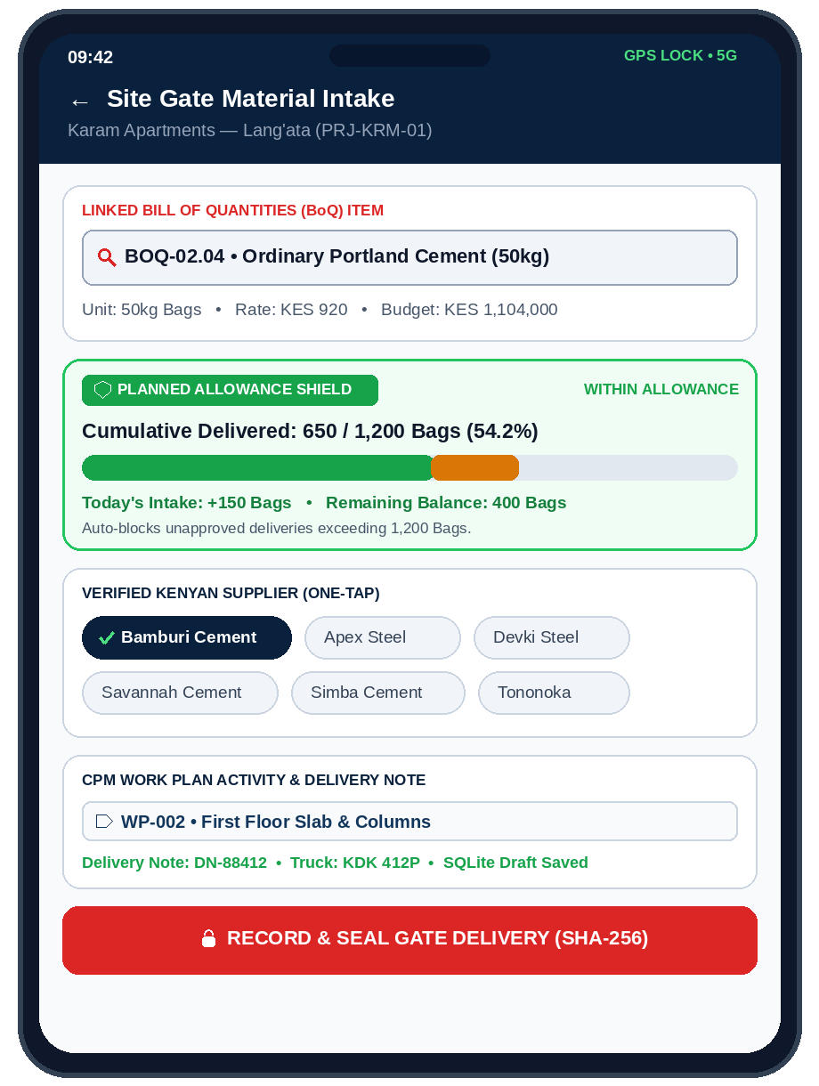
Center Estates ERP
03
CONSTRUCTION OVERSIGHT • FIELD TELEMETRY • STAGE-GATE GOVERNANCE
03 • FIELD MATERIAL CONTROL
Site Gate Deliveries Bound to BoQ Allowances
Preventing material over-delivery and budget leakage before the truck leaves the site perimeter.
01
Searchable BoQ Item Picker
02
Kenyan Supplier Quick-Chips
Clerk selects directly from the project's approved Bill of Quantities (e.g. BOQ-02.04 Cement). Automatically binds item code, unit, and contractual rate.
One-tap verified supplier chips (Bamburi, Apex Steel, Devki, Savannah, Simba, Tononoka) eliminate typos and standardize procurement audits.
03
Planned Allowance Shield
04
Work Plan Task Tagging
Live progress bar compares cumulative delivered quantity against total BoQ allowance. Triggers an immediate red warning if intake exceeds budget.
Every material intake is tagged to a specific CPM Work Plan activity (e.g. WP-002 First Floor Slab) and persists locally via useFormDraft.
GOVERNANCE GUARANTEE
100% Traceability: Every bag of cement and ton of steel is linked to a BoQ line item, supplier, and work plan task.

Slide 5
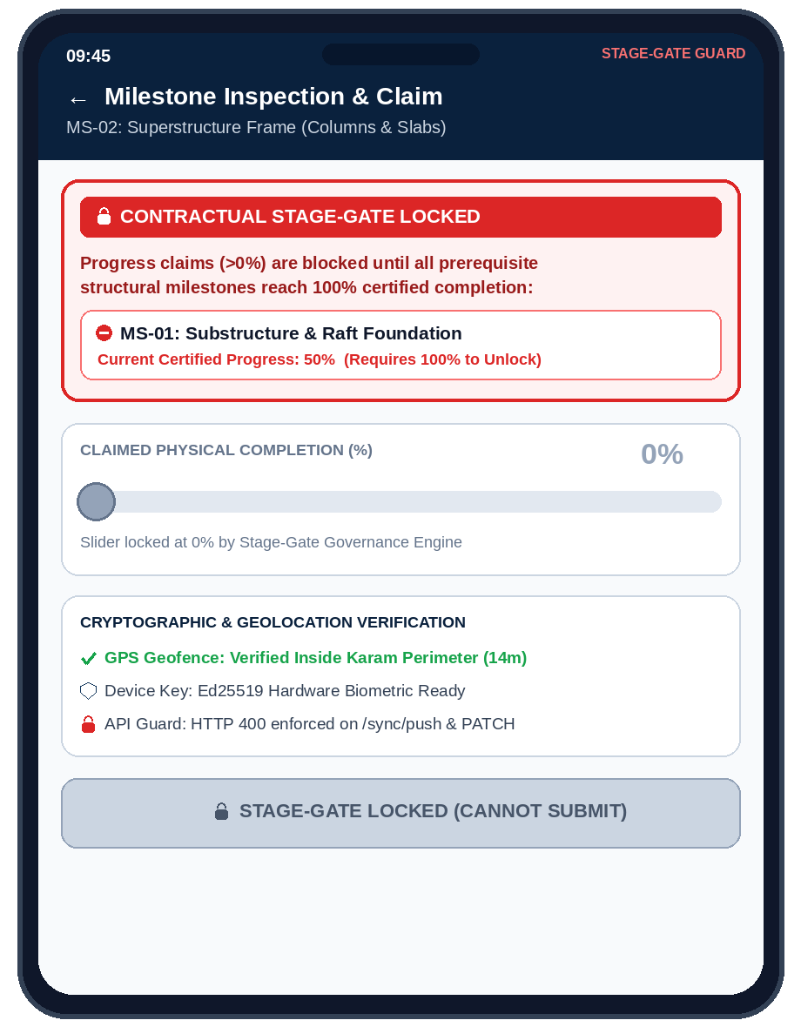
Center Estates ERP
04
CONSTRUCTION OVERSIGHT • FIELD TELEMETRY • STAGE-GATE GOVERNANCE
04 • CONTRACTUAL GOVERNANCE
The Stage-Gate Engine: Mathematical Payout Protection
Downstream milestones cannot advance above 0% until all prerequisite structural works reach 100%.
MS-01: Substructure & Raft
MS-02: Superstructure Frame
MS-03: Roofing & Finishes
50% IN PROGRESS
➔
🔒 LOCKED AT 0%
➔
🔒 LOCKED AT 0%
Prerequisite Incomplete
Blocked by MS-01 (<100%)
Blocked by MS-02 (<100%)
🔒
Dual-Layer Enforcement (Mobile UI + Backend API)
▸ Mobile Stage-Gate Lock Banner: MilestoneDetailScreen evaluates evaluateMilestoneGovernance() in real time, displaying the exact blocking predecessors and disabling the submit button.
▸ Strict Backend Validation: Both PATCH /milestones/<id>/ and POST /sync/push call milestone.get_incomplete_prerequisites() and return HTTP 400 if any predecessor is <100%.
▸ Zero Premature Drawdowns: Protects developers and lenders from paying for superstructure or finishes before foundational integrity is 100% certified.
GOVERNANCE GUARANTEE
Stage-gates turn construction contracts into executable code—eliminating subjective certification bias.

Slide 6
Center Estates ERP
05
CONSTRUCTION OVERSIGHT • FIELD TELEMETRY • STAGE-GATE GOVERNANCE
05 • QUALITY, STRUCTURAL TESTING & HSE
Field Snagging, Concrete Cube Lifecycle & Safety Escalation
Capturing structural quality tests and engineering defects at the source with live Kanban synchronization.
⚡
Mobile Snag & Defect Ticketing
🧱
Concrete Cube Curing Scheduler
🦺
HSE & Regulatory Compliance
Resident Engineers log structural and finishing defects directly from the floor plate.
Automated structural pour compliance aligned with BS 8110 / Eurocode 2 standards.
Immediate escalation protocol for site safety inspections, near-misses, and NCA/DOSHS compliance.
▸ Severity & Category: Urgent / High / Normal routing across Structural, MEP, and Finishes.
▸ Geotagged Photo Proof: Mandatory camera capture with hardware GPS coordinates.
▸ Live Office Kanban: Syncs immediately to the Web ERP oversight board for contractor resolution.
▸ Closure Verification: Requires before-and-after photographic sign-off.
▸ Batch & Slump Intake: Logs concrete grade (e.g. C30/37), mixer truck, and slump test results.
▸ Automated 7 / 14 / 28-Day Alerts: Automatically schedules mandatory lab crushing tests.
▸ Pass/Fail Thresholds: Highlights compressive strength shortfalls (MPa) before slab loading.
▸ Permanent Audit Archive: Lab certificates attached directly to the structural milestone.
▸ PPE & Scaffold Audits: Daily digital checklists completed by the Clerk of Works.
▸ Incident Root-Cause Tracking: Severity grading and Corrective Action Plan (CAP) workflows.
▸ Statutory Readiness: Maintains full National Construction Authority (NCA) inspection logs.
▸ Zero-Delay Escalation: High-severity incidents trigger instant executive alerts.
GOVERNANCE GUARANTEE
Quality assurance records and concrete test certificates form an immutable structural passport for handover.

Slide 7
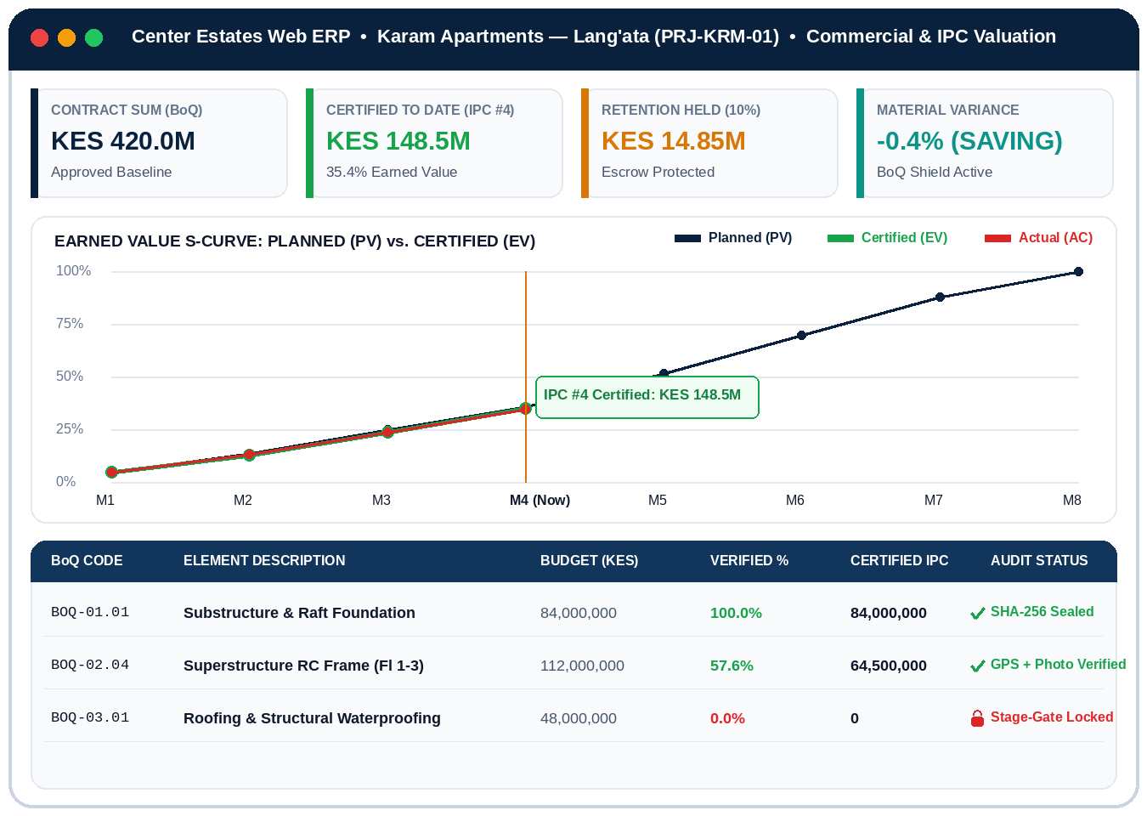
Center Estates ERP
06
CONSTRUCTION OVERSIGHT • FIELD TELEMETRY • STAGE-GATE GOVERNANCE
06 • COMMERCIAL & FINANCIAL CONTROL
Earned Value S-Curve & Automated Mini-BoQ Valuations (IPCs)
Converting verified field progress into audit-ready Interim Payment Certificates in minutes.
QS
1. Mini-BoQ Line-Item Valuation
Quantity Surveyors inspect the exact BoQ sub-elements linked to each milestone, calculating certified KES earned value with zero spreadsheet formulas.
AI
2. AI Progress & Variance Audit
Automated variance engine compares Planned Value (PV), Earned Value (EV), and Actual Cost (AC), flagging schedule slippage and material anomalies.
IPC
3. Escrow & Retention Drawdowns
Generates bank-ready PDF Interim Payment Certificates with automatic 10% retention deductions and cryptographic links to supporting site photos.
GOVERNANCE GUARANTEE
Every shilling certified on an Interim Payment Certificate is backed by geotagged photos and sealed gate deliveries.

Slide 8
Center Estates ERP
07
CONSTRUCTION OVERSIGHT • FIELD TELEMETRY • STAGE-GATE GOVERNANCE
07 • ANTI-FRAUD ARCHITECTURE
Offline Resilience & Cryptographic Non-Repudiation
Purpose-built for deep basements and remote sites without sacrificing bank-grade security.
01
Offline SQLite Engine
02
Biometric Hardware Keys
03
GPS Geofence Guard
04
SHA-256 Evidence Seals
Deep excavations and basements rarely have reliable 4G.
Eliminates shared passwords and unauthorized proxy sign-offs.
Prevents off-site photo uploads and Recycled Photo fraud.
Tamper-evident cryptographic sealing at the moment of capture.
▸ Local Persistence: All BoQ items, milestones, and daily logs cached in SQLite.
▸ Draft Recovery: useFormDraft hook prevents data loss if battery dies mid-inspection.
▸ Auto Delta-Sync: Queued payloads sync atomically once connectivity returns.
▸ Ed25519 Keypair: Generated inside the mobile device's secure hardware keystore.
▸ Biometric Prompt: Fingerprint / FaceID required to sign milestone submissions.
▸ Non-Repudiation: Cryptographic proof of the exact engineer who certified the work.
▸ Perimeter Lock: Compares hardware GPS coordinates against project polygon.
▸ Distance Telemetry: Records exact meter offset and GPS accuracy radius.
▸ Fraud Flagging: Out-of-bounds submissions are automatically flagged for audit.
▸ Composite Hash: Computed over milestone ID, progress %, notes, GPS, and photo bytes.
▸ Server Verification: Re-verified upon ingestion by api.centerestates.com.
▸ Audit Certificate: Displayed on Web ERP alongside the green Verified badge.
GOVERNANCE GUARANTEE
Security is embedded directly into the mobile data capture layer—making fraudulent progress claims mathematically impossible.

Slide 9
Center Estates ERP
08
CONSTRUCTION OVERSIGHT • FIELD TELEMETRY • STAGE-GATE GOVERNANCE
08 • LIVE DEMONSTRATION SCRIPT
Recommended 5-Step Live Demonstration Flow (8 Minutes)
A high-impact, cohesive walkthrough using Karam Apartments — Lang'ata (PRJ-KRM-01).
STEP 01
Office Baseline Setup (Web ERP)
Open Karam Apartments (PRJ-KRM-01). Show the CPM Work Plan Gantt and approved BoQ allowances.
1.5 MIN
STEP 02
Site Gate Delivery (Mobile App)
Open Daily Log -> Material Delivery. Pick 'BOQ-02.04 Cement', tap 'Bamburi', show Planned Allowance Shield.
2.0 MIN
STEP 03
Stage-Gate Lockout (Mobile App)
Open 'Superstructure Frame'. Highlight the red '🔒 Contractual Stage-Gate Locked' banner blocking claims.
1.5 MIN
STEP 04
Live Defect Sync (Mobile -> Web)
Capture a rebar spacing snag on Mobile. Switch to Web ERP to show immediate appearance on the Kanban board.
1.5 MIN
STEP 05
Mini-BoQ & IPC Valuation (Web)
Open Milestones -> Mini-BoQ Valuation. Inspect certified KES value, retention deduction, and AI Progress Audit.
1.5 MIN
GOVERNANCE GUARANTEE
Keep the entire demonstration anchored inside Karam Apartments (PRJ-KRM-01) to prove end-to-end data continuity.

Slide 10
Center Estates ERP
09
CONSTRUCTION OVERSIGHT • FIELD TELEMETRY • STAGE-GATE GOVERNANCE
09 • BUSINESS CASE & ROI
Measurable Financial Impact Across Every Project Stakeholder
Why institutional developers, consultants, and project financiers standardize on Center Estates.
DEV
Real Estate Developers
QS
Project Managers & QSs
FIN
Banks & Project Financiers
Protects equity capital and accelerates project delivery.
Replaces manual spreadsheet reconciliation with automated governance.
De-risks construction debt drawdowns with cryptographic proof.
▸ 15%–20% Cost Protection: Eliminates phantom deliveries and unapproved BoQ overages.
▸ Real-Time Visibility: Live executive S-Curve across all active development sites.
▸ Seamless Handover: Completed units transition directly into Center Estates Sales & Lettings.
▸ 80% Faster IPC Valuations: Mini-BoQ calculations generated in minutes instead of days.
▸ Standardized Site Records: Automated concrete cube schedules and daily weather/labour logs.
▸ Dispute Defense: Time-stamped, geotagged photographic proof resolves contractor claims.
▸ Verified Drawdowns: Every tranche disbursement tied to 100% stage-gated milestones.
▸ Anti-Collusion Controls: Ed25519 biometric signatures + GPS geofence validation.
▸ ESG & Statutory Audit: Complete NCA, DOSHS, and structural quality compliance trail.
GOVERNANCE GUARANTEE
Center Estates transforms construction monitoring from a passive reporting chore into an active financial shield.

Slide 11
Center Estates ERP
10
CONSTRUCTION OVERSIGHT • FIELD TELEMETRY • STAGE-GATE GOVERNANCE
10 • SUMMARY & LIVE Q&A
One Operating Record: From Groundbreaking to Estate Handover
The mobile app is live, the backend is synchronized, and Karam Apartments is ready for inspection.
GATE INTAKE (BoQ) ➔ FIELD VERIFICATION ➔ STAGE-GATE GUARD ➔ IPC CERTIFICATION ➔ ESTATE HANDOVER
Ready for Live Walkthrough & Stakeholder Scenarios
🌐
Live Demonstration Environment
🛡
Platform & Engineering Governance
▸ Web ERP Command Center: https://centerestates.com
▸ Presentation & Resource Hub: https://centerestates.com/presentations/
▸ Featured Project: Karam Apartments — Lang'ata (PRJ-KRM-01)
▸ Automated Test Suite: 100% Pass Rate (135 Web + 73 Mobile Tests)
▸ Suite: Center Estates Enterprise Construction & Field Mobility
▸ Architecture: Next.js 14 Web • Expo React Native • Django REST API
▸ Security: Ed25519 Biometrics • SHA-256 Seals • SQLite Offline Sync
▸ Organization: Center Estates Enterprise Engineering
GOVERNANCE GUARANTEE
Thank you. Let us open Karam Apartments (PRJ-KRM-01) for the live demonstration.

